Slide 1
CAPACITY AND DEMAND
SIMULATION FEEDBACK
Dr Paul Walley, Director of Learning, CPRL

Slide 2
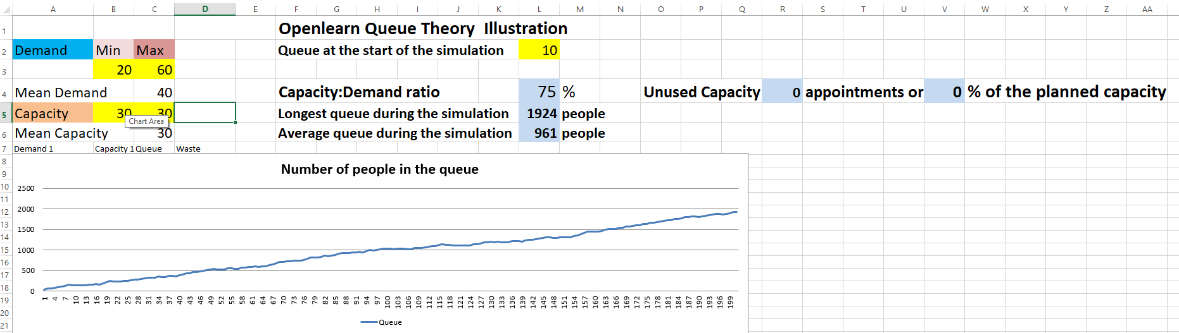

WHEN DEMAND IS GREATER
THAN CAPACITY

Slide 3
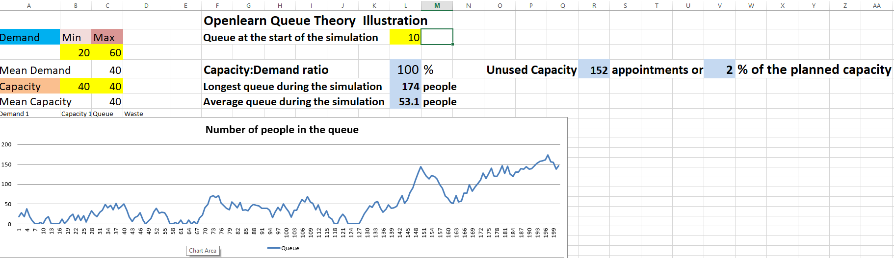
WHEN DEMAND AND CAPACITY
ARE ABOUT THE SAME

Slide 4
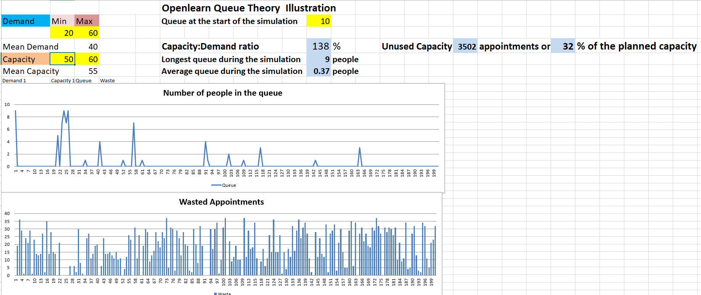
WHEN CAPACITY EXCEEDS
DEMAND SIGNIFICANTLY

