Slide 1
AIM
To follow the journey from ground to plate covering planting, harvesting, cooking and eating

Slide 2
What we will cover
The soil
Growing and seeds
What we harvest
Cooking and eating

Slide 3
What is soil ?

Slide 4
45% minerals,
25% water,
25% air,
5% organic matter
Notes:
Scotland’s soils are an important natural resource. They play an essential part in all of our lives, providing us with a wide range of benefits. Some of these benefits are obvious, like growing food, while many are less clear, like filtering water, reducing flood risk and influencing climate.
http://soils.environment.gov.scot/resources/education/
http://www.hutton.ac.uk/learning/dirt-doctor

Slide 5
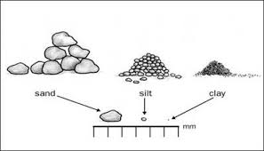
Notes:
https://www.youtube.com/watch?list=PLPFv9syphoctmEv2Xdz-8HGrQRw8WS_2I&v=wspKtgHzT-c
Soil texture video

Slide 6
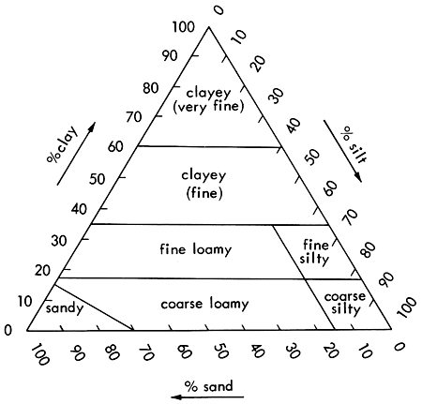
Test soil
Notes:
After undertaking the soil texture test you can get a tough idea of the % of sand, silt and clay in your soil. This is important as different crops grow best in different soils. For example:
Carrots like sandy free draining soils
Organic matter can added to your soil. In sandy soils organic matter helps with structure and in clay soils organic matter can make the soils more workable.
http://www.gardenorganic.org.uk/sites/www.gardenorganic.org.uk/files/resources/fflp/A9-Testing-soil-and-improving-fertility.pdf

Slide 7
Growing and seeds
Notes:
There are many different things you could grow but there are several things you need to consider which can be found on the attached handout.

Slide 8
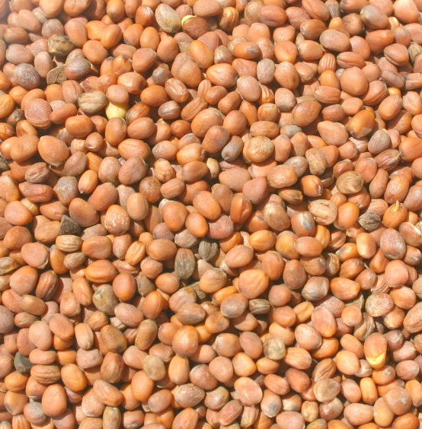
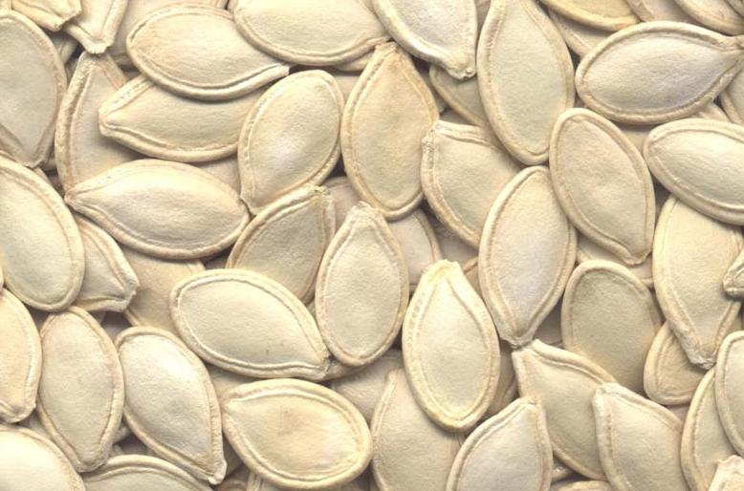
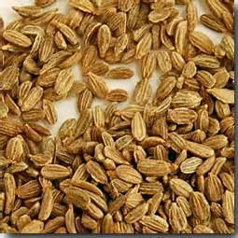
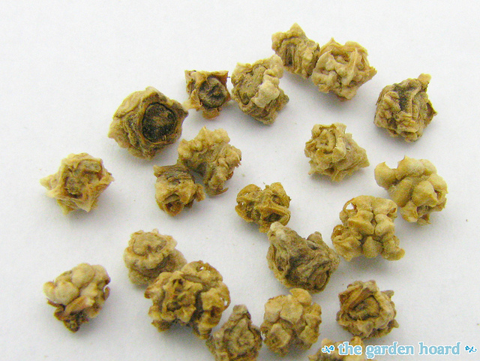
Notes:
There is a wide variety of seeds which you can plant in school. Seeds are a great resource to look at – they come in all shapes and sizes.
http://www.gardenorganic.org.uk/sites/www.gardenorganic.org.uk/files/resources/fflp/A7-Crop-and-family-games.pdf
You need to choose which seeds you are going to plant and the system you are going to use, keeping in mind the type of soil you have and requirements of the plants.

Slide 9
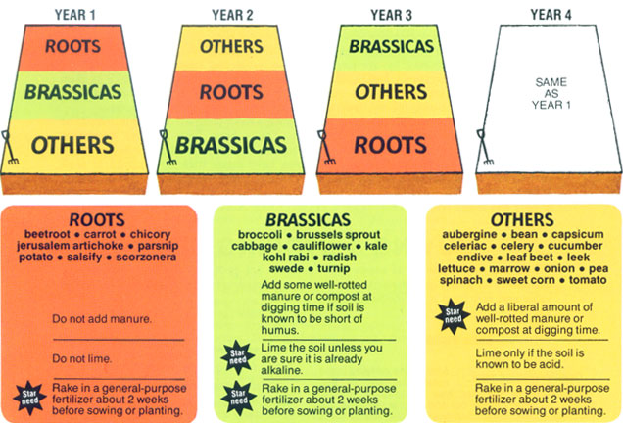
Notes:
https://www.gardenorganic.org.uk/sites/www.gardenorganic.org.uk/files/resources/fflp/A34-Developing-a-crop-rotation-plan.pdf
https://www.gardenorganic.org.uk/sites/www.gardenorganic.org.uk/files/resources/fflp/A35-Creating-a-term-time-harvest-plan.pdf
Rotating what you plant where, is important to help prevent the build up of pests and diseases in the soil. The example the above image shows a 3 year rotation, using roots, brassicas and others. Rotations can vary in length depending on what you grow. The idea in rotations is that plants in the same family are planted together as they suffer from the similar pests and diseases.

Slide 10
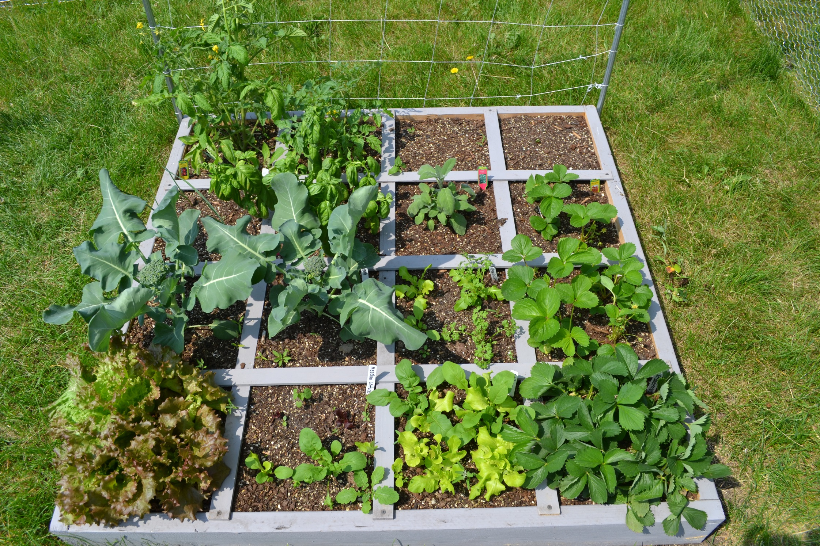
Seed quiz Families
Notes:
http://www.gardenorganic.org.uk/sites/www.gardenorganic.org.uk/files/resources/fflp/A59-Setting-up-a-square-foot-garden.pdf
Square foot gardening is a way of trying out lots of different crops in minimal space and works well for school raised beds. You get to try a little bit of lots of different fruits and vegetables.
It is important to make a note of what you plant where so you can avoid planting the same thing in the same spot the following year.

Slide 11
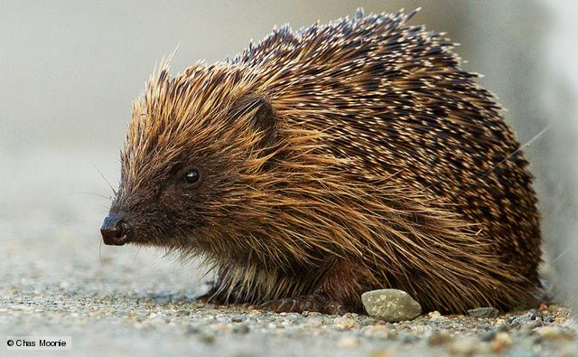
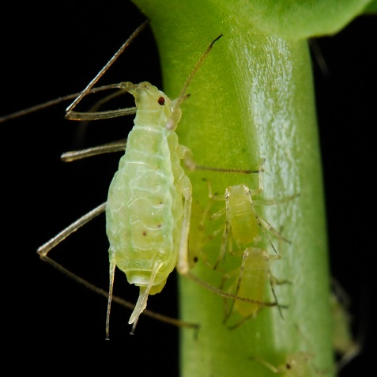
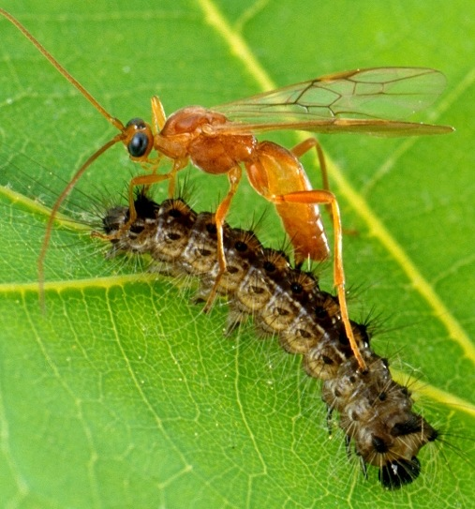
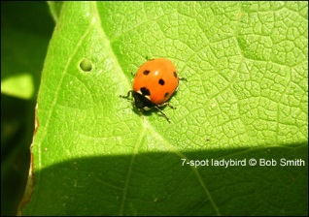
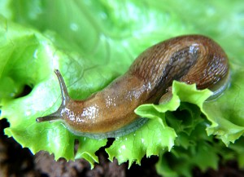
Notes:
A whole range of creatures may visit your patch. Some are good and some you don’t want to see. Some creatures like hedgehogs and parasitic wasps are well worth encouraging, whilst others like slugs and aphids you want to avoid.
http://www.gardenorganic.org.uk/sites/www.gardenorganic.org.uk/files/resources/fflp/A28-Friend-and-foe-game.pdf

Slide 12
YOUR PLAN !
Identify your soil
Add organic matter (lime if needed)
Choose your system – rotation in beds or rotation in ft squares
Choose your seeds
Get planting
Keep a note of what you planted for future rotations

Slide 13
What we harvest

Slide 14
Cereals – oats, barley, wheat, OSR
Potatoes – ware and seed
Vegetables – carrots, kale, sprouts, broccoli, neeps
Beans and peas
Tomatoes
Notes:
In Scotland, we grow a whole range of cereals, fruit and vegetables as well as grass on a commercial scale. As part of the your growing journey you can compare and contrast commercial production with what you grow in your own plot.

Slide 15
Notes:
This clip shows how wheat farming works on a commercial scale. In school, you can grow your own loaf in a metre square.
Please look at the instructions and step by step guide for growing your own loaf in school.

