Slide 1
Islands in the Sky
Situational awareness and strategic/scenario
futures planning toolkit
This toolkit has been designed for you to adapt for your purposes.

Slide 2
Contents
Introduction
Overview of Islands in the Sky
Managing uncertainty
How do you feel about uncertainty and change?
01
02
Using Islands in the Sky
Guidance for running your own workshop
Tips for using Islands in the Sky
03
04

Slide 3
How to use this toolkit
This toolkit has been designed to assist you in using the Islands in the Sky methodology for futures planning and exploring opportunities and problems. The method is very simple and based on Islands in the Sky by Matt Finch of mechanicaldolphin.com, derived from the Oxford Scenario Planning Approach.
It provides an introduction to the approach and activities to build confidence in dealing with uncertainty, before taking you through running a workshop, and we provide tips at the end.
When running workshops, we have found that either remote or face to face are more effective than hybrid. We suggest the use of an online whiteboard for collaboration. If you are in a face-to-face environment, consider nominating someone to capture any outputs using non-online approaches for a record of the workshop.
The toolkit is not prescriptive, and designed for you to adapt for your own needs.

Slide 4
Resources
If you are new to the Islands in the Sky approach, we recommend you review the following resource(s):
Online resources
Hybrid working: Planning for the future, sections 5.3 – 5.4 – OpenLearn course https://www.open.edu/openlearn/money-business/hybrid-working-planning-the-future/content-section-0?active-tab=description-tab
An Introduction to the Oxford Scenarios Planning Approach - Rafael Ramirez (YouTube video -https://www.youtube.com/watch?v=wrwn7oc26Vk)
Books (if you are a member of a HEI you may be able to access online versions through your institutes library.)
Whittington, Richard (2019). Exploring Strategy, text and cases. 12th Edition.
Ramirez, Rafael (2018). Strategic Reframing: The Oxford Scenario Planning Approach

Slide 5
Resources
Scenario planning – a strategic approach for engaging the future in Journal (No. 1, 2021) Strategy development in a rapidly changing world https://www.eca.europa.eu/lists/ecadocuments/journal21_01/journal21_01.pdf – Interview with Rafael Ramirez, Director of the Oxford Scenarios Programme and Professor of Practice, and Trudi Lang, Senior Fellow in Management Practice, of the Saïd Business School, University of Oxford.
Lang, Trudi and Whittington, Richard (2022). The Best Strategies Don’t Just Take a Long View. They Take a Board View. https://hbr.org/2022/05/the-best-strategies-dont-just-take-a-long-view-they-take-a-broad-view.
Trudi Lang's PhD thesis ‘Essays on How Scenario Planning and the Building of New Social Capital are Related’ - https://ora.ox.ac.uk/objects/uuid:8a081082-0d41-4022-b323-e026239cfdec/download_file?file_format=pdf&safe_filename=Trudi%2BLang%2BFinal%2BDPhil%2BThesis.pdf&type_of_work=Thesis
What are rich pictures? Video tutorials on OpenLearn - https://www.open.edu/openlearn/science-maths-technology/engineering-technology/rich-pictures

Slide 6
Introduction to
Islands in the Sky
The slides in this section can be used to introduce Islands in the Sky, and to start think about
the context in which you operate and how you feel about uncertainty.
01

Slide 7
Introduction to Islands in the Sky - IiTs
The Islands in the Sky approach is based on the Oxford Scenario Planning Approach (OSPA) and simplified for teams and organisations to enable rapid scenario planning.
It is a situational awareness and scenario-based strategic planning tool that is especially useful for managing uncertainty.
It is designed for structuring conversations about the future business environment to inform decision-making in the present.
It allows everyone a voice, to get things done quickly, that might not quite be perfect but from which we can learn and iteratively develop from.
It offers an approach for those less familiar with futures and scenario planning to engage with different approaches, feel comfortable planning for unknown, and consider future possibilities.

Slide 8
Riding a bicycle – Activity 1
The Islands in the Sky approach can help with navigating uncertain futures and understanding your social and transactional relationships and asks you to think about:
How do I go beyond expectation and the things I currently anticipate even beyond my hopes and fears, to really see how the future could be different in ways that previously lay in my blind spot? [Source: Dr Matt Finch]
This approach expects action learning, where you give it a try and make a few mistakes. Using the analogy that it is similar to learning to riding a bicycle, if you fall off, you get back on and try again. [Source: Professor Rafael Ramírez]
Notes:
How comfortable you feel with this approach will depend on your experience of managing uncertainty and change. In an organisational setting where we often have little control over the strategic direction and organisational objectives, uncertainty can be a common feeling.
This activity can help to consider your feelings towards uncertainty by reframing the context and feeling more comfortable with the unknown. Similar to if you learnt to ride a bicycle, the first time you tried it you had no idea what it would feel like, but as your ability and confidence grows, you are willing to try new things – how many of you as a child (and now) still trying riding your bike with no hands!

Slide 9
Riding a bicycle – Activity 1
Think about the statement and the bicycle analogy:
How might this help you be aware of your blind spots?
How open to action learning for uncertain futures are you?
Optional – create a vote to help with discussion of the above
Completely open to this embracing this approach
Slightly confident to trying this approach
Interested in trying this approach
Nervous about trying this approach
This is not an approach I feel comfortable with

Slide 10
Managing uncertainty
The slides in this section focus on manging uncertainty and considering ‘TUNA’ conditions to help
develop your situational awareness and understand the context you operate in.
02

Slide 11
Managing uncertainty
At its core, IiTs asks you to focus on your transactional relationship against a backdrop of rapid change and uncertainty, where you can’t see what tomorrow is going to hold.
These are often referred to as ‘TUNA’ conditions, in which taking a systems-thinking approach can enable teams/organisations to develop their situational awareness and better understand the context they are operating in to create a better future.
Notes:
When we are operating in times of unpredictable uncertainty, and if we cannot draw on data or our experience of similar situations, then we have to find vantage points from which to draw.
Explain what is meant by transactional relationship in your context.

Slide 12
Activity 2: Build your confidence with uncertainty
The name of Islands in the Sky itself is an invitation. When taking part in this process, there is an element of play, and make believe, as the foundations of imagined future contexts because they won't be like yesterday.
[Source: Dr Matt Finch]
Consider the following:
What if things turn out differently to how I expect?
What if those choices and their consequences have to exist in that future?
Are they still good choices?
If that future was going to happen, what would it mean for our choices today?
If you were to look up to the sky and think about possible futures, and the ‘Islands’ and transactional relationships on those Islands, what would this look like?

Slide 13
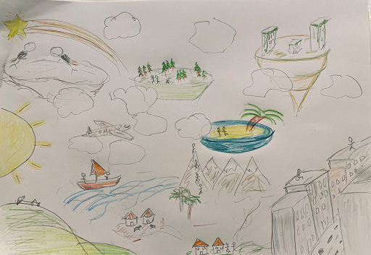
Activity 2: Build your confidence with uncertainty
To help with your thinking, take time to draw a ‘Rich Picture’ of the images that come to mind as you reflect on the questions.
Then discuss the question and your pictures.

Slide 14
Using Islands in the Sky
The slides in this section take you through the stages of using Islands in the Sky. These can be done
as one or more workshops, and conversations with others depending on your requirements.
03

Slide 15
Overview of the approach
Islands in the sky can help surface insights about future challenges & opportunities and create a space for creative discussion & fresh ideas regarding different possible futures to develop future strategies.
The methodology has five simple stages.
Confirm the purpose.
Map the transactional environment – internal and external relationships involved in the mission.
Label the relationships with Social and Functional value generated for both parties.
Identify the uncertainties that shape decisions on the island, and how these might play out to redraw the future.
Review the opportunities and challenges:
Select those that require more investigation or could be progressed.
Apply the learnings.
Notes:
Explain what is meant by transactional relationship in your context

Slide 16
Stage 1:
Purpose
04

Slide 17
Stage 1: Purpose
Review your current Mission statement (purpose), then clarify what are you trying to imagine a different future for/of?
The method can be used for a variety of purposes, from organisational future planning, focusing on a specific topic/change required to issues or for generating idea for innovation.
Consider:
What decisions are you trying to explore?
What is your time ‘horizon’?
Which entity has to make that decision?
You may wish to use the ‘What’s your Why?’ approach prior to running the Islands in the Sky workshop, if you are not clear of the purpose.

Slide 18
Stage 2:
Transactional environment
05

Slide 19
Stage 2: Transactional environment
A transactional environment is the “island” that you inhabit, based on communication and relationships between those that you interact with in the course of business. It is important to understand the different needs and perspectives of each person, to reach an understanding or an agreement together.
Map your transactional environment – capturing all the entities they interact with directly as they carry out their work. To map all the internal and external relationships involved in their mission.
Consider:
Internally and externally:
Who do you work with?
Who do you have to consider?

Slide 20
Stage 3:
Value of the relationship
06

Slide 21
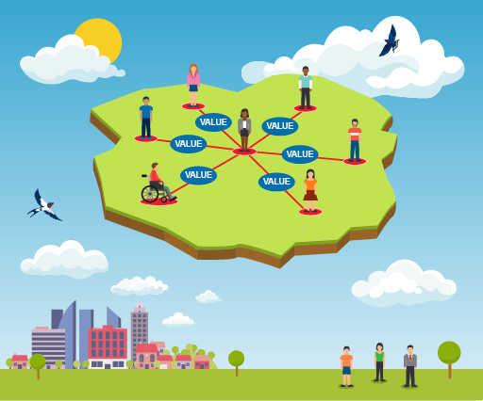
Stage 3: Value of the relationships
The Islands methodology was originally devised to explore post-pandemic hybrid ways of working. This meant considering when people and teams needed to gather in person or online for social, collaborative reasons, and when they were purely task-focussed.
Consider the relationships with social and functional value generated to both parties, and label these, with the value it generates for both parties.
Asking quantitatively and qualitatively:
What difference does each relationship make in each direction?
Social: You discuss and collaborate
Functional: Primarily transactional/task focused

Slide 22
Stage 3: Value of the relationships
Think of the things that influence the decisions people or organisations make, the things that might change their behaviours.
You can use the box below to help your thinking.
Political
Technological
Feelings
Challenges
Economic
Legal
Perceptions
Opportunities
Social
Environmental
Trends
Threats

Slide 23
Stage 4:
Uncertainties
07

Slide 24
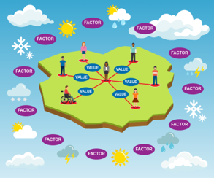
Stage 4: Uncertainties
Identify the uncertainties which shape and drive decisions made by the entities on the island.
Which factors beyond our own direct control shape the decisions of the other actors on our island? Such factors could affect just one actor, or many.
Consider what factors or forces that can’t be fully predicted in advance might redraw the map of the island to come.
What:
do you feel most uncertain about?
have the biggest impact?
take you out of business-as-usual thinking?
do you not really think about?
could really change your focus/how you go about your day-to-day if they changed?
offer a different perspective?

Slide 25
Stage 4: Uncertainties
Consider your forces, external and internal environment:
Which forces are most uncertain or uncomfortable?
Which forces aren’t you playing attention to?
Which can’t be known in advance?
What does the island look like if these forces play out?
How is your decision-maker’s ecosystem reshaped?

Slide 26
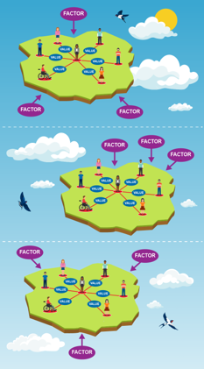
Stage 4: Multiple island sketch scenarios
Multiple islands can then be drawn as sketch scenarios to explore how different combinations of factors might ‘wash ashore’ and redraw the map of relationships in the future.
Consider:
How might our transactional environment change, depending on how these uncertainties play out in combination?
Would there be new or different actors on the island? Would the relationships and values change? How would the island differ from today?

Slide 27
Stage 4: Multiple island sketch scenarios
Consider:
What are the external factors relevant to your focus area that could be critical to your work if they were to change?
What difference does it make if you change your time ‘Horizon’?
What are the signs that this type of change might already be happen?

Slide 28
Stage 5: Review the opportunities and challenges
Stage 5:
Review the opportunities
and challenges
08

Slide 29
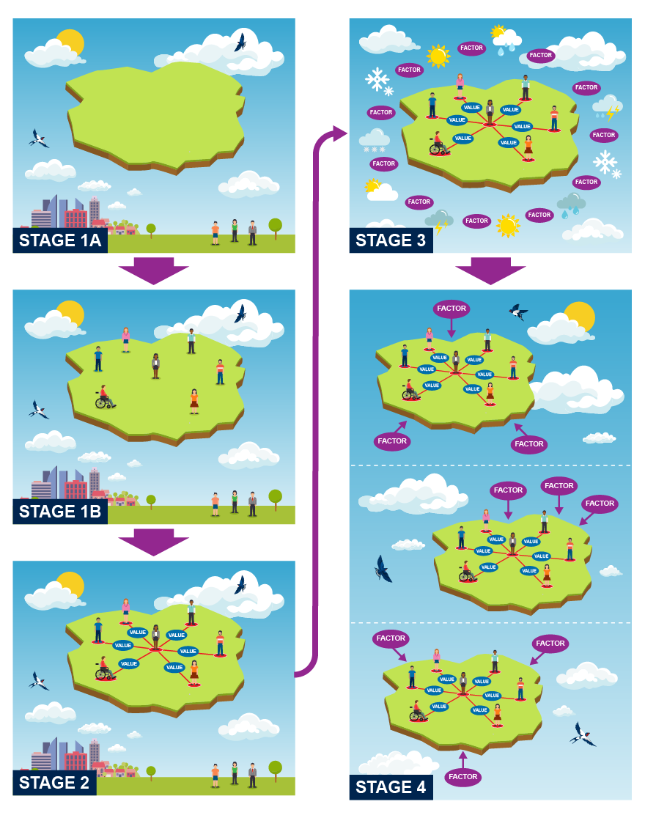
Stage 5: Review the opportunities and challenges
In the final part of the workshop, take time to review your island(s) and consider the implications, opportunities, and challenges.
If this future came to pass, what would be the wisest choices for us to make today?
How would our current decisions, policies, and values be judged by the inhabitants of that future island?
Are there choices we can make which are resilient across a number of possible futures?
Review these implications, opportunities and challenges further, and then develop your options for the purposes required.
The approach for developing options and presenting these to others will depend on the purpose of your workshop and your organisational needs.

Slide 30
Stage 6:
Workshop feedback
and follow up
09

Slide 31
Stage 6: Feedback
At the end of the workshop, provide an opportunity for participants to share their experience of doing the workshop and how they now feel about futures planning.
Questions that may be useful to consider:
How do participants feel?​
What has been the impact on them?​
What else do they want to know?​
What else do they want to share?​
Is this what they expected?
What would they change?

Slide 32
Stage 6: Follow up
It is then important to follow up with participants to seek any clarification from their input into the workshop, having had time to reflect is there anything else they wish to contribute, and provide a summary of the outcomes.
Futures planning should be an ongoing process within organisations, so consider your approach to planning cycles.

Slide 33
Tips for using
Islands in the Sky
10

Slide 34
Tips for using Islands in the Sky
Think very hard when you map that island of relationships. It's very easy to overlook an actor or to take them for granted. When you really take the time to think about every single entity that your institution or your team or your community interact with, in the part of going about their business, you'll find that there's this rich and complex ecosystem.
Take time iterating, ensuring that there are multiple people involved, each of whom will have different perspectives, who will spot relationships that you've overlooked, all of which will be of benefit.
Consider the extent that those contextual uncertainties that are driving forces, which shaped the decisions of other actors. It's worth taking the time to almost go and inhabit the shoes of each different actor on that island with you and think ‘What does drive their decisions?’.

Slide 35
Tips for using Islands in the sky
Where you can pull in insights from, for example, user experience, and the use of personas, you can really try and imagine what it is like for each one of those actors to live on that island in the here and now. What drives their decisions? What would it be like for them to live, work and inhabit that future context?
The workshops are spaces almost like a sandbox or a playpen, where participants can consider how issues might play out in ways that are challenging or opportune. Look at things which might not be considered in the run-of-the-mill business of conducting their operations; the aim is to go beyond current expectations.
Encourage participants to bring their own concerns and their own questions. Make them comfortable with surprise and discomfit too. Seeing something that surprises us means we can expect that slightly unsettling moment.

Slide 36
Thank you

