Slide 1
WHAT CAUSES A QUEUE?
Dr Paul Walley, Director of Learning, CPRL

Slide 2
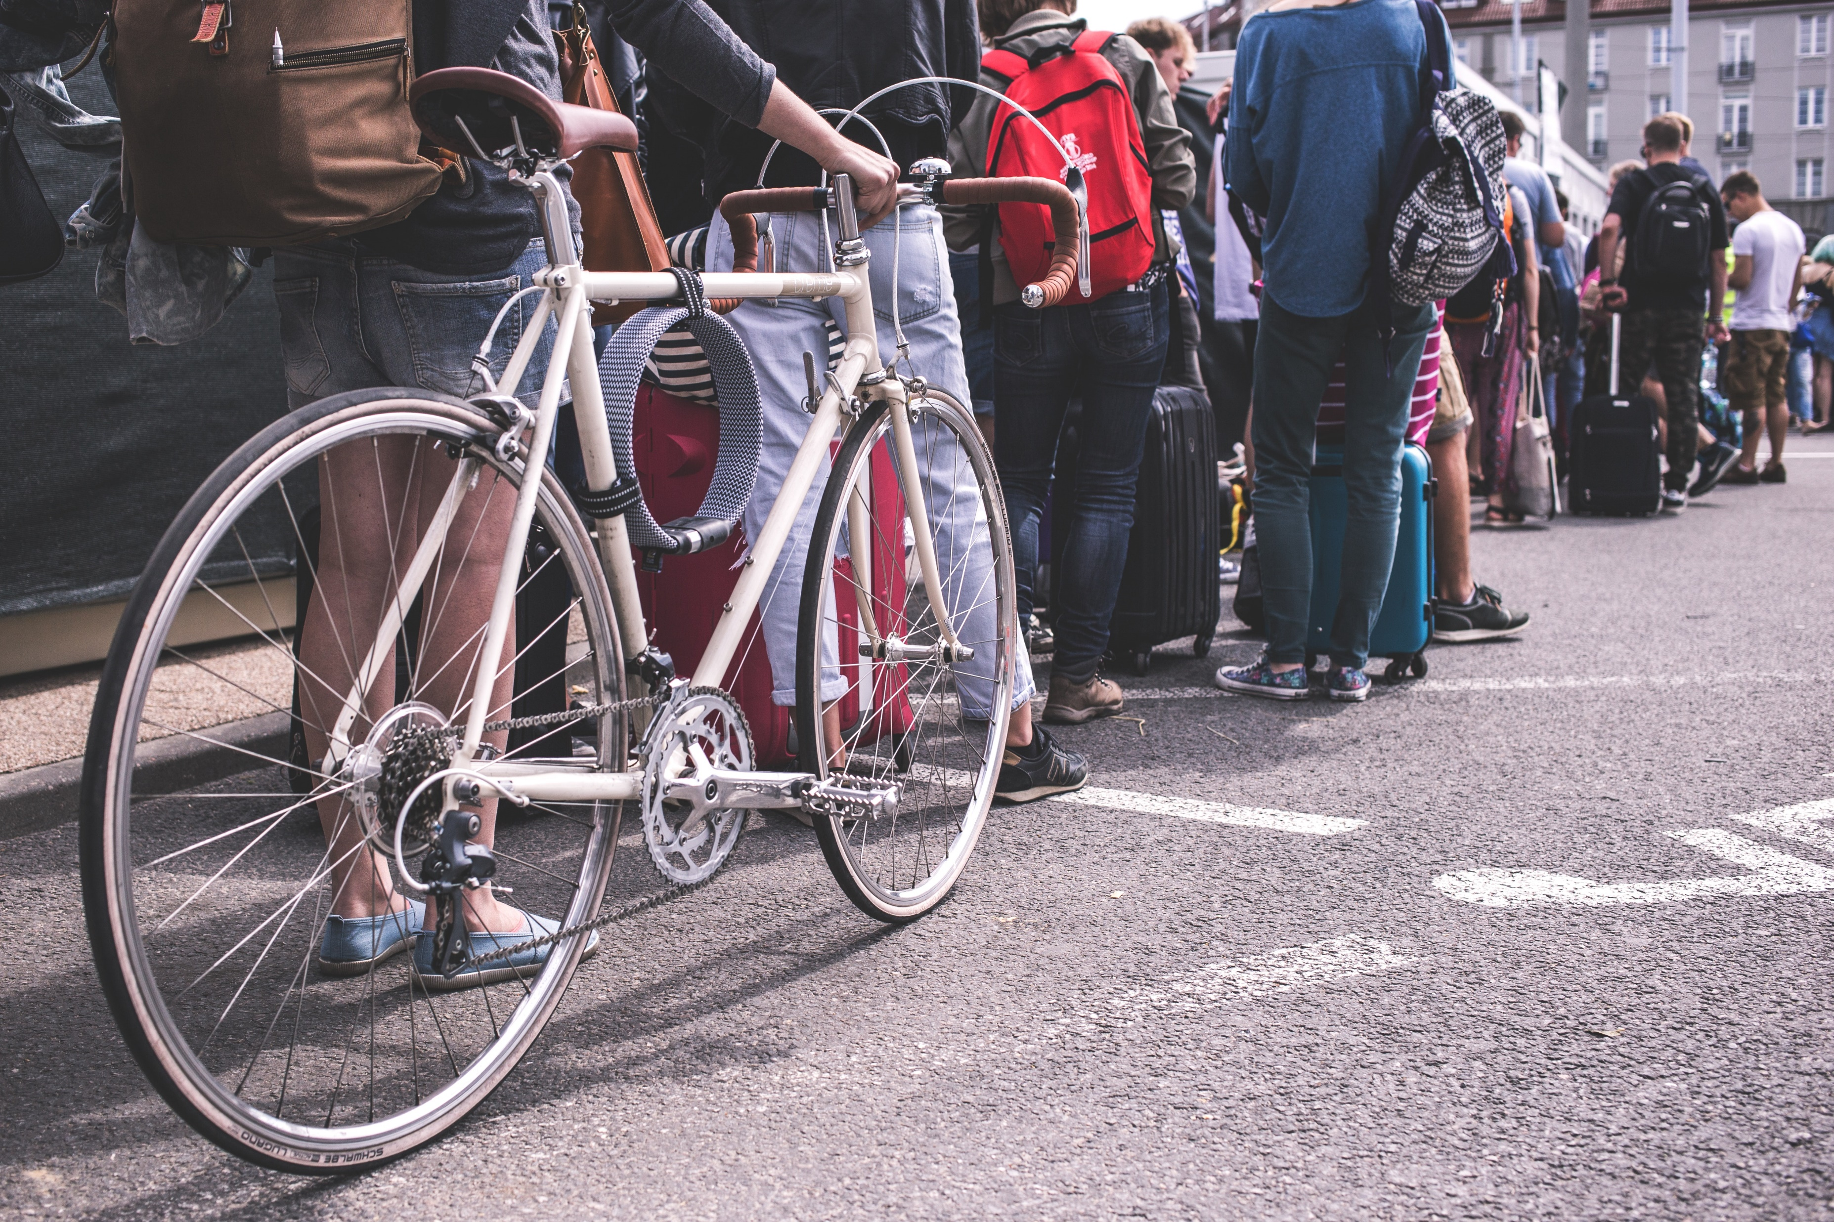
WE SEE QUEUES ALL THE TIME

Slide 3
WILL THERE BE
A QUEUE?
You arrive at an office reception.
On average it takes 3 minutes to sign in.
On average visitors arrive one every 3 minutes.
Will there be a queue?

Slide 4
High
Queue length
0
0%
Utilisation
100%

Slide 5
High
Queue length
0
0%
Utilisation
100%

Slide 6
High
Queue length
0
0%
Utilisation
100%

Slide 7
WILL THERE BE
A QUEUE?
CAPACITY AND DEMAND
VARIATION
A queue increases here
Capacity
Capacity/Demand
Demand
A queue reduces here
0
Time

Slide 8
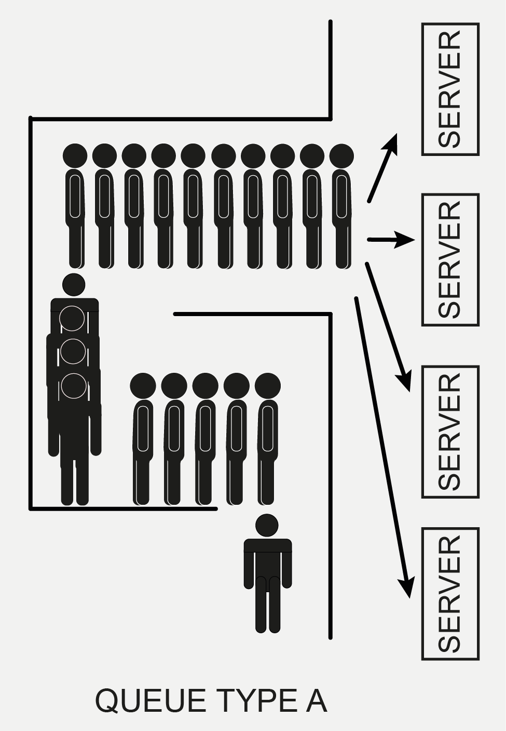
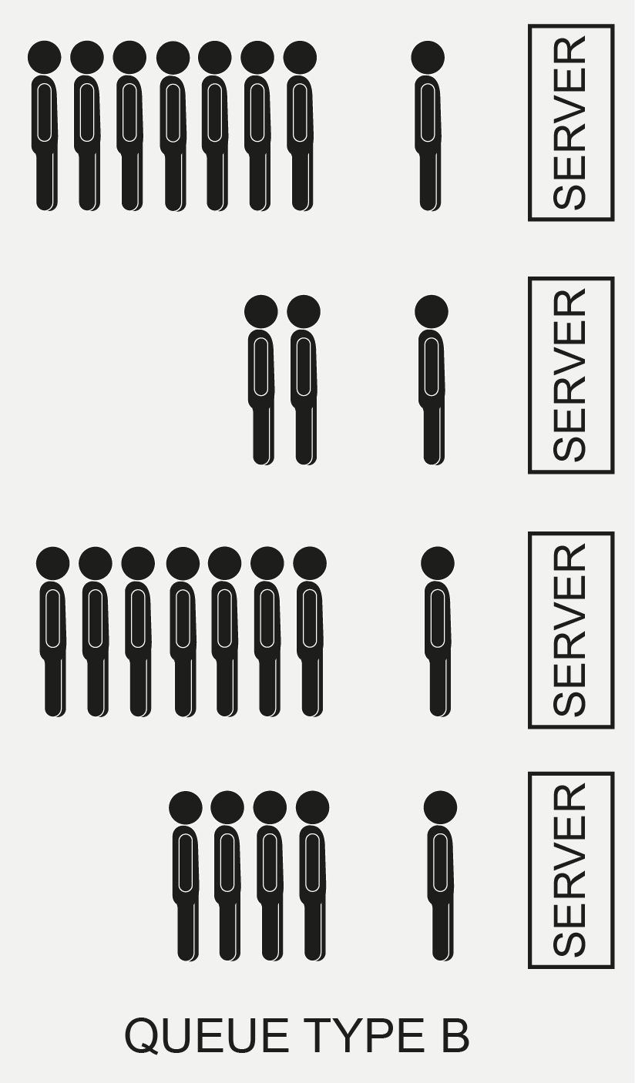
WILL THERE BE
A QUEUE?

Slide 9
WILL THERE BE
A QUEUE?
WILL THERE BE
A QUEUE?
KEY POINTS
Queues form in two different types of situation:
Where demand exceeds capacity and the queue or work backlog steadily grows over time
Where capacity exceeds demand but one or both randomly vary over time creating short-term mismatches. In this situation the queue length fluctuates.
Take time to understand why you have queues and think about how these waits and delays can be minimised.

