Slide 1
CAPACITY AND DEMAND SIMULATION FEEDBACK
Dr Paul Walley, Director of Learning, CPRL

Slide 2
WHEN DEMAND IS GREATER
THAN CAPACITY

Slide 3
WHEN DEMAND AND CAPACITY
ARE ABOUT THE SAME

Slide 4
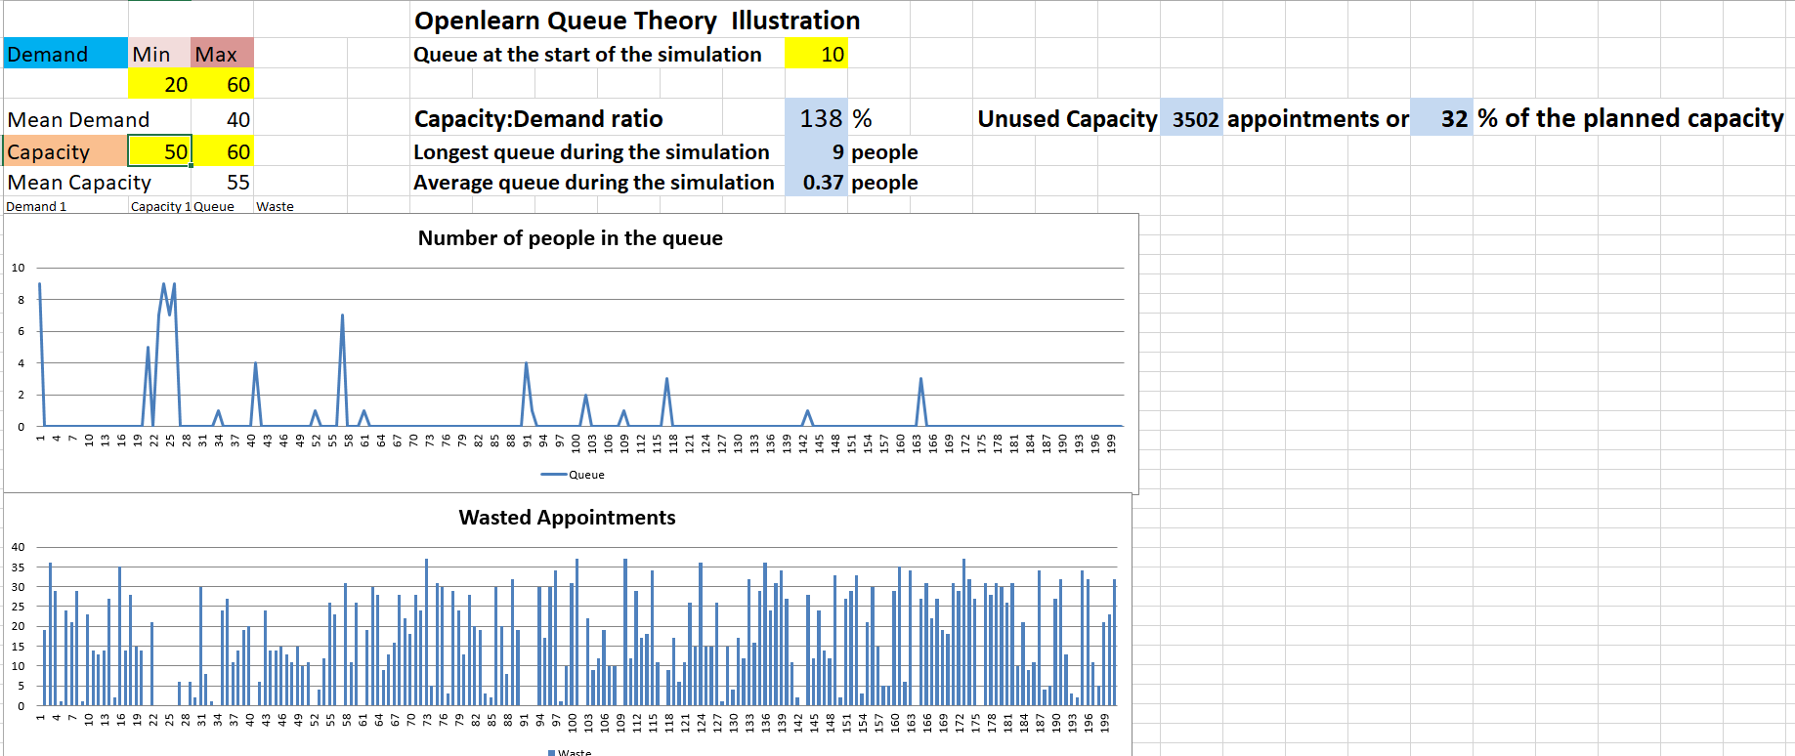
WHEN CAPACITY EXCEEDS
DEMAND SIGNIFICANTLY

