Slide 1
INSTRUCTIONS FOR USING THE CAPACITY AND DEMAND SIMULATION
Dr Paul Walley, Director of Learning, CPRL

Slide 2
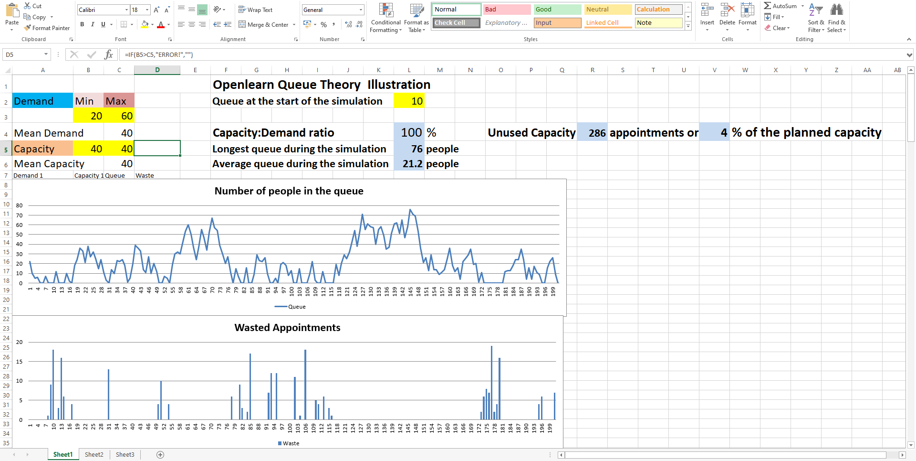

Slide 3
EXERCISE
Set your capacity much below average capacity. What happens to the size of the queue? Make a note of this.
Set your capacity at the average demand. Has the queue behaviour changed? Again make a note.
Incrementally increase capacity until you think you have enough. How much capacity makes you queue disappear to almost zero? How much waste does this create?

