Slide 1
Flood Management in Myanmar MOOC
Module 1 Lecture

Slide 2
Lecture 1: Introduction of Flood Risk in Myanmar
This lecture will cover the following topics:
What is a flood?
What are main causes of floods?
What is the flood risk in Myanmar?

Slide 3
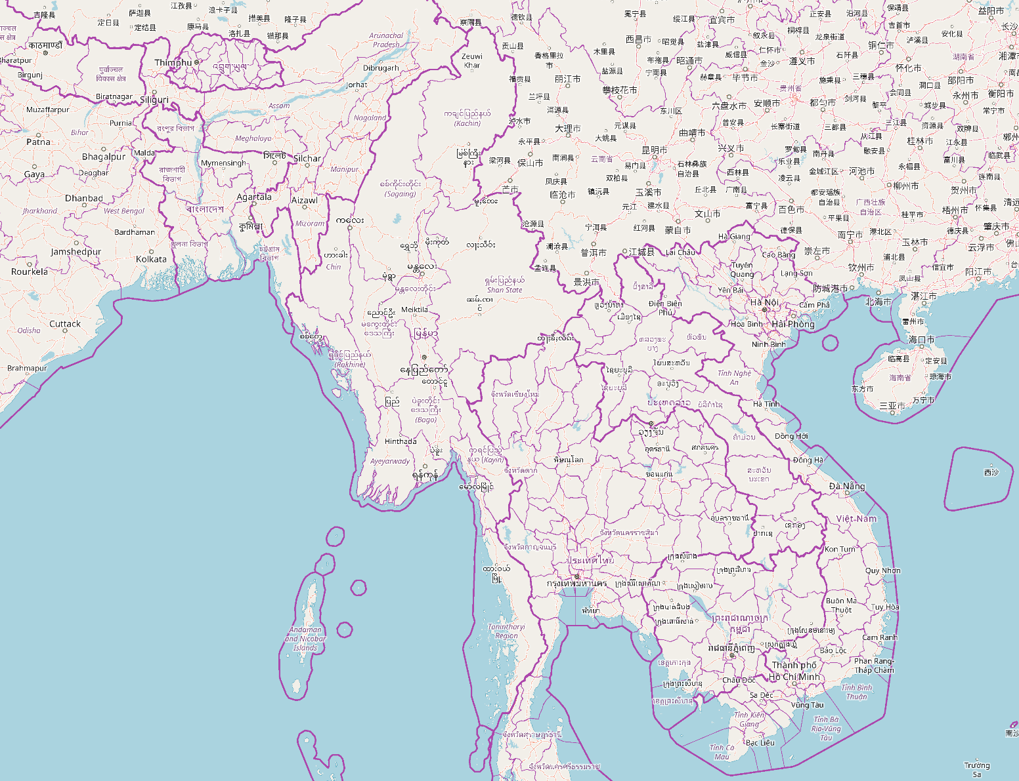
What is a flood?
Concepts & Definitions

Slide 4
What is a flood?
Flood – “an overflow of a large amount of water beyond its normal limits, especially over what is normally dry land” (Source: Oxford English Dictionary)
Flooding may occur as a result of an overflow from any type of water body: river, lake, ocean
Excess water leads to water either overtopping or breaking a flood barrier and water escapes it’s traditional boundary
Floods tend to cause destruction to lives, property, and natural surroundings
Notes:
Photo of flash flood and tree source: By Walter Siegmund - Own work, CC BY 2.5, https://commons.wikimedia.org/w/index.php?curid=1440750
Text source: https://en.wikipedia.org/wiki/Flood#cite_note-1 – Wikipedia

Slide 5
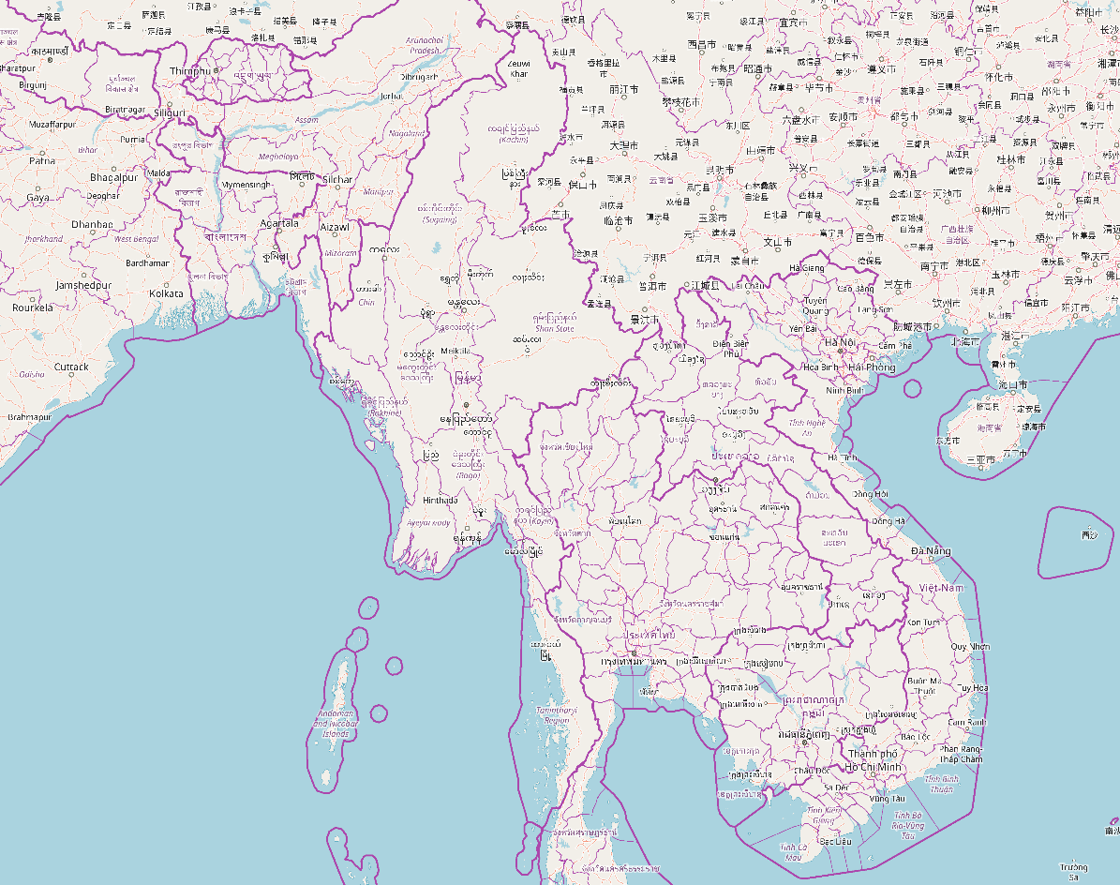
Causes & Types of Floods

Slide 6
Causes of Floods in Myanmar
Prolonged rainfall:
If it rains for a long time, the land around a river can become saturated (it's holding as much water or moisture as can be absorbed).
If there is more rainfall it cannot be soaked up, so it runs along the surface - this is known as surface run-off.
Intensive and long-term rainfall in Myanmar causes floods and landslides that affect thousands of people every year (Mohsan et al., 2018) (Required Reading: Sen-Roy et al., (2000)
Highest average rainfall is in southern Myanmar – along the Tenasserim and Dawna mountain range
Second highest average rainfall is in western Myanmar along the Arakan mountain range.
Third highest average rainfall along the coast is located in the deltaic area – including the capital, Yangon (Mohsan et al., 2018)
Notes:
Source of images: https://eoimages.gsfc.nasa.gov/images/imagerecords/18000/18709/Myanmar_TMO_2007192.jpg
Source of text: Mohsan, M. (2018). Preliminary Assessment of GPM Satellite Rainfall over Myanmar. Journal of Disaster Research, Vol. 13. No. 1, 2018.
Required Reading: Sen Roy, N. & Kaur, S., 2000. Climatology of monsoon rains of Myanmar (Burma. International Journal of Climatology, 20(8), pp.913–928.

Slide 7
Global Archive of Large Flood Events
Dartmouth Flood Observatory (DFO) built international and comprehensive flood database of large-scale events from 1985-present
Go to the site and explore: http://floodobservatory.colorado.edu/Version3/MasterListrev.htm
Other common causes of floods: heavy rain, snowmelt, dam, and levy break, tidal surges (Paper 1 required reading; Adhikari et al., 2010)
Notes:
Source of text: Adhikari, P. et al., 2010. A digitized global flood inventory (1998–2008): compilation and preliminary results. Natural Hazards, 55(2), pp.405–422.

Slide 8
Global common causes of floods
Most common causative factors for floods are: “heavy rain” (64%);
Monsoon rain is the second most reported cause (11%) followed by brief torrential rain (9%) and tropical cyclones (6%) (Adhikari et al., 2018)
Notes:
Source of image: Adhikari, P. et al., 2010. A digitized global flood inventory (1998–2008): compilation and preliminary results. Natural Hazards, 55(2), pp.405–422.
Source of text: Adhikari, P. et al., 2010. A digitized global flood inventory (1998–2008): compilation and preliminary results. Natural Hazards, 55(2), pp.405–422.

Slide 9
Flood Events in Myanmar
Risks and Consequences

Slide 10
Cyclone Nargis
2008 more than 138,000 people died in Myanmar in southern delta storm surge or flood disaster called ”Nargis”
Worst cyclone in Myanmar’s history
Flood damage (immediate) and losses (long term changes to the economy) are most clearly affected by:
a) flood intensity and duration,
b) the total population and economic assets located in harm's way,
c) warnings that can allow evacuation, and
d) any protective measures from wind and flood water.
In regard to the Nargis storm intensity and warnings, there was difficulty in accurately predicting this storm's path, and especially due to a sudden strengthening over unusually warm water (Required reading -Brackenridge et al., 2017)
Notes:
Source of Photo: Brakenridge et al., 2017. Design with nature: Causation and avoidance of catastrophic flooding, Myanmar. Earth-Science Reviews, 165, pp.81–109.
Text: Brakenridge et al., 2017. Design with nature: Causation and avoidance of catastrophic flooding, Myanmar. Earth-Science Reviews, 165, pp.81–109.

Slide 11
Cyclone Nargis
In figure - red area is satellite-mapped surge inundation by Cyclone Nargis in 2008 (Brackenridge, et al., 2017)
Cyclone Nargis flooded 14,400 km2 in the delta; more than 100 m of shoreline loss at some locations
Destructiveness of the surge was from Nargis' direction of approach from the west to the southern delta region - resulted in maximum winds having a counterclockwise circulation in the shallow offshore continental shelf area.
These winds and the coastal geomorphology of the region produced a high storm surge into the bay
Notes:
Source of all text: Brakenridge et al., 2017. Design with nature: Causation and avoidance of catastrophic flooding, Myanmar. Earth-Science Reviews, 165, pp.81–109.

Slide 12
Cyclone Nargis
Labutta Township (along the Ywe River, one of the Ayeyarwady distributaries in the southwest delta) reported 80,000 dead
10,000 deaths along the Bogale River, a distributary in the southeast delta.
Another ~55,000 reported missing
Economic damage was estimated at over USD 10 billion.
Myanmar government formally declared five regions—Yangon, Ayeyarwady, Bago Divisions and Mon and Kayin States as disaster areas.
Minimum of 2.4 million people severely affected.
Structural damage throughout Myanmar was extensive, causing over a million to become homeless.
An estimated 90–95% of the buildings in the delta and much farmland, livestock, and fisheries were lost.
Notes:
Source of all text: Brakenridge et al., 2017. Design with nature: Causation and avoidance of catastrophic flooding, Myanmar. Earth-Science Reviews, 165, pp.81–109.

Slide 13
Why was Nargis so deadly?
Nargis represents the deadliest tropical cyclone worldwide and one of the worst natural disasters (Required reading 3: Hermann et al., (2009)
Ephemeral coastal erosion, and vegetation and infrastructure damage were documented (Required reading 3: Hermann et al., (2009)
Affected communities ignored warnings due to lack of cyclone awareness and evacuation plans, absence of high ground or shelters, and no indigenous knowledge of comparable previous storm-surge flooding in the Ayeyarwady River (Hermann et al., (2009))
Ayeyarwady Delta is widely deforested, low-lying and densely populated with poor housing construction – thus extremely vulnerable to future storm-surge flooding, potential sea-level rise or tsunami.
Coastal protection in the Bay of Bengal must be approached with community-based education and awareness programs suited for a multi- hazard perspective
Notes:
Source of all text: Hermann M. Fritz, Christopher D. Blount, Swe Thwin, Moe Kyaw Thu, & Nyein Chan. (2009). Cyclone Nargis storm surge in Myanmar. Nature Geoscience, 2(7), 448-449.

Slide 14
Why is flooding so common in Myanmar?
Geographical effects

Slide 15
Major Factors Causing Floods in Myanmar
Physiography & climatology
High occurrence of surface process effects of large storm events
Steep highlands susceptible to major and lethal & flash floods
Upstream - along main stem of major rivers - rapid lateral channel migration, cut-offs, common during flood flows - this caused major damage in 2015
In Lowlands - major floods transport pulses of sediment downstream - including delta landforms - require inputs for stability.
Notes:
Source of image: Brakenridge et al., 2017. Design with nature: Causation and avoidance of catastrophic flooding, Myanmar. Earth-Science Reviews, 165, pp.81–109.
Source of text: Brakenridge et al., 2017. Design with nature: Causation and avoidance of catastrophic flooding, Myanmar. Earth-Science Reviews, 165, pp.81–109.

Slide 16
Next Module: Early Warnings Systems and Hazard Maps – Tools for Detecting Floods

