Slide 1
LECTURE 10 NON-TECHNICAL PROCESSES FOR SETTING UP AND MAINTAINING AN SDI
GEOSPATIAL DATA MANAGEMENT FOR ENERGY ACCESS
Supported by and in collaboration with Sustainable Energy for All. Consolidated by Kartoza
Version 1.0

Slide 2
Learning Outcome
In this lecture, you will continue to set up an SDI ecosystem, with a focus on the non-technical processes for setting up and maintaining an SDI. The following actions will be performed in the lecture:
Working groups, key personnel and team qualifications
Responsibility distribution
Licencing & costs
Data security
Maintenance, de-bugging and how to procure support
Dissemination, outreach & coordination of efforts (e.g., different stakeholders, agendas)
Other topic relevant to the proper operation of an SDI after its launch
1

Slide 3
10.1 Working Groups, Key Personnel and Team Qualifications
In a Spatial Data Infrastructure, establishing working groups, selecting key personnel, and defining team qualifications are necessary steps to ensure the effective management and operation of the infrastructure.
2
Notes:
Within the framework of a Spatial Data Infrastructure (SDI), the foundational steps of establishing working groups, hand-picking key personnel, and delineating team qualifications hold pivotal significance. These essential measures are essential to orchestrate the smooth and efficient management and operation of the SDI. Working groups facilitate organized collaboration and decision-making, key personnel assume critical roles in leadership and expertise, and clearly defined team qualifications ensure that the workforce possesses the requisite skills and competencies to effectively handle the SDI's multifaceted responsibilities. This strategic approach forms the bedrock upon which the SDI can be structured and managed to meet its objectives and deliver valuable geospatial services seamlessly.

Slide 4
10.1 Working Groups, Key Personnel and Team Qualifications
Working Groups
Working groups are teams of individuals with specific knowledge and focus areas related to the SDI.
These groups are tasked to address aspects of the SDI development, implementation, and ongoing maintenance.
Source: SDI cookbook
3
Notes:
Working groups are teams of individuals with specific knowledge and focus areas related to the SDI.
These groups are tasked to address aspects of the SDI development, implementation, and ongoing maintenance.
Examples of working groups in an SDI include data acquisition and management, technical infrastructure, policy and governance, data standards and interoperability, outreach and communication, and user engagement.
The point of a working group is to collaborate and offer information to make sure that all sections of the SDI are coordinated properly with the goals of the project.

Slide 5
10.1 Working Groups, Key Personnel and Team Qualifications
Key Personnel
Key personnel are individuals who have vital roles and responsibilities within the SDI.
Picture by pch.vector on Freepik
Source: OGC Development of Disaster Spatial Data Infrastructures for Disaster Resilience and the SDI cookbook
4
Notes:
Key personnel are individuals who have vital roles and responsibilities within the SDI. They are the leaders or managers who will oversee specific areas of the infrastructure.
Examples of key persons are the SDI project managers, data managers, technical experts, policy analysts, and communication specialists.
Key personnel ensure that the SDI operation is efficient, follows the SDI guidelines, and achieves the objectives set out for the SDI.

Slide 6
10.1 Working Groups, Key Personnel and Team Qualifications
Team Qualifications
Team qualifications refer to the skills, knowledge, and expertise required by individuals so that they can fulfil their roles within the SDI.
Attribution link: Geralt on Pixabay
Source: OGC Development of Disaster Spatial Data Infrastructures for Disaster Resilience and the SDI cookbook
5
Notes:
The qualifications of individuals in a Spatial Data Infrastructure (SDI) are intricately linked to the specific roles they undertake within the infrastructure. This means that the skill sets, knowledge, and expertise required for each role are tailored to the responsibilities and functions associated with that particular position. In essence, the qualifications of SDI personnel are finely tuned to align with the demands and intricacies of their respective roles, ensuring that they can effectively contribute to the overall success and functionality of the SDI in their designated capacities.

Slide 7
10.2 Responsibility Distribution
In an SDI, responsibility distribution is a very important aspect of proper governance and management.
Picture by storyset on Freepik
Source: OGC Development of Disaster Spatial Data Infrastructures for Disaster Resilience and the SDI cookbook
6
Notes:
It involves defining roles, assigning tasks, and allocating decision-making authority to various stakeholders to make sure that there is a smooth operation and sustainability of the SDI.
By defining and sharing responsibilities between the different entities involved in an SDI, it ensures that each individual section of the infrastructure gets the appropriate amount of attention and will therefore contribute to the overall success of the project. It also helps define clear ways of communicating as well as accountability amongst the stakeholders.

Slide 8
10.3 Licencing & Costs
Licensing and costs include:
1. Data Licensing
2. Software Licensing
3. Costs of Data Acquisition and Updates
4. Technology Infrastructure Costs
5. Personnel Costs
6. Training and Capacity Building Costs
7. Outreach and Communication Costs
8. Funding Sources and Sustainability
7
Notes:
Licensing and costs in a Spatial Data Infrastructure play a large role in making sure of legal compliance, sustainability, and financial viability.

Slide 9
10.4 Data Security
Data security is a crucial aspect of an SDI to protect sensitive information, maintain data integrity, and enforce the confidentiality of geospatial data. The following list comprises data security considerations when building an SDI:
1. Access Control and Authentication
2. Encryption
3. Data Privacy and Anonymization
4. Secure Data Storage and Transmission
5. Firewalls and Intrusion Detection Systems
6. Disaster Recovery and Backup
7. Training and Awareness
Image by jcomp on Freepik
Source: OGC Development of Disaster Spatial Data Infrastructures for Disaster Resilience and the SDI cookbook
8
Notes:
It’s vital to emphasise that data security is an ongoing endeavour, demanding continual assessment and adjustment in response to emerging threats and vulnerabilities.

Slide 10
10.5 Maintenance, De-bugging and How to Procure Support
Maintenance
Regular maintenance is vital for keeping the SDI's components (such as hardware, software, and data) to date and functioning optimally. Maintenance tasks could consist of updating software versions, validating data quality, monitoring system performance, and addressing hardware issues.
Attribution link: FREE-VECTORS.NET
Source: SDI cookbook
9
Notes:
Routine maintenance plays a pivotal role in ensuring that the various components of an SDI, including hardware, software, and data, remain up-to-date and operate at their peak performance levels.

Slide 11
10.5 Maintenance, De-bugging and How to Procure Support
De-bugging
Debugging is made up of identifying and resolving errors, issues, and software bugs that may arise in the SDI's functionality.
Picture by vector4stock on Freepik
Source: SDI cookbook
10
Notes:
Debugging entails a critical process of meticulous problem identification and resolution within a Spatial Data Infrastructure (SDI), aiming to rectify errors, issues, and software bugs that have the potential to disrupt or impede the proper functioning of the SDI. This crucial task involves pinpointing and remedying any anomalies or inconsistencies, ensuring the seamless and reliable operation of the infrastructure's various components and functionalities.

Slide 12
10.5 Maintenance, De-bugging and How to Procure Support
Procuring Support
SDIs may need technical support and expertise beyond the abilities of the team and could therefore mean that getting support could involve contracting with external vendors, consulting experts, or engaging technical support services.
Attribution link: Maxpixel
Source: SDI cookbook
11
Notes:
In certain cases, the complexity of SDIs may necessitate technical support and expertise that surpass the in-house capabilities of the team. Consequently, seeking external support might entail contracting with external vendors, consulting subject matter experts, or engaging specialised technical support services to ensure the SDI's uninterrupted functionality and effectiveness.

Slide 13
1.5 Maintenance, De-bugging and How to Procure Support
User Support and Help desk
User support could be achieved by creating a user support system such as a help desk system to aid SDI users in solving data access and technical issues.
Picture by Freepik
Source: SDI cookbook
12
Notes:
User support could be achieved by creating a user support system such as a help desk system to aid SDI users in solving data access and technical issues. Providing user documentation and training materials also enhances user self-sufficiency and can reduce the amount of user support that is needed.

Slide 14
10.6 Dissemination, Outreach, and Coordination of Efforts
Dissemination, outreach, and coordination of efforts are vital components in the successful operation of an SDI.
These activities involve:
Sharing geospatial data and services,
Engaging with various stakeholders
Promoting collaboration to enhance the impact and usefulness of the SDI
Source: The Role of Spatial Data Infrastructures in the Digital Government Transformation of Public Administrations and the SDI cookbook
13
Notes:
In Spatial Data Infrastructures (SDI), dissemination, outreach, and coordination emerge as indispensable pillars, pivotal to its thriving functionality. These facets encompass multifaceted endeavours, ranging from the sharing of geospatial data and services to active involvement with a diverse array of stakeholders. Such proactive engagement is driven by the overarching goal of fostering collaboration, thereby augmenting the SDI's resonance and utility within the broader ecosystem of geospatial information management. These activities collectively contribute to the SDI's vitality, ensuring that it effectively serves its intended purpose and meets the evolving needs of its user base

Slide 15
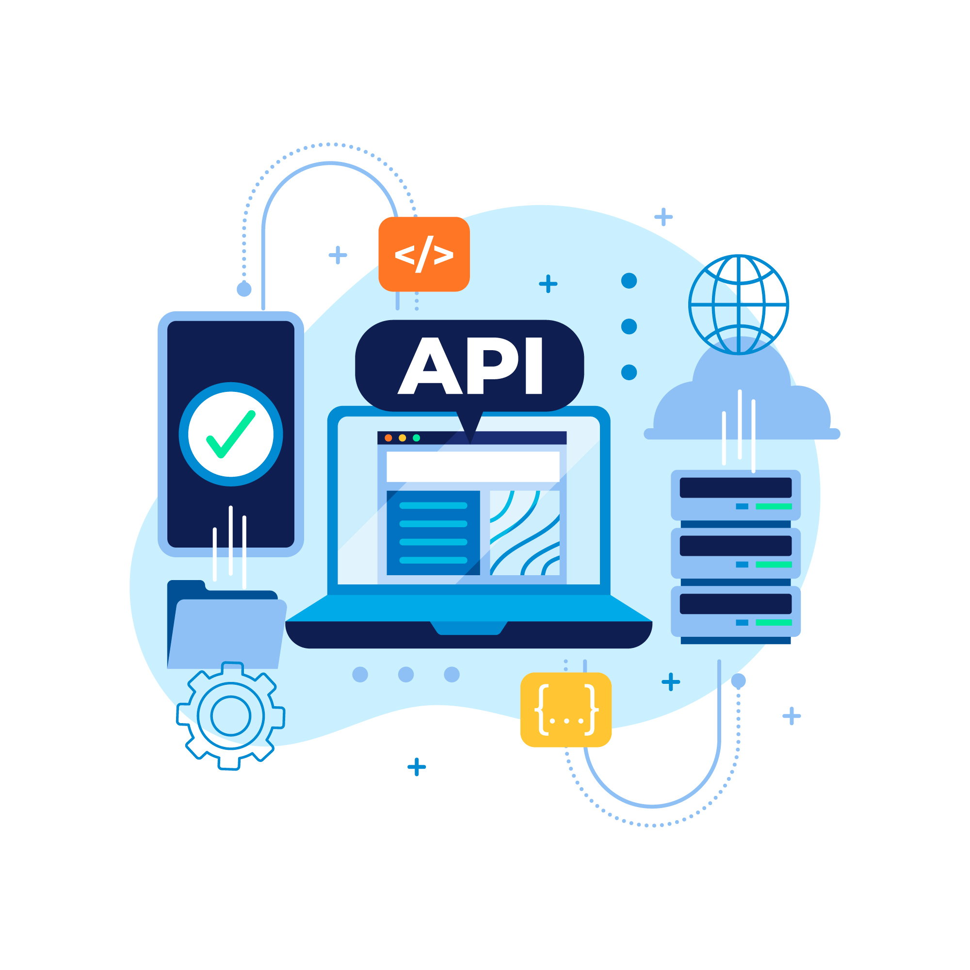
10.6 Dissemination, Outreach, and Coordination of Efforts
Outreach and Communication
Dissemination of Data and Services
Picture by vector4stock Freepik
Picture by Freepik
Picture by gstudioimagen1 on Freepik
Source: The Role of Spatial Data Infrastructures in the Digital Government Transformation of Public Administrations and the SDI cookbook
14
Notes:
Dissemination involves making data, maps, and other services available to the SDI users through various channels (user-friendly web portals, APIs, and data download options) to make sure that data is easily accessible and usable by diverse audiences with diverse needs.
Outreach activities are there to raise awareness of the SDI's capabilities and therefore encourage its use among potential users and stakeholders. Communication includes events such as workshops, training sessions, webinars, and public awareness campaigns.

Slide 16
10.6 Dissemination, Outreach, and Coordination of Efforts
Engagement with Different Stakeholders
Coordinating Efforts and Agendas
Coordinating efforts involves:
Aligning the activities of different stakeholders to ensure their contributions complement each other.
Interacting with stakeholders, such as:
Government agencies
Private sector entities
Academia
Civil society organizations
Source: The Role of Spatial Data Infrastructures in the Digital Government Transformation of Public Administrations and the SDI cookbook
15
Notes:
Interacting with stakeholders, such as government agencies, private sector entities, academia, and civil society organizations, helps pinpoint user needs and encourages collaboration. Understanding the range of requirements of the stakeholders ensures that the SDI aligns with their specific use cases.
Coordinating efforts involves aligning the activities of different stakeholders to ensure their contributions complement each other. It may include establishing data-sharing agreements, coordinating data collection initiatives, and aligning data standards.

Slide 17
1.6 Dissemination, Outreach, and Coordination of Efforts
User Feedback and Collaboration
Encouraging user feedback and collaboration helps improve the SDI based on real-world needs and challenges.
Involving users in the decision-making process enhances user satisfaction and fosters a sense of ownership.
Attribution link: sketchvalley.com
Source: The Role of Spatial Data Infrastructures in the Digital Government Transformation of Public Administrations and the SDI cookbook
16
Notes:
Spatial Data Infrastructures (SDIs) play a pivotal role in cultivating a dynamic ecosystem designed to cater to a wide spectrum of user requirements and optimize the utility of geospatial data. This is achieved through a range of proactive activities, including:
Disseminating Data and Services: SDIs ensure that geospatial data and services are readily accessible and distributed, making valuable information available to a broad user base.
Conducting Outreach: Outreach initiatives are undertaken to raise awareness about the SDI's capabilities and offerings, ensuring that potential users and stakeholders are informed about its benefits and functionalities.
Engaging Stakeholders: SDIs actively involve various stakeholders, including government agencies, businesses, academia, and the public. Engaging these diverse groups helps align the SDI with their unique needs and perspectives.
Synchronising Efforts: Coordination and collaboration are key components of SDIs. By synchronising efforts across multiple sectors and organisations, SDIs create a cohesive and integrated geospatial data landscape.
Through these multifaceted efforts, SDIs not only serve as hubs for geospatial data but also foster an environment where data-driven decision-making and innovation flourish, ultimately maximising the value and impact of geospatial information.

Slide 18
10.7 Continuous Improvement and Evolution
Continuous improvement and evolution are important to ensure that the infrastructure of the SDI remains relevant, efficient, and responsive to changing user needs and technological advancements.
1. User Feedback and Needs Assessment
2. Data Quality Enhancement
3. Technology Updates and Upgrades
Source: The Role of Spatial Data Infrastructures in the Digital Government Transformation of Public Administrations and the SDI cookbook
17
Notes:
Continuous improvement and evolution are important to ensure that the infrastructure of the SDI remains relevant, efficient, and responsive to changing user needs and technological advancements.
User Feedback and Needs Assessment
Data Quality Enhancement
Technology Updates and Upgrades
Standards and Interoperability
Incorporating New Data Sources
Capacity Building and Training
Performance Optimization
Innovation and Research
Collaboration and Partnerships
Strategic Planning

Slide 19
10.7 Continuous Improvement and Evolution
By fully embracing continuous improvement and evolution, SDIs can remain malleable and buoyant in the face of changing requirements and advancements within the geospatial field.
Attribution link: Tumisu on Pixabay
Source: The Role of Spatial Data Infrastructures in the Digital Government Transformation of Public Administrations and the SDI cookbook
18
Notes:
Frequent and systematic updates to the Spatial Data Infrastructure (SDI) serve as a cornerstone for its sustained effectiveness. By adhering to a regular updating regimen, the SDI is poised to consistently provide valuable and up-to-date geospatial information. This proactive approach ensures that the data and services within the SDI remain relevant, accurate, and aligned with the dynamic nature of the geographic landscape. Consequently, stakeholders and users can rely on the SDI to access current and pertinent geospatial information, making it a reliable resource for informed decision-making and analysis in various domains.

Slide 20
Summary
Key Concepts of the Lecture
The lecture covered essential non-technical processes for operating and maintaining a Spatial Data Infrastructure (SDI) post-launch, including:
Working Groups, Key Personnel, and Team Qualifications
Formation of working groups
Data Security
Maintenance, Debugging, and Support Procurement:
Dissemination, Outreach, and Coordination
User Feedback and Collaboration:
Continuous Improvement and Evolution
19
Notes:
The lecture covered essential non-technical processes for operating and maintaining a Spatial Data Infrastructure (SDI) post-launch, including:
Working Groups, Key Personnel, and Team Qualifications:
Formation of working groups
Identification of key personnel
Team qualifications assessment
Distribution of responsibilities
Licensing and cost considerations
Data Security:
Ensuring data security measures
Maintenance, Debugging, and Support Procurement:
Maintenance strategies
Debugging procedures
Procurement of support
User support and helpdesk setup
Dissemination, Outreach, and Coordination:
Data and service dissemination strategies
Outreach and communication efforts
Engagement with various stakeholders
Coordination of initiatives and agendas
User Feedback and Collaboration:
Encouraging user feedback
Promoting collaboration
Continuous Improvement and Evolution:
Strategies for ongoing improvement and evolution of the SDI.

Slide 21
References
Barbero, M., Potes, M.L., Vancauwenberghe, G. and Vandenbroucke, D., 2019. The role of spatial data infrastructures in the digital government transformation of public administrations. Publications Office of the European Union: Luxembourg.
Nebert, D.D., 2001. The SDI cookbook. http://www. gsdi. org/pubs. html.
REPORT: Development of Disaster Spatial Data Infrastructures for Disaster Resilience. URL https://portal.ogc.org/files/18-087r5
20

Slide 22
Supported by and in collaboration with
Sustainable Energy for All
Consolidated by Admire Nyakudya, Seabilwe Tilodi and Thiasha Vythilingam
from Kartoza
Moksnes N., Sahlberg A., Khavari B. 2021. Lecture 1: OnSSET/Global Electrification Platform. Release Version 1.0. [online presentation]. Climate Compatible Growth Programme, Energy Sector Management Assistance Program and World Bank Group
Nyakudya A., Tilodi S., Vythilingam T., 2023. Lecture 10: Geospatial Data Management for Energy Access. Release Version 1.0 [online presentation]. Climate Compatible Growth Programme, Sustainable Energy for All, Kartoza
CCG courses (this will take you to the website link http://www.ClimateCompatibleGrowth.com/teachingmaterials)

