Slide 1
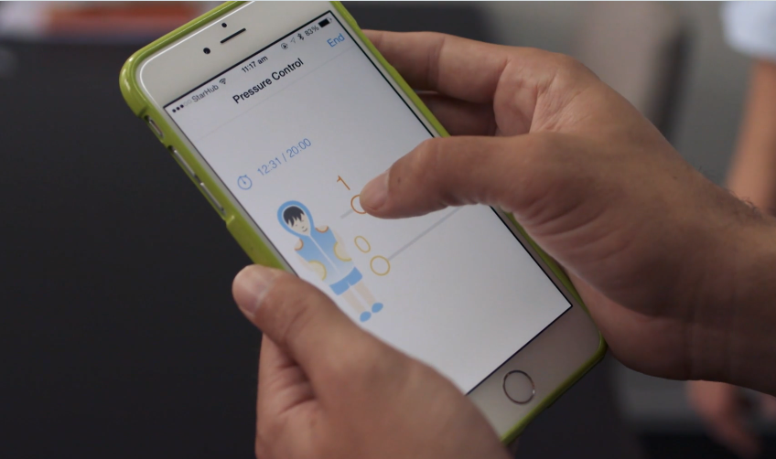
E-body
Video Link : B2 E-body
Video lesson

Slide 2
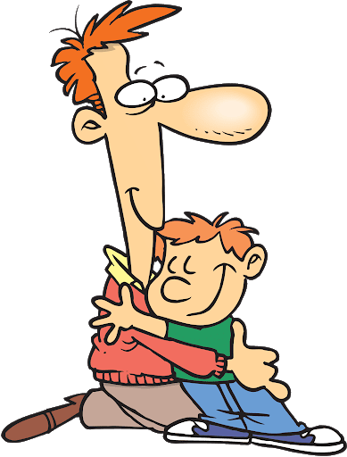
Lead-in
Hugs are a key theme in this lesson.
Who would you be comfortable hugging?
colleague family member in-laws
friend classmate new acquaintance
Do you think people in other cultures feel the same?

Slide 3
Vocabulary
What’s the difference between these words?
You can use a dictionary to help you.
sense / sensory / sensation

Slide 4
Vocabulary
Match these words to their meanings
survival pretend to be
reciprocation continued life
crucial very important
simulate giving something back

Slide 5
Vocabulary
Match these words to their meanings
assurance excite, cause a reaction
stimulate fill with air to increase size
inflate use something to replace something
substitute self-confidence, assertiveness

Slide 6
As you watch
(B2 E-body)
What does Professor Teh’s invention do and why?

Slide 7
Prediction
Which word is missing from these sentences?
Some scientists say ____ you need four hugs a day for survival.
That seems ____ a lot of hugs.
There’s something ____ the reciprocation of human touch.
He believes the sense of touch is crucial ____ our emotional well-being.
The jacket might ____ be the solution.
It helps ____ shut of all the other sensory information.
Has it helped him calm ____?
It really takes a big load ____ my shoulders.

Slide 8
As you watch
Now watch again and check your answers.

Slide 9
Discussion
What habits and practices can we use to take care of our emotional well-being each day?

