Slide 1
Species interactions: parasitism and mutualism
Dr Ellen Fry
The Transformation by Innovation in Distance Education (TIDE) project is enhancing distance learning in Myanmar by building the capacity of Higher Education staff and students, enhancing programmes of study, and strengthening systems that support Higher Educational Institutions in Myanmar. TIDE is part of the UK-Aid-funded Strategic Partnerships for Higher Education Innovation and Reform (SPHEIR) programme(www.spheir.org.uk). SPHEIR is managed on behalf of FCDO by a consortium led by the British Council that includes PwC and Universities UK International. The TIDE project will close in May 2021.

Slide 2
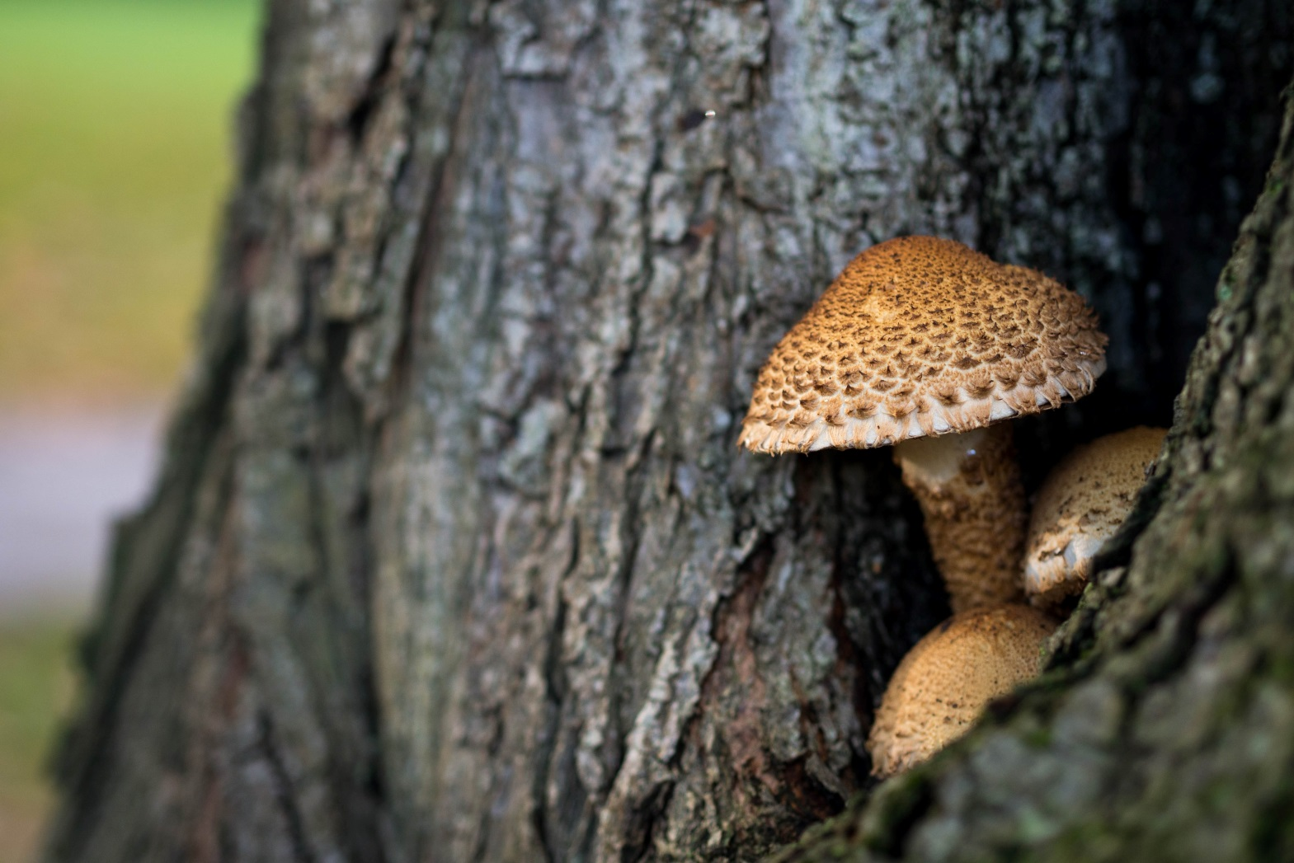
Species interactions: parasitism and mutualism
Lecture 9

Slide 3
Learning outcomes
Understand the types of symbiosis
Be able to describe what a parasite is and give an example.
Be able to describe an example of a mutualistic relationship.

Slide 4
Types of species interactions
Competition: two species using the same limited resource, and negatively affecting each other
Predation: one animal eating another
Herbivory: one animal eating a plant
Parasitism: relationship that negatively affects one partner and positively affects the other
Mutualism: symbiotic relationship that benefits both partners
Disease: an association between a pathogenic organism and a host to the detriment of the host

Slide 5
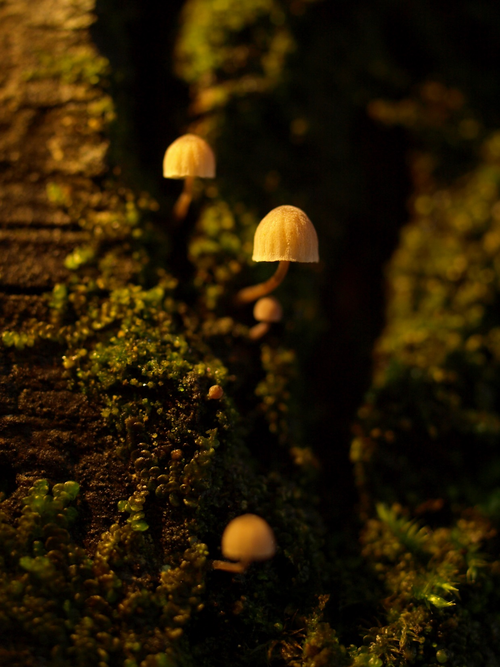
Parasite: an organism living inside or on the surface of a partner (host) species that derives benefits from the association at the expense of the host.
Occurs in all animals and most plants.
Enormous health and economic cost.

Slide 6
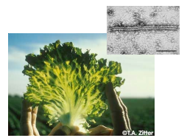
Parasites consume the tissues or body fluids of the host.
Degree of harm to the host varies.
Sub-lethal or lethal.
Obligate parasite: the parasite depends on the host for survival. Will die without it.
Facultative parasite: parasite can live without the host.
Lettuce big vein disease caused by Mirafiori lettuce virus
Reduce growth, development, reproduction of host.

Slide 7
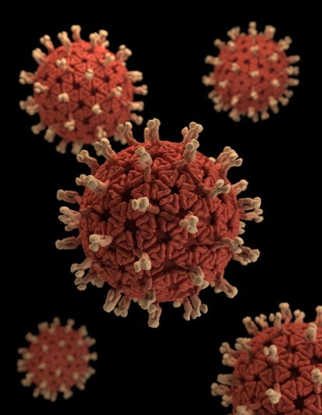
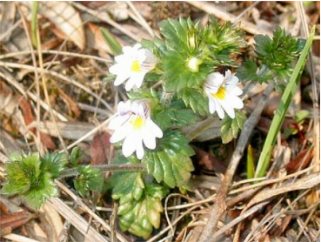
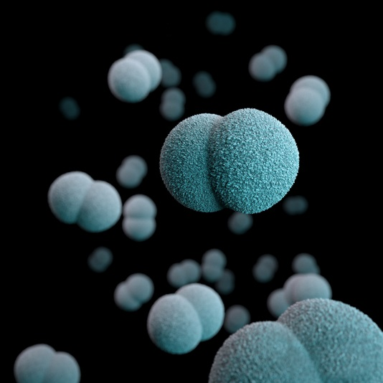
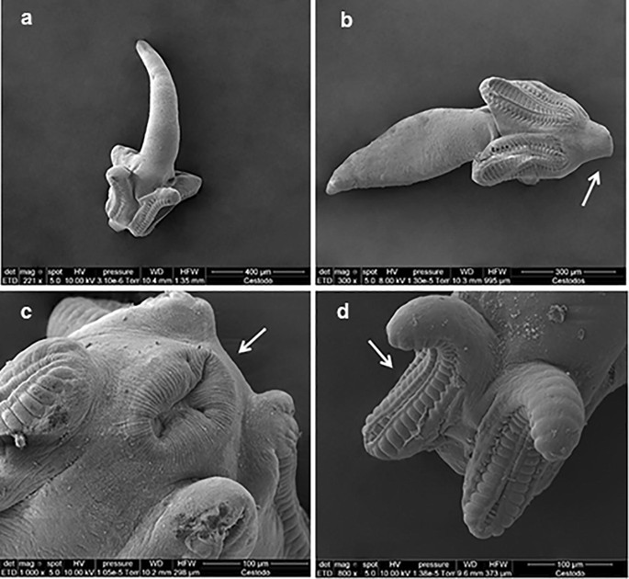
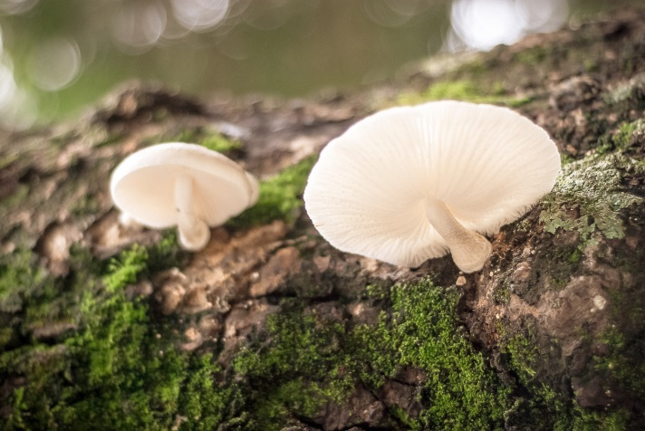
Macroparasites (parasites)
Microparasites (pathogens)
Plants
Virus
Bacteria
Tapeworms Castro et al. 2019
Fungi

Slide 8
 | Ectoparasites (outside host) | Endoparasites (inside host)
Advantages + | Easy dispersal | Easy feeding
 | Safe from host immune system | Protected from external environment
 |  | Safe from enemies
Disadvantages - | Vulnerable to natural enemies | Dispersal difficult
 | Exposed to external environment
 | Feeding more difficult

Slide 9
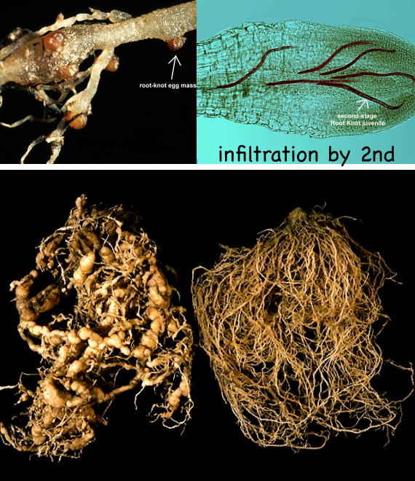
Nematode parasites
Root knot nematodes Meloidogyne spp.
Cause swellings on tomato roots.
Reduce plant growth and fruit production.
They can live in the soil as free living worms (facultative parasites) then become endoparasites.

Slide 10
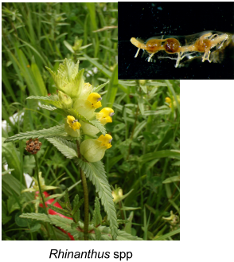
Plant parasites
Yellow rattle, Rhinanthus minor is a hemiparasite of grasses.
It attaches to the root system of grasses and takes nutrients.
This is a facultative parasite- it has some green leaves and can photosynthesise.

Slide 11
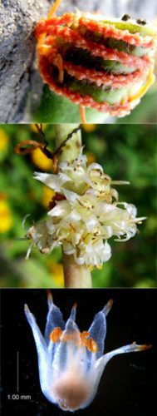
Dodder (Cuscuta spp) is an obligate parasite found all over the Tropics. >201 species
It has no ability to photosynthesise, so relies on the host.
Very diverse through Asia, many different species.
Grows a haustorium to insert into vascular system of the host to take nutrients and water.
It can SMELL out its host using chemical cues.
Can attack lots of hosts at the same time.
Has economic implications- attacks agricultural and horticultural crops.
Cuscuta bonafortunae Costea & I Garcia, new species published in Botany 89: 724. 2011

Slide 12
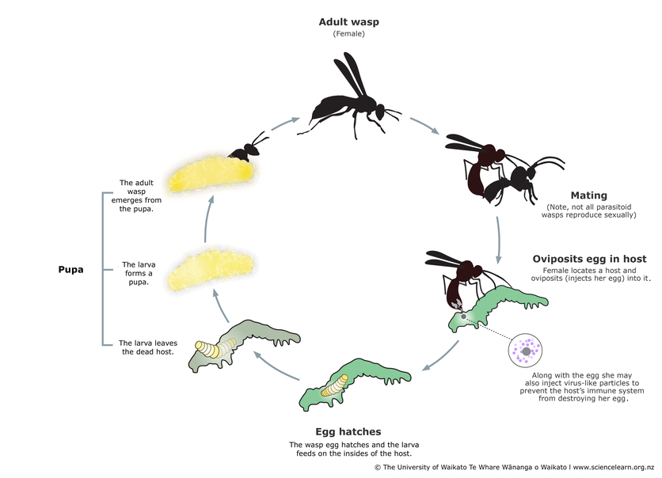
Parasitoids
Usually Hymenoptera (bees, wasps), or flies (Diptera)

Slide 13
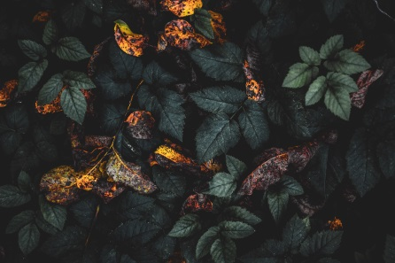
Microparasites
Fungi: skin diseases in animals, ergot on rye (Claviceps spp) can kill animals and people. Irish potato blight.
Fungal infections of insects can result in ‘summit disease’
Bacteria: fewer soil-borne diseases than fungi. Don’t live long in soil.
In plants: soft rots, wilts, blights, cankers, galls.
Lots of diseases of animals: cholera, Lyme disease from deer. Very infectious.

Slide 14
Plant responses to infection
No antibodies- lack of adaptive immune system.
Rely on innate immunity of cells
Infection sites send systemic signals so can respond to those.
Can isolate and sacrifice infected areas: hypersensitive response.
Insect responses to infection
Groom spores from each other
Generate fever response
Leave nest to die away from group.

Slide 15
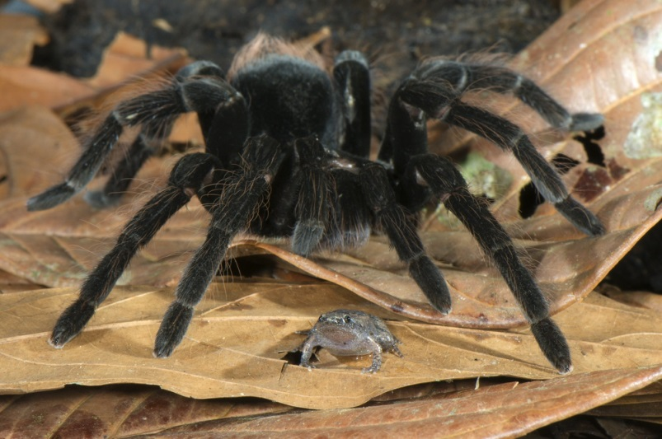
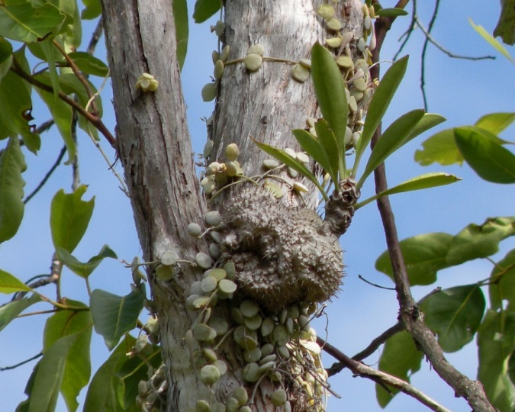
Mutualism
A mutualism is a interaction between individuals of different species that result in a positive outcome for both.
Many examples, some very strange!
http://www.isopoda.net/bio-francesco-tomasinelli-naturalist-author-and-photographer/
Credit: Dave Kimble https://creativecommons.org/licenses/by-sa/3.0

Slide 16
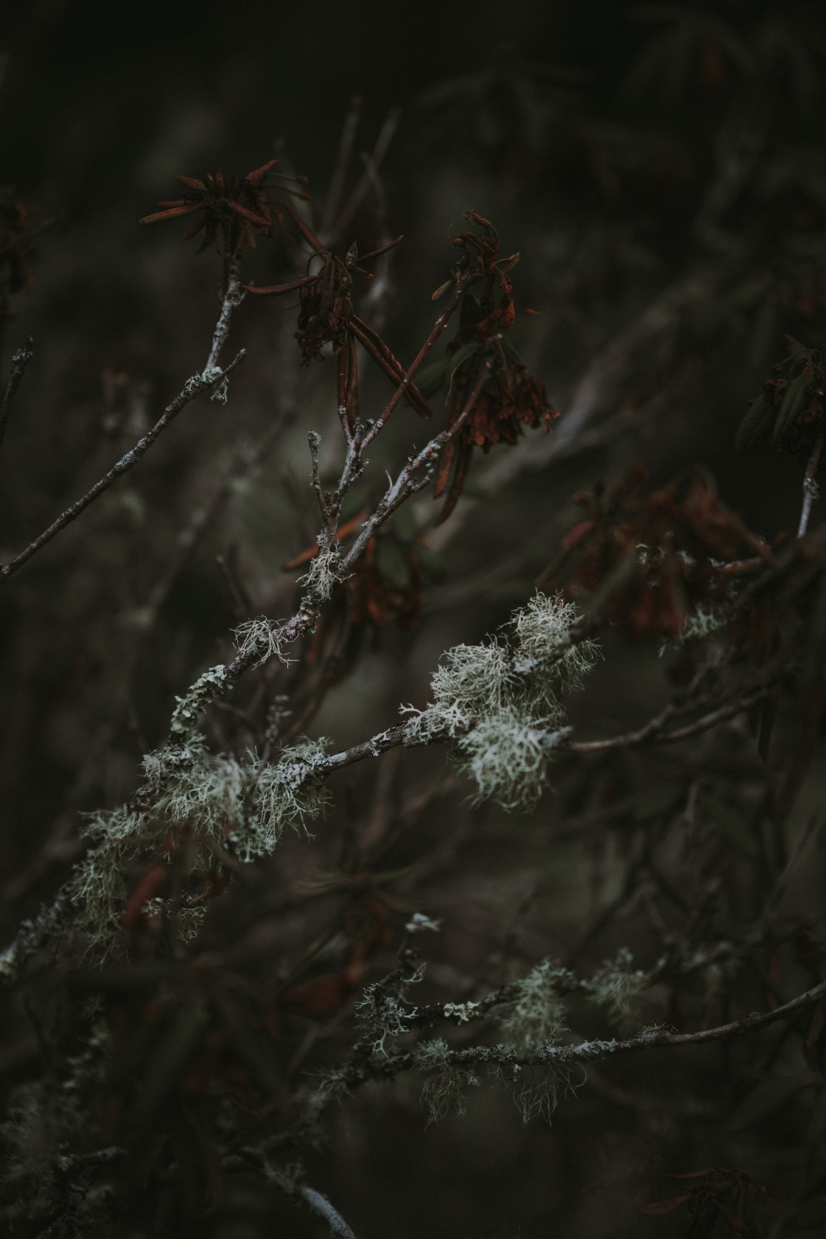
Lichens
A symbiosis between a fungus (mycobiont) and an alga or cyanobacteria (photobiont).
Fungus provides:
Thallus (physical structure)
Unique fungal chemicals that provide protection from UV, drying, herbivory.
Mineral nutrients
Alga/cyanobacteria provides:
Sugars from photosynthesis

Slide 17
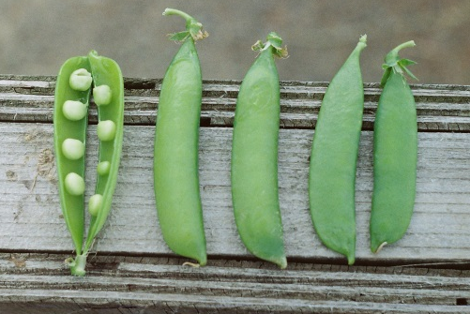
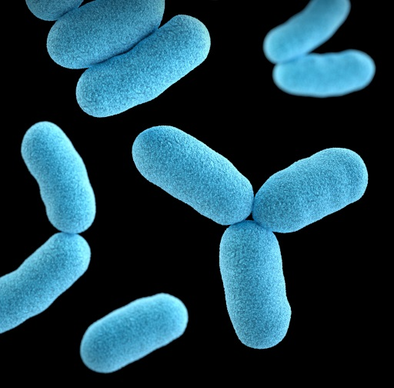
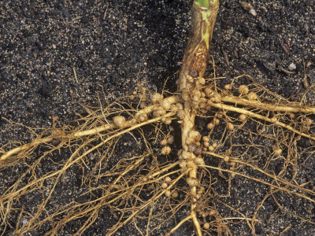
Legume – Rhizobium mutualism
Rhizobium sp: a plant growth promoting bacterium
Family Fabaceae. e.g. peas and beans, Acacia spp.
Carbon
Nitrogen
Root nodules

Slide 18
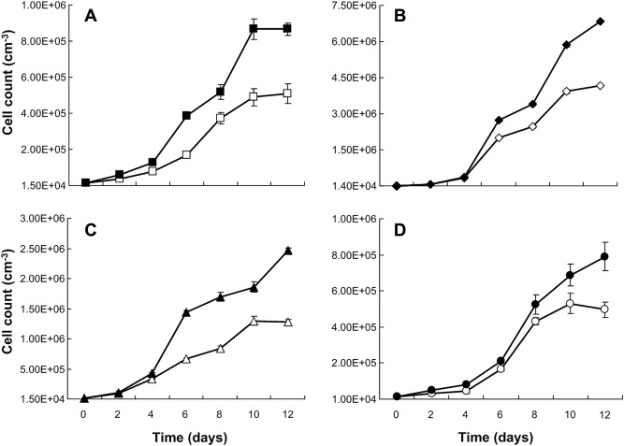
Rhizobium sp: a plant growth promoting bacterium
Rhizobium
NO Rhizobium
Kim et al. (2014) Biomass & Bioenergy 69, 95-105

Slide 19
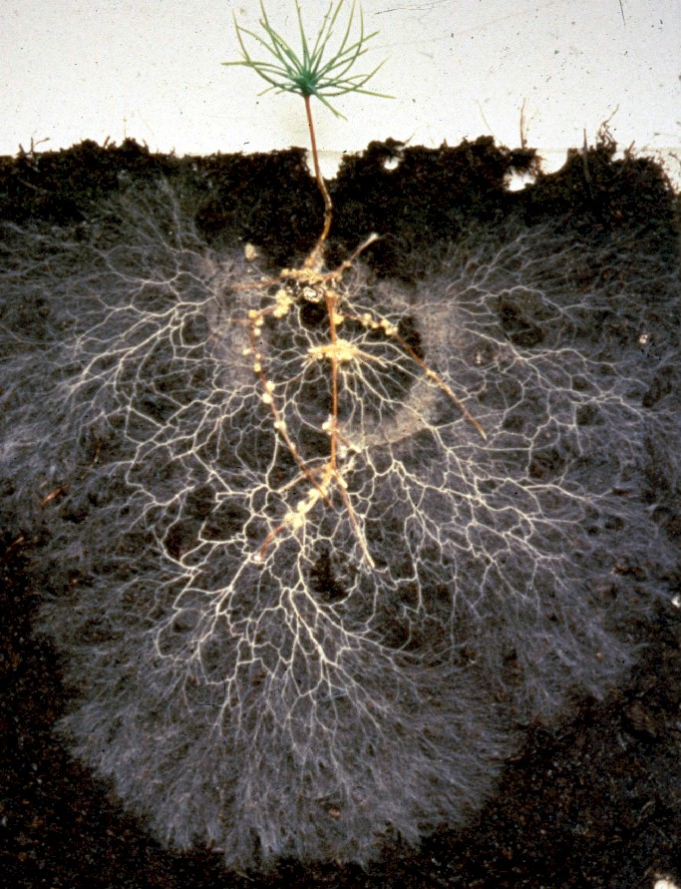
Mycorrhiza – literal translation: “fungus root”
Fungus that associates with vascular plants.
Almost all land plants have mycorrhizal associations.
Ectomycorrhiza- trees
Vesicular-Arbuscular Mycorrhiza- grasses and herbs
Ericoid mycorrhiza- heather
Orchid mycorrhizas- orchids
Photo credit: Filipa Cox

Slide 20
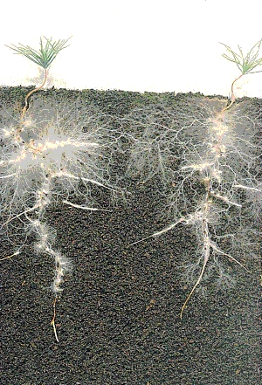
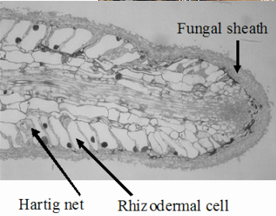
Ectomycorrhizas (EM)- trees
Fungal hyphae (branching structures) BETWEEN plant cells. This is called a Hartig net.
Common mycelial network

Slide 21
“Donor” plant – gets supplied with ¹⁴C in a sealed chamber
“receiver” plants
Finlay & Read (1986) New Phytologist 103 143-156

Slide 22
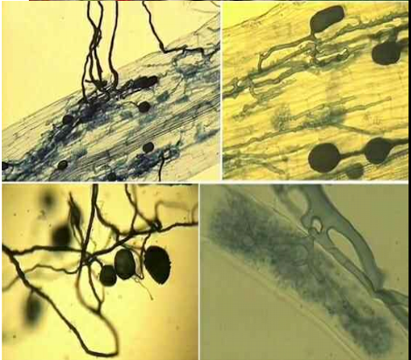
Vesicular-arbuscular mycorrhizas (AM fungi)- grasses and herbaceous plants
Nearly 90% of plant species form AMF associations
Arbuscules (tree-like)
Vesicles

Slide 23
Summary
A parasite negatively affects its host for food, shelter or reproduction.
A mutualist works together with another organism and both benefit.
Many examples of both in nature, with varying degrees of cost or benefit.
Interesting video of parasitism: https://www.youtube.com/watch?v=vMG-LWyNcAs

