Slide 1
May 2019
Residential School
Yangon University
20 – 24 May 2019
Municipal waste management
Notes:
Tutor instructions:
This activity is split into two sessions each one should take about one to one and a half hours to complete.

Slide 2
Introducing your tutor
Dr Stephen Burnley CEng, FIChemE, FCIWM, SFHEA
Senior Lecturer in Environmental Engineering at the Open University.
Teaching interests
General engineering
Waste management
Environmental management
Research Interests
Waste and the circular economy
Environmental education
Notes:
Tutor instruction:
Introduce yourself and give a brief outline of your career background.
Ask each participant to introduce themselves in turn and to say something about their academic background and their knowledge of waste and waste management.
Comment on the diversity of the participants'’ areas of expertise and remind them that solving environmental problems requires input from a wide community including physical and biological scientists, engineers and social scientists.

Slide 3
Activity outline
This two part activity will focus on solid waste in Myanmar and on how this waste can be managed in a way that minimises harm to human health and environmental pollution.
Session 1 covers the generation of solid waste in Myanmar.
Session 2 covers pollution from waste management and how this can be reduced by applying the principle of the “3 Rs”.
Both sessions will include group discussions and exercises.
Notes:
This activity is split into 2 parts.
In the first session we will look at the amounts of solid waste produced in Myanmar and what this waste consists of. We will also look at the national policies for dealing with waste.
In the second session we will learn about the health and environmental hazards caused by waste and look at practical measures to reduce these hazards.
Each part begins with a short presentation followed by practical and discussion activities.

Slide 4
Session 1 - Solid waste in Myanmar
Learning outcomes
Understand the amount of solid waste produced in Myanmar and its composition.
Appreciate Myanmar’s waste management policy and plans.
Understand the concept of “stakeholders”.
Identify the stakeholders involved in waste management in Myanmar.
Notes:
This first session has four learning outcomes or objectives that we want to achieve by the end of the session.
Firstly, to understand how much solid waste is produced by the country and what it consists of.
Secondly to know about the Government’s policy on waste and its plans for the future.
Finally we need to understand the concept of a “stakeholder” and to identify the key stakeholders when it comes to managing waste in Myanmar.

Slide 5
What is “municipal waste”?
Solid waste produced in cities and townships.
In Myanmar this consists of waste from
Households 60%
Markets 15%
Commerce 10%
Hotels 2%
Gardens 5%
Other sources 8%
Other sources include industrial, medical and agricultural wastes.
Notes:
The definition of municipal waste varies form country to country, but we can think of it as covering all the solid wastes produced in the nation's cities, townships and rural communities. This definition excludes the specialised wastes produced in large quantities by processes such as minerals extraction, large-scale agriculture and chemicals and energy production.
The main source of municipal waste is the individual households and the materials we throw away every day.
Markets are also an important source of wastes – mainly food-related items.
The commercial sector (retail, education, government, banking etc) represents the third largest sector when it comes to municipal waste.
The rest of the waste comes from gardens, hotel and sources such as industry carried out in urban areas and healthcare waste from hospitals, medical centres, dentists and veterinary practices.

Slide 6
How much municipal waste is produced in Myanmar?
A difficult question because the only waste that is weighed is that arriving at the Mandalay landfill site.
Based on results from this weighbridge and data from similar countries, the Word Bank estimates that Myanmar produces about 10.8 million tonnes of municipal waste each year.
Yangon accounts for about 1.5 million tonnes per year (4,200 tonnes per day) and Mandalay produces around 0.4 million tonnes per year (1,100 tonnes per day).
Notes:
It is important to know how much waste a particular country has got to manage. Unfortunately, it is impossible to produce a precise value of the waste generated in Myanmar. This is a common situation in many countries where waste is not routinely weighed.
The only waste that is weighed in Myanmar is the material taken to the Mandalay landfill site that serves three townships.
The World Bank has used data from this landfill to predict the waste produced in urban areas. For rural areas, they used data from similar countries to arrive at an overall national estimate of 10.8 million tonnes per year.
Around 14% of this total is produced in Yangon and Mandalay accounts for another 4%,

Slide 7
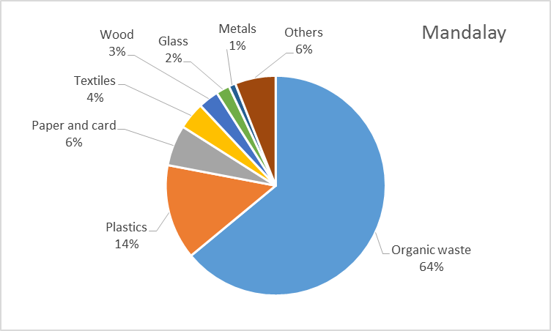
What does municipal waste consist of? (Source: “Quick study on waste management in Myanmar, (2016) Institute for Global environmental Strategies, https://www.iges.or.jp/files/research/scp/PDF/20160613/17_Quick_study_Web.pdf)
Notes:
As well as the quantities of waste generated, we need to know what it consists of.
Based on samples of waste collected in Yangon and Mandalay, we can see that the main component is organic waste. This mainly comes from food preparation and consists of vegetable waste (peelings, leaves of root crops etc) and smaller quantities of meat products (fat, skin, bones etc).
The other major component is plastic from drink bottles and other packaging. The problem of plastic wastes is of international concern due to its potential for polluting the oceans.
The proportions of other materials that are widely collected for recycling in European countries (paper, glass and metals) are relatively low in Myanmar’s waste.

Slide 8
How is municipal waste collected and managed?
Collection and disposal is the responsibility of the cities and townships.
In rural areas all waste management is “informal”.
In urban areas:
Primary collections are from households and blocks using carts or tricycles. Collectors transport the waste to local depots.
Secondary collections are from the depots and use dumper trucks.
Disposal in landfill sites (typically 10-25 km from the centre of the township).
Usually “open dump” sites but there are small engineered landfills in Mandalay.
Notes:
Myanmar does not have a nationwide formal waste collection system. Cities and townships do have a responsibility to collect and dispose of wastes. However, only about 50% of Yangon’s waste is collected and in Mandalay around 80% is collected. In rural areas, all waste management is “informal” in that it is carried out by the people who deposit their waste in unofficial landfills.
In urban areas, the primary collection from individual households and businesses is usually made using handcarts or tricycles. These collectors take the waste to local depots.
Secondary collectors use powered vehicles to collect waste from the depots and drive it to the landfill sites.
Generally, the landfill sites are “open dumps” with few (if any) pollution control measures. The exception is in Mandalay where there are engineered landfills which provide some protection of people and the environment from pollution.

Slide 9
Recycling
Collecting materials for recycling is carried out in most urban areas by the informal sector. Collections are made:
from households; or
by sorting from mixed wastes at the dump sites.
Collectors sell the materials to merchants.
Merchants often then sell the materials to larger merchants.
Finally, the materials are sold to reprocessing factories or exported to other countries.
Recycling statistics are unreliable or non-existent, but one survey for Yangon estimated that 86 tonnes of waste is recycled each day.
Notes:
Recycling does take place in Myanmar, but this is mainly done by the informal sector rather than by the city authority or its contractors.
Self-employed people collect recyclable material either from households or by picking it from waste deposited at the landfills. These collectors sell the material to larger merchants.
The merchants sell the material onwards until it reaches factories that reprocess the collected materials or export it for processing overseas.
There are no reliable statistics on recycling in Myanmar, but one survey done in Yangon suggests that the city recycles about 85 tonnes per day. This equates to about 2% of the city’s waste.

Slide 10
National waste management strategy and action plan - goals
Extend waste collection to all and end uncontrolled disposal.
Extend sustainable management of industrial wastes etc.
Reduce waste through the 3Rs (targets to be introduced).
Ensure sustainable financial mechanisms.
Increase awareness raising and education programmes in schools.
Establish benchmark performance indicators and take action against non-compliant organisations.
(Source: 8th Regional 3Rs forum, http://www.uncrd.or.jp/content/documents/6285Country-G-2-Myanmar.pdf)
Notes:
Myanmar has a national waste management strategy. This strategy takes a sensible approach in that its first aim is to provide a waste collection service to all people and to end the informal disposal of waste in the uncontrolled landfills.
The strategy also aims to control the management of industrial and other wastes so that they are managed in a sustainable way.
In common with most countries, the plan is to reduce waste by applying the principle of the 3 Rs (which we will look at in the next slide). This can only be achieved with widespread publicity and this will be done through education programmes in schools and publicity among the wider community.
Of course, implementing such as system will be costly and the strategy plans to set up financial mechanisms and charges to cover the costs on a long-term basis.
Finally, performance indicators will be set and the government will take action against cities and organisations that fail to meet the standards.

Slide 11
What are the “3R”s?
Notes:
Tutor instruction
Most participants will have heard of the “3 Rs”. Give the participants 5-10 minutes in groups to list the 3 Rs and discuss what they mean in practice.
Then give them a further 5 minutes to write down their views on a piece of flipchart paper to be posted on the room wall. Then reveal the answers on the next slide.

Slide 12
What are the “3R”s?
Reduce
Reuse
Recycle
We will discuss this further in Session two.
Notes:
Tutor instruction
Briefly work through he answers, picking out an example or two from the groups’ flipcharts.

Slide 13
Identifying stakeholders
What or who is a stakeholder in an activity?
Person, group, or organisation who affects or can be affected by the activity in question.
Notes:
We can think of a stakeholder as any person, group of people or organisation who affects or is affected by a particular activity. As university staff, we are all stakeholders in our Universities. So are our students, management colleagues, the firms that go on to employ our graduates, the organisations that fund our research, the people who live and work near our campuses and our education ministries. No doubt there are also many more stakeholders.
From the example of a university you can see that any communal activity such as developing and implementing a waste management plan requires the participation and cooperation of large numbers of stakeholders.
In the next activity you will identify the stakeholders in waste management in Myanmar.

Slide 14
Identifying municipal waste stakeholders
In your groups:
Discuss “who are the municipal waste management stakeholders in Myanmar”.
Write down your answers on the flipcharts provided.
Notes:
Tutor instruction
Ask the participants to spend 10 minutes in their groups identifying all the stakeholders that relate to municipal waste management in Myanmar. If a group completes this very quickly, ask them to rank the stakeholders in order of importance.
Next, ask the participants to transfer their findings to a flipchart paper and post this on the wall.

Slide 15
Municipal waste stakeholders in Myanmar
People
Residents.
Waste collectors.
Recycling collectors and merchants.
Those living near depots/dumps etc.
Policymakers.
Politicians.
Regulators.
Organisations
Central government.
City/township authorities.
Municipal cleansing departments.
Private sector waste companies.
Companies selling goods that will become waste.
Notes:
Tutor instruction
Review the participants’’ posted flipcharts and draw the groups’ attention to any particularly interesting stakeholders, any that had only been identified by just one team.
Now show the list from this slide and ask for comments from the participants. Comment on any stakeholders that the participants didn’t identify or any that they identified that are not on this list.

Slide 16
Session one - summary
At this point you should now:
Know where solid waste comes from in Myanmar, how much the country produces and what it is composed of.
Appreciate Myanmar’s waste management policy and plans for the future.
Understand the concept of “stakeholders”.
Have Identified the stakeholders involved in waste management in Myanmar.
Notes:
At this point we have reached the end of the first session and you should feel confident that you have met its learning outcomes.
You have also participated in some group activities where you have thought about waste and the stakeholders in Myanmar’s waste management plans and practices.
After the break, in the second session we will think about managing wastes in more detail and look at practical ways of implementing the 3 Rs.

Slide 17
Session 2 - Implementing the 3Rs
Learning outcomes
Appreciate the hazards and pollutants resulting from waste disposal in dump sites.
Understand the concept of the 3Rs.
Explain how you can apply the 3Rs at home and at your university.
Notes:
This second session looks at some of the pollutants and hazards that can be generated from waste deposited in uncontrolled landfills. The best way to deal with any pollutant is to not produce it in the first place. So we will also look at ways of eliminating the problem of wastes.
There are three learning outcomes for this session.
After looking at the potential hazards of landfill we will consider the principle of pollution prevention. We will do this by applying the 3Rs and thinking about how they could be adopted in our homes and at our Universities.

Slide 18
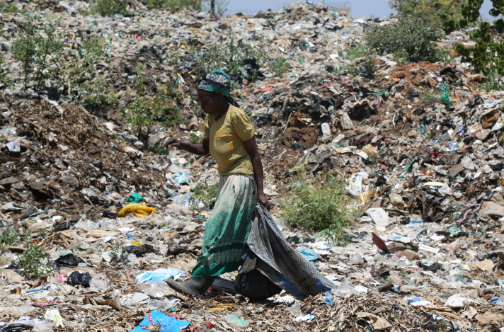
Hazards and pollution from dump sites
What are the main hazards and pollutants from uncontrolled dump sites?
Photograph by Lubega Ibrahim - https://commons.wikimedia.org/wiki/File:An_old_woman_on_a_dumping_site.jpg
Notes:
Tutor instructions
Introduce the first activity by reviewing the photograph, but without supplying the answers to the question.
Ask the participants to spend around 15 minutes writing down the main hazards to human health and sources of environmental pollution that such as site will generate. They should write their answers down on a piece of flipchart paper and post them on the wall.

Slide 19
Hazards and pollutants from dump sites
Groundwater pollution from leachate and run-off.
River and surface water pollution from run-off and leachate.
Fires – CO, smoke, hydrocarbon released to the air.
Greenhouse gas emissions – CO₂ and CH₄.
Dust and odours.
Ingestion of waste by wildlife and farm animals.
Risk of injury to site workers.
Long term land contamination.
Supports rats, flies, mosquitoes etc.
Notes:
Tutor instruction
Comment on the participants’ lists and make the following comments based on this list
Leachate is formed by rainwater percolating through the deposited waste and mixing with the liquids produced as the waste decomposes. This can contain high levels of ammonia, organic pollutants and heavy metals. If leachate enters any groundwater, it can lead to the pollution of water supplies for humans, animals and crops and can also contaminate rivers.
Direct contamination of surface waters can occur when rainwater runs over or through the waste into rivers. This is a particular issue during Myanmar’s rainy season.
If a site contains dry waste and items like vehicle tyres, it can ignite and burn while discharging smoke, hydrocarbons, CO2 and particles contaminated with heavy metals into the air. These can all be inhaled by people and animals and be deposited on crops grown for food.
If anaerobic conditions develop, organic material in the waste decomposes to produce the greenhouse gases methane and carbon dioxide.
All landfills release dust and odours; these are at best a nuisance but can contaminate land and food crops.
If a site is not surrounded by strong fencing, wild and domestic animals can graze on the site and ingest harmful and /or toxic materials. For example, glass, plastic bags, spoiled food.
People who work on the site are at risk of injury from broken glass etc – this is a particular issue for those who recover recyclable material from the site and generally lack protective gloves and footwear.
Contamination accumulates in the landfilled waste and the land will remain unusable for decades after the closure of the site.
Finally, landfill sites are attractive to rates, flies, mosquitoes and other disease carrying organisms.

Slide 20
The principle of the 3Rs
If we can reduce the waste going to landfill we can reduce these risks.
The 3 Rs
REDUCE – reduce the amount of waste produced.
Examples; more efficient manufacturing, avoiding unnecessary packaging,
REUSE – use something for its original purpose more than once without processing.
Examples; reuse of clothing, reusing glass and plastic containers,
RECYCLING - transforming materials into useful products using physical, chemical or biological processing.
Examples; using waste glass and metals in glass and metal manufacture, making paper from waste paper. Composting organic wastes.
Notes:
As We said in the first slide, if we reduce, or better still eliminate, landfills, the risks that we have just identified are reduced or eliminated also.
The 3Rs that we looked at in the first session are recognised throughout the world as a way of reducing pollution from wastes.
Reducing simply means reducing the amount of wastes generated. Examples include improving the efficiencies of manufacturing processes, finding uses for by-products form manufacturing and avoiding unnecessary packaging.
Reuse is when something is used for its original purpose more than once without the need for any reprocessing. For example, passing outgrown clothing to family members, refilling and reusing plastic drink containers.
Recycling involves the use of physical, biological or chemical processes to transform wastes into usable raw materials. Glass, paper, plastic and metal recycling are obvious examples, but converting organic waste into compost is an important way of recycling the largest component of Myanmar’s waste.

Slide 21
Group exercise
In your groups
discuss what people at home and universities can do to practice the 3Rs.
discuss how local and national government can encourage this.
Write down your ideas on the flip charts.
Whole group review
Spend a few minutes looking at the other groups’ ideas.
Notes:
Tutor instruction
Ask each group to spend about 20 minutes “brainstorming” ways that the 3Rs can be implemented in the home and on university campuses. Also ask them to think about how the Government can encourage people to do this.
Ask the groups to record their ideas on paper and post these on the wall.
Once they have done this, get the entire class to walk round the room looking at everyone else’s postings and comment on the suggestions.
End by summing up some of the common suggestions and draw their attention any particularly innovative ideas.

Slide 22
The 3Rs at home
Reduce
Avoid buying over-packaged goods and food
Repair broken furniture when possible
Buy durable (longer lasting) products and clothes
Reuse
Use finished food jars for storing other items.
Give outgrown children’s clothing to family members and friends
Share books and magazines with friends
Recycle
Give my recyclable waste to collectors
Try and avoid buying items in non-recyclable packaging
Compost my vegetable waste (if I have space to do this)
Notes:
Here are a few examples that I came up with
You can reduce waste by looking at the amount of packaging is used – buy the product with the least packaging. Is it possible to repair a broken piece of furniture rather than throw it away? Longer lasting product and clothes mean they need replacing less often – therefore less waste.
We can reuse lots of items at home. Use old food containers to store pens and pencils, or screws and nails. If you have children and they grow out of their clothes, can you give them to family members for their children? Have you got a book that you've read? Perhaps you could swap it for a different book with a friend.
You can help recycling by segregating recyclable waste and given it to collectors. Make sure that the packaged items that you buy use packaging materials that can be recycled in your local area. Finally, if you have space, you could compost food waste for use as a soil improver.

Slide 23
The 3Rs on campus
Reduce
Provide water coolers to reduce bottled water use
Discourage printing of emails etc
Provide notes to students in pdf rather than hard copies
Reuse
Buy refillable printer ink/toner cartridges
Use scrap paper for note-taking etc
Donate old tables, chairs etc to charities
Recycle
Install containers to collect recyclable material.
Buy paper etc with a high recycled content.
Set up student research projects on waste recycling.
Notes:
Again here is a list of a few examples.
Students and staff will reduce their consumption of plastic bottles if you provide water coolers on campus.
Could you have a policy of not printing emails and of providing lecture notes to students in pdf format rather than as printed copies?
Reuse also has a lot of potential from refillable printer cartridges through reusing scrap paper for note taking to giving old furniture and equipment to charities or local schools.
Does your campus have containers for recyclable wastes that can be collected by merchants? If you buy paper with a high recycled content, this helps to stimulate the market for recycled paper and therefore encourages more people to collect waste paper. Finally, you can help to develop new recycling processes, technologies and systems by encouraging students to undertake recycling-related research projects.

Slide 24
Session two summary
At the end of this session you should be able to
Appreciate the hazards and pollutants resulting from waste disposal in dump sites.
Understand the concept of the 3Rs.
Explain how you can apply the 3Rs at home and at your university.
Notes:
This brings us to the end of session two.
As well as having taken part in group discussions about the waste problem and potential ways of contributing to its solution, you will now be able to
Appreciate the hazards and sources of pollution present in uncontrolled landfill sites.
Understand the concept of the 3Rs
Explain how the 3Rs can be applied at home and on the university campus.

