Slide 1
Lecture 3 Delivery Mechanisms – Case Study
The Electricity Transition Playbook
Supported by and in collaboration with CCG and Green Grids Initiative
Version 1.0

Slide 2
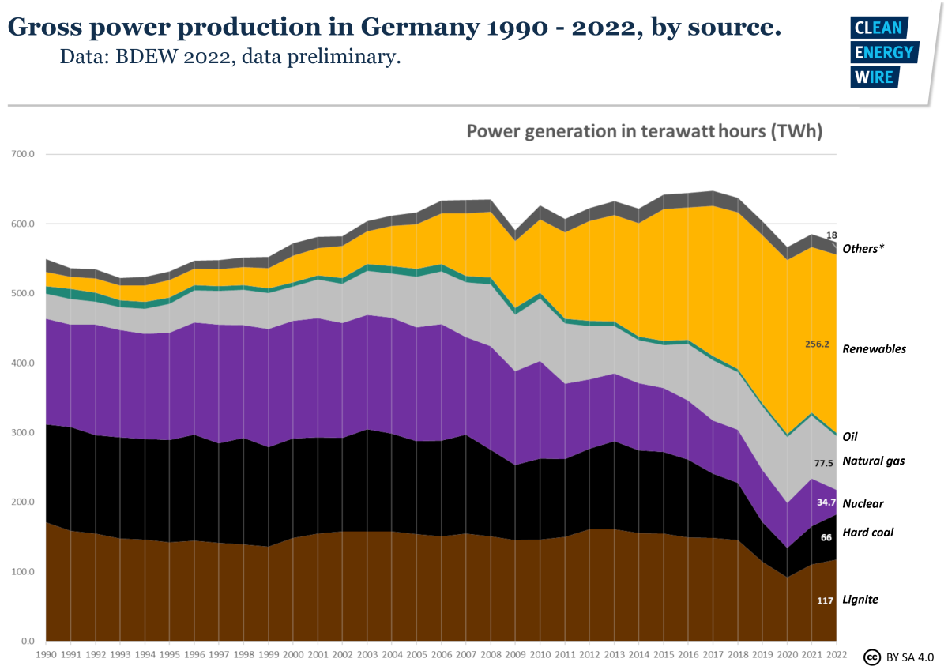
Case study overview
This block uses the example of Germany to reflect on the three pillars (delivery mechanisms) facilitating net zero transitions in the electricity sector.
Germany is the most populous European Union (EU) country, with a population of ~84 million.
6th largest energy consumer in the world.
One of the largest natural gas importers in the world
Roughly equal share of electricity comes from fossils and renewables (2022).
As of 16th April 2023, Nuclear Power production has been stopped completely.
Most of the coal in the country is imported except for the lignite.
4th largest installed Solar PV capacity in the world
NZ policy: GHG neutral by 2045; emission reductions 65% by 2030 compared to 1990, and 88% by 2040.
Aggressive policies focussed on VRE adoption.
October 2023 - plans to revive new Lignite plants as a reserve for Natural gas shortages during winter
Source: image obtained from https://www.bdew.de/service/publikationen/jahresbericht-energieversorgung/. License CC BY SA 4.0
Notes:
This block uses the example of Germany to reflect on the three pillars (delivery mechanisms) facilitating net zero transitions in the electricity sector.
Germany is a prominent and influential EU country with a high energy demand. It uses both fossil fuels and renewables to generate electricity and has the fourth largest solar PV capacity in the world. It has stopped nuclear power production entirely in 2023. It aims to be net zero by 2045, which means balancing its emissions with removals. It plans to reduce its emissions by 65% by 2030 and 88% by 2040 compared to 1990 levels. It also focuses on increasing variable renewable energy sources. However, it faces the challenge of natural gas shortages during winter, which may lead it to revive polluting lignite plants. This may present challenges to its net zero goal.

Slide 3
Germany’s Net Zero strategy and its delivery
Germany leads Europe with target to reach 100% clean power by 2035
Contributes to Germany’s broader goal to reach climate neutrality by 2045
A comprehensive transformation of the power sector,
Accounts for about 40% of the country’s emissions (2022)
Phasing out coal by 2038 and nuclear by 2022 (done in 2023),
Expanding renewable capacity and grid infrastructure
Increasing energy efficiency and demand management.
Reliance on domestic action and innovation and commitment to fairness and social balance
Fully liberalised and competitive market, with more than one thousand market participants to support the transition. Largest electricity market in Europe
Germany promotes innovative auction mechanisms that promote both technology-specific and neutral alternatives to promote renewables.
Innovative cross-border trade to enhance regional integration and optimise resource allocation among countries
Robust incentive mechanisms under the Renewable Energy Sources Act (EEG), for expanding renewable energy in the electricity sector.
Goes beyond the EU-ETS to include carbon pricing for the building and transportation sectors.
Notes:
Germany aims to achieve 100% clean power by 2035 and climate neutrality by 2045. It has a legal framework that sets sectoral targets for emissions reduction and removals, and a periodic review process by an expert council. It plans to transform the power sector, which accounts for 40% of its emissions, by phasing out coal and nuclear, expanding renewables and grid infrastructure, and increasing efficiency and demand management.
Germany has a fully liberalized and competitive electricity market, which supports the transition to renewable energy sources. It is the largest electricity market in Europe. Germany uses innovative auction mechanisms that allow different technologies to compete for subsidy levels and capacity. Germany also cooperates with other countries to trade and transmit electricity across borders. Germany has robust incentive mechanisms under the Renewable Energy Sources Act (EEG), which guarantees fixed feed-in tariffs or premiums for renewable generators. Germany also includes carbon pricing for the heating and transport sectors, which are not covered by the European Union’s Emission trading System.

Slide 4
Market deregulation and liberalisation in Germany
Regional and municipal utilities governed electricity generation, transmission, and distribution.
Government setting prices and controlling market entry.
Regional utilities, known as "Stadtwerke," dominated the market, providing electricity to their regions.
German electricity exchange (EEX) created in 2000.
The EEX facilitated the trading of electricity contracts, including spot markets, futures, and options.
The German TSOs divided the country into several market areas for efficient transmission.
The 1990s: Germany initiated reforms to liberalise its electricity market following the EU
1998: The Electricity Market Act (StromVG) was introduced, allowing electricity generation and retail competition.
Independent power producers (IPPs) allowed to enter the market. Feed-In Act introduced in 1990.
Energiewende, a national energy transition, aimed for a sustainable and low-carbon energy system.
Phase out nuclear power, increase renewable energy share and improve energy efficiency.
Renewable energy auctions introduced to determine technology support levels
The integration of intermittent renewable energy sources posed challenges to grid stability, requiring investments in grid infrastructure and smart grid technologies.
Energy Transition and Energiewende (2010s-present)
Wholesale Electricity Market (2000s)
Germany established the Renewable Energy Sources Act (EEG) enacted in 2000.
Official feed-in tariff system introduced
Renewable Energy Expansion and Feed-in Tariffs (2000s-2010s)
Monopoly and Regulation (Late 19th Century – 1990’s)
Deregulation and Liberalization (1990s)
Germany is part of the EU’s internal energy market
Has four bidding zones maintained by Transmission System Operators (TSOs): 50Hertz, Amprion, TenneT, and TransnetBW
Over 900 Distribution systems operators (DSOs) handle the retail market
Federal Network Agency (BNetzA) and the Federal Ministry for Economic Affairs and climate action (BMWi), oversee the electricity sector and enforce regulations
Source: Agora Energiewende (2019): The Liberalisation of Electricity Markets in Germany History, Development and Current Status under CC-BY-4.0 license.
Notes:
To give a bit of history. Germany’s market liberalisation started in the 1990s. It was one of the first countries to introduce an early form of feed-in tariff in 1990. In 1998, the Electricity Market Act was passed to allow retail competition. The German electricity exchange was created in the year 2000. In the year 200, the Renewable Energy Sources act (EEG) was established with periodic updates. Germany is part of the European Union’s internal energy market. It has four zones maintained by 4four different Transmission System Operators (TSOs). They are 50Hertz, Amprion, TenneT, and TransnetBW. And there are over 900 Distribution systems operators (DSOs) that handle the retail market. Federal Network Agency (BNetzA) and the Federal Ministry for Economic Affairs and Climate Action (BMWi), oversee the electricity sector and enforce regulations.

Slide 5
Renewables in the Liberalised Power Market
The Renewable Energy Act
Since 2000, the Renewable Energy Act (Erneu-erbare-Energien-Gesetz, EEG) has been the central instrument for the promotion of electricity from renewable sources in Germany.
Amended every third year since its adoption.
Its three main provisions are:
An obligation for the grid operator (TSO or DSO) to connect renewable energy systems to the grid immediately and as a matter of priority.
An obligation of the grid operator (TSO or DSO) to prioritise the feed-in, transmission and distribution of renewable electricity.
The payment of fixed, technology-specific feed-in tariff compensation for 20 years
Funded by a surcharge on electricity consumers
EEG update 2014 and onwards
Transition from a feed-in tariff scheme to an auction system
Notes:
The Renewable Energy Act is a German law that supports the production and use of electricity from renewable sources. It was introduced in 2000 and has been revised several times. It requires grid operators to connect and prioritize renewable energy systems, and to pay them fixed, technology-specific feed-in tariffs for 20 years. The law is funded by a surcharge on electricity consumers. In 2014, the law was updated to introduce an auction system for new renewable energy projects, instead of feed-in tariffs. This law was gradually implemented starting in 2014 in multiple phases for different technology types and capacities.

Slide 6
Renewables in the Liberalised Power Market
When the EEG subsidies from 2000s end…..(as of 2019)
Since the first EEG came into force in 2000, subsidies are paid for 20 years plus the first year of operation
In 2021, the first old installations will leave the subsidy system and will have to sell their electricity either directly to the market or will need a Power Purchase Agreement (PPA) with a consumer or utility.
In the coming years, ever more renewable capacity will leave the subsidy system.
Some of them might continue running as long as possible, while others might be repowered with new installations, thus allowing participation in the auction process run by the Federal Network Agency.
EEG 2021 (the latest edition)
An increase in the tender volume for Solar PV and onshore wind energy.
A reduction in the feed-in tariffs for new solar PV installations and new onshore wind installations.
The introduction of a market premium model for new renewable energy installations.
Subsidization of existing wind turbines that will stop receiving subsidies in 2021.
Introduces quotas for the south of Germany to reduce the imbalance in generating capacity between the north and the south.
Notes:
To recap, EEG is the German law that supports renewable energy sources by paying them subsidies for 20 years. In 2021, the first renewable energy plants that started in 2000 stopped receiving subsidies and had to sell their electricity on the market or through contracts with buyers. This will affect more and more renewable energy plants in the future. Some may keep operating without subsidies, while others may replace their old equipment with new ones and join the auction system for new subsidies.
The EEG had an update in 2021. It increased the amount of solar PV and onshore wind energy that can be built and received subsidies through auctions. It lowered the feed-in tariffs for new solar PV and onshore wind installations. It introduced a market premium model for new renewable energy installations, which means they will receive a variable payment that depends on the market price of electricity. This is supposed to make them more competitive and responsive to market signals. It provided a follow-up regulation for subsidising existing wind turbines that will stop receiving subsidies in 2021. This is intended to prevent them from shutting down or being replaced by new ones. It introduces quotas for the south of Germany to reduce the imbalance in generating capacity between the north and the south. This was meant to address the grid congestion and stability issues caused by the uneven distribution of renewable energy sources.

Slide 7
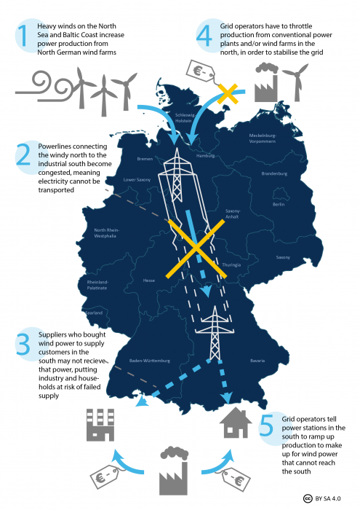
Renewables in the Liberalised Power Market Some challenges
Germany’s network expansion areas for the distribution and transmission grids
The north of Germany produces more wind power than it can consume
The transmission infrastructure cannot transport all this power to industrial centres in the south.
Economically prosperous South (Bavaria etc.) are historically opposed to wind farms and high-voltage power lines on their territory
In 2017, the bottlenecks required grid-stabilisation efforts costing EUR 1.4 billion
Forced grid operators to curtail wind plants during periods of high wind in northern and eastern Germany.
Sometimes, the electricity had to be looped through Poland
RE projects not evenly distributed within northern or southern districts, creating issues in the distribution grids.
Solution
Transmission network expansion areas established for wind projects.
The auctioneer defines a maximum quantity of power to be met by wind projects located in the north, even if the limit means turning away financially attractive projects
RE auctions have been designed by factoring the location of projects into the selection of winners to limit issues on the distribution grid.
Districts in which an additional renewable energy plant is likely to require expansion of the distribution grid are determined prior to the auction.
Wind and solar bids for projects located in one of those overloaded districts are penalised by adding a virtual premium to their bid prices.
Source: Re-dispatch situation in the German power grid image from Energy transition.org obtained under CC-BY SA 4.0
Notes:
The march towards Net zero with a high share of variable renewables is not always a cakewalk. Here, we discuss a particular case in Germany.
Germany has a problem of balancing its wind power supply and demand. The north of Germany produces more wind power than it can use, but the transmission infrastructure is not enough to transport it to the industrial centres in the south. This causes grid congestion and stability issues, which require costly interventions and curtailment of wind plants. Sometimes, the electricity has to be routed through neighbouring countries like Poland.
The north and the south of Germany have different views on how to solve this problem. The south, which is economically prosperous and opposed to wind farms and power lines on its territory, wants to keep a uniform electricity price and bidding zone for the whole country. The north, which has a high share of renewable energy, wants to have different bidding zones to reflect the regional differences in power generation and consumption. This would create price signals for investments in transmission and generation capacity.
Germany also plans to build new transmission lines and limit the wind capacity in the north. It uses technology-neutral auctions to select wind and solar projects based on their location and impact on the distribution grid. This way, Germany tries to align its renewable energy expansion with its grid development.

Slide 8
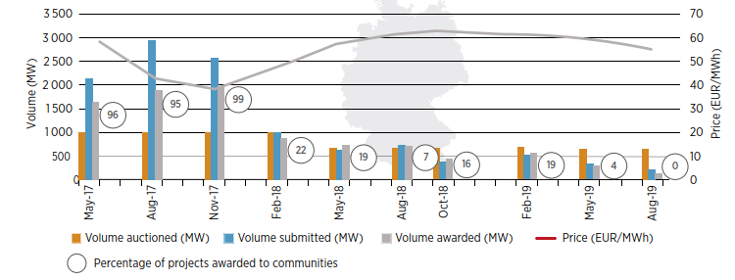
Auctions and Incentives: Lessons from Germany
Risk allocation and remuneration of auction participants
Germany adopted marginal pricing for citizen wind parks as part of their preferential rules, whereby winners are granted a price equal to the highest awarded bid while regular bidders are paid as bid.
Germany does not offer any indexing of prices, leaving sellers unprotected against inflation risks while the plant is being built. Neither does it offer any hedge against currency risk.
Qualification requirements for auctions
Since 2018, all wind power auctions required all projects to obtain environmental permits before the bidding stage. This led to undersubscriptions in 2018 and an increase in price in the next auction cycle.
Source: Image obtained from World Wind Energy Association (WWEA). (2019). Community Wind projects under the Auctions Model: A Critical Appraisal. Under CC BY SA 4.0
Notes:
Here, we discuss the various, Germany focussed, Renewable energy auctions and incentives and the lessons learned in their implementation.
Germany’s preferential rules for citizen wind parks affect their bidding behaviour in renewable energy auctions. Citizen wind parks are granted a price equal to the highest awarded bid, while regular bidders are paid as bid. It creates a risk that they will submit overaggressive bids just to be selected, which may undermine the efficiency and effectiveness of the auction. Germany does not offer any indexing of prices, leaving sellers unprotected against inflation risks while the plant is being built. Neither does it offer any hedge against currency risk. Though the wind energy economy is a well-oiled machine, currency fluctuation could have a stronger effect on Solar PV development.
Germany’s wind auctions require projects to obtain permits before bidding. However, the permitting process has become more difficult and time-consuming, and many projects have faced legal disputes and public opposition. As a result, developers have been reluctant to bid, fearing penalties for non-delivery. This has led to undersubscribed auctions, where the bids received were much lower than the volume offered. For example, in May 2019, only 295 MW of bids were received for 650 MW of volume. This shows that compliance rules and permitting issues can have a significant impact on the success of renewable energy auctions.

Slide 9
Auctions and Incentives: Lessons from Germany
Strict compliance rules for delays in project start
Germany has some of the strictest compliance rules related to delays in Solar PV projects
Failure to meet the target commercial operation date, usually 18 months from the time the project is awarded:
Penalties are pro-rated to the absent capacity
Additionally, the contract is reduced by EUR 3/MWh for the entirety of the plant’s useful life
Stricter rules have contributed to fewer delays in project completion in Solar PV projects in Germany
Inclusivity of small and new players in Auctions
Germany has strong Community ownership (CO) structures that allow small-scale actors such as households, individuals and businesses to unite in investing, developing and operating energy assets.
This creates a level playing field for all participants
CO wind projects had up to two years after winning a bid to obtain a building permit, unlike other bidders.
However, the CO projects proved challenging in Germany’s wind auctions
Less than 10% of the capacity awarded to CO projects had obtained building permits
The share of CO projects in auctions declined dramatically from more than 90% in 2017 to less than 16% at the end of 2018.
Lessons were learnt on the importance of developer experience in bidding for building large infrastructure
Notes:
Here we discuss two features in Germany’s renewable energy auctions regarding compliance rules and community ownership. Germany has strict compliance rules for solar PV projects, which impose penalties for delays in project start. These penalties are proportional to the amount of capacity that is not delivered on time, and they also reduce the contract price for the entire duration of the project. These rules have helped to reduce the delays in project completion, as bidders have to be more careful and realistic about their timelines. The wind energy auctions in 2017 had strong community ownership structures, allowing small-scale actors to participate in energy projects. Community ownership projects have some advantages, such as lower financing costs, higher social acceptance, and more local benefits. However, the community ownership projects have faced challenges obtaining building permits and competing with other bidders. Despite having some relaxation in obtaining building permits, most community projects did not obtain permits beyond their period of relaxation. They lacked the experience of a seasoned project developer. Developer experience is essential for building large infrastructure, and community ownership projects may need more support and guidance in this regard

Slide 10
Auctions and Incentives: Lessons from Germany
“Reference yield Model”
Is a way of compensating wind projects in regions with lower wind resources by paying them a higher price than the bid price, and vice versa for regions with higher wind resources.
Aims to level the playing field for different sites and to reduce grid congestion.
Does not limit the supply of wind projects and can potentially lower the grid and congestion costs,
Requires careful setting of parameters to ensure that good projects remain competitive and that location-specific adjustments do not distort the auction outcomes.
Way to encourage marginalised communities and regions with lower resource endowments.
Replacement of Feed-in tariffs by Auctions
Until 2015, the feed-in-tariff (FIT) system gave stability to RE investment
Since 2015, Germany has shifted to an auctions approach for installations above 100 MW to:
Improve control over installed capacity (over capacity was an issue with the FIT)
Raise competition
Germany also introduced joint cross-border auctions, opening the market to bidders from Denmark and neighbours
Demand Response Programs
Germany has several demand response (DR) programs for industrial and commercial customers
However, DR for residential customers is still limited and voluntary and depends on the availability of smart meters (which is surprisingly low in Germany).
Notes:
Germany uses a reference yield model to adjust the payments for wind projects based on their location and wind resources. This way, it compensates for the lower wind resources in some regions and the grid congestion between the north and the south. The reference yield model does not affect the supply of wind projects and can lower the grid costs, but it needs careful parameter setting to avoid distortion. The reference yield model also makes the low-carbon energy transition more equitable and inclusive by supporting the participation of communities and regions with lower wind resources. The reference yield model is not for sub-optimal projects, but for facilitating renewable energy development in different regions.
Germany used to have a feed-in tariff system that guaranteed a fixed price for renewable energy producers, but it switched to an auction system for large-scale projects above 100 MW in 2015. The auction system aims to improve the control over the installed capacity and to increase the competition among the bidders. Germany has also introduced cross-border auctions, which allow bidders from Denmark and neighbouring countries to participate in the German market. Additionally, Germany has several demand response programs for industrial and commercial customers, who can receive payments or discounts for reducing or increasing their demand when needed. However, demand response for residential customers is still limited and voluntary and depends on the penetration of smart meters, which is surprisingly low in German households.

Slide 11
Auctions and Incentives: Lessons from Germany
Green Bonds
First sovereign green bond issued in September 2020, raising €6.5 billion ($7.7 billion) for green budget expenditures in areas such as public transport and building renovation.
Between 2020-2022, €38.5 Billion was made available to invest in climate action, environmental protection and nature conservation.
Green bonds are not just issued by the federal government, they can be issued by public and private entities, such as municipalities, banks, corporations, etc.
Carbon Contracts for Difference (CCFDs)
CCfD scheme will provide €50 billion ($53.45 billion) to businesses facing substantial clean energy costs over the next 15 years, starting in 2023
The scheme will pay the difference between the carbon price and a fixed reference price for low-carbon technologies, such as hydrogen, carbon capture and storage.
Over 15 years, CCFDs expect to save 350 Million tons of carbon emissions
Summary
Germany has ambitious Net Zero targets.
It has efficient systems set in place to reach the targets. This goes beyond the energy systems as well.
However, the systems need regular updates to learn from mistakes and provide opportunities for innovation
These systems or delivery mechanisms must also go beyond the cheapest price allocation ideology and include just transition principles. However, this does not come without its challenges related to financial and societal risks
Notes:
Germany uses financing instruments like green bonds and carbon contracts for difference to support its net zero transition. Germany issued its first sovereign green bond in September 2020, raising €6.5 billion ($7.7 billion) for green budget expenditures. Between 2020-2022, €38.5 billion was made available to invest in climate action, environmental protection and nature conservation. Green bonds are not only issued by the federal government but also by other public and private entities. Germany launched a new scheme called carbon contracts for difference in 2023, which will provide €50 billion ($53.45 billion) to businesses facing substantial clean energy costs over the next 15 years. The scheme will pay the difference between the carbon price and a fixed reference price for low-carbon technologies. Over 15 years, the scheme expects to save 350 million tons of carbon emissions.
To summarize this case study, Germany has ambitious net zero targets that go beyond the energy systems and cover other sectors as well. Germany's efficient systems need regular updates to learn from mistakes and provide opportunities for innovation to throttle the net zero transition. These systems or delivery mechanisms should not only focus on the cheapest price allocation but also include just-transition principles that ensure a fair and inclusive transition. It is also important to acknowledge that these transitions involve financial and societal risks that need to be addressed.

Slide 12
References and resources
Relevant resources include:
BDEW energy supply report 2022: www.bdew.de/service/publikationen/jahresbericht-energieversorgung
https://www.cleanenergywire.org/factsheets/germanys-dependence-imported-fossil-fuels
The Liberalisation of Electricity Markets in Germany (2019: Agora Energiewende)
https://www.pv-magazine.com/2022/07/07/germany-raises-feed-in-tariffs-for-solar-up-to-750-kw/
https://www.gtai.de/en/invest/industries/energy/photovoltaic
The Smart Meter Rollout in Germany and Europe – FfE
Carbon Contracts for Difference (CCfD) program for energy-intensive industries – Policies – IEA

Slide 13
Supported by and in collaboration with CCG and Green Grids Initiative
Consolidated by Vignesh Sridharan from CCG and Green Grids Initiative
Sridharan, V., 2023, Lecture 3: Delivery Mechanisms – Case Study.
The Electricity Transition Playbook. Release Version 1.0 [online presentation]. Climate Compatible Growth Programme, Green Grids Initiative

