Slide 1
Supported by and in collaboration with
Politecnico di Milano
Off-Grid Systems Modelling with MicroGridsPy
LECTURE 10
Example Case Study
Version 1.0

Slide 2
Learning Outcomes of the Lesson
Comprehensive Understanding of MicroGridsPy Usage
Participants will gain detailed knowledge on how to utilize MicroGridsPy from start to finish in a sample project, including basic features and functionalities
Insight into Result Variability Based on Input
Learners will understand how different inputs can significantly alter the outcomes of the MicroGridsPy model, highlighting the importance of accurate and context-specific data
Awareness of the Model's Limitations and Potentials
Participants will comprehend the strengths and limitations of MicroGridsPy in modelling off-grid energy systems, providing a realistic perspective on its applicability in various scenarios
1

Slide 3
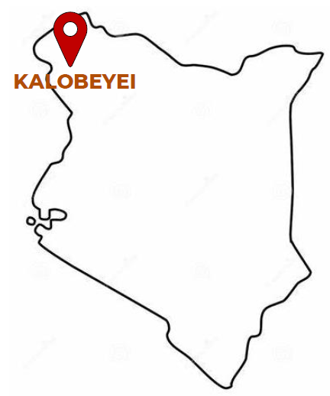
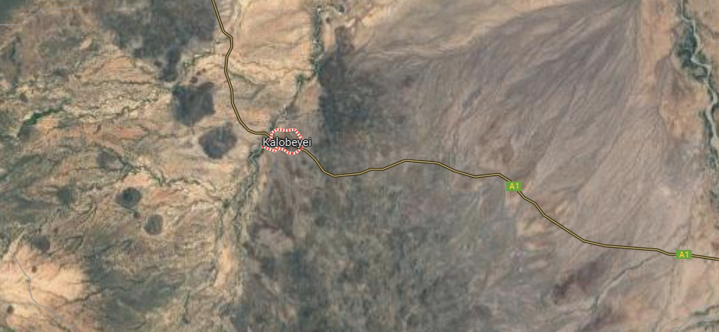
Call for proposals on rural electrification
The call for proposal from the UNESCO Chair in Energy for Sustainable Development seeks innovative off-grid rural electrification solutions for Kalobeyei settlement (Kenya), focusing on hybrid systems that combine renewable and non-renewable technologies. It underscores the importance of energy in local development and environmental preservation in line with global sustainable development goals, particularly SDG7.
Coordinates
Lon: 3°46’7.644’’
Lat: 34°37’ 14.458’’
Satellite location picture from Google Maps
2

Slide 4
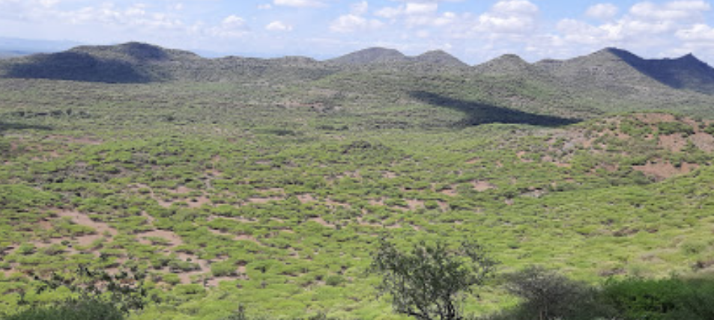
Kalobeyei Village
Kalobeyei, located in northern Kenya, is a remote village not serviced by the national grid and inhabited by around 700 families. The residents predominantly use traditional energy sources such as kerosene, diesel, and biomass for their daily needs. The village presents a unique case for developing a sustainable, off-grid, hybrid energy solution to meet its residential and communal energy requirements.
700 Households divided into 3 groups based on their existing appliances and on the appliances which are expected to be installed in the near future.
2 Primary schools with around 30 lights are installed; some external lights are also considered
1 dispensary having 3 rooms and 7 beds in total
Productive activities: tailor workshop, bars, garages.
Location pictures from Google Maps
3

Slide 5
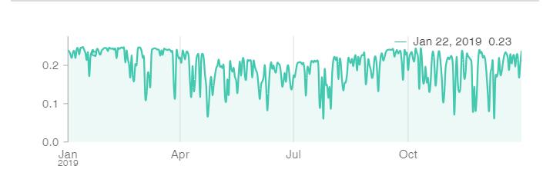
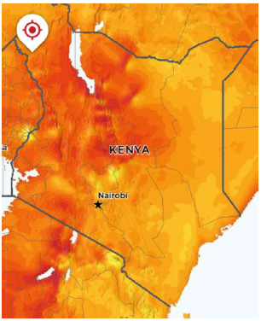
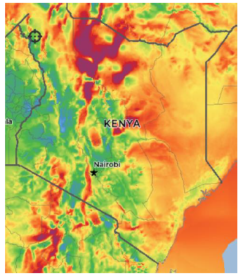
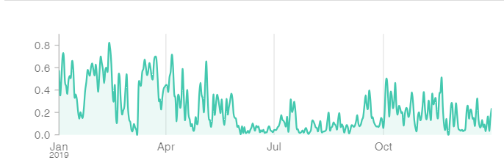
Resource Assessment
The most important resource available in the intervention area is certainly solar radiation, which is particularly high as it is throughout the country. Regarding the presence of winds that can be suitable for electricity production, despite the proximity to the equator would suggest good availability, the village region does not have large amounts of wind due to the morphology of the territory.
Daily average PV capacity factor
Solar Atlas
Wind Atlas
Daily average Wind capacity factor
Solar and Wind Atlas of the Kalobeyei Village [1]
Daily average capacity factor for PV and Wind generated for Kalobeyei village [2]
Sources for images: [1] Global Solar Atlas, Global Wind Atlas, [2] Renewables.ninja
4

Slide 6
Technology Characterization
Presented below is a simplified dataset of all available energy technologies in the Kalobeyei, Kenya area. It encompasses renewable sources like solar and wind, alongside non-renewable options such as diesel generator as well as two different types of battery bank and a biogas generator option.
 | PV | Wind generator | Diesel generator | Biogas generator + ICE | Battery type 1 (Lead-Acid) | Battery type 2 (Li-Ion) | Electronics
Capital cost [$/W] | 1.2 | 3 | 0.4 | 1.05 | 0.2 ($/Wh) | 0.3 ($/Wh) | 0.15 ($/Wh) for Li-ion 0.1 for Lead-Acid
O&M cost [%investment] | 1.8% | 2% | 4.5% | 4.5% | 2% | 2%
Lifetime [y] | 20 | 20 | 20 | 20 | 4000 cycles | 5500 cycles
Other info | System loss: 0.05 | NPS100c-21 | Diesel cost: 1.3 $/L Genset eff.: 34% | Crop residues price: 90 $/t ICE eff.: 30% | Eff. (round-trip): 0.86 DOD: 50% Ch./disch. time: 6 h | Eff. (ch&disch): 0.93 DOD: 20% Ch./disch. time: 4 h | Efficiency (inverter and rectifier) 96%
Discount Rate: 7.4%
5

Slide 7
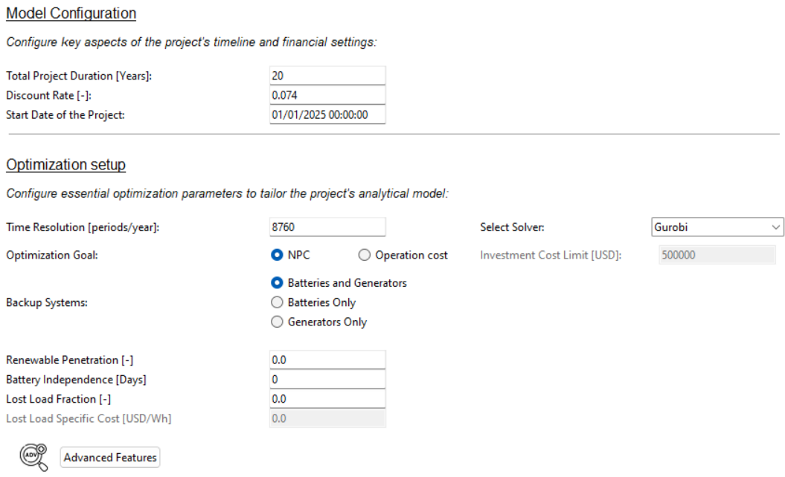
Model Configuration
The configuration for the mini-grid project in Kalobeyei involves a 20-year project duration, with a discount rate of 7.4%, starting on January 1, 2025
The mini-grid in Kalobeyei would be designed to deliver electricity at the lowest possible cost. It integrates storage and backup systems strategically, ensuring an economical supply of power without stringent restrictions on technology choices.
6

Slide 8
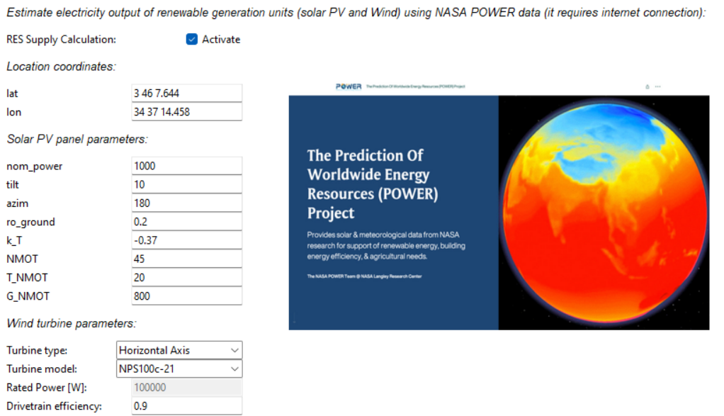
RES Time Series Estimation
In assessing the renewables resources for the caste study area, the project will utilize NASA POWER project datasets to evaluate the availability of solar and wind energy, ensuring a data-driven approach to harnessing local renewable resources for Kalobeyei.
7

Slide 9
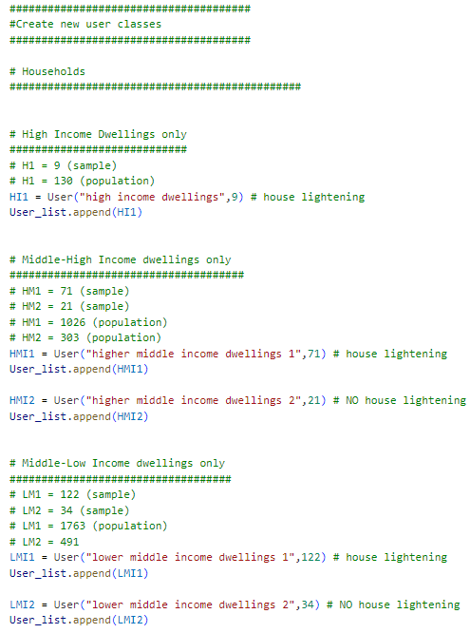
Exogenous Load Demand
Load Demand is estimated using advanced stochastic approach to have a reliable and on-minute basis load curve. The software used is RAMP, an open-source model for the generation of high-resolution multi-energy profiles
80 kW Peak Power at evening (around 19:30)
65 kW Secondary Peak at morning (around 8:30)
Baseload during the day: 40 kW
RAMP inputs file and exemplative load demand data in Excel
8

Slide 10
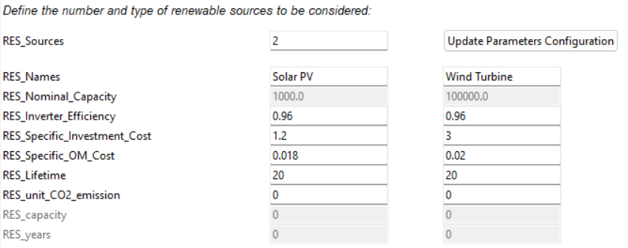
Renewable Parameters
The available renewable generation technologies for the project include photovoltaic (PV) panels and wind turbines. Comparatively, PV systems offer a suitable solution for consistent energy generation with lower specific investment costs. In contrast, wind turbines, while having a higher upfront cost, can be more efficient in areas with strong, consistent wind conditions. The model would operate a selection between these technologies based on their relative costs, performance efficiencies, and local resource assessment.
9

Slide 11
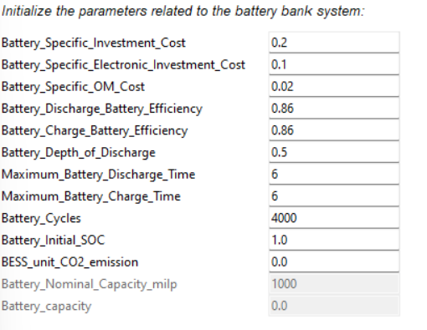
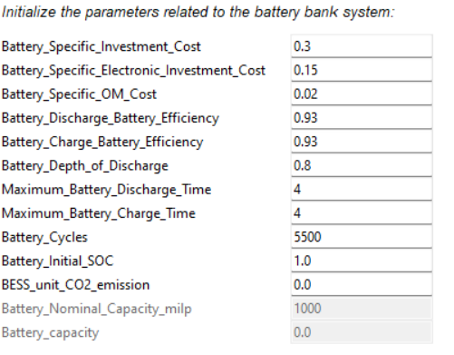
Battery Parameters
For the mini-grid project, two different scenarios using lead-acid and lithium-ion batteries will be compared to determine which is more cost-effective for the Kalobeyei area. Lead-acid batteries have lower specific investment costs and are robust, but offer fewer cycles and lower efficiency than lithium-ion batteries. Lithium-ion batteries, while more expensive initially, provide higher efficiency and a greater number of cycles.
Lead-Acid Battery
Lithium-Ion Battery
10

Slide 12
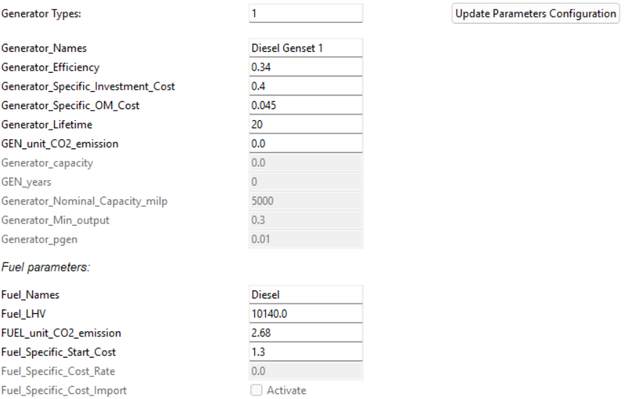
Diesel Generator Parameters
As a backup system for the mini-grid project, a diesel generator will be considered, chosen for its established reliability and known operational parameters. It is characterized by relatively low specific investment costs and offers a balance between efficiency and operational expenditure.
While diesel generators are not the most environmentally friendly due to CO2 emissions, they are often used in energy systems for their dependability and ease of integration, making them a practical choice in scenarios where renewable sources may be intermittent.
11

Slide 13
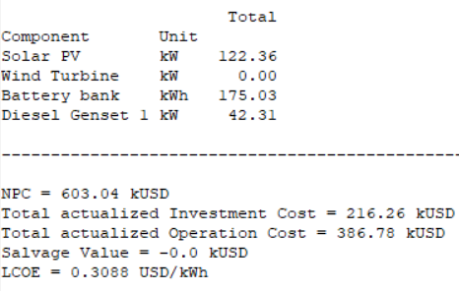
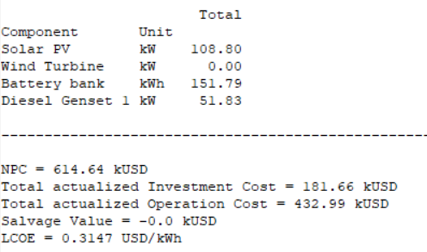
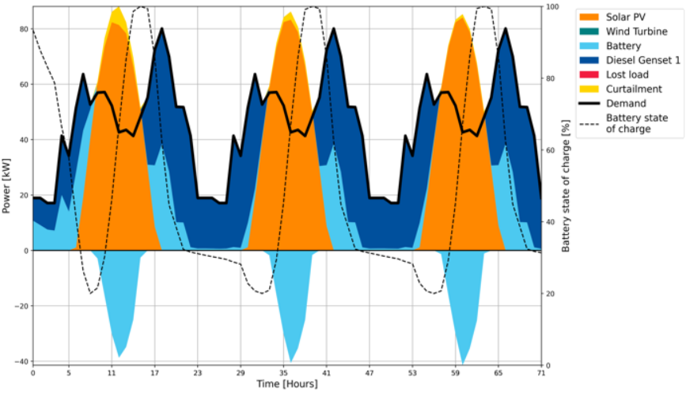
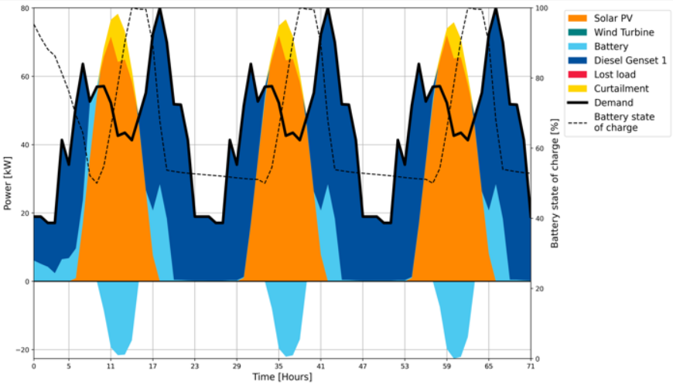
Results Comparison
Lithium-Ion
Lead-Acid
12

Slide 14
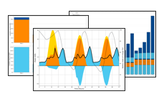
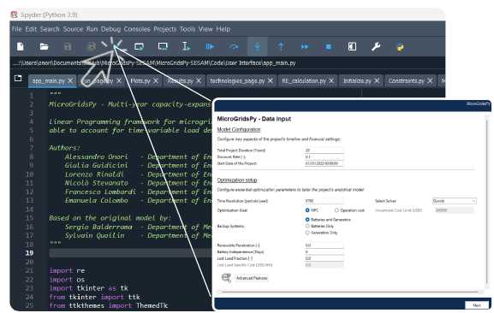
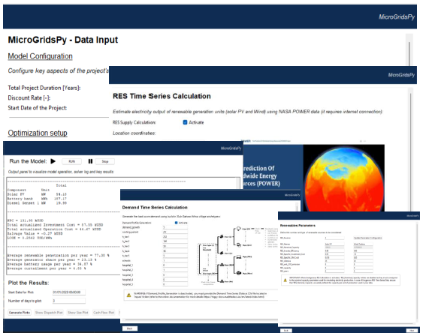
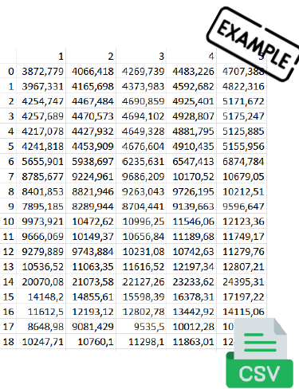
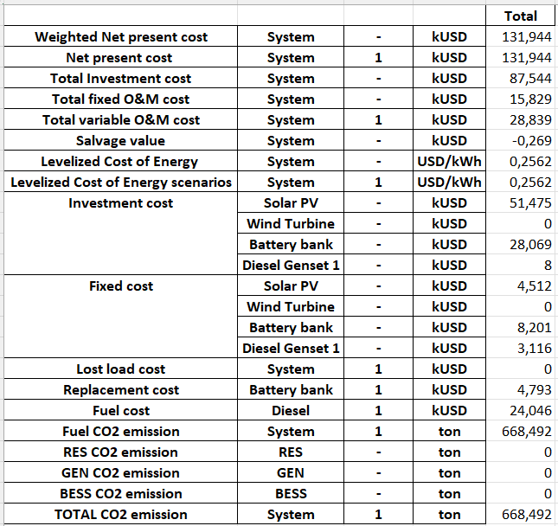
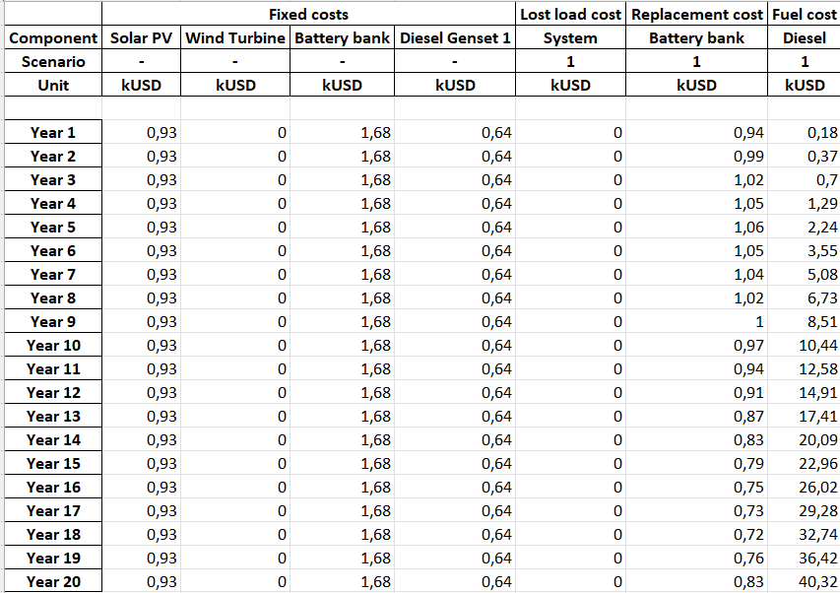
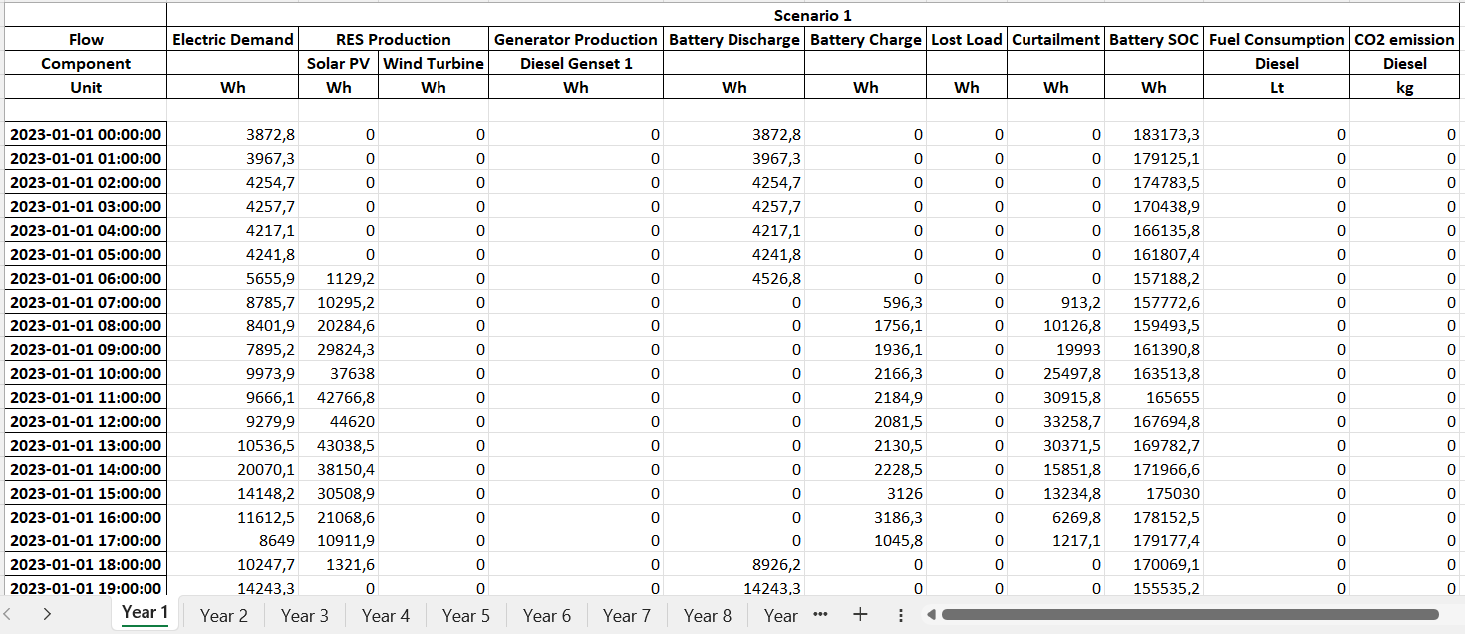
Let’s Practice!
Participants are encouraged to apply the knowledge and skills they've acquired by replicating the analysis presented:
Generate and provide Renewables Time Series Data as input in MicroGridsPy
Analyse the Load Demand curve (file in “Material” folder) and use it as input in MicroGridsPy
Input techno-economic parameters for mini-grid components (Technology Characterization)
Running and compare two scenarios: lead-acid and lithium-ion battery
Remember to save all the results, including key results, plots and the spreadsheets.
As you embark on this task, we wish you the best of luck in successfully completing it and in your upcoming final quiz!
13

Slide 15
Supported by and in collaboration with
Politecnico di Milano
Consolidated by Nicolò Stevanato, Alessandro Onori, Riccardo Mereu and Emanuela Colombo from Politecnico di Milano
Moksnes N., Sahlberg A., Khavari B. 2021. Lecture 1: OnSSET/Global Electrification Platform. Release Version 1.0. [online presentation]. Climate Compatible Growth Programme, Energy Sector Management Assistance Program and World Bank Group
Stevanato, N., Onori, A., Mereu, R., & Colombo, E., 2024. Lecture 1: Off-Grid Energy Systems Modelling with MicroGridsPy. Release Version 1.0 [online presentation]. Climate Compatible Growth Programme, Politecnico di Milano
CCG courses (this will take you to the website link http://www.ClimateCompatibleGrowth.com/teachingmaterials)

