Slide 1
LECTURE 7 INTRODUCTION TO MARIO
Supported by and in collaboration with
Politecnico di Milano
Input-Output analysis and modelling with MARIO
by Lorenzo Rinaldi, Nicolò Golinucci, Matteo Vincenzo Rocco and Emanuela Colombo

Slide 2
Learning Outcomes
By the end of this lecture, you will:
Have an overview of what is MARIO
Understand what you can do with MARIO
Understand how MARIO code is structured and how it handles matrices and calculations

Slide 3
7.1 Introduction to MARIO
Why do we need an open-source tool for input-output analysis? A synthetic “problem tree” based on lessons learnt
MA R I O
Inefficiency
Solution?
Adoption of an integrated tool to support model generation
Low replicability and accessibility
Less time to write codes
=
More time to formulate better ideas
Reduced margin of errors in scripting phase, leading to more reliable results
New projects require hard-start for setting up the models
Tiny differences in user choice may affect the results considerably
Increased flexibility and attractiveness for future projects, thesis…
Bringing contribution to standardize IOA practices

Slide 4
7.1 Introduction to MARIO
There are many Industrial Ecology open tools. Why did we develop MARIO?
Brightway2
Main limitations of open science
Lack of comprehensiveness
Each model is an island
While in the learning process, starting from scratch is the most effective way to learn programming
pySUT
pyLCAIO
ecospold2matrix
pymrio
Possible solutions
Integrating modelling tools and communities
Spreading the knowledge with open courses (like this one!)
pycirk
…

Slide 5
7.1 Introduction to MARIO
MARIO is an open-source framework aiming at easing input-output analysis operations and modelling
MARIO stands for Multifunctional Analysis of Regions through Input-Output
It handles some of the most well-known Input-Output or Supply and Use tables with dedicated parsing functions…but it virtually handles whatever table, including customized ones
It is based on Python and available on Github (it-is-me-mario/MARIO), Zenodo (record/5879383) and comes with a full documentation (including tutorials and installation guide - mario-suite.readthedocs.io)
Input
Output
Any Input-Output database
Additional description of technologies or sectors
Additional information on scenarios
MARIO:
Open Python-based objective programming for easing IO analysis
Aggregated (products, activities, regions, …) database
Multidimensional impacts
Results visualization
Dedicated parsing functions
Processing
EORA (EORA 26. National tables)
Shock analysis
Multiple scenarios
Describing a new supply-chain within the described economy
Hybrid

Slide 6
7.2 What you can do with MARIO
MARIO scales up the navigation and application of input-output tables without requiring advanced programming skills and supporting the user via Excel interface
It allows to:
Aggregate tables
Add new activities and/or commodities
Implement shocks
z₀
Δz
3 regions, 4 industries, 5 commodities
z₁
49 regions, 164 industries, 200 commodities

Slide 7
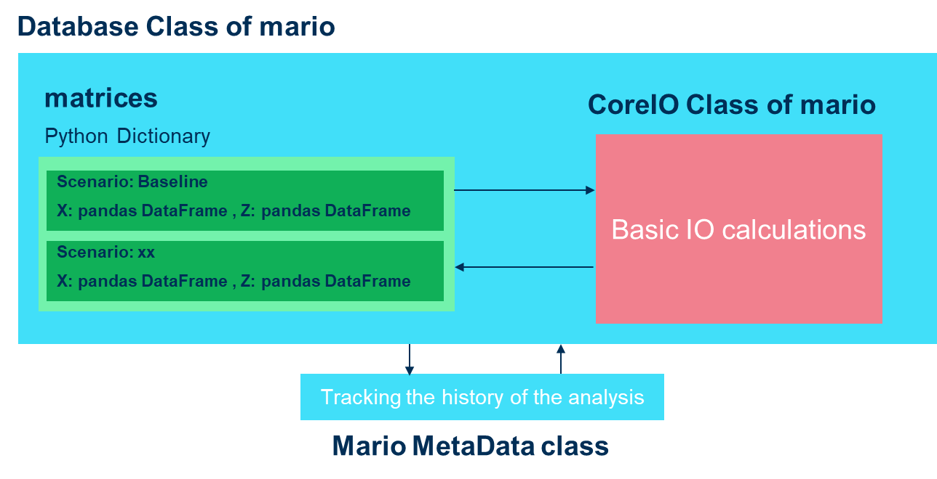
7.3 MARIO code structure
Handling any unit of measure initialized when parsing the table
Handling scenarios thus easing results exploration

Slide 8
7.4 How matrices and calculations are handled in MARIO
Supply-Use table in absolute flows
Z
COMMODITY OUTPUT
U USE
Y FINAL
DEMAND
Taking advantage of thermodynamics’ style in nomenclature
X
ACTIVITY OUTPUT
M MAKE
V VALUE ADDED
E SATELLITE ACCOUNT

Slide 9
7.4 How matrices and calculations are handled in MARIO
Supply-Use table in technical coefficients
z
COMMODITY OUTPUT
u specific use
Y FINAL
DEMAND
Taking advantage of thermodynamics’ style in nomenclature
Uppercase: matrices of absolute values
Lowercase: matrices of coefficients
X
ACTIVITY OUTPUT
m market share
Applying industry-based technology assumption (product-based technology assumption to be implemented)
v value added intensities
e satellite account intensities

Slide 10
7.4 How matrices and calculations are handled in MARIO
Supply-Use shocked matrices
z’
COMMODITY OUTPUT
u’ specific use
Y’ FINAL
DEMAND
Performing shock analysis (matrices signed with ‘ are “shocked” matrices)…
X’
ACTIVITY OUTPUT
m’ market share
v' value added intensities
e’ satellite account intensities

Slide 11
7.4 How matrices and calculations are handled in MARIO
Supply-Use table in absolute flows after the implementation of the shock
Z’
COMMODITY OUTPUT
U’ USE
Y’ FINAL
DEMAND
Performing shock analysis (matrices signed with ‘ are “shocked” matrices)…
X’
… and assessing its impacts by applying the Leontief models
ACTIVITY OUTPUT
M’ MAKE
v’ VALUE ADDED
e’ SATELLITE ACCOUNT

Slide 12
7.4 How matrices and calculations are handled in MARIO
Input-output table obtained by transforming the original supply-use table
MARIO also allows to transform a SUT into an IOT
SECTORAL OUTPUT
X
Z’
INTERSECTORAL FLOWS
Y’ FINAL
DEMAND
V’ VALUE ADDED
E’ SATELLITE ACCOUNT

Slide 13
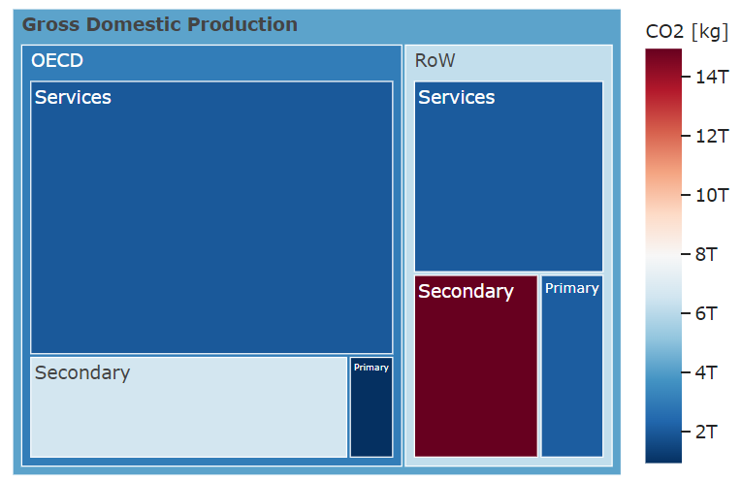
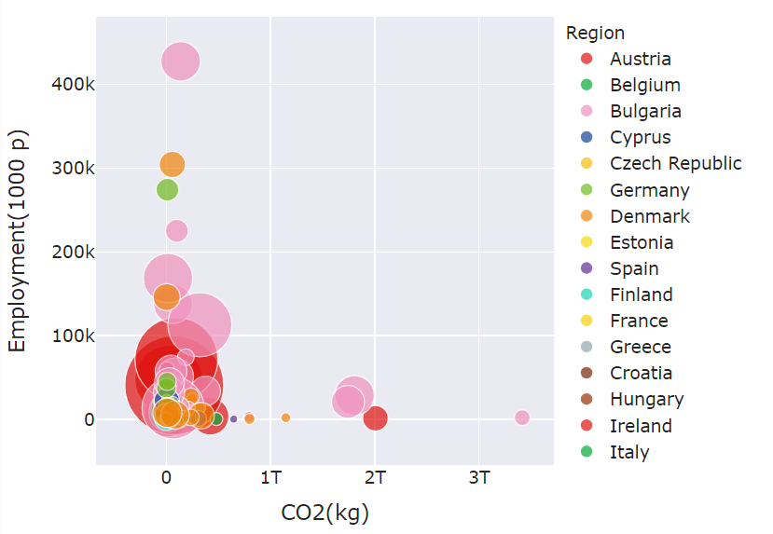
7.5 Example of results
Taking advantage of plotly library to investigate full-scale or aggregated database with some built-in functions

Slide 14
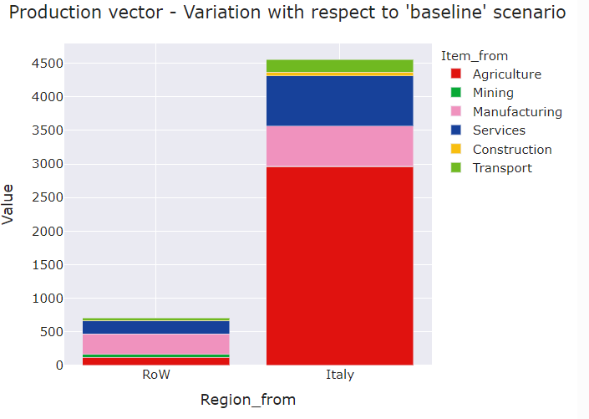
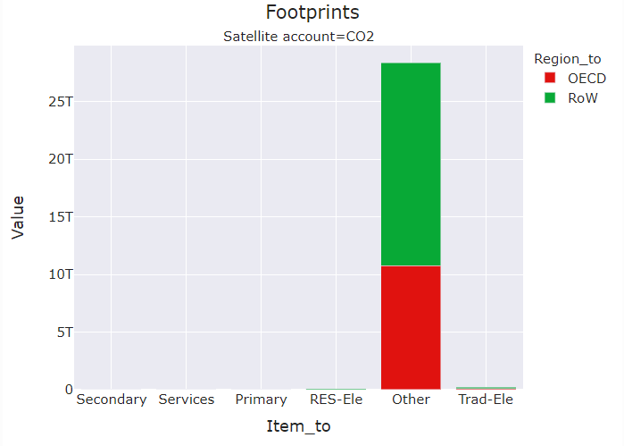
7.5 Example of results
Taking advantage of plotly library to investigate full-scale or aggregated database with some built-in functions

Slide 15
MARIO availability and credits
MARIO availability
MARIO code documentation: https://mario-suite.readthedocs.io/en/latest/index.html
MARIO on Github: https://github.com/it-is-me-mario/MARIO
MARIO on Zenodo: https://doi.org/10.5281/zenodo.5879382
Authors: Mohammad Amin Tahavori, Lorenzo Rinaldi, Nicolo Golinucci
How to cite?
Mohammad Amin Tahavori, Lorenzo Rinaldi, Nicolò Golinucci, Matteo Vincenzo Rocco, Emanuela Colombo, Journal of Open Research Software (2023). https://doi.org/10.5334/jors.473

Slide 16
Supported by and in collaboration with
Politecnico di Milano
Consolidated by Lorenzo Rinaldi, Nicolò Golinucci, Matteo Vincenzo Rocco and Emanuela Colombo from Politecnico di Milano
Rinaldi R., Golinucci N., Rocco M. V., Colombo E., 2023. Lecture 7: Input-Output analysis and modelling with MARIO. Release Version 1.0 [online presentation]. Climate Compatible Growth Programme, Politecnico di Milano

