Slide 1
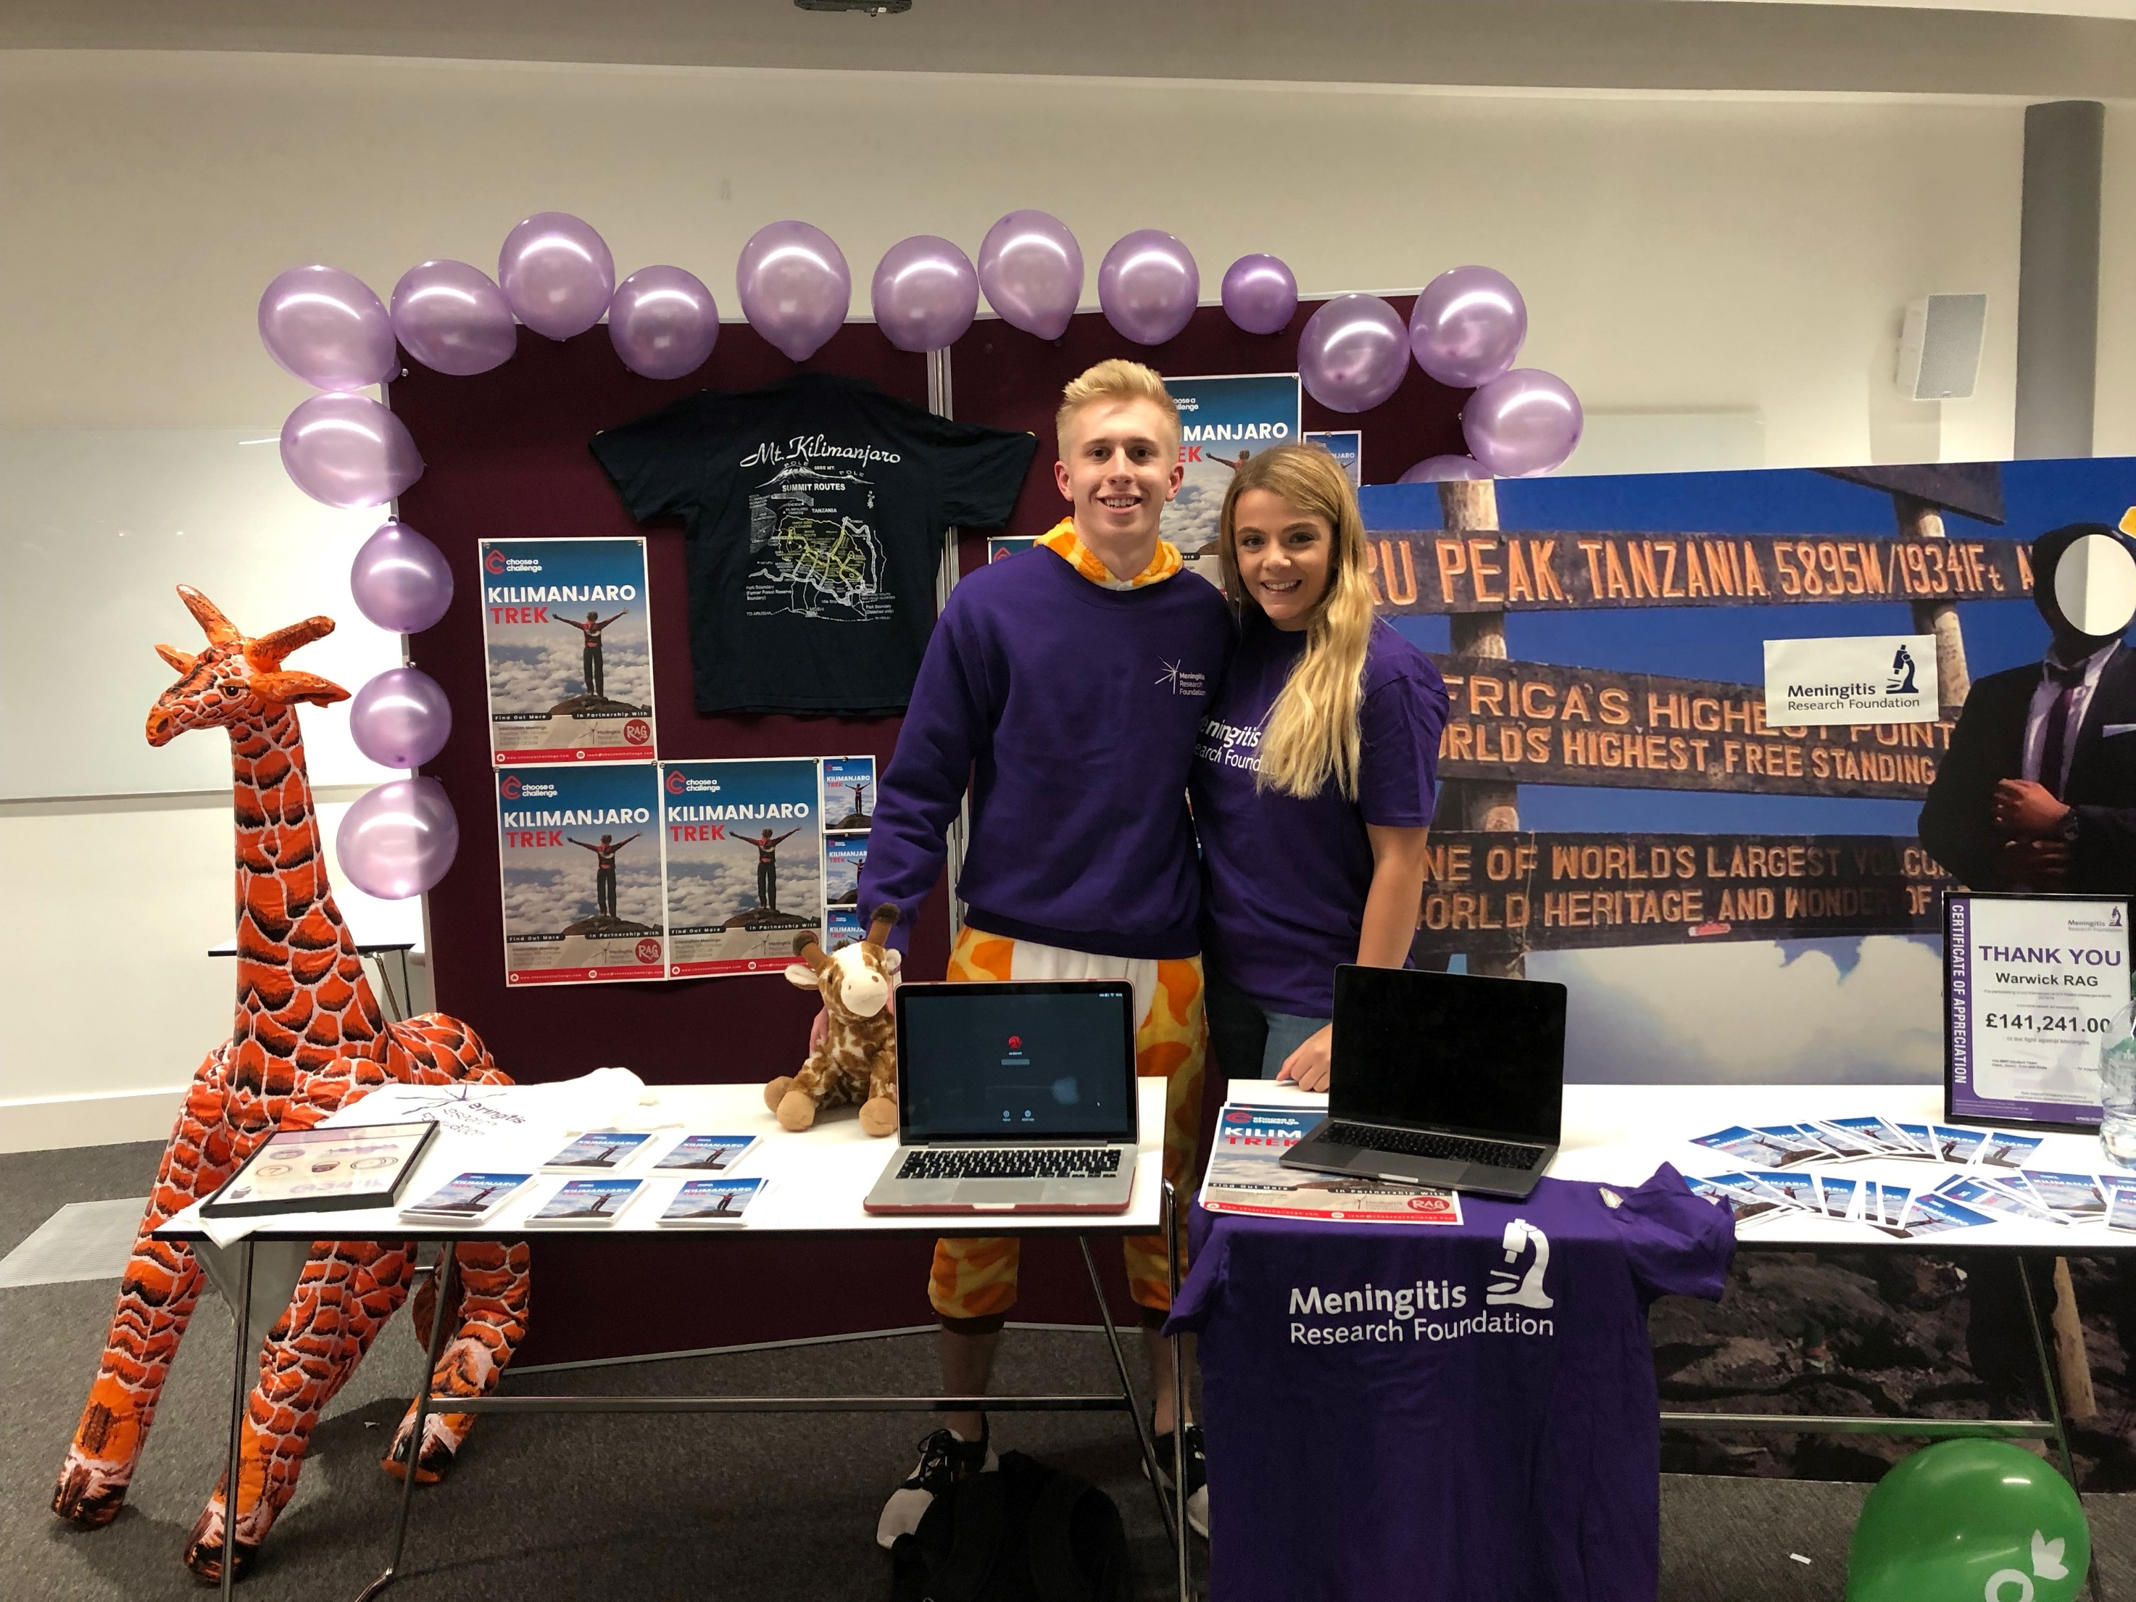
What is your role?
Notes:
Jenny

Slide 2
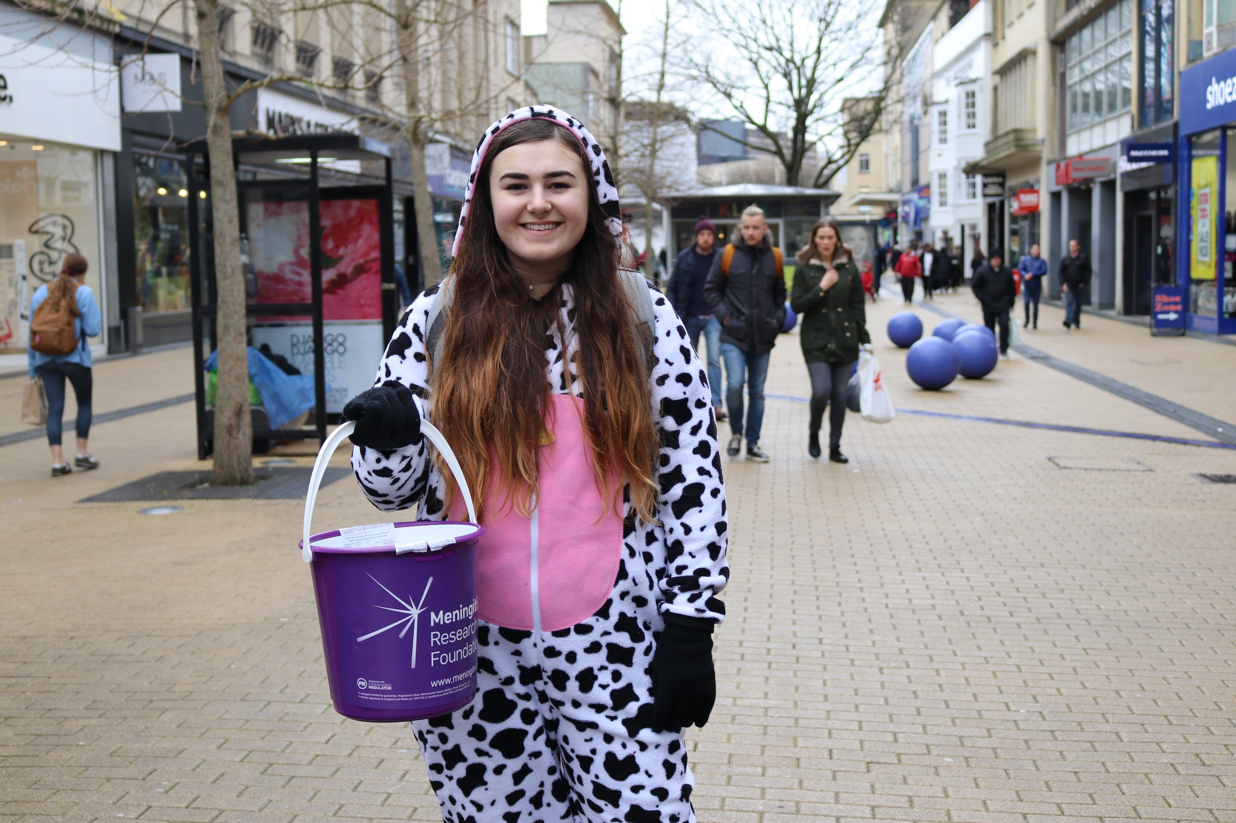
WHAT IS YOUR ROLE?
a
Leadership
Be a representative of MRF
Organise regular socials – team spirit!
Communicate with MRF on the teams progress
Keep the team informed (via Facebook)
Recruitment
Support MRF and CACH to recruit a team for the challenge
Support MRF and CACH with the follow up process to get as many sign up’s a possible

Slide 3
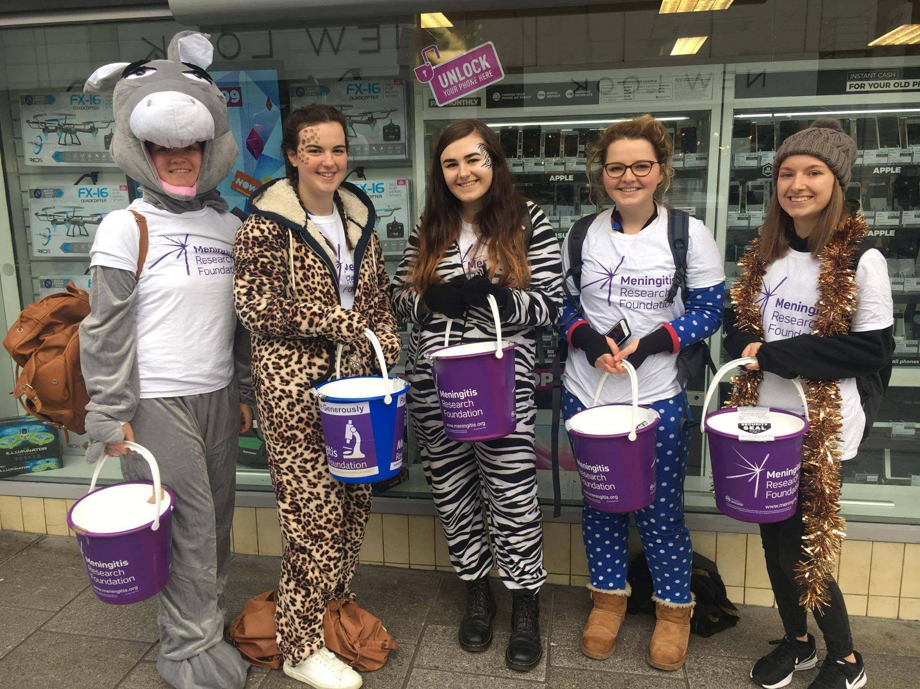
a
WHAT IS YOUR ROLE?
Fundraising
Ensure the team is equipped with fundraising resources
Hold face-to-face meetings with the team once a term
Hold workshops once a term – (all prepped for you!)
Organise fundraising opportunities for the team 1-2 per term
Help with the return of fundraising resources
You don’t have to be amazing at fundraising already, we have all the tools and resources for you!
Check your CL Pack for all of the above

Slide 4
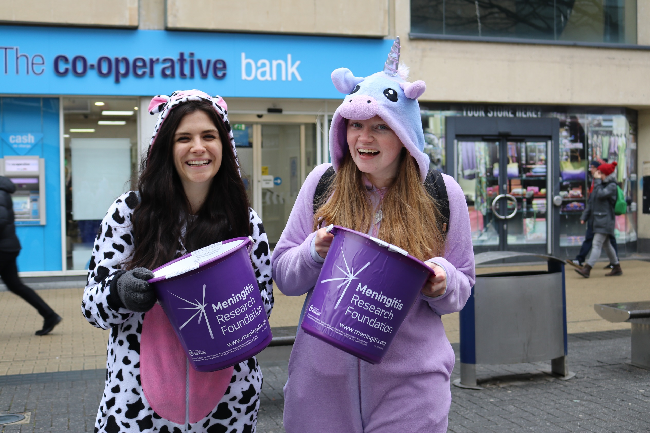
DISCOUNTS
a
Why?
You put in a lot of hard work to support your team
We want to reward you for your efforts!
How?
It’s an effort based system, per leader to ensure it is fair
Check your CL Pack for your specific discounts and guide
Discount 1
Just sign up to the challenge before the info meeting!

Slide 5
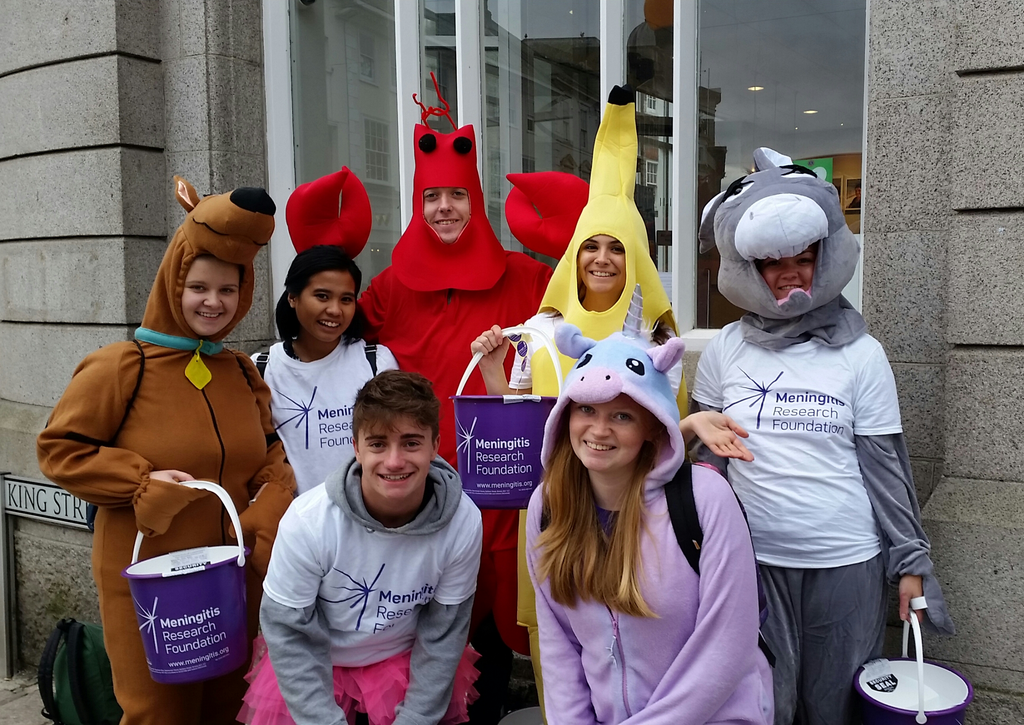
DISCOUNTS
a
Discount 2
Actively recruit your team
Help with follow up
Ensure all recruits have their fundraising resources
Discount 3/4
Hold 121 fundraising sessions with your participants
Host a provided fundraising workshop
Had all your monthly catch up calls with your account manager
Held at least 1 sober social

Slide 6
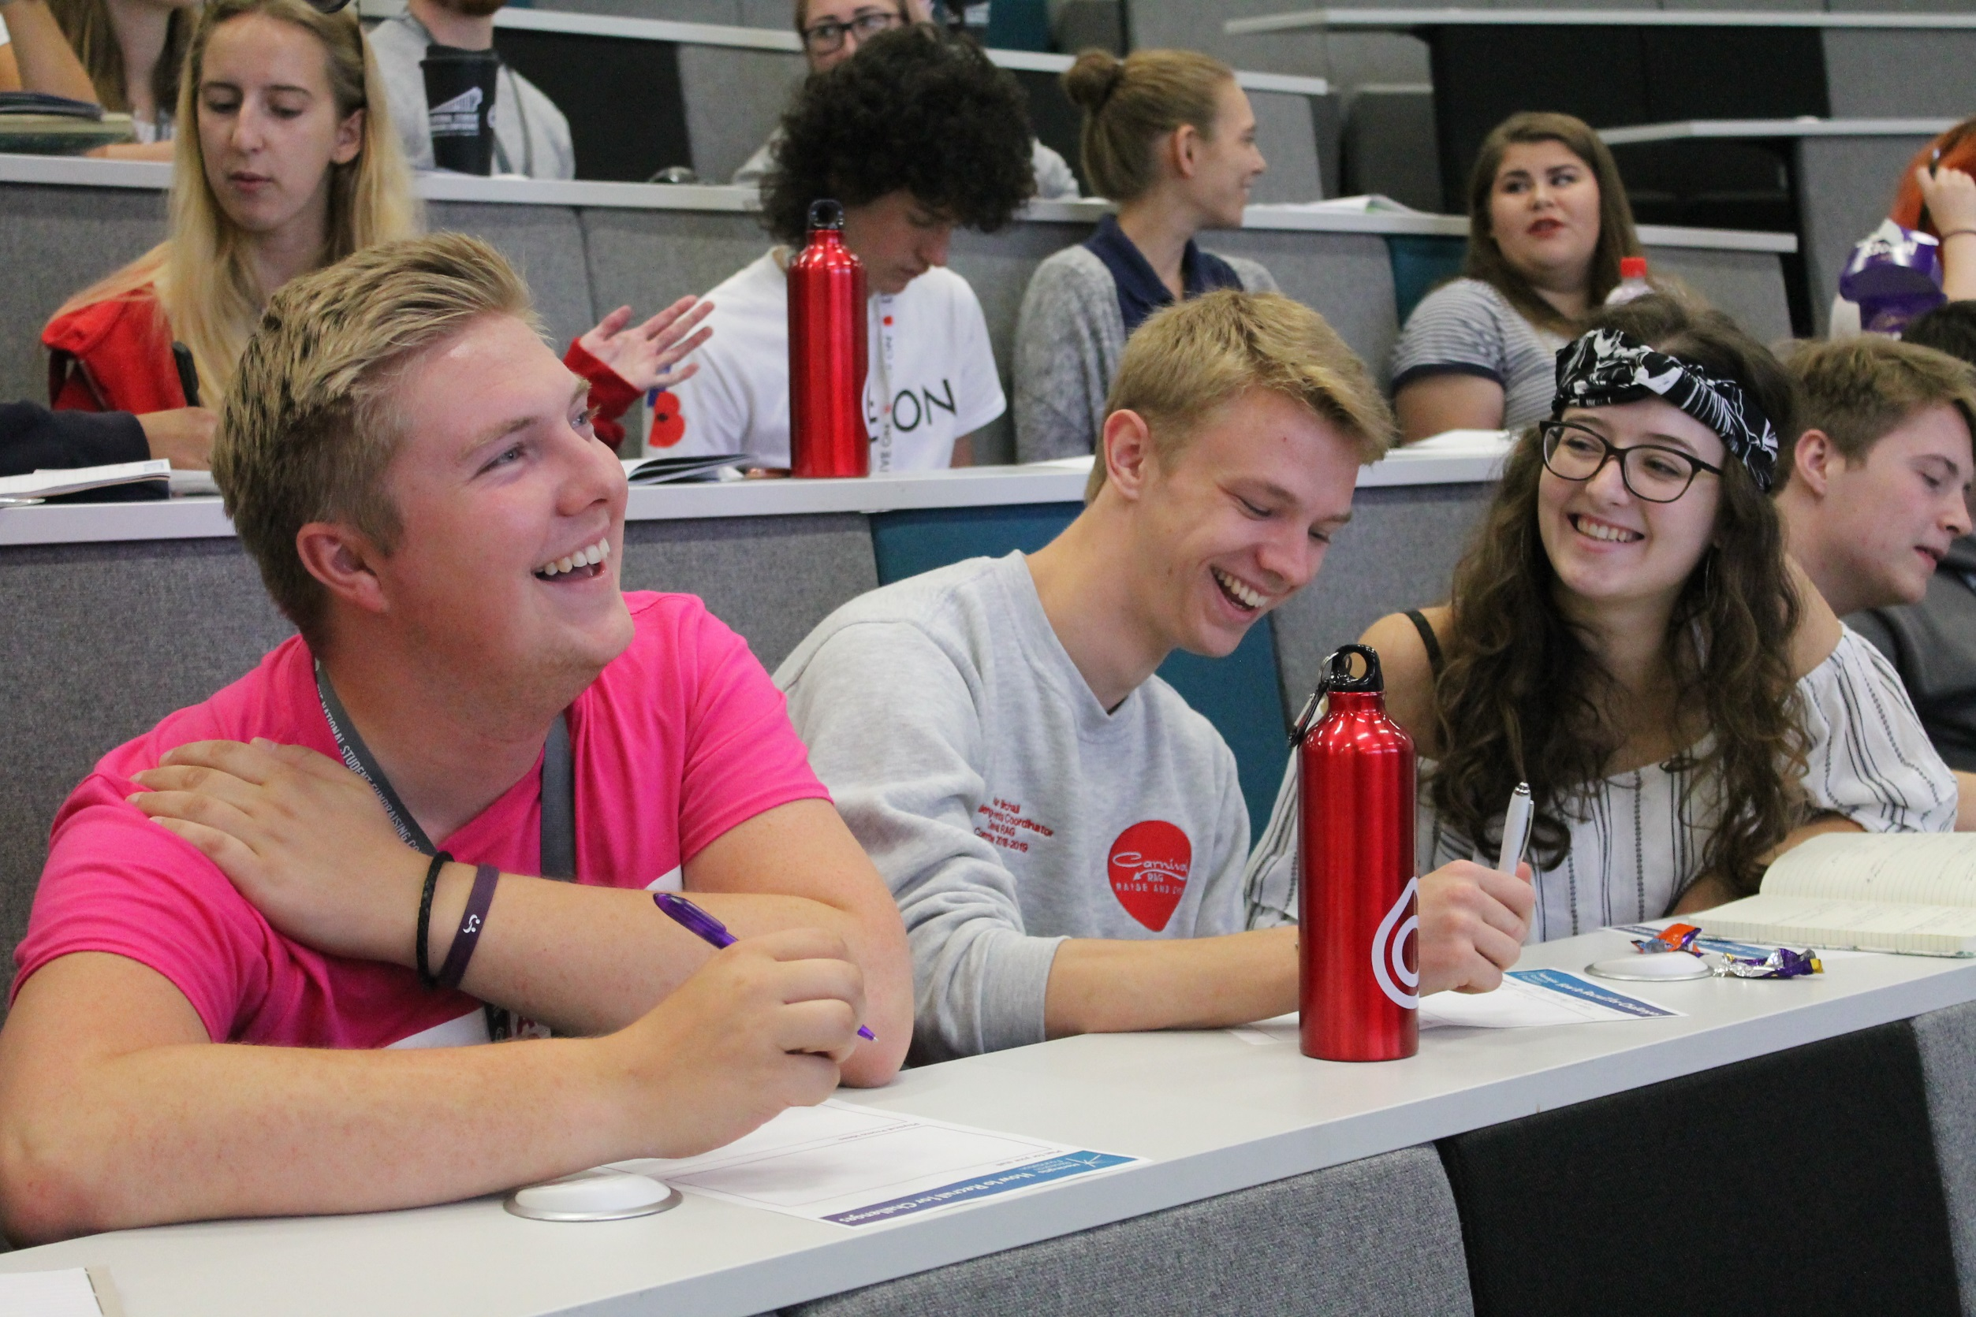
DISCOUNTS
a
Final Discount
Hold 121 fundraising sessions with your participants
Host a provided fundraising workshop
Had all your monthly catch up calls with your account manager
Held at least 1 sober social
Organised 2 group fundraisers through the year at minimum
Extra Benefit – help us get buckets back after your trip!
Signed, personalised Letter of Recommendation

