Slide 1
Session 1: Global environmental change
Nick Harvey
Conservation PhD candidate
University of Manchester

Slide 2
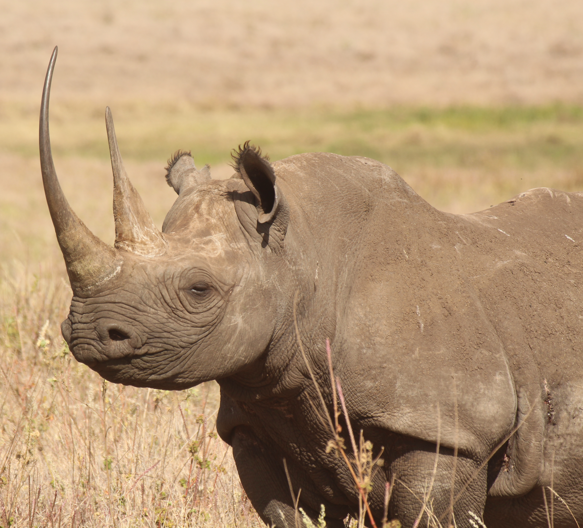
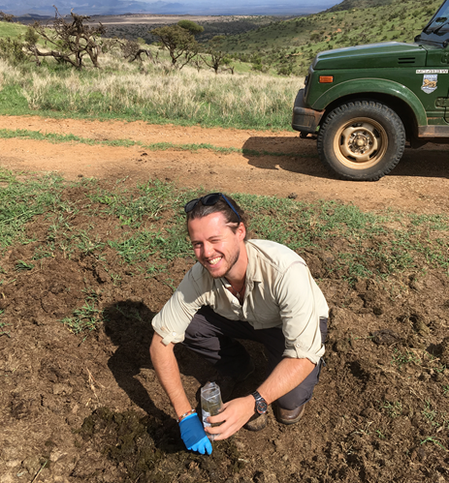
PhD – Conservation of eastern black rhinos (Diceros bicornis michaeli) in Kenya

Slide 3
Learning objectives
Understand spatial and temporal patterns of anthropogenic impacts on climate and land use
Relate variation in environmental change impacts to different biomes
Establish link between anthropogenic land use and bias in protected area cover
Case study

Slide 4
Extinction
Ceballos et al. (2015) Accelerated modern human–induced species losses: Entering the sixth mass extinction Science advances

Slide 5
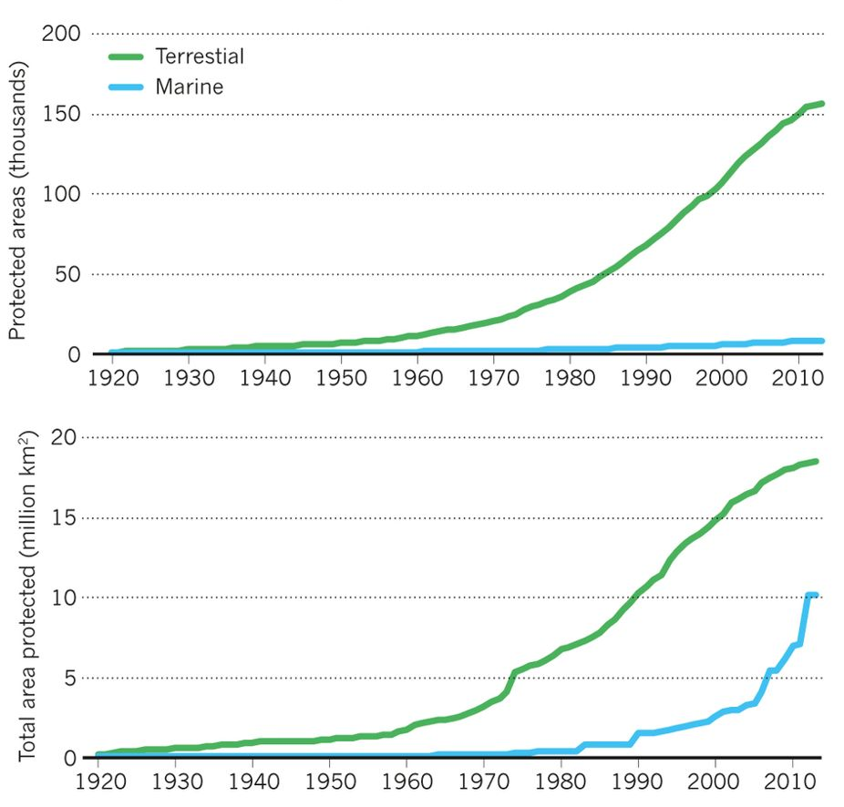
Protected Areas
The global protected area estate has grown massively but species are still going extinct
What is going on?
Watson et al. (2014) The performance and potential of protected areas. Nature

Slide 6
Anthropogenic actions are altering the natural world and driving extinction

Slide 7
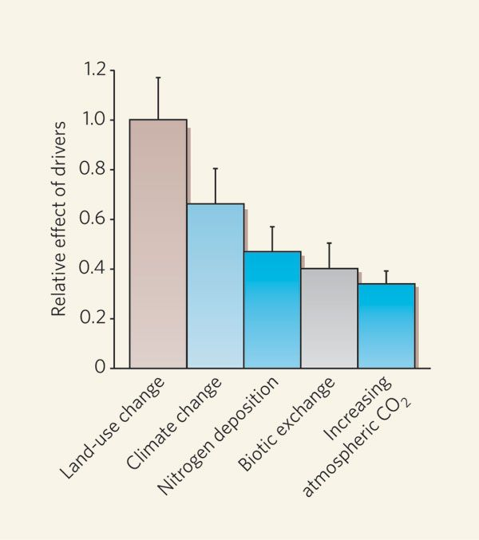
Thuiller, W. (2007) Biodiversity: climate change and the ecologist. Nature

Slide 8
Land Use Change
Ellis et al (2010) Anthropogenic transformation 1700-2000. Global Ecology and Biogeography

Slide 9
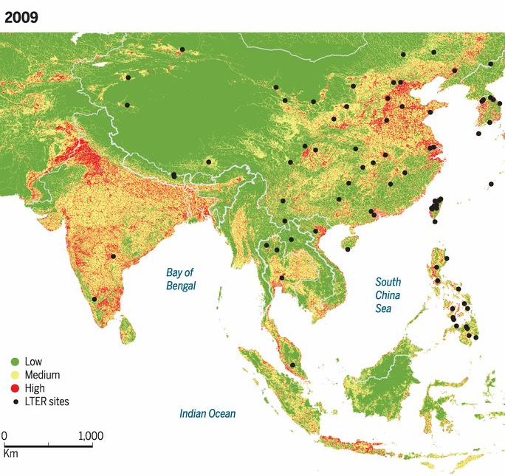

Slide 10
Most anthropogenic transformation in tropical and temperate deciduous forests and grasslands/shrublands
Why is this important?
Ellis et al (2010) Anthropogenic transformation 1700-2000. Global Ecology and Biogeography

Slide 11
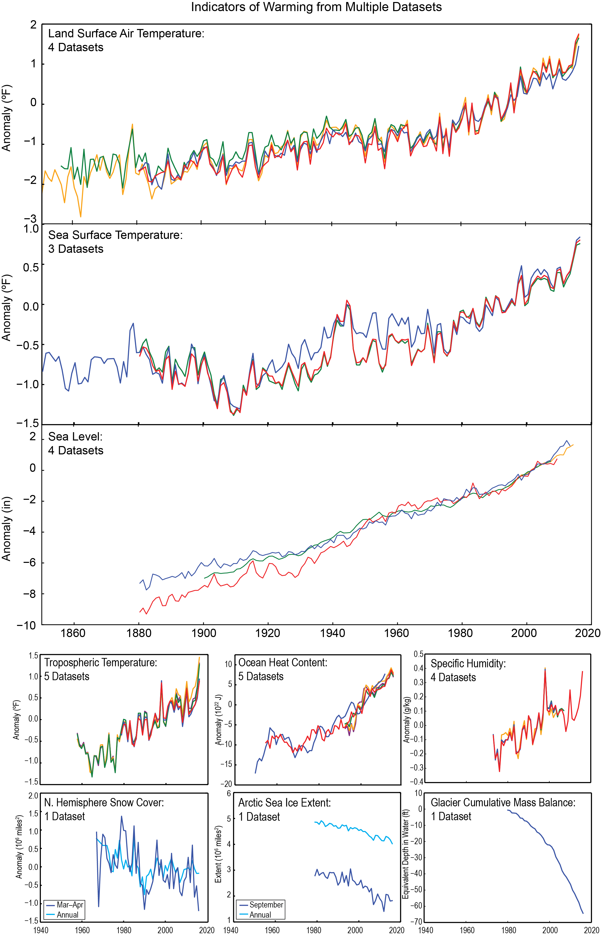
Climate Change
USGCRP, 2017: Climate Science Special Report: Fourth National Climate Assessment, Volume I [Wuebbles, D.J., D.W. Fahey, K.A. Hibbard, D.J. Dokken, B.C. Stewart, and T.K. Maycock (eds.)]. U.S. Global Change Research Program, Washington, DC, USA, 470 pp.
Notes:
Caption: This image shows observations globally from nine different variables that are key indicators of a warming climate. The indicators (listed below) all show long-term trends that are consistent with global warming. In parentheses are the number of datasets shown in each graph, the length of time covered by the combined datasets and their anomaly reference period (where applicable), and the direction of the trend: land surface air temperature (4 datasets, 1850–2016 relative to 1976–2005, increase); sea surface temperature (3 datasets, 1850–2016 relative to 1976–2005, increase); sea level (4 datasets, 1880–2014 relative to 1996–2005, increase); tropospheric temperature (5 datasets, 1958–2016 relative to 1981–2005, increase); ocean heat content, upper 700m (5 datasets, 1950–2016 relative to 1996–2005, increase); specific humidity (4 datasets, 1973–2016 relative to 1980–2003, increase); Northern Hemisphere snow cover, March–April and annual (1 dataset, 1967–2016 relative to 1976–2005, decrease); arctic sea ice extent, September and annual (1 dataset, 1979–2016, decrease); glacier cumulative mass balance (1 dataset, 1980–2016, decrease). More information on the datasets can be found in the accompanying metadata. (Figure source: NOAA NCEI and CICS-NC, updated from Melillo et al. 2014;¹ Blunden and Arndt 2016² ).

Slide 12
Climate Change
USGCRP, 2017: Climate Science Special Report: Fourth National Climate Assessment, Volume I [Wuebbles, D.J., D.W. Fahey, K.A. Hibbard, D.J. Dokken, B.C. Stewart, and T.K. Maycock (eds.)]. U.S. Global Change Research Program, Washington, DC, USA, 470 pp.
Notes:
Caption: This image shows observations globally from nine different variables that are key indicators of a warming climate. The indicators (listed below) all show long-term trends that are consistent with global warming. In parentheses are the number of datasets shown in each graph, the length of time covered by the combined datasets and their anomaly reference period (where applicable), and the direction of the trend: land surface air temperature (4 datasets, 1850–2016 relative to 1976–2005, increase); sea surface temperature (3 datasets, 1850–2016 relative to 1976–2005, increase); sea level (4 datasets, 1880–2014 relative to 1996–2005, increase); tropospheric temperature (5 datasets, 1958–2016 relative to 1981–2005, increase); ocean heat content, upper 700m (5 datasets, 1950–2016 relative to 1996–2005, increase); specific humidity (4 datasets, 1973–2016 relative to 1980–2003, increase); Northern Hemisphere snow cover, March–April and annual (1 dataset, 1967–2016 relative to 1976–2005, decrease); arctic sea ice extent, September and annual (1 dataset, 1979–2016, decrease); glacier cumulative mass balance (1 dataset, 1980–2016, decrease). More information on the datasets can be found in the accompanying metadata. (Figure source: NOAA NCEI and CICS-NC, updated from Melillo et al. 2014;¹ Blunden and Arndt 2016² ).

Slide 14
Hayhoe, K., J. Edmonds, R.E. Kopp, A.N. LeGrande, B.M. Sanderson, M.F. Wehner, and D.J. Wuebbles, 2017: Climate models, scenarios, and projections. In: Climate Science Special Report: Fourth National Climate Assessment, Volume I [Wuebbles, D.J., D.W. Fahey, K.A. Hibbard, D.J. Dokken, B.C. Stewart, and T.K. Maycock (eds.)]. U.S. Global Change Research Program, Washington, DC, USA, pp. 133-160, doi: 10.7930/J0WH2N54.

Slide 15
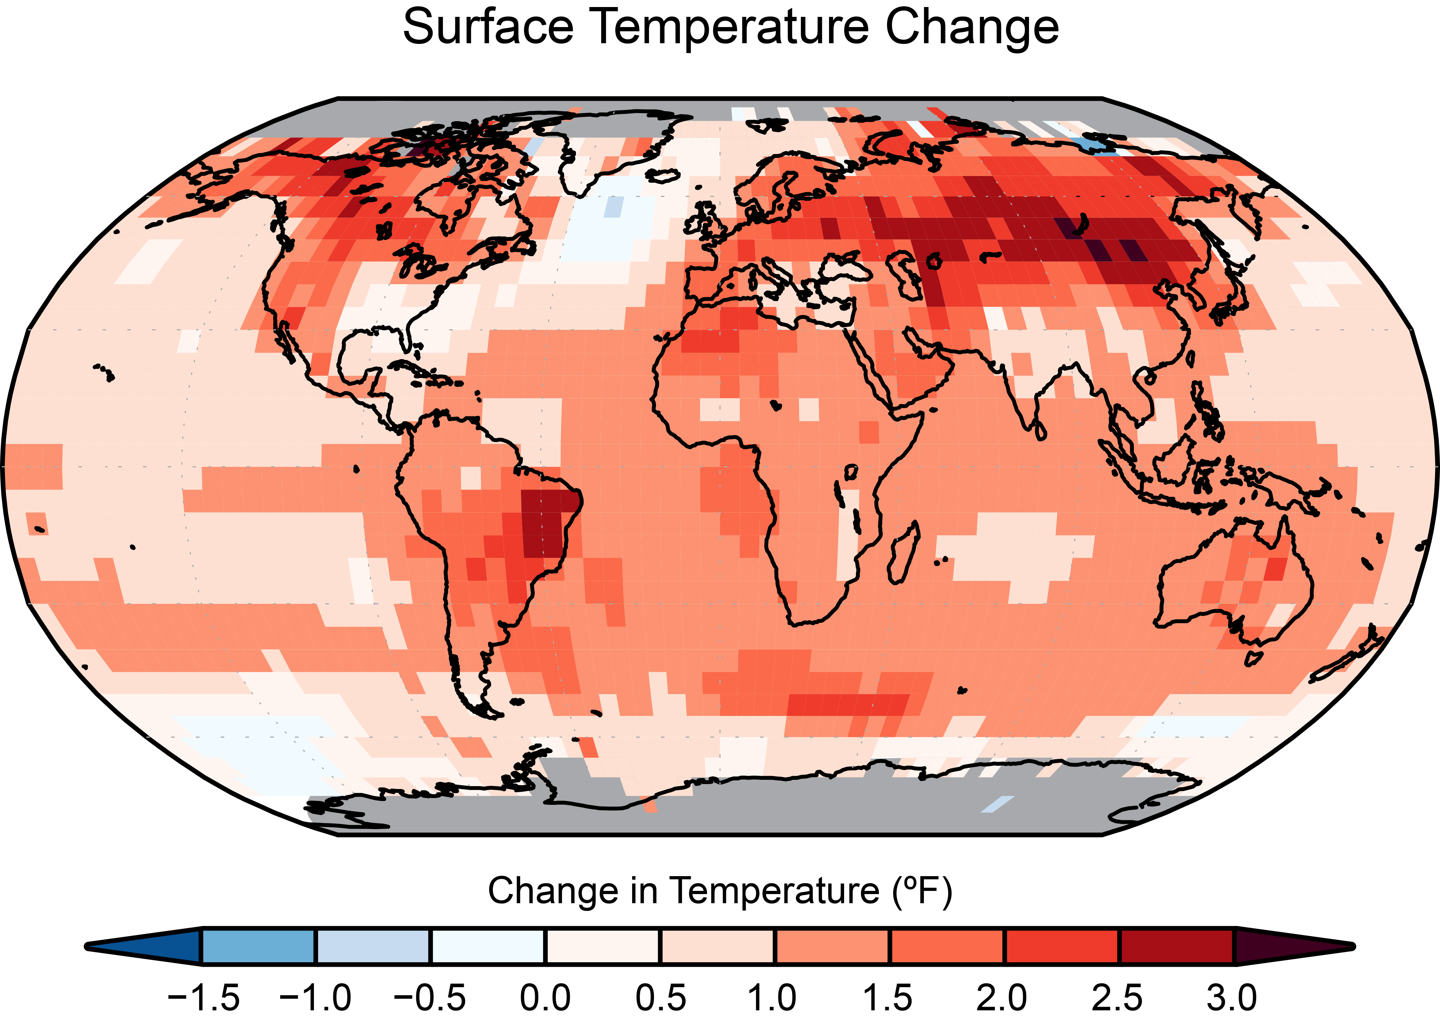
Temperature change is spatially variable
Effects will be more severe for some biomes and species
USGCRP, 2017: Climate Science Special Report: Fourth National Climate Assessment, Volume I [Wuebbles, D.J., D.W. Fahey, K.A. Hibbard, D.J. Dokken, B.C. Stewart, and T.K. Maycock (eds.)]. U.S. Global Change Research Program, Washington, DC, USA, 470 pp.

Slide 16
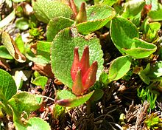
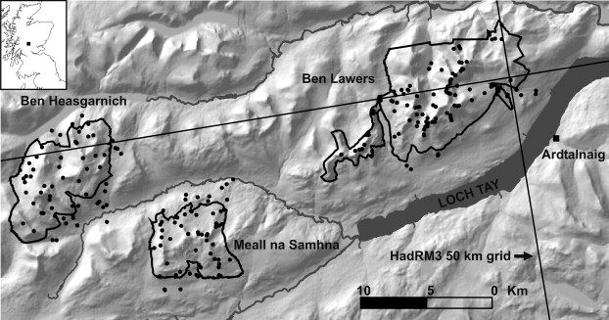
Climate change
What about polar and high altitude species?
They may have nowhere else to go
Alpine and polar plants in montane nature reserves, Scotland
Dwarf willow Salix herbacea

Slide 17
Protected areas are our main method of protecting biodiversity

Slide 18
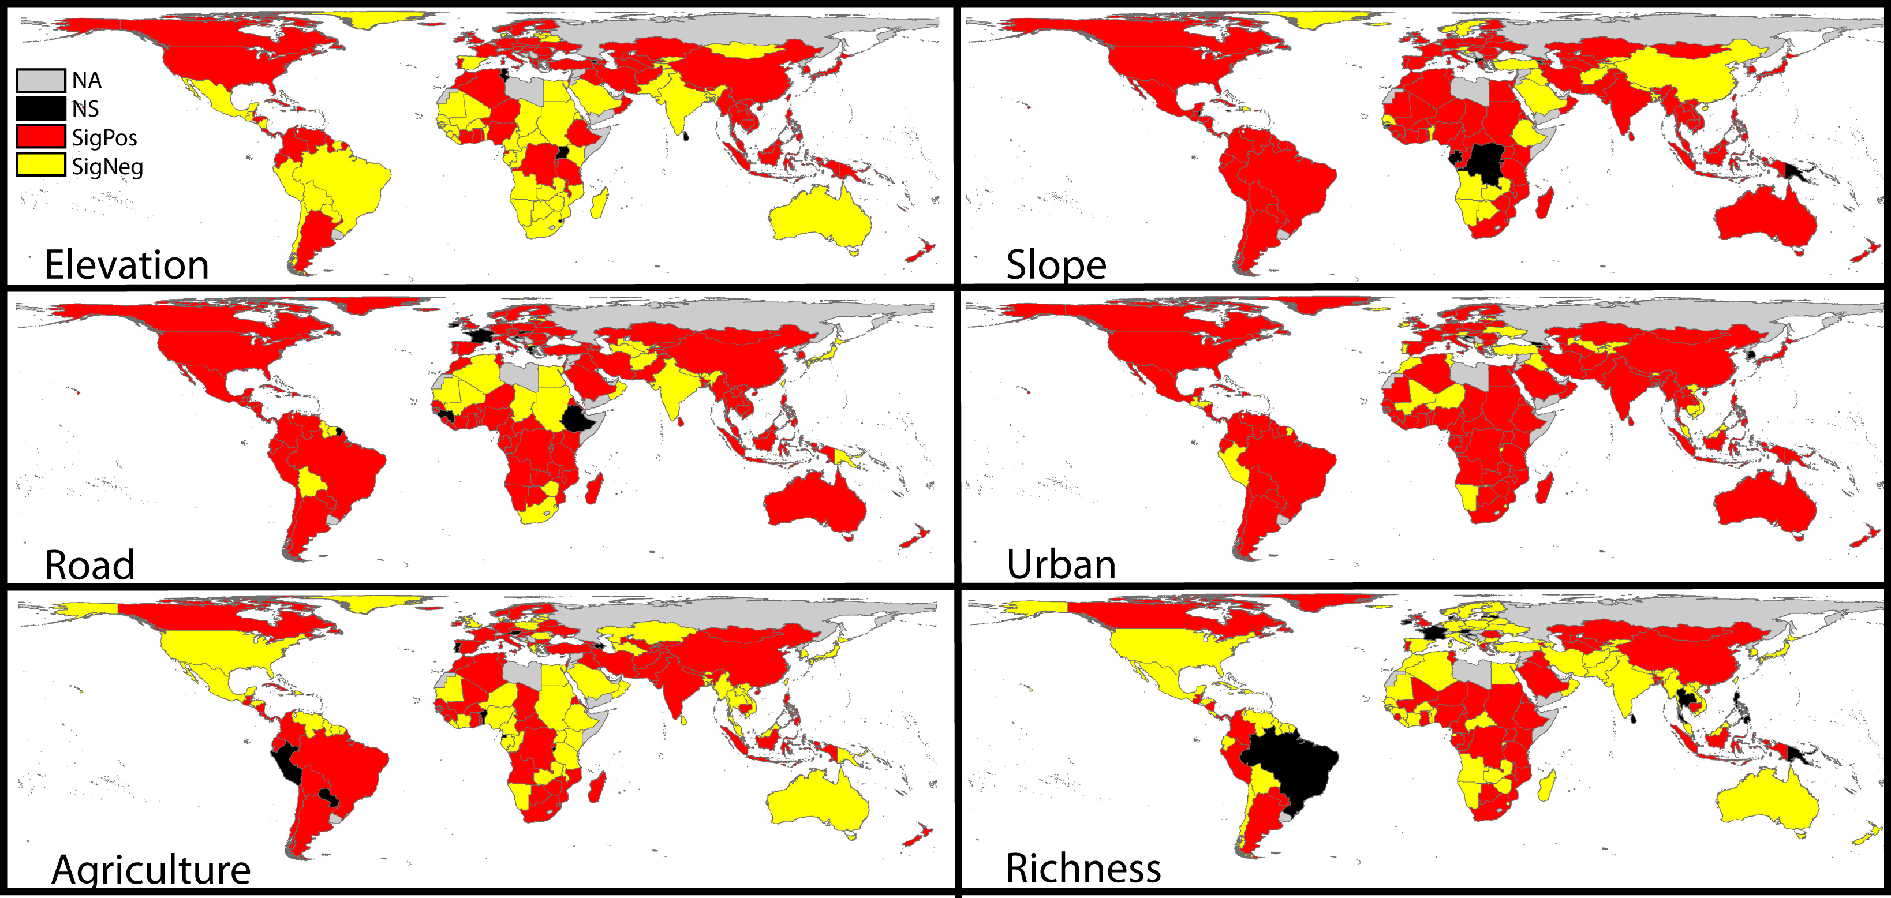
High and Far: Biases in the Location of Protected Areas
Joppa and Pfaff (2009) High and far: biases in the location of protected areas. PloS one

Slide 19
Many species do not occur within formally protected areas
92% of Critically Endangered species are gap or partial gap
Rodrigueset al. (2004) Global gap analysis: priority regions for expanding the global protected-area network. BioScience

Slide 20
Not only is protected area placement biased, so is research

Slide 21
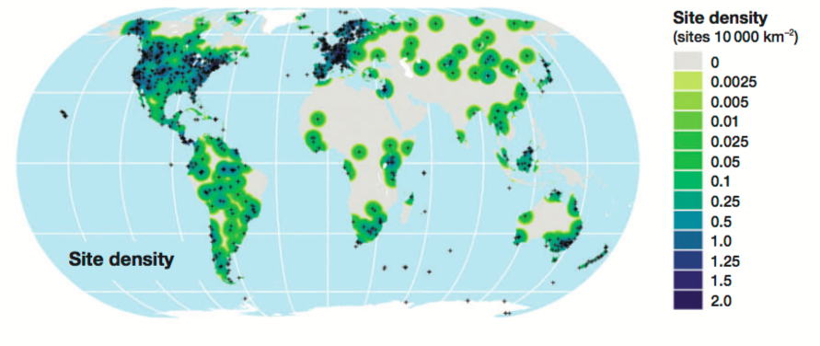
Biases in ecological studies

Slide 22
Conservation Bias A Case Study

Slide 23
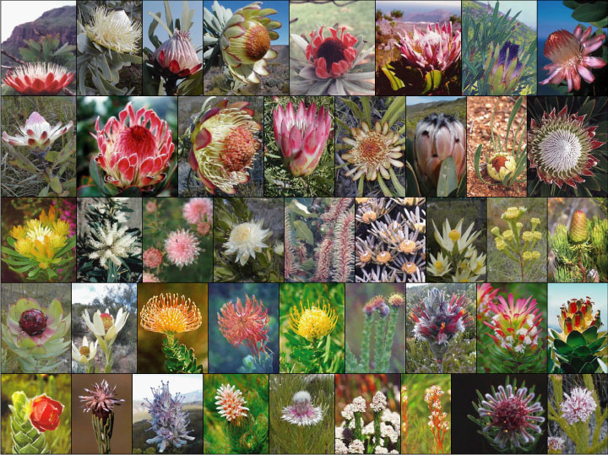
Cape Floristic Region

Slide 24
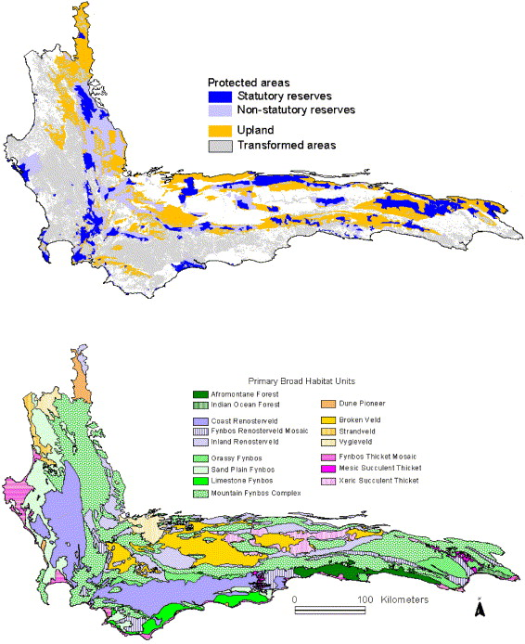
Some habitats in the Cape Floristic Region are better protected than others
Rouget et al. (2003) The current configuration of protected areas in the Cape Floristic Region, South Africa—reservation bias and representation of biodiversity patterns and processes. Biological Conservation

Slide 25
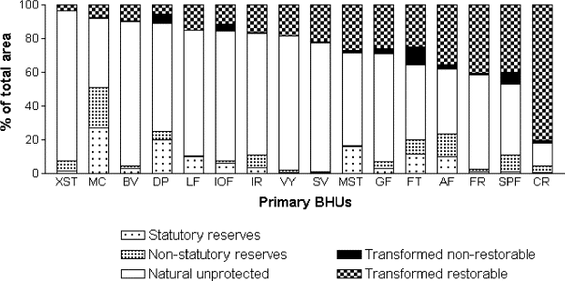
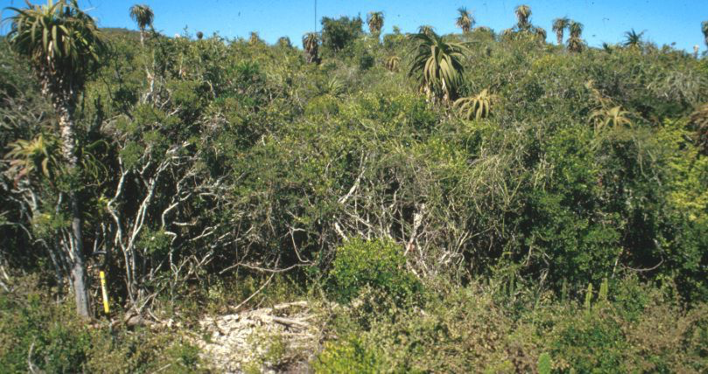
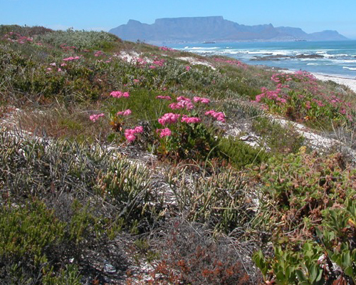
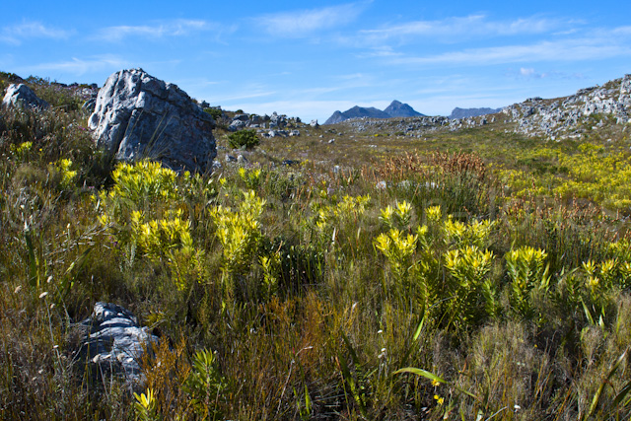
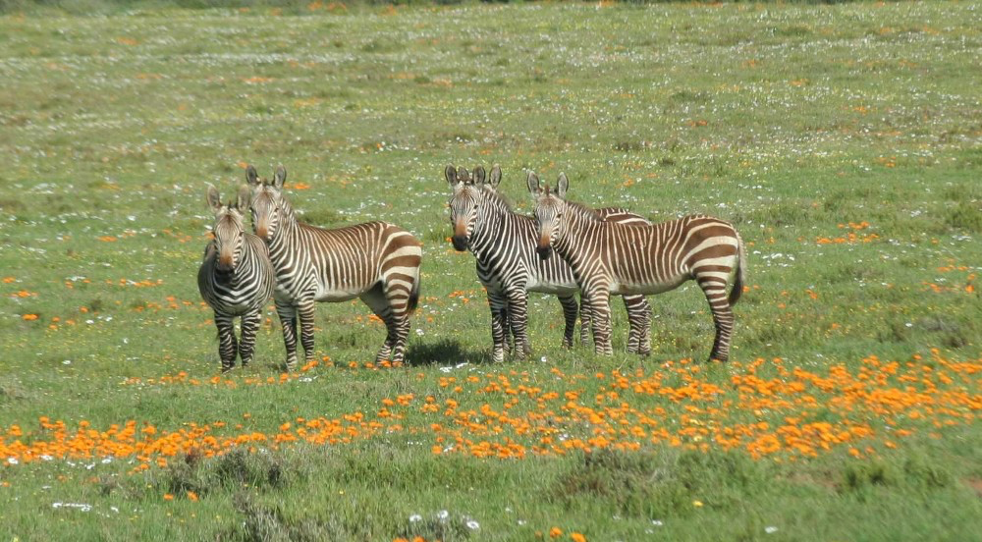
XST- Xeric Succulent Thicket
SV- Strandveld
MC- Montane Fynbos
CR- Coastal Renosterveld
Rouget et al. (2003) Biological Conservation

Slide 26
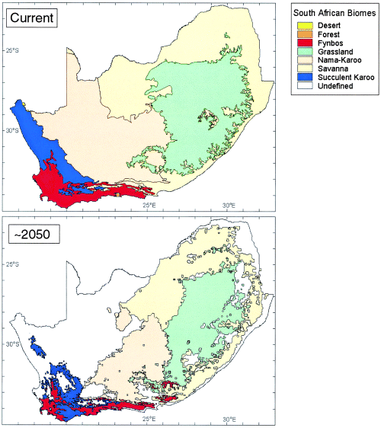
Protecting for the future
Climate change means species will move in the future as habitats change
Should we plan protected areas for this?

Slide 27
Summary
Protected area coverage increasing, but extinction rates continue to increase
Human land use patterns have transformed many biomes extensively
Climate change adding to environmental change
Bias in protected areas towards areas humans don’t want
Bias in our information as well

Slide 28
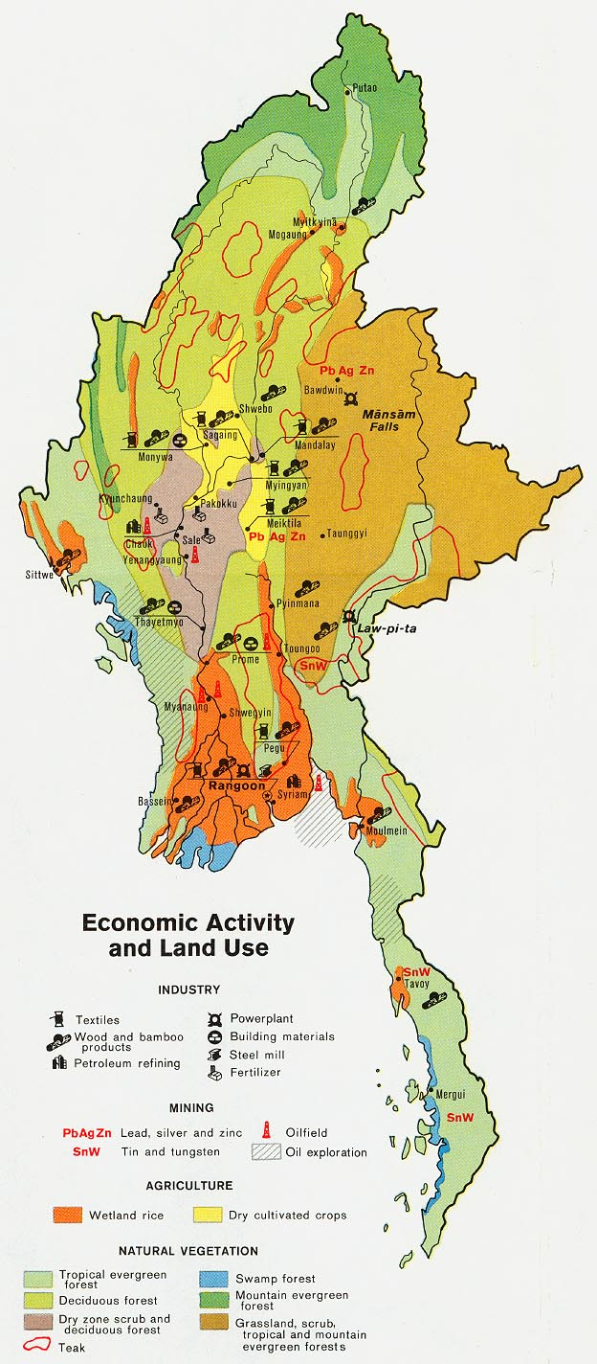
Next
Activity sheet
Identifying patterns of land use change and protected area distribution in South East Asia
What habitats have been changed most?
Debate
What habitats should be prioritized for conservation?
Where should we make a new protected area?

