Slide 1
Supported by and in collaboration with
Politecnico di Milano
Off-Grid Energy Systems Modelling with MicroGridsPy
LECTURE 2
Hybrid Mini-Grids
Version 1.0

Slide 2
Learning Outcomes of the Lesson
Technological evolution and Components of modern Mini-Grids
Understanding the development of mini-grids over time and learning about the components and technology of modern hybrid mini-grids
Market Analysis and Projections
Analyzing the current market status of mini-grids, their role in universal electricity access, and future market trends and financial aspects
Technological Trends and Cost Analysis
Gaining insights into technological advancements in mini-grids, including renewable integration, and understanding their cost structures and economic viability
Beginning Exploration of Electrification Planning Tools
Starting to explore tools and methodologies for planning electrification strategies using mini-grids
24

Slide 3
Historical context of mini-grids
Mini grids are not a new technology: nearly all current centralized electricity grid systems started as isolated electricity systems, which gradually interconnected. Here a brief timeline with the historical electrification phases [1]:
The second generation of mini-grids were small, isolated systems primarily in rural areas without main grid access. These were often community or entrepreneur-built, utilizing diesel or hydro power to electrify households.
Pilot Projects
Social Scale-Up
Late 19th - Early 20th centuries
19th - Early 21th centuries
Nowadays
The first generation of mini-grids was pivotal to the early development and industrialization of modern advanced economies, facing similar regulatory and operational challenges as those currently in Asia and Sub-Saharan Africa.
Third-generation mini-grids benefit from lower technology costs and regulations tailored for private investment with developers collaborating in industry groups to shape policies that promote private-sector investment.
Technological Roll-out and Economic Expansion
24

Slide 4
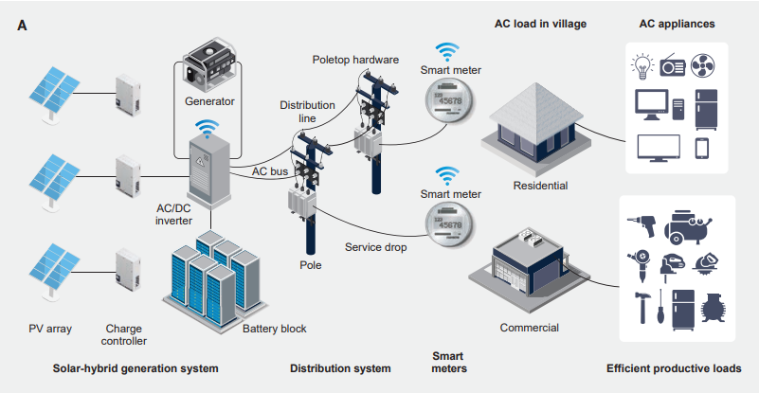
Third-Generation Hybrid Mini-Grid
Hybrid mini grids consist of specialized components for the generation, distribution, metering, and consumption of electricity.
A typical third-generation mini grid comprises:
Hybrid generation system
Renewable Generation Tech (e.g.: PV, Wind, Hydro)
Batteries
Charge controllers
Inverters
Diesel backup generators
Distribution network
Poles
Low-voltage wires
Smart meters
Not necessarily isolated
Third-generation mini-grids are being designed to be grid-compatible, deployed by private operators in areas where the state utility has failed to provide reliable service, especially during peak hours.
Example of a common third generation solar-hybrid mini grid setup [2]
24
Notes:
[1] World Bank Document

Slide 5
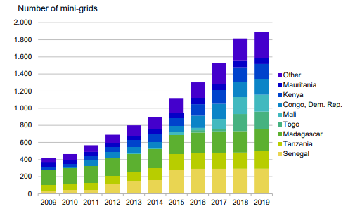
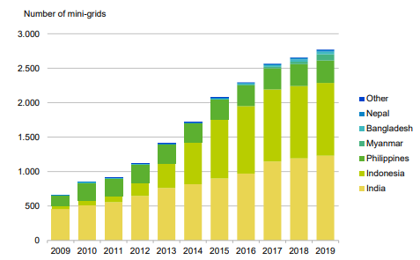
Mini-grids Market Status
Today the mini-grid market is nascent, despite being the least-cost option for electricity access in many areas.
> 21500
0,49-0,68 $/kWh
Estimated cost of electricity for isolated solar hybrid mini-grids for productive use customers and households [3]
Installed mini-grids in Sub-Saharan Africa, Asia and Latin America [2]
Historical cumulatively installed mini-grids in:
Central and East Asia
South Asia
> 7300 installed mini-grids
> 9500 installed mini-grids
Sub-Saharan Africa
Other Regions
Africa
>1000 installed mini-grids
> 3000 installed mini-grids
Asia
Number of installed mini grids by region – graphical elaboration on ESMAP data [2]
Number of cumulatively installed mini-grids [3]
24
Notes:
[1] World Bank Document

Slide 6
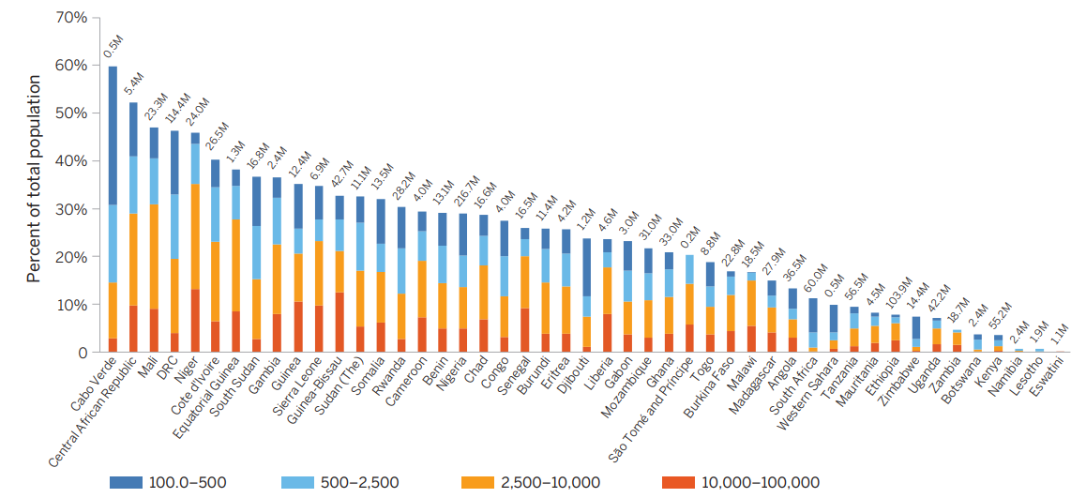
Mini-grids Addressable Market
According to an ESMAP Least-Cost Electrification analysis [2] from The Global Electrification Platform (GEP) using OnSSET, the potential addressable market for mini-grids depending on different levels of demand is:
Low demand: $\sim$66 Millions of people
Intermediate demand: $\sim$87,2 Millions of people
High demand: $\sim$131 Millions of people
Sub-Saharan Africa’s addressable market for mini grids - ESMAP Least-Cost Electrification analysis [2]
24
Notes:
[1] World Bank Document

Slide 7
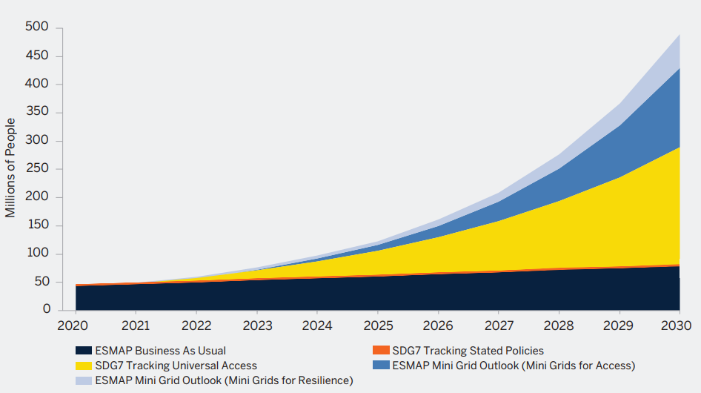
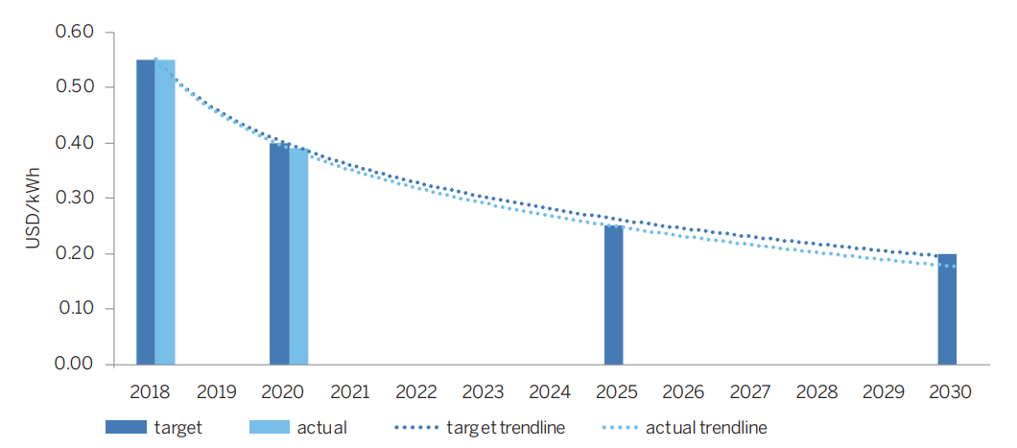
Mini-grids Market Projections
The current pace of mini grid development, as per ESMAP's analysis (Business-As-Usual or BAU scenario), forecasts serving 71.5 million people with an investment of $47 billion by 2030. However, contrasting scenarios reveal different scales of ambition. The "SDG7 Tracking 2019: Universal Access" scenario aims significantly higher, proposing to connect nearly 430 million people through over 185,000 mini grids, requiring more than $280 billion.
0,20 $/kWh
estimated LCOE by 2030 [2]
Number of people connected to mini grids under business-as-usual and universal access
scenarios, 2020–30 [2]
LCOE of best-in-class solar hybrid mini grids [2]
24
Notes:
[1] World Bank Document

Slide 8
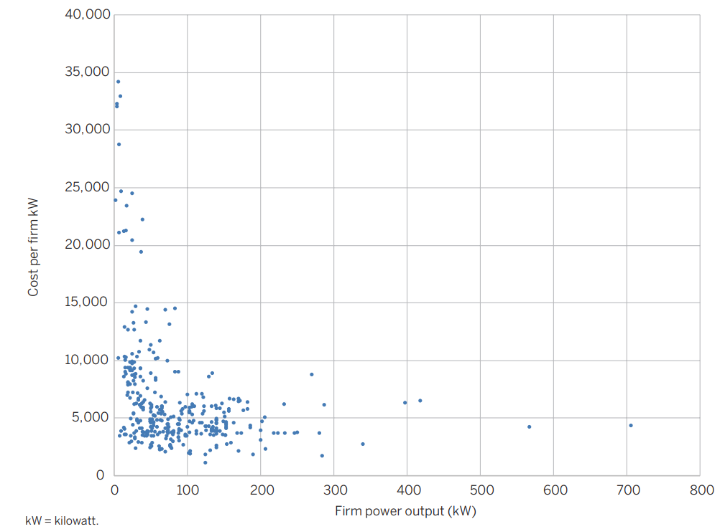
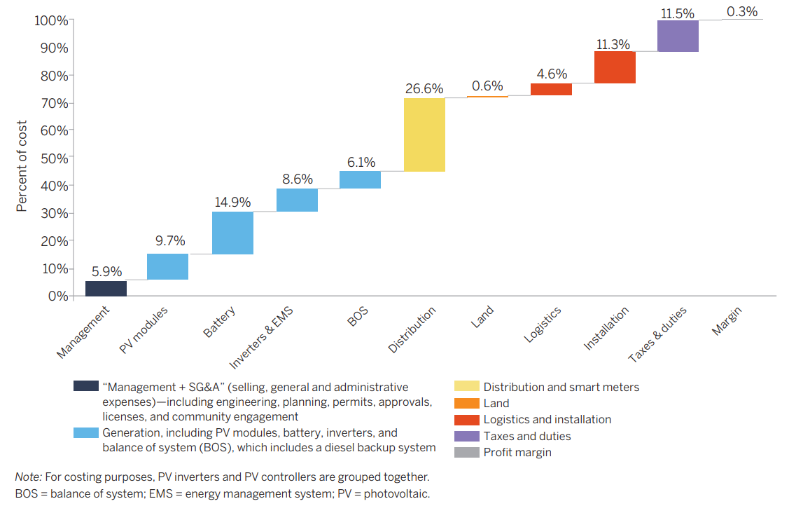
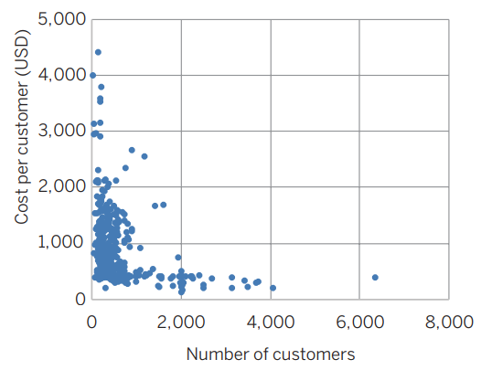
Mini-grids Costs
In the mini-grid sector, a primary concern is the total investment cost relative to the capacity provided.
$\sim$5000 $/kW installed
$\sim$846 $/costumer
(Sample average of 356 mini grids)
Total economic cost of mini grids per kW as a function of firm power output and Mini grid economic costs per customer [2]
Average share of component economic costs in total capital costs of mini grids [2]
In general, mini grids display economies of scale in generation, with smaller mini grids costing more per kW than larger mini grids. In addition, on average, for every additional 100 customers a mini grid serves, its per customer costs fall by about $9. Whereas in 2018 most mini grids had fewer than 200 customers, today most serve between 200 and 600 customers.
24
Notes:
[1] World Bank Document

Slide 9
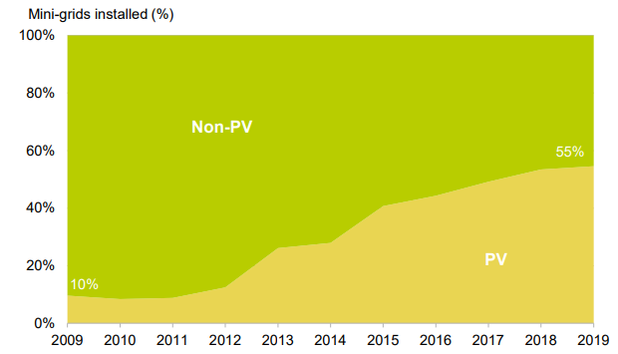
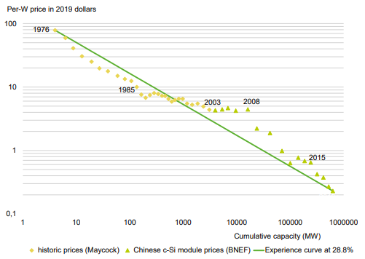
Mini-grids Technologies Trends
There is a strong mandate to hybridize diesel mini-grids with the use of solar and batteries as storage system.
55%
of operating mini-grids incorporating PV, x5 increase from 2009 to 2019 [3]
37%
further reduction in c-Si module prices can be achieved by 2025 [3]
Rapid uptake of PV in the mini-grid sector, 2009-2019 [3]
PV module experience curve (logarithmic) [3]
24

Slide 10
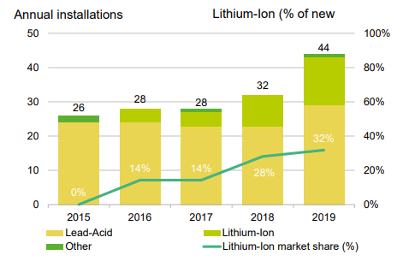
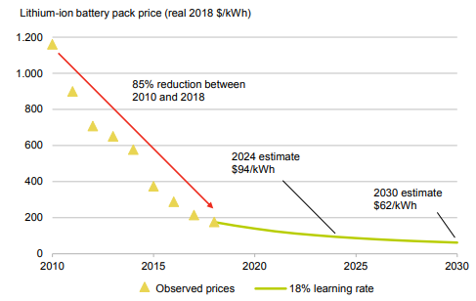
Mini-grids Technologies Trends
Mini-grids use various storage technologies, including lithium-ion, lead-acid and flow batteries. Overall, developers in emerging markets favour lead-acid batteries because they are more readily available and have a lower upfront cost even if lithium-ion batteries usage is constantly increasing over the years.
0,62 $/kWh
estimated Lithium-ion battery pack price by 2030 [3]
Battery technologies used for installed mini-grids [3]
Volume-weighted average lithium-ion battery prices, historical and forecast [3]
24

Slide 11
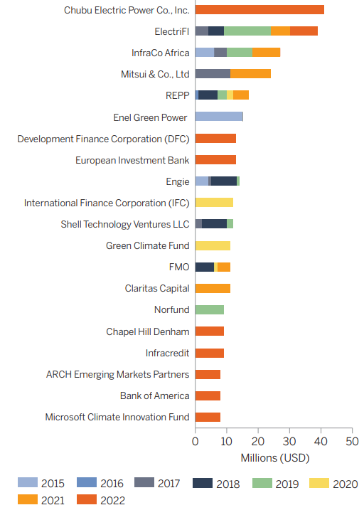
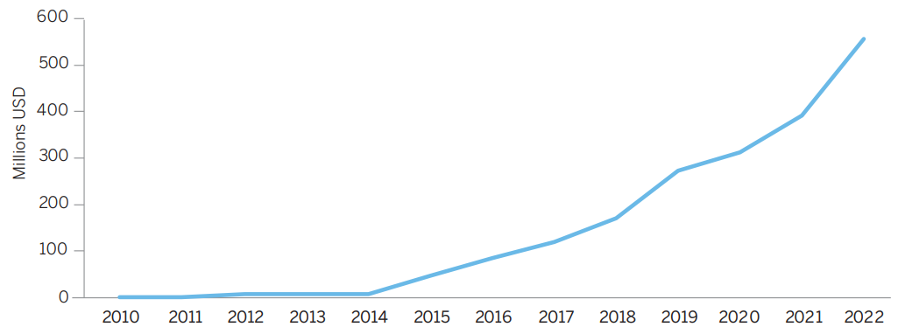
Financing Solar Mini-Grid
The financing of mini-grids is a critical area that involves both public and private sectors, focusing on the diverse financial needs of developers, from large companies to smaller, local entities, including female-led businesses. Essential financial mechanisms include equity, debt, subsidies, and risk-sharing, with options like project and corporate finance playing pivotal roles.
Payback Period: 10-15 years
Cumulative investments: $\sim$$557 Millions 2010-2022
Cumulative private-sector investment in mini grid companies [2]
Top 20 investors in mini grid companies
by cumulative investment [2]
24

Slide 12
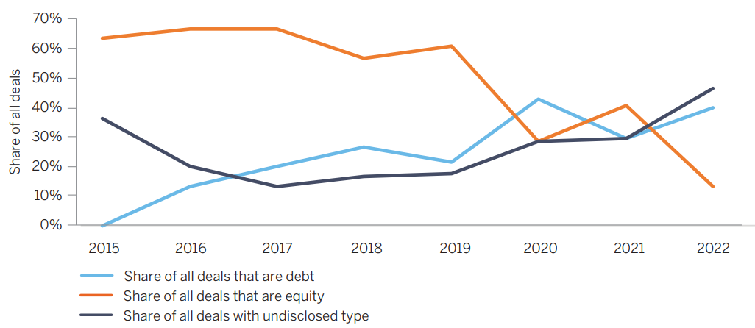
Debt and Equity Financing
In sub-Saharan Africa, the mini-grid sector faces challenges such as high capital costs and market fragmentation. Recently, there’s been notable shift in financing trends: a decrease in equity deals and an increase in debt financing. This trend suggests the industry's maturation, as more established companies with proven cash flows become less risky, attracting debt investors.
Debt Financing
Involves borrowing capital with the obligation of repayment at a high-interest rate, often unattractive due to high perceived risks in the mini-grid market.
Equity Financing
Involves investment from the developer’s own capital or project promoters and is characterized by high returns on investment due to the high-risk nature of mini-grid projects.
Trends in debt and equity [2]
Built-In Advanced Feature in MicroGridsPy:
Weighted Average Cost of Capital (WACC) implementation, modelling debt and equity financing
24

Slide 13
Electrification Planning Tools
Electrification planning tools are diverse and cater to different aspects of the process. They include web-based platforms, offering accessible data and analytics for a wide audience; open-source computational models, providing detailed technical analysis for in-depth research; and commercial decision support tools, delivering proprietary, professional-grade solutions for the energy sector.
Web-Based Platform
Interactive, user-friendly online platforms that provide access to data, analytics, and simulations for electrification planning. They are designed to be accessible to a wide range of users, from policymakers to project developers.
Open-Source Computational Models
More technical tools, often requiring specialized knowledge, that use algorithms and simulations to analyse electrification scenarios, costs, and impacts. They are typically used for in-depth analysis and research.
Commercial Models
Proprietary tools developed by companies, offering specialized services and features for electrification planning. They often include customer support and are tailored for professional use in the energy sector.
24

Slide 14
References
[1] Korkovelos et al., A Retrospective Analysis of Energy Access with a Focus on the Role of Mini-Grids. Sustainability 2020. https://doi.org/10.3390/su12051793
[2] ESMAP, MINI GRIDS FOR HALF A BILLION PEOPLE, Market Outlook and Handbook for Decision Makers. 2022
[3] Minigrid Partnership, State of the Global Mini-grids Market Report. 2020
24

Slide 15
Supported by and in collaboration with
Politecnico di Milano
Consolidated by Nicolò Stevanato, Alessandro Onori, Riccardo Mereu and Emanuela Colombo from Politecnico di Milano
Moksnes N., Sahlberg A., Khavari B. 2021. Lecture 1: OnSSET/Global Electrification Platform. Release Version 1.0. [online presentation]. Climate Compatible Growth Programme, Energy Sector Management Assistance Program and World Bank Group
Stevanato, N., Onori, A., Mereu, R., & Colombo, E., 2024. Lecture 2: Off-Grid Energy Systems Modelling with MicroGridsPy. Release Version 1.0 [online presentation]. Climate Compatible Growth Programme, Politecnico di Milano
CCG courses (this will take you to the website link http://www.ClimateCompatibleGrowth.com/teachingmaterials)

