Slide 1
Energy and Flexibility Modelling
LECTURE 15 Designing a FlexTool Flexibility Assessment
1

Slide 2
Learning Outcomes
By the end of this lecture, you will be able to:
ILO1: Investigate an example case study.
ILO2: Evaluate the flexibility of an example case study.
ILO3: Identify key flexibility metrics.
ILO4: Understand the differences between different scenarios.
Course Name
MINI LECTURE NUMBER & NAME
Mini Lecture Learning Objective
2
Notes:
By the end of this lecture, you will be able to:
1) Investigate an example case study. In this lecture, we use Thailand as an example country.
2) Evaluate the flexibility of an example case study.
3) Identify key flexibility metrics
4) Understand the differences between different scenarios.

Slide 3
15.1 Example case study
15.1.1 Thailand
Two scenarios regarding the future generation mix in 2036 are considered:
A Reference scenario based on the Alternative Energy Development Plan [1], with insights from the Power Development Plan [2].
The REmap scenario based on the Thailand Renewable Energy Outlook [3].
The REmap scenario considers higher renewable deployment and lower generation capacity.
Main challenges of the Thai power system and FlexTool analysis done (IRENA, 2019) [4]
3
Notes:
In this lecture, we will explore an example case study of Thailand. The FlexTool engagement process for Thailand started with a formal invitation for the International Renewable Energy Agency (or IRENA) to act as the focal point entity for Thailand, the Ministry of Energy, and more specifically the Department of Alternative Energy Development and Efficiency.
This analysis helped to assess grid capacity to integrate more renewables, along with the economic impact of these renewables. The scenarios considered the future generation mix in 2036, with two specific scenarios: the reference scenario and the REmap scenario. The REmap scenario considers higher renewables deployment and lowers thermal generation capacity.
The Figure shows the main challenges identified before starting the assessment, as well as the relevant analysis, that was undertaken to cope with these challenges.
Firstly, there was limited experience in operating systems with high shares of variable renewable energy or VRE. Secondly, there was weak interconnection with other countries, and finally, the peak load of Thailand occurs after sunset.
The analysis undertaken simulates different VRE penetration scenarios (the reference scenario and REmap), as well as an assessment of the optimal power-generation capacity mix (including storage). Finally, the long-term planning for possible increases in VRE share, mostly from photovoltaics was analysed.

Slide 4
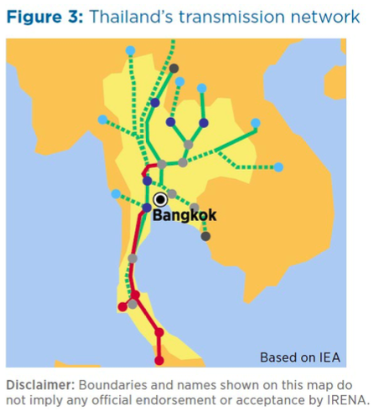
15.1 Example case study
15.1.2 Grid Analysis
Connections with neighbouring countries:
Long-term contracts with hydropower operators in Laos.
Plans to expand hydropower in Laos and Myanmar.
Otherwise weak connections.
Internal grid:
Long country with uneven demand and production.
Hydropower at north.
Bangkok consumes much more than it produces.
Not enough regional data available.
Modelling decisions:
Model Thailand as a single node (main thing to improve).
Thailand’s transmission network
(IRENA, 2019) [4]
4
Notes:
Firstly, we will analyse Thailand’s electricity grid.
Thailand has connections with Myanmar, with long-term contracts with hydropower operators there. However, there are plans to expand hydropower in both Laos and Myanmar. Otherwise, there are weak connections between neighbouring countries.
In terms of the internal grid, Thailand is a long country with uneven demand and production. For example, Bangkok consumes a lot more electricity than it produces, and there are large hydro facilities in the North of the country. However, not enough regional data are available for Thailand’s internal grid.
Several modelling decisions were made in this case study. For example, Thailand was modelled as a single node, which can be improved upon in future studies. The case study also includes contracted hydropower plants in Laos and Myanmar as part of the Thailand model.

Slide 5
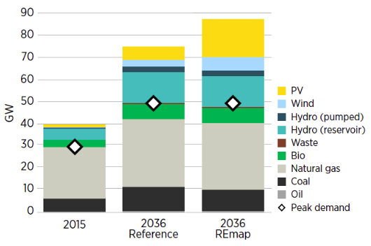
15.1 Example case study
15.1.3 Capacity expansion scenarios
Fast growth in electricity demand.
Current capacity expansion plans (“reference”):
Meet demand by adding fossil fuel generation capacity.
Invest relatively small share in wind and solar.
Build several GW of pumped hydro capacity.
In one node model:
No capacity adequacy issues expected (strong capacity balance).
No ramping capacity issues expected (hydro reservoirs and natural gas).
No curtailment expected (low VRE share).
But could additional VRE capacity be cheaper than fossil fuel-based generation?
Expected evolution of Thailand’s generation capacity mix, 2015–2036
(IRENA, 2019) [4]
5
Notes:
In this slide, we will explore the capacity expansion scenarios.
Annual electricity demand is expected to grow by 70% from 2015 to 2036 according to E. GAT and the Ministry of Energy.
It is expected that this rapid increase in electricity demand is met by the addition of fossil fuel generation capacity. A relatively small amount of share of wind and solar is expected, with several gigawatts of pumped hydro capacity to be built.
In the one node model, no capacity adequacy issues are expected, due to a strong capacity balance. There are not expected to be any capacity issues due to the presence of hydro reservoirs and natural gas. No curtailment is expected due to the low share of variable renewable energy (or V.R.E.) and the presence of hydro reservoirs and pumped hydro. However, a question that can be asked is, would additional variable renewable energy capacity be cheaper than fossil fuel-based generation?

Slide 6
15.1 Example case study
15.1.4 Lessons from operation practices
Thailand’s peak electricity demand is after sunset.
Solar PV cannot contribute directly to peak power.
Storage is needed → Thailand has decided to invest in reservoir hydro and pumped hydro.
Hydro inflow variance between years can cause some issues.
The variations between years are not exceptionally large, but dry years need to be simulated.
Geographical dispersion of VRE cannot be analysed with a one node model.
Strength of internal grid cannot be analysed with a one node model.
Thailand has data in 30-minute intervals, and the model was built with 30-minute time steps to pay additional attention to ramp rates.
6
Notes:
In this slide, we review some lessons from operation practices.
A large factor in understanding the flexibility of Thailand is that its peak electricity demand is after the sunset. Therefore solar photovoltaics cannot contribute directly to peak power. This means that storage is needed. To this end, Thailand has decided to invest in both reservoir and pumped hydro. This can be used to meet the peaks in demand and lulls in supply from variable renewable energy.
A second factor which deserves attention is the hydro inflow variance. The variations between years in hydro inflow are not exceptionally large, but especially dry years do need to be simulated within FlexTool.
Another factor is that the geographical dispersion of variable renewable energy cannot be analysed with a single node model. Therefore, if we were to assess the effects of different weather conditions at different locations within Thailand more nodes would be required. Similarly, the strength of the internal grid cannot be analysed with a single node model.
Finally, Thailand had data in 30-minute intervals, which allowed us to model and pay particular attention to ramp rates.

Slide 7
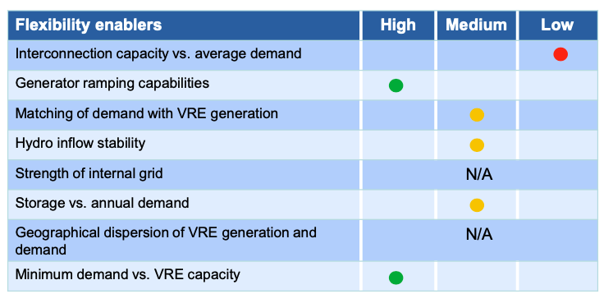
15.1 Example case study
15.1.5 Status of flexibility enablers
Flexibility enables in Thailand’s power system (IRENA, 2019) [4]
7
Notes:
Next, we will assess the flexibility enablers within Thailand’s power system.
Here, “high” flexibility enabler values indicate very good conditions, ”medium" levels indicate normal conditions, and “low” levels indicate significant challenges or poor conditions for increasing power system flexibility at present. Some of these are labelled as N/A due to the system being modelled as a single node.
The interconnection capacity versus average demand is low. This is because, as previously mentioned, the interconnection capacity between external countries and Thailand is relatively small. However, Thailand possesses high generator ramping capabilities. This is due to the high amount of natural gas and hydro options.
Due to the low amount of variable renewable energy, matching demand with V.R.E. generation is medium. The storage versus annual demand is medium. The “high” rating of minimum demand versus V.R.E. capacity is due to the low amount of V.R.E. supply.
Finally, as previously mentioned, as this case study Thailand is modelled as a single node model, it is not possible to analyse the strength of the internal grid and geographical dispersion of V.R.E. generation and demand.

Slide 8
Lecture 15.1 References
Ministry of Energy (2015), Alternative energy development plan, Thailand Ministry of Energy, Bangkok, http://www.eppo.go.th/images/POLICY/ENG/AEDP2015ENG.pdf
EGAT (2015), Thailand power development plan 2015-2036, Electricity Generating Authority of Thailand, Bangkok, https://www.egat.co.th/en/images/about-egat/PDP2015_Eng.pdf
IRENA (2017a), Renewable energy outlook: Thailand, International Renewable Energy Agency, Abu Dhabi.
IRENA (2019), Thailand power system flexibility assessment: IRENA FlexTool Case Study, International Renewable Energy Agency, Abu Dhabi.
Course Name
MINI LECTURE NUMBER & NAME
Mini Lecture Learning Objective
8

Slide 9
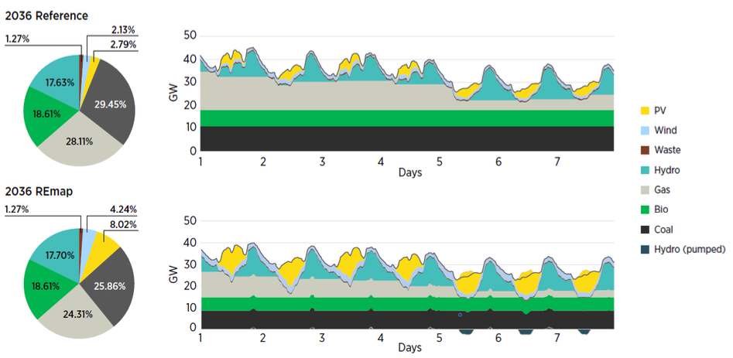
15.2 Analysing scenarios
15.2.1 Dispatch in 2036
Power generation (annual share) and hourly dispatch over a week in 2036, with the highest VRE penetration: Reference and REmap scenarios (IRENA, 2019) [1].
9
Notes:
On this slide, we see four figures. The top two figures refer to the 2036 reference scenario, whereas the bottom two figures refer to the REmap scenario.
The reference scenario shows that we have a majority of coal and gas, making up over 29% and 28% respectively. These are followed by over 18% of electricity provided by biogas and over 17% from hydro. There is a much smaller amount of solar and wind power generation, which both makeup over 2%. Finally waste provides over 1% of electricity.
When compared with the REmap scenario, we see an increase in solar photovoltaics and wind, at the expense primarily of coal and gas. Solar photovoltaics jumps from under 3% to just over 8%. Additionally wind makes up about 4% of dispatch.
The impact of flexibility on this can be seen by the graphs on the right. Whilst in the reference scenario photovoltaics reduces the amount of gas required on certain days, in the REmap scenario, solar reduces the use of gas on all days – sometimes down to zero.
Additionally, the REmap scenario displays a much more significant increase in the use of pumped hydro due to the storing of energy during the day and use during the night.

Slide 10
15.2 Analysing scenarios
15.2.2 Flexibility in 2036
Main flexibility indicators for Thailand’s power system in 2036 reference and REmap scenarios (IRENA, 2019) [1].
10
Notes:
In this slide, we will explore the metrics used to measure whether there is enough flexibility in the system in both the reference and REmap scenarios.
These metrics are curtailment, loss of load, spillage, and reserves inadequacy.
Curtailment is where variable renewable energy sources are restricted in their output to prevent oversupply. Loss of load is when system load exceeds available generation; in other words, demand is larger than supply. Spillage occurs when the water inflow exceeds the amount that can be used by hydropower generators when reservoirs are full. Reserves inadequacy is when the reserve requirement cannot be met.
In all of these metrics, the results are zero. That means that with the combination of 12% of wind and solar, as shown in the previous slide, no flexibility issues were encountered.

Slide 11
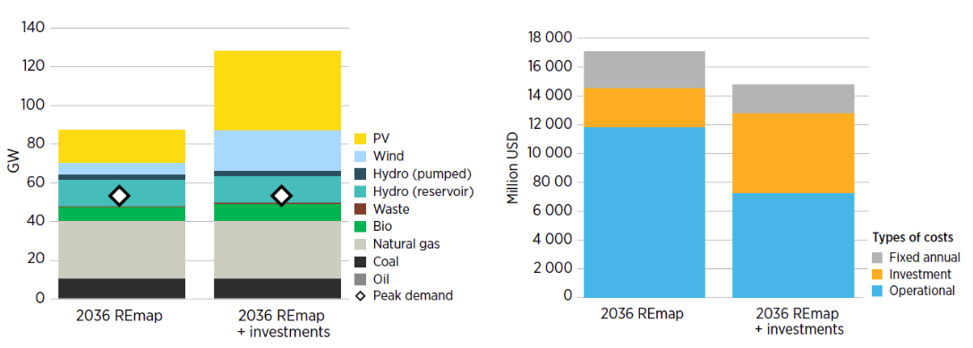
15.2 Analysing scenarios
15.2.3 Evaluating additional investments
Additional investments in wind and solar could save more than 2,000 million USD per year for Thailand, including investment costs (IRENA, 2019) [1].
11
Notes:
In this slide, we present the investment scenario.
Since no flexibility issues were identified in the 2036 reference and REmap scenarios, a sensitivity analysis was performed to check if there were cost-efficient additional investments. To do this, the expansion mode of FlexTool was used and identified that the minimum total system cost is achieved in the REmap scenario by adding 15GW of wind, 23.8 GW of solar, and 2 GW of biomass. This increases the variable renewable energy share from 12.3% to 33.4% (for example, photovoltaics and wind) and the renewable energy share, which also includes hydro and bio, from 49% to 74%. This can be seen in the Figure on the left-hand side which shows generation capacity.
The Figure on the right-hand side shows the total system costs with and without additional investments. The increased investment costs in wind, solar, and, to a lesser extent, biomass – as well as curtailment costs of 2%, are covered by savings in operational costs from fossil-fuelled capacity.

Slide 12
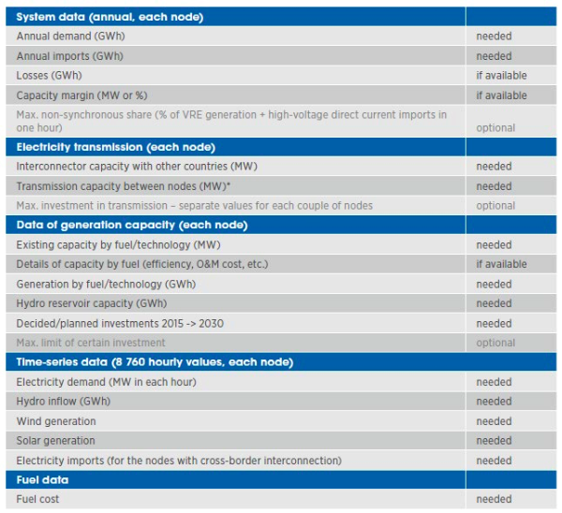
15.2 Analysing scenarios
15.2.4 Preparing to create your own input data
files
When preparing input data files, modellers need to decide the structure of the model:
Number of nodes
Modelled technologies, etc.
The amount of detail effects the required data. For example, multi-node models need considerably more data than a single node model.
Data required for the input data files are shown on the right.
Plus all data for both base year and future years.
Summary of data needed for a FlexTool Case Study (IRENA, 2020) [2].
12
Notes:
To create your own input data file you need to decide the structure of the model. This includes, for example, the number of nodes and the modelled technologies.
The more detailed the model you wish to design is, the more data you need. For example, multi-node models need considerably more data than the single-node model.
The data required for the input files are shown on the right. Of the system data, the annual demand and annual imports are required in gigawatt hours. The losses and capacity margin should be used if available.
For each node, the interconnector capacity with other countries is required, as is the transmission capacity between nodes.
The existing capacity by fuel or technology is required in megawatts. The parameters which inform this capacity, such as efficiency and operation and maintenance costs, can be input if available. The generation by fuel or technology is required in gigawatt hours. The hydro reservoir capacity and decided or planned investments between 2015 to 2030 are required.
Finally, apart from fuel cost, the electricity demand, hydro inflow, wind generation, solar generation, and electricity imports are all required for the time series data.

Slide 13
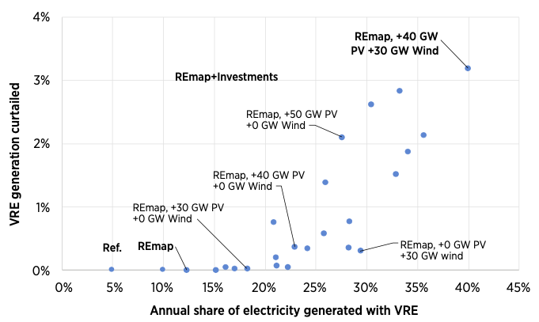
15.2 Analysing scenarios
15.2.5 Sensitivity analysis
A sensitivity analysis was performed to investigate the impact of solar PV and wind on system flexibility.
In the reference and REmap scenario there are no curtailment and no flexibility issues.
In the REmap scenario with 40 GW of PV, VRE curtailment starts to appear (less than 0.5%).
Optimized investment REmap scenario yields 1.9% VRE curtailment.
Good match with hydro storage installed in the system.
VRE curtailment at different levels of solar and wind penetration in 2036 (IRENA, 2019) [1].
13
Notes:
A sensitivity analysis was designed to investigate the impact of solar PV and wind on system flexibility. A sensitivity analysis changes key variables to see the impact on output results.
For this sensitivity analysis, solar photovoltaics and wind are gradually added to test the system’s flexibility limits. In total, 34 variable renewable energy scenarios were simulated. The figure on the right shows variable renewable energy curtailment given different V.R.E. shares for 26 of the simulated scenarios.
As can be seen, with the reference and REmap scenario, there is no V.R.E. generation curtailment. Curtailment begins to appear in the REmap scenario with 40 gigawatts of photovoltaics and zero gigawatts of wind. However, the total curtailment is less than 0.5% which is at a reasonable level.
The optimized investment REmap scenario yields 1.9% level of curtailment.
The curtailment in the system begins to increase significantly after the 40 gigawatts of photovoltaic scenario or the 30 gigawatts of wind scenario. For example, the scenario modelling 40 gigawatts of photovoltaics and 30 gigawatts of wind reaches over 3% of curtailment.

Slide 14
Lecture 15.2 References
IRENA (2019), Thailand power system flexibility assessment: IRENA FlexTool Case Study, International Renewable Energy Agency, Abu Dhabi.
IRENA (2020), IRENA FlexTool Basic Training, International Renewable Energy Agency, Abu Dhabi.
14

Slide 15
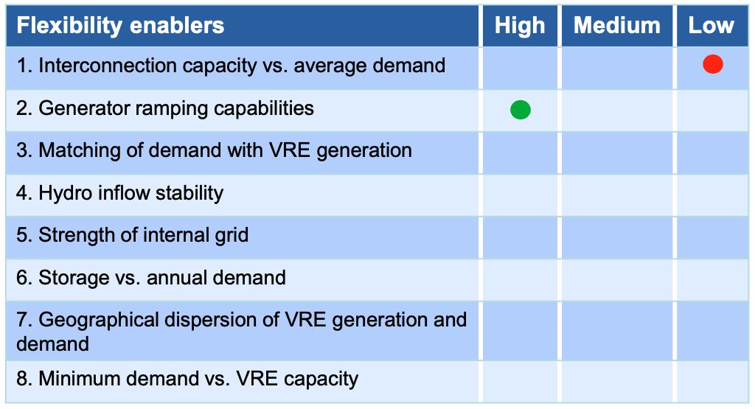
15.3 Assessing flexibility enablers
15.3.1 demoModel-1
Interconnection capacity (to other countries):
With demoModel-1, we do not know the capacity, but annual imported energy is less than 3% of annual demand.
See gridNode sheet in demoModel-1.xlsm
Generator ramping capabilities:
No ramping issues identified.
In a real case study, a full year run will be required.
Flexibility enablers (IRENA, 2019) [1].
15
Notes:
In this mini-lecture series, we will assess the flexibility enablers within demoModel-1.
Firstly, we will check the interconnection capacity. In other words, the connections which allow for imports or exports of electricity. Within demoModel-1 we do not know the capacity, but it can be seen that the annual imported energy is less than 3 percent of annual demand.
To see this, see the input data file (demoModel-1) sheet, grid node.
This is flagged as low, but more data are needed in real case studies.
Secondly, we will check the generator ramping capabilities. No ramping issues were identified for demoModel-1. We will therefore flag this as high; however in a real case study, a full year run is required and the system operator should be consulted. This is because something may not have been fully captured with the existing model. For example, days with particularly high electricity demand.

Slide 16
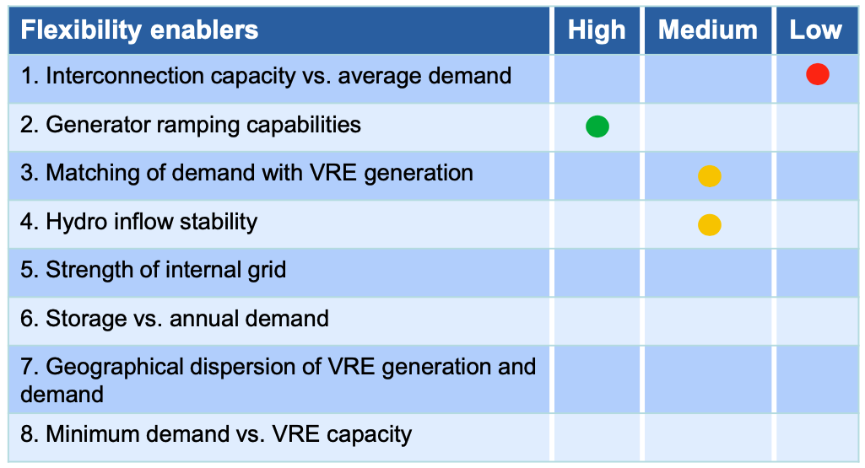
15.3 Assessing flexibility enablers
15.3.2 demoModel-1
Matching demand with VRE:
Peak demand after sunset (see dispatch figures).
Annual time series of wind and solar do not have large seasonal variability (ts_cf sheet).
Hydro inflow stability:
Run of river (Hydro_ROR) production has large variance between seasons (ts_inflow sheet)
Reservoir hydro inflow is more stable between the seasons.
No data about different years.
Flexibility enablers (IRENA, 2019) [1].
16
Notes:
In this slide, we will cover the ability to match demand with variable renewable energy and the stability of hydro inflow.
With regards to matching demand with variable renewable energy, by looking at the dispatch figures, we see that peak demand is after sunset. However, the annual time series of wind and solar do not have large seasonal variability. We will therefore give the matching of demand with variable renewable energy a medium score.
Secondly, for the stability of hydro inflow, the run of river hydro production has a large variation between seasons. However, the reservoir hydro inflow is more stable between seasons. Therefore we will give the hydro inflow a score of medium.
We, therefore, have flagged both flexibility enablers here as medium, however, in a real case study, more data is needed. These could also be marked as low.

Slide 17
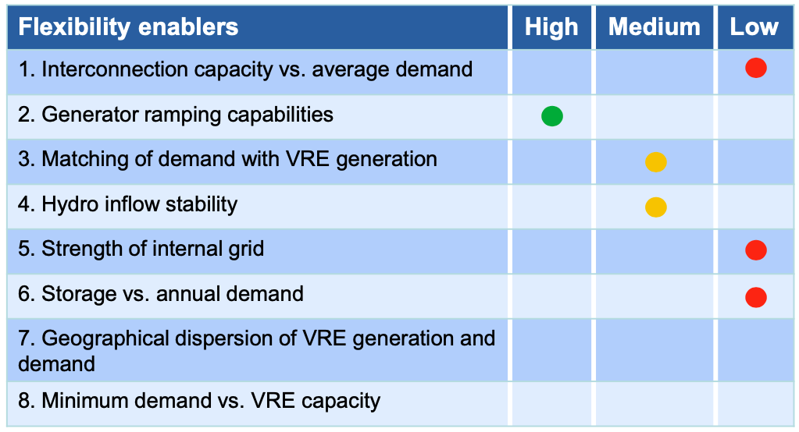
15.3 Assessing flexibility enablers
15.3.3 demoModel-1
Strength of internal grid:
node A has a loss of load and node C has excess capacity. Therefore, the transmission lines do not have enough capacity.
Flagged low.
Storage versus annual demand:
Check storage capacity input data units sheet.
Check annual demand from input data gridNode sheet.
Calculate the storage / total annual demand (~1%).
Reservoir hydro unit is small compared to the annual demand.
Flagged low
Flexibility enablers (IRENA, 2019) [1].
17
Notes:
Next, we will analyse the strength of the internal grid. We found in the previous hands-on exercise that Node A has a loss of load, whereas Node C has excess capacity. Therefore, we can deduce from this that the transmission lines do not have a high enough capacity. We, therefore, flag the strength of the internal grid as low.
Next, we will analyse the storage versus annual demand. We can check the storage capacity input data by looking at the units sheet. In addition to this, we can check the annual demand of the input data from the grid node sheet.
The size of the storage is around 1 per cent of the total annual demand. Therefore the reservoir hydro unit is small compared to the annual demand. We, therefore, flag this as low.

Slide 18
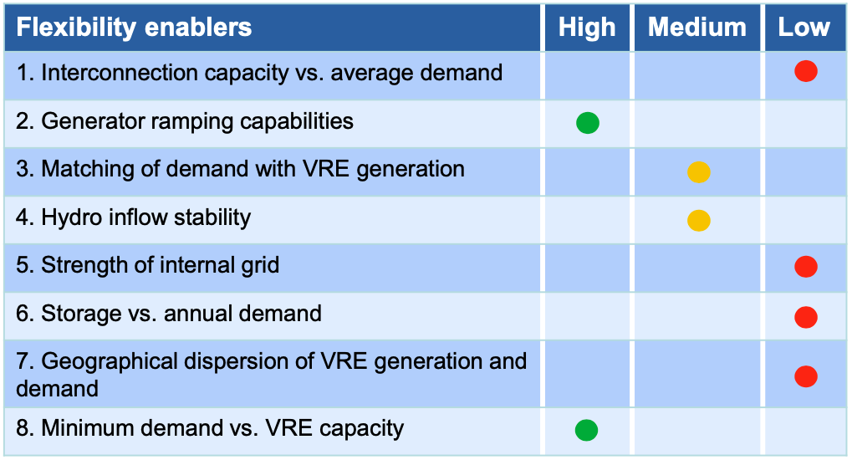
15.3 Assessing flexibility enablers
15.3.4 demoModel-1
Geographic dispersion of VRE generation and demand
Check node level demand from input data gridNode sheet.
Check node level VRE generation from results file: units_elec sheet.
node A – 53% of demand, 2% of VRE generation.
node B – 17% of demand, 60% of VRE generation.
node C – 27% of demand, 37% of VRE generation.
node D – 3% of demand, 1% of VRE generation.
Flagged low, but future investments might make it medium.
Minimum demand versus VRE capacity
Check minimum net load (demand + export − import − VRE) from results file from genUnit_elec sheet
In invest_all scenario, the minimum net load is 675 MW, no issues here either.
Flexibility enablers (IRENA, 2019) [1].
18
Notes:
In this slide, we cover the geographic dispersion of variable renewable energy generation and demand, as well as the minimum demand versus variable renewable energy capacity.
To check the geographic dispersion of variable renewable energy generation and demand, we must check the demand at each node in the grid node sheet from the input data. Secondly, we must check the level of variable renewable energy at each node.
The results are as follows:
Node A has 53% of demand, whilst at 2% of variable renewable energy generation.
Node B has 17% of demand, whilst at 60% of variable renewable energy generation.
Node C has 27% of demand, whilst at 37% of variable renewable energy generation.
Node D has 3% of demand, whilst at 1% of variable renewable energy generation.
This means that demand and variable renewable energy generation are not well matched, especially at Node A and node B. This has been given a flag of low; however, this could be improved in the future.
Next, we will analyse the minimum demand versus variable renewable energy generation. To do this we check that there is enough capacity to cover variable renewable energy generation and imports. By doing this calculation we find that the minimum net load is 675 MW which is good. We will therefore give this a high score.

Slide 19
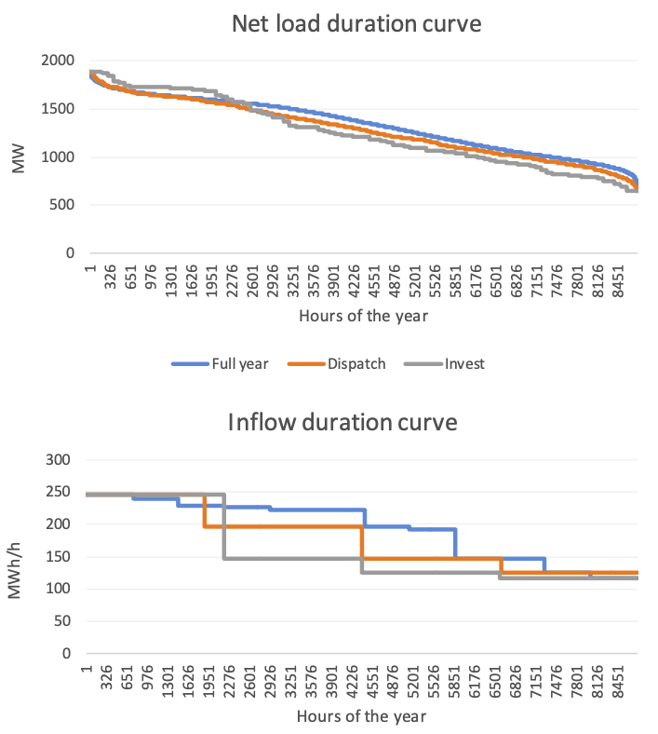
15.3 Assessing flexibility enablers
15.3.5 Representative time periods
Selecting representative days based on:
Net load (min and max).
Inflow (min and max).
Open file input/demoModel-1-select-weeks.xlsx
Selecting 4 weeks for dispatch and 4 days for investing.
1 week/day with max net load and one with min net load.
1 week/day with max inflow and one with min inflow.
Quality check by comparing the duration curves of the full year to selected time series
Representative days (IRENA, 2020) [2].
19
Notes:
In this slide, we explore representative time periods. Representative time periods are a way to reduce the total computation that would be required to run the simulation for an entire year. We can select a few representative days which, as the name suggests, represents an entire year.
We select these representative days based upon the net load and inflow.
Specifically, we select 4 weeks for dispatch and 4 days for investing. We choose 1 week per day with max net load and one with minimum net load. We also choose 1 week per day with max inflow and one with minimum inflow.
We are able to check the quality by comparing the duration curves of the full year to the selected time series.

Slide 20
Lecture 15.3 References
IRENA (2019), Thailand power system flexibility assessment: IRENA FlexTool Case Study, International Renewable Energy Agency, Abu Dhabi.
IRENA (2020), IRENA FlexTool Basic Training, International Renewable Energy Agency, Abu Dhabi.
20

Slide 21
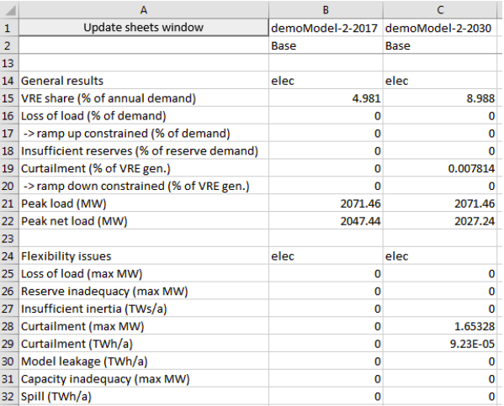
15.4 Digging deeper into flexibility
15.4.1 Demo Model 2
Open: inputData\demoModel-2-2017.xlsm and inputData\demoModel-2-2030.xlsm
Demonstration of a case study assessing current situation (2017) and capacity expansion plan (2030).
New investments for 2030 are natural gas plants in node C, wind power in node A, and small shares of PV at all nodes.
Run models: no flexibility issues found, only tiny number of curtailments.
Demo Model 2 results (IRENA, 2020) [1].
21
Notes:
In this mini-lecture, we will analyse the results of demo model 2.
Demo model 2 is made up of two files – one for 2017 and one for 2030. You will find these models within the input data folder.
The 2017 model assesses the current situation, whilst the 2030 model assesses the capacity expansion plan.
The new investments for 2030 are natural gas plants in node C, wind power in node A, and small shares of photovoltaics at all nodes.
After running these models, we see no significant flexibility issues. The flexibility issues are highlighted by the red oval on the right-hand side. The demo model shown in 2017 shows no issues whatsoever, whereas the model in 2030 shows no significant issues. This can be seen by assessing the numbers in the table.

Slide 22
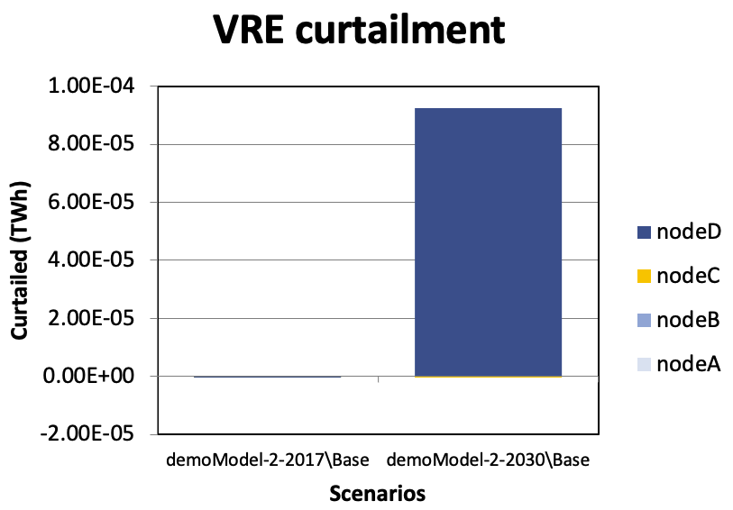
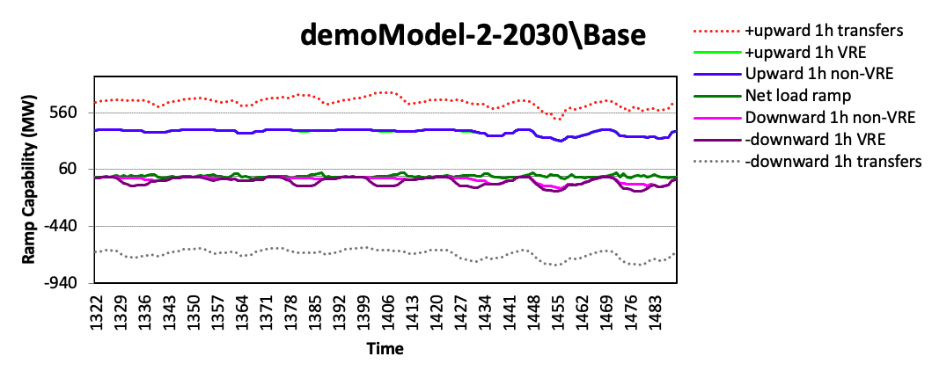
15.4 Digging deeper into flexibility
15.4.2 demoModel-2
Identifying the source of curtailment:
node D has curtailment
Check rampRoom_1h_elec_nodeX_plot sheet to study ramping capabilities of different nodes.
All nodes have enough ramping capability.
node B at 2030 has limited downward ramping capability within the node, but very good ramping capabilities when adding transfer connections.
Demo Model 2 results (IRENA, 2020) [1].
22
Notes:
In this slide, we want to further investigate the flexibility of our system. We saw in the previous slide that there was a small amount of curtailment in the 2030 model scenario. By looking at the node plot sheet, which is the top right-hand figure, we see that this curtailment occurs at node D.
Next, we want to see whether there is a sufficient ramping capability at the nodes. To do this, check the ramp room 1 hour elec node plot sheet. We see that all of the nodes have enough capability. In this sheet we have highlighted the ramp room 1 hour elec node B plot. We can see that node B at 2030 has a limited downward ramping capability within the node. However, this capability becomes very good when adding transfer connections.

Slide 23
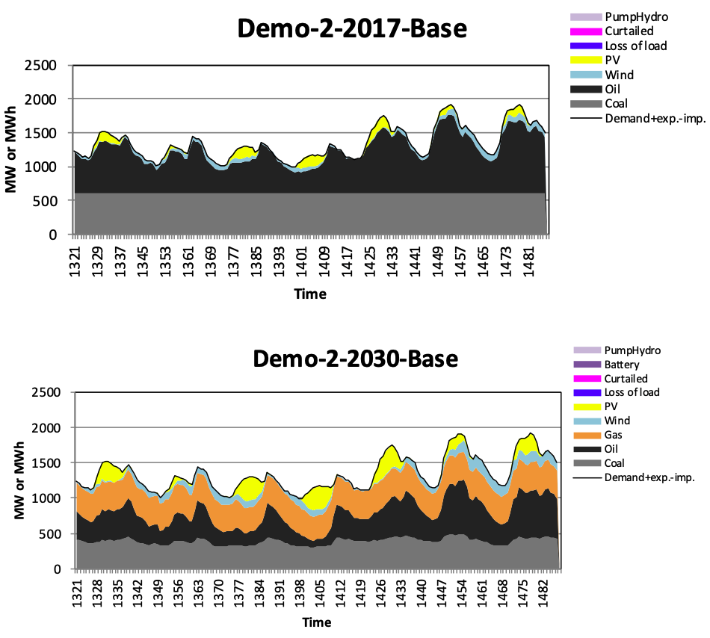
15.4 Digging deeper into flexibility
15.4.3 Dispatch Data
Open dispatch figures from sheet genUnitGroup_elec_plot.
The scroll bar allows one to change the week.
The first week has the lowest demand, the third week has the highest net load.
Minimum loads of coal and gas units seem to be acceptable in the 2030 run.
If there are many small oil units, these should also be sufficient.
Demo Model 2 results (IRENA, 2020) [1].
23
Notes:
In this slide, we will continue to dig deeper into the flexibility of our scenarios.
The gen unit group elec plot sheet allows us to open the dispatch figures. A dispatch figure shows the contribution of each technology to the total electricity demand. So, for example, in the top figure, coal provides base load of just over 500 megawatts, and the rest of the demand for this week is met by oil, photovoltaics and a small bit of wind.
The scroll bar allows one to change the week. The first week has the lowest demand, whereas the third week has the highest net load.
The minimum loads of coal and gas units seem to be acceptable in the 2030 run. The small oil units should also be acceptable.

Slide 24
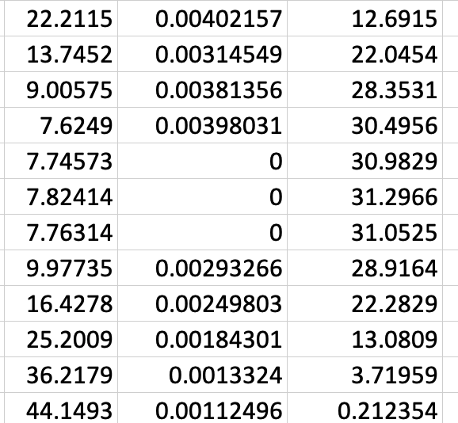
15.4 Digging deeper into flexibility
15.4.4 Why does node D have curtailments?
See genUnit_elec sheet.
Find which hours node D has curtailments (1403–1406)
During these hours, local non-synchronous share grows to 80% and the VRE generation is curtailed.
The maximum non-synchronous share is defined in the input data (gridNode sheet and nodeGroups sheets).
Demo Model 2 results (IRENA, 2020) [1].
24
Notes:
In a previous slide, we saw that Node D has some curtailments. However, why do we have these curtailments? To find out we will do some further investigation.
First, we will look at the gen Unit elec sheet. We will then look at the 2030 scenario, node D. And then we will look for the variable renewable energy sources which have zero output. In this case, we will look at wind, because photovoltaics can have zero output in the absence of solar irradiance.
We can see that between the hours of 1403 and 1406, for node D, there is zero output for wind. Therefore there has been curtailment here.
During these hours, we can further investigate and see that the local non-synchronous share grows to 80% and therefore, the variable renewable energy generation is curtailed.
The maximum non-synchronous share is defined in the input data. Specifically, in the grid node sheet and node groups sheet.

Slide 25
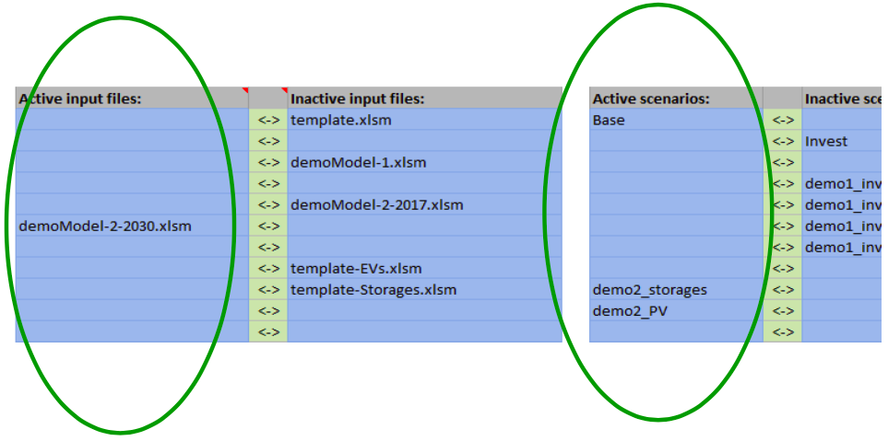
15.4 Digging deeper into flexibility
15.4.5 Predefined investment runs
Predefined investment runs allow users to easily try alternative investment plans.
Select the following scenarios in flexTool.xlsm and run them with base scenario.
Storage scenario adds 5 MW battery storage to node D (island node with minor curtailment).
PV scenario forces FlexTool to invest an additional 100 MW of PV in node A, 50 MW of PV in node B. And 100 MW of PV in node C.
See FlexTool.xlsm sensitivity definition sheet to see how these two scenarios are defined.
Selection of scenarios (IRENA, 2020) [2].
25
Notes:
In this slide, we show you how to run active scenarios, and predefined investment runs. Predefined investment runs allow users to easily try alternative investment plans.
These can be selected in the FlexTool excel spreadsheet and run with the base scenario. The storages scenario adds 5 megawatts of battery storage to node D. Node D is an island node with minor curtailments.
The photovoltaic scenario forces FlexTool to invest an additional 100 megawatts of photovoltaics in node A, 50 megawatts of photovoltaics in node B and 100 megawatts of photovoltaics in node C.
To see how these two scenarios are defined, check the sensitivity definition sheet of the FlexTool sheet.
You have reached the end of lecture 15. Lecture 16 will look at flexibility options in FlexTool.

Slide 26
Lecture 15.4 References
IRENA, Abu Dhabi, FlexTool Model, 2020.
IRENA (2020), IRENA FlexTool Basic Training, International Renewable Energy Agency, Abu Dhabi.
26

Slide 27
27

