Slide 1
OnSSET/Global Electrification Platform
LECTURE 5
GEP SCENARIO BUILDING
Version 1.0

Slide 2
Learning Outcomes
By the end of this lecture, you will be able to:
ILO1: Explain the data acquisition for building your model
ILO2: Describe the grid-extension algorithm in OnSSET
ILO3: List key datasets used in OnSSET
ILO4: Describe the LCOE and why it is useful in OnSSET
Notes:
By the end of this lecture, you will be able to:
Explain the data acquisition for building your model
Describe the grid-extension algorithm in OnSSET
List key datasets used in OnSSET
Describe the L.C.O.E and why it is useful in OnSSET
This will be important for your understanding regarding the OnSSET calculations and results.

Slide 3
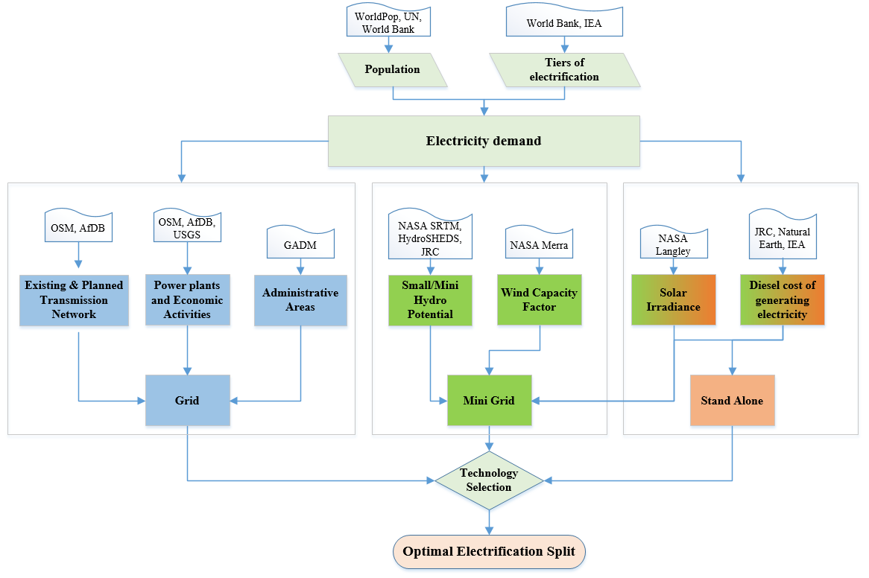
5.1 The Seven step methodology
The ‘Seven step’ methodology to create a scenario using OnSSET
Source: Sahlberg et al. 2021
Picture Source: Mentis et al. 2017, image licensed under CC-BY 3.0
Notes:
In this lecture we will go through what we call the Seven step methodology to create a scenario using OnSSET. Step one to six will be covered in this lecture and the seventh step will be covered in lecture 6. The modelling process is divided into seven different steps that we undertake to do an electrification analysis using the OnSSET tool. These steps are presented here for the OnSSET tool, but they can be generalized to other electrification models. The first step is to collect the geospatial data for the area that we're studying. We can do studies for an entire country, or we can do it for a region of the country, or we could even scale up and do it for all of the countries in sub-Saharan Africa or an entire continent.
You need to determine the area that you're studying and then collect the geospatial data, which can provide location based information for all the settlements that you're interested in.

Slide 4
5.1 The Seven step methodology
Step 1. Acquire the necessary GIS data for the area of interest
# | Dataset | Type
1 | Population density & distribution | Raster
2 | Administrative boundaries | Raster
3 | Existing grid network | Line shapefile
4 | Substations | Point shapefile
5 | Power plants | Point shapefile
6 | Mines & Quarries | Point shapefile
7 | Roads | Line shapefile
8 | Planned grid network | Line shapefile
# | Dataset | Type
9 | Nighttime lights | Raster
10 | GHI | Raster
11 | Wind speed | Raster
12 | Hydro power potential | Point shapefile
13 | Travel time | Raster
14 | Elevation Map | Raster
15 | Slope | Raster
16 | Land Cover | Raster
GIS data requirements may vary depending on the objective of the electrification study
Source: Sahlberg et al. 2021
Picture source: Khavari et al. 2021, image, license under CC-BY 4.0
Notes:
In the table, we can see that we have a number of different geospatial datasets which are general requirements. Some of the datasets are mandatory and some of the geospatial data are optional and can be used to improve the detail of the study. Other optional datasets can also be interesting that are not shown in the figure. We can divide the datasets into a few different types or classes.
First of all, we need population data or settlement data which provide the base of the study. This outlines where the beneficiaries of electrification are, information such as where does the population live, and how are they spread out within the county or the region? The administrative boundaries help us to delineate the area that we're studying.
The second type of geospatial data is infrastructure data. These data can be information about high voltage lines, medium voltage lines, or substations. Additionally, they can consist of information about distance to roads, which could be important for transport purposes.
In addition we also collect information about the local energy resources. What is the solar, wind, or hydro resource at each location? Furthermore, the landscapes surrounding the settlement are important. Questions like what is the elevation in the area? Or what is the slope or land cover type?
All of these spatial data are information that we need to know in order to determine the least-cost electrification options in OnSSET.

Slide 5
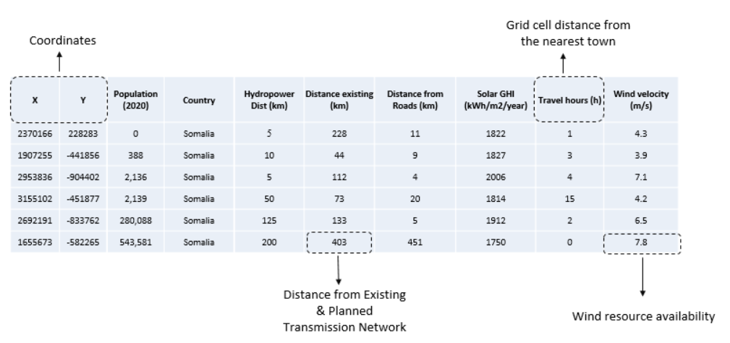
5.1 The Seven step methodology
Step 2. Use GIS techniques to extract useful information for the analysis
Source: Sahlberg et al. 2021
Picture source: Khavari et al. 2021, image, license under CC-BY 4.0
Notes:
In the next step, we combine all of these geospatial data that we have collected so far and we extract them for every single settlement in the area that we are studying.
We are combining the G.I.S into a CSV file which is used in the OnSSET tool. The CSV file looks like this picture where every row represents one settlement. For every settlement, there are a number of different things we know. To start with, we have the X and Y coordinates which indicate where the settlement is located. We also have some information about the population in the settlement. Another column covers the distance from mini-hydropower for each settlement and how much power could be generated from that resource. We also calculate the distance to the closest main road and the distance to the closest existing medium and high voltage line. Furthermore we identify the locally available resources. In the table every row represents one location and all of the attributed information that we get from the geospatial data.

Slide 6
5.1 The Seven step methodology
Step 3a. Collect country-specific data (Social)
Parameter | Metric | Base Year Value | Value 2030
Population, total | Million Persons | 42.5 | 65.4
Urban population | Per cent of total population | 25 % | 32%
Rural population | Per cent of total population | 75% | 68%
Electricity access, Total | Per cent of total population | 31% | 100%
Electricity access, Urban | Per cent of urban population | 80% | 100%
Electricity access, Rural | Per cent of rural population | 15% | 100%
Household size, Urban | People per household | 5 | 4
Household size, Rural | People per household | 7 | 6
Source: Sahlberg et al. 2021
Picture source: Khavari et al. 2021, image, license under CC-BY 4.0
Notes:
Next, we also need a number of non-geospatial data. First of all, we need to collect demographic parameters for the country or the region that we are studying.
1. We need to know what the total population is according to the latest population estimate or the latest population census. We collect that information for the start year of our analysis, which can be, for example, 2020.
The population data also need to project growth until the end of our analysis. In this case, it could be 2030.
2. Apart from the population we also need to know how many per cent of the population lives in urban locations in the start year as well as in the end year. This will give us both the urban and rural share.
3. We also need to know the average household size in urban areas and in rural areas. This dataset is used to calculate the approximate number of buildings in the village.
Finally, a key dataset concerns how many people have access to electricity today. In this example here, we have 31 per cent, meaning 69 per cent don't have access to electricity today. In addition, we break it down further to how much of the rural and urban population has access to electricity.
The OnSSET tool's main objective is to electrify the un-electrified population and, in the example here, we aim for universal access to electricity by 2030 by setting all of the electricity access rate targets at 100 per cent.

Slide 7
5.1 The Seven step methodology
Step 3b. Collect country-specific data (Technology specifications & Costs)
Plant type | Typical Plant capacity (kW) | Investment cost ($/kW) | O&M costs (% of investment cost/year) | Fuel cost $/litre | Efficiency | Capacity factor | Life (years)
Diesel Genset Mini-Grid | 100 | 721 | 10% | 0.50 | 33% | 0.7 | 15
Small Hydro Mini-Grid | 1000 | 5,000 | 2% | - | - | 0.7 | 30
Solar PV Mini-Grid | 100 | 3,200 | 1.5% | - | - | Obtained for each grid point depending on solar availability | 20
Wind Turbines Mini-Grid | 100 | 3,000 | 2% | - | - | Obtained for each grid point depending on wind availability | 20
Diesel Genset Stand-Alone | 1 | 938 | 10% | 0.50 | 28% | 0.7 | 10
Solar PV Stand-Alone | 0.4 | 5,500 | 1.2% | - | - | Obtained for each grid point depending on solar availability | 15
Source: Sahlberg et al. 2021
Picture source: Khavari et al. 2021, image, license under CC-BY 4.0
Notes:
Next, we need to collect information about technology specifications and costs.
In this slide we see the off-grid options that we include in the model, both for mini-grid and stand-alone technologies. There are a number of different pieces of information that we collect, and we can see that it varies a bit for the different technologies. First of all, we are collecting information about the investment cost, in dollars per kilowatt of installed capacity, for the different technologies. We can see in the table that a mini-grid diesel generator costs on average 721 dollars per kilowatt of installed capacity.
To determine the right power plant related cost we define a typical plant capacity. The OnSSET model is able to take different plant capacities into account. The cost per kilowatt of installed capacity is normally lower for the larger system due to economies of scale. This is especially true for solar PV stand-alone systems. The second cost we consider is the operation and maintenance cost. We define it as a per cent of the investment cost per year.
Next, we collect information about fuel cost in dollars per litre. In addition to the fuel cost, the model also calculates a transportation cost for more remote settlements. This means that the cost of diesel will increase a bit depending on the cost of transporting diesel there. And we can see that for all of the other technologies, we do not have a fuel cost. This is because the renewable energy resource does not have any fuel cost.

Slide 8
Lecture 5.1 References
Sahlberg, A., Khavari, B., Korkovelos, A., Mentis, D., n.d. Lecture 3: Application of GIS in electrification analysis in the OnSSET tool [WWW Document]. OnSSET Teaching Kit. URL https://onsset.github.io/teaching_kit/courses/module_2/Lecture%203/ (accessed 2.18.21).

Slide 9
5.2 Acquire the data
Step 3b. Collect country-specific data (Technology specifications & Costs)
Plant type | Typical Plant capacity (kW) | Investment cost ($/kW) | O&M costs (% of investment cost/year) | Fuel cost $/litre | Efficiency | Capacity factor | Life (years)
Diesel Genset Mini-Grid | 100 | 721 | 10% | 0.50 | 33% | 0.7 | 15
Small Hydro Mini-Grid | 1000 | 5,000 | 2% | - | - | 0.7 | 30
Solar PV Mini-Grid | 100 | 3,200 | 1.5% | - | - | Obtained for each grid point depending on solar availability | 20
Wind Turbines Mini-Grid | 100 | 3,000 | 2% | - | - | Obtained for each grid point depending on wind availability | 20
Diesel Genset Stand-Alone | 1 | 938 | 10% | 0.50 | 28% | 0.7 | 10
Solar PV Stand-Alone | 0.4 | 5,500 | 1.2% | - | - | Obtained for each grid point depending on solar availability | 15
Source: Sahlberg et al. 2021
Picture source: Khavari et al. 2021, image, license under CC-BY 4.0
Notes:
Now we are going to look at the efficiency of the generator. We include the efficiency for the diesel technologies, but not for the renewable technologies. The reason is that we use the efficiency to calculate how much fuel is needed to generate the required electricity. As we don’t have a fuel cost for hydro, solar, or wind technologies, we do not need the efficiency for those.
However, we define the capacity factors for the renewable technologies. The capacity factor relates to how much electricity can be generated in a year compared to the maximum generation (which is the maximum capacity multiplied by number of hours per year).
We estimate that a diesel generator can produce up to 70 per cent of full capacity. The reason we don't expect the diesel generators to operate at their full capacity all of the time is partly due to operational maintenance and other downtime.

Slide 10
5.2 Acquire the data
Step 3b. Collect country-specific data (Technology specifications & Costs)
Plant type | Typical Plant capacity (kW) | Investment cost ($/kW) | O&M costs (% of investment cost/year) | Fuel cost $/litre | Efficiency | Capacity factor | Life (years)
Diesel Genset Mini-Grid | 100 | 721 | 10% | 0.50 | 33% | 0.7 | 15
Small Hydro Mini-Grid | 1000 | 5,000 | 2% | - | - | 0.7 | 30
Solar PV Mini-Grid | 100 | 3,200 | 1.5% | - | - | Obtained for each grid point depending on solar availability | 20
Wind Turbines Mini-Grid | 100 | 3,000 | 2% | - | - | Obtained for each grid point depending on wind availability | 20
Diesel Genset Stand-Alone | 1 | 938 | 10% | 0.50 | 28% | 0.7 | 10
Solar PV Stand-Alone | 0.4 | 5,500 | 1.2% | - | - | Obtained for each grid point depending on solar availability | 15
Source: Sahlberg et al. 2021
Picture source: Khavari et al. 2021, image, license under CC-BY 4.0
Notes:
If we focus on the renewable technologies instead, the capacity factor relates to the availability of the energy resources. For solar panels, for example, the sun is not always shining, so it cannot always produce electricity. In addition, during the day it will produce at its maximum capacity, but in the mornings or late afternoons it might produce electricity, but below its maximum capacity because the solar resource is not as strong. During nighttime, the PV panels will not produce electricity at all. This means that the capacity factor for these renewable technologies are dynamic in the OnSSET tool. We calculate depending on the local resource availability from the geospatial data.
Finally, we need to define the technology lifetime. As an example, we can expect PV panels, for example, to produce electricity for 20–25 years.

Slide 11
5.2 Acquire the data
Step 3b. Collect country-specific data (Technology specifications & Costs)
Parameter | Capital cost
HV lines (69 kV or above) | 53,900 $/km
MV lines (33 kV) | 9,000 $/km
LV lines (220 V) | 5,000 $/km
HV/MV transformer | 10,000 $ per unit
Service transformer | 5,000 $ per unit
Transmission losses | 18%
Connection cost per household | 125 $/connection
Cost of producing electricity | 0.05 $/kWh
Source: Sahlberg et al. 2021
Picture source: Khavari et al. 2021, image, license under CC-BY 4.0
Notes:
Next, we also need to know some information about the transmission and distribution network costs, which relate to the costs of grid produced electricity.
There are different types of transmission lines: high voltage lines, medium voltage lines, and low voltage lines.
The definition of high voltage line is case specific and needs to be defined within the area that you're studying. What is the kilovoltage and what are the investment costs of these lines? In some cases, the high voltage line at 69 kilovolt costs around
54,000 dollars per kilometer. For a specific medium voltage line, for example 33 kilovolts, we have an estimated cost of 9,000 dollars per kilometer. Then we have the low voltage line with a cost of approximately 5,000 dollar per kilometer.
We also need information about the transformer costs from high voltage to medium voltage and the distribution transformers within the distribution network to the customers. In addition, there are also transmission and distribution losses in the network. When looking at developed countries the losses are quite low. However, in developing countries losses can be around 15–20%. We also need information about the connection cost per household when you connect a household to a mini-grid or a grid. And finally, the OnSSET model needs to know the cost of producing electricity on average from the national grid.

Slide 12
5.2 Acquire the data
Step 3c. Collect country-specific data (Energy Access Target)
Access Level | Tier 1 | Tier 2 | Tier 3 | Tier 4 | Tier 5
Indicative appliances powered | Task lighting + phone charging or radio | General lighting + fan + television | Tier 2 + medium power appliances (i.e., general food processing, refrigeration) | Tier 3 + medium or continuous appliances (i.e., water heating, ironing, water pumping, rice cooking, microwave) | Tier 4 + high power and continuous appliances (i.e., air conditioning)
Consumption per capita & year (kWh) | 8 | 44 | 160 | 423 | 598
Consumption per urban household/year (based on average household size: 5) | 40 | 220 | 800 | 2,115 | 2,990
What should be the electricity consumption level per household?
Friday, May 10, 2019
Adapted from Global Tracking Framework, 2015
Source: Sahlberg et al. 2021
Picture source: Khavari et al. 2021, image, license under CC-BY 4.0
Notes:
Finally, we need to define what is the electricity demand that we are targeting in the end year? In the table we see the multi-tier framework of energy access developed by ESMAP (Energy Sector Management Assistance Program). In OnSSET we want to estimate the electricity consumption level per household. These tiers relate to different types of electricity services and their associated appliances and consumption levels. Electricity access is not a binary, yes or no question. Instead, there is this tiered energy ladder with different levels of energy services. Tier 1 access is just enough electricity for some light bulbs and phone charging. This means you need just a few kilowatt hours per household per year. Tier 2 you have maybe an electric fan or a TV, and the number of kilowatt hour of electricity needed in the year increases. At tier 3 some general food processing or refrigeration is included. The electricity consumption level per household increases depending on the appliances. Tier 5 is the highest tier with 3,000 kilowatt hour per household per year. The consumption can be decreased, but deliver the same service level, if you start using more efficient appliances.
The tiers only cover the residential demand; however, the tool is also flexible in that it can include demands for other sectors such as commercial uses, social uses (health facilities, schools), and agriculture (irrigation or post harvest processing).
In summary for the data acquisition we use around 15 to 20 geospatial datasets and around 150 other input variables which we have described in this mini-lecture.

Slide 13
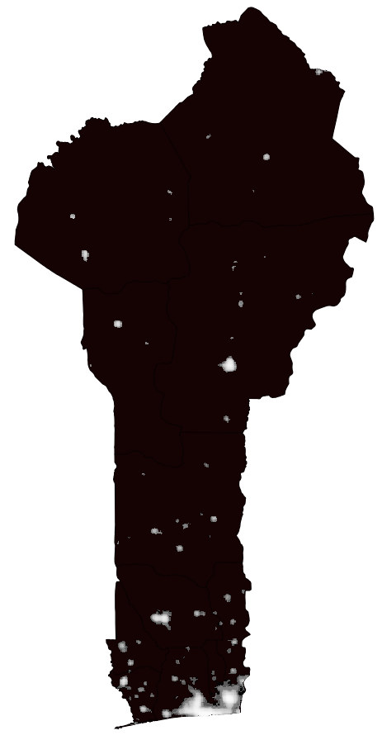
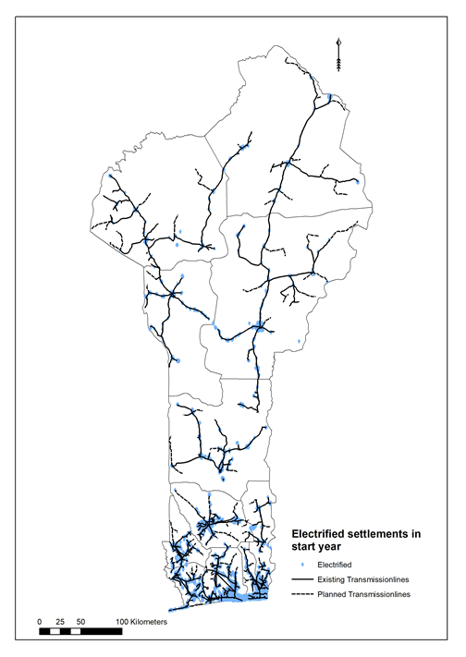
5.2 Acquire the data
Step 4. Data Processing, Projection, and Calibration
Identify current electrification status:
Night Lights index: >0.05
Population: >50 people
Distance from grid: <5 km
Source: Sahlberg et al. 2021
Picture source: Khavari et al. 2021, image, license under CC-BY 4.0
Picture source: Sahlberg et al. 2018, image
Notes:
Now we are going to look into the data preparation, processing, and calibration.
In step four we start by using all of the geospatial data that we have extracted, and the non-geospatial data to calibrate the model for the start year. One of the key steps here is that we calibrate the population to understand which settlements are urban and rural. The method used to do this involves defining an urban settlement based on certain criteria, such as a settlement with at least 50, 100 people or 5,000 people, or a certain settlement size and close to the existing road network. These criteria often vary between countries, so there's no universal definition of urban versus rural settlement. The way that the OnSSET model works by default is that it classifies the most densely populated and largest settlements as urban to match the national statistics. If your data say that 20 per cent of the population is urban in the start year, the model will take the settlements with the largest population and classify those as urban and the rest as a rural.

Slide 14
Lecture 5.2 References
Sahlberg, A., Khavari, B., Korkovelos, A., Mentis, D., n.d. Lecture 3: Application of GIS in electrification analysis in the OnSSET tool [WWW Document]. OnSSET Teaching Kit. URL https://onsset.github.io/teaching_kit/courses/module_2/Lecture%203/ (accessed 2.18.21).

Slide 15
5.3 Prepare the required data, processing and calibration
Step 4. Data Processing, Projection, and Calibration
Identify current Electrification status:
Night Lights index: >0.05
Population: >50 people
Distance from grid: <5 km
Source: Sahlberg et al. 2021
Picture source: Khavari et al. 2021, image, license under CC-BY 4.0
Picture source: Sahlberg et al. 2018, image
Notes:
Next, we also need to identify which settlements already have access to electricity and which do not. This sets the basis for our analysis, so we can understand where there is access to electricity today and where we need to extend the technology to provide access to electricity in the future. In the best case, there would have been mapping done that identifies exactly where the grid networks are, where existing mini-grids are, and where stand-alone technologies have been deployed. Usually we do not have access to all of this information. Instead, we try and calibrate the model to reflect the start year based on geospatial data that we collected.
We use three different datasets: population dataset, nighttime lights, and electricity infrastructure. In the picture to the left you can see the nighttime light which is a satellite image captured during the night detecting where there is light. If there is light this often indicates electricity usage. We combined the population data with the nighttime lights data and also the existing electricity infrastructure data (picture to the right). Depending on the level of detail we have (high voltage, medium voltage, transformers) we assume that people have access to electricity if within a certain distance from the electricity infrastructure.
Once the current electrification rate has been entered into the model, the model iteratively tries to match the current electrification rate by adjusting these thresholds (distance to electricity infrastructure, population density, and nighttime light).

Slide 16
5.3 Prepare the required data, processing, and calibration
Step 5. Calculate off-grid technology costs for every settlement in the country
Source: Sahlberg et al. 2021
Picture Source: Mentis et al. 2017, image licensed under CC-BY 3.0
Notes:
When we have calibrated the model to make it reflect the start year conditions accurately, and we have defined our demand levels, we move onto the next step.
Now we want to calculate the technology costs in order to find the least-cost solutions. We start by comparing all of the different technologies that we are considering in the study. This include stand-alone PV and diesel, as well as mini-grid technologies powered by different energy resources.

Slide 17
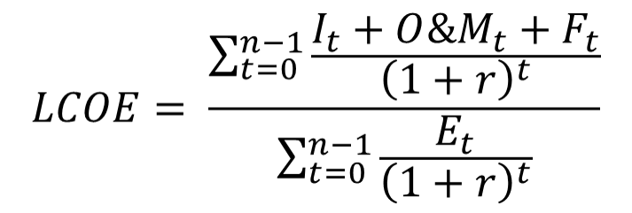
5.3 Prepare the required data, processing, and calibration
Levelized Cost of generating Electricity (LCOE)
The LCOE from a specific source represents the final cost of electricity required for the overall system to break even over the project lifetime.
I_{t}: Investment expenditure for a specific system in year t,
O&M_{t}: the operation and maintenance costs,
F_{t}: the fuel expenditures,
E_{t}: the generated electricity,
r: the discount rate,
n: the lifetime of the system.
Picture Source: Mentis et al. 2017, image licensed under CC-BY 3.0
Source: Sahlberg et al. 2021
Notes:
The way we compare technologies is by using the levelized cost of generating electricity (or L.C.O.E). The L.C.O.E identifies the cost of electricity at which each system needs to sell in order to not make monetary loss. The L.C.O.E takes into account the investment costs required to buy and install a system, and the operation and maintenance costs for each year in order to keep the system running efficiently. It also includes the fuel costs in case we need to buy fuel to produce the electricity. The cost is then divided by how much electricity is generated by the system. By adding up all of these costs and dividing them by the electricity generated, accounting for the discount rate and system lifetime, we get a cost in dollars per kilowatt hour of electricity generated in order for the system to break even. The slide shows this calculation as a formula.
The L.C.O.E is a good way of comparing technologies that have different cost structures. One technology might have a high investment cost but lower costs during the following years, while another technology might have lower investment cost but higher running costs during the lifetime. With the L.C.O.E we can compare different technologies and identify the one with the lowest cost.

Slide 18
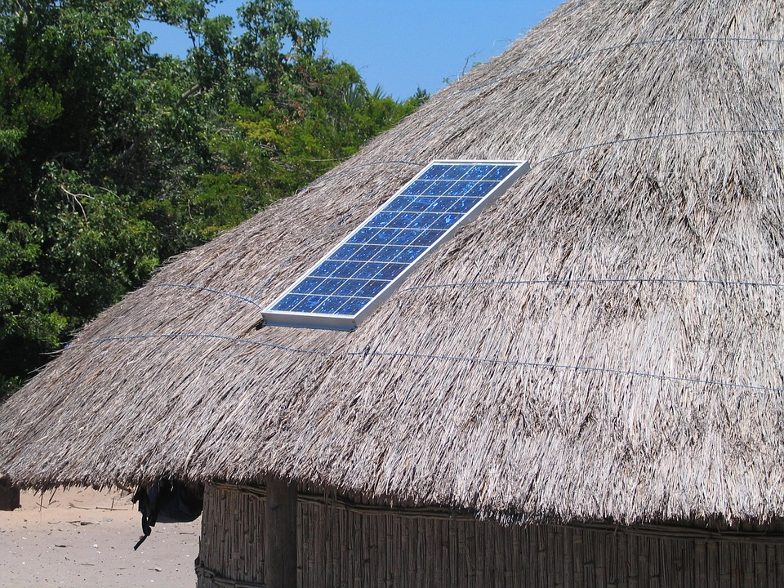
Example of stand-alone PV cost
5.3 Prepare the required data, processing, and calibration
The cost per Solar Home System (SHS) multiplied by the number of households
Example: If 1 SHS costs 200 USD, the total investment cost will be: 6 x 200 = 1,200 USD
The cost per SHS depends on the size of the system
Picture source: Khavari et al. 2021, image, license under CC-BY 4.0
Source: Sahlberg et al. 2021
Notes:
Here we have an example looking at stand-alone systems. That means that every customer will use their own system. If we have a small village where we are looking at the cost of supplying electricity by solar home systems, we need to find out which type of solar system is needed to meet the demand in the household, and how many households are in the village. The cost of the system will simply be the solar home systems for each of the households. Of course, if we have a high demand, we need a large solar home system for each household. If we have a lower demand, we can use a smaller solar system.

Slide 19
Example of mini-grid costs
5.3 Prepare the required data, processing, and calibration
Cost of generation system
PV panels
Batteries
BoS (inverter, charge controller, battery bank, etc.)
The cost of the distribution system
Low-Voltage (LV) lines
Medium-Voltage (MV) lines
Cost per connection per household…
Example: If the distribution grid requires 2 km of LV lines and the cost per LV lines is 5000 USD/km, the total cost for LV lines in the settlement is 10,000 USD
Source: Sahlberg et al. 2021
Picture source: Khavari et al. 2021, image, license under CC-BY 4.0
Notes:
If you look at a mini-grid, we have a slightly different design. Instead of providing solar panels for every single household we install one larger generation site. The mini-grid could be powered by diesel, hydro, wind, or a combination of these three sources. Depending on the size of the village, economy of scale can justify the larger investment. If we install renewable resources, they are usually intermittent which then needs to be supported by batteries. But what sets the mini-grids apart from the stand-alone costs are that we also need to build a distribution network. We need to get the electricity from where it is generated to each household. In the stand-alone example, every household had their own generation, so there was no need for a distribution network. But here, the generation source is not directly at the customer, so we need a network to distribute electricity to the households. The area of the settlement affects the demand for distribution network. The model estimates how many lower voltage lines are needed to connect all of the customers and if a medium voltage line is required. In addition there is a connection cost per household. None of these additional infrastructure costs are part of the stand-alone costs.

Slide 20
Lecture 5.3 References
Sahlberg, A., Khavari, B., Korkovelos, A., Mentis, D., n.d. Lecture 3: Application of GIS in electrification analysis in the OnSSET tool [WWW Document]. OnSSET Teaching Kit. URL https://onsset.github.io/teaching_kit/courses/module_2/Lecture%203/ (accessed 2.18.21).

Slide 21
5.4 OnSSET calculations and summaries
Identify least-cost off-grid electrification options
Mini-grid PV/Diesel: 0.32 USD/kWh​
Mini-grid Wind/Diesel: 0.60 USD/kWh​
Mini-grid Hydro: - USD/kWh​
Stand-alone PV: 0.40 USD/kWh​
In every location, select the technology with the lowest cost (LCOE)
Mini-grid PV/Diesel: 1.40 USD/kWh
Mini-grid Wind/Diesel: 1.60 USD/kWh
Mini-grid Hydro: - USD/kWh
Stand-alone PV: 0.40 USD/kWh
Mini-grid PV/Diesel: 0.32 USD/kWh
Mini-grid Wind/Diesel: 0.60 USD/kWh
Mini-grid Hydro: 0.25 USD/kWh
Stand-alone PV: 0.40 USD/kWh
Source: Sahlberg et al. 2021
Picture source: Khavari et al. 2021, image, license under CC-BY 4.0
Notes:
Here is an example with more details on the costs. For each and every location within the study area, we calculate the cost of the different off-grid technologies. Here we see the L.C.O.E, and we can see in the larger settlement to the right we have calculated different costs for different systems. A solar hybrid mini-grid would produce at 32 cents/kilowatt hour compared to a wind hybrid mini-grid in this location, which would be higher at 60 cent/kilowatt hour. This settlement is located close to a river which leads to a low L.C.O.E for the hydro mini-grid at 25 cent per kilowatt hour.
If we instead look at the smaller settlement to the bottom left, we will see different costs for different technologies. In a smaller settlement there is a lower demand due to lower population density. We can see that the L.C.O.E calculation shows that all mini-grid options have a relatively high cost per kilowatt hour. You can see that there is no value for the hydro-based grid in this location as there are no hydro resources nearby. In this location we can see that stand-alone PV, highlighted in red, would be the least-cost technology option in this location.
And to the top left we see another location where we have calculated the L.C.O.E for all the off-grid technologies. In this location, taking into account the local characteristics in terms of population demand and energy resources, a PV/Diesel hybrid mini-grid would be least-cost electrification option.

Slide 22
5.4 OnSSET calculations and summaries
Step 6. The electrification algorithm – Grid extension or off-grid?
Source: Sahlberg et al. 2021
Picture Source: Mentis et al. 2017, image CC-BY 3.0
Notes:
Once we have calculated all the off-grid options, we have identified which is the least-cost off-grid option. Now we need to identify the least-cost option for grid to each settlement.

Slide 23
5.4 OnSSET calculations and summaries
Existing/planned HV line
Example of grid connection cost
The cost of grid-connection depends on:
The distribution network
The new MV line required to connect the settlement
The cost of electricity generated (or imported) for the grid
New MV line
Example: If the new MV line is 3 km and the cost of MV lines is 9,000 USD/km, the total cost of the new line is 27,000 USD
Source: Sahlberg et al. 2021
Picture source: Khavari et al. 2021, image, license under CC-BY 4.0
Notes:
This is called the electrification algorithm which compares grid extension to the least-cost of grid technology. When we look at the cost of connection to the centralized grid, we follow a similar approach as the previous technologies to calculate the L.C.O.E. However, there are some additions. We need to know where the existing infrastructure is to calculate the cost of connecting a new settlement to it.
When we extend a medium voltage line from the existing grid infrastructure, we need to define how long it has to be. Depending on how far away the settlement is from the existing infrastructure, we can calculate the cost per kilometer of these medium voltage lines. Similar to the mini-grid network, we need to have a distribution network within the settlement using low voltage lines and potentially a medium voltage line, depending on its size and demand levels.
Finally, we also need to include the cost of the electricity that is produced by the national power plants. In summary, we have the extension of the grid to connect the settlement, the cost of building the distribution network, and the cost of buying electricity from the central grid. All of these costs combined are the cost for a grid to a settlement. Again, we follow a similar approach where we calculate investment costs for extension and the distribution network and take into account the operation and maintenance costs of all of these technologies. One important aspect here is that we use the cost of generated electricity as a fuel cost, as we need to buy that from the grid connected power plants.

Slide 24
5.4 OnSSET calculations and summaries
Location B Off-grid = 0.25 USD/kWh
The grid-extension algorithm
Grid extension = 0.40 USD/kWh
Too expensive
Location A Off-grid = 0.30 USD/kWh
Existing/ Planned network
Grid extension = 0.25 USD/kWh
Location C Off-grid = 0.20 USD/kWh
Source: Sahlberg et al. 2021
Picture source: Khavari et al. 2021, image, license under CC-BY 4.0
Notes:
The core of the OnSSET model is the grid extension algorithm. We see in the picture here on the left, we have the existing or the already planned infrastructure that has been committed to. On the right we have three different settlements or locations which are to be electrified. For these locations, we have already calculated the off-grid technology costs. We know the L.C.O.E of the least-cost electrification technology in the settlements. In the example here, we have different L.C.O.E depending on local characteristics where we see that location C, as an example, would have a very low cost. Location A would have a slightly higher cost if electrified by off-grid technologies.
Next, we calculate what would be the L.C.O.E of a grid extension. We start at the existing network and the cost of extending it to location B. We calculate the cost based on the extension cost, the distribution network costs, and the consumption of electricity. Connecting location B to the existing network from the closest point would cost 40 cents per kilowatt hour. However, 40 cents per kilowatt hour is more expensive than what could be achieved by off-grid technology. In this example, that would be about 25 cents per kilowatt hour. This grid extension would not be able to compete in this model.
The next step in the extension algorithm is that it goes to check for the next settlement. In this case to extend to Location A the grid extension would cost 25 cents per kilowatt hour. We see that the costs of extending the grid to connect this settlement is lower than the costs of supplying it with an off-grid technology, which means the model identifies this as a settlement which will be connected to the grid.

Slide 25
5.4 OnSSET calculations and summaries
Location B Grid = 0.20 USD/kWh
The grid-extension algorithm
Grid extension = 0.40 USD/kWh
Too expensive
Location A Off-grid = 0.30 USD/kWh
Grid-extension = 0.20 USD/kWh
Existing/ Planned network
Grid-extension = 0.25 USD/kWh
Too expensive
Grid extension = 0.25 USD/kWh
Location C Off-grid = 0.20 USD/kWh
Grid extension = 0.45 USD/kWh
Too expensive
Source: Sahlberg et al. 2021
Picture source: Khavari et al. 2021, image, license under CC-BY 4.0
Notes:
Next, once the model identifies the cost effectiveness of a grid extension to Location A, we can see if we can keep building the network to connect settlements that are located further away. Connecting location B to the grid through location A we will have a new shorter distance to build. Therefore, the cost is the distance between location A and B and not the distance from the currently existing network to location B.
This will reduce the extension distance. We get another L.C.O.E whereby we see that grid extension would cost 20 cents per kilowatt hour, which is lower than the cost for off-grid technologies in location B.
The model chooses to connect this settlement as well. We then checked from the existing network to location C and from location A to location C. And we see that in all of these cases, the cost of grid extension is higher than the cost of off-grid technologies. This means that location C will remain electrified by off-grid technologies in this iteration. In the next iteration Location B will assess grid extension to Location C, as Location B is now electrified by grid.
The grid extension algorithm iterates through all of the settlements in the area that we're studying, and when it adds more settlements to connect to the grid, it also checks if it can connect further settlements from the new electrified locations.

Slide 26
Lecture 5.4 References
Sahlberg, A., Khavari, B., Korkovelos, A., Mentis, D., n.d. Lecture 3: Application of GIS in electrification analysis in the OnSSET tool [WWW Document]. OnSSET Teaching Kit. URL https://onsset.github.io/teaching_kit/courses/module_2/Lecture%203/ (accessed 2.18.21).

Slide 27
Thank you for your attention in this lecture!
22

Slide 28
Take Quiz
Moksnes N., Sahlberg A., Khavari B. 2021. Lecture 5: OnSSET/Global Electrification Platform. Release Version 1.0. [online presentation]. Climate Compatible Growth Programme, Energy Sector Management Assistance Program and World Bank Group
CCG courses (this will take you to the website link http://www.ClimateCompatibleGrowth.com/teachingmaterials)

