Slide 1
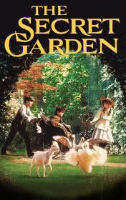
The Secret Garden
A graded reader for PI TEs
With questions
By Frances Hodgson Burnett
Source English e-Reader https://english-e-reader.net/

Slide 2
The Secret Garden
Little Miss Mary - Chapter 1
Vocabulary check: Chapter 1 = moor, secret, crooked
1. Pre-reading: What does ‘secret’ mean ?
2. Post-reading: What happens to Mary in chapter 1 ?
3. What is Mary like ?

Slide 3
Mary in Yorkshire - Chapter 2
Vocabulary Check: shadowy/dialect/disagreeable/spade
1. While: Think about the differences between Mary’s life in India & her life in Yorkshire.
2. Post: Discuss your opinions about Mary’s life in India and in Yorkshire.

Slide 4
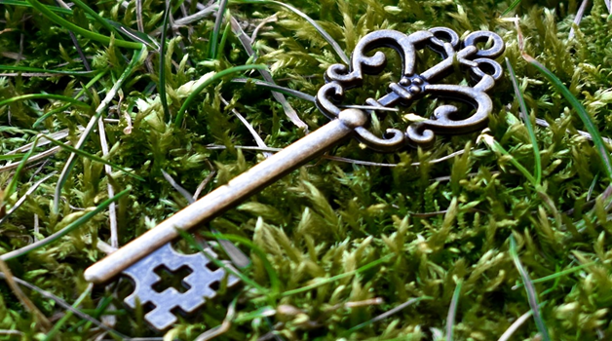
Finding the Secret Garden - Chapter 3
Vocabulary check: keyhole
1.Pre: What do you think Mary will find inside the secret garden ?
2. While: How does Mary enter the secret garden ?
3. Post: What is inside the secret garden ?

Slide 5
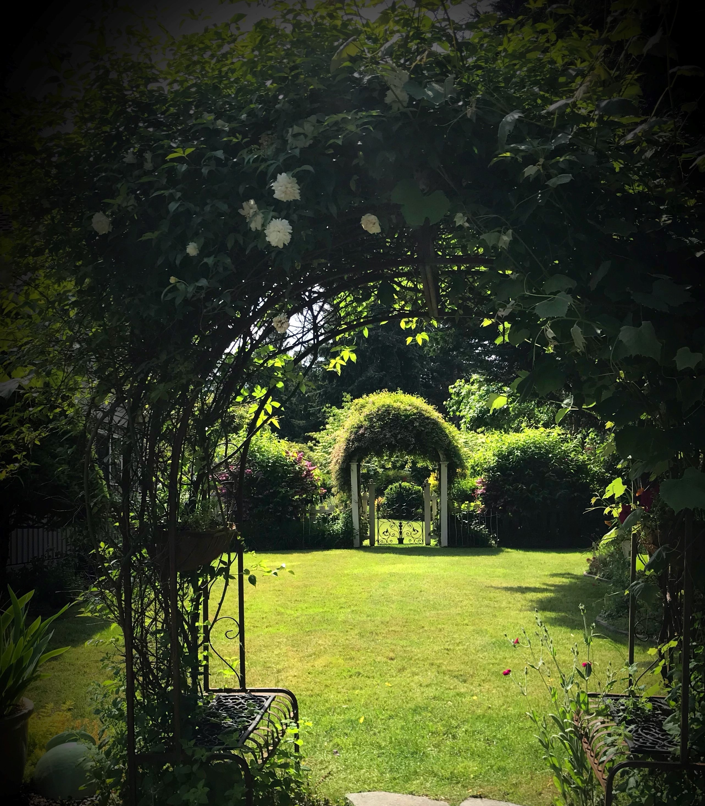
Meeting Dickon - Chapter 4
1. While: Who is Dickon ?
2. Post: What does Dickon look like ?
3. What’s Dickon like ?

Slide 6
Meeting Colin - Chapter 5
Vocabulary check: housekeeper
1. While: Mary hears crying – Who is crying ?
2. Post: What’s Colin like ?
3. Who is Colin’s father ?

Slide 7
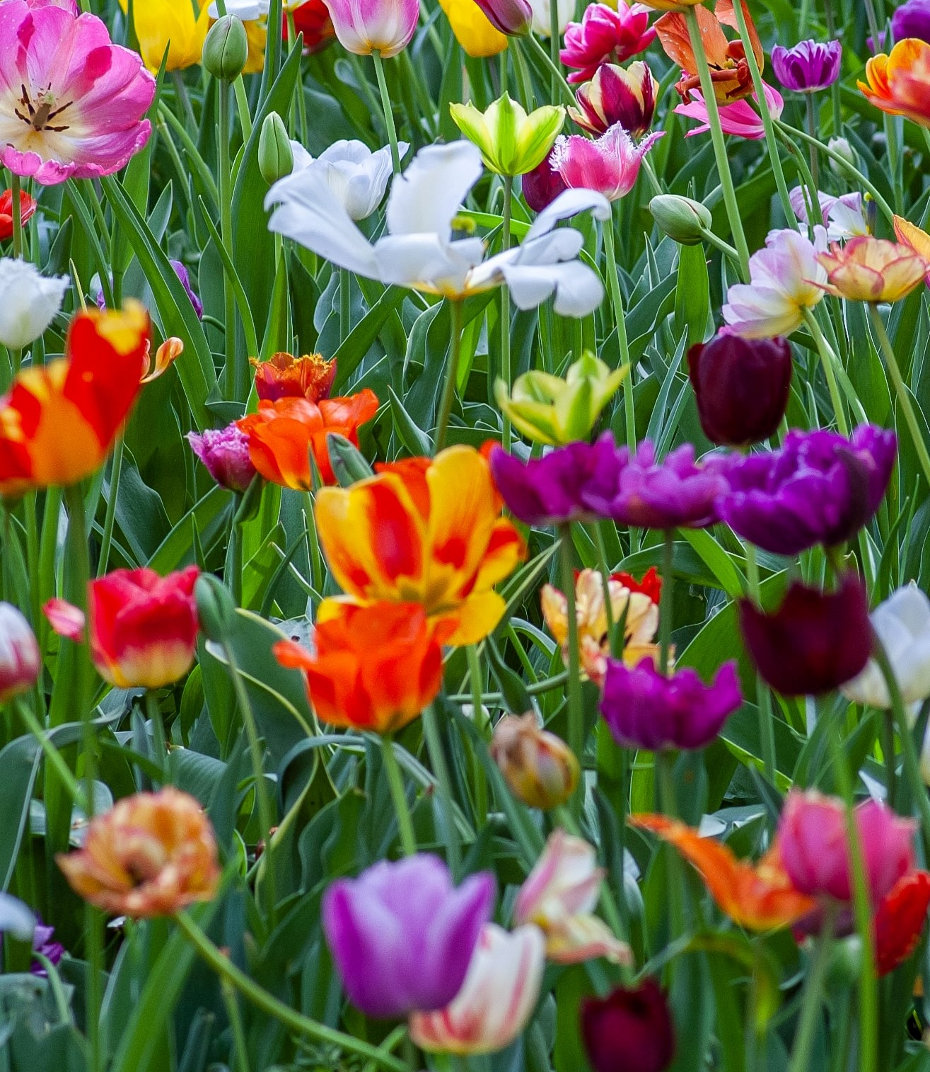
Colin is Afraid - Chapter 6
1. While: Why is Colin afraid ?
2. Post: What do Colin & Mary plan to do next ?

Slide 8
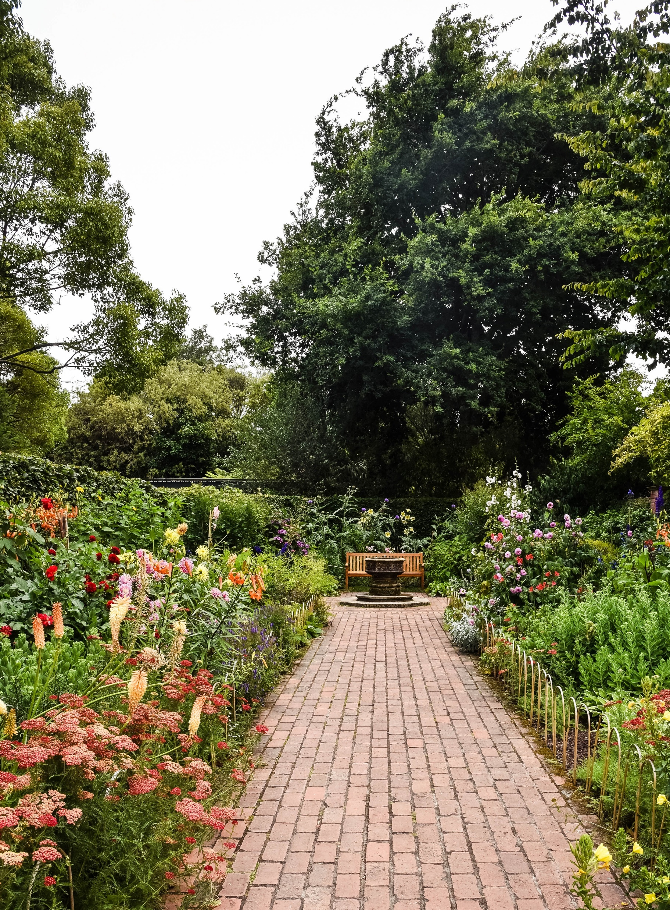
Colin & the Garden – Chapter 7
1. Pre: Where do Colin and Mary go ?
2. While: How do they feel when
they are in the garden ?
3. Post: Why does Colin get stronger ?

Slide 9
Mr. Craven Comes Home - Chapter 8
Vocabulary check: unbelieving
1. Predict - What’s the end of the story ?
2. Post: What’s the end of the story ?
3. How have Mary and Colin changed during the story ?

Slide 10
Adjectives to describe characters in the Secret Garden: Match the words with the opposites
Example: 1. kind cruel
2. selfish sad
3. happy generous
4. friendly unselfish
5. mean unfriendly

Slide 11
Adjectives to describe characters in the Secret Garden: ANSWERS Match the words with the opposites - ANSWERS
Example: 1. kind cruel
2. selfish sad
3. happy generous
4. friendly unselfish
5. mean unfriendly

Slide 12
Adjectives to describe characters in the Secret Garden: annotate ! Draw arrows to show the correct places for the words in yellow.
Example 1. kind unkind cruel
2. happy unselfish sad
3. selfish unhappy selfless

Slide 13
Adjectives to describe characters in the Secret Garden: ANSWERS !
Example 1. kind unkind cruel
2. happy unhappy sad
3. selfish unselfish generous

Slide 14
Adjectives to describe: Dickon - What’s Dickon like ? Discuss & annotate !
selfish unselfish generous
happy unhappy sad
kind unkind cruel

Slide 15
Adjectives to describe: Dickon 2. Think of some more adjectives to describe Dickon
selfish unselfish generous
Example: cheerful

Slide 16
Adjectives to describe Mary at the start of the book Discuss and Annotate !
selfish unselfish generous
happy unhappy sad
kind unkind cruel
Add more adjectives – to describe Mary: Example lonely

Slide 17
Adjectives to describe Mary at the end of the book
Write examples in the chat box.

