Slide 1
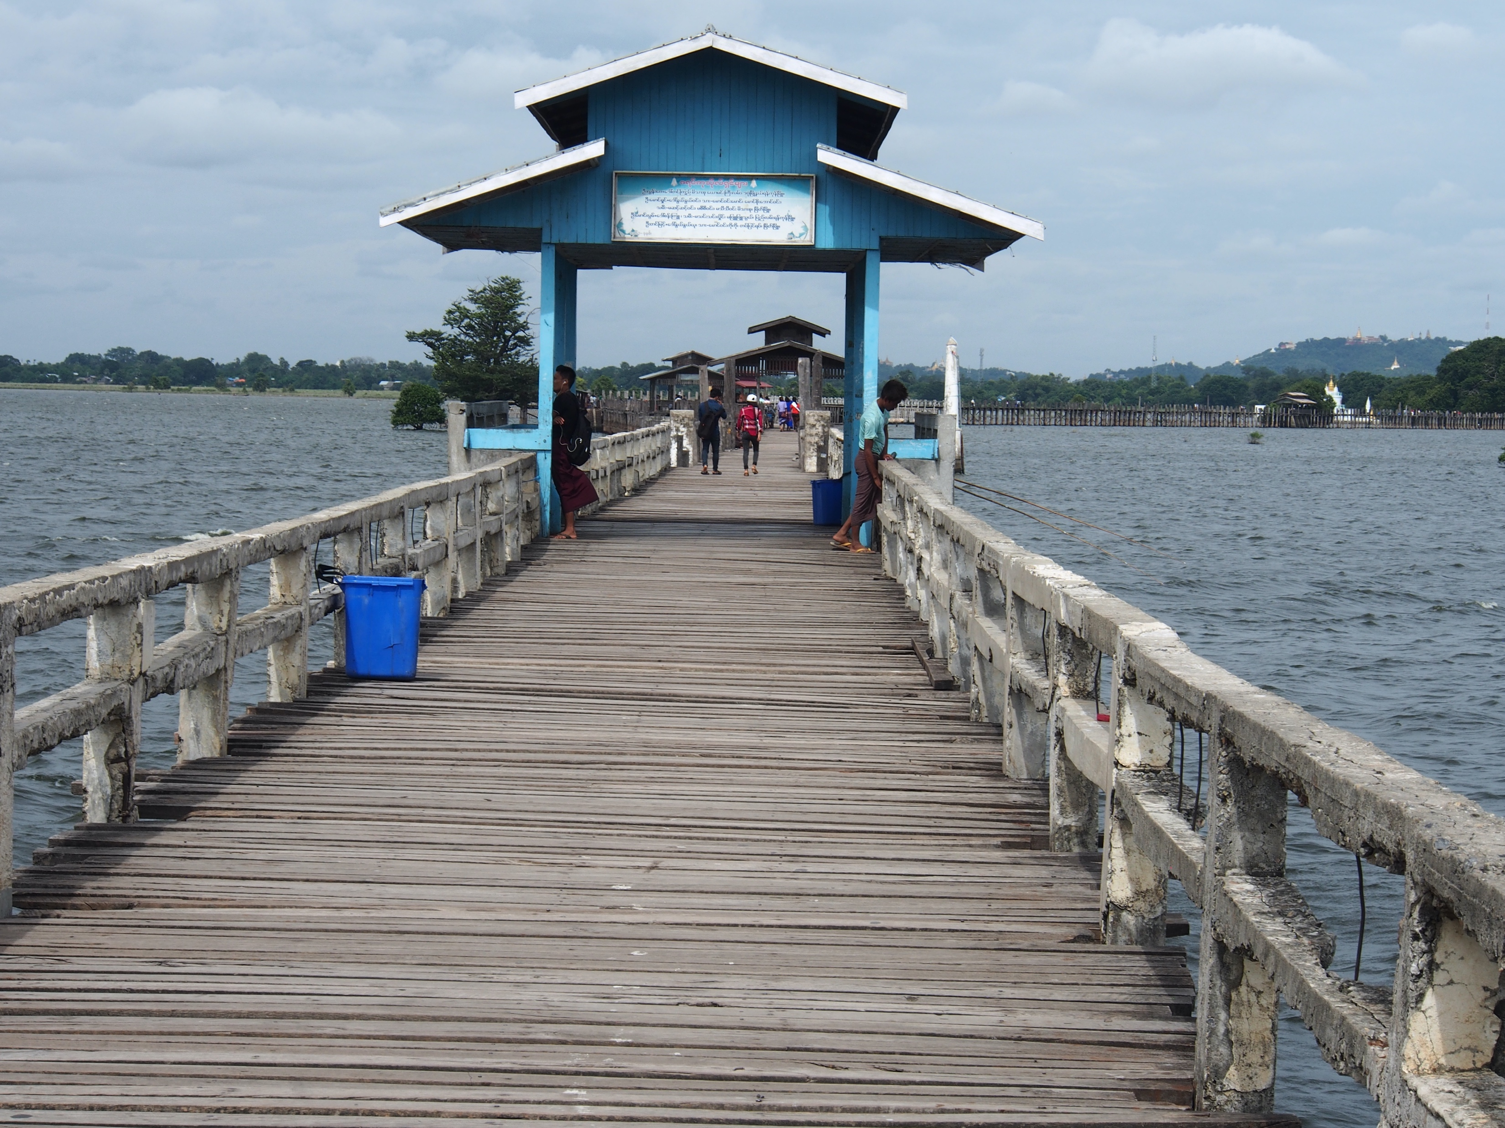
Aquascience: Assessing the health of rivers and lakes
Lecture 1: Introduction and physio-chemical monitoring
Photo by A. Bamford
Dr. Cecilia Medupin and Professor Amanda Bamford, University of Manchester

Slide 2
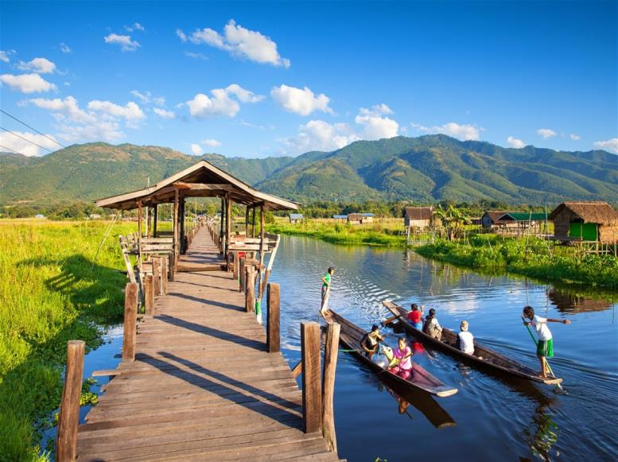
Freshwater Ecosystems
Inle Lake
https://www.lonelyplanet.com/
Dr. Cecilia Medupin
University of Manchester, UK

Slide 3
Introduction
Components of the freshwater ecosystems
Lakes, ponds; Rivers, streams
Monitoring and assessment
Physical and Chemical
Biological
Challenges of freshwater ecosystems
Environmental Regulation and Protection

Slide 4
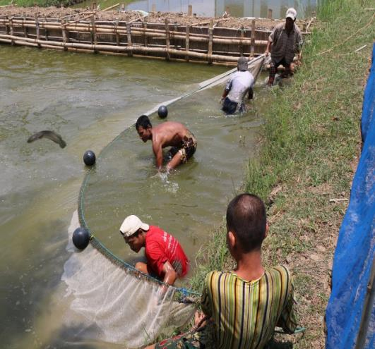
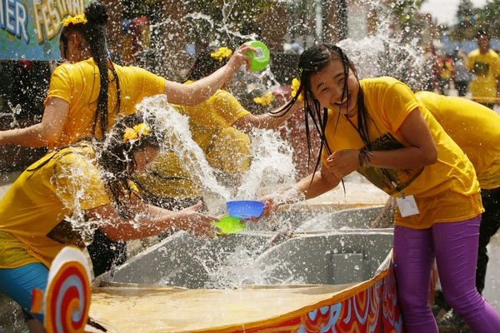
Freshwater Ecosystems
Water - the ‘medium of life’
Made up of lakes or ponds rivers or streams (surface waters); groundwater
Serves diverse purposes
Globally, freshwaters make up less than 1% in the hydrosphere.
Myanmar aquaculture
Myanmar water festival
http://blog.worldfishcenter.org/

Slide 5
Lakes (Standing water)
Inle lake
https://www.lonelyplanet.com/

Slide 6
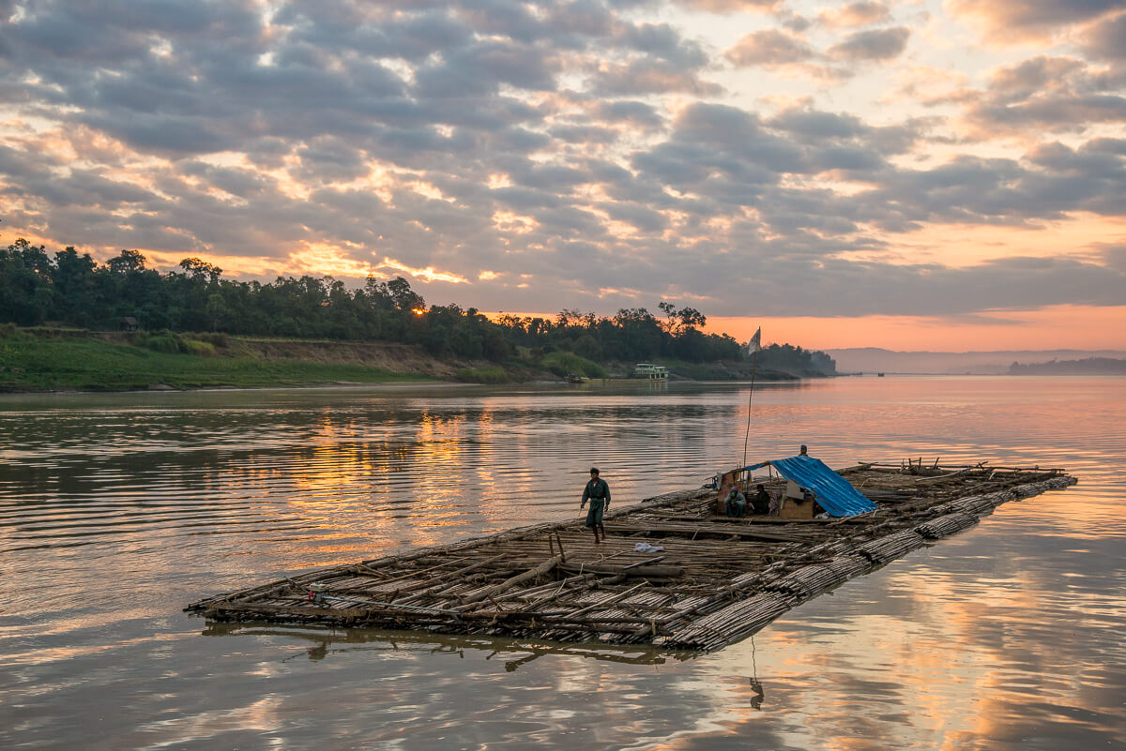
Rivers (Running water)
Chindwin River
Boat on the Chindwin by Jeffry J. Cotner [2015]; http://www.jeffcotner.com/2015/02/14/riverside/

Slide 7
What is in our freshwaters?
Categories | Approximate size ranges
Coarse Particulate Organic Matter (CPOM) | >1mm
Large woody debris | >64mm
Terrestrial leaves forming leaf packs | >16 to <64mm
Leaf, twig & bark fragments, needles, fruits, buds & flowers | >4 to <16mm
Plant and animal detritus, faeces | > 1 to < 4mm
Fine Particulate Organic Matter (FPOM) | > 0.5µm to < 1mm
Ultrafine particulate organic matter (including microbes) | > 0.45µm to <75µm
Dissolved Organic Matter (DOM) | < 0.45µm

Slide 8
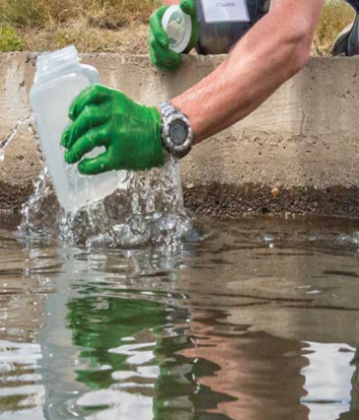
What do we measure? Physical & chemical variables
Physical variables
Dissolved Oxygen
Temperature
Light
Substrate
Riparian vegetation
Chemical variables
Conductivity
pH
Suspended solids
Macroelements and Microelements

Slide 9
What do we measure?
Dissolved oxygen
Important for all aerobic organisms.
Can increase in streams during the day due to photosynthetic activity.
Impoundments such as dams can reduce oxygen levels & increase levels of carbon dioxide.
Very low levels of oxygen are found in other conditions e.g. pollution, low flow or high temperature conditions.

Slide 10
What do we measure?
Temperature
All animals have a temperature range for which they can survive.
Affects the physiological processes such as respiration, digestion, length of life cycles or growth.
These animals have upper & lower tolerance limits, so that above or below these limits, the animals would eventually die
Salmonid species
http://www.necropsymanual.net/en/fish-groups/salmonids/

Slide 11
What do we measure?
Light
Major energy source in freshwater ecosystems
It is likely to influence plant populations
Based on the amount of energy produced by primary producers
This relationship forms the basis of the food chain.
Primary producers are able to produce their own food using light as an energy source

Slide 12
What do we measure?
Substrate
Provides a natural home for a variety of activities e.g. resting, movement.
Riparian vegetation
Influences the amount & nature of particular organic matter (litter) inputs to streams and rivers.

Slide 13
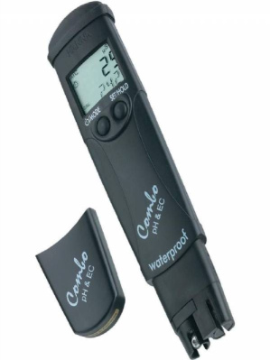
What do we measure?
pH measures the acidity of water
Conductivity which measures the total ionic content of aquatic systems.
Suspended solids- particulate materials suspended in freshwater
https://www.hydroponics.eu/digital-meter-hanna-instruments-phec-c-mod-combo-waterproof-~1112.html

Slide 14
What do we measure? Microelements
ELEMENT | COMPOUNDS PRESENT IN WATER | MAJOR BIOLOGICAL ROLES
Carbon | Gas: CO₂; Anions: HCO₃¯; CO₃^{²¯} | Photosynthesis pH of water
Oxygen | Present as gas & oxidized compounds | Aerobic respiration Oxidation reactions
Sodium, Potassium, Magnesium, Calcium | Cations: Na⁺; K⁺ ; Mg²⁺; Ca²⁺ | Ionic balance in cells
Calcium | Free and bound state | Structural component of cell walls and exoskeleton.
Chloride | Anions: Cl¯ | Ionic balance in cells, osmoregulation and enzyme activity
Aluminium | Cations: Al³⁺; | No apparent biological function, but taken up by phytoplankton cells as ions or related ionic complexes.

Slide 15
What do we measure? Macroelements
ELEMENT | COMPOUNDS PRESENT IN WATER | MAJOR BIOLOGICAL ROLES
Nitrogen | Gas: N₂; Cation: NH₄⁺ Anions: NO₂¯; NO₃¯ | Component of amino acid & proteins Ammonia and nitrite occur as breakdown products-oxidised to nitrate
Phosphorus | Anions: ortho- & polyphosphates | Component of nucleotides –DNA, RNA & ATP
Sulphur | Anions: SO₄^{²¯}; S₂^{²¯} | Component of amino acid cysteine & methionine
Nutrients are important factors for plant growth and productivity in aquatic habitats

Slide 16
Sources of nutrients to freshwater ecosystems
Nitrogen: Rain, aerial deposition, dust particles or fertiliser application
Phosphorus- weathering of rocks, human activities e.g. pollution from detergents
Drainage area of freshwaters
Nutrient cycling within the freshwater ecosystem
Concentrations vary by location & seasons

Slide 17
Water protection: water quality & water quantity
UN Sustainable Development Goal 6-clean water & sanitation
Quality: Protect water from pollution e.g. eutrophication, acidification
Quantity: to regulate the amount of water abstracted for industrial use e.g. Hydroelectric power generation
Why?
Global population (2018) is 7.6billion
Population of Myanmar is 51million people who need water resources
Main source of water is from reservoirs and rivers, but limited
groundwater use

Slide 18
Water Quantity in Myanmar
~90% rainfall from May to October --more rainfall in the delta region compared to the central dry region
In 2000, total water withdrawal from surface & groundwater = 33,230 million m³/year
~89% was used for irrigation & livestock
~10% was used in the municipalities & 1% for industry
2.8% per inhabitant water for domestic use
Source: FAO, 2014 in NIWR, 2017

Slide 19
Water Quantity in Myanmar
11% needed for domestic & industrial activities
Should we be concerned? Possibly Yes.
There are some local water shortages
There are potential development projects
Water quality & sanitation could be compromised
Source: FAO, 2014 in NIWR, 2017

Slide 20
Development Projects & Other Pressures
Increased hydroelectric power (HEP) dams- 40 HEP plants in operation & 89 are planned
Increased water abstraction
Straightening of river channels~ Hydromorphological changes
Mining activities~ runoff from spoil heaps; use of chemicals for the separation of target minerals
Deforestation ~runoff of materials during raining season
Increased agricultural activities~ runoff of fertilisers to freshwater

Slide 21
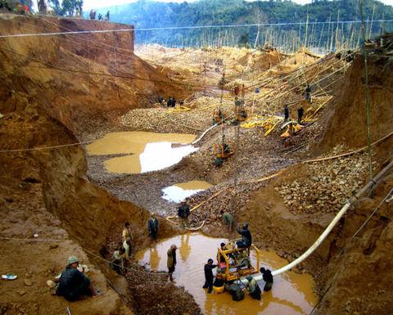
Implications for Water Quality
Reduced water quantity
Impact on freshwater biodiversity
Heavy metal contamination from mining e.g. arsenic
Acid mine drainage from mineral extraction
Erosion & sedimentation from logging activities
Nutrient enrichment in lakes
Mining in Yangon
https://www.miningnews.net/

Slide 22
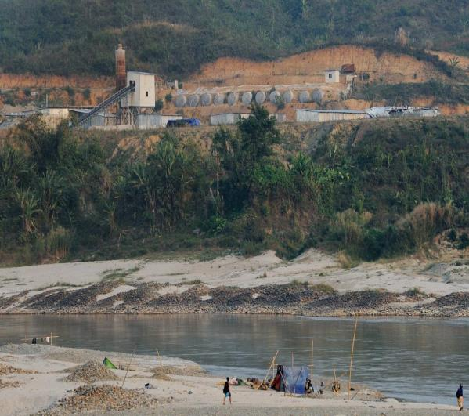
Implications for Water Quality/Quantity
Dam construction
Upstream
Deposit of fine sediments onto the original river substrate
Reduction of flow behind the dam.
Downstream
Release of huge volumes of water from the dam
High sediment concentration generated downstream
Impact on physical, chemical & biological variables
Dam construction in Myitsone
https://frontiermyanmar.net/en/the-myitsone-dam-chinas-three-options

Slide 23
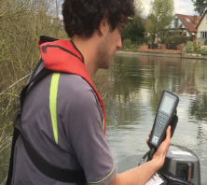
How do we protect our freshwaters?
Environmental Regulation & Enforcement
International, EU and national standards
Enforcement by environmental regulators
& environmental Institutions
Monitoring and assessment
Physical, chemical & biological variables

Slide 24
Standards: National Water Framework Directive
Based on the European Union’s Water Framework Directive (EU WFD)
Protection of EU surface waters, rivers, lakes & groundwater
Broad Aims of the EU WFD:
To achieve “good ecological status” for all surface waters by 2021.
To prevent deterioration
Ensure the conservation of high water quality where possible

Slide 25
Main Focus in the EU WFD
Assess status of the biological elements
Physical and chemical elements
Hydromorphological element -- describes water flow conditions & water levels
All parts of the physical, chemical and biological components have to be “good” for the water body to comply with the EU WFD (NWFD) for --“good ecological status”

Slide 26
Recommendations
Collaboration between research institutes, academics & government officials in environmental monitoring & assessment of water quality.
Effective data collection & storage
Effective water regulation & protection
Communication & participation through media, workshops etc.
Cooperation between Government, States & Divisional Governments

Slide 27
In conclusion,
We have learnt about freshwater ecosystems
Challenges to freshwater ecosystems
Environmental regulation and institutions e.g. NWFD
Monitoring and assessment
Physical and chemical variables
Biological parameters
Thank you!

Slide 28
