Slide 1
Lecture 1 Long-Term Vision for the Energy Mix – Case Study
The Electricity Transition Playbook
Supported by and in collaboration with CCG and Green Grids Initiative
Version 1.0

Slide 2
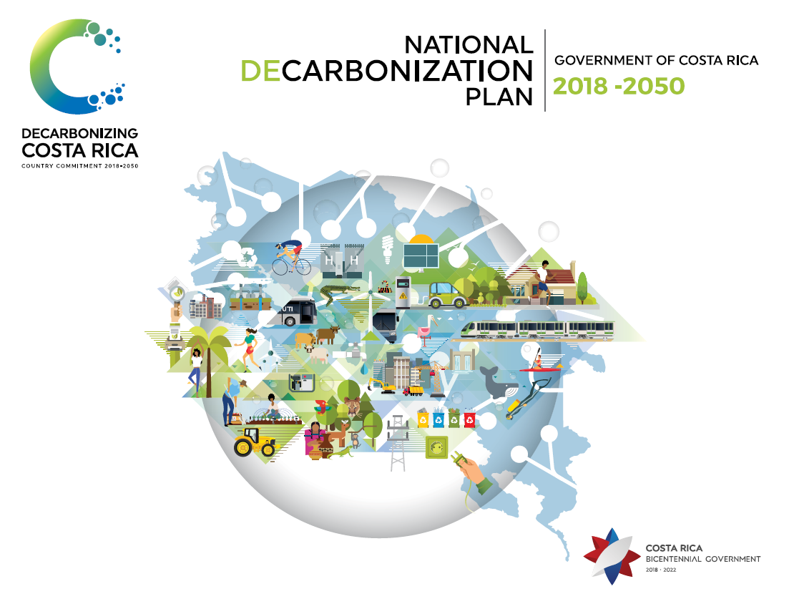
1. Defining the overarching vision
Costa Rica wants to be seen as a pioneer in the protection of peace and nature and sets an example for the region and for the world.
Costa Rica aspires to be a modern, green and emission-free economy - and to strengthen its leadership – and commits to becoming a decarbonized economy with net-zero emissions by 2050.
Notes:
Costa Rica wants to be seen as a pioneer in the protection of peace and nature and sets an example for the region and for the world. The country has a tradition of nature protection and leadership to fight climate change and has already put in place policies that resulted in almost 100% renewable electricity and a forest coverage of approximately 60%.
The vision defined in its long-term strategy for decarbonization submitted to the UNFCCC is the following:
Costa Rica aspires to be a modern, green and emission-free economy - and to strengthen its leadership – and commits to becoming a decarbonized economy with net-zero emissions by 2050.
Decarbonization and resilience are recognized as the means to transform the current economic development model into one that is based on bioeconomy, green growth, inclusion, and on enhancing the well-being of all citizens.
This vision has been pushed mainly by the Government of Costa Rica but it has also involved a wide range of stakeholders to agree on the different priorities. It is now part of the National Decarbonisation Plan (NDP) and has been submitted to the UNFCCC as its Long-term low greenhouse gas emission development strategy

Slide 3
2. Costa Rica situation
Assets:
High share of of GDP allocated to social progress, the investments in health and education have been significant.
Economic strengths in education, openness and natural capital, increased income from ecotourism, macroeconomic stability.
Electricity system: zero-emissions but needs to reduce its costs.
Challenges:
Shortcomings in infrastructure: limit urban and rural mobility.
Fiscal constraints.
Notes:
Costa Rica achieved a high level of social development compared to countries with similar income per capita. The country invested a lot in its education and health systems. It developed the export of goods and services, ecotourism, and achieved macroeconomic stability with low inflation and a stable exchange rate. Regarding its energy system, its electricity system is almost zero-emissions but needs to reduce its costs. Even though capacity is sufficient to meet current demand, electrifying various sectors is challenging. It may be necessary to use more renewable energy, but it will affect the stability of the system.
The country has many assets to deploy in making significant changes. However, it also faces some challenges. Decades of insufficient investment in infrastructure have limited urban and rural mobility. The unsustainable fiscal deficit requires fiscal reform to limit impacts on employment and production. The unemployment rate increased in recent decades and reached 11% in 2022. Moreover, the vulnerability of the infrastructure to climate impacts exacerbates these challenges.

Slide 4
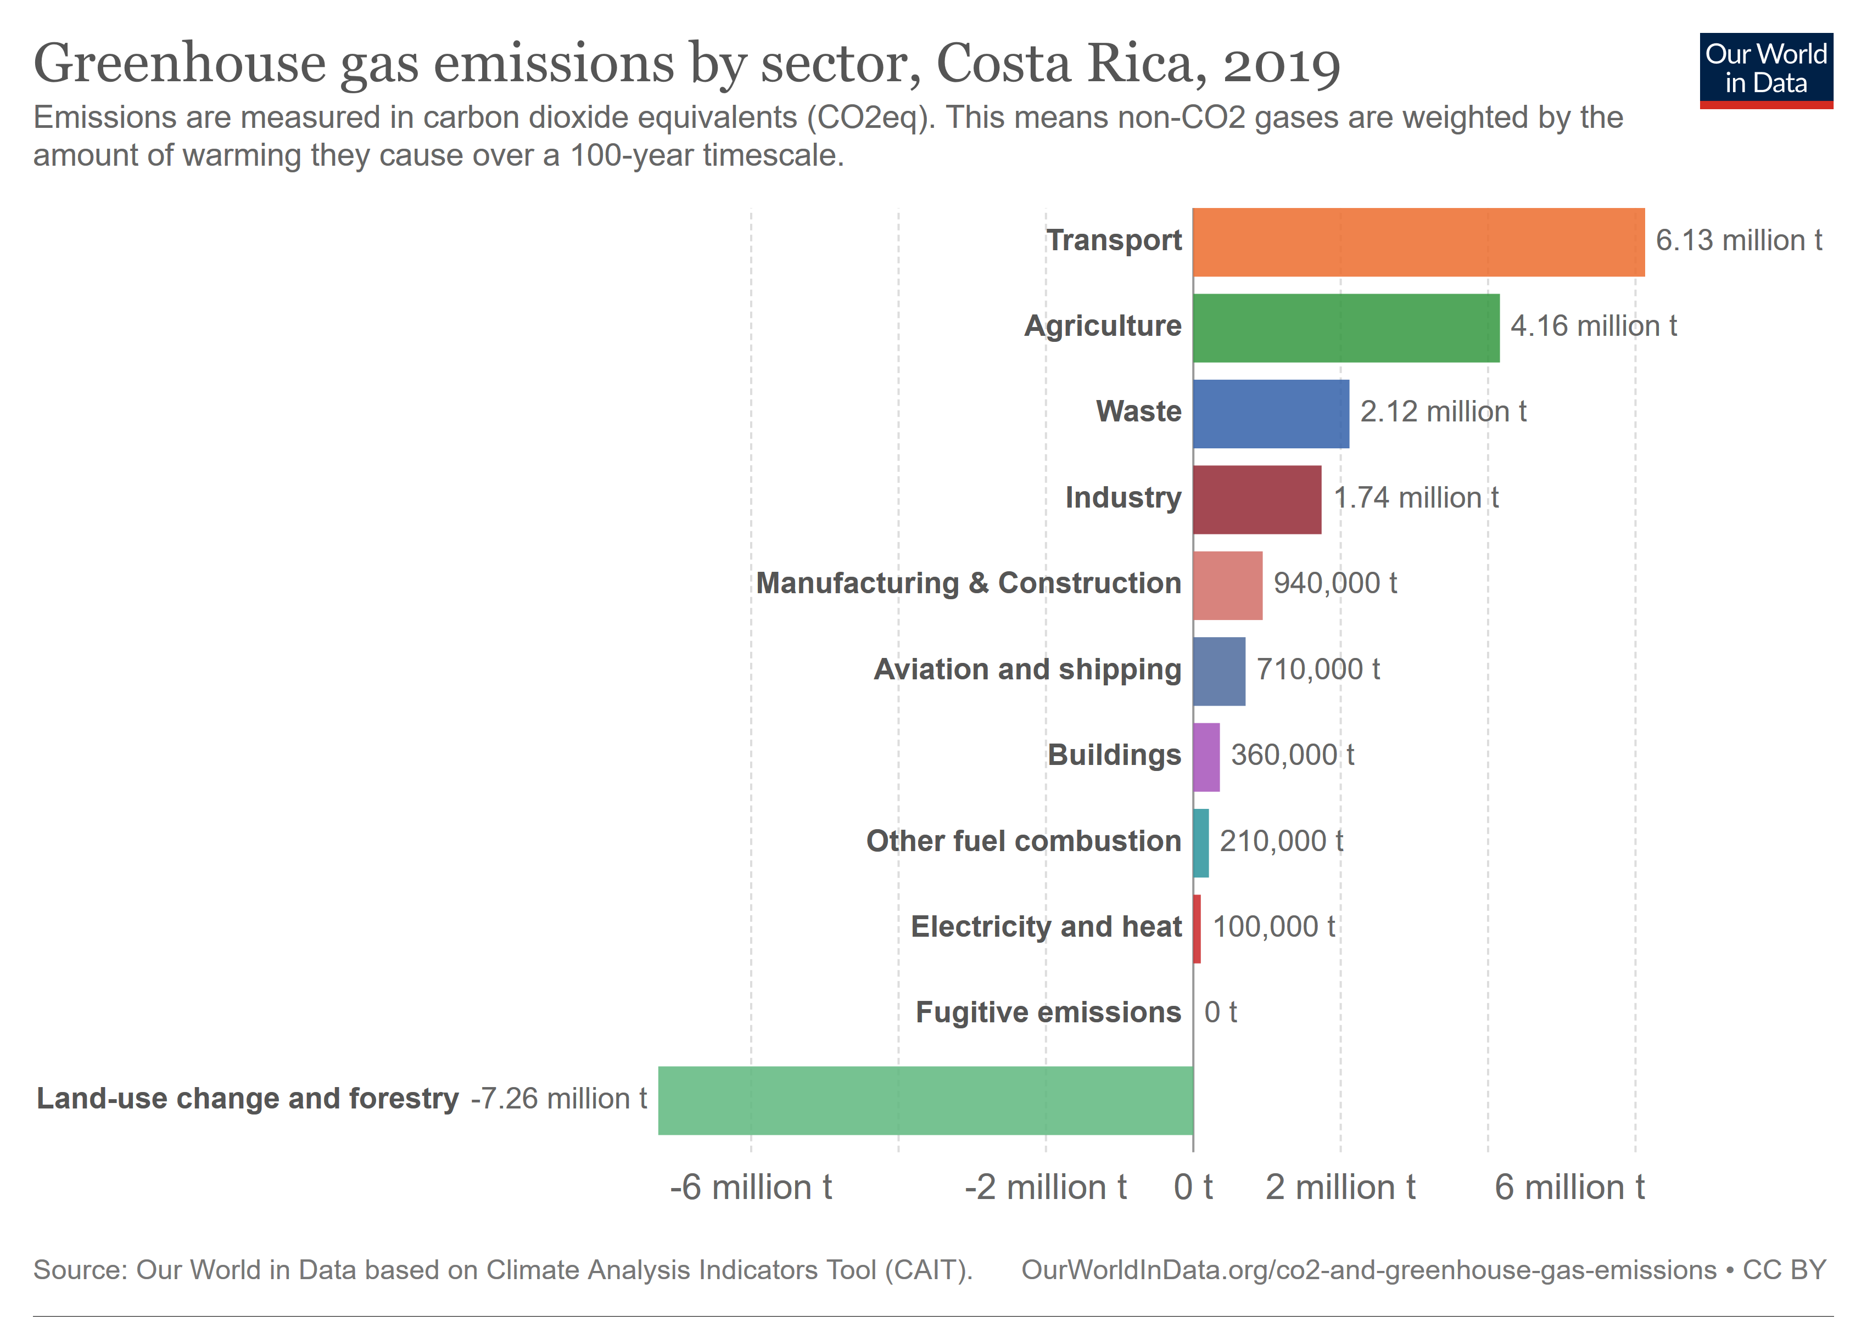
3. Identifying the challenges to achieve the vision
Notes:
In order to achieve the long term vision for Costa Rica, the main challenges need to be identified in order to explore scenarios that will address them.
To reduce greenhouse gas emissions, the main challenge resides in the decarbonisation of the transport sector. Most of the emissions come from this sector, which faces a backlog of infrastructure and standards and has experienced the fastest-rising emissions level. The vehicle fleet, dominated by private vehicles, has tripled in the last 30 years without proportional investment in infrastructure. Urban public transport suffers from routes that do not correspond to the demand, leading to a greater use of private vehicles, which, in turn, creates an increasing demand for gasoline imports.
To address these problems, the country needs to invest in electric vehicles and improve its mobility systems, while ensuring that its electricity generation remains clean and affordable. The electricity system, which is already almost zero-emissions thanks to its renewable sources, needs to reduce its costs and increase its reliability and resilience.

Slide 5
4. Modelling approach
Combination of qualitative and quantitative methods:
Qualitative: narratives and storylines around the decarbonisation pathway
Stakeholder-driven back-casting participatory approach
Discussion around the strategies and actions
Quantitative: Open-Source Energy Modelling System (OSeMOSYS) tool
Energy systems optimization model
Least-cost pathway for the energy system
Assessment of robustness of different strategies
Notes:
The Government of Costa Rica, led by the Directorate of Climate Change, recognised the need to inform the technological pathway using an innovative approach that combined qualitative and quantitative methods.
For the qualitative approach, narratives and storylines around the decarbonisation pathway were defined through a stakeholder-driven back-casting participatory approach. They were also used to establish the policy packages in the ideal decarbonised future and define the strategies and actions around the decarbonisation pathway.
For the Quantitative analysis, a modelling tool (OSeMOSYS-CR) based on open-source datasets was developed by a local team established at the university that enabled the understanding of the costs and benefits of technological pathways in the transport and energy sectors. This model is based on the Open-Source Energy Modelling System framework. It is an energy system optimization model, which is widely used for long-term energy planning. It gives the most cost-effective technological transition towards deep decarbonisation in the transport (in particular) and the energy sector while also studying the corresponding socioeconomic effects. This model was used to assess robustly different strategies and scenarios to achieve the long-term vision.

Slide 6
5. Process for stakeholder engagement
Source: (Godínez-Zamora, G. et al. 2021)
Notes:
The Ministry of Energy and the Directorate of Climate Change supervised the process of stakeholder engagement and managed the co-creation process and collaboration between academia and the different stakeholders.
First, bilateral meetings were carried out between high-level government actors, the private sector, civil society, and academia in order to identify the different priorities of the sectors, define the national vision, and establish a first base structure of the decarbonisation plan.
Then, two series of workshops with directors, sectoral and key technical experts were carried out aiming to build the decarbonisation scenario and narratives according to the view of the different experts. More than 150 participants were involved in each workshop. They agreed on two main narratives, the Business As Usual (BAU) and the decarbonisation scenario.
Next, these scenarios were assessed with the modelling tool. The results and analysis were then discussed again with the stakeholders before being used to advise on climate change policies.

Slide 7
6. Scenarios explored by the stakeholders
A Business as Usual (BAU):
Trends based on historical data.
Power system: a moderate penetration of distributed generation
A deep-decarbonisation scenario (NDP)
The narrative of the NDP maintains the social and economic situation described in the BAU
Evolutions in urban planning and low-emissions technologies.
Notes:
Two main scenarios were defined through the qualitative approach.
The first one is the Business as Usual (BAU): it projects the current evolution of emissions caused by the growing demand for fossil fuels ignoring the effects of future climate policies. The narrative of the BAU considers that energy consumption, GDP, population growth, and aspects related to the transport sector will follow a trend based on historical data. For the power system, a moderate penetration of distributed generation (5% of total capacity), especially rooftop photovoltaic systems is assumed.
The second one is the deep-decarbonisation scenario (NDP): it promotes public transport and the electro-mobility consistent with net-zero emissions by 2050. The narrative of the NDP maintains the social and economic situation described in the BAU but there are some evolutions in urban planning and non-motorized mobility, replacement of fossil fuel technologies and switch of energy carriers to zero- or low-emissions technologies.

Slide 8
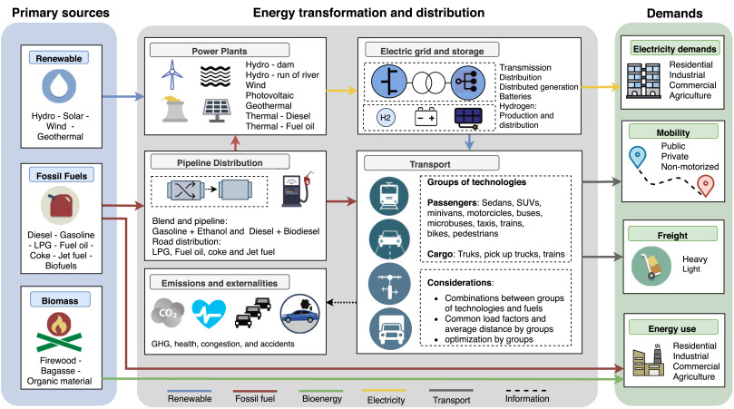
7. OSeMOSYS-CR: a transparent model
Source: (Godínez-Zamora, G. et al. 2021)
Notes:
Costa Rica, via the University of Costa Rica and international experts from the KTH - Royal Institute of Technology (Sweden), developed OSeMOSYS-CR. This energy system model is maintained by academia, ensuring that it is updated with the latest available information. While building the model key institutions in the transport and energy sectors were involved in capturing the respective particularities. They also provided data that currently feeds the technological and socioeconomic assessments.
OSeMOSYS-CR represents the whole energy system of Costa Rica from primary energy supply to demands. Based on its technology-trich description, it provides the least cost pathway for the energy system under different constraints on resources, demands etc. It also includes estimations of externalities associated with pollution from fuel consumption, accidents related to vehicle use, and the cost of vehicle congestion. The full description and the underlying data of the OSeMOSYS-CR can be retrieved from the online documentation and the model is available under an open-source license repository.

Slide 9
8. Results : distributions of passenger and cargo transport demand
Source: (Godínez-Zamora, G. et al. 2021)
Notes:
The graphs show the distribution of passenger transport technologies for the two scenarios, the Business as Usual and the Decarbonisation scenario.
The technological transition in the passenger transport sector shows the underlying consideration in the use of public transport and the electrification process that takes place in the different passenger demands. It highlights that electro-mobility for passengers starts to grow by 2022 as the technology is already accessible to many people. While the deployment of electric buses starts from 2021, a massive adoption takes place primarily after 2030 – when the technology becomes even more cost-effective.
Overall, the transport sector transformation is key for the deep decarbonisation objective. Along with energy efficiency, the adoption of electromobility, a modal shift towards public transport and active mobility, as well as reduced demand due to digitalisation and teleworking enable a 25% reduction of energy primary production by 2050.

Slide 10
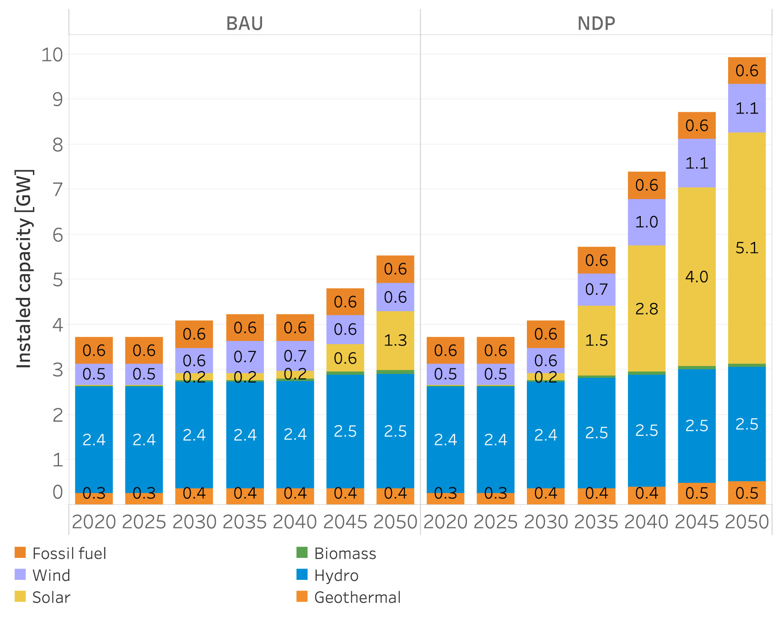
8. Results: installed capacity in the power sector
Source: (Godínez-Zamora, G. et al. 2021)
Notes:
To support the electrification of the transport sector, new renewable power plants are needed. Compared to the BAU scenario in 2050, the study found that the deep decarbonisation scenario requires about 4.4 GW of additional installed capacity, being solar and wind as the main technologies due to their decreasing total cost compared to other technologies. Their operation is, nonetheless, needed primarily after 2035 given that the massive deployment of electro-mobility starts to take place. This implies that investments may not be significant as the cost of low-carbon generation technologies is expected to be much lower in the future.
The power system analysis is a crucial aspect, as it involves not only technical issues such as stability, security, reliability, and optimal operation of power grids, but also economic, regulatory, and social issues such as investment, energy markets, and tariffs. The smart grid concept also requires further research on how demand-side management can contribute to the decarbonisation process.

Slide 11
9. Policy impact
The deep decarbonisation pathway is technically feasible and is coupled with socioeconomic benefits. It was used to support the:
Definition of policy packages in the short-term, mid-term and long-term,
Establishment of a framework with more than 70 targets,
Identification of concrete actions to align public finances across government agencies, including regulatory actions, investments, studies, and policy and institutional reform,
Information on the National Development and Public Investment Plan which helped to mobilize financing: at least USD 2.4 billion of international finance.
Notes:
The deep decarbonisation pathway is not only technically feasible, but also socioeconomically beneficial as the results show that it can generate an economic benefit of around US$ 20.6 billion by 2050. This scenarios was used to support:
The definition of policy packages for the short-term, mid-term and long-term periods.
The establishment of a framework with more than 70 targets from 35 different government agencies and line ministries to be implemented by 2023.
The identification of concrete actions to align public finances across government agencies, including regulatory actions (e.g., establishing the rules on how the electricity price for electric vehicle charging stations can be set), investments (notably to enable public transit), studies (e.g., assessing options to fund an updated payment for ecosystem services scheme), and policy and institutional reform (e.g., evaluating fiscal policy given the decarbonization of the transport sector).
The information of the National Development and Public Investment Plan of the Ministry of National Planning and Economic Policy (MIDEPLAN), which helped to mobilize financing from international public sources. At least USD 2.4 billion of international finance are directly linked to it between 2018 and 2022.

Slide 12
10. Challenges faced by the country
Lack of modelling capacity in Costa Rica → International collaboration helped to build capacity.
Engagement with affected stakeholders → High-level discussions helped to promote collaboration to overcome future challenges.
Reflection of different perspectives in one coherent pathway → A transparent and open model helped to include them.
Notes:
There were a few challenges that Costa Rica faced during the overall process.
One of them was the limited modelling capacity to design a low-carbon energy system. This was overcome by collaborating with international partners who provided technical support and expertise.
Another challenge was the resistance from some stakeholders, such as fossil fuel producers and distributors, who feared losing their business and opposed the change. To address this issue, high-level discussions were held to engage with the affected parties of the transition and promote a shared vision of future challenges and opportunities.
Finally, the process of creating a coherent pathway that considered multiple points of view was very challenging. A transparent and open model helped to ensure that different perspectives were reflected and taken into account.

Slide 13
References
Goldstein, G. A. et al. Costa Rica — Assessing Climate Mitigation Pathways to Support NDC Implementation. Environ Model Assess 26, 927–946 (2021).
Jaramillo, M., Quirs-Torts, J., Vogt-Schilb, A., Money, A. & Howells, M. Data-to-Deal (D2D): Open Data and Modelling of Long Term Strategies to Financial Resource Mobilization - the case of Costa Rica. Preprint at https://doi.org/10.33774/coe-2023-sqbfm-v5 (2023).
Godínez-Zamora, G. et al. Decarbonising the transport and energy sectors: Technical feasibility and socioeconomic impacts in Costa Rica. Energy Strategy Reviews 32, 100573 (2020).
Government of Costa Rica. National Decarbonisation Plan 2018-2050. https://unfccc.int/documents/204474 (2019).
Kwakkel, J. H., Haasnoot, M. & Walker, W. E. Comparing Robust Decision-Making and Dynamic Adaptive Policy Pathways for model-based decision support under deep uncertainty. Environmental Modelling & Software 86, 168–183 (2016).

Slide 14
Supported by and in collaboration with CCG and Green Grids Initiative
Consolidated by Ariane Millot from CCG and Green Grids Initiative
Millot A., 2023. Lecture 1: Long-term vision for the energy mix – Case Study. The Electricity Transition Playbook. Release Version 1.0 [online presentation]. Climate Compatible Growth Programme, Green Grids Initiative

