Slide 1
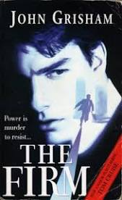
Extended Reading Intermediate
THE FIRM
Adapted from the novel by John Grisham
English e-Reader
https://english-e-reader.net/

Slide 2
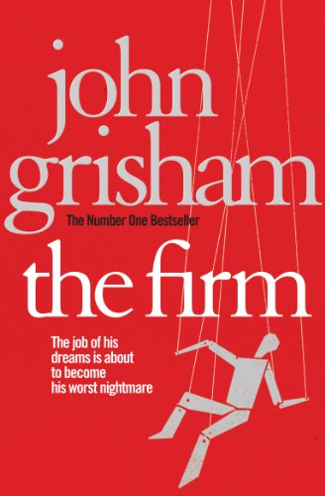
Before Reading: Look at the book cover
Is this a popular novel? How do you know?
What is another word for a firm? Can you give an example of a firm in Myanmar?
What do you think is the ‘job of his dreams’?
What idea does the picture give you about the story?
Have you seen the film (with Tom Cruise?)
What kind of story do you think this will be? (romantic? exciting? historical? funny? sad? about crime? an adventure?
a thriller?)

Slide 3
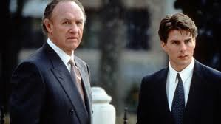
Watch the film trailer if you’d like an idea about the story:
https://www.youtube.com/watch?v=FX3AXA3icR0
Write key words for the main ideas you get as you watch the trailer
Do you think this looks an interesting story?

Slide 4
Chapter 1: Mitchell McDeere
In the first chapter, Mitchell McDeere looks for a good job after graduation. Which of the following factors do you think are most important to him? Put them in order, then read and check.
a big, well-known firm a high salary
living in New York an expensive car
a lot of holiday a nice house being near family

Slide 5
CHAPTER ONE
Mitchell McDeere
Mitchell Y. McDeere was twenty-five years old. He was about to graduate in the top five from Harvard Law School. He had a beautiful wife, Abby. He was white, handsome, tall and physically fit. He didn't take drugs or drink too much. And he was hungry. He wanted it all: money, power, a big house, a fast car... he urgently wanted to succeed.
In other words, he was perfect for the Memphis law firm of Bendini, Lambert & Locke. Every one of the twenty partners in the firm was given a thick file on him. They knew that he had been born in poverty in Kentucky and brought up by his mother after his father's death. They knew that she had wasted the money the army gave her after her eldest son's death in Vietnam, and that only the other brother, Ray, had cared for him. They knew that he had won a place at Western Kentucky University because he was good at football, and had graduated top of his class. They could see the poverty hurt, and that he wanted to climb away from it.

Slide 6
Now he was about to leave Harvard. Two firms in New York and one in Chicago were interested in him, according to the file. The highest offer was $76,000 and the lowest was $68,000. All the partners agreed that he was the one they wanted. They needed a new associate this year and they wanted it to be him. The first interview, in a hotel near Harvard, went well. Oliver Lambert took with him Lamar Quin, an associate who had been with the firm for seven years, and offered Mitch $80,000, a new BMW and help in buying a house. Mitch was interested, of course. Lambert invited him down to Memphis to visit the firm. He said he would send the air tickets.
The figure of $80,000 started Mitch and Abby dreaming.
'Eighty thousand in Memphis is the same as one hundred and twenty thousand in New York,' Mitch said. 'We'll be able to afford almost anything we want. And it's only the money I'll start at: in two years I'll be into six figures. They say that on average an associate becomes a partner in about ten years, and then I'll be earning about half a million dollars a year! And what about the car and the house?'

Slide 7
'Who wants New York?' Abby said, smiling, and thinking about new furniture in a big old house - and dreaming of babies. 'What sort of work is it?'
'Taxes,' Mitch said, 'which is what I enjoy. The firm specializes in international tax law. Bendini started it in 1944. He had a lot of clients in the south, so he moved down to Memphis. And obviously everyone who works there loves it: they say that members very rarely leave the firm.'
'And you'd be closer to Ray.'
'True. And we both hate the cold weather in the north-east.'
'If they're offering so much, why doesn't everybody try to work there?'
'Lambert says they like to stay small. There are only 41 members. They get one new member every two years, and they approach him rather than the other way round.'
'Why would they help us with a house?' Abby asked.
'It's important to the firm that their members stay happy and look rich. It helps to bring business in.'
'Memphis, here we come,' said Abby. 'I like this firm already.'

Slide 8
Read the chapter again and answer the following questions:
Which of these adjectives could describe Mitch McDeere?
rich intelligent ambitious
hard-working good-looking poor
2. Which of these adjectives could describe the law firm Bendini, Lambert and Locke?
successful friendly boring
large generous well-known

Slide 9
Discuss with a partner:
Do you agree with Mitch’s priorities in looking for a good job?
What are the most important factors for you?
Do you think Mitch made the right decision in accepting the job with Bendini, Lambert and Locke?
Read the next chapter for more information about the Firm.

Slide 10
Chapter 2: Bendini, Lambert and Locke
Before Reading
Mitch visits the building of the firm Bendini, Lambert and Locke and discusses working conditions.
What would you expect him to see there and receive information about? Tick your ideas. Read and check.
offices? a meeting room? a gym? a car?
a secretary? alcohol? company rules? holidays?
a contract? a calendar of special events?
hidden cameras? a library?

Slide 11
CHAPTER TWO: Bendini, Lambert and Locke
Bendini had loved the firm's office building; he had also loved secrecy. Before his death in 1970 he had filled the 100-year-old building with electronic surveillance equipment, as well as with every luxury money could buy. Only a few special members could enter certain parts of the building.
In twenty years Bendini built the richest law firm in Memphis. It was also definitely the quietest. Every associate hired by the firm was taught the evils of a loose tongue. Everything was secret - especially clients' business. Talking about the firm's business outside the firm could delay the prize of a partnership. Nothing left the building on Front Street. Wives were told not to ask questions - or were lied to. The associates were expected to work hard, keep quiet and spend their healthy incomes.
Lamar Quin met Mitch at the entrance to the building. After an embarrassing speech by Oliver Lambert in front of all the other associates in the second-floor library, Lamar took him on a tour of the office. There were excellent libraries on the first four floors of the five-floor building, so that no member needed to leave the office to find out anything.

Slide 12
The first four floors were almost the same. The centre of each floor was filled with secretaries, their desks and the necessary machines. On one side of the open area was the library and on the other were offices and smaller conference-rooms. Partners got the large corner offices, with wonderful views over the river and the city.
'You won't see any pretty secretaries,' Lamar said softly as they watched them work. 'These are the best legal secretaries in Memphis, but they also have to be over a certain age. The firm likes its members to have steady marriages. Babies are encouraged. Of course wives are not forbidden to work.'
'I hope not,' said Mitch, puzzled by the word 'forbidden'. He decided to change the subject. 'Does every lawyer get his own secretary?'
'Yes, until you're a partner. Then you'll get another, and by then you'll need one. Nathan Locke has three, all with twenty years' experience, and he keeps them busy. You'll find that the work takes at least eighty hours a week at first. And there's always more if you want it. Everyone works a hundred hours a week during tax season. We get well paid, all right, but we earn it, believe me.'

Slide 13
Read chapter 2 again and answer the questions:
1 What is unusual about the office building?
What is the most important rule of the company?
How many hours will Mitch have to work?
How many weeks holiday will he get?
Why does the firm do a lot of business in the Cayman Islands?
Think, then discuss with a partner:
Would you like this job with the Firm? Why? Why not?

Slide 14
'What about holidays?'
'Two weeks a year for the first five years. I know that doesn't sound like very much, but the firm does own a couple of beach houses in the Cayman Islands, and you can usually get one for your holiday - as long as a partner doesn't want it, of course. We do a lot of business in the Caymans, as well, because the islands are tax-free. Nathan Locke's there at the moment, in fact, which is why you can't meet him today.'
Mitch had lunch with the partners in their special dining-room on the fifth floor. Again the generous public praise was embarrassing, but pleasing. Mitch wanted a beer to help him feel comfortable, but looking round he saw that no one had any alcohol, and he learned that drinking at lunch-time was not liked by the firm. Nor was heavy drinking at any time. They wanted members they could rely on. That was all right with Mitch. He was determined to succeed.
By the time Mitch left the building in the evening, after a meeting with Royce McKnight to discuss further details of his contract, he had decided: there could be no better offer in the whole country.

