Slide 1
Reading a Short Story Intermediate
Lamb to the Slaughter by Roald Dahl
Parts 1-3
https://www.classicshorts.com/stories/lamb.html
B&L Associates, Bangor, Maine, U.S.A.

Slide 2
Think and make notes / Discuss with a partner
1 Do you enjoy reading?
2 What kinds of things do you read?
3 What was the last good book you read?
4 How often do you read in English? What do you read?
(news? / short stories? / novels? / blogs? / Facebook posts?)
5 Do you think it’s necessary to understand every word?
6 If there is a film of a book, do you prefer to see that, or read a book, or do you do both?
7 Apart from enjoyment and interest, how can reading help with studying English?

Slide 3
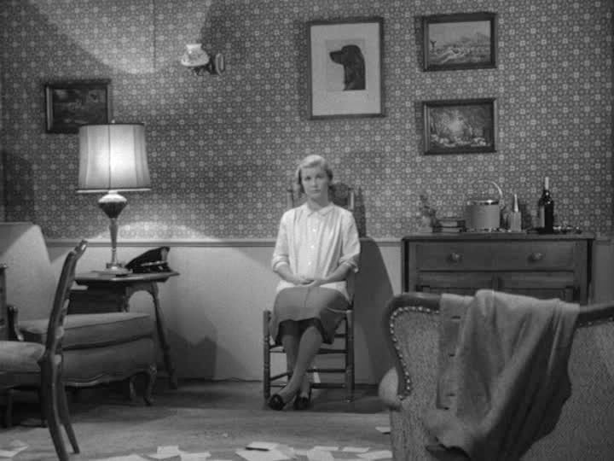

Slide 4
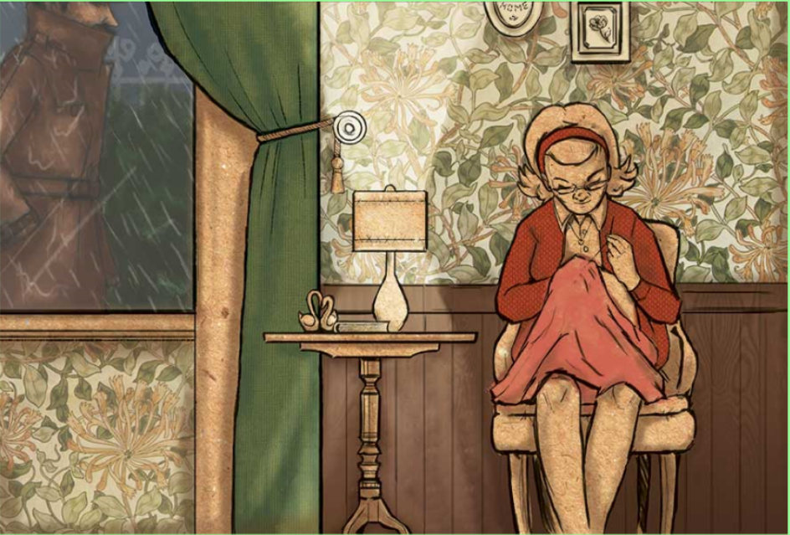
Part 1 Before reading, look at the scene at the beginning of the story. Make notes or discuss with a
partner
1 Describe the woman. What is she doing? Who do you think she is?
2 Describe the man. Who is he? What do you think is going to happen?
Read Part 1 of the story and check your ideas.

Slide 5
Lamb to the Slaughter by Roald Dahl. Part 1
The room was warm and clean, the curtains drawn, the two table lamps alight - hers and the one by the empty chair opposite. On the sideboard behind her, two tall glasses, soda water, whiskey. Fresh ice cubes in the Thermos bucket.
Mary Maloney was waiting for her husband to come home from work.
Now and again she would glance up at the clock, but without anxiety, merely to please herself with the thought that each minute gone by made it nearer the time when he would come. There was a slow smiling air about her, and about everything she did. The drop of her head as she bent over her sewing was curiously tranquil. Her skin - for this was her sixth month with child - had acquired a wonderful translucent quality, the mouth was soft, and the eyes, with their new placid look, seemed larger and darker than before. When the clock said ten minutes to five, she began to listen, and a few moments later, punctually as always, she heard the tires on the gravel outside, and the car door slamming, the footsteps passing the window, the key turning in the lock. She laid aside her sewing, stood up, and went forward to kiss him as he came in.

Slide 6
“Hullo darling,” she said. “Hullo darling,” he answered.
She took his coat and hung it in the closet. Then she walked over and made the drinks, a strongish one for him, a weak one for herself; and soon she was back again in her chair with the sewing, and he in the other, opposite, holding the tall glass with both hands, rocking it so the ice cubes tinkled against the side.
For her, this was always a blissful time of day. She knew he didn’t want to speak much until the first drink was finished, and she, on her side, was content to sit quietly, enjoying his company after the long hours alone in the house. She loved to luxuriate in the presence of this man, and to feel - almost as a sunbather feels the sun - that warm, male glow that came out of him to her when they were alone together. She loved him for the way he sat loosely in a chair, for the way he came in a door, or moved slowly across the room with long strides. She loved that intent, far look in his eyes when they rested on her, the funny shape of the mouth, and especially the way he remained silent about his tiredness, sitting still with himself until the whiskey had taken some of it away.

Slide 7
Make notes / Discuss with a partner
1 Check your ideas from the ‘before reading’ exercise.
2 What do you know now about the woman and the man?
3 Are they happy?
4 Do they have children?
Part 2 Before reading:
How do you think they are going to spend their evening?
Read Part 2 to find out what they usually do on a Thursday, and for more information about the couple

Slide 8
Part 2
“Tired darling?”
“Yes,” he said. “I’m tired,” and as he spoke, he did an unusual thing. He lifted his glass and drank it in one swallow, although there was still half of it, at least half of it left. She wasn’t really watching him, but she knew what he had done because she heard the ice cubes falling back against the bottom of the empty glass when he lowered his arm. He paused a moment, leaning forward in the chair, then he got up and went slowly over to fetch himself another.
“I’ll get it!” she cried, jumping up. “Sit down,” he said.
When he came back, she noticed that the new drink was dark amber with the quantity of whiskey in it.
“Darling, shall I get your slippers?” “No.”
She watched him as he began to sip the dark yellow drink, and she could see little oily swirls in the liquid because it was so strong.

Slide 9
“I think it’s a shame,” she said, “that when a policeman gets to be as senior as you,
they keep him walking about on his feet all day long.”
He didn’t answer, so she bent her head again and went on with her sewing; but each time he lifted the drink to his lips, she heard the ice cubes clinking against the side of the glass.
“Darling,” she said. “Would you like me to get you some cheese? I haven’t made any supper because it’s Thursday.” “No,” he said.
“If you’re too tired to eat out,” she went on, “it’s still not too late. There’s plenty of meat and stuff in the freezer, and you can have it right here and not even move out of the chair.”
Her eyes waited on him for an answer, a smile, a little nod, but he made no sign.
“Anyway,” she went on, “I’ll get you some cheese and crackers first.”
“I don’t want it,” he said.

Slide 10
Part 2 Check your understanding by deciding if the following sentences are true or false. Compare your ideas with a partner
1 On Thursday evening the couple usually have supper at home.
2 The husband is a policeman.
3 Mary is very loving and patient with her husband.
4 Her husband is very loving and kind towards Mary.
5 The husband’s behaviour today is unusual.

Slide 11
Part 3 Before reading.
Make notes or discuss with a partner
1 How do you think the husband is feeling?
2 How do you think Mary is feeling?
3 Why do you think Mary’s husband is behaving in this unusual way?
Read Part 3 to find out

Slide 12
Part 3
She moved uneasily in her chair, the large eyes still watching his face. “But you must eat! I’ll fix it anyway, and then you can have it or not, as you like.”
She stood up and placed her sewing on the table by the lamp.
“Sit down,” he said. “Just for a minute, sit down.”
It wasn’t till then that she began to get frightened. “Go on,” he said. “Sit down.”
She sat down slowly in the chair, watching him all the time with those large, bewildered eyes. He had finished the second drink and was staring down into the glass, frowning.
“Listen,” he said. “I’ve got something to tell you.”
“What is it, darling? What’s the matter?”

Slide 13
He had now become absolutely motionless, and he kept his head down. She noticed there was a little muscle moving near the corner of his left eye.
“This is going to be a bit of a shock to you, I’m afraid,” he said. “But I’ve thought about it a good deal and I’ve decided the only thing to do is tell you right away. I hope you won’t blame me too much.”
And he told her. It didn’t take long, four or five minutes at most, and she sat very still through it all, watching him with a kind of dazed horror as he went further and further away from her with each word.
“So there it is,” he added. “And I know it’s kind of a bad time to be telling you, but there simply wasn’t any other way. Of course I’ll give you money and see you’re looked after. But there needn’t really be any fuss. I hope not anyway. It wouldn’t be very good for my job.”

Slide 14
Part 3 Check your understanding
Make notes / Discuss with a partner
1 What did Mary’s husband tell Mary?
Is it clear? What do you infer (understand from the context)?
2 What emotions does Mary experience during this conversation?
3 What do you think she will say and do in response?
Read Part 4 to check your ideas

