Slide 1
Supported by and in collaboration with
Politecnico di Milano
Off-Grid Energy Systems Modelling with MicroGridsPy
LECTURE 8
Technology Characterization B
Version 1.0

Slide 2
Learning Outcomes of the Lesson
Generator Technology Characterization in MicroGridsPy
Gain an understanding of how to characterize generators in MicroGridsPy, including how to input basic parameters like efficiency, costs, and emissions. Learn the basic mathematical formulations used for calculating the total investment and operational & maintenance costs associated with this technology
Fuels Characterization in MicroGridsPy
Develop the ability to characterize fuels within MicroGridsPy by specifying basic parameters such as costs and performance metrics.
Navigating and Utilizing the MicroGridsPy Interface
Learn to navigate the MicroGridsPy interface effectively, including how to update parameters for generator types
1

Slide 3
Technology Characterization in MicroGridsPy
Technology characterization in MicroGridsPy encompasses the modelling of renewable sources, energy storage, and backup systems, each defined by specific parameters that ensure a precise representation of their operational and economic profiles
Renewable Generation Technologies
Any renewable generation technologies can be accurately modelled in MicroGridsPy by inputting their electricity output time series and basic parameters like, efficiency, costs, and emissions. For solar and wind resources, the process is streamlined with integrated estimation features.
Storage system
MicroGridsPy models energy storage using a singular battery type, incorporating parameters for costs, efficiencies, discharge depth, cycle life, and charge times to simulate its operation and financial impact within the mini-grid system.
Backup system
MicroGridsPy enables the modelling of backup generators, allowing for multiple types and fuel options, such as diesel or biogas. This flexibility facilitates the design of diversified backup systems tailored to specific energy needs and fuel availability scenarios
2

Slide 4
Backup system
In MicroGridsPy, the backup system is characterized by detailing generator types, efficiencies, costs, and sustainability impacts, alongside the corresponding fuel specifications such as type, energy content, cost, and emissions.
Types
Types
Fuel_Names [text]
Fuel name for each generators within MicroGridsPy
Generator_Types [unit]
Number of Generators types to be included within the possible backup systems
Generator_Names [text]
Generator name for each sources within MicroGridsPy
Energy conversion
Generator_Efficiency [fraction]
Efficiency of each generator
Energy conversion
Fuel_LHV [Wh/lt]
Lower Heating value (LHV) for each type of fuel
Sustainability
Generator_Lifetime [years]
Lifetime of each generator types
GEN_unit_CO2_emissions [kgCO2/kW]
Specific emissions of capacity installed (indirect emissions)
Costs
Costs
Fuel_Specific_Cost [$/lt]
Specific cost for each type of fuel
Generator_Specific_Investment_Cost [$/W]
Specific investment cost for each type of generator
Generator_Specific_OM_Cost [fraction]
O&M cost for each type of generator as a fraction of the specific investment cost
Sustainability
GEN_unit_CO2_emissions [kgCO2/lt]
Emissions for each lt of fuel consumed (direct emissions)
3
24

Slide 5
Mathematical Formulation
Generator:
Marginal cost (slope of the operation cost curve
Specific fuel cost
Energy produced:
$$E_{{gen}_{g}}\left(t\right) [Wh]≤C_{nom, {gen}_{g}}[W]∙∆t[h]$$
$$α_{g}[\$/Wh]=\frac{U_{fuel_{g}} [\$/l]}{\left(LHV_{fuel_{g}}[Wh/l]∙η_{Gen_{g}}\right)}$$
Fuel consumption:
$$C_{{fuel}_{g}}\left(t\right) [\$]=E_{{gen}_{g}}(t)[Wh]∙α_{g}[\$/Wh]$$
Nominal capacity of the generator
$${Inv}_{{RES}_{g}}\left[\$\right]=\sum_{ut}^{inv steps}{C_{nom,gen}[Wh]∙c_{inv,gen_{g}}[\$/{Wh]}} , ∀g:generator type$$
Total Investment costs:
Specific investment costs
$${O\&M}_{{RES}_{g}}\left[\$\right]=\sum_{ut}^{inv steps}{C_{nom,gen_{g}}[Wh]∙c_{inv,gen_{g}}[\$/{Wh]}∙c_{O\&M,g}\left[−\right] , ∀g:generator type}$$
Total Fixed O&M costs:
Specific O&M costs as a fraction of the investment cost
4

Slide 6
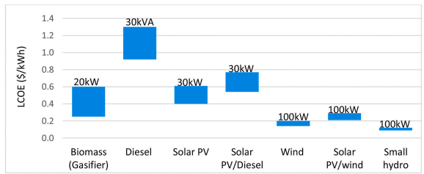
. Diesel mini-grid shows the highest LCOE compared to other generation sources and are highly dependent on fuel price fluctuations.
Diesel
Diesel mini-grids have been the preferred option for off-grid electrification, because they have short lead times, are modular, and are easy to site and relocate. However, diesel price is highly fluctuating and heavily dependent on external factors.
Diesel mini-grid shows the highest LCOE compared to other generation sources and are highly dependent on fuel price fluctuations.
LCOE (USD/kWh) of mini-grid and hybrid mini-grid options at different scales (kVA, kW) [1]
Africa Petrol and Diesel Averages 2016 – 2022 [2]
Built-In Advanced Feature in MicroGridsPy:
Yearly variable fuel costs for generator technology
5

Slide 7
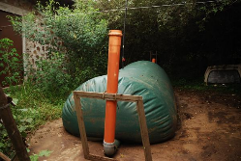
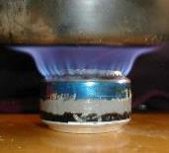
Biomass and Biogas
MicroGridsPy enables the simulation of biogas as a generator within its existing framework, utilizing adjustable parameters that are already implemented. This allows for the existing flexible parameters to accommodate the unique characteristics of biogas without the need for additional parameter inputs, thereby integrating this sustainable energy source into the energy mix of microgrid models
Generator: Biogas burner
A biogas burner is a type of generator that runs on biogas, a renewable energy source produced from the anaerobic digestion of organic waste.
Costs: biogas burners may require higher initial investment for the digestion infrastructure but often benefit from lower operational costs compared to diesel generators, due to the use of readily available organic waste.
Operational parameters for biogas burners can differ significantly, with efficiencies being influenced by the quality of biogas and the technology used.
Fuel: Biogas
Renewable fuel produced from anaerobic digestion of organic matter – the conversion of organic waste, in the absence of air (oxygen), into a mixture of combustible gases. The process usually takes place in an airtight tank called digester where animal, human and agricultural wastes produce biogas which is usually composed mainly by methane and carbon dioxide. Utilizing biogas can lead to reduced greenhouse gas emissions while. the cost and operational parameters of biogas as a fuel are influenced by local availability of feedstock and the scale of the biogas production system
On-field pictures of biomass digestor and biogas burners
6

Slide 8
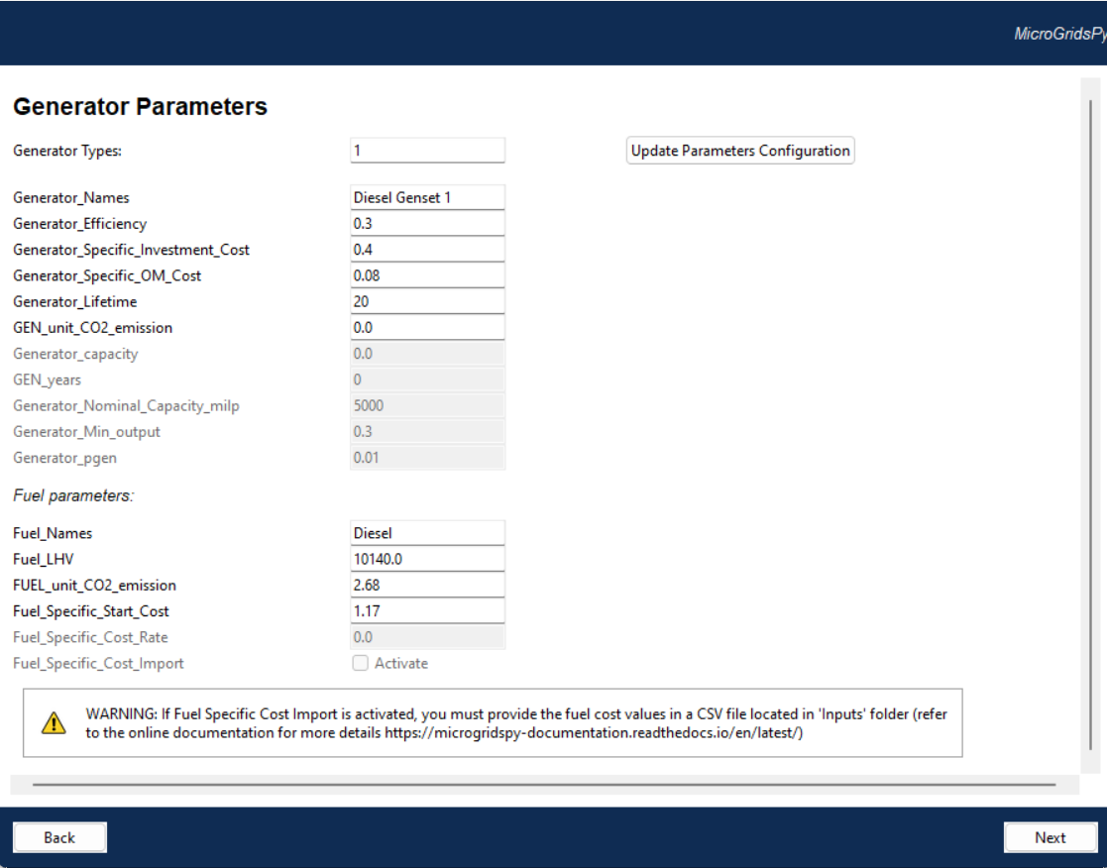
Generator Parameters
Generator Characterization
It allows setting the names, efficiencies, costs, lifespans, emissions, and capacity parameters for generators, as well as configuring fuel types, energy content, and cost parameters
Parameters which would be enabled or disabled according to specific advanced features activated (MILP, brownfield and partial load in the example)
7

Slide 9
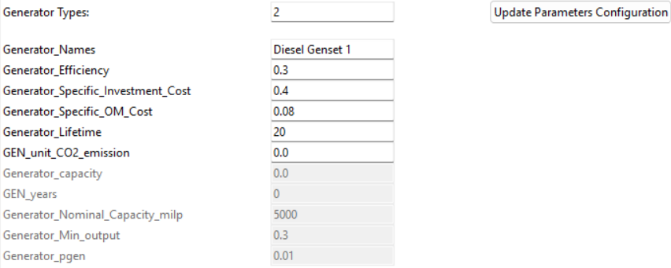
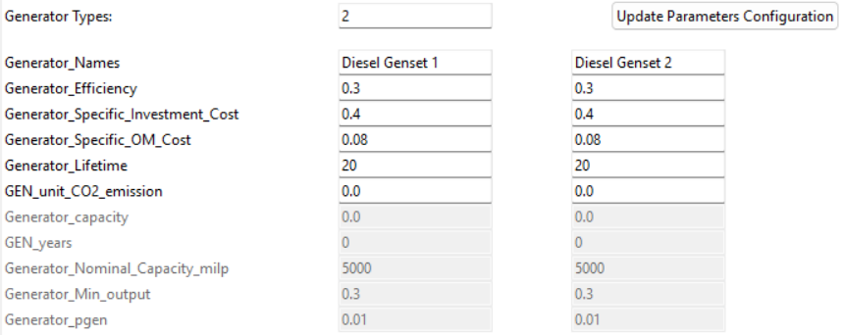
Generator Parameters
The interface includes an "Update Parameters Configuration" button for applying new settings to generator parameters. In particular:
Set the number of generators in Generator Types
Press the button to update the entries for each parameter
Visualize the new set of default values for each parameter
Edit the values as preferred
8

Slide 10
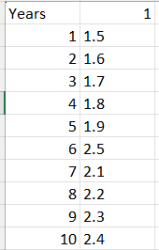
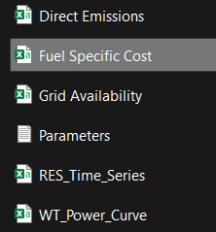
Exogenous Fuel Specific Cost
Numbered columns equal to the number of fuel types
1 2 …
1
2
3
4
5
6
7
8
9
10
11
12
13
….
Yearly price of each type of fuel
Years in the time horizon
Code/Inputs/Fuel Specific Cost.csv
9

Slide 11
References
[1] Zebra et al., A review of hybrid renewable energy systems in mini-grids for off-grid electrification in developing countries, Renewable and Sustainable Energy Reviews, https://doi.org/10.1016/j.rser.2021.111036
[2] Fuel Prices in Africa - Petrol and Diesel Pump Prices in Africa, Statistics and Averages (rhinocarhire.com)
10

Slide 12
Supported by and in collaboration with
Politecnico di Milano
Consolidated by Nicolò Stevanato, Alessandro Onori and Riccardo Mereu from Politecnico di Milano
Moksnes N., Sahlberg A., Khavari B. 2021. Lecture 1: OnSSET/Global Electrification Platform. Release Version 1.0. [online presentation]. Climate Compatible Growth Programme, Energy Sector Management Assistance Program and World Bank Group
Stevanato, N., Onori, A. & Mereu, R., 2024. Lecture 8: Off-Grid Energy Systems Modelling with MicroGridsPy. Release Version 1.0 [online presentation]. Climate Compatible Growth Programme, Politecnico di Milano
CCG courses (this will take you to the website link http://www.ClimateCompatibleGrowth.com/teachingmaterials)

