Slide 1
Ecology
Dr Ellen Fry
The Transformation by Innovation in Distance Education (TIDE) project is enhancing distance learning in Myanmar by building the capacity of Higher Education staff and students, enhancing programmes of study, and strengthening systems that support Higher Educational Institutions in Myanmar. TIDE is part of the UK-Aid-funded Strategic Partnerships for Higher Education Innovation and Reform (SPHEIR) programme(www.spheir.org.uk). SPHEIR is managed on behalf of FCDO by a consortium led by the British Council that includes PwC and Universities UK International. The TIDE project will close in May 2021.

Slide 2
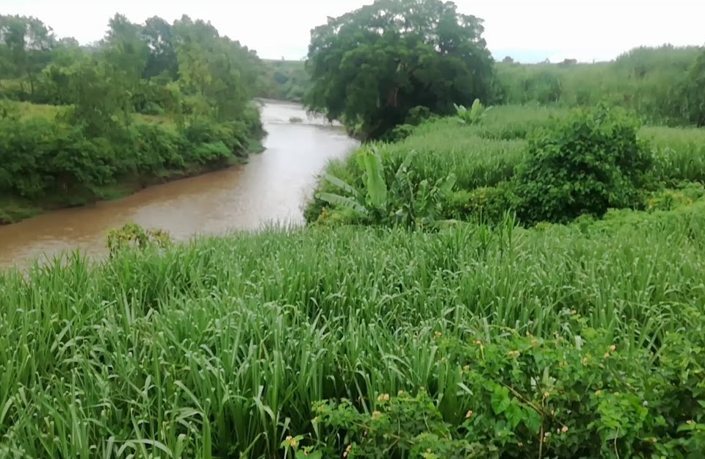
Ecology
Dr Ellen Fry

Slide 3
Structure of course
30 minute lectures recorded before time. Two per week for 10 weeks. Background reading set each week. This will appear at the bottom of the lecture transcript.
Three assignments
Each student has a space to submit work, and ask questions.

Slide 4
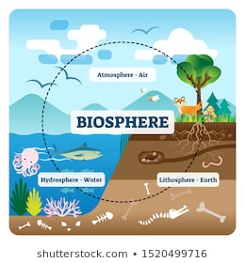
Structure of course (2)
What is ecology?
Abiotic limits on species
Population ecology
Species interactions
Community Ecology
Ecosystem services
Designing experiments

Slide 5
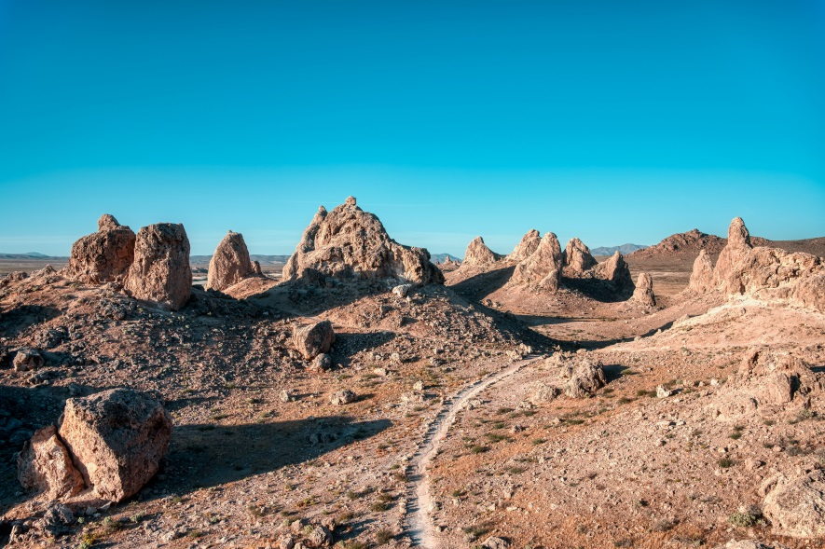
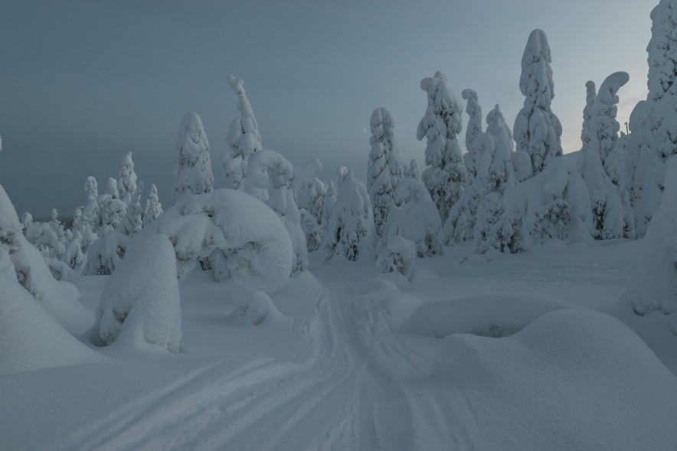
Structure of course (2)
What is ecology?
Abiotic limits on species
Population ecology
Species interactions
Community Ecology
Ecosystem services
Designing experiments

Slide 6
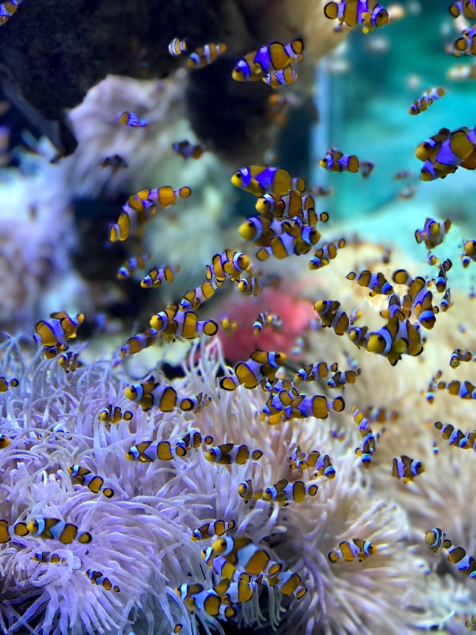
Structure of course (2)
What is ecology?
Abiotic limits on species
Population ecology
Species interactions
Community Ecology
Ecosystem services
Designing experiments

Slide 7
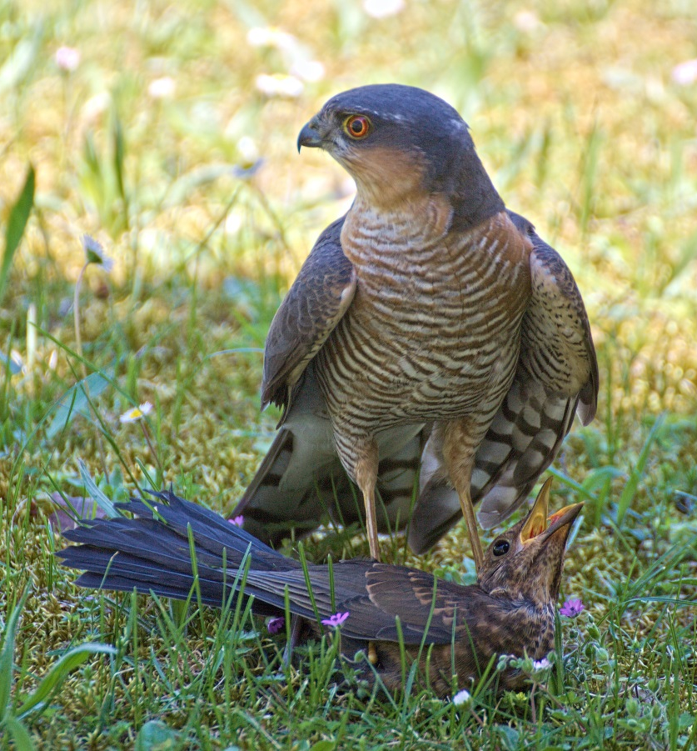
Structure of course (2)
What is ecology?
Abiotic limits on species
Population ecology
Species interactions
Community Ecology
Ecosystem services
Designing experiments

Slide 8
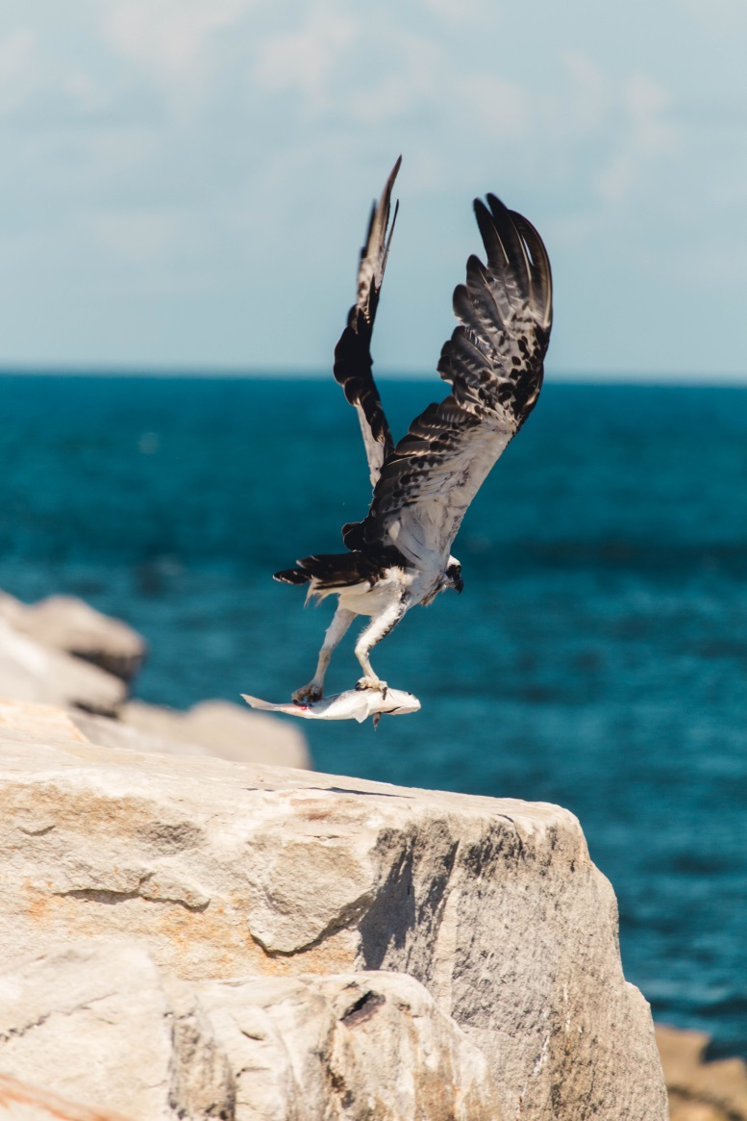
Structure of course (2)
What is ecology?
Abiotic limits on species
Population ecology
Species interactions
Community Ecology
Ecosystem services
Designing experiments

Slide 9
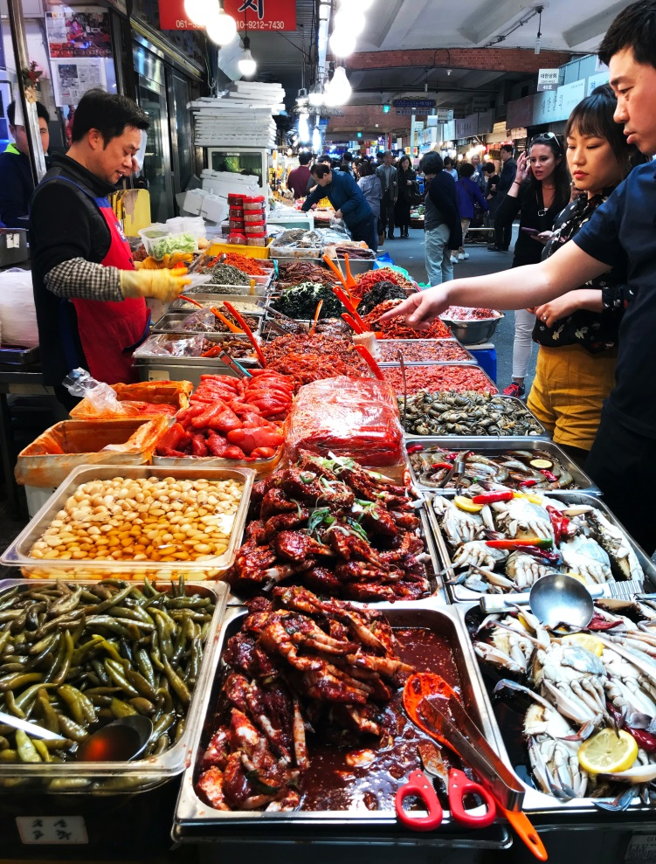
Structure of course (2)
What is ecology?
Abiotic limits on species
Population ecology
Species interactions
Community Ecology
Ecosystem services
Designing experiments

Slide 10
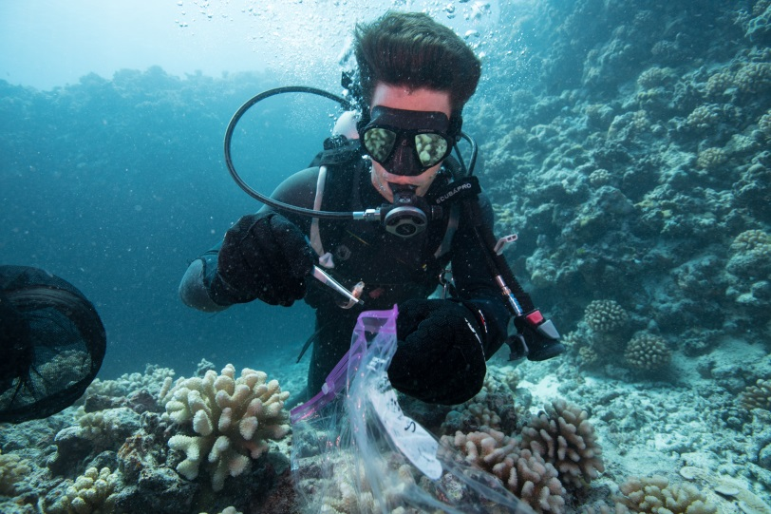
Structure of course (2)
What is ecology?
Abiotic limits on species
Population ecology
Species interactions
Community Ecology
Ecosystem services
Designing experiments
Photo credits: Jennifer Adler, Smithsonian Institute

Slide 11
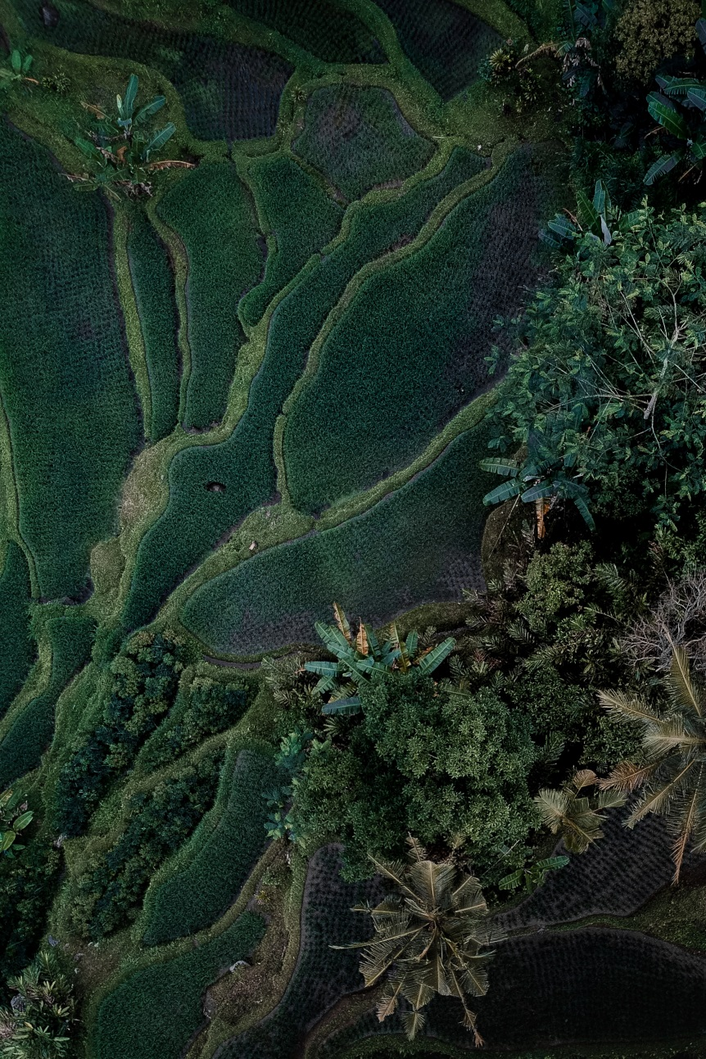
Learning objectives
Understand why plants and animals live in certain places.
Know the types of interactions between individuals and populations.
Understand the threats to the natural world.
Understand how to ask scientific questions, to design a scientific study and to look at data.

Slide 12
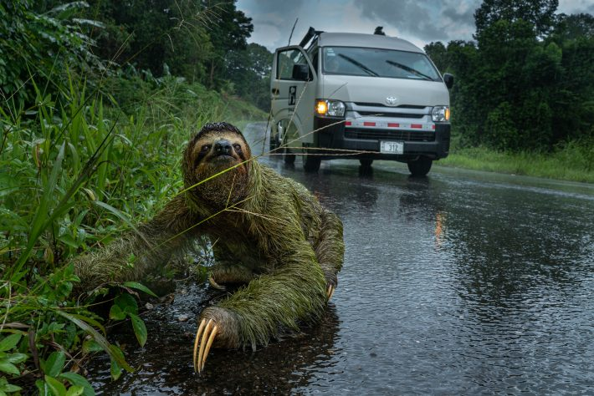
Reading for the first session
Foundations of translational ecology, Enquist et al. (2017), doi: 10.1002/fee.1733
British Ecological Society magazine The Niche:
“Why researchers should be using local traditional knowledge to estimate biodiversity”
(On Blackboard)
Photo credit: Andrew Whitworth, Osa Conservation & The University of Glasgow, UK, Why did the sloth cross the road?

