Slide 1
Social research methods - Local communities and felid conservation
Name: Kim Jacobsen
Date: November 2019
The Transformation by Innovation in Distance Education (TIDE) project is enhancing distance learning in Myanmar by building the capacity of Higher Education staff and students, enhancing programmes of study, and strengthening systems that support Higher Educational Institutions in Myanmar. TIDE is part of the UK-Aid-funded Strategic Partnerships for Higher Education Innovation and Reform (SPHEIR) programme(www.spheir.org.uk). SPHEIR is managed on behalf of FCDO by a consortium led by the British Council that includes PwC and Universities UK International. The TIDE project will close in May 2021.

Slide 2
Surveys for conservation
Integration of ecology and social science for conservation planning

Slide 3
About me
Name: Kim S. Jacobsen
Affiliation: University of Oxford and London School of Economics
Field work: Zimbabwe
Research:
Investigating what variables determine attitude to co-exisiting with lions
- using ordinal logistic regressions
2. Happiness economics
Estimating the impact of quantitative variables on subjective wellbeing
3. Economic valuation of lion presence
- Using choice experiments and discrete choice modelling

Slide 4
Structure of today’s material
How can ecological data be used for conservation planning?
How does that interact with social concerns?
How do we design and carry out a social survey to avoid conservation conflict?

Slide 5
Structure of today’s material
How can ecological data be used for conservation planning?
How does that interact with social concerns?
How do we design and carry out a social survey to avoid conflict?

Slide 6
Structure of today’s material
How can ecological data be used for conservation planning?
How does that interact with social concerns?
How do we design and carry out a social survey to avoid conflict?

Slide 7
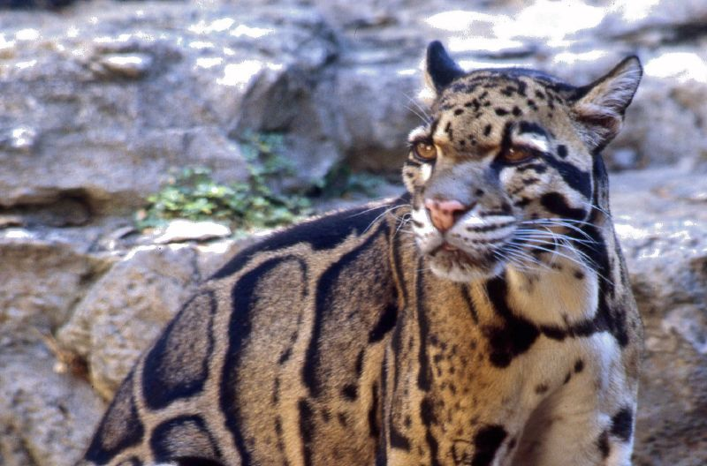
Clouded leopard habitat

Slide 8
Habitat suitability model
Final model variables | Standardized coefficient
Closed forest | 0.65
Precipitation | 0.40
Shrub-grass | 0.27
Protected areas | 0.19
Slope standard deviation | 0.07
Slope focal mean | 0.002
Mosaic of land cover | -0.37
Compound Topographic Index | -0.25
Camera effort | 0.22
Table by Zaneta Kaszta, WildCRU

Slide 9
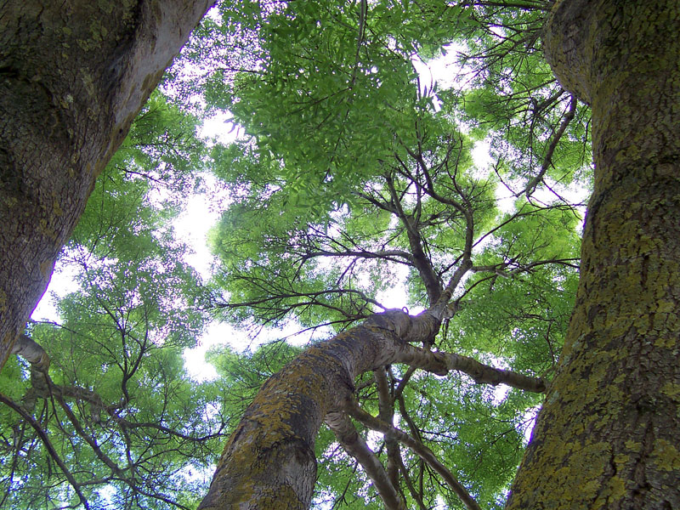
Habitat suitability model
Final model variables | Standardized coefficient
Closed forest | 0.65
Precipitation | 0.40
Shrub-grass | 0.27
Protected areas | 0.19
Slope standard deviation | 0.07
Slope focal mean | 0.002
Mosaic of land cover | -0.37
Compound Topographic Index | -0.25
Camera effort | 0.22
Table by Zaneta Kaszta, WildCRU

Slide 10
Habitat suitability model
Final model variables | Standardized coefficient
Closed forest | 0.65
Precipitation | 0.40
Shrub-grass | 0.27
Protected areas | 0.19
Slope standard deviation | 0.07
Slope focal mean | 0.002
Mosaic of land cover | -0.37
Compound Topographic Index | -0.25
Camera effort | 0.22
Table by Zaneta Kaszta, WildCRU

Slide 11
Habitat suitability model
Final model variables | Standardized coefficient
Closed forest | 0.65
Precipitation | 0.40
Shrub-grass | 0.27
Protected areas | 0.19
Slope standard deviation | 0.07
Slope focal mean | 0.002
Mosaic of land cover | -0.37
Compound Topographic Index | -0.25
Camera effort | 0.22
Table by Zaneta Kaszta, WildCRU

Slide 12
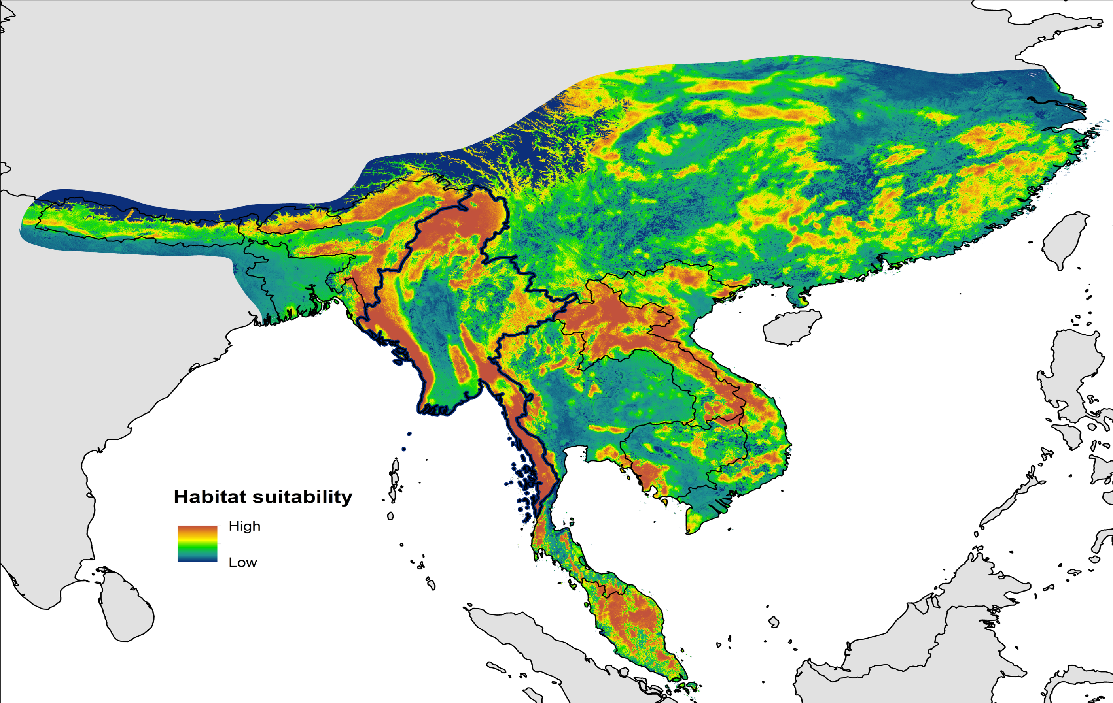
Habitat suitability map
Illustration by Zaneta Kaszta, WildCRU

Slide 13
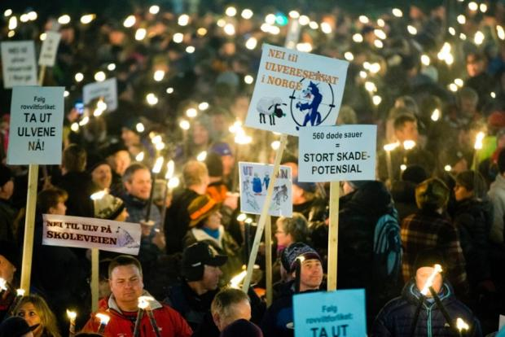
Conservation conflicts

Slide 14
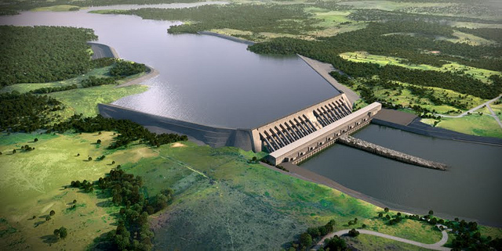
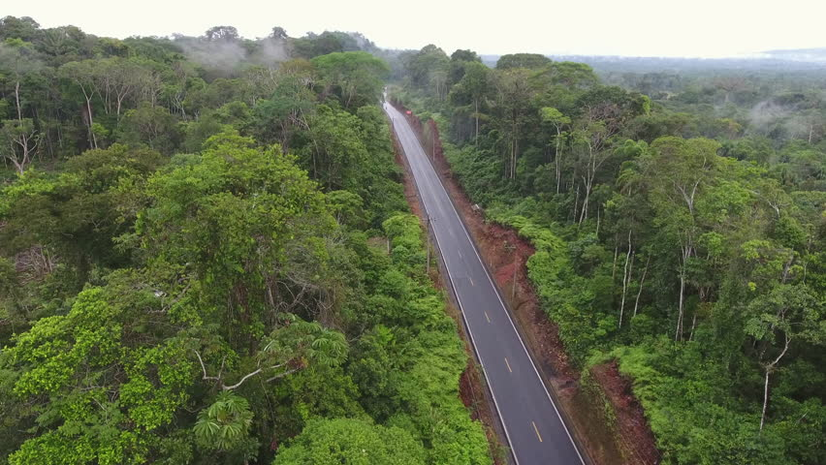
Surveys can be used for any issue

Slide 15
Chatthin Wildlife Sanctuary
Allendorf, T.D., Aung, M. and Songer, M., 2012. Using residents' perceptions to improve park-people relationships in Chatthin Wildlife Sanctuary, Myanmar. Journal of environmental management, 99, pp.36-43.

Slide 16
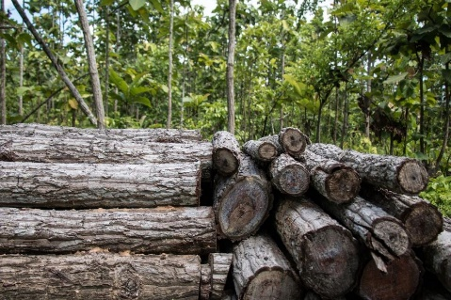
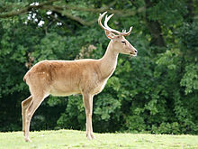
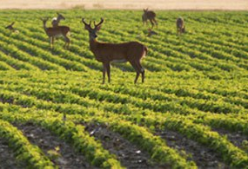
Allendorf, T.D., Aung, M. and Songer, M., 2012. Using residents' perceptions to improve park-people relationships in Chatthin Wildlife Sanctuary, Myanmar. Journal of environmental management, 99, pp.36-43.
Problems: Benefits:
Resource use Conservation
Mangement Resource use
Crop damage Benefits for country

Slide 17
We need to investigate the views of the affected communities
But how?

Slide 18
Surveys!

Slide 19
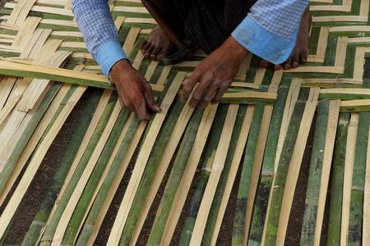
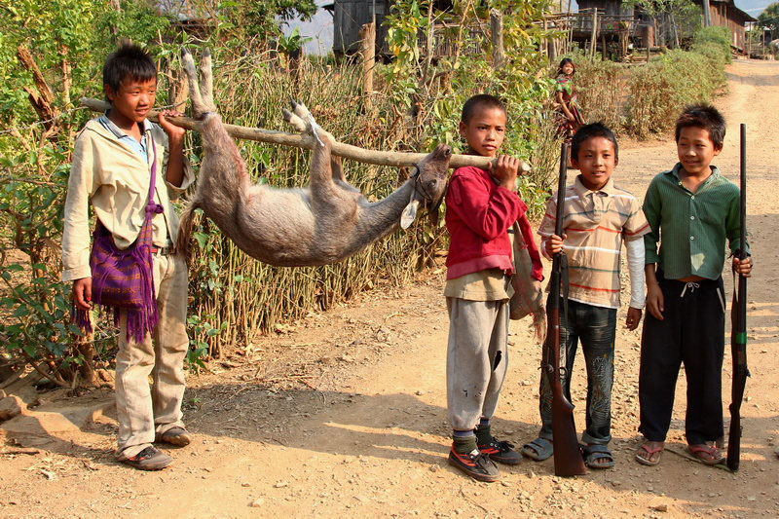
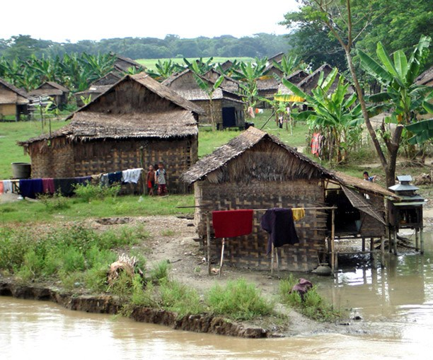
Conservation scenarios
Task: How might the proposed scenario affect local communities?

Slide 20
The stages of making a survey
Survey design
Piloting (testing)
Data collection

Slide 22
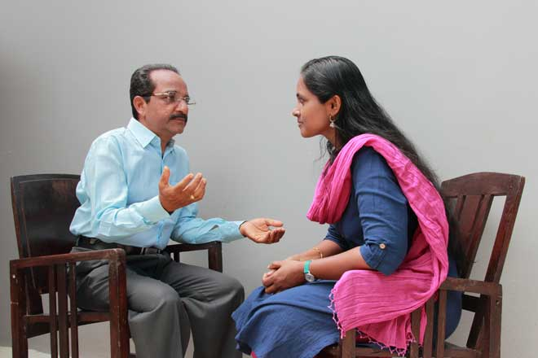
Survey design – phase 1
Qualitative interviews

Slide 23
Practice: qualitative interview stage
Ask qualitative interview questions about the issues of your scenario

Slide 24
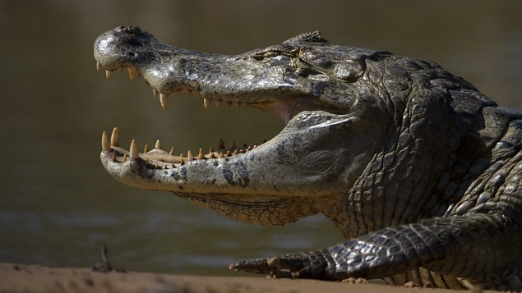
Writing the first survey
Survey design – phase 2

Slide 25
Writing the first survey
Survey design – phase 2
Frequency

Slide 26
Writing the first survey
Survey design – phase 2
Multiple choice

Slide 27
Writing the first survey
Survey design – phase 2
Numeric answer

Slide 28
Writing the first survey
Survey design – phase 2
Multiple choice and text box

Slide 29
Writing the first survey
Survey design – phase 2
Likert-type item

Slide 30
Writing the first survey
Survey design – phase 2
Open-ended qualiative

Slide 31
Writing the first survey
Survey design – phase 2
Another likert-type item

Slide 32
Writing the first survey
Survey design – phase 2
Yes/no question

Slide 33
What do you think about these questions?
Do you not agree that there is no problem with accessing firewood in the zone?
Are tigers bad?
To what extent do you think that establishing a new protected area near your village, which the state is considering doing, would interfer with your ability to find firewood?
Do you depend on fish and forest products for your daily life?
Yes
No

Slide 34
What do you think about these questions?
Do you not agree that there is no problem with accessing firewood in the zone?
Are tigers bad?
To what extent do you think that establishing a new protected area near your village, which the state is considering doing, would interfer with your ability to find firewood?
Do you depend on fish and forest products for your daily life?
Yes
No

Slide 35
What do you think about these questions?
Do you not agree that there is no problem with accessing firewood in the zone?
Are tigers bad?
To what extent do you think that establishing a new protected area near your village, which the state is considering doing, would interfer with your ability to find firewood?
Do you depend on fish and forest products for your daily life?
Yes
No

Slide 36
What do you think about these questions?
Do you not agree that there is no problem with accessing firewood in the zone?
Are tigers bad?
To what extent do you think that establishing a new protected area near your village, which the state is considering doing, would interfer with your ability to find firewood?
Do you depend on fish and forest products for your daily life?
Yes
No

Slide 37
Practice: Design survey questions
Make some example questions based on the issues you identified in your scenario

Slide 38
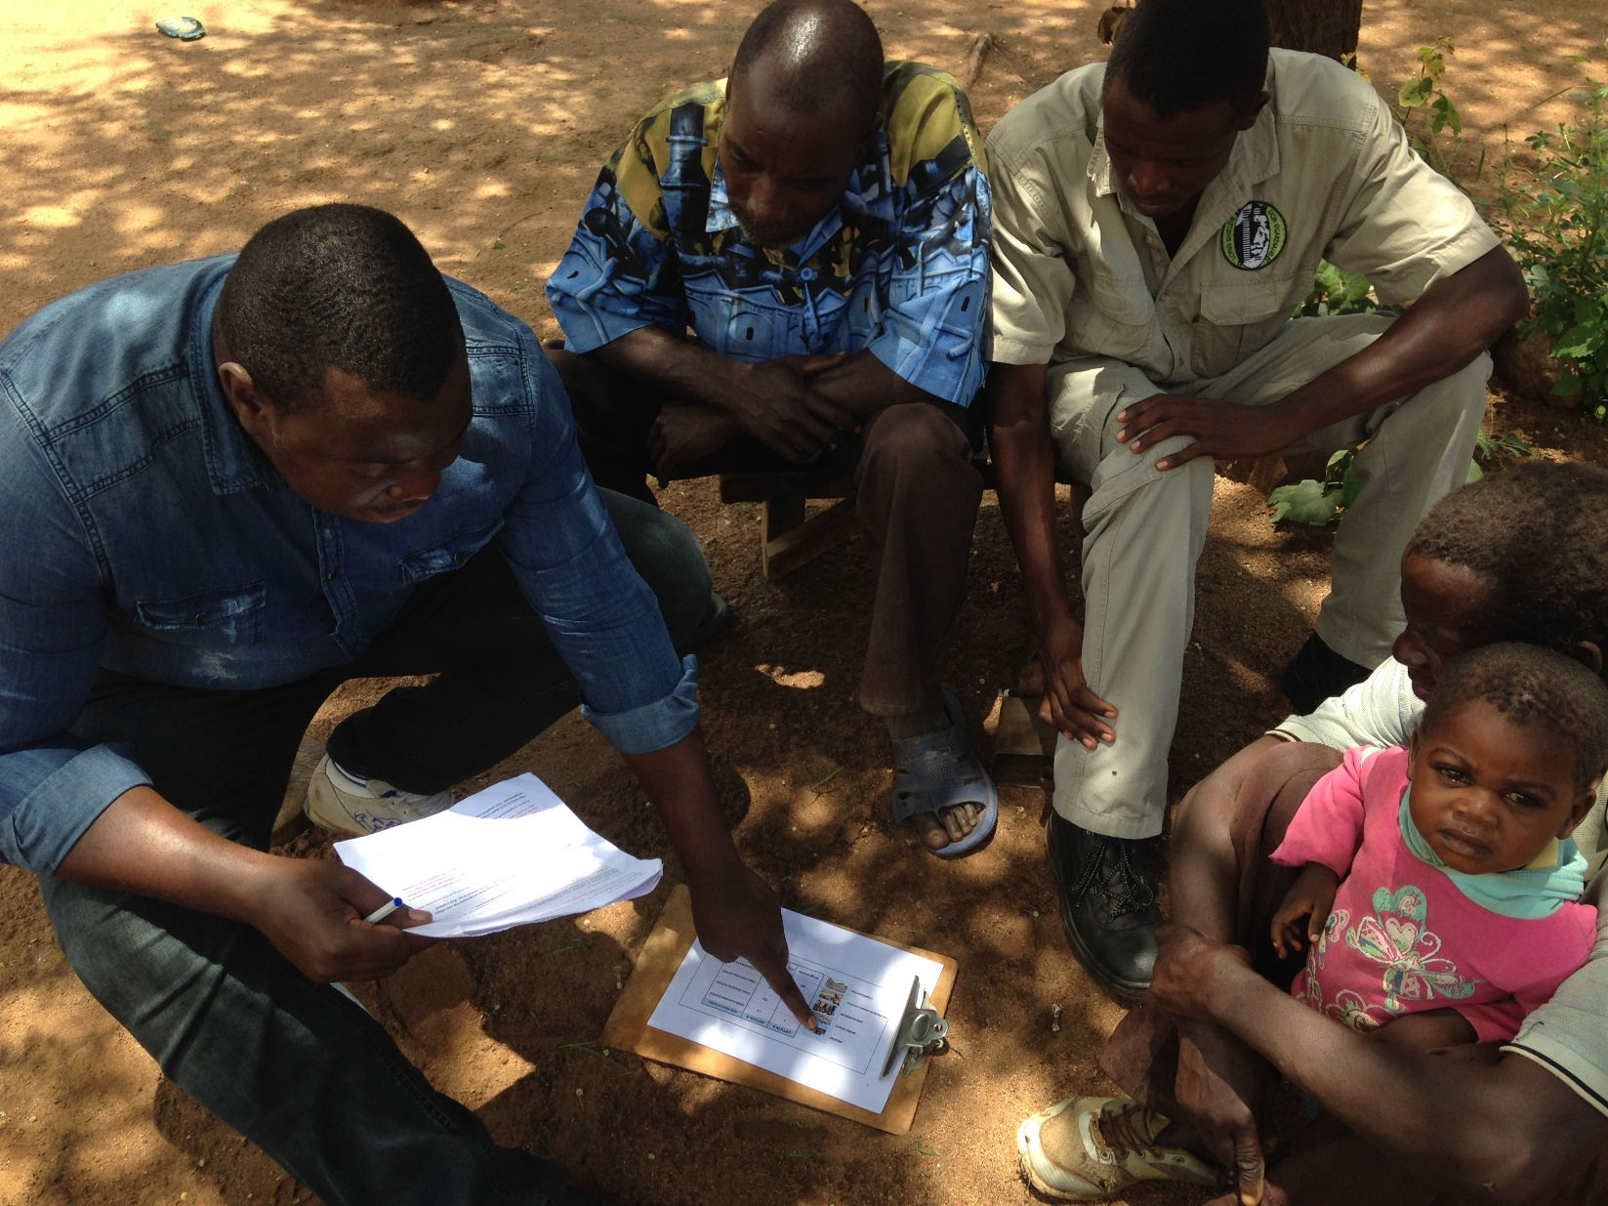
Piloting – phase 1
Testing your questionnaire

Slide 39
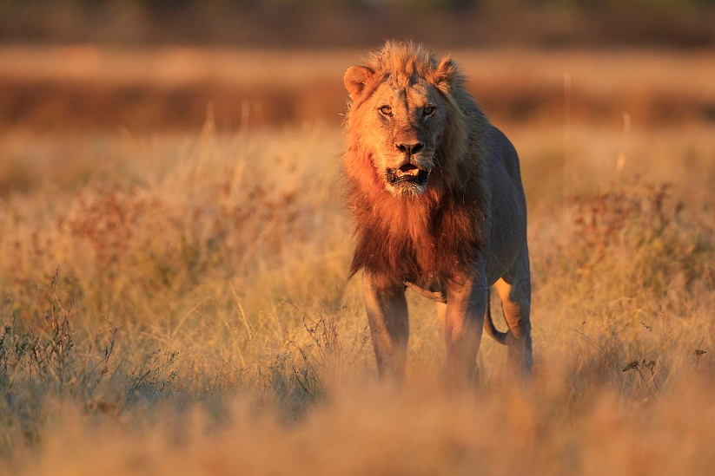
Piloting – phase 1
Pilot both form and content
Question: Are you afraid of lions?
Yes
No

Slide 40
Piloting – phase 1
Pilot both form and content
Question: Are you afraid of lions?
Yes
No
I don’t know
Notes:
Ask the class to put hand up if afraid. Ask the ones who said yes, why. Ask those who said no, why. Demonstrates that they were imagining different scenarios (one said yes because if he met a lion he’d be scared. The other said no because he never has chance to run into them.

Slide 41
Piloting – phase 1
Pilot both form and content
Question: Does fear of lions interfere with your daily activities?
Yes
No
I don’t know

Slide 42
Piloting – phase 1
Pilot both form and content
Question: Does fear of lions interfere with your daily activities? (such as going to school, fetching water, going to visit friends or relatives, or other activities)
Yes
No
I don’t know

Slide 43
Piloting – phase 1
Pilot both form and content
Question: Does fear of lions interfere with your daily activities? (such as going to school, fetching water, going to visit friends or relatives, or other activities)
Doesn’t interfere at all (1)
Barely interferes (2)
Moderately interferes (3)
Severely interferes (4)
Very severely interferes (5)

Slide 44
Piloting – phase 2
Do it all again!

Slide 45
Practice: piloting
Do a first pilot
Then do second pilot: Improve the questions based on the results from your first pilot
Notes:
Practical activity – the studens role play piloting. Do a demonstration for them first.
Then do second pilot: Improve the questions based on the results from your first pilot

Slide 46
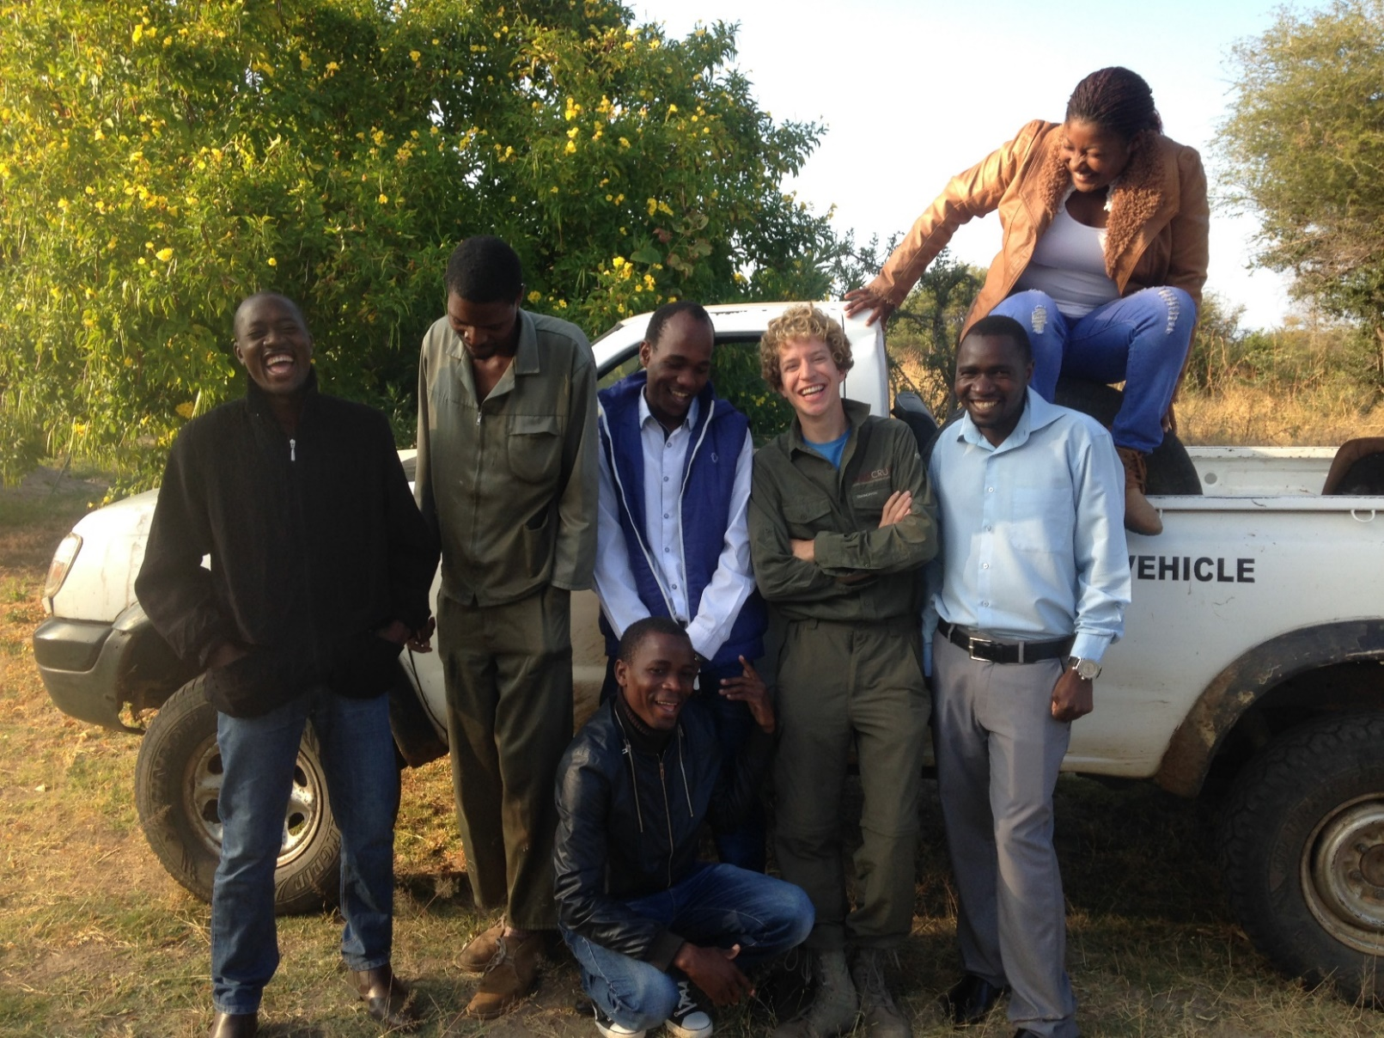
Data collection
Recruiting interviewers

Slide 47
Data collection
Prior, informed consent

Slide 48
Hello my name is Kim S. Jacobsen. I’m doing some research and I wondered if you’d be interested in being involved. I’m currently doing a PhD at the University of Oxford in the Department of Zoology. My research aims to learn more about how the communities around Hwange National Park experience their coexistence with wildlife.
If you take part, I’ll need you to between different scenarios regarding wildlife and livestock protection measures presented on paper cards, which lasts approximately 20 minutes.
This research is anonymous, which means that in any publications, your name will not be used, unless you insist on the opposite.
Taking part is completely voluntary and we can stop any time you like without giving a reason and without any negative consequences.
With your permission, I would like to make an audio recording of our discussion to make sure I’m getting an accurate record of your thoughts. Alternatively, I can take notes in my notebook. Which would you prefer? I may want to re-contact you to clarify information you gave me in your interview. In that case, I will ask you if you have time to answer some more questions.
If you agree to take part in this project, the research will be written up as an article that will form part of my thesis.
The research may also be published in academic journals.
Do you have any questions?
Do you accept and are willing to participate?

Slide 49
Hello my name is Kim S. Jacobsen. I’m doing some research and I wondered if you’d be interested in being involved. I’m currently doing a PhD at the University of Oxford in the Department of Zoology. My research aims to learn more about how the communities around Hwange National Park experience their coexistence with wildlife.
If you take part, I’ll need you to between different scenarios regarding wildlife and livestock protection measures presented on paper cards, which lasts approximately 20 minutes.
This research is anonymous, which means that in any publications, your name will not be used, unless you insist on the opposite.
Taking part is completely voluntary and we can stop any time you like without giving a reason and without any negative consequences.
With your permission, I would like to make an audio recording of our discussion to make sure I’m getting an accurate record of your thoughts. Alternatively, I can take notes in my notebook. Which would you prefer? I may want to re-contact you to clarify information you gave me in your interview. In that case, I will ask you if you have time to answer some more questions.
If you agree to take part in this project, the research will be written up as an article that will form part of my thesis.
The research may also be published in academic journals.
Do you have any questions?
Do you accept and are willing to participate?

Slide 50
Hello my name is Kim S. Jacobsen. I’m doing some research and I wondered if you’d be interested in being involved. I’m currently doing a PhD at the University of Oxford in the Department of Zoology. My research aims to learn more about how the communities around Hwange National Park experience their coexistence with wildlife.
If you take part, I’ll need you to between different scenarios regarding wildlife and livestock protection measures presented on paper cards, which lasts approximately 20 minutes.
This research is anonymous, which means that in any publications, your name will not be used, unless you insist on the opposite.
Taking part is completely voluntary and we can stop any time you like without giving a reason and without any negative consequences.
With your permission, I would like to make an audio recording of our discussion to make sure I’m getting an accurate record of your thoughts. Alternatively, I can take notes in my notebook. Which would you prefer? I may want to re-contact you to clarify information you gave me in your interview. In that case, I will ask you if you have time to answer some more questions.
If you agree to take part in this project, the research will be written up as an article that will form part of my thesis.
The research may also be published in academic journals.
Do you have any questions?
Do you accept and are willing to participate?

Slide 51
Hello my name is Kim S. Jacobsen. I’m doing some research and I wondered if you’d be interested in being involved. I’m currently doing a PhD at the University of Oxford in the Department of Zoology. My research aims to learn more about how the communities around Hwange National Park experience their coexistence with wildlife.
If you take part, I’ll need you to between different scenarios regarding wildlife and livestock protection measures presented on paper cards, which lasts approximately 20 minutes.
This research is anonymous, which means that in any publications, your name will not be used, unless you insist on the opposite.
Taking part is completely voluntary and we can stop any time you like without giving a reason and without any negative consequences.
With your permission, I would like to make an audio recording of our discussion to make sure I’m getting an accurate record of your thoughts. Alternatively, I can take notes in my notebook. Which would you prefer? I may want to re-contact you to clarify information you gave me in your interview. In that case, I will ask you if you have time to answer some more questions.
If you agree to take part in this project, the research will be written up as an article that will form part of my thesis.
The research may also be published in academic journals.
Do you have any questions?
Do you accept and are willing to participate?

Slide 52
Hello my name is Kim S. Jacobsen. I’m doing some research and I wondered if you’d be interested in being involved. I’m currently doing a PhD at the University of Oxford in the Department of Zoology. My research aims to learn more about how the communities around Hwange National Park experience their coexistence with wildlife.
If you take part, I’ll need you to between different scenarios regarding wildlife and livestock protection measures presented on paper cards, which lasts approximately 20 minutes.
This research is anonymous, which means that in any publications, your name will not be used, unless you insist on the opposite.
Taking part is completely voluntary and we can stop any time you like without giving a reason and without any negative consequences.
With your permission, I would like to make an audio recording of our discussion to make sure I’m getting an accurate record of your thoughts. Alternatively, I can take notes in my notebook. Which would you prefer? I may want to re-contact you to clarify information you gave me in your interview. In that case, I will ask you if you have time to answer some more questions.
If you agree to take part in this project, the research will be written up as an article that will form part of my thesis.
The research may also be published in academic journals.
Do you have any questions?
Do you accept and are willing to participate?

Slide 53
Hello my name is Kim S. Jacobsen. I’m doing some research and I wondered if you’d be interested in being involved. I’m currently doing a PhD at the University of Oxford in the Department of Zoology. My research aims to learn more about how the communities around Hwange National Park experience their coexistence with wildlife.
If you take part, I’ll need you to between different scenarios regarding wildlife and livestock protection measures presented on paper cards, which lasts approximately 20 minutes.
This research is anonymous, which means that in any publications, your name will not be used, unless you insist on the opposite.
Taking part is completely voluntary and we can stop any time you like without giving a reason and without any negative consequences.
With your permission, I would like to make an audio recording of our discussion to make sure I’m getting an accurate record of your thoughts. Alternatively, I can take notes in my notebook. Which would you prefer? I may want to re-contact you to clarify information you gave me in your interview. In that case, I will ask you if you have time to answer some more questions.
If you agree to take part in this project, the research will be written up as an article that will form part of my thesis.
The research may also be published in academic journals.
Do you have any questions?
Do you accept and are willing to participate?

Slide 54
Hello my name is Kim S. Jacobsen. I’m doing some research and I wondered if you’d be interested in being involved. I’m currently doing a PhD at the University of Oxford in the Department of Zoology. My research aims to learn more about how the communities around Hwange National Park experience their coexistence with wildlife.
If you take part, I’ll need you to between different scenarios regarding wildlife and livestock protection measures presented on paper cards, which lasts approximately 20 minutes.
This research is anonymous, which means that in any publications, your name will not be used, unless you insist on the opposite.
Taking part is completely voluntary and we can stop any time you like without giving a reason and without any negative consequences.
With your permission, I would like to make an audio recording of our discussion to make sure I’m getting an accurate record of your thoughts. Alternatively, I can take notes in my notebook. Which would you prefer? I may want to re-contact you to clarify information you gave me in your interview. In that case, I will ask you if you have time to answer some more questions.
If you agree to take part in this project, the research will be written up as an article that will form part of my thesis.
The research may also be published in academic journals.
Do you have any questions?
Do you accept and are willing to participate?

Slide 55
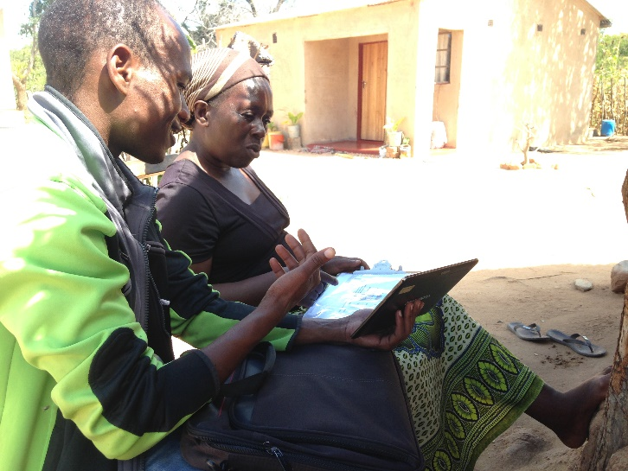
Data collection – phase 3
Carrying out the interview
Try to interview one person at a time
Stick to the script
Pre-decide how to answer questions
Don’t lead them
Keeping their attention – questions and body language
Dealing with hostile behaviour

Slide 56
Practice: Can you all now teach me the process?
Please write down the steps of the survey process and present

Slide 57
Congratulations!
Now you know how to do a survey!
Notes:
Add more fun celebration gif

Slide 58
Section name: Social science methods
Name of teacher: Kim S. Jacobsen
If you want to contact me: kimsjacobsen@gmail.com
Notes:
Takes 4.5 hours to do the whole thing – in Myanmar

Slide 59
Now its your turn!

