Slide 1
EBS
LECTURE 4 INTRODUCTION TO ENERGY BALANCE STUDIO
Version 1.0

Slide 2
Learning Outcomes
By the end of this lecture, you will be able to:
ILO1: Understand what energy balance is
ILO2: Ascertain why energy balance is important
ILO3: Learn about the steps involved in calculating an energy balance
ILO4: Get introduced to energy balance in practice
4.1. Energy balance
4.2. Its importance
4.3. Calculating energy balance
Course Name
4.4. Practical application
Mini Lecture Learning Objective
2
Notes:
This lecture has the following four learning outcomes.
Firstly, to recap and further understand what an energy balance is.
Secondly, to ascertain why energy balance is important.
Thirdly, to learn about the steps involved in calculating an energy balance.
Finally, to get introduced to energy balance in practice

Slide 3
4.1 Energy Balance
What is Energy Balance?
Energy can neither be created nor destroyed.
It can only be converted from one form to another.
Energy Balance presents an overall picture of the production, conversion, and consumption in a particular system.
3
Notes:
Energy can neither be created nor destroyed. It can only be converted from one form to another.
Energy Balance presents an overall picture of the production, conversion, and consumption in a particular system.
In the energy sector, it is an aggregated representation of all human activities related to energy except for natural and biological processes.

Slide 4
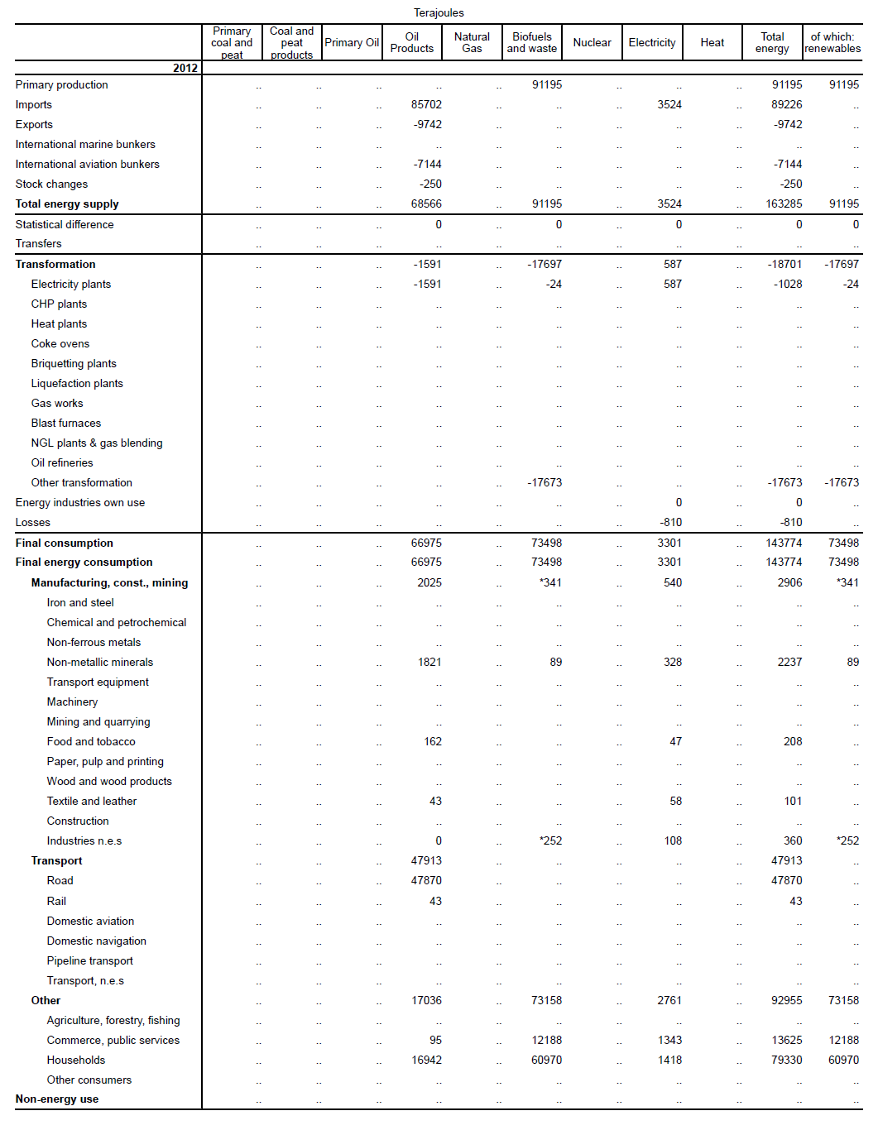
4.1 Energy Balance
Energy balance is commonly displayed as a table
4
Notes:
Energy Balance can be shown as a table that accounts for different categories such as coal, oil, gas, biomass, and so on. These are reported from their source (production, imports, etc.) down to final use.
The columns represent different energy forms.
Rows in the upper part show production, trade ,and storage changes.
Rows in the middle part show transformation or conversion of one energy form into another energy form.
Rows in the lower part show final consumption of energy forms by different categories of customers, including non-energy uses.

Slide 5
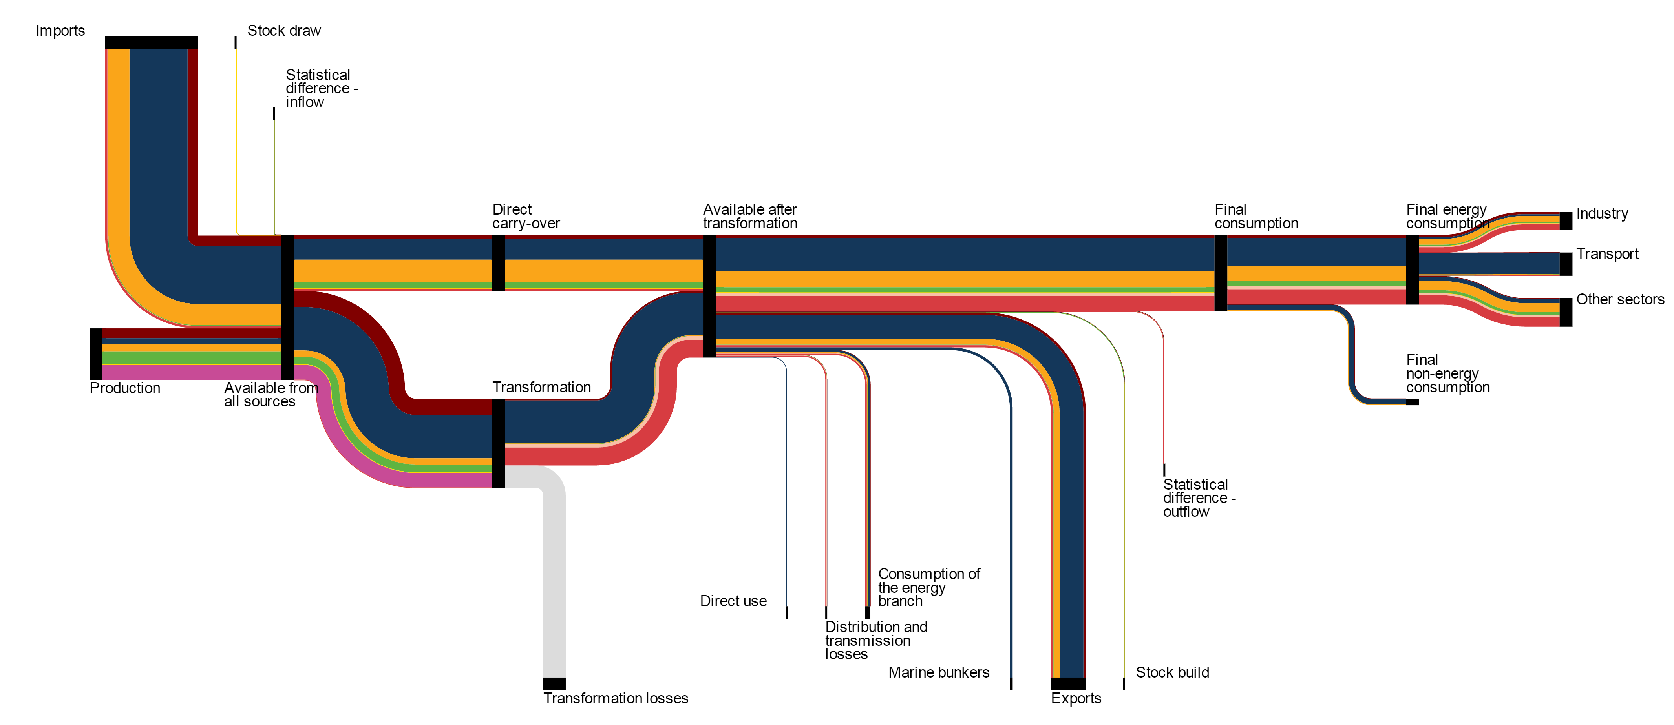
4.1 Energy Balance
Other representations of energy balance
5
Notes:
Energy balances can also be represented in a schematic. This is known as a Sankey diagram.
They have directed flows from the energy source to the point of end-use. The width of the flow represents the magnitude of energy.
Since each flow is always connecting at least two nodes, the diagram shows the structure and distribution of energy within the system.

Slide 6
4.1 Energy Balance
Is a balance between…
Energy balance presents an equilibrium between supply and demand.
Supply consists of production, energy trade, stocks change and transformation and distribution losses.
Demand is a sum of final energy consumption in manufacturing, transportation, other sectors and final non-energy use.
Energy Supplied
Trade, stocks changes
Production
Energy Used
Final non-energy use
Manufacturing
Transformation
Loses
Other (Agriculture, Households, etc.)
Transportation
6
Notes:
Every instance of energy balance presents an equilibrium between supply and demand.
Supply consists of production, energy trade, stocks change and transformation and distribution losses.
Demand is a sum of final energy consumption in manufacturing, transportation, other sectors and final non-energy use.

Slide 7
4.1 Energy Balance
Characteristics of an Energy Balance instance:
It reports energy data in the common energy units.
It allows comparison between countries.
It allows calculation of useful indicators such as import dependence, energy transformation efficiency, share of renewables, etc.
It is used as a basis for greenhouse gas calculation.
7
Notes:
An energy balance has the following characteristics.
It reports energy data in the common energy units.
It allows comparison between countries.
It allows calculation of useful indicators such as import dependence, energy transformation efficiency, share of renewables, and so on.
It can be used as a basis for greenhouse gas calculations.

Slide 8
4.2 Importance of Energy Balance
Why is energy balance important?
Energy drives economic and social development.
Realistic planning must have quantitative targets.
Statistics helps to visualize targets and to measure the achievements quantitatively.
The foundation of good planning and modelling is the baseline statistics.
8
Notes:
Energy drives economic and social development.
Realistic planning must have quantitative targets.
Statistics helps to visualize targets and to measure the achievements quantitatively.
The foundation of good planning and modelling is the baseline statistics (as input data and for model-case studies calibration).

Slide 9
4.2 Importance of Energy Balance
Roles of energy balance
Analysis
Understanding the system behaviour and driving forces
Energy Balances and other data sets
Planning
Evaluation of alternatives
Policy and decision making
Monitoring
Measure
Assess
Management
Compare
Check compliance
9
Notes:
Energy balance plays many roles.
In terms of analysis, it presents a quick picture of an energy system.
It helps users understand energy needs and their drivers.
In terms of planning, it provides background data for evaluation of future energy demand and supply options in order to prepare future policies, take appropriate decisions, and manage energy sectors.
In terms of monitoring, it helps assess and measure the effectiveness of different policies and compare and benchmark between countries.

Slide 10
4.2 Importance of Energy Balance
Who uses energy balances
Governments: social, energy, and environmental planning departments and regulatory agencies.
Energy industry: energy market operators, analysts, and trade associations.
Academics and NGO members: who comment on energy and environment issues.
International organisations at various stages of treaties, agreements, and protocols.
10
Notes:
Governments use them within social, energy, and environmental planning departments and regulatory agencies.
In the energy industry they are used by energy market operators, analysts, and trade associations.
Energy balances are used extensively by academics and members of N.G.Os who comment on energy and environment issues.
Finally, they are used by international organizations at various stages of treaties, agreements, and protocols.

Slide 11
4.2 Importance of Energy Balance
Integral Approach
Data collection
Data processing
Data analysis
Planning
Policies
Monitoring
11
Notes:
The figure shows the process followed when using energy balances as a decision support tool.
The blue boxes represent the steps that lead up to an energy balance instance, namely, data collection, processing and analysis.
Using this information, planning, policies, and monitoring are performed.
The next iteration connects the monitoring and data collection stages for the cycle to continue.

Slide 12
4.2 Importance of Energy Balance
Common issues encountered
Inconsistent usage of energy units.
Non-standard categorization of fuels/energy forms.
Difference between calendar and fiscal year.
Inconsistent use of calorific values: net versus gross.
12
Notes:
Common problems include the following.
Inconsistent usage of energy units.
Non-standard categorization of fuels or energy forms. For example peat is considered as a renewable source in some cases.
Difference between calendar and fiscal year.
Inconsistent use of calorific values: net versus gross.
Though these pitfalls can be avoided easily, they are found to increase administrative workload and effort required to move the process along.

Slide 13
4.3 Raw Data to Energy Balance
Steps involved
Data Collection
Basic Statistics
(Commodity Balances)
Conversion to Common Energy Units
Energy Balance
Applying Balance Rules
13
Notes:
There are five steps to get to an energy balance from raw data.
The different stages involve data collection, commodity balances (which displays the commodity values with their natural units), conversion to common energy units, the application of the balance rules and finally arrival at an energy balance.

Slide 14
4.3 Raw Data to Energy Balance
Data collection - I
Data Collection​
Data collection is the most complex and critical step in energy balances.
Data sources can be diverse, depending on the energy forms, energy supply, transformation processes, and energy uses → data collection strategies and approaches differ.
Data collection becomes increasingly more complicated as entities to collect data increases towards final consumption levels → there are several producers, but many more consumers.
14
Notes:
Data collection is probably the most complex and critical step in the overall process of an energy balance compilation.
Data sources can be diverse, depending on the energy forms, energy supply, transformation processes, and energy uses. Data collection strategies and approaches will differ accordingly.
For example, when considering the electricity sector, generation, losses, and consumption data can be collected directly from the plant and or system operators. But collecting data from smaller size facilities and small-scale producers like small P.V. installations and non-grid connected generation like micro-grids can be challenging.
Usually data collection becomes more complicated as one goes down the commodity balance table. The main reason is that the number of entities to collect data from increases towards final consumption levels (there are several producers, but many more consumers).

Slide 15
4.3 Raw Data to Energy Balance
Data collection - II
Energy forms
Energy supplies
Energy transformation
Number of entities to collect data from or to provide data increases
Energy and non-energy consumption
Energy flows
15
Notes:
As previously mentioned, data collection usually becomes more complicated as one goes down the commodity balance table. The main reason is that the number of entities to collect data from increases towards final consumption levels (there are several producers, but many more consumers).
Due to liberalization of energy markets and ever increasing requirements for the protection of business sensitive data, overall data collection procedures are more and more complex and difficult to implement.
On the other hand, detailed data on energy consumption patterns and customer needs, behaviour, and preferences are very important for implementation of appropriate energy policies to support sustainable social and economic development.

Slide 16
4.3 Raw Data to Energy Balance
Unit conversion
By applying appropriate conversion factors.
Different conversion factors can be used for different energy flows or different fuel grades inside the same commodity group.
https://thenounproject.com/term/dial-knob/2413142/
16
Notes:
After commodity balances are completed and verified, each commodity balance is converted into common energy units by applying appropriate conversion factors.
It is possible to use different conversion factors for different energy flows or different fuel grades inside the same commodity group.

Slide 17
4.3 Raw Data to Energy Balance
Energy balance rules
17
Notes:
After all balances are expressed in the common unit, appropriate energy flows (rows) are aligned and an energy balance is produced.

Slide 18
4.4 Energy Balance in Practice
UNSD Annual Questionnaire on Energy Statistics
It is part of the UN Statistical Division data collection programme.
It includes production, transformation, and use of energy products in physical and energy units.
It is the primary source of information for the UNSD Energy Statistics Database and contributes to the Energy Balances, Electricity Profiles, and Energy Statistics Yearbook
It is harmonized with the UN’s International Recommendations for Energy Statistics.
18
Notes:
The UN’s annual questionnaire on energy statistics is part of the UN Statistical Division data collection programme. It includes production, transformation, and use of energy products in physical and energy units.
It is the primary source of information for the U.N.S.D. Energy Statistics Database and contributes to the Energy Balances, Electricity Profiles, and Energy Statistics Yearbook.
It is harmonized with the U.N.’s International Recommendations for Energy Statistics.

Slide 19
4.4 Energy Balance in Practice
UNSD Publications
Energy Balances: data on yearly production, trade, transformation, and consumption for more than 200 countries.
Electricity Profiles: overall picture of the electricity sector of over 200 countries.
Energy Statistics Yearbook: series of annual compilations of internationally comparable world energy trends statistics.
19
Notes:
U.N.S.D. releases several publications based on data.
Energy Balances present data on yearly production, trade, transformation, and consumption for more than 200 countries.
Electricity Profiles provide an overall picture of the electricity sector of over 200 countries and areas on an internationally comparable basis.
The Energy Statistics Yearbook is a series of annual compilations of internationally comparable statistics summarizing world energy trends.

Slide 20
4.4 Energy Balance in Practice
IAEA – Energy Balances Studio (EBS)
It is a computer based tool compatible with the UNSD questionnaire.
It helps with first order energy balances.
It is compatible with current arrangements of UNSD.
It is flexible to accommodate different changes.
It is straight forward to use, stable and with minimum support required.
20
Notes:
Energy Balance Studio (E.B.S.) is a computer based tool that is compatible with the U.N.S.D. questionnaire, and it may be used to help in preparation of the first order energy balances.
It should be noted that U.N.S.D. questionnaire is changing and evolving from year to year and the user may need to make some minor changes to the structure of E.B.S. in order to make it fully compatible with those updates.
It is flexible to accommodate different changes such as definitions of fuels or energy commodities; links between energy levels and flows etc.
It is straight forward to use, stable and with minimum support required. No advanced I.T. knowledge is assumed.

Slide 21
4.4 Energy Balance in Practice
Energy Balances Studio Details
Step1: check primary energy requirements, transformation of energy, and final energy consumption.
Step 2: identify energy forms and energy flows from primary energy requirements.
Step 3: feed sources to EBS.
Step 4: check the results generated by EBS with those present in the publication.
21
Notes:
The first step involves checking primary energy requirements, transformation of energy, and final energy consumption.
Next we have to identify energy forms and energy flows from primary energy requirements.
Specific energy coefficients are used if applicable.
These sources of data are fed to E.B.S..
The final step is to check the results generated by E.B.S. with those present in the publication.

Slide 22
4.4 Summary
Key take away points
Sound energy planning needs sound energy statistics
Energy balance plays a key role in this process
Best practices to arrive at an energy balance have been presented
Useful tools have been introduced: UNSD data and Energy Balance Studio
22
https://thenounproject.com/term/software-support/2209184/
Notes:
In summary, this lecture has highlighted the following
Sound energy planning needs sound energy statistics.
Energy balance plays a key role in this process.
Best practices to arrive at an energy balance have been presented.
Useful tools have been introduced: U.N.S.D. data and Energy Balance Studio.
This concludes lecture 4, the intro to energy balance studio.

Slide 23
Take Quiz
Collett, K.A., Charbonnier F., Ahsan A., Halloran C., Vijay, A., Berdellans I., Hasanovic S., Gritsevskyi A, Stankeviciute L., Tot M.; Welsch M., Hirmer S., 2021. Lecture 4: Introduction to Energy Balance Studio, Energy Balance Studio. Release Version 1.0. [online presentation]. Climate Compatible Growth Programme and International Atomic Energy Agency.
CCG courses (this will take you to the website link http://www.ClimateCompatibleGrowth.com/teachingmaterials)

