Slide 1
Source English e-Reader https://english-e-reader.net/
A graded reader for Elementary TEs

Slide 2
Breakfast
Breakfast plays a big part in this story.
What do people in your culture eat for breakfast?
Do you know what people eat for breakfast in other parts of the world?
What do you think people in England eat for breakfast?

Slide 3
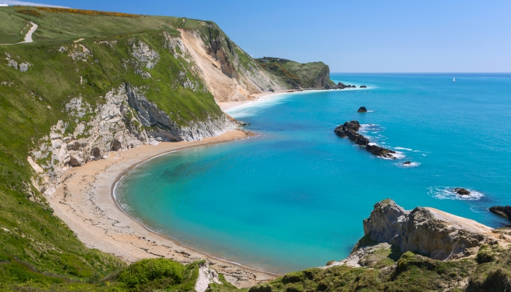
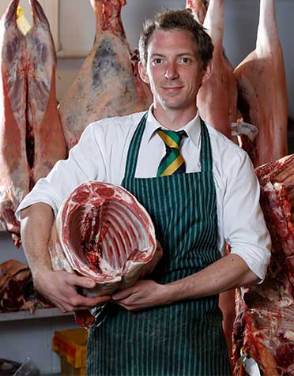
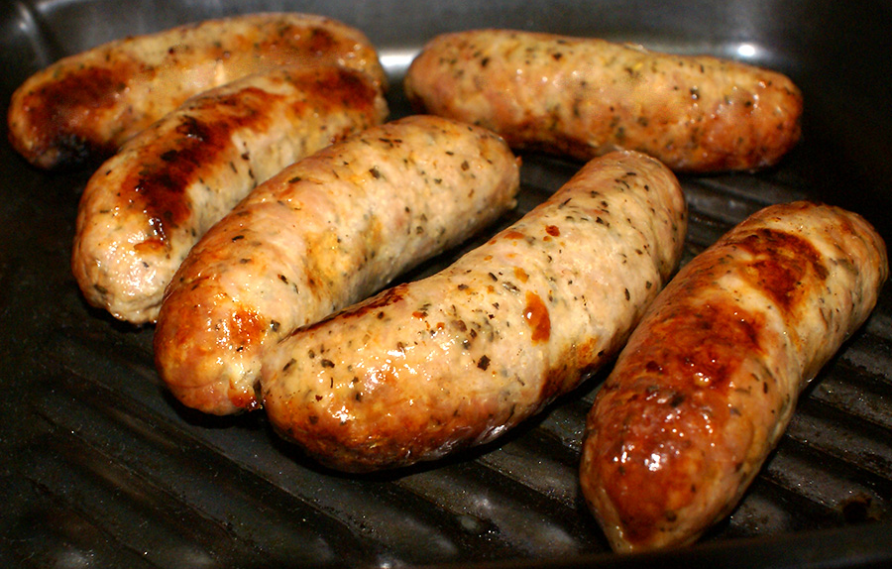
Vocabulary
Coast
Butcher
Sausages
Rude The opposite of “polite.”

Slide 4
Time: the present
Place: Hastings, on the southeast coast of England
My Aunt Brenda owns a small hotel called the Sea View Guesthouse in Hastings. It's got five bedrooms and it's a very good guesthouse. People come from everywhere to stay there. Hastings is a good place to stay if you want to see the beautiful southeast coast of England. It's an old town. Aunt Brenda's house is over a hundred years old and she has managed it as a guesthouse for the last ten years. Aunt Brenda is a good-looking woman. Everybody says so. She's almost forty years of age with red hair and a mind of her own. Her husband is my Uncle Ralph and he loves her very much. Her guests always like her too.
My Uncle Ralph is a local butcher and he has a shop. The shop is well known in the town. He provides all the meat for the guesthouse. His sausages, Aunt Brenda always says, are the best in England. She always persuades her guests to have them for breakfast. Her 'Full English Breakfast', as she calls it, is famous in Hastings. Brenda's 'Full English Breakfast' includes bacon, eggs, mushrooms, tomatoes, toast and, of course, Uncle Ralph's sausages.

Slide 5
They are the most important part of it. Aunt Brenda takes great pleasure in the fact that all of her guests have tried Ralph's sausages and loved them.
All, that is, except Mr Dunn.
'Don't you worry,' Brenda told me. 'I'll make sure he eats Ralph's sausages before he leaves here. Just you wait and see!'
Aunt Brenda's 'Full English Breakfast' is mentioned in all the holiday web pages. It's the reason why most people stay at the guesthouse. If you don't eat it all, especially the sausages, she thinks you are just being rude. And there is no way she will accept that! She always likes to hear her guests say how much they enjoy the sausages. In fact, she expects them to say it.
Now don't think for one moment that Ralph's sausages are anything less than delicious. He makes sausages out of different kinds of meat. They are made in all kinds of different ways and flavours to please all kinds of tastes.
Except Mr Dunn's.

Slide 6
Aunt Brenda
What did you learn about Aunt Branda in the first part of the story?
Which of these adjectives would describe her?
shy / proud / stubborn / brave / lazy

Slide 7
Aunt Brenda
Do you know anyone like Aunt Brenda? Describe them to your group.
eg. My husband is a little like Aunt Brenda because he is very proud of what he does, but he doesn’t run a guesthouse…

Slide 8
You see, Mr Dunn was a vegetarian. A vegetarian doesn't eat meat at all. No chicken, no beef, no pork and not even any fish. In fact, Mr Dunn didn't even wear leather shoes. Even his sweaters, Brenda tells me, weren't made of wool.
'Now don't tell me that's normal,' Brenda told me. 'We've had vegetarians at the guesthouse before. I always manage to persuade them to have a sausage and once they've had one...' Here Brenda raised her eyes to the ceiling. When she did this, she meant, 'you know what happens next.' And, of course, I do. Nobody has ever tasted Ralph's sausages before and not wanted another. I could see that she wasn't going to let Mr Dunn be the first to refuse. Not if she could help it. I knew then that Mr Dunn, one way or another, was going to eat a sausage.
Me? I'm Claire, Aunt Brenda's niece. I live in Hastings, too, with my mum. My aunt and I have always got on well and I see a lot of her. We both love Hastings. Like many towns by the sea, it has lots of visitors. Some of them are rather strange. Some pass through and some stay. Seaside towns like Hastings seem to interest all kinds of people. I think that's part of the reason we both like Hastings.
But Mr Dunn was stranger than anybody I'd ever seen before.

Slide 9
To begin with, he looked as if he hadn't had a good meal for a long time. He was tall and thin and his hair was as grey as iron. His nose was big and made him look like a wild, hungry eagle. His eyes were deep in his head and his teeth were long and yellow. One thinks of vegetarians as being gentle people. He didn't look gentle at all. He looked like he could kill things with his teeth alone - if he wanted to.
Then there were his hands. They were long and he had thin fingers with thick, sharp fingernails. His fingers looked very strong. I don't know what he did for a living. I wouldn't like to work with him, I'm sure of that!
Mr Dunn was going to be staying at my aunt's house for three weeks. Aunt Brenda had to buy vegetarian stuff just for him, like soya milk. He never had cow's milk. She didn't like that! He always ate his cereal with soya milk for breakfast without speaking to anyone. She didn't like that either.
I have breakfast at Aunt Brenda's place every Saturday morning. She likes to look after her little niece, even though I am already seventeen years old. This Saturday she wanted me to talk to Mr Dunn.
'You see what you can find out about him, Claire!' she told me. 'I want to see him eating a nice sausage, not that soya rubbish! And please hurry up. He's already been here for over a week. I've only got ten days left to do it!'
I don't see anything wrong with being a vegetarian, I really don't. But you don't argue with Aunt Brenda.

Slide 10
Vegetarians
What is a vegetarian?
What would you serve a vegetarian if they came to visit you?

Slide 11
Comprehension
As you read the next section, find the answers to these questions:
What does Claire have for breakfast?
What does Mr. Dunn eat for breakfast?
Why has Mr. Dunn got to be careful with his diet?
Has Mr. Dunn ever eaten meat?

Slide 12
So, at eight o'clock on Saturday morning, I was sitting across the table from Mr Dunn. I was given my 'Full English Breakfast', complete with Ralph's beautiful sausages, and Mr Dunn had his cereal and soya milk.
'Good morning!' I said cheerfully. 'Lovely day, isn't it?'
Mr Dunn looked up from his bowl. His eyes were big and grey.
'Hmm...' he replied with a voice that sounded like a bear with a bad throat. The sun was shining. It was early September. It was a lovely day.
'Have you tried these sausages?' I asked. 'They really are delicious!'
'I don't eat meat,' he said. 'Not any more.'
'Er... you used to eat it then?' I asked.
Mr Dunn gave me a bad-tempered look and then he answered slowly, 'I was told I had to give it up.
'Er... for health reasons?' I asked.
Mr Dunn almost smiled at me as he raised a corner of his mouth. 'Oh, yes. My health... and others' too!'
I heard him make a deep sound that may have been laughter - it was hard to tell with Mr Dunn.

Slide 13
'Surely just one sausage wouldn't hurt you? I said, holding up a piece on my fork, as if to make my point clear. They really are good!'
Mr Dunn said nothing, but the look he gave me was enough to make me shut up.
I finished my breakfast and left as soon as I could.
'For health reasons?' said Brenda over a cup of tea later that morning. 'Ralph's sausages would be really good for anybody's health! He needs a bit of meat if you ask me. It would do him good.'
I could see by the look in her eyes that Brenda was thinking of something. When Brenda starts thinking of something, it usually means trouble for somebody. Usually me.
'You say he used to eat meat?' Brenda looked towards me. 'He ate it once; he'll eat it again. I just to have to think of a plan...'
'Oh, no!' I thought to myself.

Slide 14
Brenda had, of course, tried to interest Mr Dunn in her sausages from the first day he arrived. Every morning she asked him again until he told her not to. That was only on the third day. So Brenda said nothing more and gave him his vegetarian breakfasts. She asked him about himself, just to make conversation. The truth is, Brenda is the kind of person who likes to know other people's business. She didn't get much out of Mr Dunn, but she didn't give up. Eventually, on the Monday of the second week, she got some information out of him.
'So that's what he told me, Claire,' she said. 'He's resting after an illness. He didn't say what it was, but he has to be careful with his diet. I told you he looked ill, didn't I? Anyway, anybody can see that all he needs is some good meat inside him. It would do him a lot of good. You can see in his eyes he wants meat. I've seen him looking at the other guests when they're eating their sausages. You can't tell me he's happy with cereal and soya milk!'

Slide 15
Role-play
Student A: you are Claire.
You don’t think there’s anything wrong with being a vegetarian.
You think it’s fine that Mr. Dunn doesn’t want to eat meat.
Student B: you are Aunt Brenda.
You want Mr. Dunn to try some of Ralph’s sausages.
Try to get Claire to help you.

Slide 16
A few days later I stopped at Aunt Brenda’s guesthouse to see what was happening with Mr Dunn.
'He's agreed to try a sausage,' my aunt told me excitedly.
'Really?' I said. I was amazed.
'Well, he said he might try a vegetarian sausage,' she said.
'So is Uncle Ralph going to make some?' I asked her.
'Well, that's what I told Mr Dunn,' my aunt replied. 'I said they would be ready on Saturday.' And then she added, 'Oh, and I also said that you would try them first and let him know what they are like!'
But, of course, Brenda was lying about the sausages. Ralph had never made vegetarian sausages in his life and he wasn't going to start now.
'Is this a good idea?' I said to my aunt slowly. 'They're not going to be vegetarian sausages at all: they'll be meat sausages, just like all the others. You're telling lies to Mr Dunn, Aunt Brenda!'
'Ah, but he won't know,' said Brenda, looking me in the eye. 'Not if nobody tells him!'
'But why do you care so much?' I asked. 'It's only a sausage!'

Slide 17
I already knew the answer. To Brenda, her 'Full English Breakfast' was what she was known for. It just wasn't a 'Full English Breakfast' without Ralph's sausages. And nobody had ever turned down the famous sausages. To turn down Brenda's sausages was to turn her down and she didn't like that at all!
I knew then that Mr Dunn didn't have a chance.
The next Saturday I arrived early at my aunt's guesthouse. I knew what to do. I sat opposite Mr Dunn during breakfast so that he could see the beach through the window. Brenda’s guesthouse was also famous for its views of the sea. She thought the sea air helped her guests to enjoy their food more.
There was a street between the guesthouse and the beach and the windows were very big so that people passing by could see everybody enjoying their food. It was good for business.

Slide 18
Mr Dunn looked even more bad-tempered than usual. He seemed to have a cold because he sneezed a lot.
Anyway, soon my aunt came out with my breakfast. It had bacon, egg, mushrooms, tomatoes, toast and Uncle Ralph's 'vegetarian sausages. All cooked perfectly. Of course, the sausages were meat sausages as usual, but I didn't tell him that.
I started eating my breakfast hungrily.
'They really are so delicious,' I said, chewing one of my sausages with a smile.
Mr Dunn looked up. Was he showing some interest at last?
'Amazing,' I said. 'So tasty.'
'And are they completely vegetarian?' he asked.
'Brenda says they are all soya and herbs, but they taste just like the best sausages ever. No meat at all, she says. Nobody could ever tell the difference. Would you like to try one?'
That's when he finally agreed to try one.

Slide 19
True or false
Ralph is going to male some vegetarian sausages
Brenda doesn’t like it when people don’t eat her food
People can see the sea from the dining room of Brenda’s guesthouse
It’s cold in the dining room

Slide 20
Language
What do you think the meaning of these phrases is?
I don't know what he did for a living. I wouldn't like to work with him, I'm sure of that!
He needs a bit of meat if you ask me. It would do him good.
Nobody had ever turned down the famous sausages. To turn down Brenda's sausages was to turn her down and she didn't like that at all!
People passing by could see everybody enjoying their food. It was good for business.
They taste just like the best sausages ever. No meat at all, she says. Nobody could ever tell the difference.
She's almost forty years of age with red hair and a mind of her own.

Slide 21
Prediction
How do you think the story will end?
Will Mr Dunn realise the sausage is filled with meat?
If he eats the sausage, what do you think will happen?

Slide 22
Brenda brought in just one meat sausage on a plate. It was beautifully cooked, all golden brown, and it smelled wonderful to me. I'm not sure Mr Dunn could smell it properly with his cold. But he certainly looked at it with hungry eyes.
We watched as Mr Dunn cut a small piece and put it on his fork. He put it to his nose and tried to smell it. He closed his eyes and put it into his mouth. He chewed it for a few seconds and smiled.
Brenda smiled at me. It had worked! Mr Dunn liked them!
Suddenly, Mr Dunn made a horrible sound, like an animal. He stood up and held his throat tightly. We watched as he seemed to grow in front of us. One moment he was Mr Dunn, the next moment he was bigger, greyer and... hairier. His ears grew and his face got longer. He cried out, just like a wolf, and jumped up from his chair.
Then he jumped across the table and straight through the window. There was a huge crash as broken glass was sent flying all over the street. He landed outside and looked around like a frightened animal. He went down onto his hands - if they were still hands - and ran straight into the road and the busy morning traffic. We couldn't see him. We heard a crash and I heard some people scream. A bus stopped suddenly.

Slide 23
When we went outside, we expected to see Mr Dunn lying in front of the bus. We saw the driver standing in the road.
'Where did that thing come from?' he asked. 'I mean, just look at the size of it!'
'He is a man staying at my aunt's guesthouse,' I told the driver without looking. 'He came out of there. His name is-'
'Man? What are you talking about?' said the driver. 'Just take a look at it!'
Aunt Brenda and I looked. There, lying dead on the ground, was the body of a huge grey dog. Its mouth was open and it had long yellow teeth. Its feet, or rather paws, were huge with thick sharp claws. It was bigger than any dog Id ever seen in my life.
'That's a wolf!' somebody shouted.
They were right: it was a wolf. But what was a wolf doing on a busy road in Hastings?
We never saw Mr Dunn again. Nobody knew anything about him. We never found out who he really was.
Or, indeed, what he really was.
Aunt Brenda still manages her guesthouse and cooks her 'Full English Breakfast', but she doesn't mind if her guests want cereal instead of sausages now.
In fact, I think she prefers it.

Slide 24
News report
Imagine you are a reporter who has arrived on the scene after Mr. Dunn ate the sausage. Write a news story of 75-150 words explaining what is happening at the scene.

