Slide 1
Experimental Design
Dr Ellen Fry
The Transformation by Innovation in Distance Education (TIDE) project is enhancing distance learning in Myanmar by building the capacity of Higher Education staff and students, enhancing programmes of study, and strengthening systems that support Higher Educational Institutions in Myanmar. TIDE is part of the UK-Aid-funded Strategic Partnerships for Higher Education Innovation and Reform (SPHEIR) programme(www.spheir.org.uk). SPHEIR is managed on behalf of FCDO by a consortium led by the British Council that includes PwC and Universities UK International. The TIDE project will close in May 2021.

Slide 2
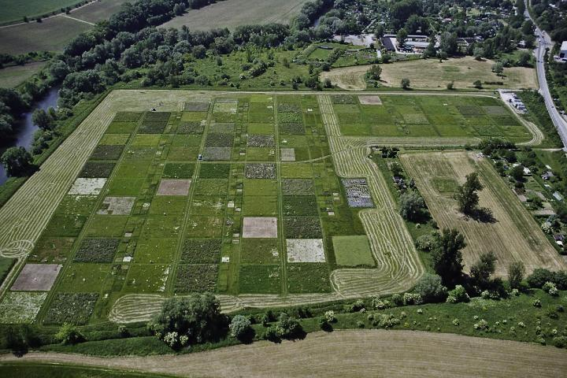
Experimental Design
Week 9 Lecture 18
Photo credit: Christoph Scherber

Slide 3
Learning outcomes
Be able to design a controlled experiment and explain your choices.

Slide 4
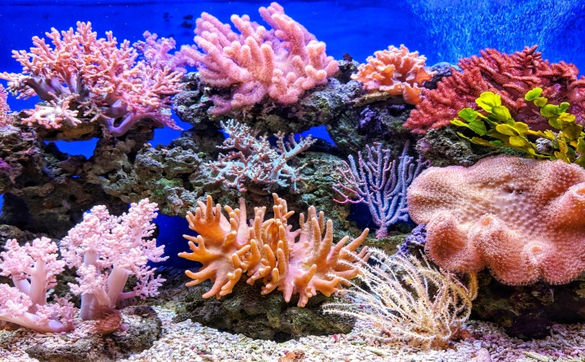
An experiment is where you manipulate one or more variables and measure their effect on another variable.
Independent variable: the cause of the effect you see. It is independent of other variables.
Dependent variable: the variable that is affected by your manipulation. Its value depends on the independent variable.
e.g. Will increasing temperatures under climate change affect coral populations?
Independent: temperature
Dependent: coral

Slide 5
Step 1: the research question
Where are knowledge gaps?
- background reading is needed.
Examples:
How will increased temperature affect populations of fish on a coral reef?
How do plants change soil nutrients?
How does predation affect food webs?

Slide 6
What variables are important?
Use your knowledge to think about what to include.
What is likely to have an effect on your organism or system of interest?
List dependent and independent variables.

Slide 7
Confounding variables
Many things are likely to impact your dependent variable that you are not interested in. You will need to make sure these are either controlled for, or accounted for in your analysis.
e.g. If you’re interested in temperature effects on plants, you will also need to think about effects of water.
You could do this experimentally, through making sure all plants have the same soil moisture
Or statistically by measuring the moisture then including it as a random effect.

Slide 8
2. Write your hypothesis.
Hypothesis testing is a formal procedure for investigating our ideas about the world using statistics. It is most often used by scientists to test specific predictions, called hypotheses, that arise from theories.
A hypothesis is a falsifiable statement that you can test.
You would create a null hypothesis (H₀) and an alternate hypothesis (H_{A}).
e.g. H₀= Myanmar does not have any bat species.
H_{A}= Myanmar does have bat species.

Slide 9
Think about where and how
Field or lab or greenhouse?
All have advantages and disadvantages.
Field- more ‘real’ but more confounding variables.
Greenhouse- more easily controlled, some realism.
Lab- very tightly controlled. Loses realism though.

Slide 10
3. Design experimental treatments
What change are you interested in? Water? Temperature? Nutrients? Species interactions?
How can you change this? Is it possible?
How big a change will this be?
What is your reason for this?
Are you staying realistic? Or looking for limits?
Categorical or continuous variables?

Slide 11
Control groups
To detect a treatment effect, we need to have a control group that has not been changed.
Always need to compare, so if you have a drought treatment, you need a treatment that has the normal ‘ambient’ rainfall. Then you can have confidence in your effects.
If you’re in very controlled conditions you need to simulate the natural conditions as closely as possible.

Slide 12
Factorial designs
If you have two or more treatments, these designs look at every combination of your treatments, so you have every possibility measured.
These are the easiest to analyse and to discuss.
A FACTOR is an independent variable e.g. drought. This is divided into LEVELS - drought and well-watered.
Drought
Warm Dry
Warm Wet
Warming
Unwarmed Dry
Unwarmed Wet

Slide 13
4. Consider the study size
What is n?
How many is appropriate or feasible/cost effective?
Can you achieve it? Each step needs to be possible.
There needs to be enough to represent the range of outcomes if possible.
More is usually better because it increases statistical power- if an effect has occurred it will be apparent.
Also means you can spot outliers (odd cases).

Slide 14
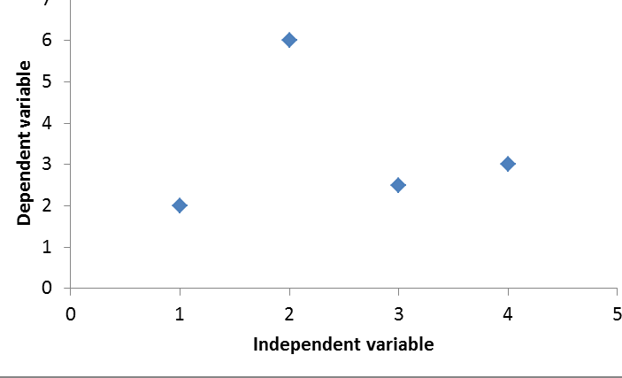
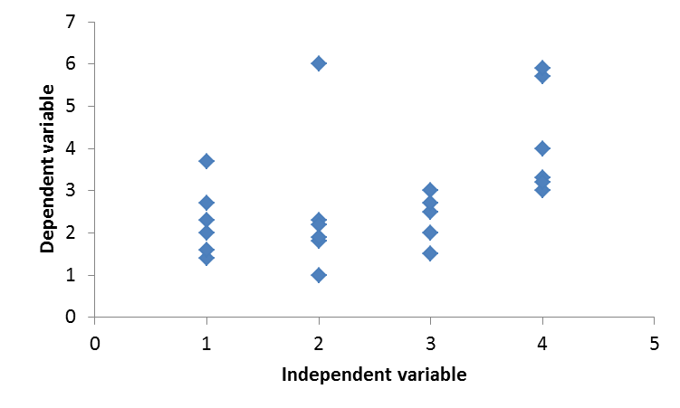
Replication
Each treatment MUST have replicates. If you only have one of a treatment, you don’t know if your treatment has worked.
You need to have at least 4 replicates to be able to see a difference.

Slide 15
5. Randomisation
Your experimental subjects must be assigned to random groups or locations.
E.g. if you have pots in a greenhouse, the treatments must be assigned to random pots, and these must be randomly located in the greenhouse, and also sampled randomly.
You can also divide them into blocks and randomise within the blocks. Each block will contain a representative of each treatment.

Slide 16
Block designs
Useful for statistics.
Important if there are changes that you cannot account for, e.g. a slope in a field, shade over a river, a hotter part of a greenhouse.
Good way to deal with confounding factors.

Slide 17
6. Take your measurements
Take a measurement of all your samples BEFORE the treatments begin.
Each sample needs to be treated the same as the others as far as possible.
Try and take measurements in as short a timeframe as possible.
Block designs might be useful here as well- could do a block on one day and another the next.

Slide 18
Repeated measures
Is this looking at an effect over days? seasons? Remember the lynx and snowshoe hare. How many times do you need to take a measurement to see the whole effect?

Slide 19
7. Analyse your data
A null outcome is where your treatments have no effect. You would accept the null hypothesis.
1. Prepare the data- enter the data, clean, check, save as a database.
2. Store metadata- when were measures taken, what instrument was used, who did it? Any analytical blanks and so on.
3. Describe the data- simple graphics analysis. What do the data show?
4. Test hypotheses and models.

Slide 20
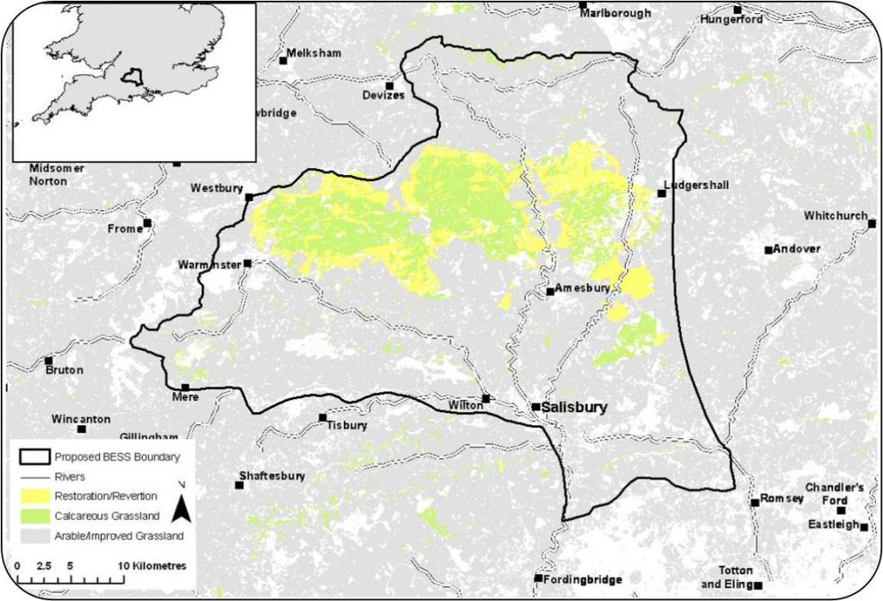
Example: Wessex BESS

Slide 21
Research question
What ecosystem functions are delivered in a chalk grassland?
How do plant communities deliver these functions?
Will plant communities show different rates of ecosystem function under climate change?

Slide 22
Research hypotheses
Plant species with functional traits that exploit resources have increased ecosystem function rates.
Exploitative functional traits are not equipped to cope with abiotic stress, so they will have lower rates of function under drought and poor recovery.

Slide 23
Randomised Block Design
Three plant functional groups:
All 7 combinations
Six replicates
Blocks to account for slope
Repeated measures
2. Very shallow, simple
1. Deep, simple
3. Shallow, complex

Slide 24
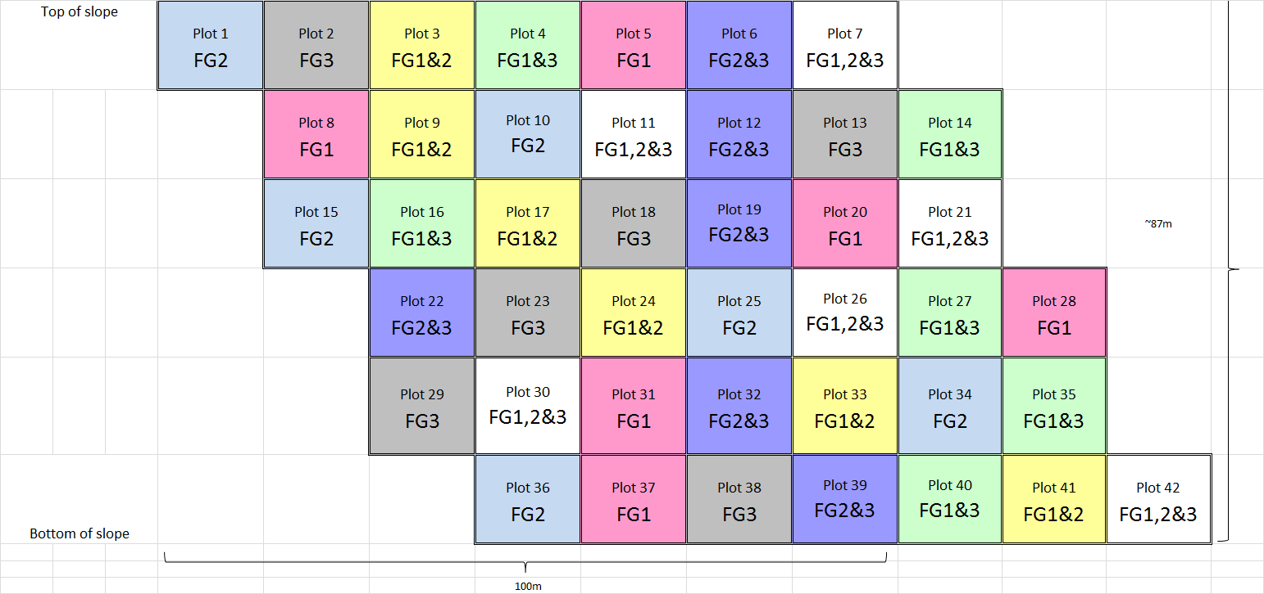
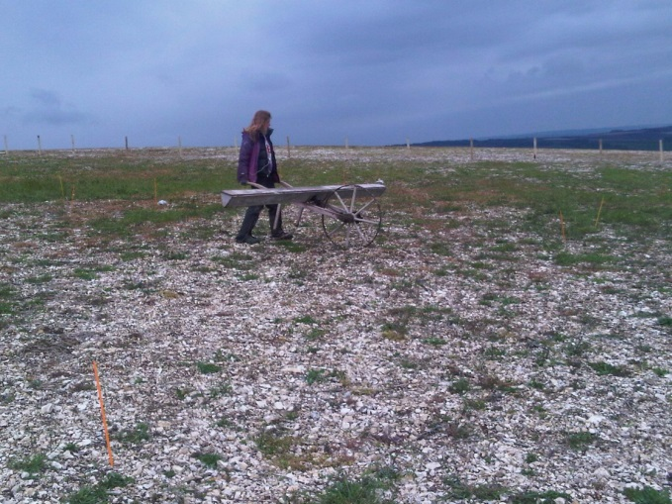
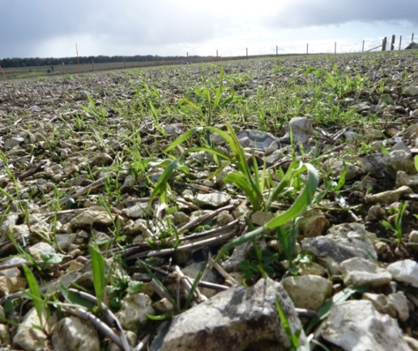
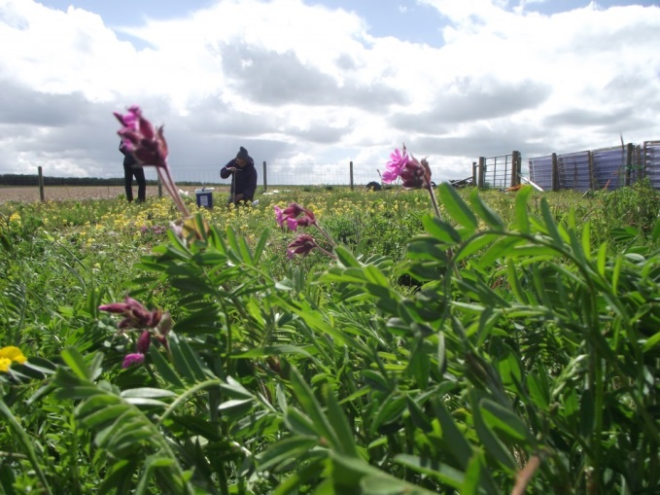
Easton Farm (Winklebury Hill)

Slide 25
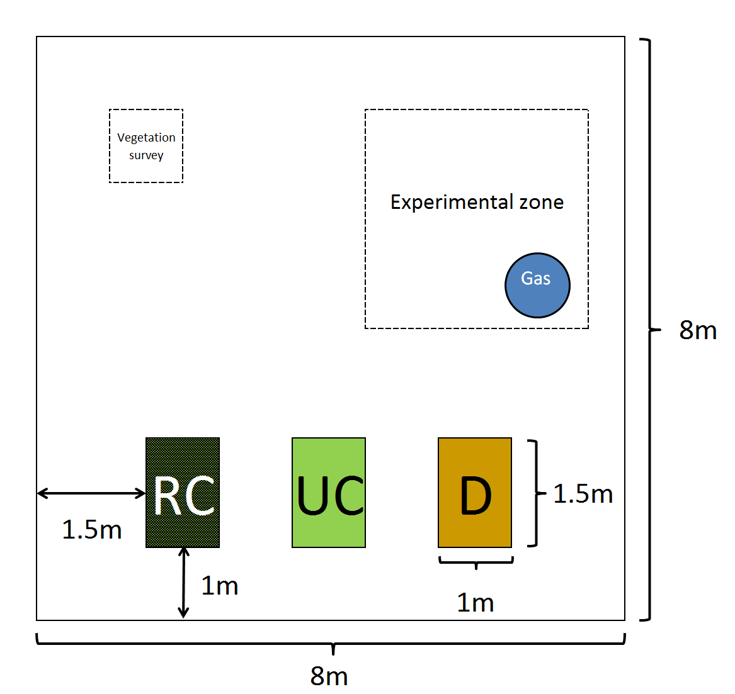

Slide 26
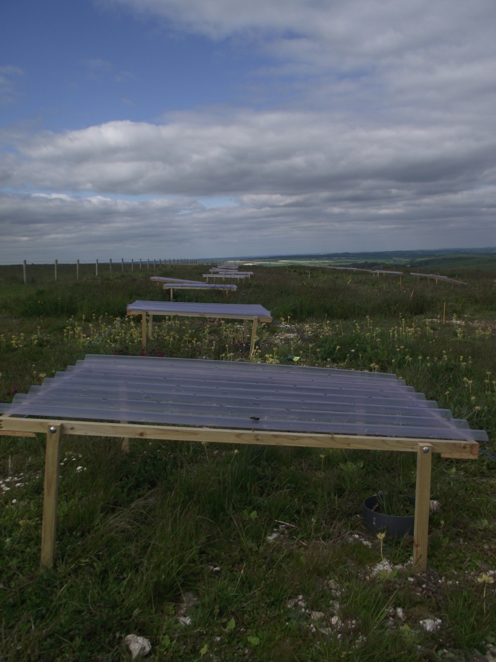
Rain shelters give 100% drought for six weeks (IPCC high emission scenario for 2100).
Fry et al. 2018 Ecology

Slide 27
Summary
Experiments must be carefully planned.
All the decisions you make must be justifiable.
Plan for your analysis at the beginning so you collect appropriate data.

