Slide 1
Building effective Quizzes on OpenLearn Create
www.open.edu/openlearncreate
Notes:
Mailbox for enquiries: openlearncreate@open.ac.uk

Slide 2
Tools on OpenLearn Create for building a course
Tools for layout and setup
Tools for learning activities
Tools for Online assessment
Book
Heading
Label
Page
Subpage
URL
Blog (requires tutor)
Choice (poll)
Forum (requires moderator)
Glossary
Wiki (requires tutor)
Quiz (avoid essay questions)
Workshop (requires moderator)
(Configure for tracking progress)
Could lead to a Digital Badge and/or a
Statement of Participation
Notes:
OpenLearn Create has several Moodle tools for layout and setup, learning activities and online assessment.
Add these tools via the ‘Add activity’ or ‘Add resource’ option.
There are some additional tools which can only be activated by OU staff.

Slide 3
How to build a Moodle quiz
Where to find good online guidance about:
The purpose of online quizzes for learning
How to write a good quiz question which tests understanding rather than memory
Some of the question types to use when building an online quiz and a demonstration of how to configure those question types
Notes:
The aim of this session is to provide guidance about the purpose of online quizzes for learning, how to write good quiz questions which test understanding rather than memory and how to configure some of the question types available in Moodle quiz.

Slide 4
Online assessment
Does your course need assessment of some kind?
Non-graded informal assessment activities through the course
Graded assessment at intervals or at the end of the course
Evidence of learning (e.g. a badge, a statement of participation)
Polls, quizzes, questionnaires, reflective exercises and self assessment questions (for developing critical thinking skills) provide different methods for learners to check their understanding.
Practice quizzes (no pass grade) – formative assessment
Graded quizzes (pass grade) – summative assessment
Quizzes can have automated feedback for learners
Notes:
You need to decide if your course needs assessment of some kind. Does it need non-graded informal assessment activities throughout the course? Do you plan to have graded assessment during or at the end of the course? Do you plan to provide some kind of evidence for learning, based on the assessment, such as a digital badge or a statement of participation, or will the learner have to complete a formal examination at an exam centre?
You could use polls, quizzes, reflective exercises and self assessment questions for learners to check their learning. This session will concentrate on quizzes.
You could include practice quizzes (no pass grade) – formative assessment in your course. You can have graded quizzes (with a pass grade) – summative assessment.
Quizzes in online courses can have automated feedback for learners, this is useful if there is no tutor or teacher available to mark the quiz.

Slide 5
Practice quizzes
Formative (practice) quizzes help learners test how much they have absorbed during a course topic, providing stepped feedback for multiple attempts at a question. For example:
(Source: 6.5.3 Quiz tool, How to make an open online course)
Learners are asked to complete a quiz checking whether they have understood a concept which has been explained in the text.
The quiz consists of some multiple choice and some drag and drop questions.
The questions give the learner feedback after each attempt which builds upon the previous information provided and after the third attempt directs the learner back to specific course material to review before they attempt the quiz again 24 hours later.
None of the questions are graded or carry any penalty and the completion criteria is set to record that the learner attempted and submitted the quiz.
Notes:
Formative (practice) quizzes help learners test how much they have absorbed during a course topic, providing stepped feedback for multiple attempts at a question.

Slide 6
Graded quizzes
Summative (graded) quizzes capture learner responses to questions which count towards course completion criteria. For example:
(Source: 6.5.3 Quiz tool, How to make an open online course)
Learners are asked to complete the end of course quiz.
The quiz consists of multiple choice, drag and drop, Yes/No, matching and numerical questions.
The questions give the learners feedback after each attempt and after the third attempt directs the learner back to the specific course material to review before they attempt the question again 24 hours later.
All the questions are graded, some carry a percentage deduction penalty for second and third attempts.
The completion criteria is set to record the grade which the learner achieves on the quiz. If the learner fails to achieve the pass grade they may reattempt the quiz 24 hours later.
Notes:
Summative (graded) quizzes capture learner responses to questions which count towards course completion criteria. They can also provide feedback to learners.

Slide 7
Reflective learning and quizzes
Provide a case study with a series of questions which promote reflective thinking and analysis, for example:
(Source: 6.3 Looking at reflection through assessment, How to make an open online course)
Instructions to learner:
Read the following case study about how this person coped with the effects of their illness. Write down your thoughts on the situation in your reflective log based on the principles discussed in this section and answer the quiz questions in light of your conclusions.
Case study text
Quiz questions
Responses graded based on criteria in the quiz settings
Notes:
You can use quizzes and reflective learning in combination, which can prompt deep thinking about a situation.
This often means providing a scenario or case study with a series of questions.

Slide 8
Quiz question behaviours
Deferred feedback A learner answers all the questions before any feedback is provided. This kind of question behaviour often encourages learners to concentrate on their overall mark than on any feedback specific questions which you might provide.
Behaviour is set at quiz level, not at question level.
Interactive with multiple tries Provides instant feedback, hints and multiple tries.
Manually graded For essay type questions especially, though can be used for all other question types.
Immediate feedback Provides instant feedback with no hints or multiple tries
Adapted from ‘How to make an open online course’: 7.1.2 Question behaviour
Notes:
Quiz question behaviours are set at quiz level. In Moodle quiz the four main behaviours are:
Deferred feedback
Immediate feedback
Interactive with multiple tries
Manually graded
Quizzes on OpenLearn are set up using Interactive with multiple tries.

Slide 9
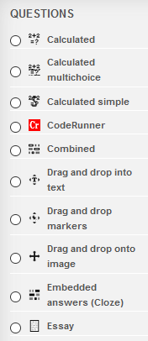
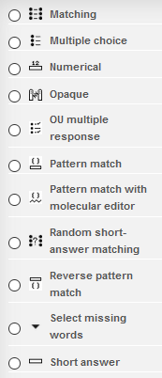
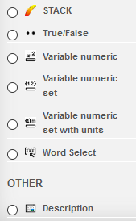
Question types in Moodle Quiz
For examples of how to use these different question types in online courses,
see 7.1.2 Question behaviour in ‘How to make an open online course’.
Notes:
Designing a good online quiz is harder than you might think.
Moodle quiz is very sophisticated and there are plenty of question types. Some of these are specifically for mathematical questions while others can be used for any subject area.
The essay question type is only suitable for a quiz which will have a human marker – it cannot be marked by the computer.
It is good practice to have a few different question types in a quiz, otherwise they become predictable and boring. The worst kind of quiz is a series of ‘true/false’ type questions.

Slide 10
Question writing activity
Step 4: Test your question versions by inviting 2 colleagues to review and give feedback on which version of the question is more effective for demonstrating learner understanding.
Step 3: Write the questions in the question type formats you have chosen, as well as hint text for multiple tries and some feedback text.
Step 2: Look at different question types and select 2 ways you could ask the question.
Step 1: Draw up different ways to ask a quiz question, using the interactive with multiple tries feedback option.
Adapted from ‘How to make an open online course’: 7.1. Question behaviour, Activity 1
Notes:
I strongly suggest that before you attempt to set up a quiz in Moodle, you write your quiz questions and test them with colleagues. These four steps are a good process to follow when writing quiz questions.
Step 1: Draw up different ways to ask a quiz question, using the interactive with multiple tries feedback option
Step 2: Look at different question types and select 2 ways you could ask the question.
Step 3: Write the questions in the question type formats you have chosen, as well as hint text for multiple tries and some feedback text.
Step 4: Test your question versions by inviting 2 colleagues to review and give feedback on which version of the question is more effective for demonstrating learner understanding.

Slide 11
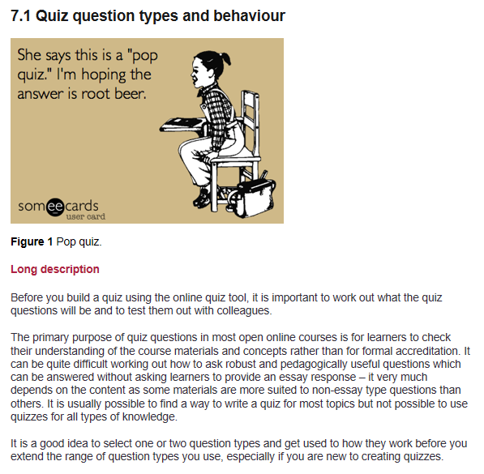
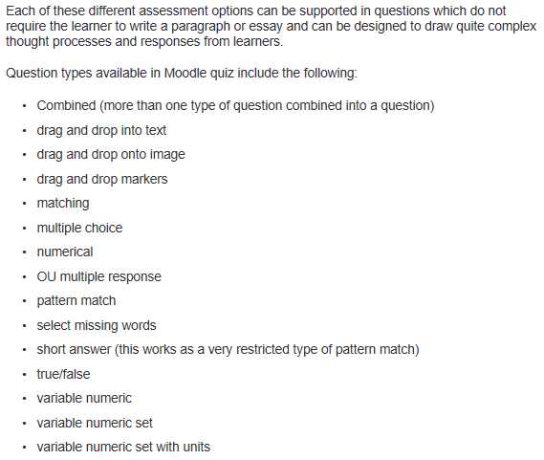
Designing effective quizzes 1
How to make an open online course – How to build a quiz for open online assessment: (Source: 7.1 Quiz question types and behaviour)
Notes:
There are various resources on OpenLearn Create which will help guide you when designing an effective quiz:
How to make an Open Online Course http://www.open.edu/openlearncreate/course/view.php?id=2221
Course builder guide http://www.open.edu/openlearncreate/course/view.php?id=2039
eAssessment with Moodle http://www.open.edu/openlearncreate/course/view.php?id=1581
Hands-on Moodle Quiz http://www.open.edu/openlearncreate/course/view.php?id=1643
How to make an open online course – How to build a quiz for open online assessment: http://www.open.edu/openlearncreate/mod/oucontent/view.php?id=87889
How to make an open online course has a section on building quizzes for online assessment which also covers the various question types.

Slide 12
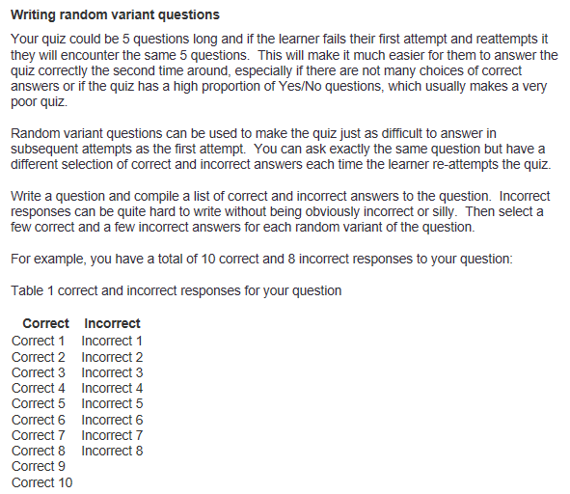
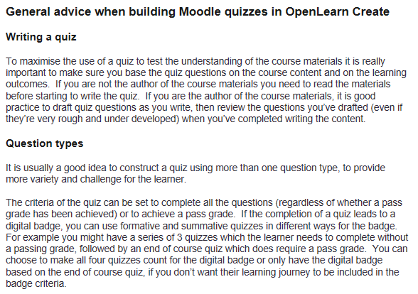
Designing effective quizzes 2
Course builder guide – quizzes: (Source: General advice when building Moodle quizzes in OpenLearn Create)
Notes:
Course builder guide – quizzes: http://www.open.edu/openlearncreate/mod/book/view.php?id=66368&chapterid=179
If you want the learner to see a different set of questions every time they attempt the quiz, you will need random variant questions in your quiz, which means you need to write more questions than will appear to the learner.
The course builder guide on OpenLearn Create has a section about writing random variant questions.

Slide 13
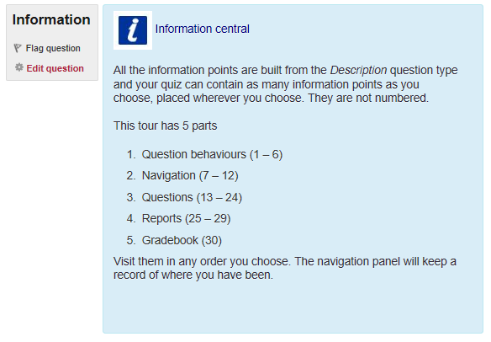
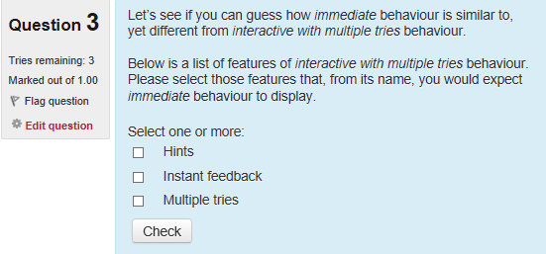
Designing effective quizzes 3
Hands-on Moodle Quiz: http://www.open.edu/openlearncreate/course/view.php?id=1643
Notes:
Hands-on Moodle Quiz: http://www.open.edu/openlearncreate/course/view.php?id=1643
Hands-on Moodle quiz has a lot of information about configuring quizzes and how the gradebook works.

Slide 14
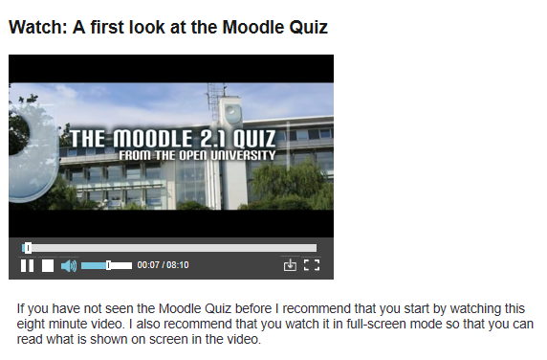
Designing effective quizzes 4
eAssessment with Moodle: hhttp://www.open.edu/openlearncreate/course/view.php?id=1581
Notes:
eAssessment with Moodle: hhttp://www.open.edu/openlearncreate/course/view.php?id=1581
eAssessment with Moodle has a video introducing Moodle quiz and some very useful worked examples of different question types.

Slide 15
Quiz creation process and checklist
Identify the topics you want to cover.
For each topic, draw up possible ways to ask the question, referring to examples of the different question types in use.
Decide on the feedback type for the quiz (a quiz can only have one feedback type for all the questions, e.g. interactive with multiple tries or deferred feedback).
Draft questions for each topic in the question formats you have chosen.
Write hint text and feedback for interactive with multiple try questions.
Write feedback text for deferred feedback and immediate feedback questions.
Compile all the questions into quizzes and organise them into a logical order, grouping the random variant versions together under one question number (for example 3a, 3b, 3c each being a variant for question 3).
Ask colleagues to review the questions and feedback text. Request that they provide comments on the pedagogical strength of the questions. Tell them about the potential audience for the open online course and the assessment strategy (including if the quiz is summative or formative).
Review and if necessary revise the questions, feedback text and assessment strategy in light of comments from colleagues.
Adapted from ‘How to make an open online course’: 7.2 Quiz creation process and checklist
Notes:
This quiz creation process and checklist is adapted from ‘How to make an open online course’.
Identify the topics you want to cover.
For each topic, draw up possible ways to ask the question, referring to examples of the different question types in use.
Decide on the feedback type for the quiz (a quiz can only have one feedback type for all the questions, e.g. interactive with multiple tries or deferred feedback).
Draft questions for each topic in the question formats you have chosen.
Write hint text and feedback for interactive with multiple try questions.
Write feedback text for deferred feedback and immediate feedback questions.
Compile all the questions into quizzes and organise them into a logical order, grouping the random variant versions together under one question number (for example 3a, 3b, 3c each being a variant for question 3).
Ask colleagues to review the questions and feedback text. Request that they provide comments on the pedagogical strength of the questions. Tell them about the potential audience for the open online course and the assessment strategy (including if the quiz is summative or formative).
Review and if necessary revise the questions, feedback text and assessment strategy in light of comments from colleagues.

Slide 16
Moodle Quiz
The quiz activity enables a teacher to create quizzes comprising questions of various types, including multiple choice, matching, short-answer and numerical.
The teacher can allow the quiz to be attempted multiple times, with the questions shuffled or randomly selected from the question bank. A time limit may be set.
Each attempt is marked automatically, with the exception of essay questions, and the grade is recorded in the gradebook.
The teacher can choose when and if hints, feedback and correct answers are shown to students.
Quizzes may be used
As course exams
As mini tests for reading assignments or at the end of a topic
As exam practice using questions from past exams
To deliver immediate feedback about performance
For self-assessment
Notes:
Once you have a set of questions for your quiz, you can start to build in your online course.
Moodle Quiz:
The quiz activity enables a teacher to create quizzes comprising questions of various types, including multiple choice, matching, short-answer and numerical. The teacher can allow the quiz to be attempted multiple times, with the questions shuffled or randomly selected from the question bank. A time limit may be set. Each attempt is marked automatically, with the exception of essay questions, and the grade is recorded in the gradebook. The teacher can choose when and if hints, feedback and correct answers are shown to students.
Quizzes may be used
As course exams
As mini tests for reading assignments or at the end of a topic
As exam practice using questions from past exams
To deliver immediate feedback about performance
For self-assessment
A quiz which is set up in a course which does not have tutor support MUST NOT include any essay type questions which require a human to mark them.

Slide 17
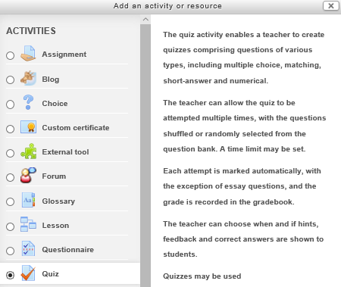
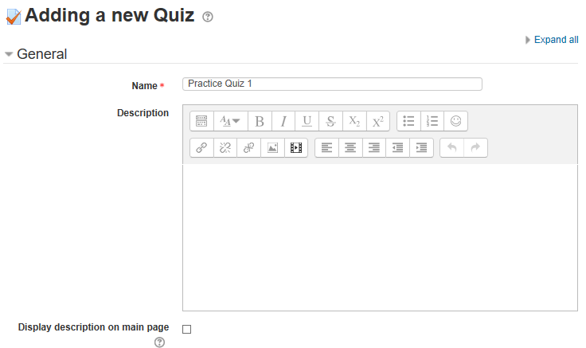
Build a quiz – step 1 (name the quiz)
Notes:
Create the quiz by clicking on add activity and selecting quiz. Fill in the adding a new quiz form – you will be able to update this any time while configuring the quiz (edit quiz settings).
Use Hands On Moodle Quiz http://www.open.edu/openlearncreate/course/view.php?id=1643 and the help text (question mark in a circle) to help with configuration.

Slide 18
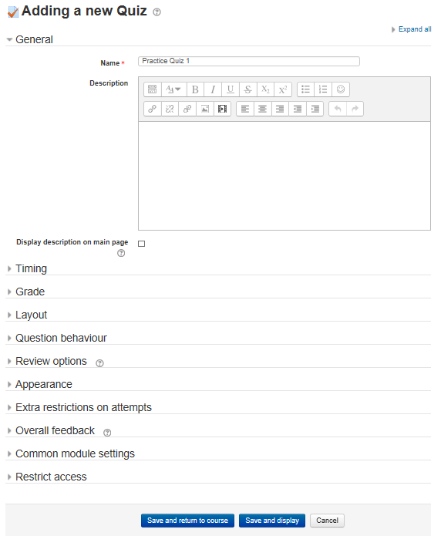
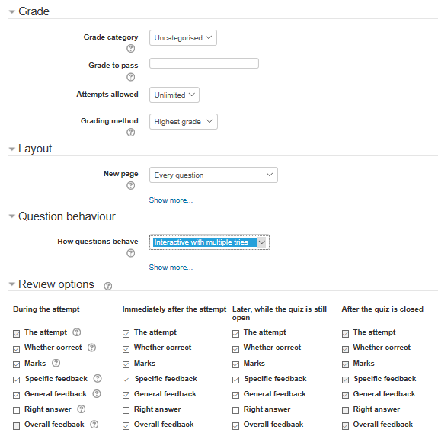
Build a quiz – step 2 (Grade)
Notes:
‘Adding a new Quiz’ form has various sections to configure. If you don’t know all the settings you want when you first set up the quiz, you can return to them later in the ‘Edit settings’ for the quiz.
For this quiz, I’ve chosen ‘Interactive with multiple tries’ question behaviour.

Slide 19
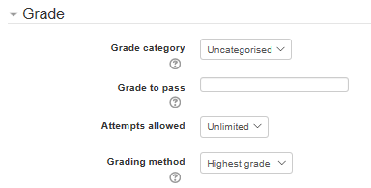
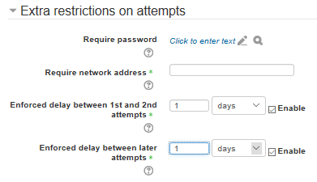
Build a quiz – step 3 (is there a Grade to pass?)
Keep ‘Grade to pass’ empty for a practice quiz.
For a graded course, insert the pass grade in the ‘grade to pass’ field, however this can be done later when all the quiz questions are set up and you know what the total grade will be.
To enforce a delay between quiz attempts (for time to revisit the course content before another attempt), use ‘Enforced delay’ in ‘Extra restrictions on attempts’ (the time options include minutes, hours, days, weeks).
Notes:
‘Grade’ is one of the sections in the form.
Keep ‘Grade to pass’ empty for a practice quiz.
For a graded course, insert the pass grade in the ‘grade to pass’ field, however this can be done later when all the quiz questions are set up and you know what the total grade will be.
‘Extra restrictions on attempts’ is used when you want to enforce a delay between each attempt of the quiz, for example to encourage learners to return to the course content to check their understanding.
To enforce a delay between quiz attempts (for time to revisit the course content before another attempt), use ‘Enforced delay’ in ‘Extra restrictions on attempts’ (the time options include minutes, hours, days, weeks).

Slide 20
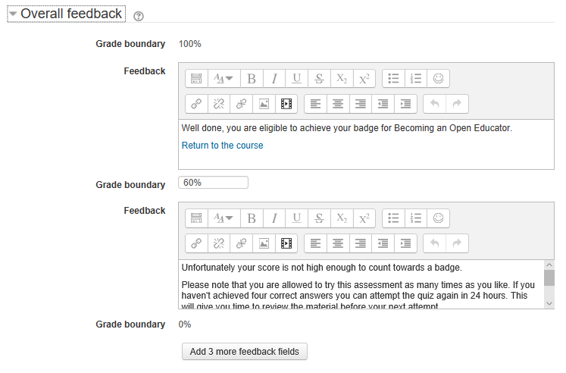
Build a quiz – step 4 (Overall feedback message)
Overall feedback is text that is shown after a quiz has been attempted. By specifying additional grade boundaries (as a percentage or as a number), the text shown can depend on the grade obtained.
Notes:
Overall feedback is text that is shown after a quiz has been attempted. By specifying additional grade boundaries (as a percentage or as a number), the text shown can depend on the grade obtained.
If there is a pass grade, place feedback for those who didn’t achieve the grade in the feedback box for that grade boundary.
Save and display the draft quiz.
The next step is to add questions to the quiz.

Slide 21
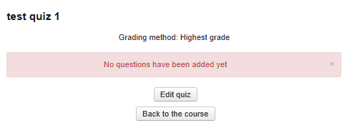
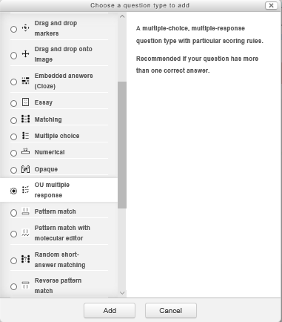
Build a quiz – step 5 (Add a question)
Notes:
Add quiz questions to your empty quiz via the edit quiz button and the add function.
You will have a choice of ‘a new question’, ‘from question bank’ or ‘a random question’.
For this example because I want to have random variant questions in the quiz which are not already in the question bank, I have chosen ‘a random question’ then clicked on ‘OU multiple response’ question type then clicked on the ‘add’ button.

Slide 22
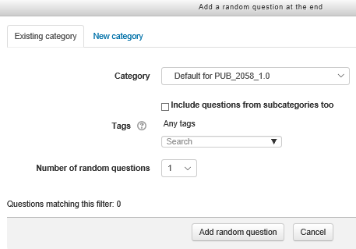
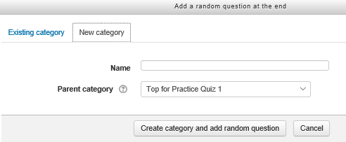
Build a quiz – step 6 (Add a random question)
Notes:
If you choose ‘A random question’ you will be prompted to create a new category for the question if you’re not using an existing question from the question bank.
The new category will be where you put all the random variants for that question.
When you have given the category a name, click on ‘create category and add random question’.

Slide 23
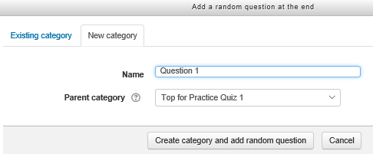
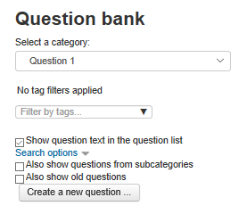
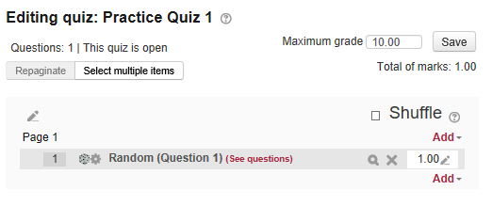
Build a quiz – step 7 (Add a random question)
Notes:
The new category called ‘Question 1’ is set up ready to add questions and will now appear in the quiz.
Add a question by clicking on ‘see questions’ and ‘create a new question.

Slide 24
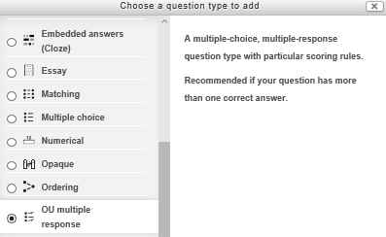
Build a quiz – step 8 (Multiple response question)
Notes:
In this example I am choosing to create a multiple response question to add to the new Question 1 category in the question bank, this will be the first variant of the question.

Slide 25
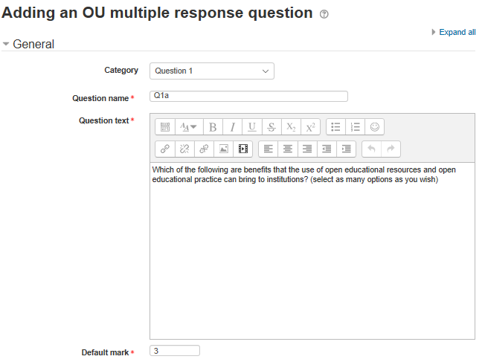
Build a quiz – step 9 (Multiple response question)
Each variant of the question needs to have its own name, for example ‘variant 1a, variant 1b, variant 1c’ or ‘Q1a’, ‘Q1b’, ‘Q1c’.
Insert the question text into the box and decide what the mark for the question will be (the default will be ‘1’)
Notes:
Each variant of the question needs to have its own name, for example ‘variant 1a, variant 1b, variant 1c’ OR ‘Q1a’, ‘Q1b’, ‘Q1c’.
Insert the question text into the box and decide what the grade mark for the question will be (the default will be ‘1’)

Slide 26
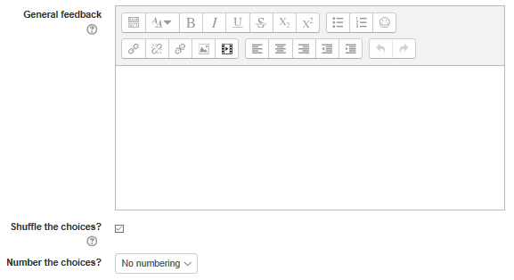
Build a quiz – step 10 (Multiple response question)
General feedback is shown to the student after they have completed the question. Unlike specific feedback, which depends on the question type and what response the student gave, the same general feedback text is shown to all students.
Notes:
General feedback is shown to the student after they have completed the question. Unlike specific feedback, which depends on the question type and what response the student gave, the same general feedback text is shown to all students.
You can use the general feedback to give students a fully worked answer and perhaps a link to more information they can use if they did not understand the question.
I usually shuffle the choices of answers so they don’t always appear in the same order and I generally don’t number them, but the choice is there to number them if you wish.

Slide 27
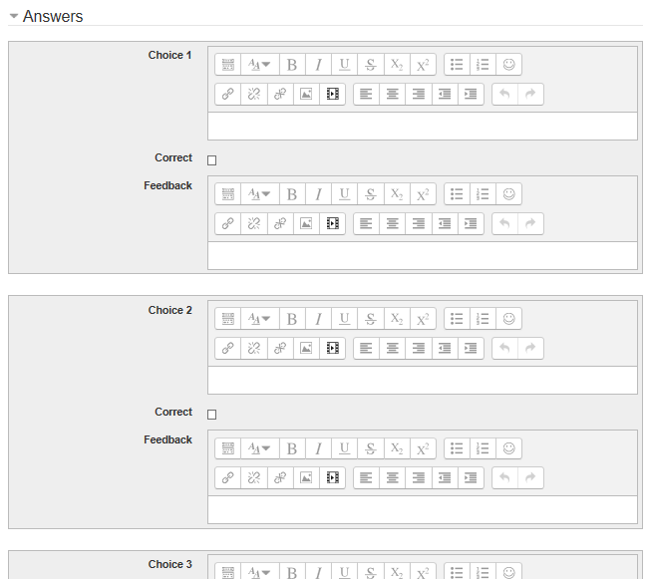
Build a quiz – step 11 (Multiple response question)
Insert an answer in each ‘choice’ box and use the ‘correct’ check box to indicate if the answer is correct or not.
There is also a space for feedback for each choice (this can be left blank if you don’t want to provide feedback).
Notes:
Insert an answer in each ‘choice’ box and use the ‘correct’ check box to indicate if the answer is correct or not. A multiple response question can have several correct and several incorrect answers.
There is also a space for feedback for each choice (this can be left blank if you don’t want to provide feedback).

Slide 28
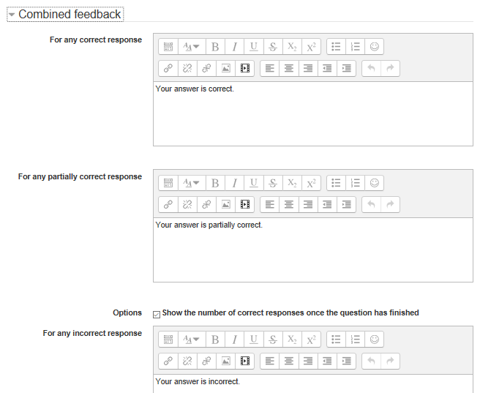
Build a quiz – step 12 (Multiple response question)
A general feedback message depending on whether the learner has answered a question correctly or not can be edited in ‘combined feedback’.
Notes:
A general feedback message depending on whether the learner has answered a question correctly or not can be edited in ‘combined feedback’.

Slide 29
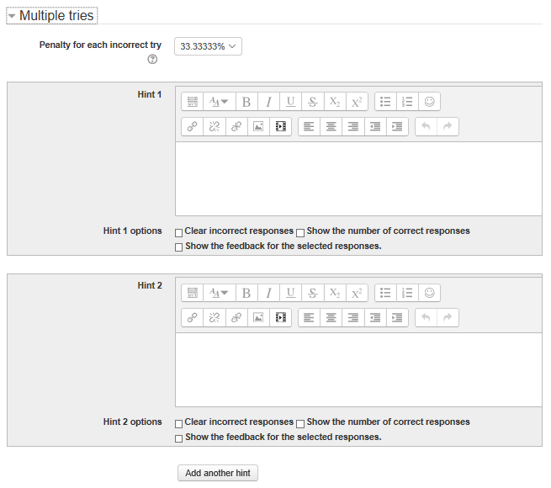
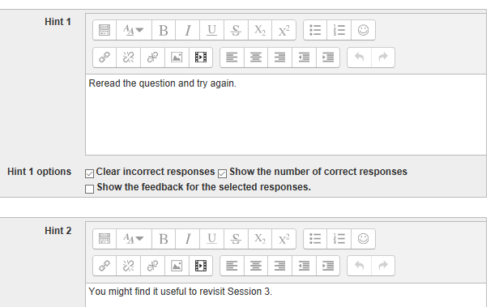
Build a quiz – step 13 (Multiple response question)
Notes:
When questions are run using the 'Interactive with multiple tries' or 'Adaptive mode' behaviour, so that the student will have several tries to get the question right, penalty option controls how much they are penalised for each incorrect try.
The penalty is a proportion of the total question grade, so if the question is worth three marks, and the penalty is 0.3333333, then the student will score 3 if they get the question right first time, 2 if they get it right second try, and 1 of they get it right on the third try.
If you want to allow learners to have more than one try for a question before they move onto the next question, you can provide hint text which helps them answer the question (this is where you can encourage some deeper thinking about the question and prompt learners to revisit some of the course content).

Slide 30
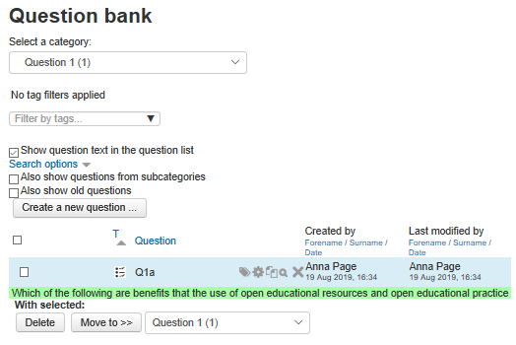
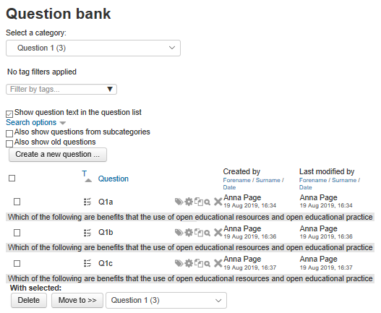
Build a quiz – step 14 (Random question - variants)
Notes:
Once you save the question it will appear in the question bank in the category. You can then add further variants of the question to the category.
In the example shown, the 3 variants all had the same question but the answer choices were a slightly different selection of right and wrong answers for each variant (there was quite a long list of right answers and a few wrong answers so these were divided up to make 3 random variant versions of the same question, none of the questions had all the possible right and wrong answers).

Slide 31
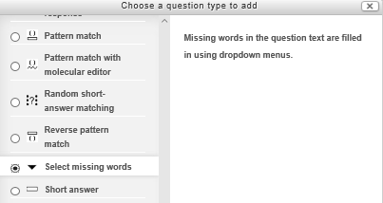
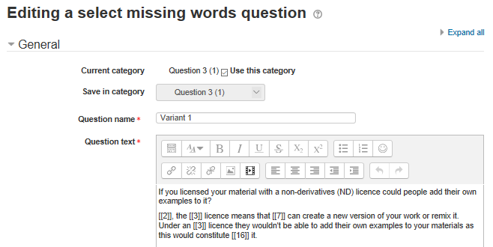
Build a quiz – step 15 (select missing words question)
Notes:
Use ‘Select missing words’ for a paragraph of text with some words missing.
Each choice has a unique number, with the correct choices placed in double brackets in the text for that dropdown box.

Slide 32
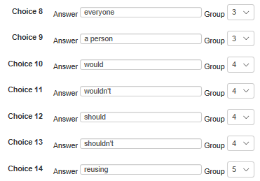
Build a quiz – step 16 (select missing words question)
Notes:
Each dropdown box in the paragraph is a different group, with several words in the dropdown for the learner to choose from.
Missing words in the question text are filled in using dropdown menus.

Slide 33
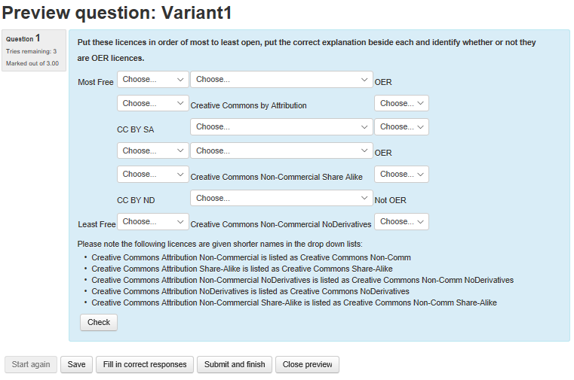
Build a quiz – step 17 (table with select missing words)
Notes:
This example of missing words is quite complex – it is a table with dropdown boxes for selecting the correct response (it is more accessible than drag and drop which doesn’t work so well on some mobile devices or for learners using a screen reader).

Slide 34
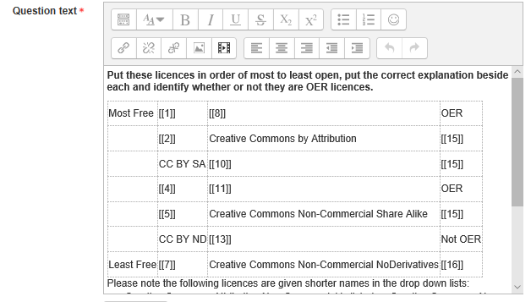
Build a quiz – step 18 (table with select missing words)
Notes:
The table with missing words in edit mode.

Slide 35
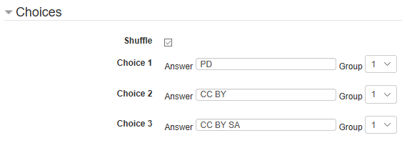
Build a quiz – step 19 (table with select missing words)
Notes:
In the edit question form, the answer choices are grouped depending upon which column they are used for in the table. Each choice is numbered and the groups are numbered.

Slide 36
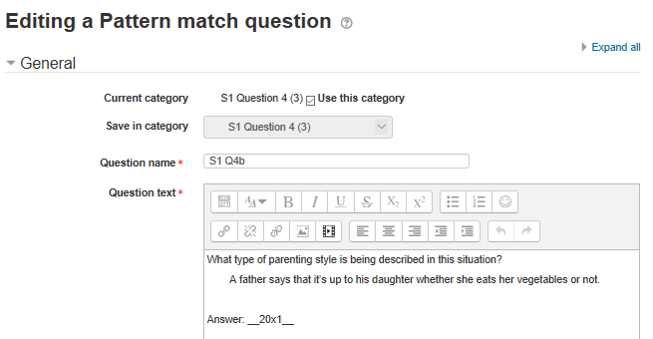
Build a quiz – step 20 (pattern match)
Notes:
Pattern match allows a short response of one or a few sentences that is graded by comparing against various model answers, which are described using the OU’s pattern match syntax.

Slide 37
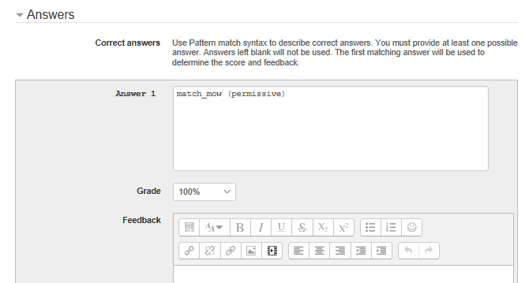
Build a quiz – step 21 (pattern match)
Notes:
Pattern match is quite complex to set up and you have to know the syntax to use. There are some worked examples of pattern match in eAssessment with Moodle http://www.open.edu/openlearnworks/course/view.php?id=1581
You can also set up a pattern match question using the ‘Combined question’ with pattern match option.

Slide 38
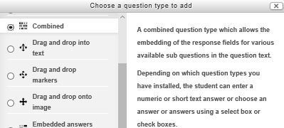
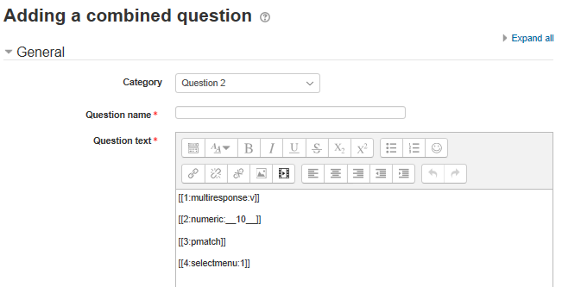
Build a quiz – step 22 (combined question type)
Notes:
A combined question type allows the embedding of the response fields for various available sub questions in the question text.
Depending on which question types you have installed, the student can enter a numeric or short text answer or choose an answer or answers using a select box or check boxes.
This is what appears when the combined question is first set up – the question text will include the four types of responses it can support. You can delete the ones you don’t need when you input the question text and duplicate the type(s) you do need (for example if you’re only using multiresponse then you’d have several of those and none of the others).
You can find worked examples of how to configure various different questions using the combined question type in the eAssessment for Moodle course http://www.open.edu/openlearnworks/course/view.php?id=1581

Slide 39
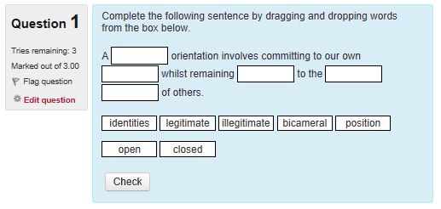
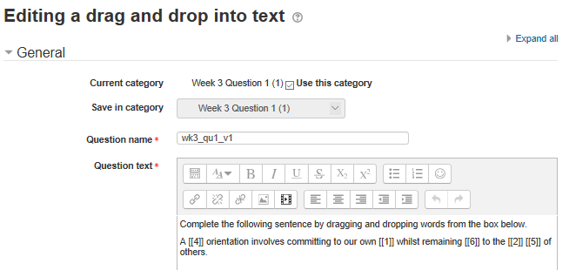
Build a quiz – step 17 (drag and drop missing words)
Notes:
Drag and drop questions can be set up in a number of ways:
Missing words in a paragraph
Missing letters in a crossword puzzle (using a table grid)
To label a diagram (images or text labels are dragged and dropped into drop zones on a background image)
In this example there are more words than spaces to fill, as plausible distractor words have been used to make the question slightly harder.
There are worked examples of how to configure different drag and drop questions in the eAssessment for Moodle course http://www.open.edu/openlearnworks/course/view.php?id=1581

Slide 40
Guidance and advice
http://www.open.edu/openlearncreate/course/view.php?id=2221
http://www.open.edu/openlearncreate/course/view.php?id=2274
http://www.open.edu/openlearncreate/course/view.php?id=2039
http://www.open.edu/openlearncreate/course/view.php?id=1581
http://www.open.edu/openlearncreate/course/view.php?id=1643
Notes:
You can find Guidance and advice online via the following courses and resources:
How to make an Open Online Course http://www.open.edu/openlearncreate/course/view.php?id=2221
Becoming an open educator http://www.open.edu/openlearncreate/course/view.php?id=2274
Course builder guide http://www.open.edu/openlearncreate/course/view.php?id=2039
eAssessment with Moodle http://www.open.edu/openlearncreate/course/view.php?id=1581
Hands-on Moodle Quiz http://www.open.edu/openlearncreate/course/view.php?id=1643
Mailbox for enquiries: openlearncreate@open.ac.uk

Slide 41
Your questions?

Slide 42
50.open.ac.uk

