Slide 1
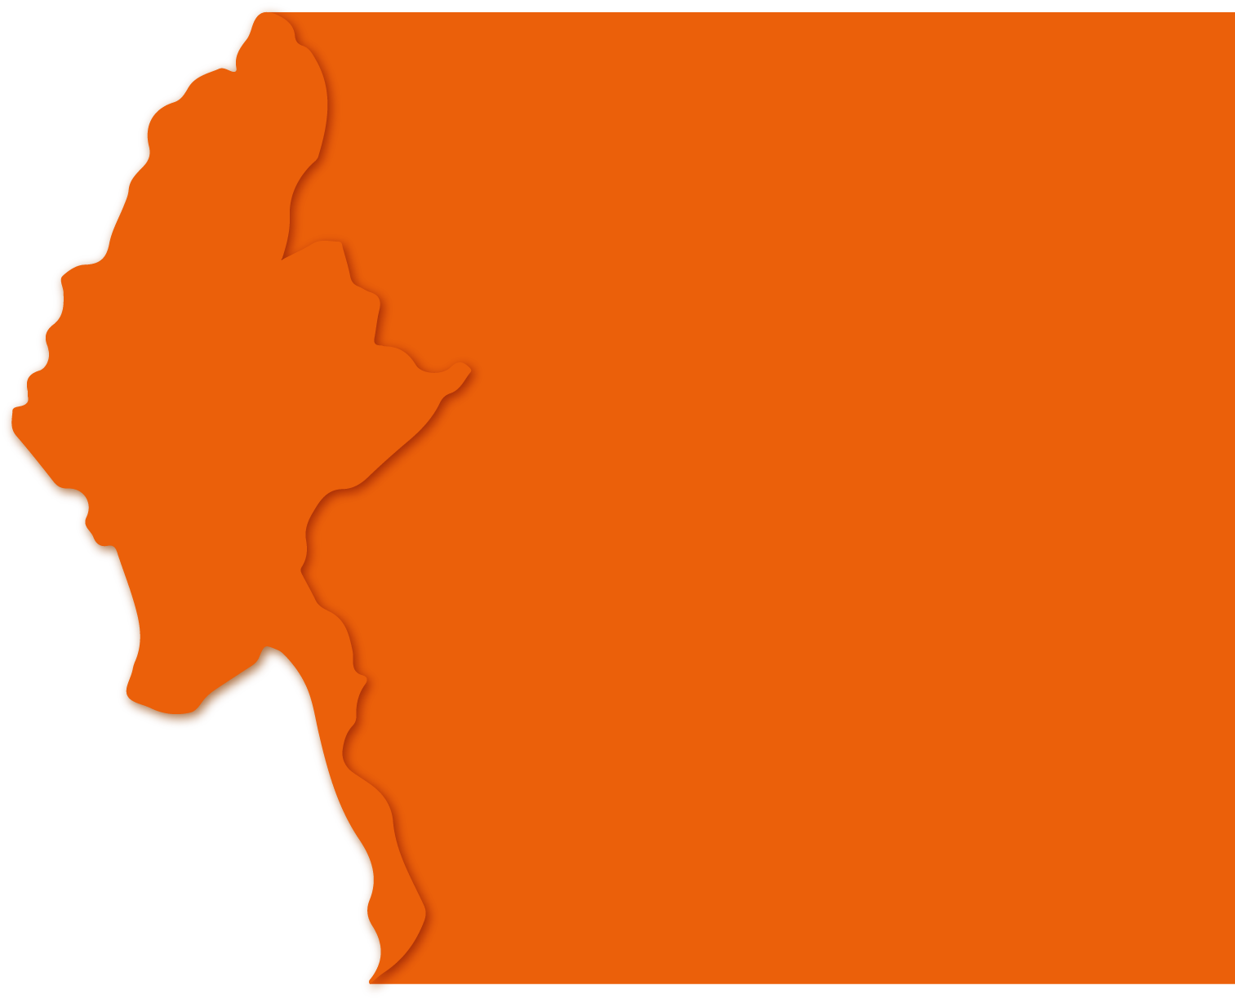
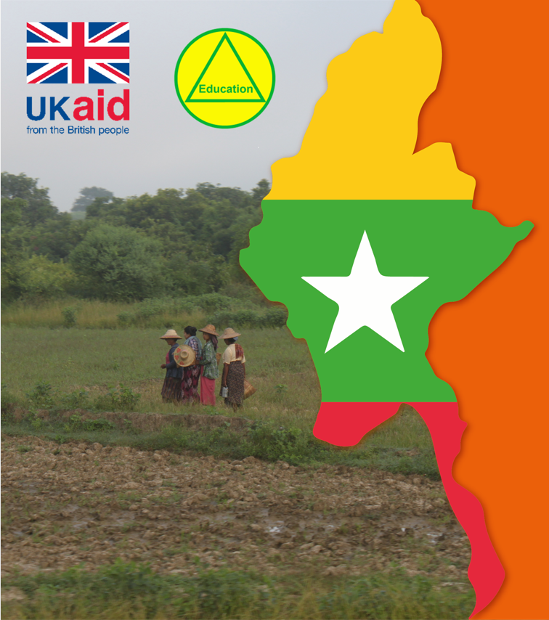
IDO Meeting 19th December 2016
Water and Human Health
Saskia Nowicki
saskia.nowicki@ouce.ox.ac.uk
@SaskiaNowicki
May 2020
Notes:
(Co-tutor please introduce yourself)
This presentation was prepared by Saskia Nowicki, a doctoral researcher at the university of Oxford, whose work focuses on the influence of water supplies and water environments on human health.
This presentation was prepared for the TIDE programme, which is supported by UK Aid and the Myanmar Ministry of Education.
Water and human health is a very interdisciplinary topic so you will see that this presentation touches on biology, chemistry, public health and epidemiology, environmental engineering, management and regulation, and socio-economic and political factors.
We will take multiple breaks throughout the presentation and there will be opportunities to ask questions and discuss the topics being presented.

Slide 2
Water-related Health Key Considerations
Microbial and chemical hazards
Short-term and long-term disease
Global goals
Service level inequalities
Water Safety Planning
Transformative WASH
“Water Supply at Shwedagon Pagoda” by Saskia Nowicki
Notes:
This slide gives and overview of the topics I will cover in this presentation.
I’ll begin by categorising some of the key microbial and chemical hazards that are related to water supplies and water resource management.
And then explain some of the short and long-term diseases that are associated with these hazards.
I’ll discuss the goals that have been created and agreed at the global level for addressing issues of drinking water safety.
And then explore some of the differences in water service levels between and within countries.
I’ll introduce you to water safety planning, which is the established approach for securing the safety of drinking-water supplies.
And I’ll end with some discussion of recent research that has looked at improving human health by improving access to WASH facilities. WASH stands for water, sanitation and hygiene.

Slide 3
Water-related Health Key Considerations
Microbial and chemical hazards
Short-term and long-term disease
Global goals
Service level inequalities
Water Safety Planning
Transformative WASH
“Water Supply at Shwedagon Pagoda” by Saskia Nowicki
Notes:
We’ll begin with a look at microbial and chemical hazards

Slide 4
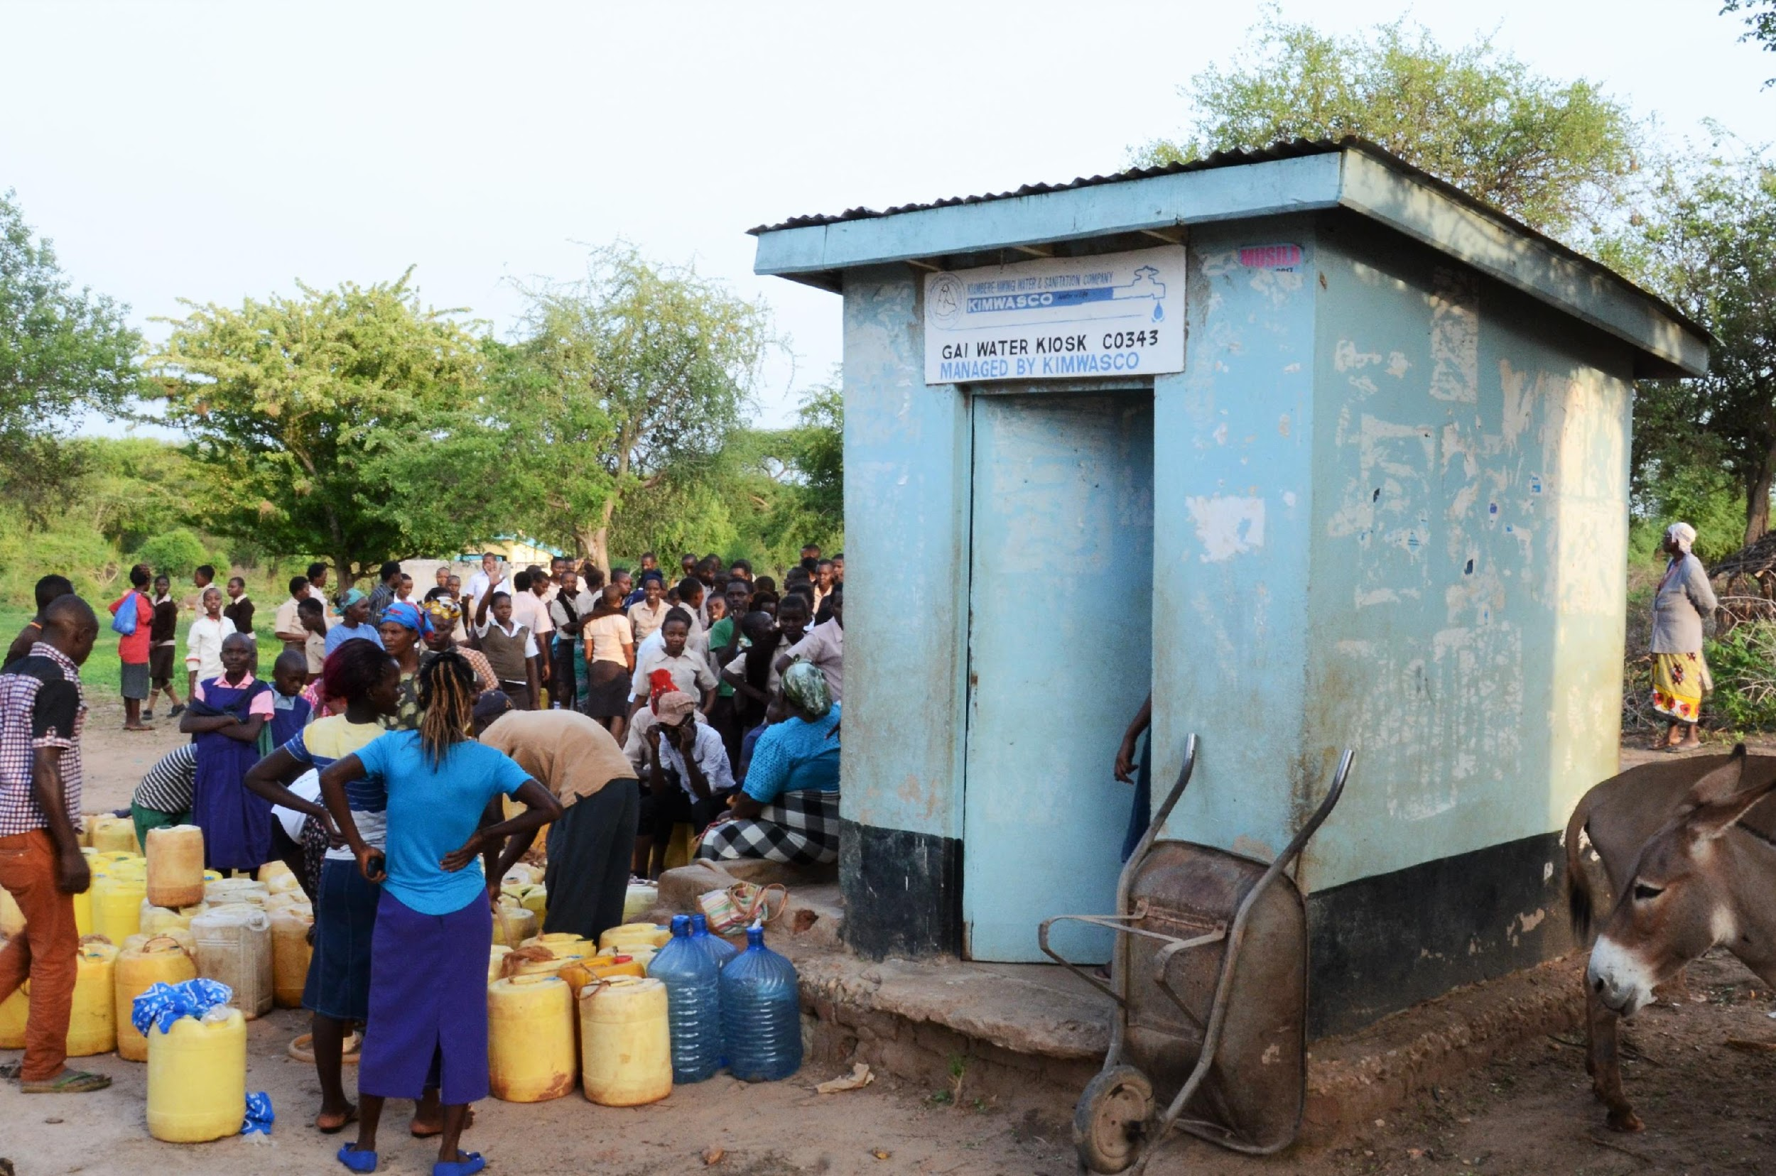
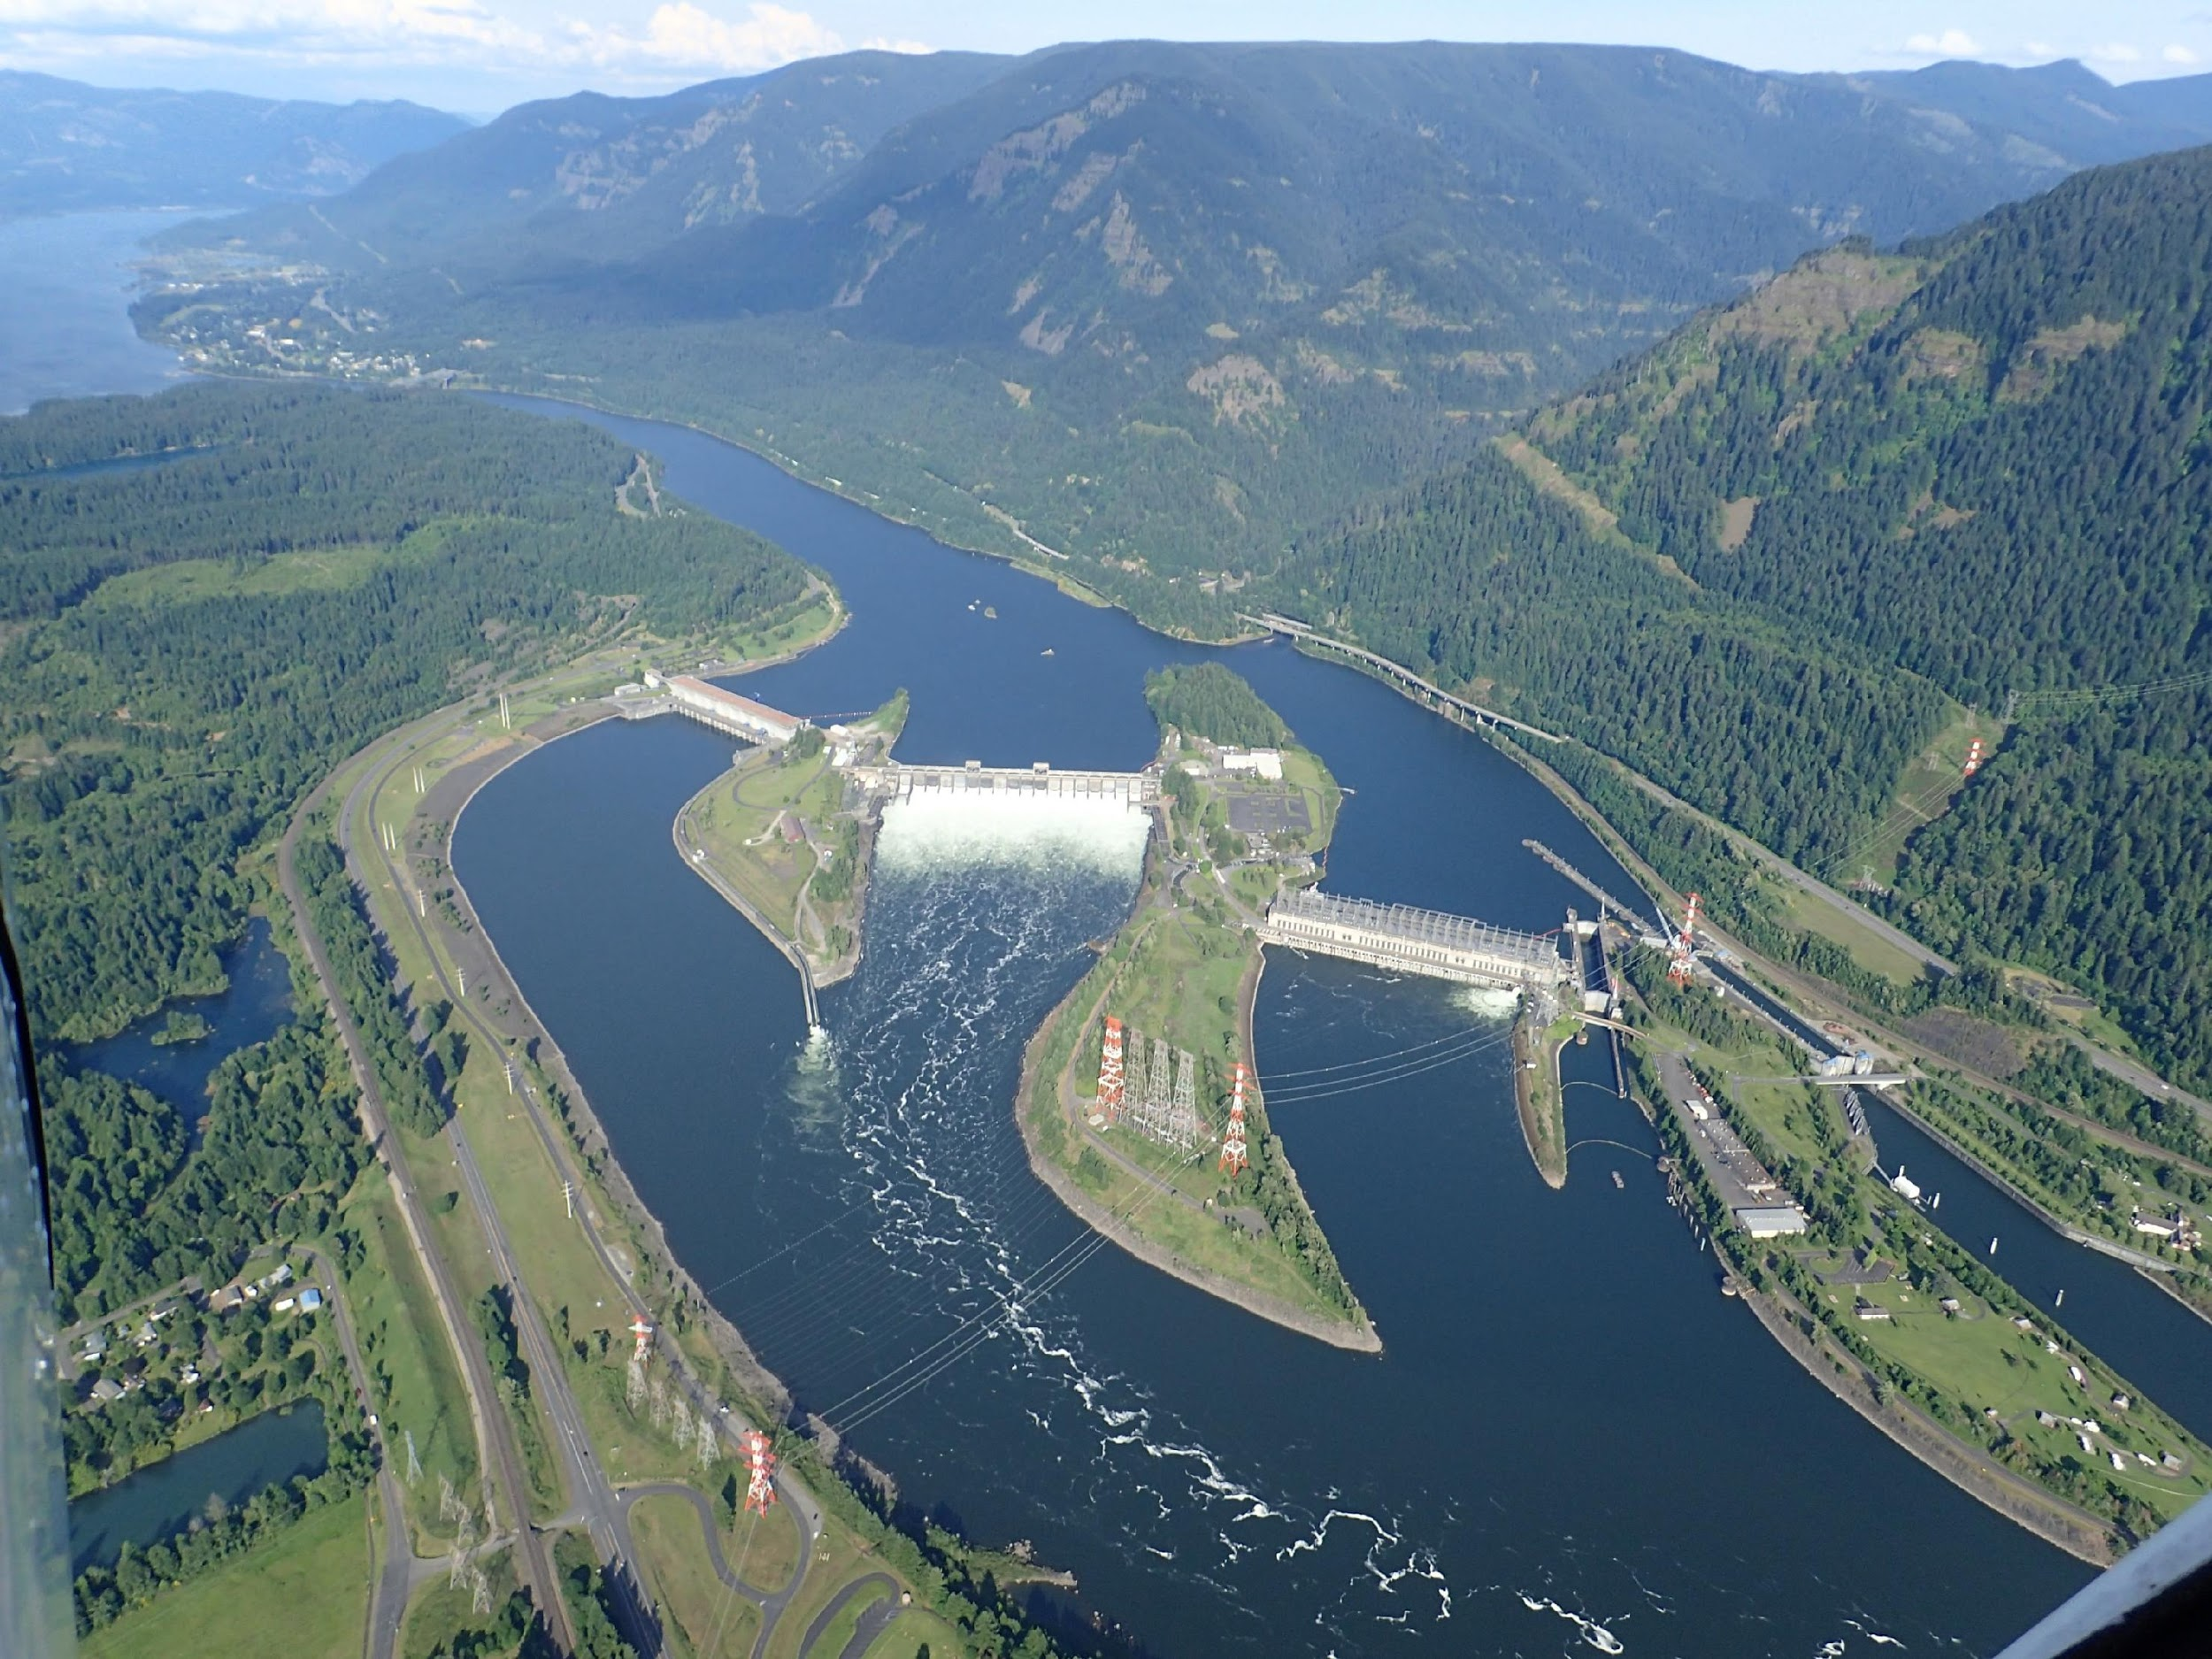
Hazard Classification
Category | Definition | Response | Examples
Water-borne | Pathogens are transported by water. | Improve water quality by protecting, treating and safely storing water. | Typhoid Hepatitis
Water-washed | Washing with water reduces infections. Water quality is less important than water quantity. | Improve access to and reliability of water supplies. | Trachoma, Scabies Shigella
Water-based | Pathogens must be hosted by an aquatic animal (e.g. a snail) to complete their life cycle. | Avoid polluting waterbodies with faecal waste and avoid swimming or bathing in polluted waterbodies. | Schistosomiasis Dracunculiasis
Water-related insect vectors | Pathogens are transported by insects that breed in or bite near water. | Reduce vector breeding habitat and implement vector and disease control measures (e.g. insecticides, nets, vaccines). | Trypanosomiasis Onchocerciasis Malaria
Water Supply
Impacts to human health through direct water use.
Water Resources
Impacts to human health via the environment.
“Water kiosk in Kitui, Kenya” and “Hydropower on the Columbia River” by Saskia Nowicki
(Adapted from: White, G., Bradley, D. and White, A. (1972) Drawers of Water. Domestic Water Use in East Africa)
Notes:
In 1972, researchers proposed a four-part classification scheme for water related health issues – which is sometimes referred to as the Bradley classification.
The four categories as listed on the side of the table on the slide are… (read the slide)
These categories belong to two different aspects of water management – the first two categories relate to water supply.
The second two relate to water resource management.

Slide 5
Hazard Classification
Category | Definition | Response | Examples
Water-borne | Pathogens are transported by water. | Improve water quality by protecting, treating and safely storing water. | Typhoid Hepatitis
Water-washed | Washing with water reduces infections. Water quality is less important than water quantity. | Improve access to and reliability of water supplies. | Trachoma Scabies
Water-based | Pathogens must be hosted by an aquatic animal (e.g. a snail) to complete their life cycle. | Avoid polluting waterbodies with faecal waste and avoid swimming or bathing in polluted waterbodies. | Schistosomiasis Dracunculiasis
Water-related insect vectors | Pathogens are transported by insects that breed in or bite near water. | Reduce vector breeding habitat and implement vector and disease control measures (e.g. insecticides, nets, vaccines). | Trypanosomiasis Onchocerciasis Malaria
Water Supply
Impacts to human health through direct water use.
Water Resources
Impacts to human health via the environment.
(Adapted from: White, G., Bradley, D. and White, A. (1972) Drawers of Water. Domestic Water Use in East Africa)
Notes:
The first category, water-borne diseases are caused by pathogens that are transported by water and cause diseases such as typhoid and hepatitis.
I’ll take a second here to point out this term, “pathogen”, because I’ll be saying this a lot throughout the presentation… (click next)

Slide 6
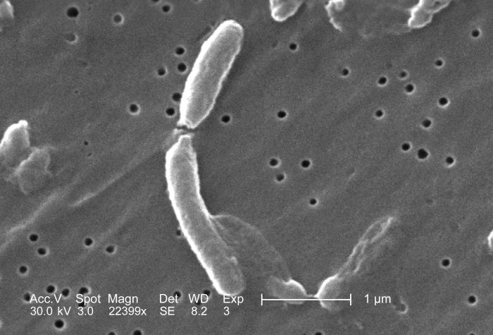
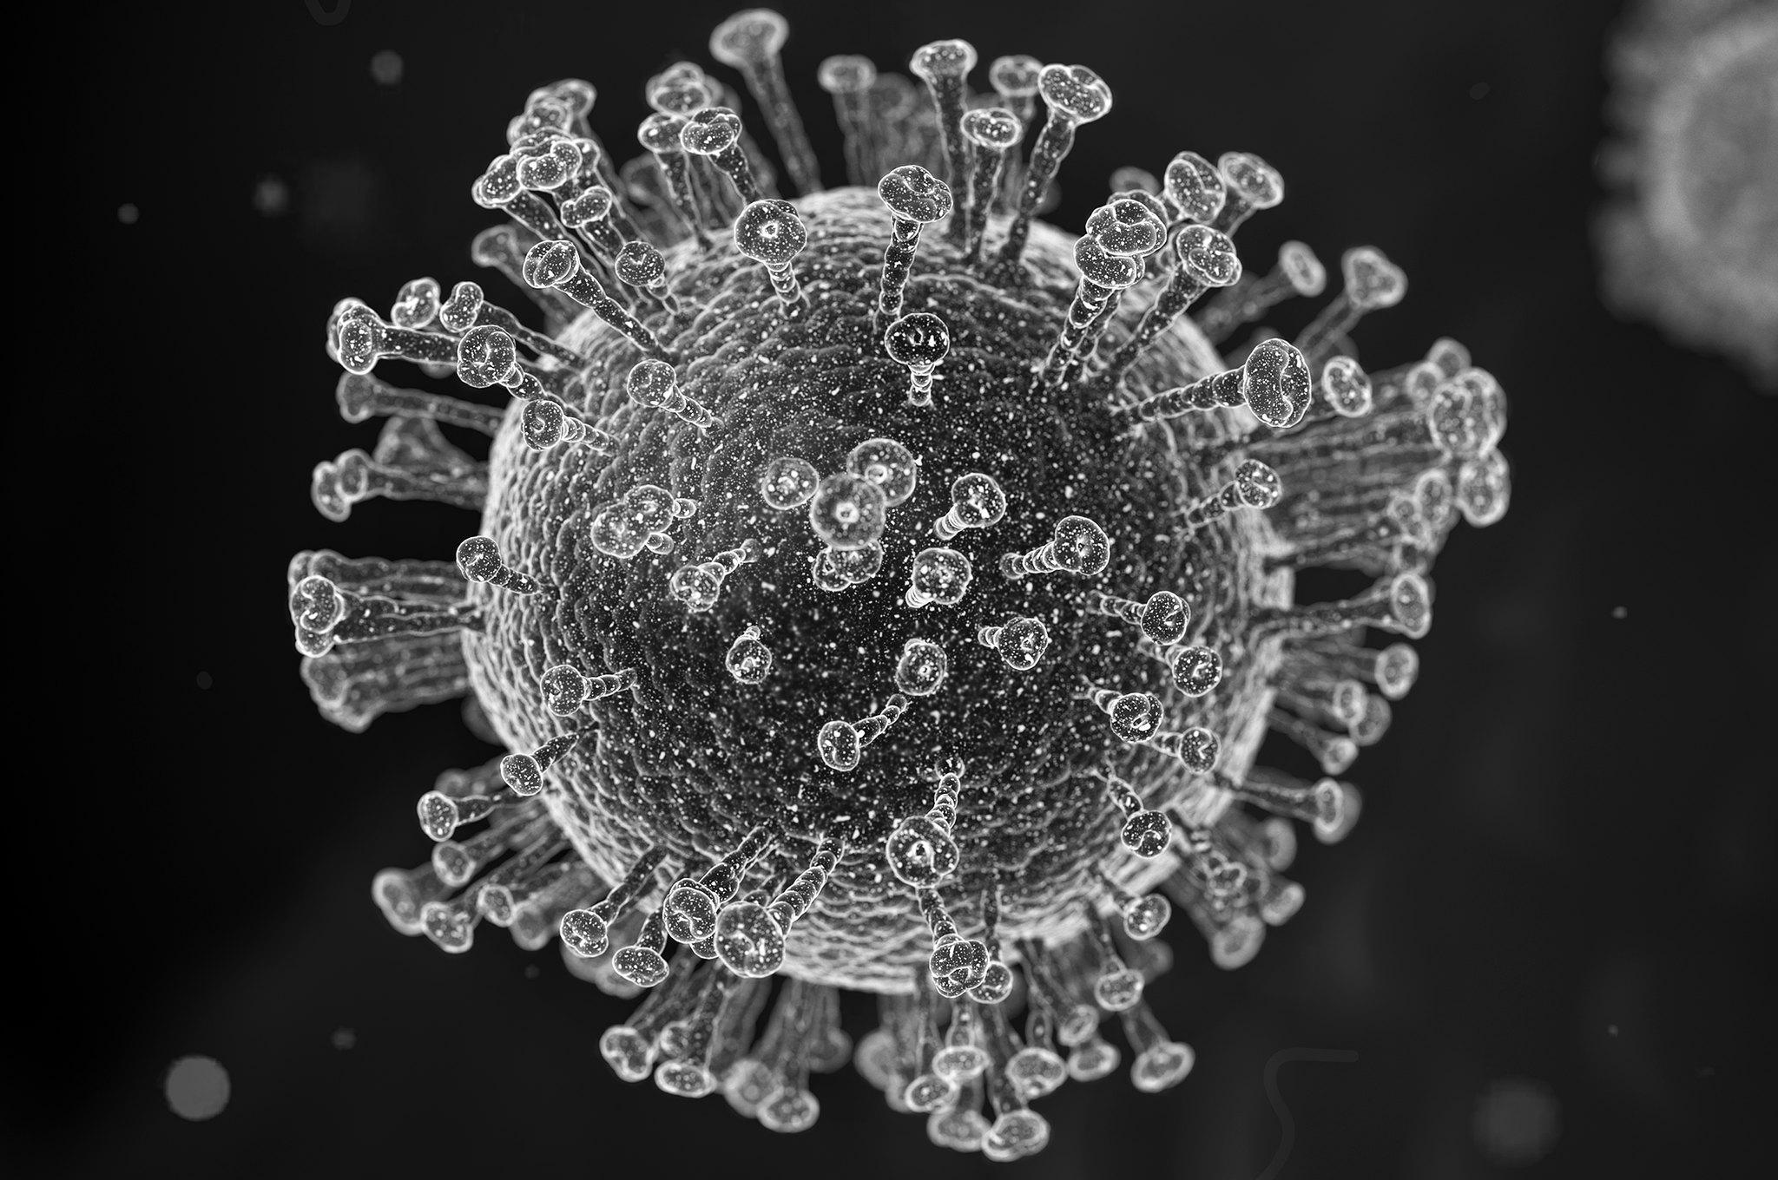
Hazard Classification
Category | Definition | Response | Examples
Water-borne | Pathogens are transported by water. | Improve water quality by protecting, treating and safely storing water. | Typhoid Hepatitis
Water-washed | Washing with water reduces infections. Water quality is less important than water quantity. | Improve access to and reliability of water supplies. | Trachoma Scabies
Water-based | Pathogens must be hosted by an aquatic animal (e.g. a snail) to complete their life cycle. | Avoid polluting waterbodies with faecal waste and avoid swimming or bathing in polluted waterbodies. | Schistosomiasis Dracunculiasis
Water-related insect vectors | Pathogens are transported by insects that breed in or bite near water. | Reduce vector breeding habitat and implement vector and disease control measures (e.g. insecticides, nets, vaccines). | Trypanosomiasis Onchocerciasis Malaria
Microbial Pathogens
Bacteria, viruses, protozoa, helminths (worms).
Water Supply
Impacts to human health through direct water use.
Water Resources
Impacts to human health via the environment.
"Vibrio cholerae (Cholera)" (CC BY-NC-ND 2.0) by hukuzatuna
"Coronavirus" (CC BY 2.0) by Yu. Samoilov
Notes:
Pathogen is the term we use to refer to bacteria, viruses, protozoans, or helminths (more commonly called worms) that can cause disease.
These two photos show vibrio cholera (which is the bacterium that causes cholera) and the coronavirus, which we have all been hearing so much about recently.

Slide 7
Hazard Classification
Category | Definition | Response | Examples
Water-borne | Pathogens are transported by water. | Improve water quality by protecting, treating and safely storing water. | Typhoid Hepatitis
Water-washed | Washing with water reduces infections. Water quality is less important than water quantity. | Improve access to and reliability of water supplies. | Trachoma Scabies
Water-based | Pathogens must be hosted by an aquatic animal (e.g. a snail) to complete their life cycle. | Avoid polluting waterbodies with faecal waste and avoid swimming or bathing in polluted waterbodies. | Schistosomiasis Dracunculiasis
Water-related insect vectors | Pathogens are transported by insects that breed in or bite near water. | Reduce vector breeding habitat and implement vector and disease control measures (e.g. insecticides, nets, vaccines). | Trypanosomiasis Onchocerciasis Malaria
Water Supply
Impacts to human health through direct water use.
Water Resources
Impacts to human health via the environment.
(Adapted from: White, G., Bradley, D. and White, A. (1972) Drawers of Water. Domestic Water Use in East Africa)
Notes:
In order to prevent transmission of water-borne pathogens, water supplies must be protected, treated and stored safely to ensure they are of good quality. I will talk a lot more about this category later in the presentation.

Slide 8
Hazard Classification
Category | Definition | Response | Examples
Water-borne | Pathogens are transported by water. | Improve water quality by protecting, treating and safely storing water. | Typhoid Hepatitis
Water-washed | Washing with water reduces infections. Water quality is less important than water quantity. | Improve access to and reliability of water supplies. | Trachoma Scabies
Water-based | Pathogens must be hosted by an aquatic animal (e.g. a snail) to complete their life cycle. | Avoid polluting waterbodies with faecal waste and avoid swimming or bathing in polluted waterbodies. | Schistosomiasis Dracunculiasis
Water-related insect vectors | Pathogens are transported by insects that breed in or bite near water. | Reduce vector breeding habitat and implement vector and disease control measures (e.g. insecticides, nets, vaccines). | Trypanosomiasis Onchocerciasis Malaria
Water Resources
Impacts to human health via the environment.
(Adapted from: White, G., Bradley, D. and White, A. (1972) Drawers of Water. Domestic Water Use in East Africa)
Notes:
The second category, water-washed diseases result from not having enough water for good hygiene practices. For this category the quality of the water is less important than the quantity of the water because infections are reduced by washing. To prevent water-washed infections such as trachoma, which is an eye infection, or scabies which is a skin infection, water supplies must be reliable and accessible for everybody.

Slide 9
Hazard Classification
Category | Definition | Response | Examples
Water-borne | Pathogens are transported by water. | Improve water quality by protecting, treating and safely storing water. | Typhoid Hepatitis
Water-washed | Washing with water reduces infections. Water quality is less important than water quantity. | Improve access to and reliability of water supplies. | Trachoma Scabies
Water-based | Pathogens must be hosted by an aquatic animal (e.g. a snail) to complete their life cycle. | Avoid polluting waterbodies with faecal waste and avoid swimming or bathing in polluted waterbodies. | Schistosomiasis Dracunculiasis
Water-related insect vectors | Pathogens are transported by insects that breed in or bite near water. | Reduce vector breeding habitat and implement vector and disease control measures (e.g. insecticides, nets, vaccines). | Trypanosomiasis Onchocerciasis Malaria
Water Resources
Impacts to human health via the environment.
(Adapted from: White, G., Bradley, D. and White, A. (1972) Drawers of Water. Domestic Water Use in East Africa)
Notes:
Now, lets look at the two water resources categories.
The water-based category is for diseases that are caused by pathogens that spend part of their life cycle inside of an aquatic animal.
The most common example in this category is schistosomiasis, which is a disease caused by worms that spend part of their life cycle in aquatic snails.

Slide 10
Hazard Classification
Category | Definition | Response | Examples
Water-borne | Pathogens are transported by water. | Improve water quality by protecting, treating and safely storing water. | Typhoid Hepatitis
Water-washed | Washing with water reduces infections. Water quality is less important than water quantity. | Improve access to and reliability of water supplies. | Trachoma Scabies
Water-based | Pathogens must be hosted by an aquatic animal (e.g. a snail) to complete their life cycle. | Avoid polluting waterbodies with faecal waste and avoid swimming or bathing in polluted waterbodies. | Schistosomiasis Dracunculiasis
Water-related insect vectors | Pathogens are transported by insects that breed in or bite near water. | Reduce vector breeding habitat and implement vector and disease control measures (e.g. insecticides, nets, vaccines). | Trypanosomiasis Onchocerciasis Malaria
Category | Definition | Response | Examples
Water-borne | Pathogens are transported by water. | Improve water quality by protecting, treating and safely storing water. | Typhoid Hepatitis
Water-washed | Washing with water reduces infections. Water quality is less important than water quantity. | Improve access to and reliability of water supplies. | Trachoma Scabies
Water-based | Pathogens must be hosted by an aquatic animal (e.g. a snail) to complete their life cycle. | Avoid polluting waterbodies with faecal waste and avoid swimming or bathing in polluted waterbodies. | Schistosomiasis Dracunculiasis
Water-related insect vectors | Pathogens are transported by insects that breed in or bite near water. | Reduce vector breeding habitat and implement vector and disease control measures (e.g. insecticides, nets, vaccines). | Trypanosomiasis Onchocerciasis Malaria
infected human
aquatic environment (lake or reservoir)
aquatic animal (snail)
human
Water Resources
Impacts to human health via the environment.
Notes:
This diagram represents a very simplified version of the schistosomiasis life cycle, showing how the schistosome pathogen (which is a worm) moved between a human host, the aquatic environment and an aquatic animal host.
To begin with, if faeces or urine from an infected human gets into an aquatic environment like a lake, it can transfer the pathogen along with it.
Once in the aquatic environment, the pathogen can seek out snails and enter inside them to continue maturing.
After reaching a more mature stage of development, the pathogen can then exit the snail and move back into the aquatic environment.
If a person then enters into the lake, for bathing or fishing for example, the mature pathogen can enter into their body through their skin, causing them to become infected and develop the disease called schistosomiasis.
And then the cycle may begin again.
The cycle can be broken by either removing the habitat of the aquatic animal host – which can be very difficult – or by preventing human waste from entering into the aquatic environment so that infected people don’t transfer the pathogen into the water. Another way to break the cycle is also to warn people to avoid going into water that is polluted.

Slide 11
Hazard Classification
Category | Definition | Response | Examples
Water-borne | Pathogens are transported by water. | Improve water quality by protecting, treating and safely storing water. | Typhoid Hepatitis
Water-washed | Washing with water reduces infections. Water quality is less important than water quantity. | Improve access to and reliability of water supplies. | Trachoma Scabies
Water-based | Pathogens must be hosted by an aquatic animal (e.g. a snail) to complete their life cycle. | Avoid polluting waterbodies with faecal waste and avoid swimming or bathing in polluted waterbodies. | Schistosomiasis Dracunculiasis
Water-related insect vectors | Pathogens are transported by insects that breed in or bite near water. | Reduce vector breeding habitat and implement vector and disease control measures (e.g. insecticides, nets, vaccines). | Trypanosomiasis Onchocerciasis Malaria
Water Resources
Impacts to human health via the environment.
(Adapted from: White, G., Bradley, D. and White, A. (1972) Drawers of Water. Domestic Water Use in East Africa)
Notes:
So we see from the schistosomiasis example that sanitation is very important for the water-based category, including making sure that people have access to latrines or toilets and that the waste mater is managed in a safe way, so it doesn’t pollute the environment.

Slide 12
Hazard Classification
Category | Definition | Response | Examples
Water-borne | Pathogens are transported by water. | Improve water quality by protecting, treating and safely storing water. | Typhoid Hepatitis
Water-washed | Washing with water reduces infections. Water quality is less important than water quantity. | Improve access to and reliability of water supplies. | Trachoma Scabies
Water-based | Pathogens must be hosted by an aquatic animal (e.g. a snail) to complete their life cycle. | Avoid polluting waterbodies with faecal waste and avoid swimming or bathing in polluted waterbodies. | Schistosomiasis Dracunculiasis
Water-related insect vectors | Pathogens are transported by insects that breed in or bite near water. | Reduce vector breeding habitat and implement vector and disease control measures (e.g. insecticides, nets, vaccines). | Malaria J. encephalitis
(Adapted from: White, G., Bradley, D. and White, A. (1972) Drawers of Water. Domestic Water Use in East Africa)
Notes:
Finally, the water-related insect vectors category involves pathogens being transported by insects that breed or bite in or near water. We use the word vector here to refer to the insects that transport the disease – often these are mosquitoes but the can also be other types of insects including certain types of flies.
Probably the most famous example in this category is malaria – which is transported by anopheles’ mosquitoes. Other common diseases that you might have heard of, which have mosquitoes as vectors are Japanese encephalitis, yellow fever, dengue fever, and the zika virus.

Slide 13
Hazard Classification
Category | Definition | Response | Examples
Water-borne | Pathogens are transported by water. | Improve water quality by protecting, treating and safely storing water. | Typhoid Hepatitis
Water-washed | Washing with water reduces infections. Water quality is less important than water quantity. | Improve access to and reliability of water supplies. | Trachoma Scabies
Water-based | Pathogens must be hosted by an aquatic animal (e.g. a snail) to complete their life cycle. | Avoid polluting waterbodies with faecal waste and avoid swimming or bathing in polluted waterbodies. | Schistosomiasis Dracunculiasis
Water-related insect vectors | Pathogens are transported by insects that breed in or bite near water. | Reduce vector breeding habitat and implement vector and disease control measures (e.g. insecticides, nets, vaccines). | Malaria J. encephalitis
Disease | Genus of mosquito | Breeding environment
malaria | Anopheles | Shallow water, transient ponds, edges of lakes and reservoirs
Japanese encephalitis | Culex | Irrigated agriculture especially rice paddies
yellow fever, dengue, zika | Aedes | Water-filled containers such as tanks, cisterns, barrels, buckets, old tires, flowerpots, roof gutters etc.
Notes:
There are different types of mosquitoes that spread these different diseases and they have different habitat preferences.
(read the table)

Slide 14
Hazard Classification
Category | Definition | Response | Examples
Water-borne | Pathogens are transported by water. | Improve water quality by protecting, treating and safely storing water. | Typhoid Hepatitis
Water-washed | Washing with water reduces infections. Water quality is less important than water quantity. | Improve access to and reliability of water supplies. | Trachoma Scabies
Water-based | Pathogens must be hosted by an aquatic animal (e.g. a snail) to complete their life cycle. | Avoid polluting waterbodies with faecal waste and avoid swimming or bathing in polluted waterbodies. | Schistosomiasis Dracunculiasis
Water-related insect vectors | Pathogens are transported by insects that breed in or bite near water. | Reduce vector breeding habitat and implement vector and disease control measures (e.g. insecticides, nets, vaccines). | Malaria J. encephalitis
(Adapted from: White, G., Bradley, D. and White, A. (1972) Drawers of Water. Domestic Water Use in East Africa)
Notes:
It is sometimes possible to manage these vector-borne diseases by getting rid of the habitat that the vectors breed in. But since the habitats are varied and often serve important functions like water storage and food production, it can be difficult to manage the diseases in this way.
Another strategy that has been tried is mass use of insecticides to kill the mosquitoes. This has had some success in some places, but its very difficult to achieve eradication, so usually the disease will come back again.
The other approach is to protect people using personal insecticides and repellents, nets, and also vaccines when they are available.
SO, we have covered the original four categories of water-related disease: water-borne, water-washed, water-based, and water-related insect vectors.
But since this classification was established in 1972, the research has advanced and there are now some additional things to consider.

Slide 15
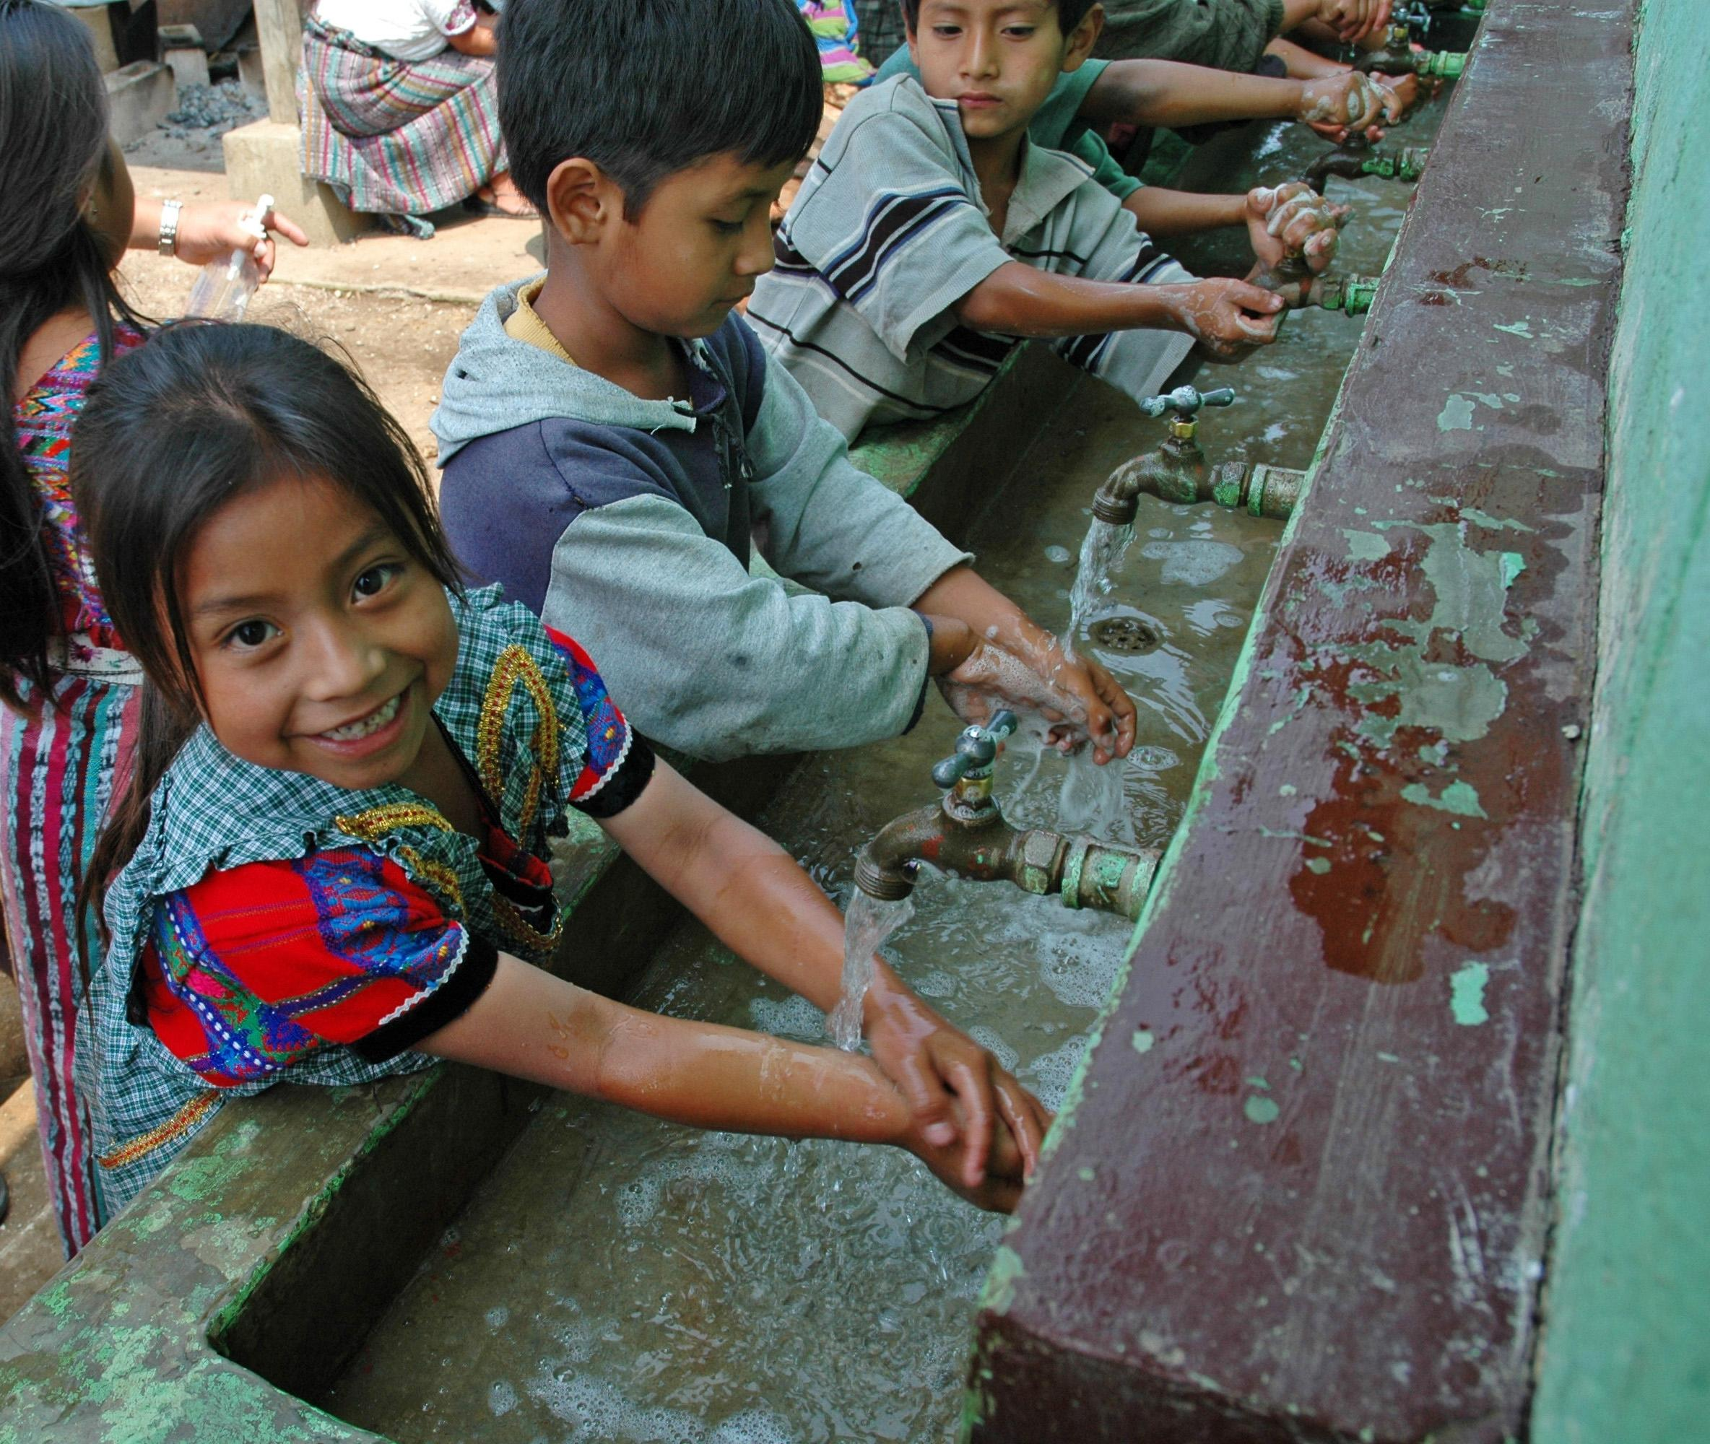
Classification Updates
Transmission via water-aerosols (e.g. Legionella)
Complex transmission cycles
New inclusion in water-washed: transmission of respiratory pathogens is reduced by handwashing with soap
New inclusion in water-based: pathogens that live non-parasitically (i.e. without a host) in fresh waters
Opportunistic pathogens
Chemical contaminants
For more information:
Bartram, J. (ed.) (2015) Routledge Handbook of Water and Health. London and New York: Routledge
"legionella transport" (CC BY-NC-ND 2.0) by sidknee23
Children Washing Hands at School Handwas" (CC BY-NC-ND 2.0) by Water, Sanitation, and Hygiene Photos
Notes:
This is a list of the main updates to the water-related disease classification.
First, a new category has been introduced to represent diseases that are transmitted through the air. This is the water-aerosols category. An example of a pathogen in this category is a bacterium called legionella, which grows inside water systems and can be transported in tiny water droplets through the air and then breathed in by people. People who are exposed to this bacterium can develop a pneumonia like disease called legionnaires disease, which is especially dangerous for elderly people.
The second update is that research has shown that some pathogens have complicated transmission cycles and can belong in multiple categories.
The third update is that respiratory pathogens have now been included in the water-washed category because it was recognised that handwashing is an important step for protecting against these pathogens.
The coronavirus that is causing the current pandemic is an example of a respiratory virus that belongs in the water-washed category because handwashing helps to prevent it from spreading. But coronavirus also applies to points 1 and 2 because it can be spread through aerosols, so it has a complex transmission cycle that involves both airborne transmission and transmission on hands.
The fourth update was the discovery that some pathogens can live in aquatic environments without a host – so they don’t need a snail for example to help them complete their life cycle.
The fifth update was the discovery that some organisms that are normally not harmful to people can become harmful under certain conditions – these are referred to as opportunistic pathogens.
And finally, chemical contaminants and pollutants are now recognised as important water-related disease agent. The health impacts of toxic chemicals are better understood now than they were when the Bradley classification was originally developed.

Slide 16
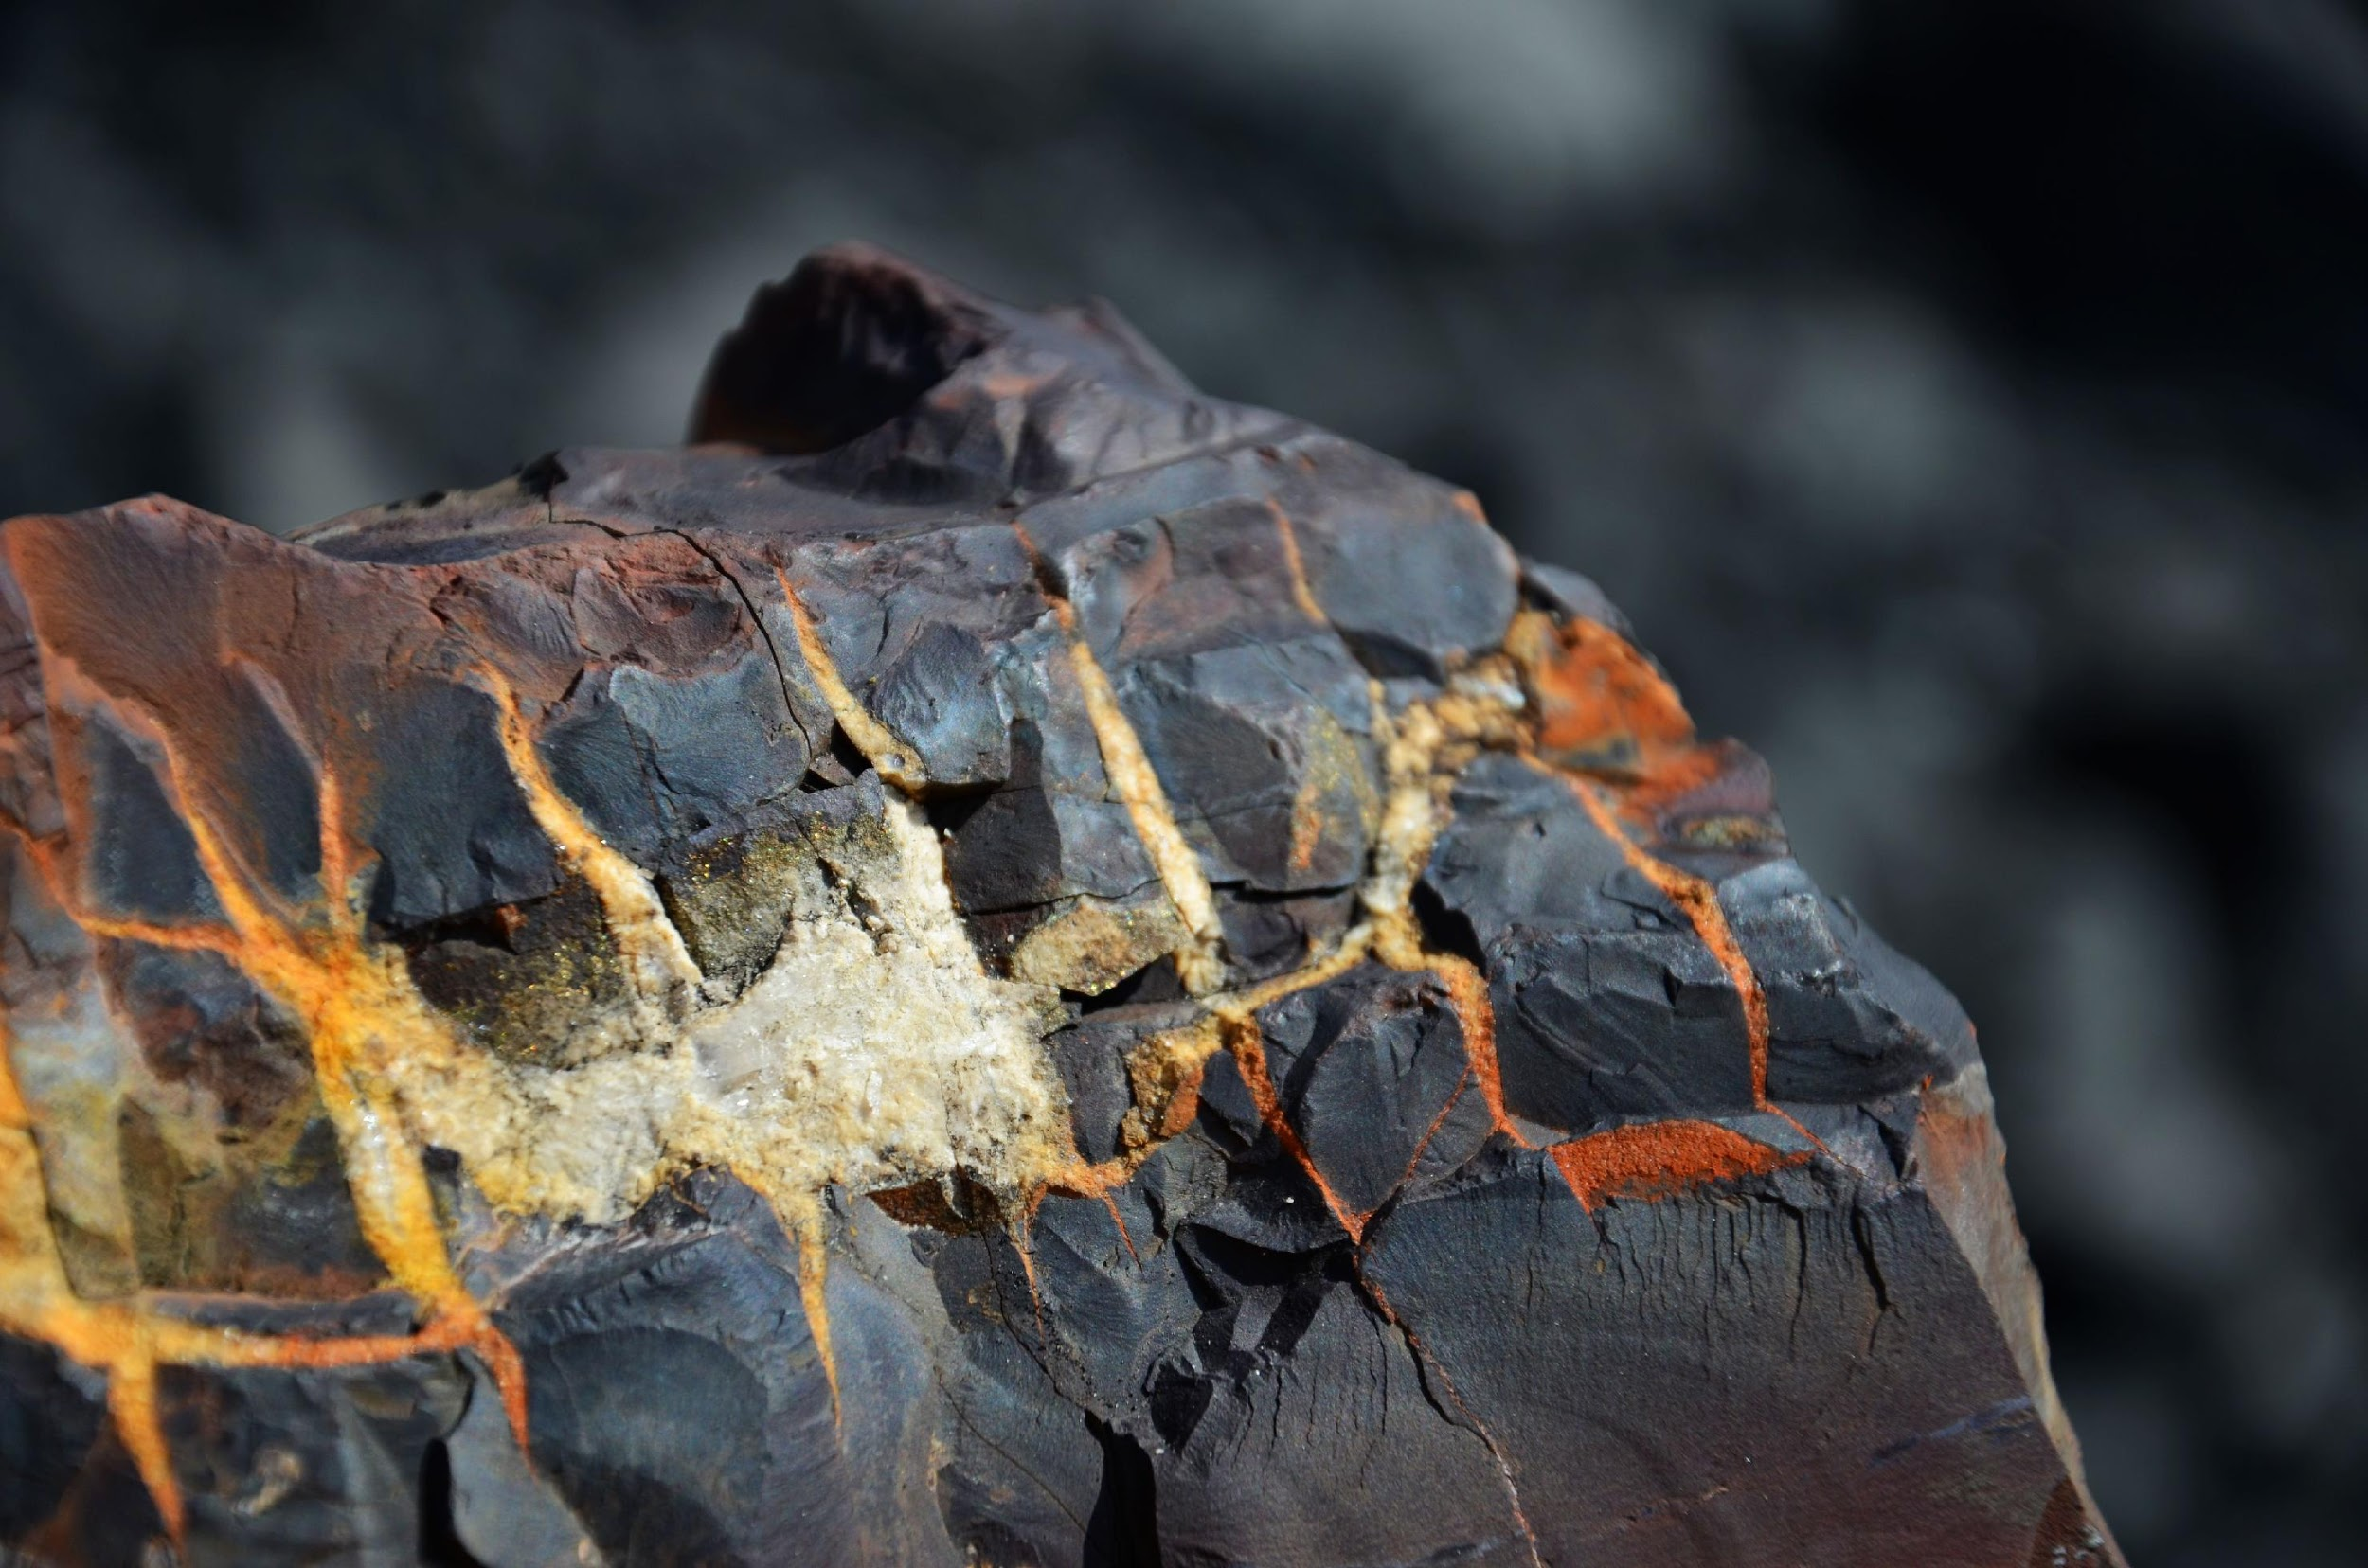
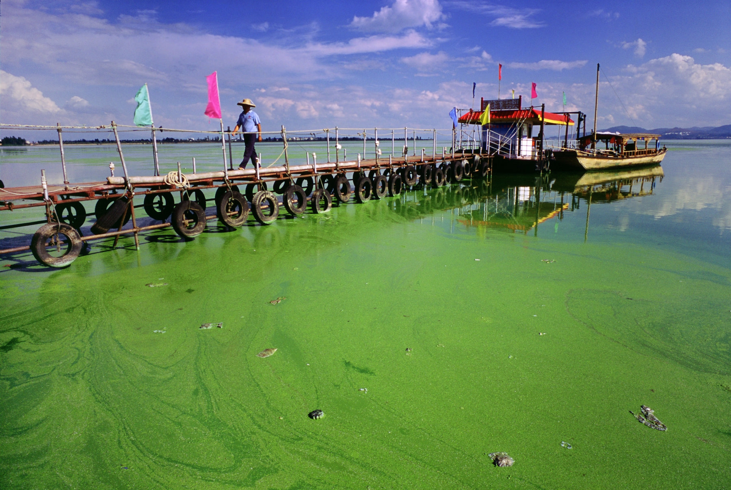
Chemical Contaminants
Geogenic e.g. arsenic, fluoride, and salinity | Biogenic e.g. neurotoxins from cyanobacterial blooms | Anthropogenic e.g. heavy metals from industry and endocrine disruptors from pharmaceuticals, hormones, pesticides, and plasticizers
“Geochemistry” by Saskia Nowicki
"Algae in Dianchi Lake, China" (CC BY 2.0) by eutrophication&hypoxia
“Acid Mine Drainage” by Saskia Nowicki
Notes:
There are different ways that toxic chemicals can come to be found in water supplies, and these can be thought of in three main groups.
Geogenic contamination is naturally occurring. It comes as a result of interactions between water and rocks that contain high concentrations of elements such as arsenic and fluoride, which can be harmful to human health when ingested. Some rocks also contain naturally high concentrations of salts, which when dissolved can make groundwater very saline and difficult to use.
Biogenic contamination, as the name suggests, occurs when ecological processes result in production of toxins that are then released into water bodies. The most common example of this is cyanobacterial blooms in lakes and rivers, where cyanobacteria grow out of control and produce a neurotoxin that gets released into the water and can be very harmful to wildlife, livestock or humans that consume it.
The final category is anthropogenic, meaning created by human activities. Anthropogenic pollutants include endocrine disruptors, hormones, pesticides and plasticizers that are released in industrial and municipal wastewaters.
Th anthropogenic category also overlaps with the geo and biogenic categories [click to trigger animation] because for example mining activity can increase weathering of highly mineralised rocks resulting in increased pollution of heavy metals in mine waters. Also, fertilisers used in agricultural activities can be washed into lakes and rivers and be the cause of the cyanobacterial blooms that release neurotoxins into the water.
So, now that I’ve introduced these many categories of water-related health hazards. Let’s go through some examples from Myanmar where people are dealing with some of these hazards.

Slide 17
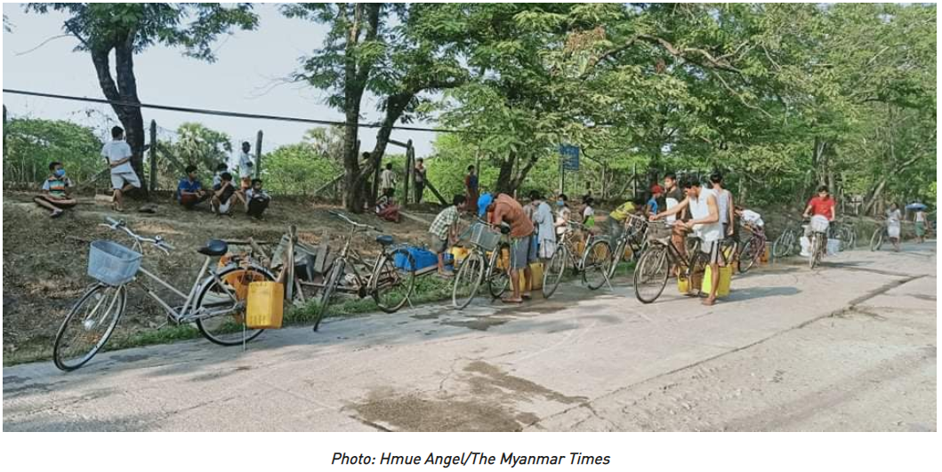
Examples: Water Shortages hazard: microbial water-washed
Dala township, Yangon
“Almost every village in Dala has some kind of water shortage. The lakes dried up because of the very high temperatures this year. We plan to provide them with water as long as the roads don’t become blocked, before the rainy season sets in” – Dala municipal committee member quoted in the Myanmar Times, May 2020
https://www.mmtimes.com/news/water-shortages-yangons-dala.html
Notes:
Lets start with a recent example. This is a quote published in the Myanmar Times in Mary 2020 from a Dala municipal committee member. They said that [read quote]
If you want to read the full article you can find it at the link on the slide.
Widespread water shortage like what this article describes often mean that a lot of people don’t have enough water for good hygiene, so transmission of water-washed diseases may increase. Since covid-19 is a water washed disease, water shortages that are causing people to have to gather and lineup for water and people not having enough water for frequent handwashing are particularly concerning when handwashing and social distancing are so important.

Slide 18
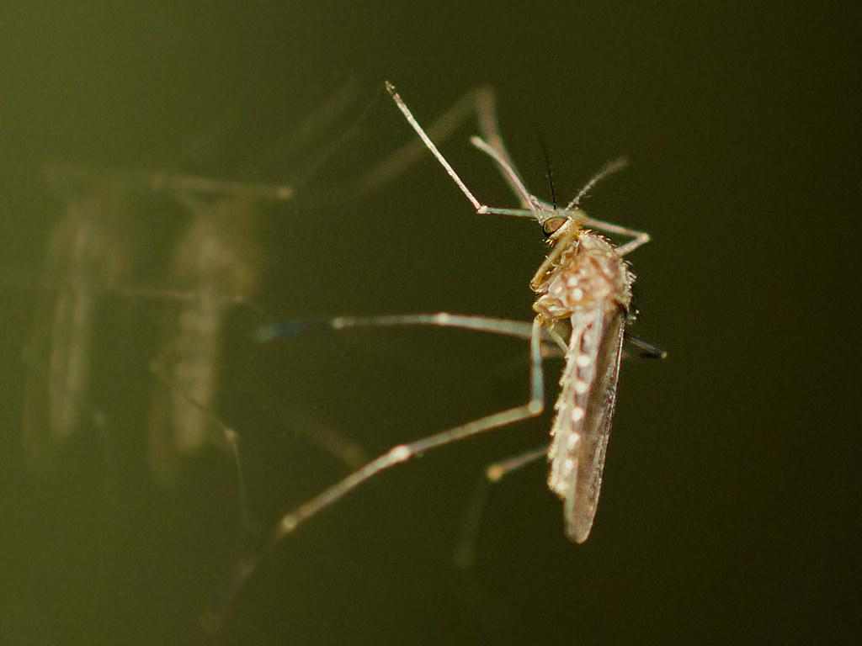
Examples: Rice Paddies & Mosquitoes hazard: microbial water-related insect vectors
Japanese encephalitis is a disease transmitted by mosquitoes that breed in rice paddies
In 2017, a vaccination campaign in Myanmar protected over 12.5 million children from the disease
https://www.path.org/articles/myanmar-launches-national-japanese-encephalitis-vaccination-campaign/
"Rice paddies and fields" (CC BY-NC-ND 2.0) by IFPRI
"mosquito-1550" (CC BY-NC-ND 2.0) by Wanderin' Weeta
Notes:
Going back a couple of years, this article, which you can read by following the link on the slide, reports on a vaccination campaign in 2017 in which more than 12.5 million children in Myanmar were vaccinated against Japanese encephalitis. Japanese encephalitis (sometimes referred to as ‘brain fever’) is one of the microbial water-related insect vector diseases. In bad cases it can be fatal or cause long-term disabilities and it is spread by the Culex mosquito which breeds in rice paddies. There is no cure or clinical treatment for the disease and since controlling the mosquitoes is very difficult, the best measure to prevent it is widespread vaccination.

Slide 19
Examples: groundwater hazard: geogenic chemical
Arsenic
Ayeyarwaddy region: 30% > 10 ppb
Bago region: 42% > 10 ppb
Fluoride
Wetlet township: 35% > 1.5 ppm
"Fluorite (Woodville, Ohio, USA) 2" (CC BY 2.0) by James St. John
MoH (2018) ‘Environmental Health in Myanmar’. The Republic of the Union of Myanmar Ministry of Health and Sports Department of Public Health Occupational and Environmental Health Division, pp. 1–14.
Notes:
Moving now to come chemistry examples.
A report from the ministry of health in 2018 reported that groundwater in some regions was exceeding the World Health Organisation guideline levels for arsenic and fluoride. The numbers shown on the slide refer to the percentage of samples collected in the region that exceed the health guidelines (which are 10 parts per billion for arsenic and 1.5 parts per million for fluoride). This groundwater contamination is naturally occurring due to the geology of the area, but it means that the groundwater must be used with caution and may need to be treated before it can safely be used for drinking water supplies.

Slide 20
Examples: Mining hazard: anthropogenic chemical
Gold mine in Ya Mae Thin township, Mandalay
12 drainage sites tested: elevated cyanide, aluminium, lead, boron, mercury, chromium, nickel, manganese
4 drinking-water sites tested: elevated levels of chromium, zinc, and cadmium
Lead mine, Kalaw township, Shan South
10 drinking-water sites tested: all tested parameters were in normal range including lead
MoH (2018) ‘Environmental Health in Myanmar’. The Republic of the Union of Myanmar Ministry of Health and Sports Department of Public Health Occupational and Environmental Health Division, pp. 1–14.
“Copper Flotation Process at a Canadian Mine” by Saskia Nowicki
Notes:
The same ministry of health report also gave results of water quality sampling that was done to assess the impact of mining activities on nearby surface water sites.
At the gold mine in Mandalay, drainage sites near the mine showed high levels of many parameters. But further downstream, only chromium, zinc and cadmium were found to be elevated.
At the lead mine in Shan South, no parameters were found to be elevated at the drinking water sites that were tested.
Because different mines have different geology, the types and severity of the water quality issues that they create are very variable. It can be difficult to assess the impact of mining on regional water quality because there are a lot of decisions to make about where to sample and what to test for, and often there are also a lot of politics involved because mining is a very profitable industry.

Slide 21
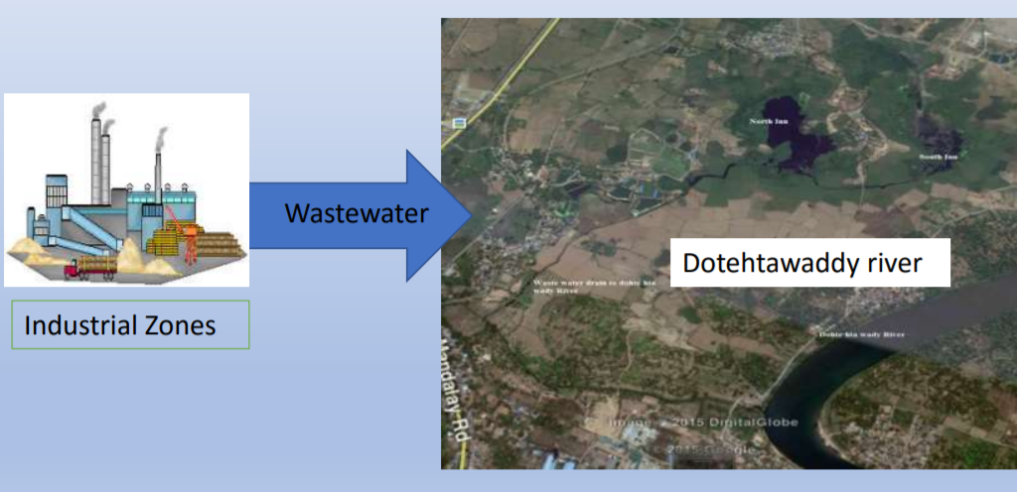
Examples: Industrial Wastewater hazard: anthropogenic chemical
Mandalay Industrial Zone Wastewater disposal.
Before 2008: After 2015:
https://www.irrawaddy.com/news/burma/17-factories-suspended-after-polluting-lake-in-central-burma.html
https://www.jica.go.jp/myanmar/english/office/topics/c8h0vm0000d1y53i-att/press180509_npt_06.pdf
Notes:
Other types of industry can also cause water pollution issues.
In the Mandalay industrial zone for example, sugar refineries, and canning, brewing and leather curing facilities all produce wastewater that needs to be managed.
These images indicate that wastewater from the industrial zone used to be discharged into Taung Tha Man Lake, but a pipeline was built and since 2015 the wastewater is now being discharged south of Mandalay city into a river that carries it away from the more populated area. This means that fewer people are being impacted by the pollution, but of course it is still impacting the environment and ideally the wastewater would be treated to remove pollutants before being discharged.

Slide 22
Examples: Health Facility Water Supply hazard: microbial and chemical
Health care facilities often use surface water and typically lack proper sanitation facilities
Twantay township health facility tried to use groundwater, which is usually better protected from faecal contamination than surface water, but found it was too salty
"IMG_2823 Twantay Canal" (CC BY-NC 2.0) by Global.finland.fi
MoH (2014) ‘Myanmar Essential Health Services Access Project Environmental Management Plan’. The Republic of the Union of Myanmar Ministry of Health.
Notes:
For a final example before moving on, I want to point out that often managers face multiple health hazards at the same time, and this can complicate the decisions that need to be made.
This example from a ministry of health report in 2014 [draw arrow], describes a health facility in Twantay township that wanted to use groundwater instead of surface water, because surface water is much more easily contaminated with microbial pathogens especially when sanitation facilities in the area are not good. And also because this health facility needed more water, they were mostly using rain and pond water which had to be rationed in the dry season.
But unfortunately, when they tried to use the groundwater, they found that it was very salty so it wasn’t drinkable.
So this is an example of a difficult management situation with issues of microbial quality, water shortages and also chemical quality challenges.
I’ll talk a bit about some of the potential solutions to challenges like this later on.

Slide 23
Summary of categories for water-related health
Original:
Microbial water-borne
Microbial water-washed
Microbial water-based
Microbial water-related insect vectors
Updates:
Microbial water-aerosols
Microbial complex transmission
Microbial opportunistic pathogens
Chemical contaminants (geo-, bio-, and anthropo-genic)
Notes:
Here’s a summary of the water-related health hazard categories that we’ve covered. Because we only have so much time, for the remainder of the presentation I am going to focus mostly on the categories related to water-supply – so we won’t talk much more about water-based or water-related insect vector hazards.

Slide 24
Water-related Health Key Considerations
Microbial and chemical hazards
Short-term and long-term disease
Global goals
Service level inequalities
Water Safety Planning
Transformative WASH
“Water Supply at Shwedagon Pagoda” by Saskia Nowicki
Notes:
In the next set of slides, we’ll have a look at some of the short-term and long-term diseases that can be caused by contaminated drinking water supplies. You’ll notice that in this section I’m focussing mostly on diseases that fit in the water-borne microbial or chemical contaminant categories.

Slide 25
Short-term Disease
Symptom | Description | Example pathogens
Gastroenteritis | Watery diarrhoea | Rotavirus (virus) Adenovirus (virus) Cryptosporidium (protozoan)
Persistent gastroenteritis | Watery diarrhoea that lasts for longer than two weeks | Giardia (protozoan) Enteropathogenic E. coli (bacterium)
Dysentery | Diarrhoea with blood | Shigella (bacterium) Entamoeba (protozoan) Salmonella (bacterium)
Profuse purging | Massive fluid loss from diarrhoea | Cholera (bacterium) Enterotoxigenic E. coli (bacterium)
Acute vomiting | Vomiting without diarrhoea | Norovirus (virus)
Notes:
One of the most common symptoms associated with acute water-borne diseases is diarrhoea. It is so common that health surveys often ask people how often they have had diarrhoea over a period of time, usually 2 weeks, in order to judge what effect potentially unsafe water supplies may be having on the population.
As this slide shows, the diarhoea symptom manifests in different ways, often depending on which pathogen is causing the illness.
At the least severe end, people can suffer from gastroenteritis, which causes watery diarrhoea usually for a few days. It can be caused by many different pathogens including rotavirus, adenovirus and cryptosporidium.
If the diarrhoea lasts for more than two weeks, it is classified as persistent and the illness is more severe. This is known to be caused by pathogens such as giardia or enteropathogenic E. coli.
Other organisms like shigella, entamoeba and salmonella can cause dysentery, which is diarrhoea that has blood in it.
Others like cholera and enterotoxigenic E. coli can cause profuse purging, which is massive loss of fluids from the bodies and can cause death by dehydration within hours or days if not treated with rehydration solutions.
Finally, some pathogens like norovirus can cause vomiting without diarrhoea.
Often, we don’t think of diarrhoea as a serious health issue. And sometimes it isn’t. But in some cases, it can be very dangerous, especially for young children and with repeated infections.
The pathogens that are in red text in this table – rotavirus, adenovirus, cryptosporisium, shigella and cholera are the 5 pathogens that are associated with the majority of childhood deaths from diarrhoea according to the global burden of disease study which was published in 2018, and which I’ll talk about more in later slides.

Slide 26
Long-term Disease
Health problem | Example(s) of water-related cause(s)
Arsenicosis: skin lesions, peripheral neuropathy, and peripheral vascular disease. | Arsenic
Dental and skeletal fluorosis: discoloured and pitted teeth, weakened bones, and immobilized joints. | Fluoride
Hypertension, which can lead to preeclampsia and cardiovascular and renal diseases. | Sodium, EED Possibly arsenic, cadmium, mercury, lead
Cancer | Arsenic, asbestos, radon, agricultural and industrial chemicals, endocrine disruptors, possibly fluoride
Cognitive impairment: nervous system damage, lower intelligence quotient scores, behavioural problems, and learning disabilities. | Arsenic, lead, EED, endocrine disruptors Possibly manganese
Psychosocial distress: social consequences, emotional distress and mental health. | Potentially all water quality inadequacies known to the people in question.
Reproductive, thyroid, adrenocortical, immune, and metabolic disfunction | Endocrine disruptors: pharmaceuticals, hormones, pesticides, and plasticizers
Bacterial infections with antimicrobial resistance | Antibiotics
Notes:
In addition to diarrhoea symptoms which indicate short-term acute infections. There are also many long-term diseases and health complications that are associated with drinking poor quality water over long periods of time.
At the top of this table we have the health problems that are associated with drinking water with high levels of arsenic and fluoride for many years. These are the most common geogenic contaminants in groundwater and they can’t be detected by taste, sight, or smell. So the only way to know if they are present in the groundwater is by sampling and testing the water.
In addition to arsenicosis and fluorosis, the table shows other health problems such as hypertension (which is persistent high blood pressure that can cause preeclampsia and cardiovascular and renal diseases), cancer, cognitive impairment and nervous system damage, psychosocial distress (which refers to the social and mental health consequences of unsafe water supplies), as well as reproductive, thyroid, adrenocortical, immune and metabolic disruptions.
Additionally, the discharge of antibiotics in human and animal wastewater, is contributing antimicrobial resistance to bacterial populations, which creates a risk of people contracting bacterial infections that are resistant to treatment with antibiotics.
You’ll notice that many of the long-term health problems in this table are related to chemical contaminants, but there are also long-term health consequences of repeated exposures to pathogens that cause diarrhoea.

Slide 27
Long-term Disease Environmental Enteric Dysfunction (EED)
Feedback loop between infection and malnutrition
Chronic health impact: stunting
Below average height
Reduced cognitive development
Metabolic disorders (e.g. diabetes)
Cardiovascular disease
Adult obesity
Intergenerational impacts
Korpe, P. S. and Petri, W. A. (2012) ‘Environmental enteropathy: Critical implications of a poorly understood condition’, Trends in Molecular Medicine. Elsevier Ltd, 18(6), pp. 328–336. doi: 10.1016/j.molmed.2012.04.007.
Notes:
If a person is consuming water that contains water-borne pathogens over a long period of time, and particularly if that person is a young child, they can develop what we refer to as Environmental Enteric Dysfunction or EED.
This flow chart on the slide is illustrating how EED develops. Beginning with poor sanitation and hygiene and faecal contamination in the domestic environment, including water supplies: children are exposed to pathogens and can either develop and infection of which diarrhoea is a common symptom, which then leads to intestinal inflammation, or they can have an asymptomatic infection with no diarrhoea but still resulting in intestinal inflammation. The result of this inflammation and the body’s response to it can be environmental enteropathy.
This is the term we use to describe the state of a person’s intestines when, as a result of prolonged inflammation, they have physically changed and become less effective at absorbing nutrients and performing immune system functions.

Slide 28
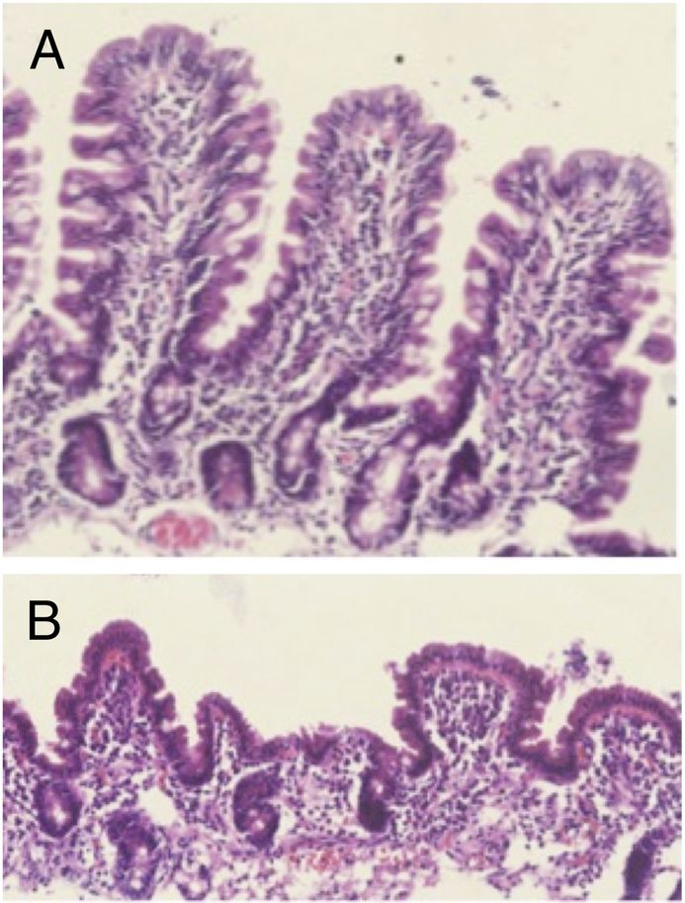
Long-term Disease Environmental Enteric Dysfunction (EED)
Feedback loop between infection and malnutrition
Chronic health impact: stunting
Below average height
Reduced cognitive development
Metabolic disorders (e.g. diabetes)
Cardiovascular disease
Adult obesity
Intergenerational impacts
Owino, V. et al. (2016) ‘Environmental enteric dysfunction and growth failure/stunting in global child health’, Pediatrics, 138(6). doi: 10.1542/peds.2016-0641.
Korpe, P. S. and Petri, W. A. (2012) ‘Environmental enteropathy: Critical implications of a poorly understood condition’, Trends in Molecular Medicine. Elsevier Ltd, 18(6), pp. 328–336. doi: 10.1016/j.molmed.2012.04.007.
Notes:
These two images are cross-sectional views of intestinal walls. Image A shows a normal intestine which has large protrusions called villi that provide a lot of surface area for absorbing nutrients.
Image B shows an intestine of a patient with environmental enteric dysfunction. You can see that the villi look stunted. They’re also more permeable to water, so they allow water to flow through easily but are not able to absorb nutrients effectively.

Slide 29
Long-term Disease Environmental Enteric Dysfunction (EED)
Feedback loop between infection and malnutrition
Chronic health impact: stunting
Below average height
Reduced cognitive development
Metabolic disorders (e.g. diabetes)
Cardiovascular disease
Adult obesity
Intergenerational impacts
Korpe, P. S. and Petri, W. A. (2012) ‘Environmental enteropathy: Critical implications of a poorly understood condition’, Trends in Molecular Medicine. Elsevier Ltd, 18(6), pp. 328–336. doi: 10.1016/j.molmed.2012.04.007.
Notes:
This condition is complicated and still poorly understood, so a lot of research is still needed to fully understand it.
But what we do know is that the physical changes to the intestine can lead to two things: weakened immune response in the intestines, and poor absorption of nutrients. The weakened immune response is thought to be the reason why vaccines are often ineffective in patients suffering from this problem. And the malabsorption of nutrients contributes to malnutrition. One of the consequences of malnutrition is increases susceptibility to infection, which leads back to the beginning of the cycle creating a feedback loop.
The ultimate consequences of EED include stunting (which means below average growth and is associated with physical smallness, reduced brain development, and higher likelihood of developing metabolic disorders, cardiovascular disease and obesity in adulthood.
A study published in 2014 found that stunting affects an estimated 165 million children under the age of 5.
One of the consequences of EED is that the people who suffer from it are often less able to work productively, and so they are less able to improve their living situations and more likely to be stuck in poverty, If they have children, the children may be exposed to faecal contamination in the same way and develop the same health problems. In this way, there are impacts across generations.

Slide 30
Disease and DALYs
Disability Adjusted Life Years (DALYs)
=
years of potential life lost due to premature death
+
years of productive life lost due to disability
Notes:
Now lets talk about how we measure impacts on health.
One of the key priorities in health research is to figure out how to actually measure health impacts.
Consuming water that is contaminated with pathogens or chemical contaminants can cause death, but as you have seen, it can also cause many difficult health problems for people who survive. So, we cannot just measure the impact in terms of the number of people killed.
Instead, we use a measure called Disability Adjusted Life Years (DALYs for short). The calculations that go into this are complicated and have to consider many different factors.
But to begin with, we can think of DALYs as calculations that include both the number of potential years lost due to premature death as well as the number of productive years lost due to disability.
One of the key things about DALYs is that they show impact on children very strongly. If a young child dies or is disabled due to a disease, they number of years that they have lost is a lot bigger than it would be for an elderly person.

Slide 31
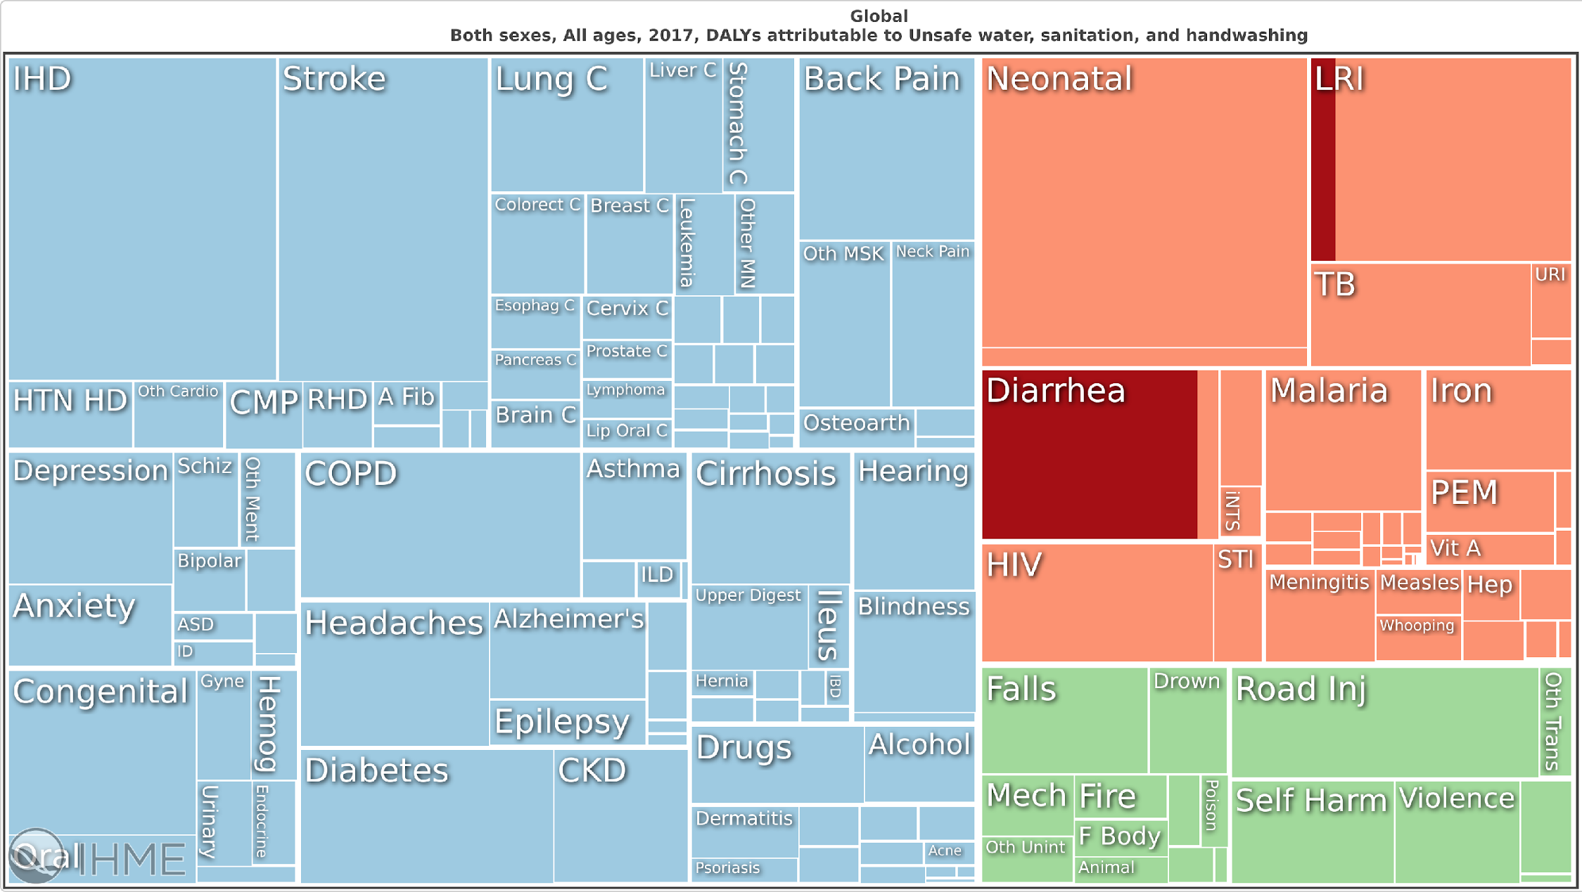
Global Burden of Disease
Non-communicable
Communicable, maternal, neonatal, and nutritional
Injuries
Institute for Health Metrics and Evaluation (IHME). GBD Compare Data Visualization. Seattle, WA: IHME, University of Washington, 2018. Available from http://vizhub.healthdata.org/gbd-compare. (Accessed [19/04/2019])
Notes:
So, keeping DALYs in mind. Let’s have a look at the results of the global burden of disease study that was published in 2018. For this study, researchers collected data from all over the world on the death and disability caused by many different types of diseases.
There are three main groups, blue is non-communicable diseases – so these are diseases that are not transmitted from one person to another. This category includes things like lung cancer, stroke, and diabetes.
The green group is injuries from causes like fires, drowning, falling, or violence.
The orange group is communicable diseases that are spread between people, as well as maternal, neonatal and nutritional complications.

Slide 32
Global Burden of Disease
Institute for Health Metrics and Evaluation (IHME). GBD Compare Data Visualization. Seattle, WA: IHME, University of Washington, 2018. Available from http://vizhub.healthdata.org/gbd-compare. (Accessed [19/04/2019])
Notes:
This slide is showing DALYs for different issues across the whole world for all ages and genders. The larger the box is, the more impact that disease has had in terms of causing death and disability.
The sections that are in dark red, are what the researchers classified as health impacts due to unsafe water, sanitation and hygiene. You can see these are mostly related to diarrhoea from acute infections and LRI – which stands for lower respiratory tract infections, so this includes things in the water-washed and water-aerosol categories that I spoke about before.
I’ll switch the slide now to show the results for Myanmar only.

Slide 33
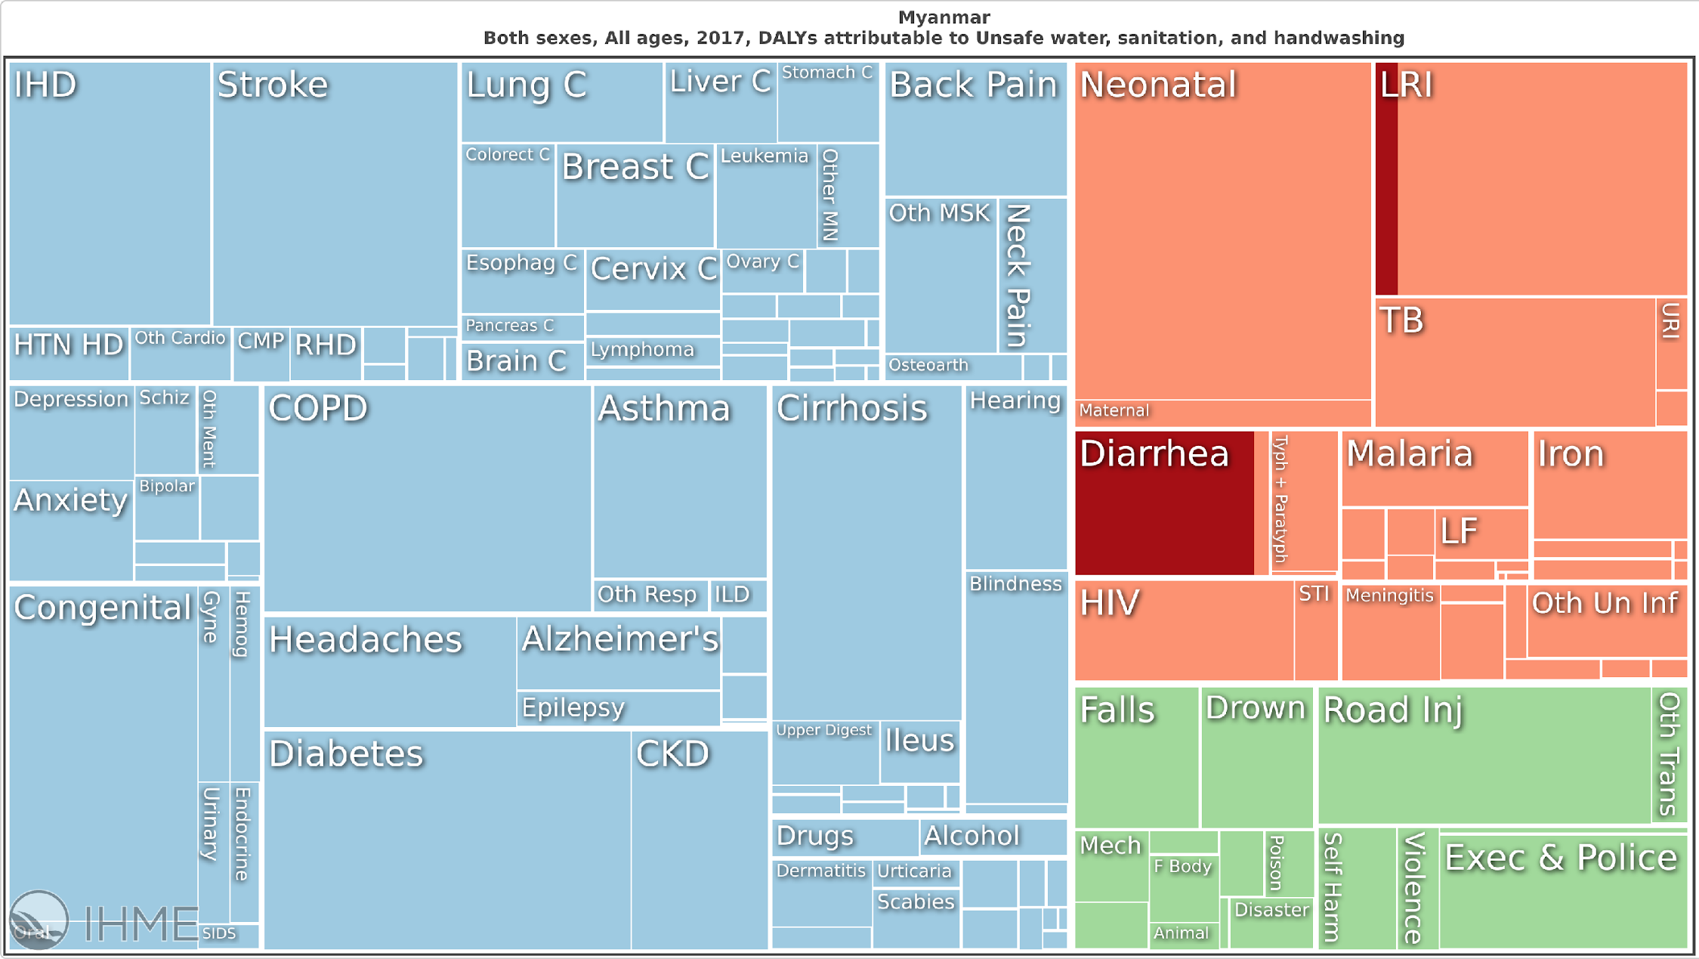
Myanmar Burden of Disease
Institute for Health Metrics and Evaluation (IHME). GBD Compare Data Visualization. Seattle, WA: IHME, University of Washington, 2018. Available from http://vizhub.healthdata.org/gbd-compare. (Accessed [19/04/2019])
Notes:
As you can see, it looks quite similar to the global chart, although boxes for the non-communicable diseases and injuries have increased a bit and the orange boxes have decreased a bit.

Slide 34
Myanmar Burden of Disease
“Diarrhoea are included in top ten leading cause of morbidity in Myanmar”
MoH (2018) ‘Environmental Health in Myanmar’. The Republic of the Union of Myanmar Ministry of Health and Sports Department of Public Health Occupational and Environmental Health Division, pp. 1–14.
Institute for Health Metrics and Evaluation (IHME). GBD Compare Data Visualization. Seattle, WA: IHME, University of Washington, 2018. Available from http://vizhub.healthdata.org/gbd-compare. (Accessed [19/04/2019])
Notes:
Diarhoea is clearly recognised as an important health concern in the country. This quote from a 2018 ministry of health report says…(read the quote on the slide)
But what’s important to recognise is that the red squares which are showing the impact of unsafe water, sanitation and hygiene, are only indicating short-term diseases. Based on what I’ve said about the long-term consequences of prolonged exposure to pathogens and chemical contaminants, you know that unsafe water is also contributing to many other types of disease when you think about long-term impacts.

Slide 35
Myanmar Burden of Disease
Cardiovascular
Cancers
Mental Health
Metabolic Disorders
Institute for Health Metrics and Evaluation (IHME). GBD Compare Data Visualization. Seattle, WA: IHME, University of Washington, 2018. Available from http://vizhub.healthdata.org/gbd-compare. (Accessed [19/04/2019])
Notes:
Here I’ve highlighted some of the non-communicable disease boxes that unsafe water is contributing to – including cardiovascular disease, cancers, mental health, and metabolic disorders.
And if we think about water-related health more broadly, we can also start to include things like vector-borne illnesses such as malaria.

Slide 36
Myanmar Burden of Disease
Cardiovascular
Cancers
Mental Health
Vector-borne
Metabolic Disorders
Institute for Health Metrics and Evaluation (IHME). GBD Compare Data Visualization. Seattle, WA: IHME, University of Washington, 2018. Available from http://vizhub.healthdata.org/gbd-compare. (Accessed [19/04/2019])
Notes:
So, although we don’t have enough information to say exactly how much of these diseases are water-related as opposed to being caused by other factors, we can see that water supply and water resource management is related to many types of disease in Myanmar and globally.

Slide 37
Water-related Health Key Considerations
Microbial and chemical hazards
Short-term and long-term disease
Global goals
Service level inequalities
Water Safety Planning
Transformative WASH
“Water Supply at Shwedagon Pagoda” by Saskia Nowicki
Notes:
So what is being done about these health impacts?
In the next set of slides I’ll tell you about the global goals that are aiming to reduce the water-related disease burden. Since we have limited time, I will focus on the drinking-water supply goals only. But it’s good to be aware that there are other goals for improving sanitation and hygiene, and also water resource management more broadly.

Slide 38
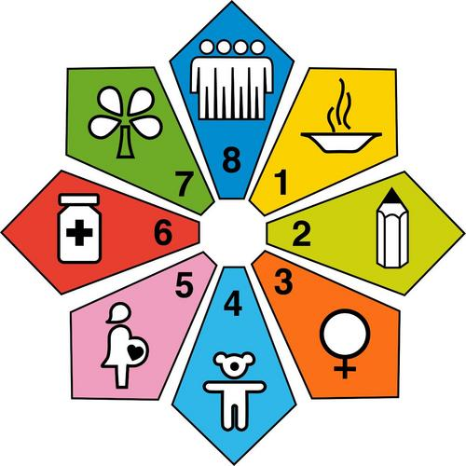
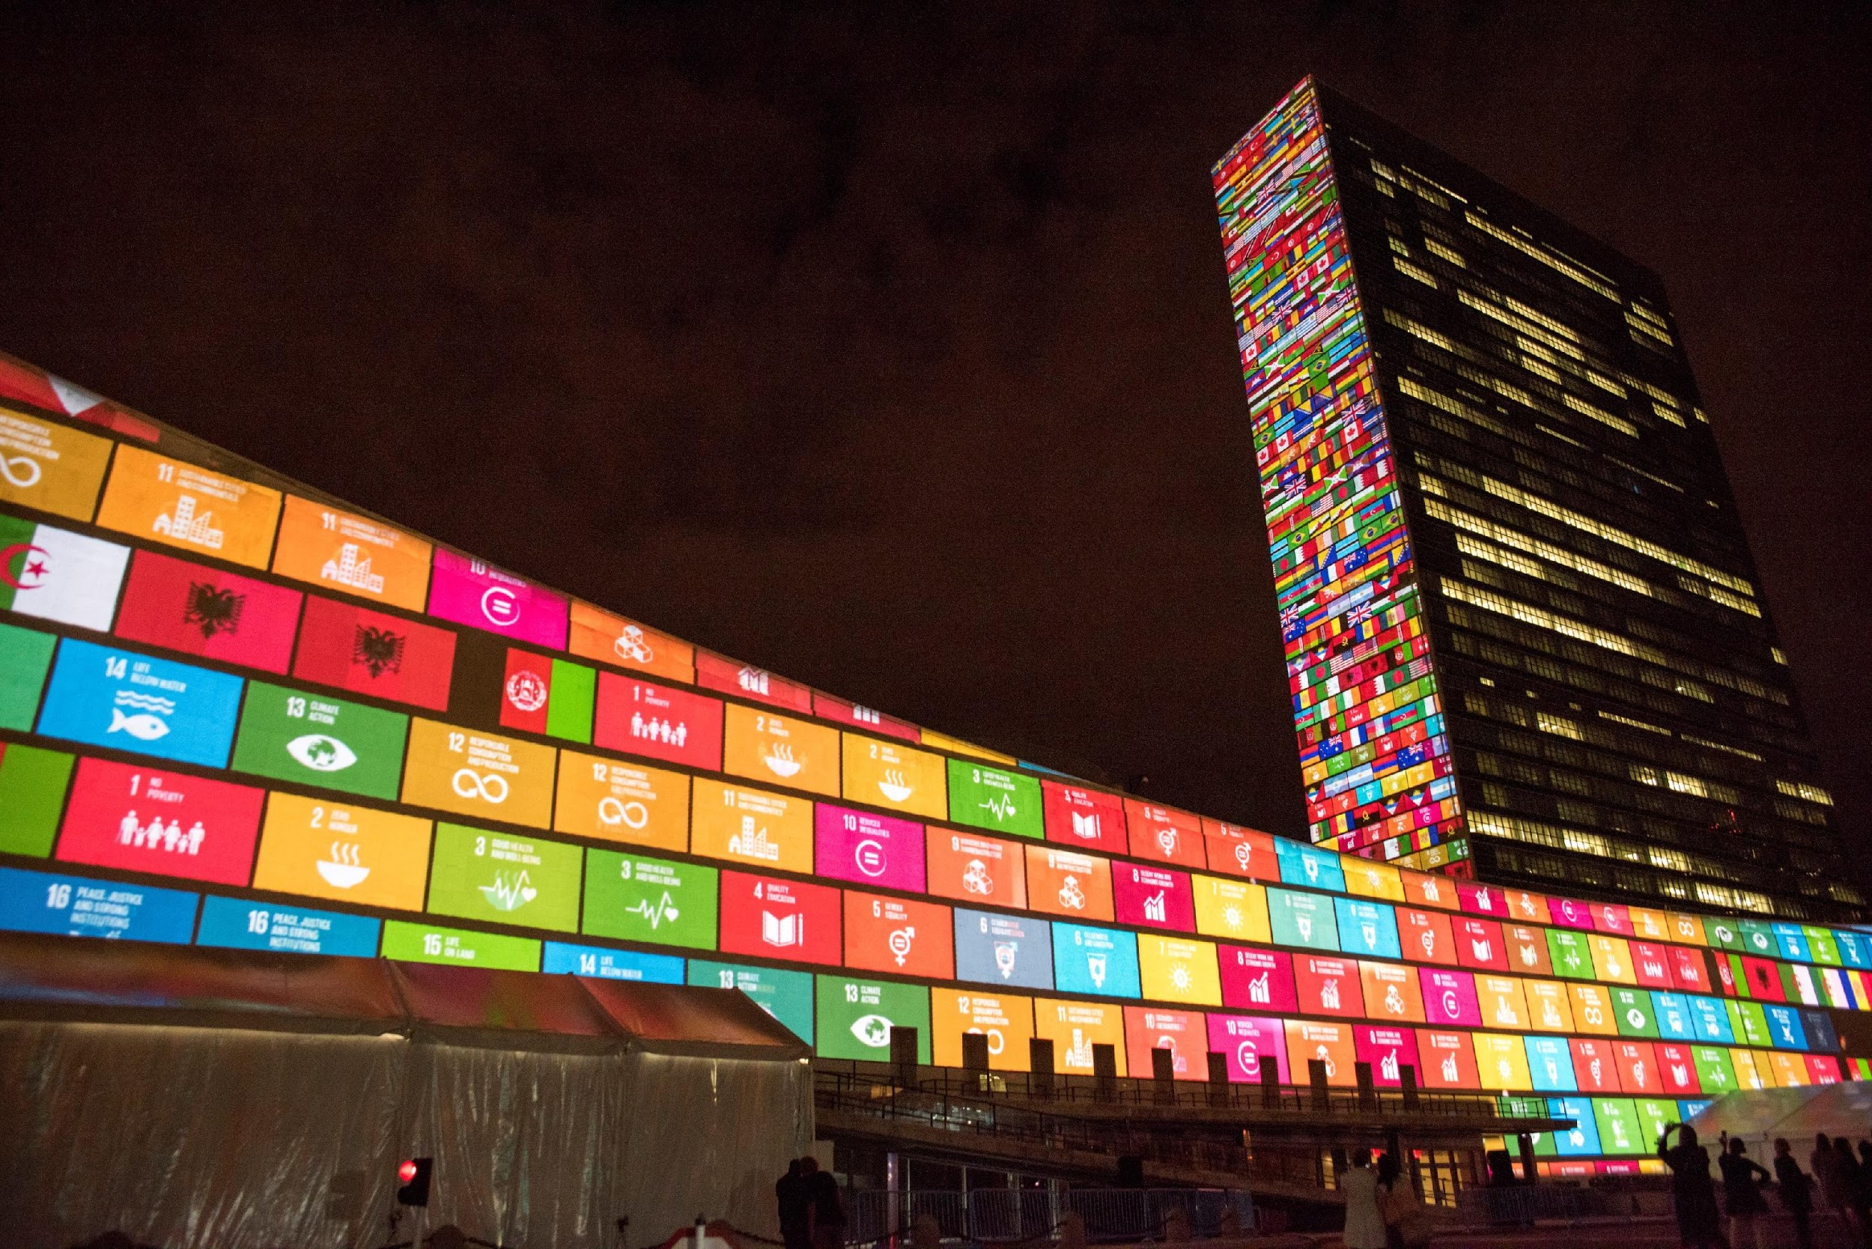
Global Development Goals
Millennium Development Goals
MDG Goal 7 – Ensure environmental sustainability
7.3 – By 2015, halve the proportion of the population without sustainable access to safe drinking water and basic sanitation.
Sustainable Development Goals
SDG Goal 6 – Ensure availability and sustainable management of water and sanitation for all
6.1 – By 2030, achieve universal and equitable access to safe and affordable drinking water for all.
"2003-04" (CC BY 2.0) by ITU Pictures
"Projections on Sustainable Development G" (CC BY-NC-ND 2.0) by United Nations Photo
Notes:
20 years ago, in 2000, the millennium development goals were announced. These were the product of more than a decade of United Nations conferences and summits and represented an agreement by world leaders to reduce extreme poverty and tackle pressing problems like lack of safe water supplies.
The 7th goal, MDG 7 was to ensure environmental sustainability, and as part of this goal. Objective 7.3 was to halve the proportion of the population living without sustainable access to safe drinking water by 2015.
Then in 2015, the sustainable development goals were announced. These are a much more detailed and ambitious set of global goals that aim to do much more than the millennium goals did.
SDG 6 is all about water and sanitation, and goal 6.1 is to achieve universal and equitable access to safe and affordable drinking water for all by 2030.

Slide 39
Global Development Goals
Millennium Development Goals
MDG Goal 7 – Ensure environmental sustainability
7.3 – By 2015, halve the proportion of the population without sustainable access to safe drinking water and basic sanitation.
Sustainable Development Goals
SDG Goal 6 – Ensure availability and sustainable management of water and sanitation for all
6.1 – By 2030, achieve universal and equitable access to safe and affordable drinking water for all.
"2003-04" (CC BY 2.0) by ITU Pictures
"Projections on Sustainable Development G" (CC BY-NC-ND 2.0) by United Nations Photo
Notes:
As you can see, both goals used the word ‘safe’. But there are important differences in the way that they are judging what safety means.
For the millennium development goals, they judged safety based on infrastructure, so certain types or water systems were assumed to be safe, while others were not. But they didn’t actually test the quality of the water to confirm if it was free from pathogens and chemical contaminants.
To understand the implications of this, we can look first at the outcome of the millennium development goal effort.

Slide 40
Global Development Goals
Achieving MDG 7.3
“Today we recognize a great achievement for the people of the world. This is one of the first [Millennium Development Goal] targets to be met. The successful efforts to provide greater access to drinking water are a testament to all who see the MDGs not as a dream, but as a vital tool for improving the lives of millions of the poorest people.”
– Ban Ki-moon (quoted in UNICEF, 2012. Joint press release: Millennium Development Goal drinking water target met.)
Notes:
In 2012, Ban Ki Moon, who was then the head of the united nations, made this announcement about achieving the water goal. He said…(read the quote on the slide)
But even while this achievement was being celebrated. Research was ongoing to investigate whether all the water supplies that were assumed to be safe because of their infrastructure design, were actually free of pathogens and hazardous chemicals when tested.

Slide 41
Global Development Goals
Achieving MDG 7.3
Further Research
Estimates of people at risk are substantially higher when water quality is tested.
Modelling suggests global microbial contamination risk around double
Priority chemicals not considered
Onda, K., Lobuglio, J. and Bartram, J. (2012) ‘Global Access to Safe Water: Accounting for Water Quality and the Resulting Impact on MDG Progress’, International Journal of Environmental Research and Public Health, 9, pp. 880–894. doi: 10.3390/ijerph9030880.
Bain, R. et al. (2012) ‘Accounting for water quality in monitoring access to safe drinking-water as part of the Millennium Development Goals: lessons from five countries’, Bulletin of the World Health Organization, 90, pp. 228–235. doi: 10.2471/BLT.11.094284.
Wolf, J., Bonjour, S. and Prüss-Ustün, A. (2013) ‘An exploration of multilevel modeling for estimating access to drinking-water and sanitation’, Journal of Water and Health, 11(1), pp. 64–77. doi: 10.2166/wh.2012.107.
Bain, R. et al. (2014) ‘Fecal Contamination of Drinking-Water in Low- and Middle-Income Countries: A Systematic Review and Meta-Analysis’, PLoS Medicine, 11(5). doi: 10.1371/journal.pmed.1001644.
WWAP (2015) The United Nations World Water Development Report 2015: Water for a Sustainable World. Paris. Available at: http://unesdoc.unesco.org/images/0023/002318/231823E.pdf.
“Today we recognize a great achievement for the people of the world. This is one of the first [Millennium Development Goal] targets to be met. The successful efforts to provide greater access to drinking water are a testament to all who see the MDGs not as a dream, but as a vital tool for improving the lives of millions of the poorest people.”
– Ban Ki-moon (quoted in UNICEF, 2012. Joint press release: Millennium Development Goal drinking water target met.)
Notes:
This research found that many water supplies that were assumed to be safe tested positive for microbial contamination and so were not truly safe. Based on this, the researchers redid the estimates of how many people had access to safe water and found that about 2 billion people still didn’t have sustained access to safe water. And this estimate didn’t consider chemical contamination, so it is still underestimating the extent of the problem.
Fortunately, when the sustainable development goals were being created, the importance of testing water quality was recognised. So the water SDG defines ‘safe’ in a more accurate way than the MDG did.

Slide 42
Global Development Goals
Millenium Development Focus
Sustainable Development Focus
Goal: increase access to ‘improved’ water sources
Focus: infrastructure
Goal: increase access to water that is consistently available, affordable and safe (free from faecal and priority chemical contamination)
Focus: service provision
Notes:
First the goal was to increase access to ‘improved’ sources of water, which means water supplies that are designed and constructed in particular ways that are meant to protect from contamination.
Now the goal has evolved, and the aim is to increase access to water supplies that are not only ‘improved’, but also that are consistently available, affordable and demonstrably free from faecal and priority chemical contamination.
So the focus of the water MDG was on infrastructure, and the focus of the SDG which we are working towards now is on service provision.

Slide 43
Service Levels
Service Level | Explanation
Safely Managed | Drinking water from an improved water source that is located on premises, available when needed and free from faecal and priority chemical contamination.
Basic | Drinking water from an improved source, provided collection time is not more than 30 minutes for a roundtrip including queuing.
Limited | Drinking water from an improved source for which collection time exceeds 30 minutes for a roundtrip including queuing.
Unimproved | Drinking water from an unprotected dug well or unprotected spring.
Surface water | Drinking water directly from a river, dam, lake, pond, stream, canal or irrigation canal.
Improved sources are better protected from faecal contamination by nature of their design. The category includes: piped water, boreholes or tubewells, protected dug wells, protected springs, rainwater, and packaged or delivered water.
Source: Adapted from World Health Organization (WHO) and the United Nations Children’s Fund (UNICEF), 2017. Progress on Drinking Water, Sanitation and Hygiene: 2017 Update and SDG Baselines. Geneva. 66pp. https://washdata.org/reports. Reproduced with permission of the World Health Organization
Notes:
The World Health Organisation and UNICEF have defined different service levels to help countries track their progress towards the ultimate goal of universal access to safely managed water.
Surface water is the lowest level – this refers to drinking water directly from a river, dam, lake, pond, stream, canal or irrigation canal.
One level above that is unimproved water sources – these are drinking water from an unprotected dug well or unprotected spring. They are still very vulnerable to faecal contamination especially in areas without good sanitation systems.
The next level up is ‘limited’ supply. This is where we see the concept of ‘improved’ sources being introduced. As I mentioned, improved sources are those that are better protected from faecal contamination by nature of their design. The category includes: piped water, boreholes or tubewells, protected dug wells, protected springs, rainwater, and packaged or delivered water.
At the limited level, improved sources are available, but people have to travel to fetch water from them and may have to wait in long ques.
At the basic level of service, the travel and queuing time for improved source is less than thirty minutes.
The golden standard is the safely managed level of service. At this level the improved source is located on premises – which means it must be a piped supply or a borehole that brings water directly to the property. For a supply to be considered safely managed, it must also be available when needed and free from faecal and priority chemical contamination.

Slide 44
Water-related Health Key Considerations
Microbial and chemical hazards
Short-term and long-term disease
Global goals
Service level inequalities
Water Safety Planning
Transformative WASH
“Water Supply at Shwedagon Pagoda” by Saskia Nowicki
Notes:
Keeping those service levels in mind. Lets now take a look at some of the data that shows how service levels vary based on location and wealth.

Slide 45
Global Drinking-Water Household Service Levels
Data reported in: JMP (2017) Progress on Drinking Water, Sanitation and Hygiene: 2017 Update and SDG Baselines. doi: 10.1111 / tmi.12329.
Chart produced at https://washdata.org/data (Accessed [18/04/2019])
Notes:
The chart in this slide and the next few slides come from the joint monitoring programme of the WHO and UNICEF. You can check out their reports, see all of their data and create charts of your own at this link here [draw arrow]. The site is updated with data up to 2017 so far.
So this chart is showing data on household drinking water service levels for all of the countries in the world. On the one end there are the very developed countries that have high coverage of safely managed water. On the other end are the less developed countries where a lot of people are still relying on surface water, unimproved sources or limited sources.
The red arrow shows the location of Myanmar.
One thing to be aware of when looking at these charts is that not all countries actually have data to report on the proportion of safely managed supplies. So although these countries only show basic water, many of them will also have some safely managed water, but it is just not reflected in the data.

Slide 46
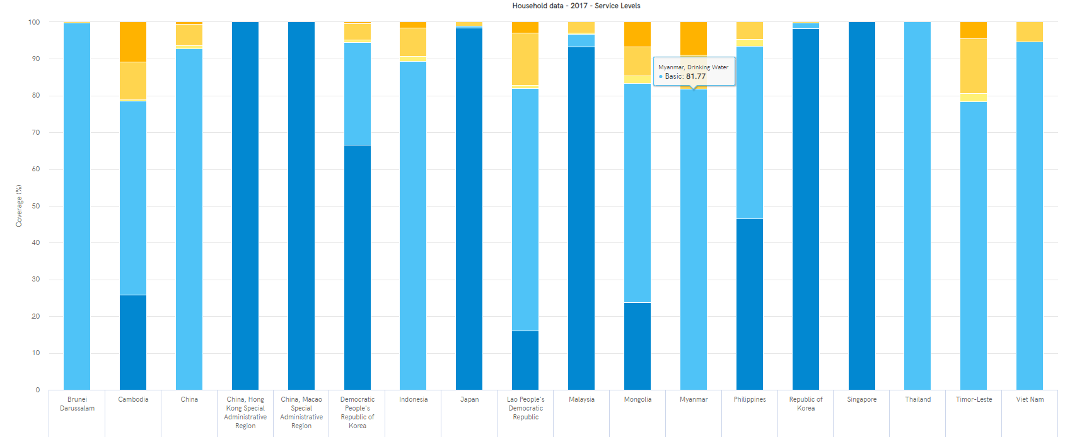
Eastern and South-eastern Asia
Household Drinking Water
Chart produced at https://washdata.org/data (Accessed [28/02/2020])
Notes:
Taking a look at countries in eastern and south eastern Asia, we can see there is a lot of variability between countries. Places like Singapore and Hong Kong report 100% safely managed services, whereas Cambodia, Laos, Mongolia, and Myanmar, and east timor still have substantial use of surface, unimproved or limited supplies.
Myanmar reports 82% coverage of at least basic services. There isn’t data on safely managed sources from Myanmar yet.

Slide 47
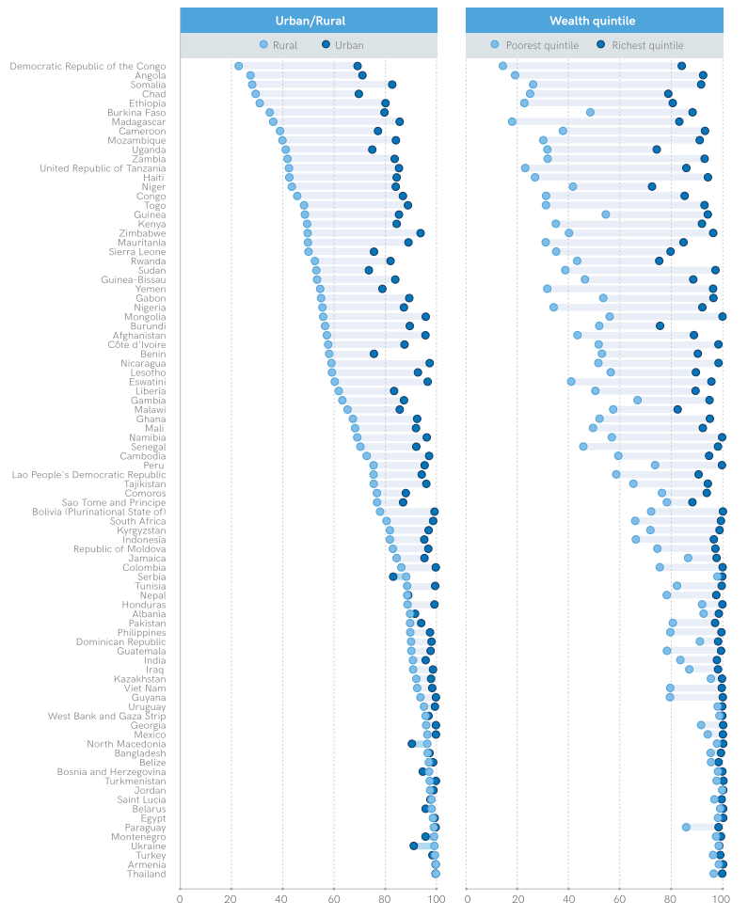
Global Drinking-Water Household Service Levels
Charts show proportion of people with at least basic water services.
Data reported in: JMP (2019) Progress on household drinking water, sanitation and hygiene 2000-2017. Special focus on inequalities. New York, USA.
Notes:
In addition to big differences in service levels between countries, there are also big differences within countries.
These charts show differences within countries between rural areas and urban areas. And between the poorest people in the population and the wealthiest people. On the bottom access is the proportion of people with at least basic water services. You can see that in many of the represented countries, poorer people and people in rural areas have less access to basic water services.
In the democratic republic of the congo for example, only just over 20% of people in rural areas have access to basic water, whereas in urban areas the proportion is almost 70%. And only about 15% of the poorest people in that country have access, whereas more than 80% of the wealthiest people do.
Again, we also need to be aware that some countries don’t report data that is separated by urban/rural or wealth quintiles, so it’s not always possible to do this type of analysis. But there is enough data to know that these inequalities are big and widespread in many places.

Slide 48
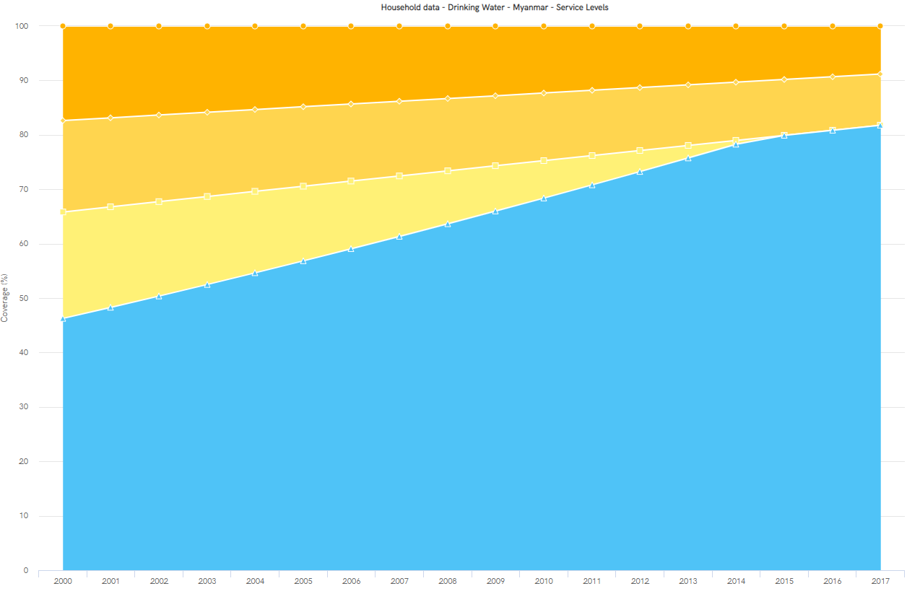
Myanmar Drinking-Water Household Service Levels 2000 – 2017
Chart produced at https://washdata.org/data (Accessed [28/02/2020])
Notes:
The good news is that the data has tracked improvement in many countries, including Myanmar.
This chart shows the service levels starting in 2000 and going until 2017. As you can see, the proportion of people with access to basic services has steadily increased, while limited water has dropped substantially and unimproved and surface water use is also decreasing.

Slide 49
Myanmar Drinking-Water Rural vs. Urban Households
Chart produced at https://washdata.org/data (Accessed [28/02/2020])
Notes:
If we look at the rural versus urban breakdown in Myanmar, we can see that urban households generally have better services, with more use of surface and unimproved water still in rural areas.

Slide 50
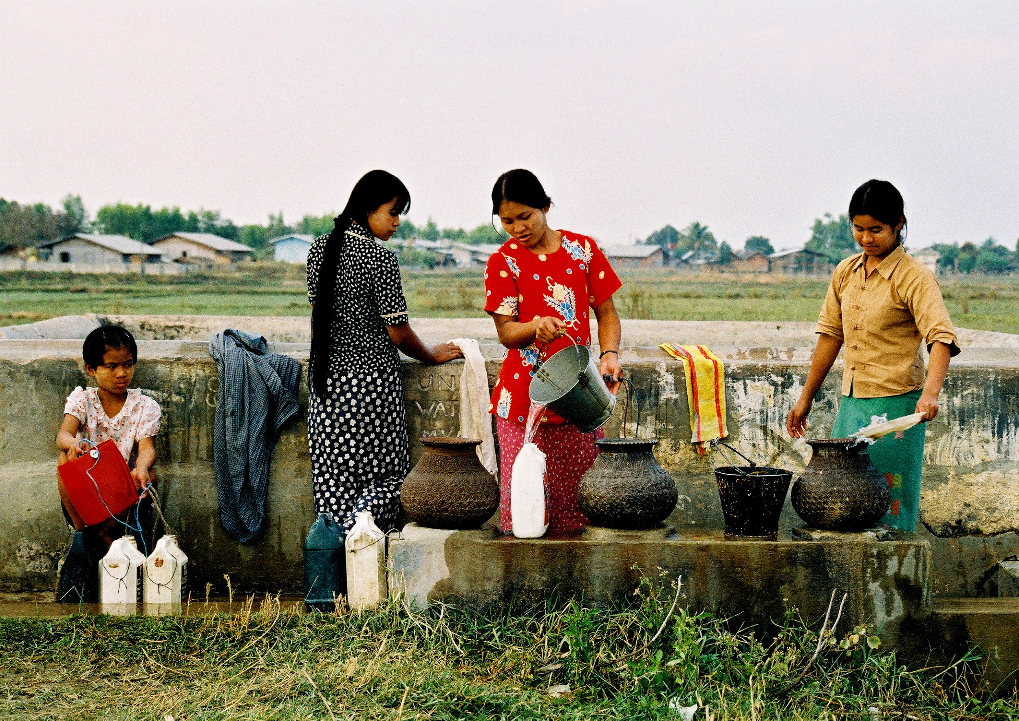
Myanmar Drinking-water Uneven Service Levels
WHO (2015) ‘UN-Water Global Analysis and Assessment of Sanitation and Drinking-Water Myanmar Country Report’. Geneva, Switzerland: WHO Press.
Households with Piped Water Supply
4% Myanmar
31% Chin state
11% Kayah state, Tanintharyi region, Yangon region
<1% several states and divisions
Use of Unprotected Wells
~10% Myanmar
44% Kayin state
37% Rakhine state
24% Kayah state
"Bamboo Pipe" (CC BY-NC-ND 2.0) by philability
"People gathering around a well, Myanmar" (CC BY-NC 2.0) by water.alternatives
Notes:
A report from the World Health Organisation published in 2015 outlined some of the uneven service levels across Myanmar. For example, the proportion of households with water piped onto the premises was 4% for the whole country but ranged from 31% in Chin state, where bamboo pipes are often used, to less than 1% in several states and division.
On the other hand, the report estimated that the proportion of households using unprotected wells was about 10% for the whole country. But was substantially higher in certain states like Kayin, Rakhine, and Kayah.

Slide 51
Myanmar Drinking-water Uneven Service Levels
Key points:
“Although improved water access has increased over time, it has been driven by the private expansion of bottled water rather than through increased and more sustainable use of piped and groundwater sources. Households in multiple states and regions have to transport water from source to consumption point, increasing the risk of contamination.”
“The use of surface water continues to be substantial in Rakhine and Ayeyarwady”
Access to improved water sources is seasonally dependent, with many households switching from rainwater (improved) to surface water (unimproved) during the dry season.
Poor households in Myanmar have significantly lower access to basic services.
Central Statistical Organization (CSO), UNDP and WB (2018) “Myanmar Living Conditions Survey 2017: Key Indicators Report”, Nay Pyi Taw and Yangon, Myanmar: Ministry of Planning and Finance, UNDP and WB https://www.mm.undp.org/content/myanmar/en/home/library/poverty/MLCS.html
Notes:
Another report published a bit more recently by the Myanmar central statistics organisation, the UN development programme, and the world bank, give more updated information.
You can find the whole report at the link on the slide. I would highly recommend reading this if you are interested. There is also a Burmese version that you can download. There is a whole section on drinking water and also a lot of other information about living conditions that impact health.
These were some of the key findings of the report (read the slide)

Slide 52
Water-related Health Key Considerations
Microbial and chemical hazards
Short-term and long-term disease
Global goals
Service level inequalities
Water Safety Planning
Transformative WASH
“Water Supply at Shwedagon Pagoda” by Saskia Nowicki
Notes:
So far, we have looked at different categories of microbial and chemical hazards, and learned about some of the short and long term diseases that contaminated drinking water can cause. We looked at the global goals and the water service levels that are being used to track progress towards supplying safe water for everyone. And we’ve had a look at some of the data on service levels globally and in Myanmar specifically.
Now in the next set of slides I’m going to talk about one of the main approaches that is used to actually assess and improve the safety of drinking water supplies.

Slide 53
Water Safety Planning
Source: A guide to equitable water safety planning: ensuring no one is left behind. Geneva: World Health Organization; 2019. Licence: CC BY-NC-SA 3.0 IGO.
Notes:
This approach is called water safety planning. And it has been recommended by the World Health Organisation for a couple of decades as part of a framework for systematically managing risks to ensure that water supplies are safe.
Generally it involves 5 main stages – which are shown on the slide.
Each stage is associated with a set of tasks.
The first stage, preparation, involves engaging the community that the water is supplying and assembling a team of people to lead the water safety planning work.

Slide 54
Water Safety Planning
Source: A guide to equitable water safety planning: ensuring no one is left behind. Geneva: World Health Organization; 2019. Licence: CC BY-NC-SA 3.0 IGO.
Notes:
Once a team is assembled, stage two is to conduct a system assessment.
One of the things that can be done for a system assessment is to see what control measures are in place to ensure the safety of the water at different stages in the system.

Slide 55
Water Safety Planning Control Measures
Source protection
Sedimentation
Filtration
Disinfection
Safe storage
Nowicki, S. and Gladstone, N. (2018) ‘The Water Module: Student resource’. Oxford, UK: School of Geography and the Environment, University of Oxford. Available at: https://upgro.files.wordpress.com/2018/03/water-module-student-resource-web.pdf. Licence: CC BY-NC-SA 4.0
Adapted from: Lawrence, A. R. et al. (2001) Guidelines for Assessing the Risk to Groundwater from On-Site Sanitation, ARGOSS British Geological Survey Commissioned Report.
Notes:
The most common control measures are source protection, sedimentation, filtration, disinfection, and safe storage.
The first measure, source protection, is about understanding and where possible removing any contamination in the area that the water is sourced from.
The figure on the slide is an example of a handpump which is sourcing groundwater. There is a latrine near the handpump which is a potential source of faecal contamination because waste from the latrine can travel through the groundwater and be drawn up into the handpump – this is called the aquifer pathway. The second potential pathway for contamination in this example is the areas directly around the borehole, called localised pathways, where dirty water from the surface can drain directly down and then be pulled up in the water supply again. When constructing boreholes, the source protection step requires that they be located away from sources of contamination like latrines, and that they are well-sealed to prevent dirty water from flowing down any localised pathways.
In larger water supply systems, source protection measures will have to consider other hazards like the location of factories, mines, or agriculture for example.

Slide 56
Water Safety Planning Control Measures
Source protection
Sedimentation
Filtration
Disinfection
Safe storage
Nowicki, S. and Gladstone, N. (2018) ‘The Water Module: Student resource’. Oxford, UK: School of Geography and the Environment, University of Oxford. Available at: https://upgro.files.wordpress.com/2018/03/water-module-student-resource-web.pdf. Licence: CC BY-NC-SA 4.0
Notes:
The second control measure is sedimentation. This step is useful when water is visibly unclean with turbidity from insoluble particles suspended in the water. the basic process of sedimentation is to store the water in large containers over time until the particles settle to the bottom and can be separated from the water. in water treatment plants they will usually add some chemical that speed up this process by causing the particles to clump together so that they get heavy and sink more quickly.

Slide 57
Water Safety Planning Control Measures
Source protection
Sedimentation
Filtration
Disinfection
Safe storage
“Household Filter Training, Kenya” by Saskia Nowicki
Notes:
Once the water is visibly clear, it should be passed through a filter to remove potential contaminants that are too small to be not visible. You don’t want to skip sedimentation and go straight to filtration if the water is turbid, because larger visible particles will clog up the filters very quickly and it will be expensive and time consuming to clean and replace them too often.
Filters can be used at many different scales. This image shows an example of table-top filters that can be used at the household level to filter water before drinking it. These filters are able to process a relatively small volume of water at a time, but they can be enough for a household. They are able to remove worms, protozoans and bacteria but not viruses, so they don’t clean the water completely.

Slide 58
Water Safety Planning Control Measures
Source protection
Sedimentation
Filtration
Disinfection
Safe storage
“Llobregat Desalination Plant, Barcelona” by Saskia Nowicki
Notes:
At a larger scale, filtration can be used in water treatment plants to process large volumes of water. these plants may have such high-quality filters that they are able to remove viruses and even chemicals from the water. This photo is an example of a treatment plant in Barcelona in Spain where they are filtering ocean water and removing all the salt and everything else from it so that they produce very pure water for drinking.
But this type of filtration is expensive and uses a lot of energy, and it produces a highly concentrated waste stream that needs to be disposed safely, so it is not always a good option.

Slide 59
Water Safety Planning Control Measures
Source protection
Sedimentation
Filtration
Disinfection
Safe storage
"SODIS Pictograms" (CC BY-SA 2.0) by ColaLife
Notes:
Besides filtration, another control measure is disinfection. This is the process of using chemicals like chlorine or ozone, or UV light, to kill any pathogens that may be remaining in the water.
Chlorination is the most common form of disinfection, but using UV light is also popular.
The images on the slide depict a solar disinfection process that is sometimes practiced at household or community level to use UV in sunlight to disinfect water that is kept in clear bottles and exposed to direct sunlight. The amount of time that the water has to be exposed for depends on the strength of the sunlight and can range from 6 hours if the sunlight is strong and direct, up to 2 days if conditions are cloudy.
The sedimentation and filtration steps are particularly important before using UV disinfection because if the water is not clear, pathogens can hide behind particulates in the water to avoid being killed by the UV light.

Slide 60
Water Safety Planning Control Measures
Source protection
Sedimentation
Filtration
Disinfection
Safe storage
“Water Storage Tank, Kenya” by Saskia Nowicki
Notes:
The final control measure is ensuring that once water has been treated, it is stored safely so that it doesn’t get contaminated. There are a lot of guidelines around safe storage but the key principles are to have a well-sealed container that is preferable elevated off the ground or kept in a clean area and from which water is drawn using a tap that only allows outflow and doesn’t let any contamination into the container. Storage containers also need to be periodically cleaned and disinfected.

Slide 61
Water Safety Planning
Source: A guide to equitable water safety planning: ensuring no one is left behind. Geneva: World Health Organization; 2019. Licence: CC BY-NC-SA 3.0 IGO.
Notes:
Following assessment of the system and the control measures in place, the next stage, stage 3, in water safety planning is monitoring. Which means regularly sampling the water and conducting inspections of the system to ensure that the control measures are working as intended.

Slide 62
Water Safety Planning Monitoring
Sanitary inspections
Microbial and chemical water samples
Identify health risks
“Tryptophan-like Fluorescence Sampling” by Saskia Nowicki
Based on WHO. 1997. Guidelines for drinking-water quality: Volume 3 Surveillance and control of community supplies, 2nd ed. World Health Organization, Geneva, Switzerland.
“E. coli Sampling” by Saskia Nowicki
Notes:
The type of monitoring that is done will depend on the characteristics of each system but generally there are two parts. The first are sanitary inspections, which are routine surveys of the system to check for any possible hazards that could lead to contamination – these could be pipe leaks, clogged filters, or new sources of pollution in the catchment area of a water supply for example.
The other part of monitoring is taking water samples and testing them for different parameters of interest. Often operators will check the level of chlorine in water supplies that use it for disinfection, to ascertain if the disinfection measures are working properly. It’s also common to use E. coli bacteria as an indicator of potential fecal contamination. And other measures like turbidity and protein-like fluorescence are also sometimes used.

Slide 63
Water Safety Planning
Source: A guide to equitable water safety planning: ensuring no one is left behind. Geneva: World Health Organization; 2019. Licence: CC BY-NC-SA 3.0 IGO.
Notes:
The next stage after monitoring is to communicate the results and make decision to address any indicated health risks.

Slide 64
Water Safety Planning
Source: A guide to equitable water safety planning: ensuring no one is left behind. Geneva: World Health Organization; 2019. Licence: CC BY-NC-SA 3.0 IGO.
Notes:
After that, the final stage is feedback and improving the system and management processes.
Basically, the key task for these last two stages, stages 4 and 5, is to document, review, and improve all aspects of the water safety plan implementation.

Slide 65
Water-related Health Key Considerations
Microbial and chemical hazards
Short-term and long-term disease
Global goals
Service level inequalities
Water Safety Planning
Transformative WASH (water, sanitation, and hygiene)
“Water Supply at Shwedagon Pagoda” by Saskia Nowicki
Notes:
For most of this presentation, I have been talking a lot about drinking water safety and the health consequences of unsafe drinking water.
But now for the final few slides, let’s take a step back and look at health a bit more generally in the context of not just drinking-water, but also sanitation and hygiene.

Slide 66
Water + Sanitation and Hygiene
WHO. 2018. Guidelines on sanitation and health. World Health Organization. https://www.who.int/water_sanitation_health/publications/guidelines-on-sanitation-and-health/en/
Notes:
If we think about the pathogens that come from human waste, the ones that can cause diarrhoea and many short-term and long-term health complications, we quickly realise that water is not the only potential source of exposure to these pathogens.
In fact the issue really starts with sanitation hazards, which can include (read the slide).
These sanitary hazards combine with various routes of spreading pathogens in the environment including…(read slide)
And the result of these hazards and routes of spreading can be contamination of food crops, hands, feed, and surfaces as well as water.
So when we think of protecting people from these pathogens, we need to consider all of these pathways through which they can be exposed. It’s not enough just to focus on water only.

Slide 67
Water + Sanitation and Hygiene
Burden of Enteric Disease
Exposure to Faecal Contamination
Combined exposure from all pathways
Intervention reduces exposure from one pathway
Intervention reduces exposure from multiple pathways or most significant pathway
Adapted from: Robb, K. et al. (2017) ‘Assessment of fecal exposure pathways in low-income urban neighborhoods in Accra, Ghana: rationale, design, methods, and key findings of the Sanipath study’, American Journal of Tropical Medicine and Hygiene, 97(4), pp. 1020–1032. doi: 10.4269/ajtmh.16-0508.
Notes:
This chart is adapted from a study published in 2017 that looked at what it takes to actually reduce the amount of disease caused by fecal pathogens in a community.
Starting at the black cross, we see that the level of disease is high and the amount of exposure to pathogens is also high.
The blue cross shows what happens when an intervention is made to decrease some of the exposure to pathogens. For example, this could be an initiative to introduce disinfection the water supply. Or to provide households with table-top filters. The intervention reduces some of the exposure to pathogens, but there is still so much exposure from other pathways that the amount of disease only reduces by a very small amount.
The green cross shows a situation in which interventions are done to decrease exposures from multiple pathways. And only then do we see that the amount of disease decreases by a substantial amount.
So the conclusion of this is that in order to substantially reduce the amount of disease that communities experience from faecal pathogens, we need to improve many aspects of the living environment to address hazards from sanitation and hygiene as well as water supply.
So, there is a lot of work to be done.

Slide 68
Water Safety Management Key Players
Government
Regulations
Market
Risk Sharing
Non-Government Organisations (NGOs) and Donors
Norms
Contracts
Community
Adapted from: Koehler, J. et al. (2018) ‘A cultural theory of drinking water risks, values and institutional change’, Global Environmental Change. Elsevier Ltd, 50(November 2017), pp. 268–277. doi: 10.1016/j.gloenvcha.2018.03.006.
Notes:
And because this work involves so many different aspects of water, sanitation, and hygiene management as well as other factors – many different organisations need to be involved in making improvements. These include private companies in the market sector, government and regulatory organisations, communities, and also non-governmental organisations and donors.
The main thing I want to say with this slide is that it’s important to remember that improving WASH related health outcomes is not just a technical challenge. It’s not just about building new infrastructure or finding better ways to monitor or treat water. There’s also a lot of work that needs to be done to enable cooperation and relationship building between all of these different organisations.

Slide 69
Myanmar Government Mandates for Water
Organisation | Role
Ministry of Agriculture, Livestock and Irrigation | Community water supply; strategy development
Ministry of Health | Guidance and promotional materials for behaviour change; environmental sanitation; water, sanitation and hygiene in health facilities
Ministry of Home Affairs | Coordination of development activities
Ministry of Social Welfare Relief | Emergency preparedness and response; early childhood education
National Water Resources Committee | Water resource management coordination
Ministry of Education and Ministry of Religious and Culture Affairs | Curriculum development; water, sanitation and hygiene in schools
Government of Myanmar (2016) ‘National Strategy for Rural Water Supply, Sanitation and Hygiene (WASH), WASH in Schools and WASH in Health Facilities 2016 - 2030’. Government of the Republic of the Union of Myanmar.
Notes:
As a partial example, here is a list of government organisations in Myanmar that have a role to play in this effort. Think about all of the work that is needed in order for these different ministries to coordinate their efforts and efficiently address issues of water supply, sanitation and hygiene in the country. And then consider all of the other non-governmental organisations that are a part of it too.
You can start to see very quickly how much logistics and politics comes into this effort.

Slide 70
Improving WASH in Myanmar
“The good thing is Myanmar government is very serious about it and very committed. There is a political will to address [WASH issues]. And there are also policies, guidelines, and strategies in place” – Olga Ghazaryan, director of international programmes for WaterAid
https://www.mmtimes.com/news/safe-drinking-water-key-countrys-growth.html
Notes:
Fortunately, it seems that there is good reason to be hopeful.
This is a quote from an article in the Myanmar Times in March last year. You can read the full article if you go to the link.
The director of international programmes for WaterAid, which is an international NGO that works on water policy, said that…(read the quote on the slide).

Slide 71
Principles for Improving WASH in Myanmar
Service delivery approach
Capacity building
Private sector involvement
Sustainability
Maintenance
Disaster risk reduction and climate change
Monitoring for management
Integration and coordination
Water resource management
Water, sanitation and hygiene (WASH) programming
Decentralization of service provision
User committees responsible for operational management
Equity and poverty
Mainstreaming gender
Mainstreaming disability
Accountability and transparency
Financing
Cost sharing for water supply
Policy on sanitation subsidies
Government of Myanmar (2016) ‘National Strategy for Rural Water Supply, Sanitation and Hygiene (WASH), WASH in Schools and WASH in Health Facilities 2016 - 2030’. Government of the Republic of the Union of Myanmar.
Notes:
And here is an example of some of the policy she was referring to. This is from a government report published in 2016 that outlines the government’s principles for improving WASH in Myanmar.
The key principles that they highlighted were:
Using a service delivery approach (which is consistent with the intention of the sustainable development goals).
Considering sustainability and incorporating monitoring in management, which is consistent with the water safety planning approach.
Encouraging integration and coordination between programming from different organisations, which we’ve just seen to be very important.
Focussing on decentralising services, reducing inequities, and improving accountability and transparency – which as we saw from the data on water services coverage are all very necessary principles.
And finally, of course, securing financing – without which no progress can be made

Slide 72
Water-related Health Key Considerations
Microbial and chemical hazards
Short-term and long-term disease
Global goals
Service level inequalities
Water Safety Planning
Transformative WASH (water, sanitation, and hygiene)
“Water Supply at Shwedagon Pagoda” by Saskia Nowicki
Notes:
So that brings us to the end of the presentation. We’ve covered a lot of material, starting with recognising different water-related health hazards, the diseases they cause, and the global goals intended to address them. We looked at differences in service levels around the world and in Myanmar specifically. And walked through the stages of the water safety planning approach that can be used to help ensure the safety of water supplies. Finally, we zoomed out a bit to consider the importance of sanitation and hygiene as well as water supply and to recognise the many organisations that are involved in the effort to improve WASH-related health.

Slide 73
IDO Meeting 19th December 2016
Thank you for listening!
Saskia Nowicki
saskia.nowicki@ouce.ox.ac.uk
@SaskiaNowicki

