Slide 1
Climate Change
Dr Ellen Fry
The Transformation by Innovation in Distance Education (TIDE) project is enhancing distance learning in Myanmar by building the capacity of Higher Education staff and students, enhancing programmes of study, and strengthening systems that support Higher Educational Institutions in Myanmar. TIDE is part of the UK-Aid-funded Strategic Partnerships for Higher Education Innovation and Reform (SPHEIR) programme(www.spheir.org.uk). SPHEIR is managed on behalf of FCDO by a consortium led by the British Council that includes PwC and Universities UK International. The TIDE project will close in May 2021.

Slide 2
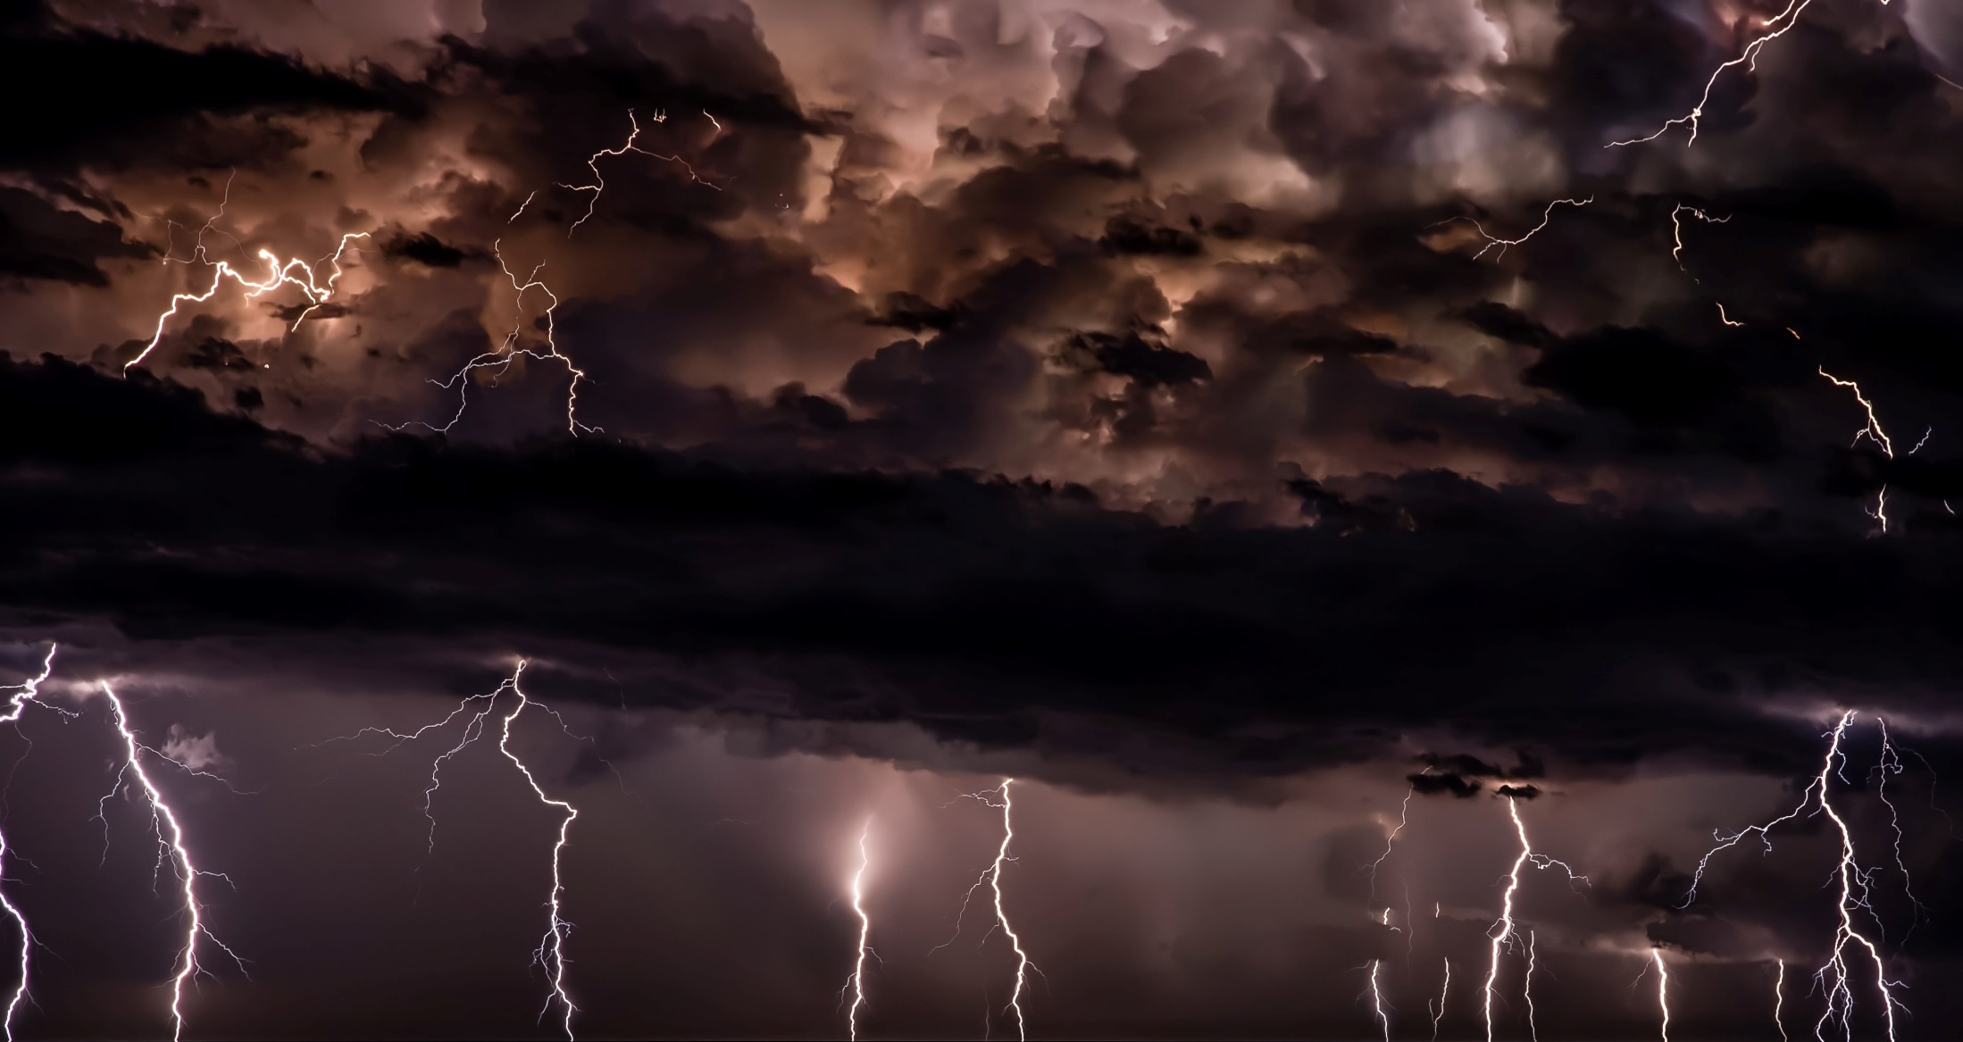
Climate change
Lecture 17

Slide 3
Learning outcomes
Be able to define anthropogenic climate change.
Be able the name the different greenhouse gases.
Understand what we mean by uncertainty in climate modelling.
Understand how climate change will impact different environments.

Slide 4
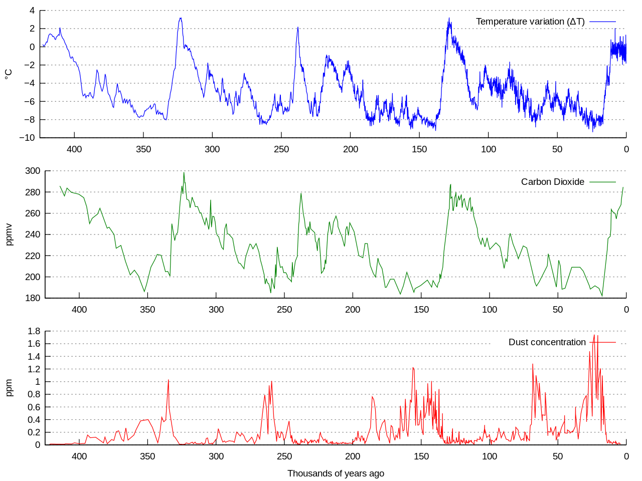
What is climate change?
Anthropogenic climate change (caused by humans) is the long-term change in global or regional climate patterns.
Climate is NOT the same as weather!
Petit et al. (1999) Creative Commons Attribution-Share Alike 3.0

Slide 5
What are the main greenhouse gases (GHGs)?
Gas | 20 year GWP | Concentration in atmosphere | Duration in atmosphere | Forcing or feedback? | Source
Carbon dioxide (CO₂) | 1 | 395.4ppm | 30-95 yrs | Forcing | Fossil fuels, deforestation
Methane (CH₄) | 84 | 1893ppb | 12yrs | Forcing | Agriculture- rice, cows.
Nitrous oxides (NO_{x}) | 264 | 326ppb | 121yrs | Forcing | Agriculture (fertilisers)
Water vapour (H₂O) |  | Only measured at local scales | 9 days | Feedback | All activities
Ozone (O₃) | 918-1022 | 337ppb |  | Forcing | Vehicles, industry
Halocarbons (including CFCs) | 10800 | ~1000ppt | ~100 years (depends on the molecule, CF₄ is 50,000 years). | Forcing | Used as coolants in fridges etc and as a fire suppressant
https://climate.nasa.gov/causes/

Slide 6
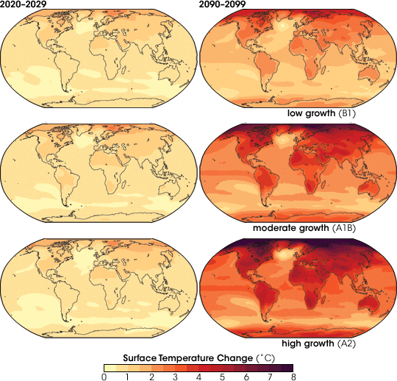
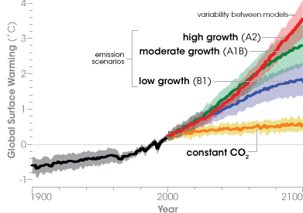
IPCC Scenarios
Ipcc.ch

Slide 7
What is uncertainty?
Unpredictability- human behaviour/ changing political systems.
Structural uncertainty- inadequate models, significant processes wrongly specified or not considered.
Value uncertainty- missing or inaccurate data, inappropriate spatial or temporal resolution, poorly known or changing model parameters.

Slide 8
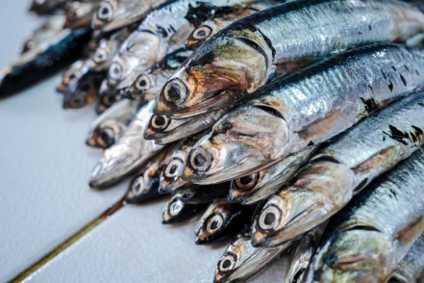
El Niňo and La Niňa
Peruvian anchoveta
El Niňo –Southern Oscillation (ENSO) occurs every 2-7 years.
Climate cycle in the Pacific Ocean that has a global effect on weather patterns

Slide 9
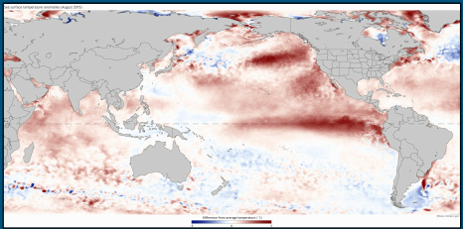
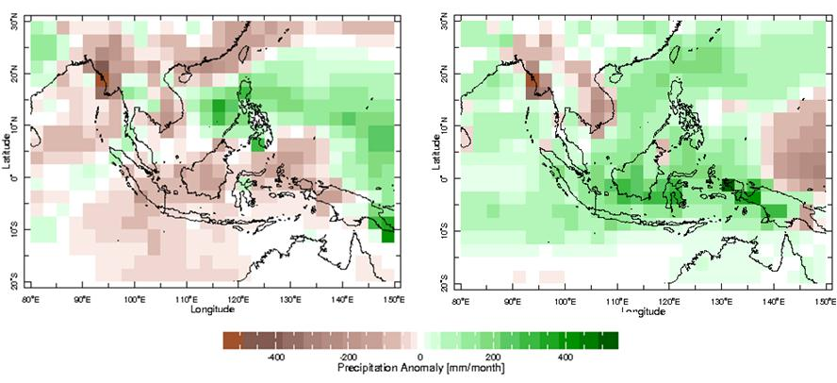
Sea surface temperature difference from average (August 2015, NOAA)
Distribution of precipitation anomalies over South East Asia (Jun – Oct) for El Niño (left) and La Niña (right) years. (Image credit: IRI Climate)

Slide 10
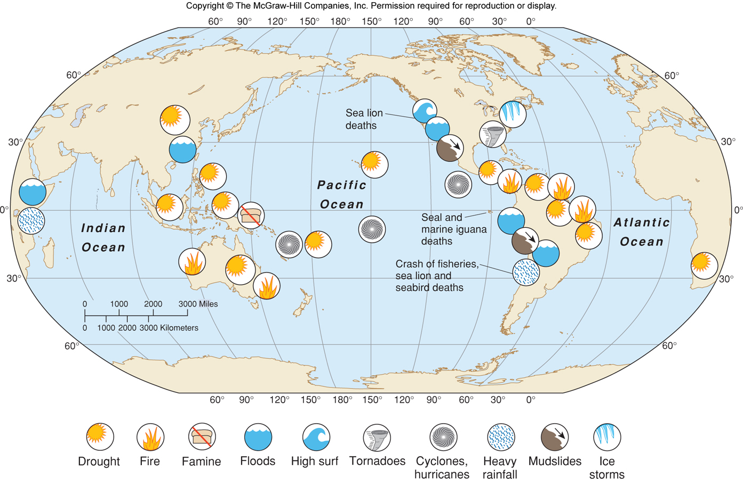
Consequences of El Niňo

Slide 11
Main effects of climate change
Between 1880 and 1912 global average temperature (land and sea) increased by 0.85˚C ± 0.20. 1983-2012 was the warmest period in the last 1400 years.
Most of this warming is from the ocean.
The ocean is also becoming more acidic (26% more H⁺).
Greenland and Antarctic ice sheets are losing ice.
Between 1901 and 2010 sea level rose by 19cm ± 2.
Extreme weather events are becoming more frequent.

Slide 12
What does climate change mean for ecosystems?
The geographic range of a species is called its ‘bioclimatic envelope’, or more broadly, ecological niche.
Many species will need to move to new areas to survive changing conditions.
Some species are tightly connected in space and time. This may change under climate change.

Slide 13
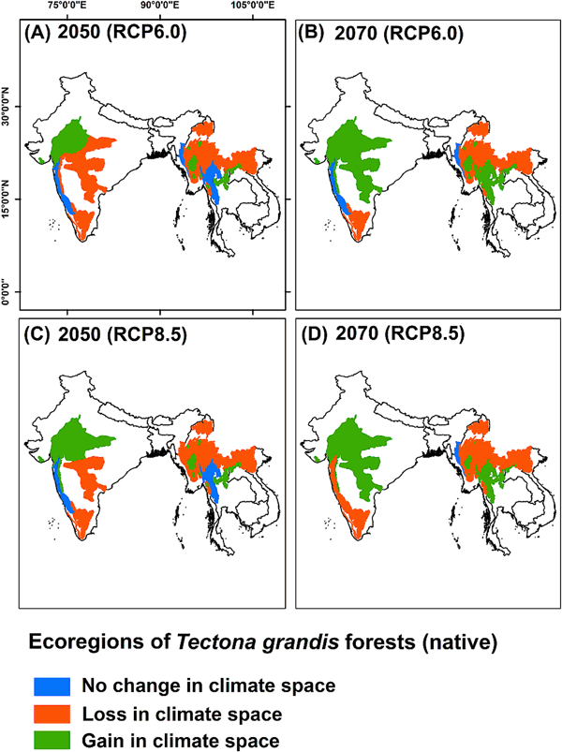
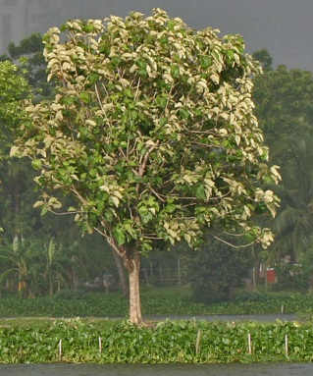
I, J.M.Garg / CC BY-SA (https://creativecommons.org/licenses/by-sa/3.0)
RCP6.0- mid range
RCP8.5- extreme climate change.
ArcGIS used to map at 1km² resolution.
Changes in the precipitation seasonality will affect the distribution of teak.
Deb et al. (2017) Env Management 60, 422-435
Notes:
The different ecoregions of natural teak (Tectona grandis) across tropical Asia those are likely to lose or gain in climate space by 2050 and 2070 under RCP6.0 and RCP8.5: the blue areas indicate no change in occupied climate space, the red shading indicates loss of climate space and the green shading indicates climate gain

Slide 14
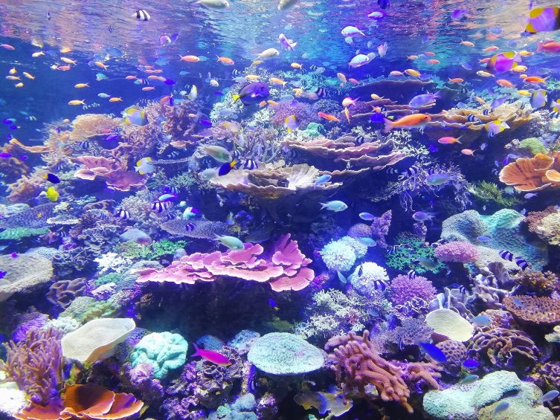
Effect of ocean acidification on coral
Sea surface temperature (SSTs) have increased by 0.3˚C between 1950 and 2009.
Elevated carbon dioxide (eCO₂) dissolves into the sea and creates a weak carbonic acid.
Over the last 150 years eCO₂ has decreased pH by 0.1.
This affects organisms that make structures from carbonate (CaCO₃) including:
Mussels
Coral
Echinoderms (sea stars)
Plankton

Slide 15
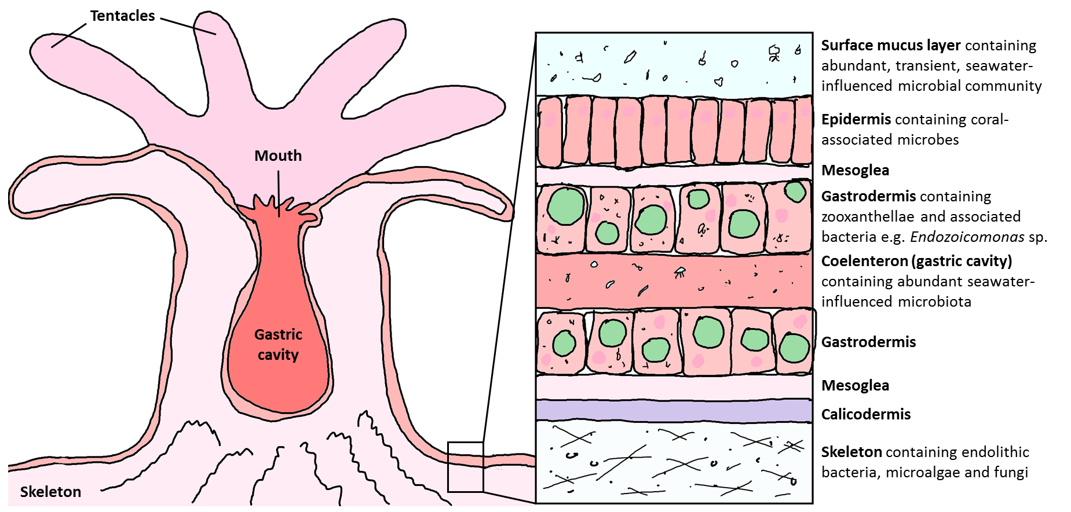
Effect of ocean acidification on coral

Slide 16
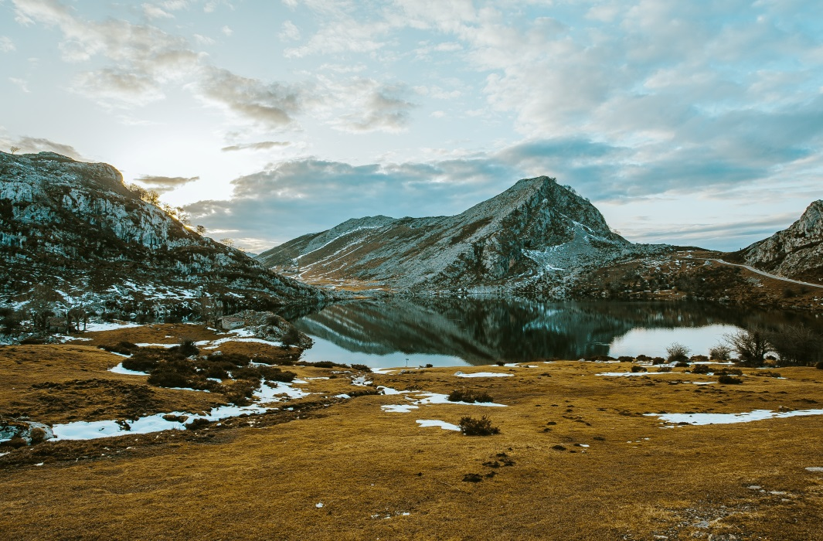
Tundra- permafrost
Tundra is near the north Pole. It is very cold and has short growing seasons.
It gets very little rain.
Decomposition and nutrient cycling is very SLOW
Important carbon SINK.
Climate change might switch
it to a carbon SOURCE.

Slide 17
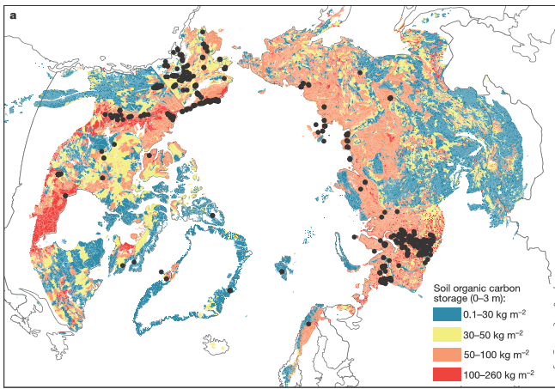
Canada
North Pole
Russia
Schuur et al. (2015) Nature Climate Change doi: 10.1038/nature14338

Slide 18
Summary
Climate change is caused by a range of different gases which all have different properties.
Climate change predictions are subject to uncertainty so we must model a range of scenarios.
Effects might be unpredictable and stronger in some areas than others.
There are thousands of scientists working on different ecosystems and different effects of the climate changing. We are beginning to get a picture of the ecosystems and habitats that are at risk.

