Slide 1
Quizzes for distance learning (QfDL): Sessions 1 and 2
November 2019 Residential School
The Transformation by Innovation in Distance Education (TIDE) project is enhancing distance learning in Myanmar by building the capacity of Higher Education staff and students, enhancing programmes of study, and strengthening systems that support Higher Educational Institutions in Myanmar. TIDE is part of the UK-Aid-funded Strategic Partnerships for Higher Education Innovation and Reform (SPHEIR) programme(www.spheir.org.uk). SPHEIR is managed on behalf of FCDO by a consortium led by the British Council that includes PwC and Universities UK International. The TIDE project will close in May 2021.
Notes:
Note for facilitators – there is some colour coding of headings in these slides
A blue heading denotes an activity, pink headings are teaching points
You might like to add a slide following this one that gives the session presenters names

Slide 2
Learning outcomes for the sessions
After completing this activity you should be able to:
explain the purpose of quizzes for distance learning
explain what is meant by cognitive levels for assessment
write quiz questions and feedback that test aspects of student learning
jointly build an online quiz
Notes:
This is one slide deck to span across 2 morning sessions of 90 mins each.

Slide 3
Activity 1: What are your environmental concerns?
In your teams, write a list of the environmental issues that you think are the most important / that worry you the most
Agree with your team which are your top 3 concerns
Share with the whole group
Notes:
For academics this could be something they are teaching or are researching; for others it could be to do with their work or their main personal environmental concerns
Ask subgroups to share with everyone (and therefore you) their environmental concerns. Likely to take a while - but could be time well spent because it helps to understand their context and gets everyone involved.
Session leader - Group the answers into categories (e.g. climate change, pollution, health, drought, flooding, extreme weather).
Could ask them to put the concerns on a post it – then can be grouped on the wall. If you do it this way make sure you ask them to put one concern per post-it!
To link this activity to the rest of the session, they’ll have the option to use the info they provide to build a quiz later
We need a back up concern/quiz topic if outcomes not ‘suitable’

Slide 4
What do we mean by ‘quiz’?
An online tool for learning and assessment
A way for learners to measure (self-assess) their achievement
A set of questions (not just one question)
Should comprise different types of questions
Automated feedback
Not a questionnaire or a survey
Today we will concentrate on the individual types of questions that can make up a quiz
Notes:
Quizzes could be done in class, or on paper, but we are going to talk (mainly) about online quizzes for learning and assessment
A quiz is made up of a set of questions
Automated marking and feedback
Not a questionnaire or survey – which are also made up of questions but with questionnaires / surveys you are collating data on a topic, they do not have automated feedback
Today we are focusing on Open Learn Create quizzes (i.e. Moodle quizzes)

Slide 5
Why use quizzes?
Practice quizzes (no pass grade) – formative (assessment for learning)
Graded quizzes (pass grade) – summative (assessment of learning)
Automated marking and automated feedback for learners
Feedback can be instant, or delayed to a specific date
Can use hints and stepped feedback for multiple attempts at a question
Advantages and disadvantages
Notes:
What is the purpose of using quizzes for learning? To help students learn and to assess learning
Formative (practice) quizzes help learners test how much they have understood during a course, providing opportunities for them to learn and improve
Summative (graded) quizzes capture learner responses to questions which count towards course completion
Automated marking –
Automated feedback -
Hints and stepped feedback –
Can have random variants so the student is presented with different variations on a question, or different wrong answers each time they try a question. This means you need to write more questions than will appear to the learner.
Advantages – can be designed in many different ways – flexible, fairly easy to build using moodle
Quizzes may be used
As course exams
As mini tests for reading assignments or at the end of a topic
As exam practice using questions from past exams
To deliver immediate feedback about performance
For self-assessment
Disadvantages – designing a good online quiz is harder than you might think, students don’t have a teacher to interact with, so the quizzes need to stand alone

Slide 6
Quiz behaviours
Behaviour is set at quiz level, not at question level.
Deferred feedback A learner answers all the questions before any feedback is provided. This often encourages learners to concentrate on their overall mark rather than on any feedback you might provide.
Interactive with multiple tries Provides instant feedback, hints and multiple tries.
Manually graded For essay type questions especially, though can be used for all other question types.
Immediate feedback Provides instant feedback with no hints or multiple tries
Notes:
Quiz behaviours in moodle are set at quiz level, not at the individual question level. In Moodle quiz the four main behaviours are:
Deferred feedback – useful for summative quizzes. Can also be used in non-graded quizzes; sometimes it’s a way of providing a summary of what the quiz was designed to achieve
Immediate feedback
Interactive with multiple tries – very powerful for helping students learn
Manually graded – needs marking by a person (won’t cover further here)
Quizzes on OpenLearn are set up using Interactive with multiple tries.
NB this refers to the behaviour of the quiz not the learner behaviour!

Slide 7
Quiz question types
calculate
multiple choice and multiple response
drag and drop
For examples of how to use these and other different question types in online courses,
see 7.1.2 Question behaviour in ‘How to make an open online course’.
Notes:
Moodle quiz is very sophisticated and there are plenty of question types. We are going to focus on a few, but there are many others and you can explore these outside this residential school in the OpenLearn course: How to make an online course
Calculate – add in example
Multiple choice and multiple response – add in examples
Drag and drop – add in example
It is good practice to have a few different question types in a quiz, otherwise they become predictable and boring.
True / false answers have their place if used sparingly – it can be a way of encouraging learners when they start doing a quiz, perhaps a precursor to a harder question that follows. But one of the worst kind of quizzes is one comprising just ‘true/false’ type questions.

Slide 8
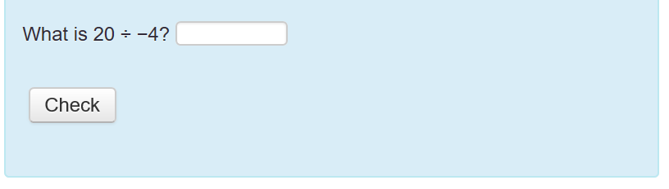
Quiz question types - Calculate
Notes:
A general point – all the following screenshots of example quiz questions are images.
Although participants have a Burmese translation of the slides, images are not translated, so you may need to explain
A very simple calculation example to start with.
As this is straightforward it only allows one try, more complicated calculations questions can have multiple tries with stepped feedback

Slide 9
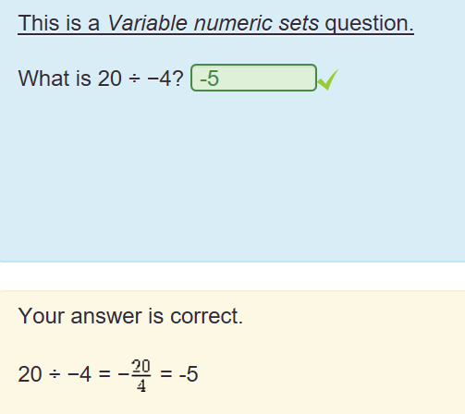
Notes:
Although the student has the correct answer the feedback still gives the working out of the calculation which could be helpful for the student to check their own working

Slide 10
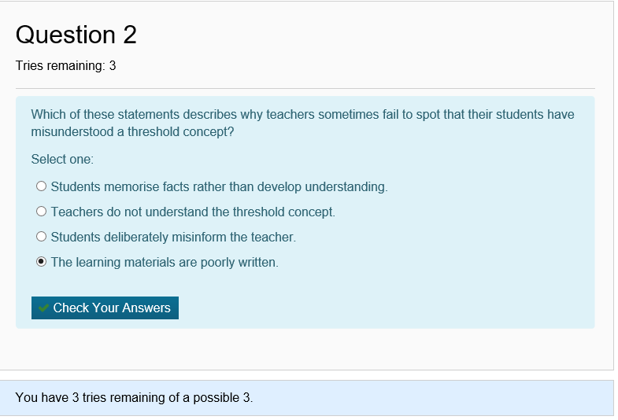
Quiz question type – multiple choice
Notes:
This example is multiple choice with one correct response – but you can also design multiple choice questions that have multiple correct responses
This is a question about threshold concepts and is taken from Week 1 of Tricky Topics – some academic participants should be familiar with this as they were asked to complete the Open Learn Tricky Topics – and support staff should be familiar with online quiz questions too
The student has 3 tries to answer the question correctly.
What the next few slides show you is what happens when a student gets the first two tries wrong, and the stepped feedback - more hints are revealed with more incorrect tries.

Slide 11
Feedback for first incorrect attempt…
Notes:
First piece of feedback is to reread the question
2 tries remaining of a possible 3

Slide 12
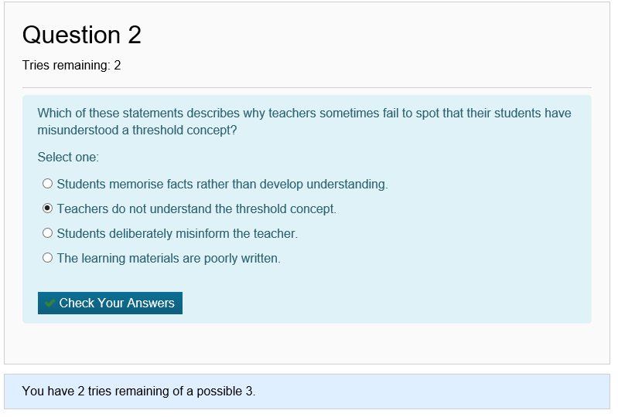
Second attempt…
Notes:
This is the second try – what happens when this is answered wrongly too?
Note just for presenter – one could argue that all these options could potentially be correct BUT this question is written to reflect what they’ve covered in the OL course Tricky Topics, so here it should just be the one answer they’ve covered in the materials

Slide 13
Feedback for second incorrect attempt…
Notes:
Second piece of feedback directs the student to the relevant course materials
1 try remaining of a possible 3

Slide 14
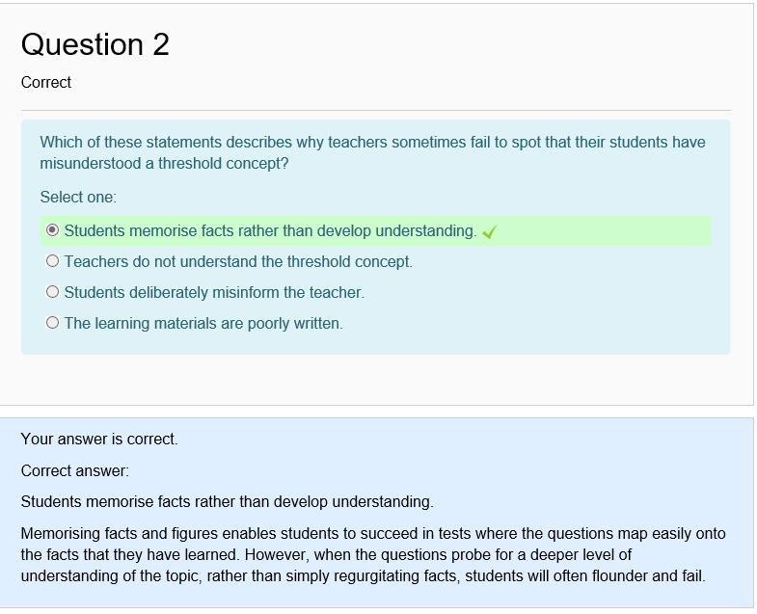
Third and final attempt
Notes:
This is the correct answer
Note that the feedback explains why the answer is correct answer, as this is multiple choice, the student could guess the correct answer, so giving an explanation is important to develop learning

Slide 15
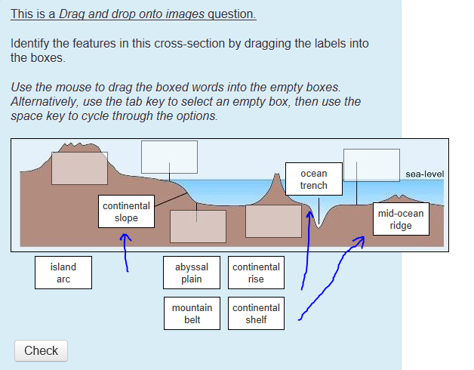
Quiz question type – Drag and drop
Notes:
This shows a simple drag and drop onto an image, where the student drags identifies the features by dragging the label into the relevant box. This has been partially completed with the blue arrows showing where the label have been dragged from and the box they have been dropped into.
Drag and drop can also be words or numbers into a piece of text or equation

Slide 16
Notes:
And this is the completed drag and drop.
Note the feedback refers the student back to the relevant section of the module materials for more information on the topic

Slide 17
Difficulties with writing quizzes
Writing distractor answers, e.g. for multiple choice
Writing hints and tips to help the student
Knowing what errors students might make
Making the quiz interesting and engaging
Notes:
discuss difficulties with quizzes, eg distractor answers for MCQs, knowing what errors students might make,
As already mentioned, it is good practice to have a few different question types in a quiz, otherwise they become predictable and boring. The worst kind of quiz is a series of ‘true/false’ type questions.

Slide 18
Activity 2: Write and build an online quiz question
Jointly decide on a quiz question type to build
Choose from: calculate - multiple choice - drag and drop
Use multiple attempts and stepped feedback
Decide on a topic and write 2 quiz questions on paper, with feedback and answers
Try out the questions in your teams, do they need changing?
IT / support staff to build the quiz questions
Notes:
This is an activity for building a formative online quiz question , using multiple attempts and stepped feedback
Structure of session:
Suggest to them to start 1 simpler type so the support staff can start to build the quiz question structure.
Write the quiz question to allow multiple tries, with hints and instant feedback
Will work on this up to the mid-morning break.
Then after the break Academic staff can go on to a discussion of cognitive levels and process words, which may refine quiz building activity, while support staff carry on building the quiz question
Note this slide will be accompanied by a handout which gives more details of each step in writing the quiz question and will be translated
Note there will be another handout that summarise the steps in building the quiz question in Moodle (from Anna P)

Slide 19
Mid-morning break
Notes:
It is expected the participants will work on writing & starting to build a quiz question up to the mid-morning break
Then the first slide after the break starts with LOs – so I’ve added this slide here to help facilitators in planning / getting to grips with the session – you may want to remove this slide in your final version

Slide 20
What are learning outcomes?
Learning outcomes describe:
what a student will be able to demonstrate that they know at the end of their study
what a student will be able to do at the end of their study.
What are process words?
Process words are:
what a student is asked to do in an assessment, which will be used to write about the subject or content, e.g. describe, identify, explain, discuss, evaluate, analyse, compare, contrast
Notes:
Set this up as quick questions to ask to the room – it is revision as they have all come across learning outcomes and process words in previous residential schools
What are learning outcomes and what are process words?

Slide 21
Cognitive (or thinking) levels
Create
Evaluate
Remember
Analyse
Apply
Understand
Bloom’s Taxonomy of Educational Objectives
(revised by Anderson and Krathwohl (2001). A taxonomy of learning for teaching: A revision of Bloom’s taxonomy of educational objectives. NY:
Notes:
When developing Learning outcomes and quiz questions its helpful to consider different cognitive levels including which levels and objectives are most appropriate for your students
The triangle represents going up the levels to higher order thinking - the simpler actions and objectives are at the bottom of the triangle and the more complex ones at the top.
but it doesn't mean most of the activity should be at the lower levels and only a little at the top levels
Generally speaking, as students progress through their degree studies, assessment should progress up the levels

Slide 22
Cognitive Levels | Meaning
Create | Produce new or original work
Evaluate | Assess and make judgements, justify a stand or decision
Analyse | Examine methodically, determine how parts relate to one another, draw connections
Apply | Carry out or use a procedure through executing, or implementing.
Understand | Explain ideas or concepts
Remember | Recall facts and basic concepts
Notes:
Start at the bottom when describing this and move up

Slide 23
Cognitive Levels | Example question (from OpenWASH)
Create | Develop a set of recommendations to help make a Health Centre sanitation facility inclusive
Evaluate | Evaluate the health impacts of climate change in Ethiopia
Analyse | Compare and contrast water access and sanitation provision in urban and rural areas
Apply | Apply examples of sustainable water use to show how you can reduce your water footprint
Understand | Explain why biomass resources are classified as renewable
Remember | Give a definition of renewable resources
Notes:
Start at the bottom when describing this and move up
These examples are taken / adapted from OpenWash –
OpenWASH is a set of learning resources that provides core teaching and learning for the water, sanitation and hygiene (WASH) sector. Original developed for use in Ethiopia, the materials have been adapted and rolled out in other areas in Africa (?)

Slide 24
Activity 3: Link the process words and cognitive levels
In pairs, choose a process word
Discuss and decide between you where to place it on the pyramid
Choose another word that you think is a different level and place that on the pyramid
Share and discuss
Notes:
The plan is for A1 size coloured pyramid that can be stuck to the wall, with the name of each level in English and Burmese
Then they have a selection of individual process words, in English and Burmese, and they place / stick the process words to the relevant level
Note this activity is likely to prompt discussion on the meaning of process words. There is a handout with definitions of the process words.

Slide 25
Cognitive (or thinking) levels
Create
Evaluate
Remember
Analyse
Apply
Understand
Generate, hypothesize, plan, design, produce, construct
Justify, critique, to what extent, appraise, conclude, assess
Examine, differentiate, categorize, compare and contrast, focus, structure
Implement, use, solve, compute, carry out, employ
Describe, discuss, explain, illustrate, summarise, outline
Identify, define, recall, name, recognise, retrieve
Bloom’s Taxonomy of Educational Objectives
(revised by Anderson and Krathwohl (2001). A taxonomy of learning for teaching: A revision of Bloom’s taxonomy of educational objectives. NY:
Notes:
This is where the author was most comfortable with the process words and levels, but its often not a hard and fast rule, and some process words can fit under more than one category
As mentioned above, this activity is likely to prompt discussion on the meaning of process words. There is a handout with definitions of the process words.

Slide 26
Activity 2 continued: Write and build an online quiz question
Do you want to revise your quiz question after the cognitive levels and process words activity?
Continue to write and build your quiz question
Groups to demonstrate their quiz questions
If you put all your quiz questions together do you have a good quiz?

Slide 27
Guidance and advice for designing effective quizzes
http://www.open.edu/openlearncreate/course/view.php?id=2221
has a section on building quizzes for online assessment and covers the various question types
http://www.open.edu/openlearncreate/course/view.php?id=2274
http://www.open.edu/openlearncreate/course/view.php?id=2039
http://www.open.edu/openlearncreate/course/view.php?id=1581
http://www.open.edu/openlearncreate/course/view.php?id=1643
Notes:
You can find Guidance and advice online via the following courses and resources:
How to make an Open Online Course http://www.open.edu/openlearncreate/course/view.php?id=2221
Becoming an open educator http://www.open.edu/openlearncreate/course/view.php?id=2274
Course builder guide http://www.open.edu/openlearncreate/course/view.php?id=2039
eAssessment with Moodle http://www.open.edu/openlearncreate/course/view.php?id=1581
Hands-on Moodle Quiz http://www.open.edu/openlearncreate/course/view.php?id=1643

Slide 28
Summary
Online quizzes are a valuable tool for learning and assessment
Can be used for formative and/or summative learning
Automated marking and feedback
Use different types of questions, with hints and multiple tries
Set questions at the appropriate level
Writing engaging and interesting quizzes can be more difficult than you think!
Notes:
– please fill in feedback form

Slide 29
To finish…
Do you have any questions?
Thank you for listening and participating!
Notes:
– please fill in feedback form

