Slide 1
Lamb to the Slaughter by Roald Dahl Follow-up Activities

Slide 2
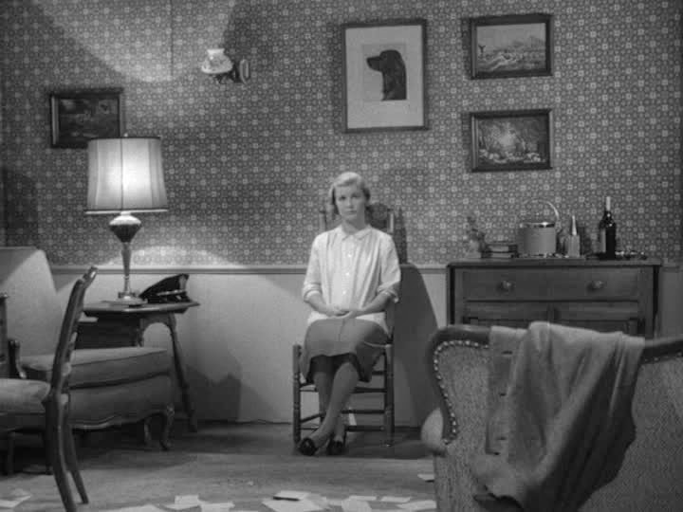
Mary is sitting alone at the end of the story.
Who do the coat and hat belong to?
Why is Mary alone?
What do you think she is thinking about?
Make notes or discuss with a partner

Slide 3
Here are some follow-up activities to do after re-reading the story.
A Put sentences in order to summarise the story (gist understanding)
B Answer questions about small details in the story (scanning exercise)
C Answer questions to check whether you can read between the lines
(inference exercise)
D Vocabulary exercise (deduce meaning from context)
E Discussion
F Writing
G Video
H A check-list of your reading skills

Slide 4
A Put the following sentences from the story in the correct order:
A Mary went out to buy vegetables
G One policeman found a clue
B Detectives arrived at the house
H Mary cried a lot and told them her story
C Patrick told Mary some bad news
I Mary put the meat in the oven
D Patrick came back from work
J The police ate the roast lamb
E Mary called the police
K Other people came to the house to investigate
F Mary killed her husband with a frozen leg of lamb
L Mary came back home

Slide 5
B Scan (read quickly) the text and answer the following questions in your notebooks / Group quiz in breakout rooms
1 How many drinks did Patrick have?
2 What did Mary want to get Patrick to eat first?
3 What kind of weapon is the leg of lamb compared to by the author?
4 What did Mary buy at the shop?
5 Why did Mary cry when she went back to the house and saw Patrick?
6 How many men came to the house?
7 What kind of weapon were the police looking for?

Slide 6
C Reading ‘between the lines’
(Understanding from the context information not explicitly stated)
1 How do we know Patrick is going to leave Mary?
2 Did Mary intend to kill Patrick? How do you know?
3 Why did Mary practise what she would say to Sam the grocer?
4 Why did a detective go to see Sam?
5 Why did Mary ‘giggle’ at the end of the story?

Slide 7
D Vocabulary
Did you know all of the words in the text?
Eg ‘blissful’ (part 1). What can you guess about the word from the context?
The writer describes everything she loved about this time of day, so ‘blissful’ here means ‘extremely happy’.
Use the text to help you match the words on the next page and their meanings.

Slide 8
tranquil (part 1)
blissful (part 1)
amber (part 2)
bewildered (3)
instinct (part 4)
club (part 4)
peculiar (part 5)
frantic (part 6)
grief (part 6)
congealed (part 6)
on the premises (part 8)
exasperated (part 8)
consoling (part 8)
hospitality (part 8)
A confused, not understanding
B a heavy stick
C extremely happy
D a very strong feeling which guides someone
E in the building
F comforting someone who is sad
G annoyed, irritated
H turned from liquid to solid
I being kind to visitors
J strange, unusual
K mad, wild
L calm, peaceful
M extreme sadness after someone dies
N an orange-yellow colour
mad, wild

Slide 9
E Discuss with a partner / Make notes in your notebook
Do you think Mary will ever be arrested? (Why / Why not?)
Do you think she is guilty of murder? (Why? / Why not?)
As there is no weapon and no witness, is this a ‘perfect murder’?
What do you think should happen to Mary?
What do you think will happen to Mary?
Does this story have a moral?
Do you like the story?

Slide 10
F Writing
Choose one of the following tasks
A You live in the same street as Mary Maloney. Write a short email to a
friend telling them about this terrible incident.
1 Tell your friend what happened
2 Say how you feel and why
3 Say who you believe killed Patrick Maloney and why
B You are a journalist. Write a short article about the murder for a
local newspaper

Slide 11
G Watch and Listen
If you are interested, you can find a 25-minute short film of this story made by Alfred Hitchcock
https://www.dailymotion.com/video/x70l4os
Do you think the film is a faithful representation of the story?
Is anything different?
Which do you prefer?

Slide 12
H Reading Skills
Which of these reading skills have you practised while reading this story?
Prediction
Skimming (reading quickly for the main idea)
Scanning (looking quickly through a text to pick out key facts)
Reading for detailed information
Inferring information not explicitly given in the text
Working out the meaning of new words from the context
Enjoyment

Slide 13
Further reading
If you enjoyed the story, look out for other short stories by Roald Dahl in his ‘Tales of the Unexpected’.
For those of you who are English TEs, Roald Dahl is also famous as a writer of children’s books.
Do some research to find out what his most popular children’s books are.

