Slide 1
Case study: Rice straw bioenergy
Session 2a

Slide 2
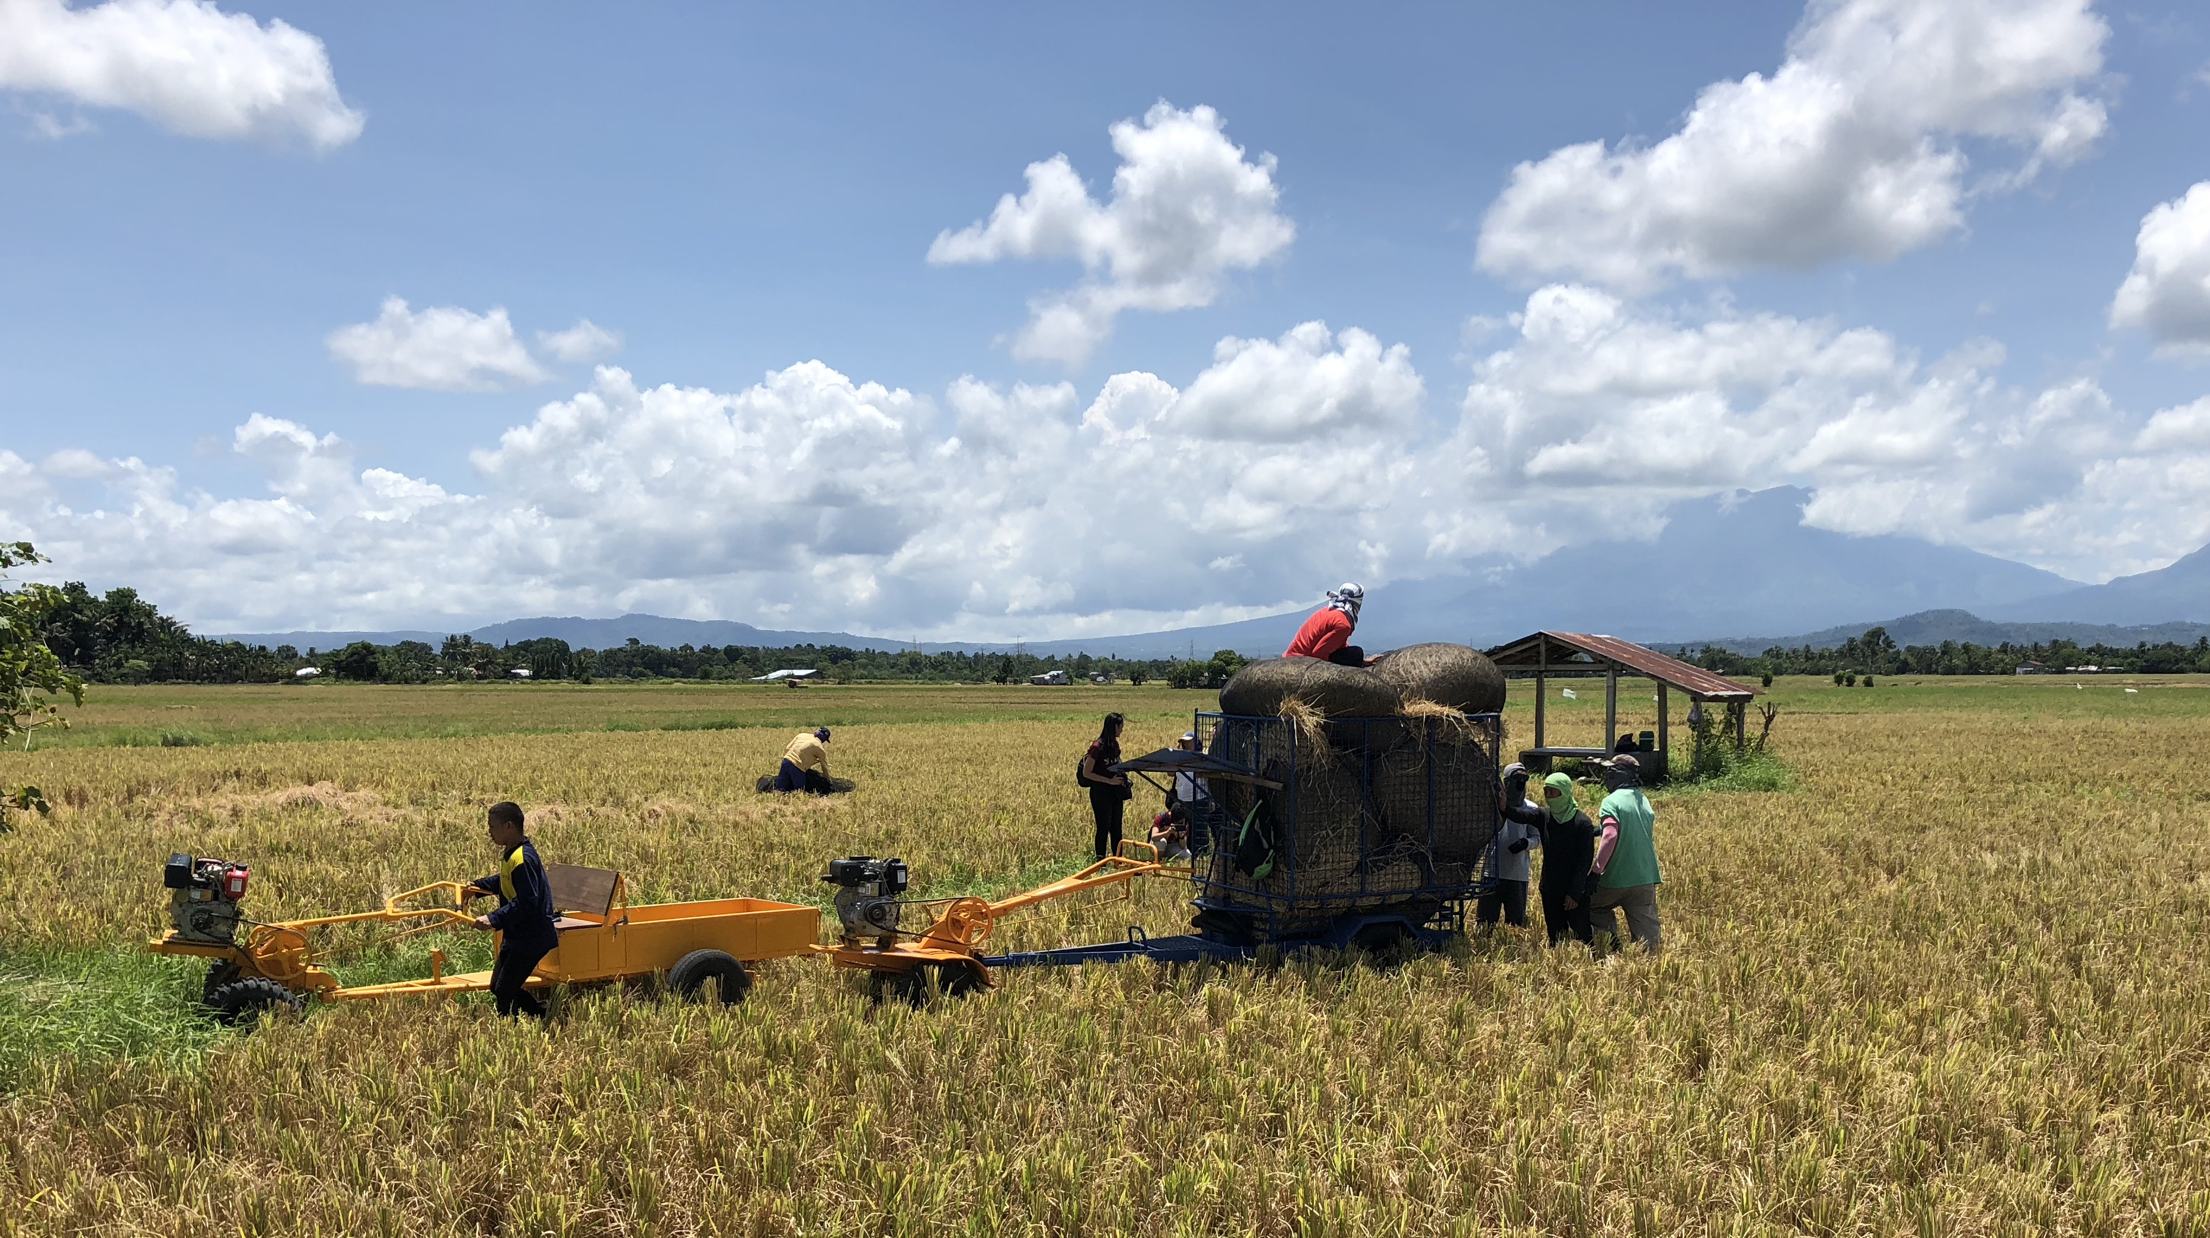
Rice straw bioenergy in the Philippines and Vietnam

Slide 3
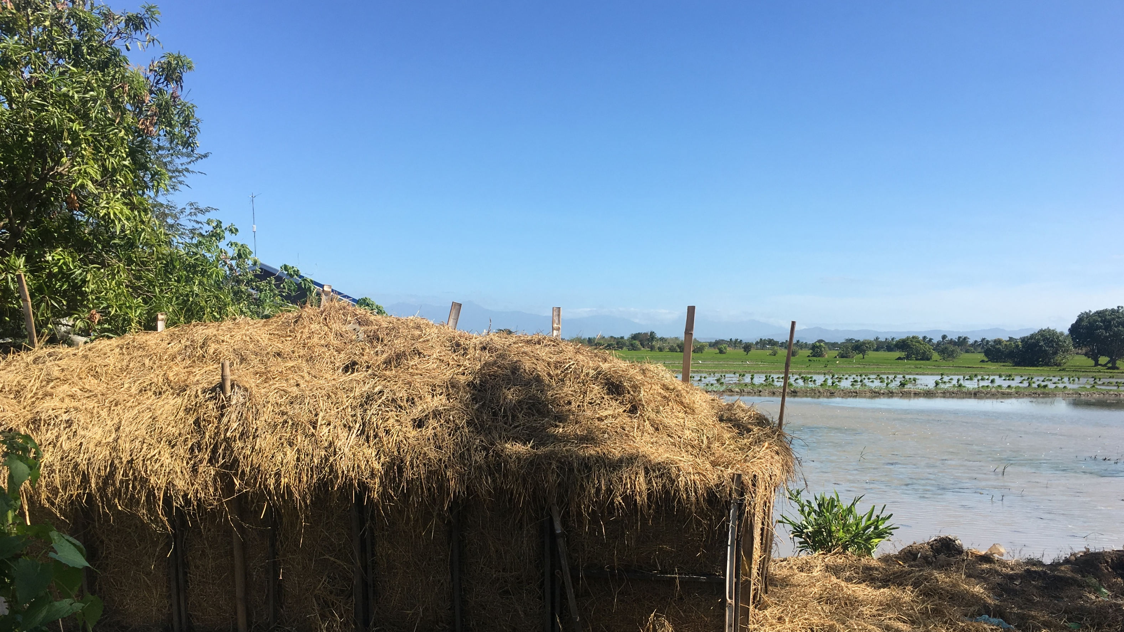
Rice straw
could potentially be one of the largest sustainable biomass energy resource in many lower income countries
Abbasi et al, 2010
731 Mt of rice straw produced globally, every year
91% from Asia

Slide 4
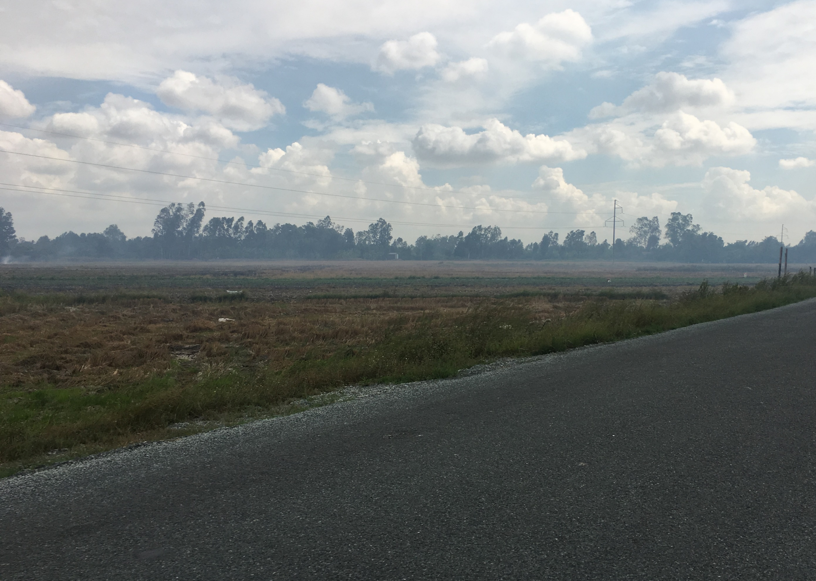
Context
It is important for rice straw burning to stop
biomass burning contributes to GHG emissions
impacts on farmers’ health and pollution
731 Mt of rice straw globally, 91% from Asia
as much as 95% gets burnt every year
(Wi et al., 2013; Gadde et al., 2009)

Slide 5
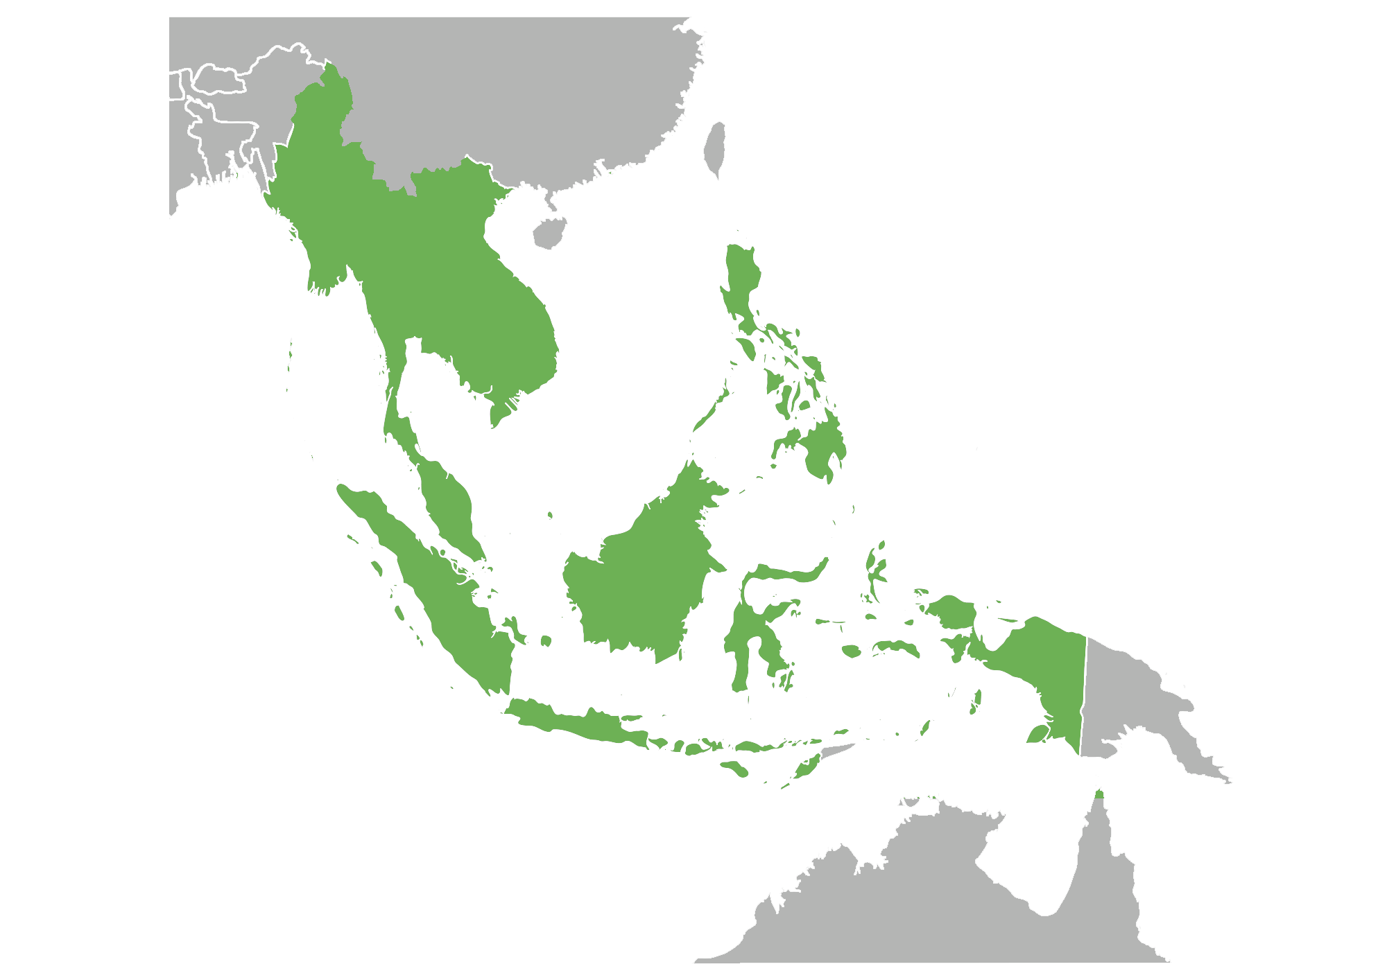
Case study sites
14 Mt
Philippines
At least 75% of rice straw is burnt every year in the Philippines and Vietnam
34 Mt
Vietnam
(Barz, 2013; Mendoza, 2015; Nguyen et al., 2016)

Slide 6
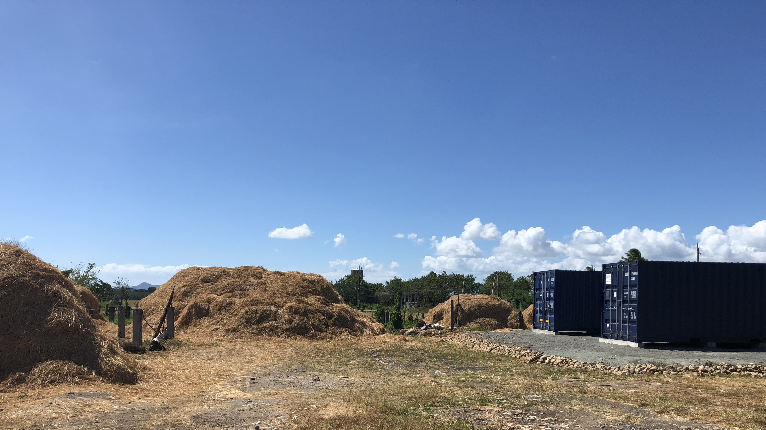
Bioenergy can provide an alternative to rice straw burning
Engage farmers and their communities in bioenergy development
Challenge

Slide 7
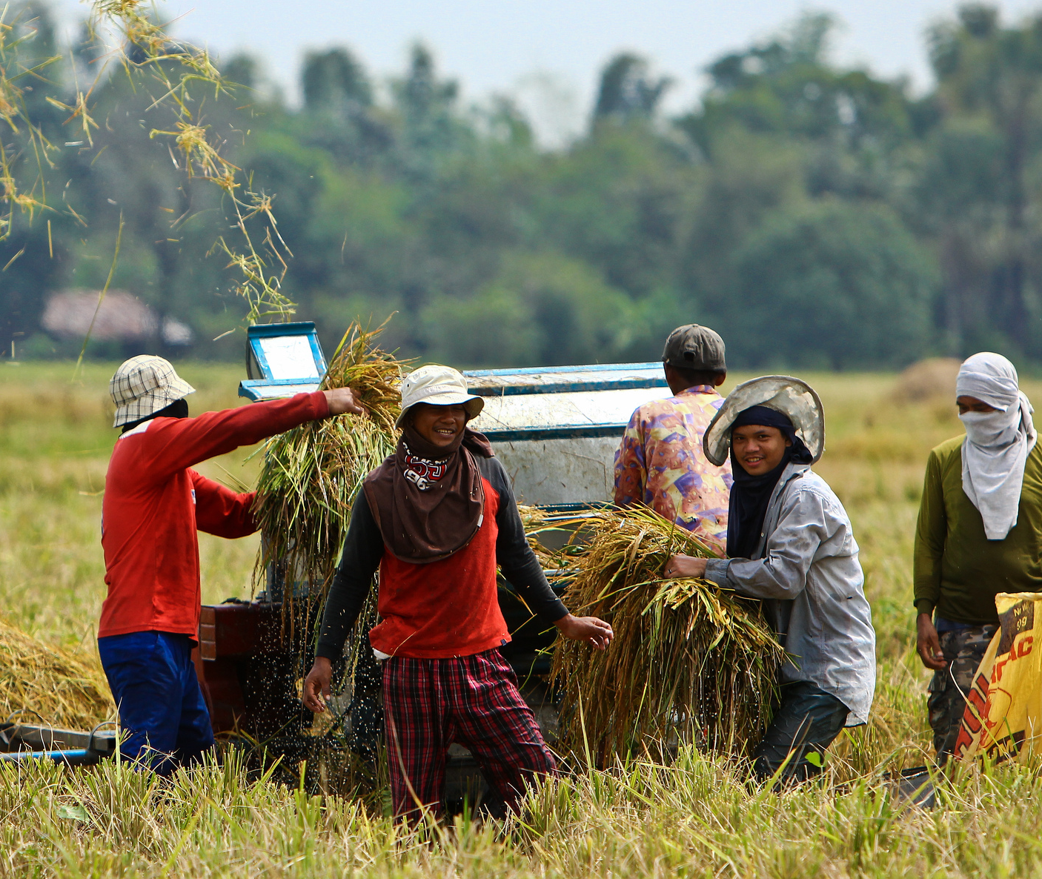
Focus on farmers
Farmers and local communities remain marginalised in bioenergy development
Limited understanding on the role of farmers and local communities
(Rossi and Hinrichs, 2011; Selfa et al., 2011)

Slide 8
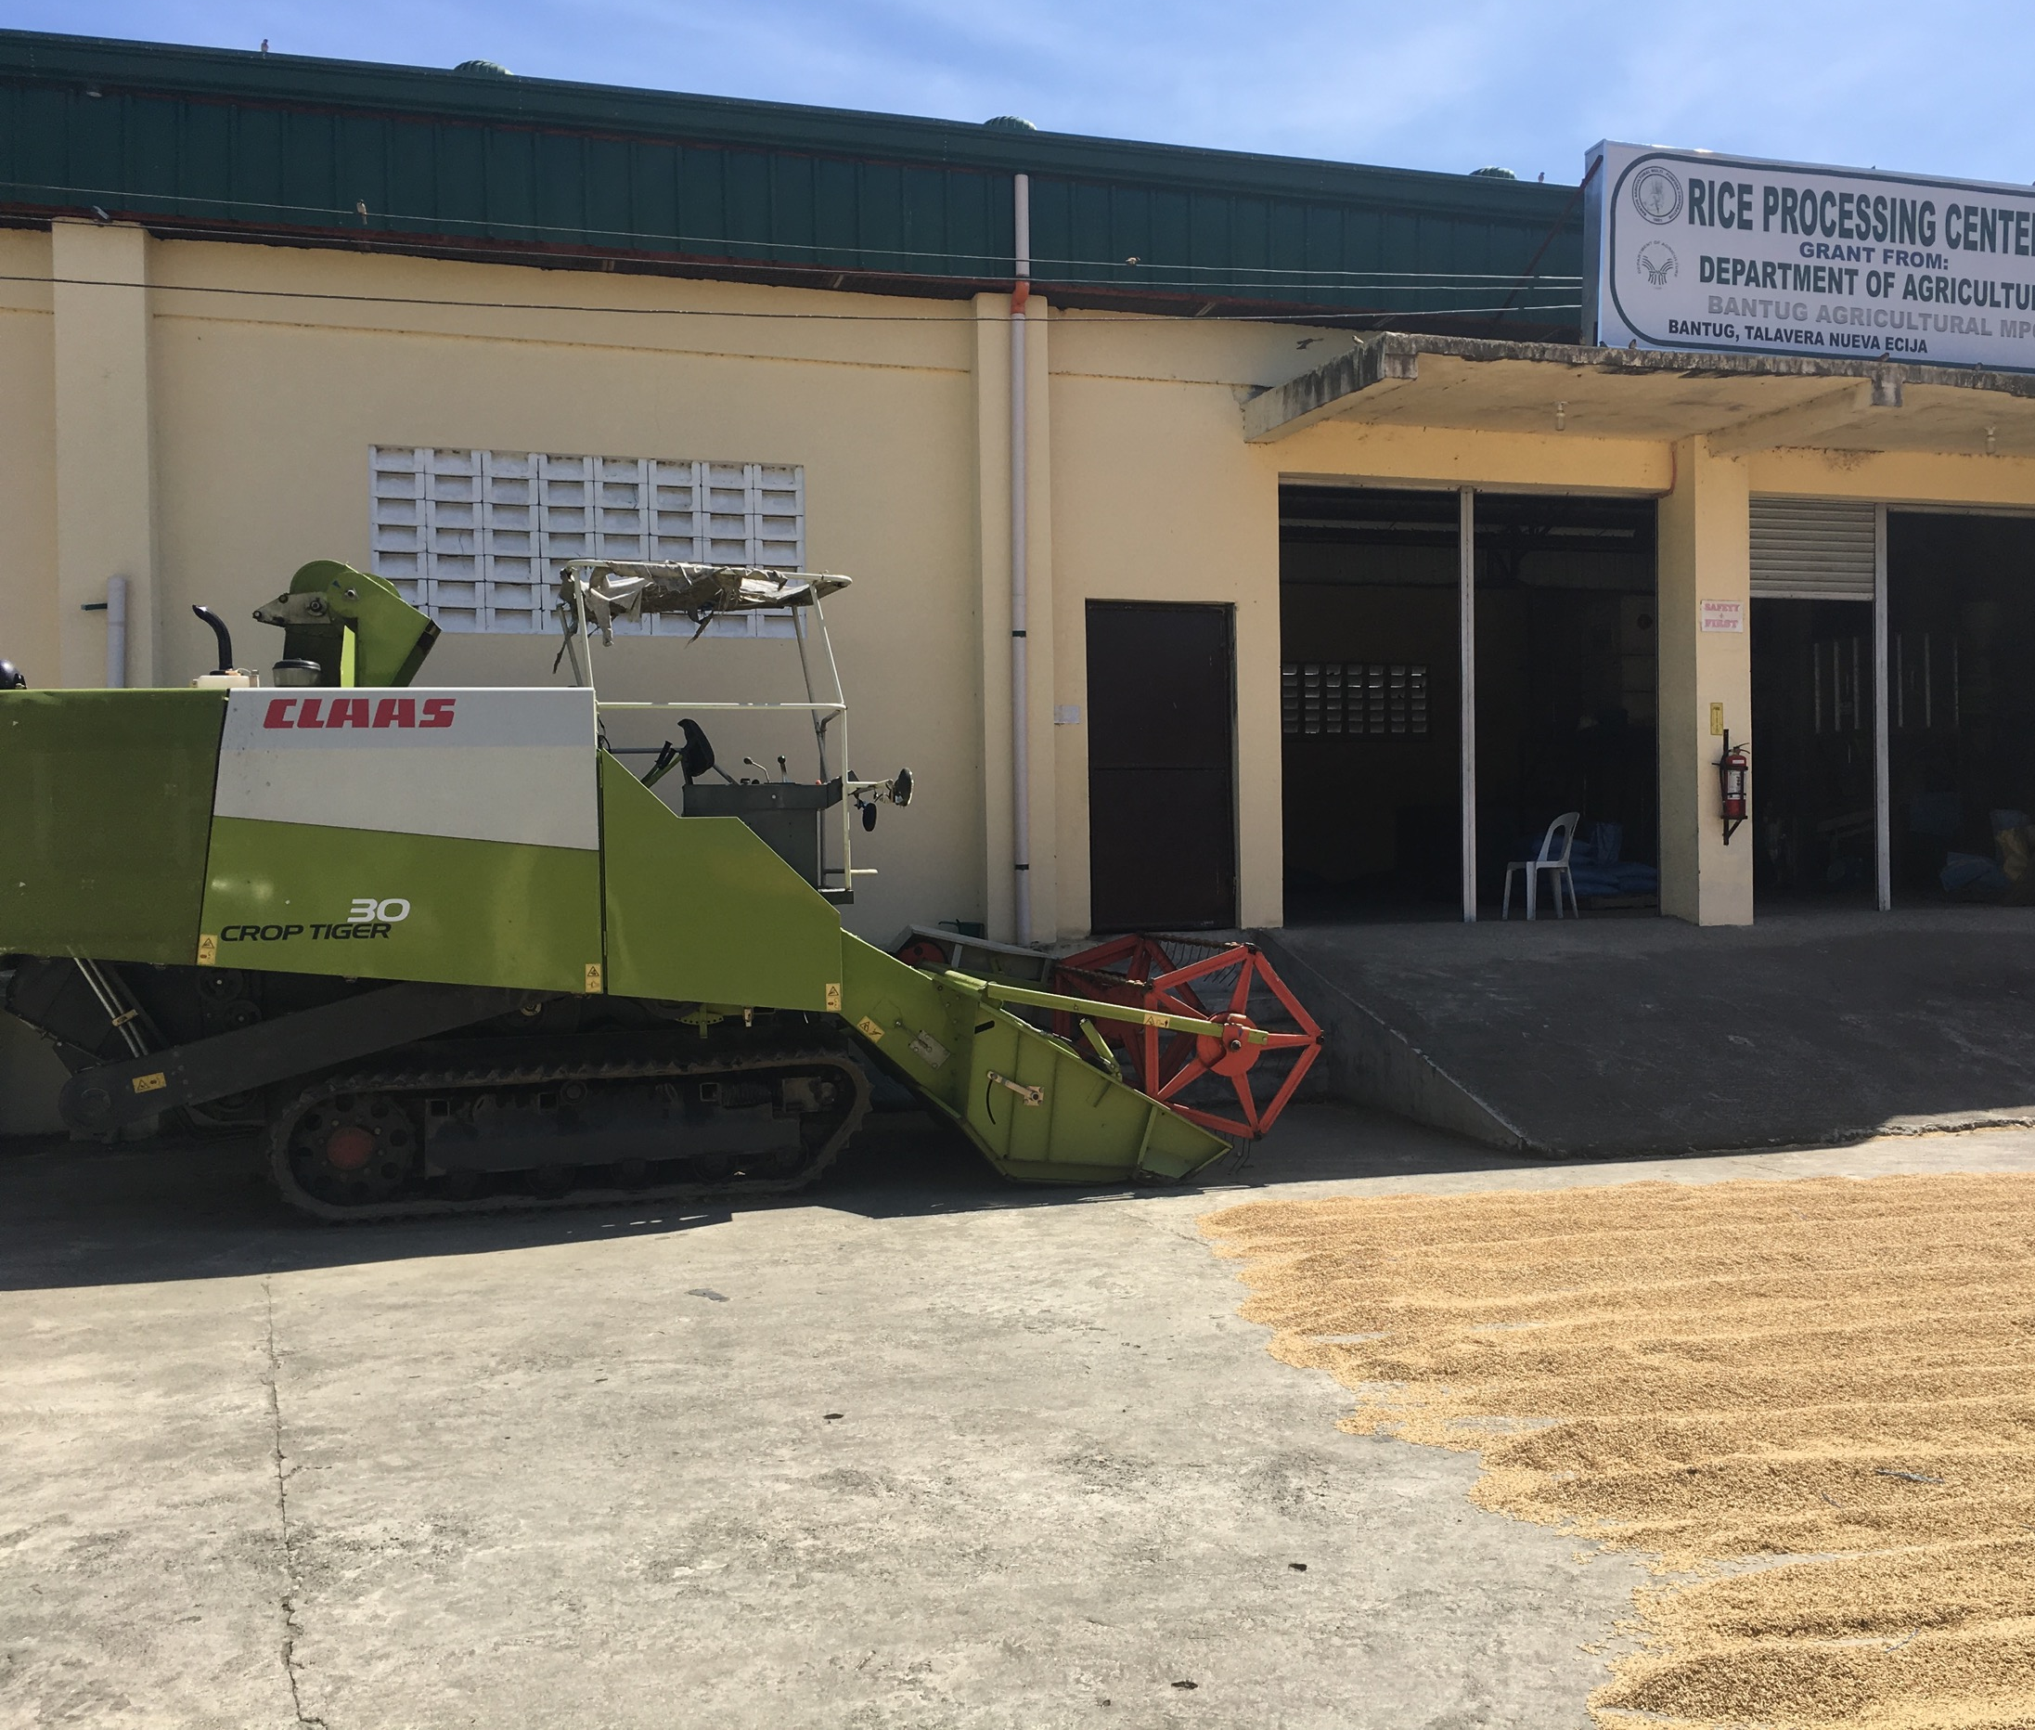
Energy challenges
Affordability of energy Payments for electricity and farm machine services
Flexibility of the electricity grid to meet demand
Blackouts when water pumps are used at the same time

Slide 9
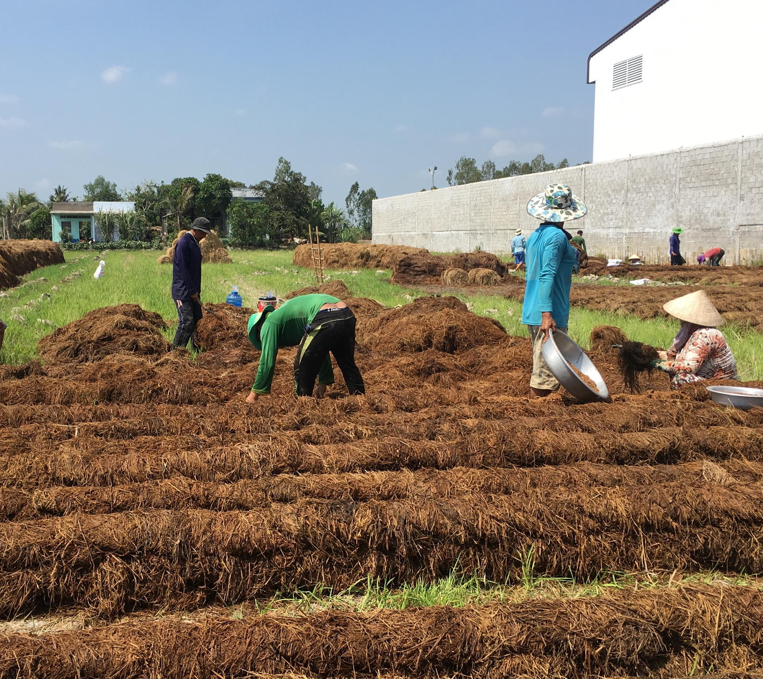
Feedstock availability
Many farmers continue to burn rice straw
In the Philippines, farmers also incorporate straw into the soil, use it as mulch for vegetables and as fodder for livestock
In Vietnam, many farmers use straw for mushroom growing

Slide 10
Potential use for bioenergy
Conversion technology: Anaerobic digestion
Scale: Village-level
Biogas can be used to generate electricity for households and to power agricultural machines (such as water pumps)
Bioenergy can provide income to local community from selling rice straw

Slide 11
Social innovation pathway
for rice straw bioenergy
Notes:
Redefining communities
Identifying social capital
Determining the business model and scale of bioenergy development
Aligning project goals with community needs and existing capacities
Identifying involvement of institutions
Organising collective leadership
Determining platforms for social learning
Defining measurements of success
Mutually reinforcing
Not sequential
Open discussion than conclusion

Slide 12
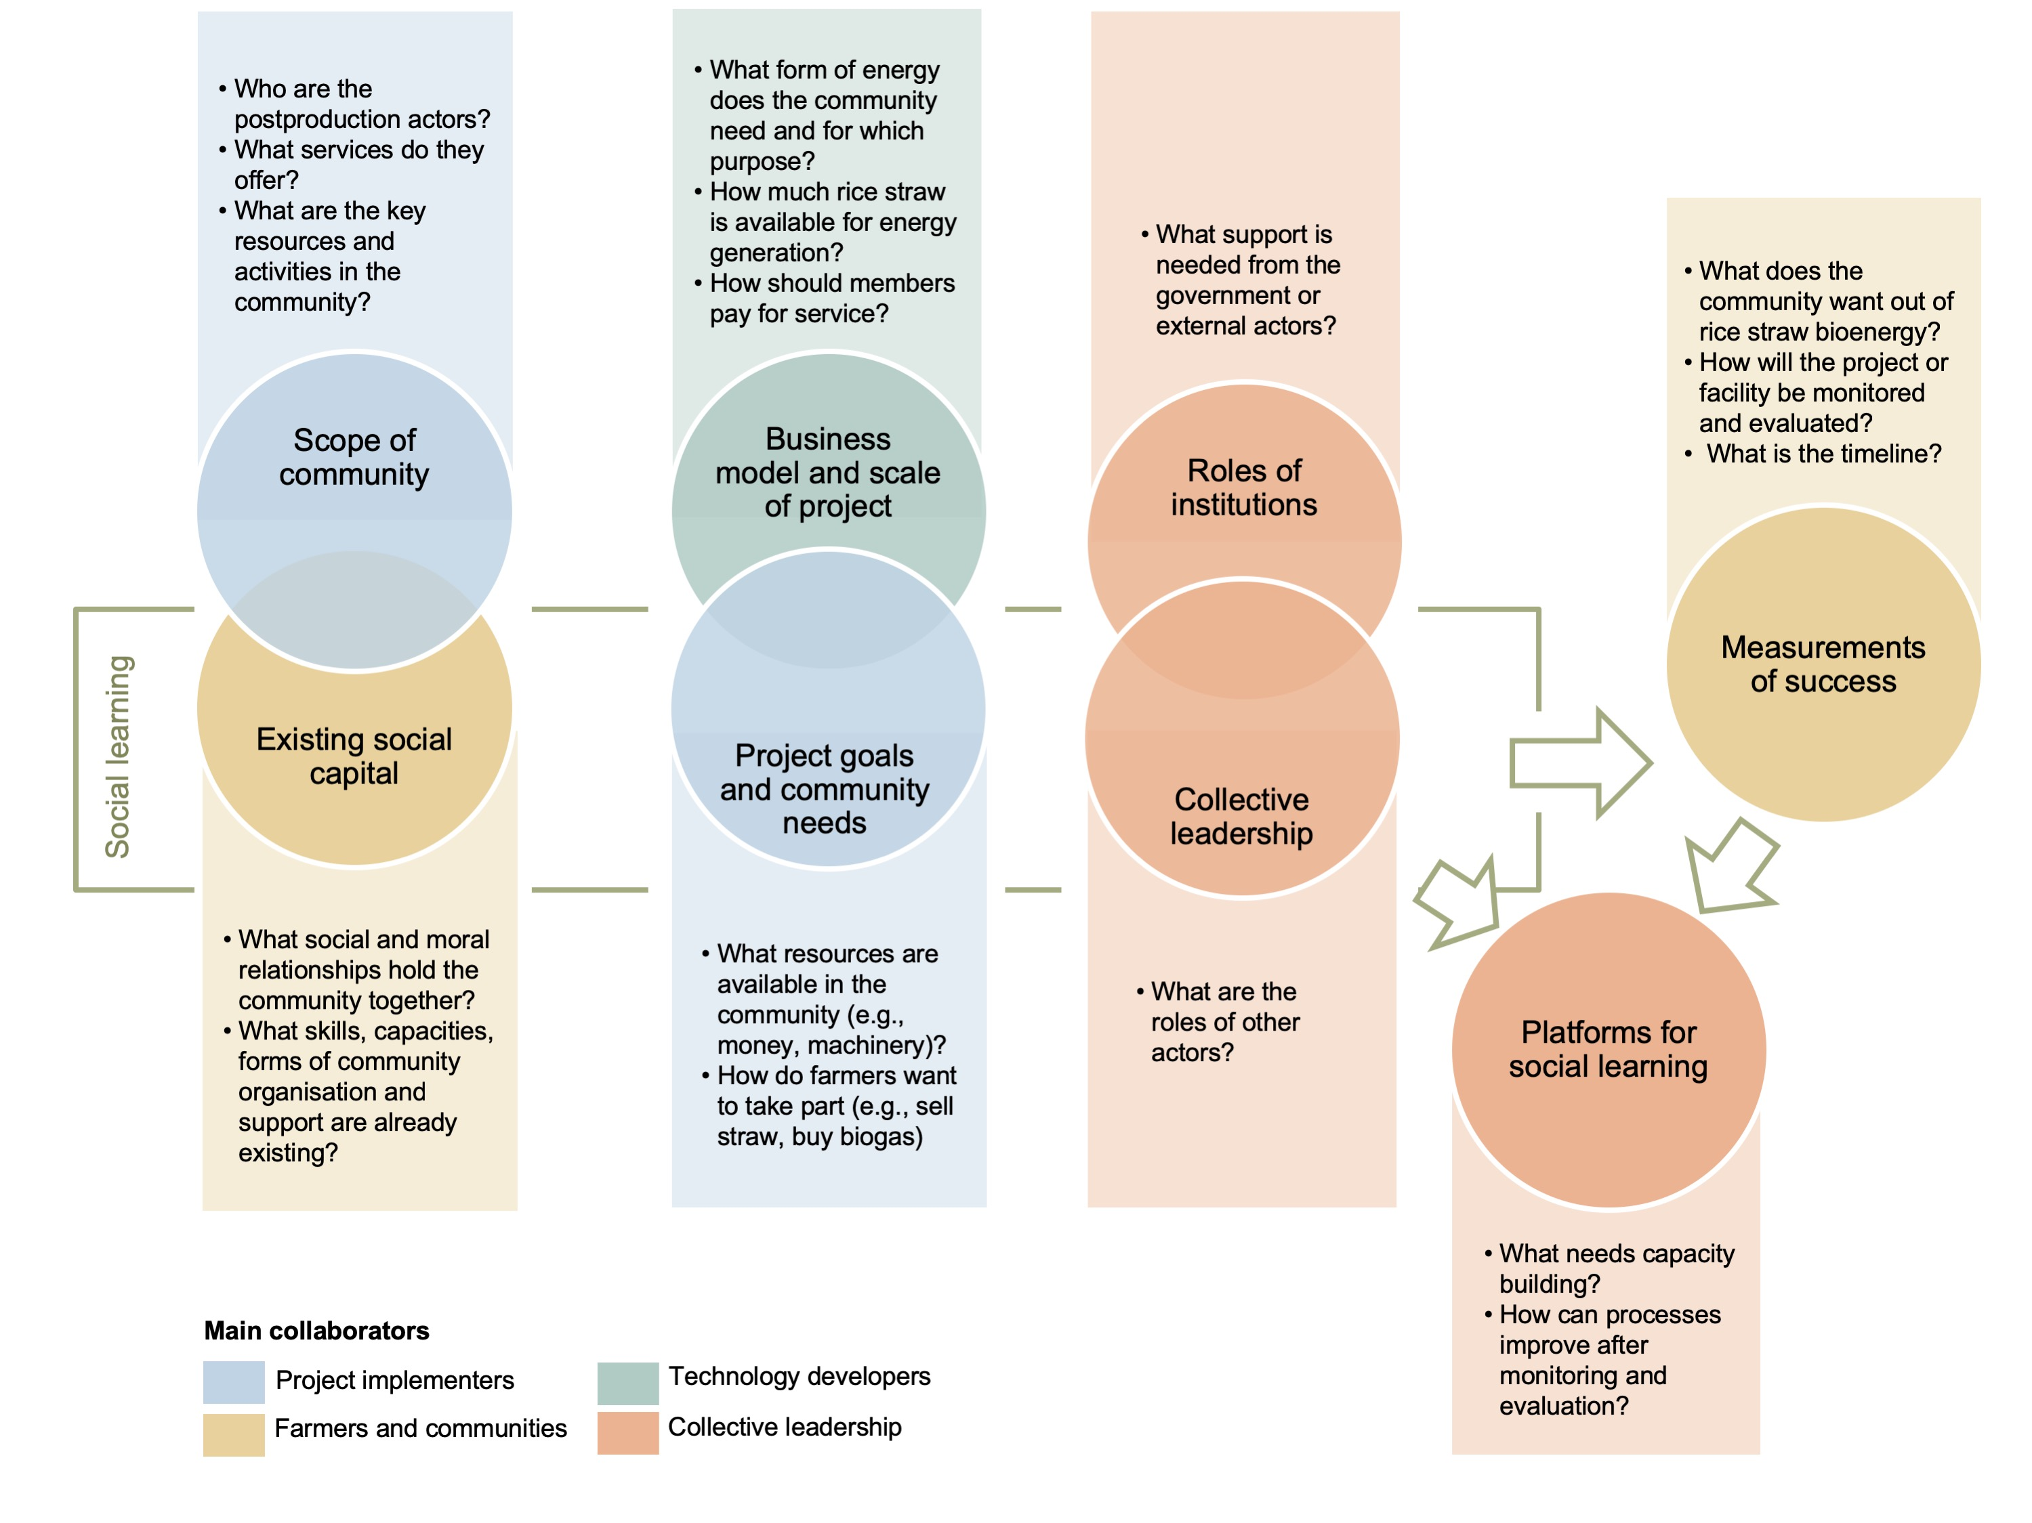
Social innovation pathway
for rice straw bioenergy
Notes:
Redefining communities
Identifying social capital
Determining the business model and scale of bioenergy development
Aligning project goals with community needs and existing capacities
Identifying involvement of institutions
Organising collective leadership
Determining platforms for social learning
Defining measurements of success
Mutually reinforcing
Not sequential
Open discussion than conclusion

Slide 13
Philippines
Social enterprise model
Biogas (electricity) for farm and household needs
Locals can pay fee for service but need micro-financing schemes
New income stream for farmers, by selling rice straw
Public-private partnerships between local agricultural businesses and government actors to share investment costs with farmers
Agricultural machine owners – collect and transport rice straw
Government agencies – offer training and capacity building for farmers
Trusted community members can serve as Project Champions

Slide 14
Vietnam
Energy cooperative model
Biogas (electricity) for farm irrigation needs, i.e., water pump
Payment for services can be done via existing schemes in the cooperative
Farmers are willing to invest if income is greater than straw mushroom growing
Agricultural businesses can partner with cooperatives
Straw traders – collect and transport rice straw
Local authority – supervise the project
Leaders of farmers’ association as Project Champions

Slide 15
Myanmar’s bioenergy future
Session 2b: Activity

Slide 16
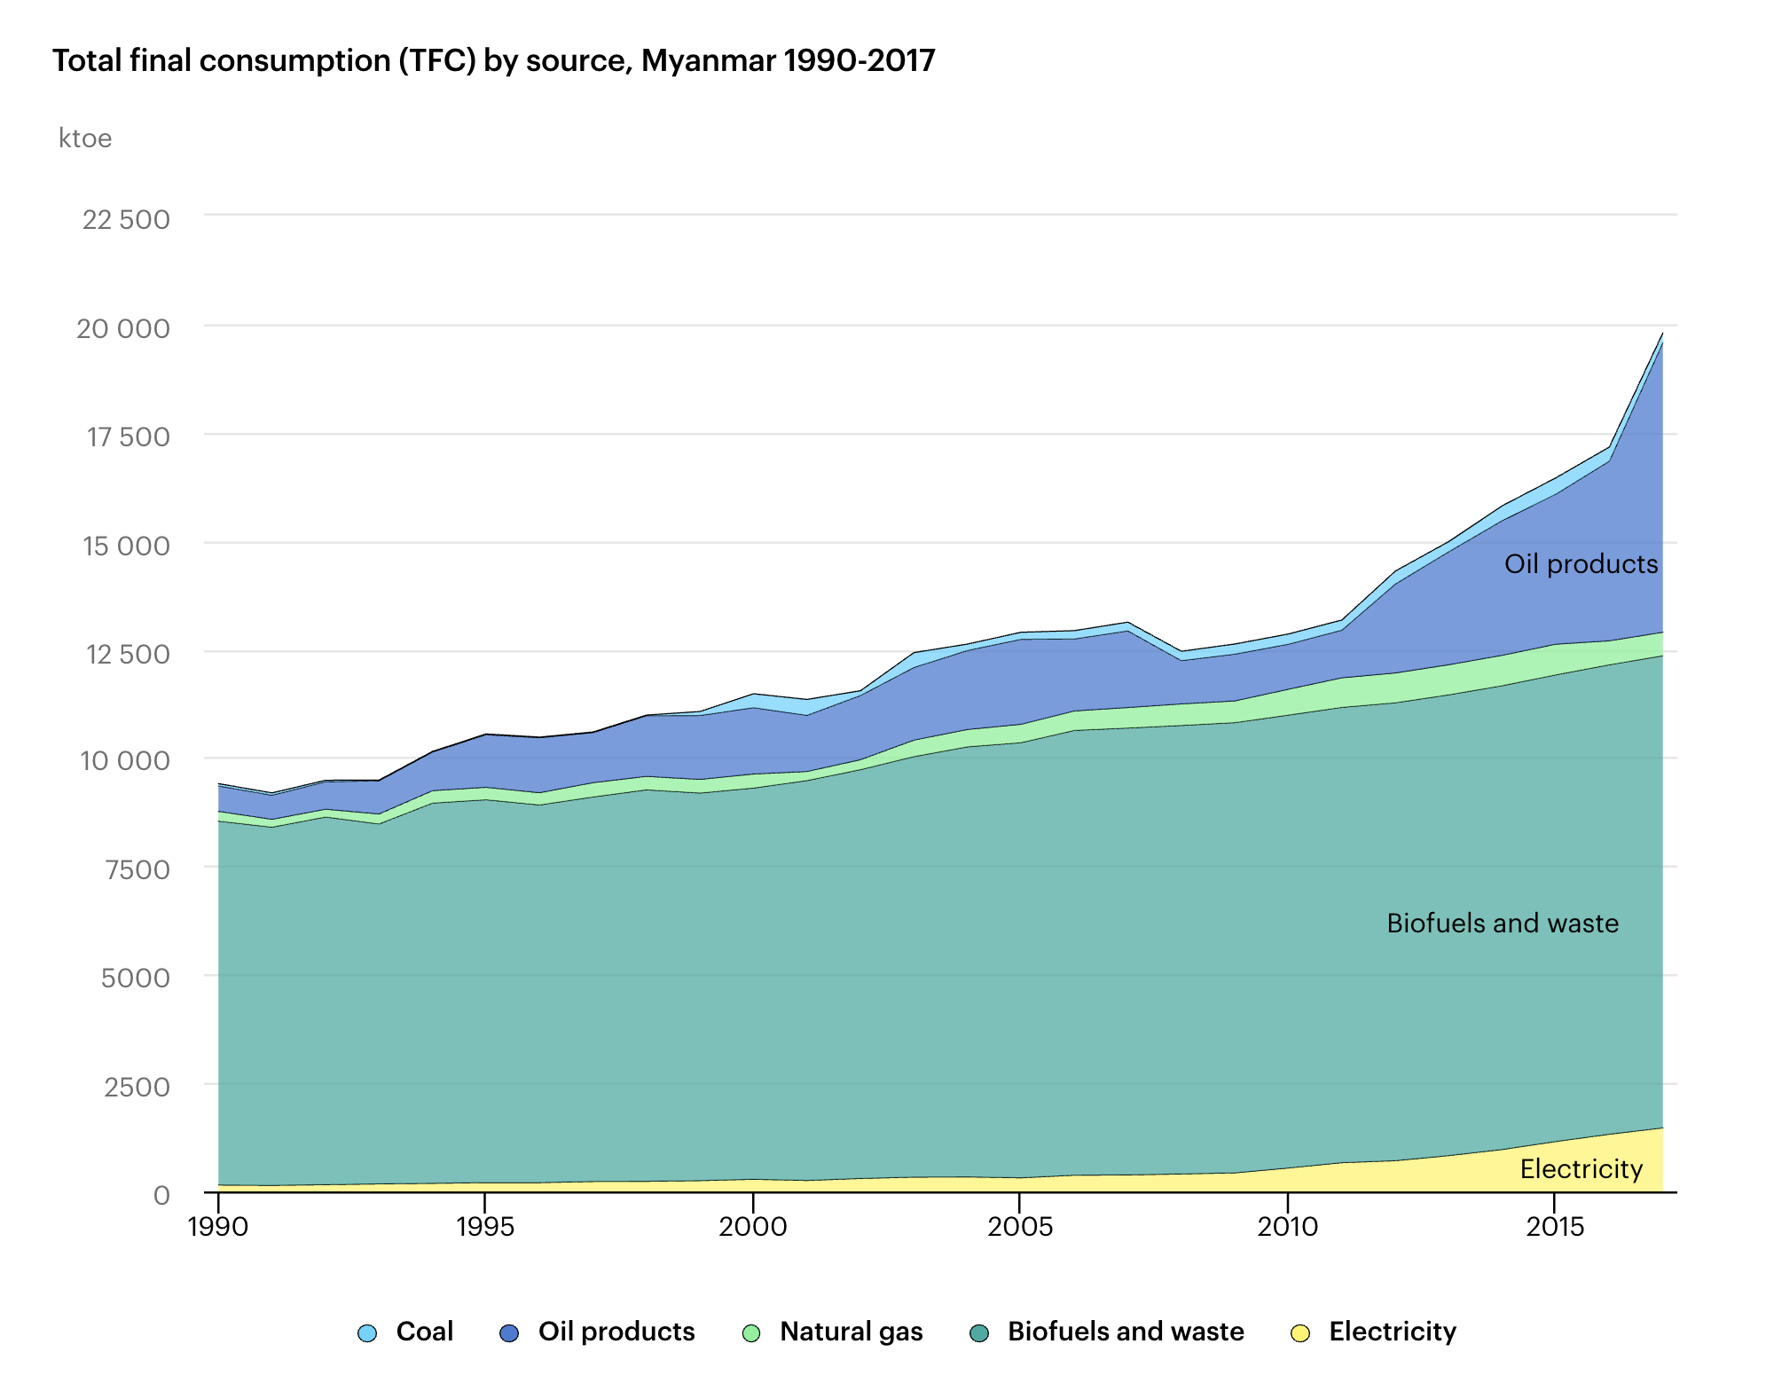
Myanmar: Energy basics
Total Final Consumption by source (1990-2017)
Only 60% of rural areas have access to electricity
More than 60% of energy consumption is from biofuels and waste
However, majority of this (82%) comes from the use of traditional biomass
Myanmar has abundant resources that can be used for bioenergy generation

Slide 17
Group activity
How would a potential sustainable bioenergy future for Myanmar might look like?
Discuss this in your group using the guide questions provided in the briefing sheets

Slide 18
Helpful links
Country Energy & Bioenergy Profiles:
https://www.iea.org/statistics/
http://resourceirena.irena.org/gateway/dashboard/
Country Bioenergy Targets + Aspirations:
https://www.iea.org/policiesandmeasures/renewableenergy/

Slide 19
activity wrap-up

Slide 20
Challenges | Examples of socially innovative responses
Provide social and economic benefits, alongside energy access | Create employment and support income-generating activities or social enterprises related to energy service provision
Encourage community ownership and participation | Form cooperatives and co-develop bioenergy programmes with local community members
Integrate social and cultural considerations in deployment | Identify values and motivations of local community during planning

Slide 21
Challenges | Examples of socially innovative responses
Raise awareness and educate locals about the project | Incorporate education and capacity-building elements in the delivery and design of bioenergy
Have supportive policies, enabling institutions, financial mechanisms | Build collaborations with actors in public (e.g., government) and private (e.g., financial bodies) sectors
Build trust between locals and technology developers | Ensure that all relevant stakeholders take roles and responsibilities in the design and management of the project

Slide 22
Further reading
Bioenergy conversion technologies: https://bit.ly/bioenergy-conversion-tech
Academic literature on bioenergy: https://bit.ly/tide-bioenergy-literature
Bioenergy comics: https://bit.ly/bioenergy-comics

