Slide 1
Exploring preferences
Using choice experiments for environmental valuation
Kim Solve Jacobsen
All images sourced from Wikimedia Commons unless otherwise specified

Slide 2
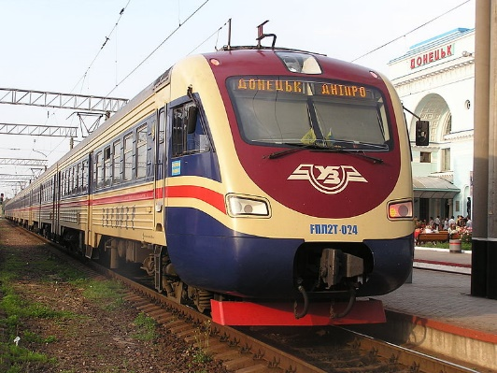
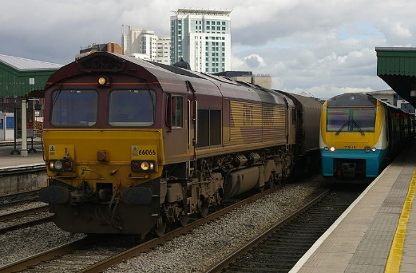
Why do we want to quanitify preferences?
Transition to green transport: train development
Option 1
Faster train
Fewer stops
More seats
Less luggage space
Option 2
Slower train
More stops
Fewer seats
More luggage space
How can we determine preferences towards trade-offs?
How to you design the service that people prefer?
Notes:
Add pics of trains

Slide 3
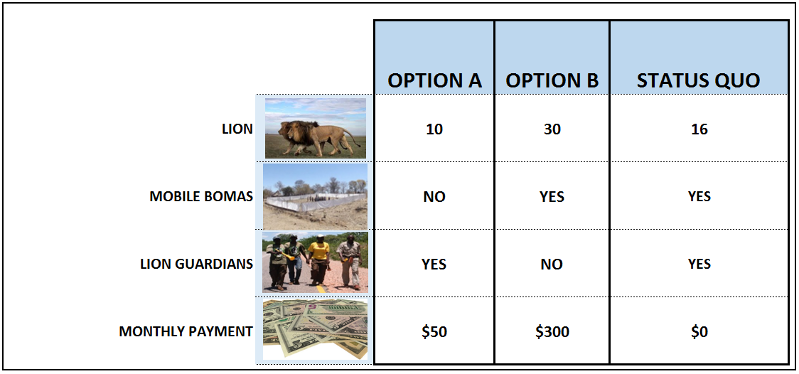
Choice experiments!

Slide 4
How do choice experiments work?
Participants choose between scenarios
The scenarios differ in the levels of the attributes
They have to trade-off the various attributes to choose the scenario they overall prefer
Optional reading: Bennett, J. and Adamowicz, V., 2001. Some fundamentals of environmental choice modelling. The choice modelling approach to environmental valuation, pp.37-69.

Slide 6
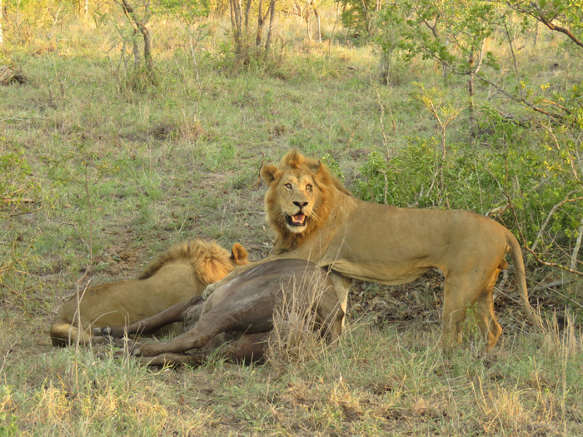
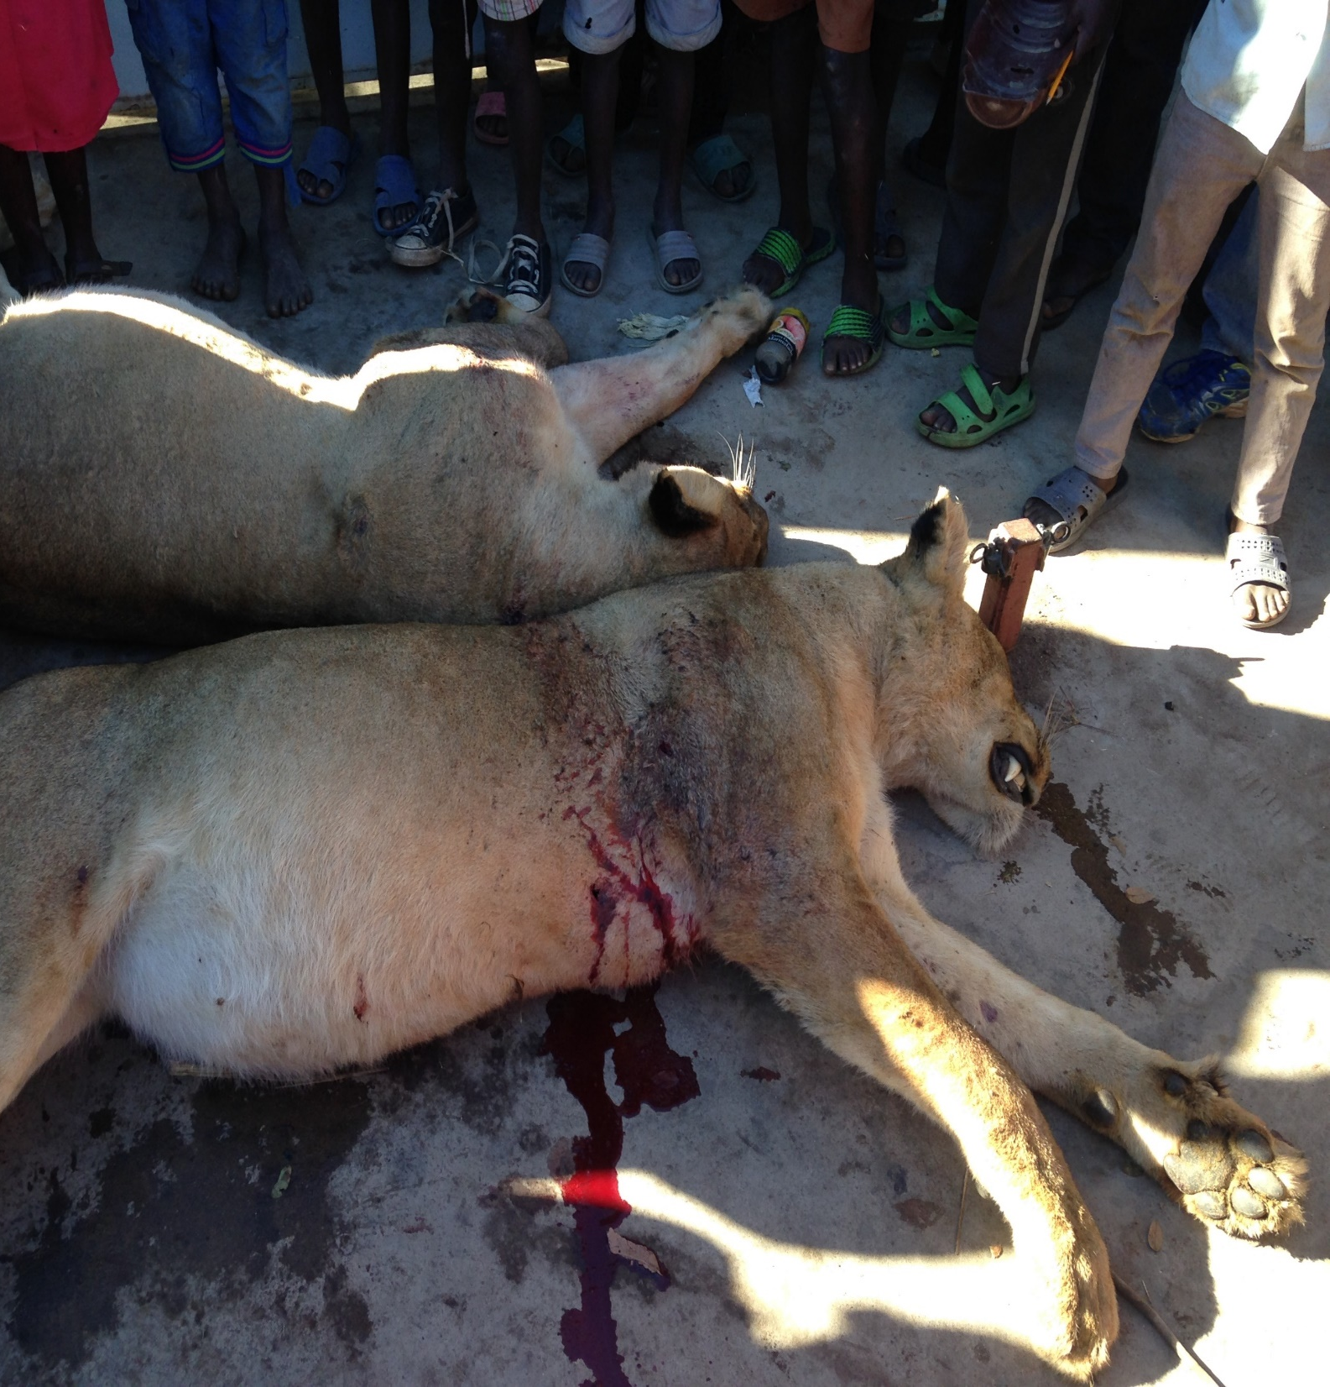

Slide 9
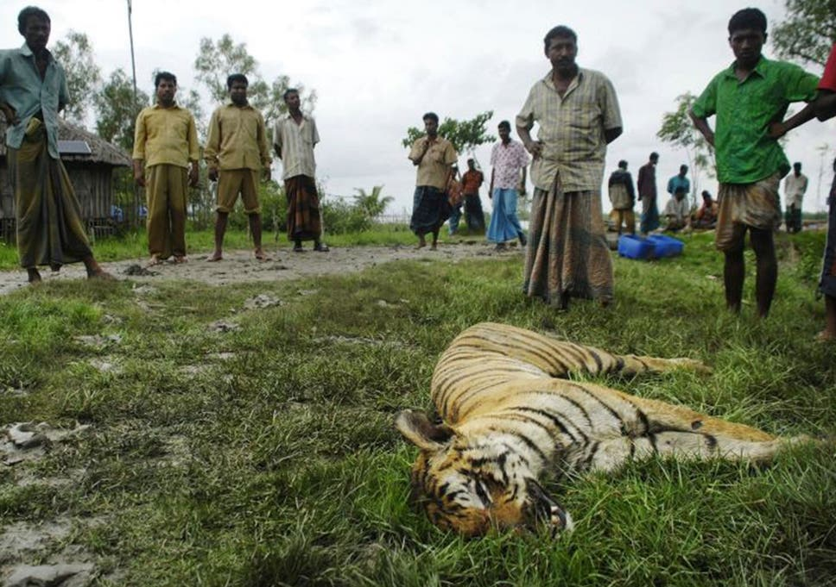
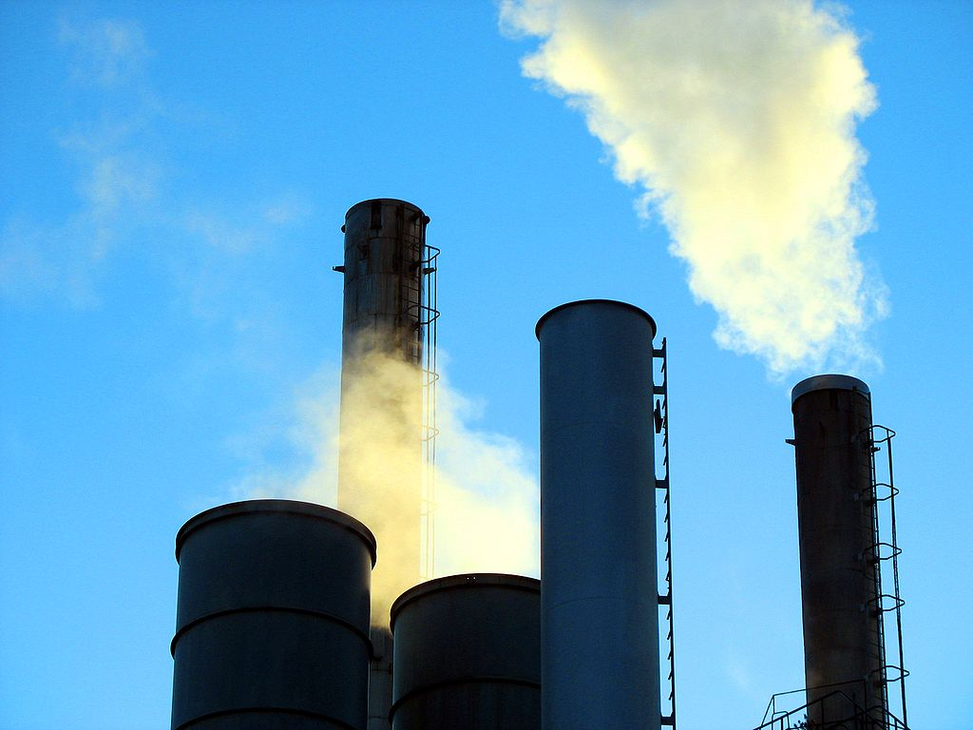
Image credit: Daily express
Image credit: The Independent
Notes:
Add factory pic

Slide 10
Lion = number of lions
Mobile bomas = protective fence
Lion guardians = keep lions away from villages
Monthly payment = monetary compensation payment

Slide 12
The multinomial logit model
The utility that individual n receives from choosing alternative i in choice situation t is described by the following function:
$$U_{nit}=βX_{nit}+ε_{nit}$$
Where $β$ is a vector of utility weights to be estimated, $X_{nit}$ the levels of our attributes, e.g. number of lions or the presence of bomas, and $ε_{nit}$ an error term. The probability that an individual will choose alternative i over the other alternatives she/he is presented with in choice situation t can be described by the multinomial logit model
$$P\left(i_{nt} | β, X_{nit}\right)=\frac{exp(βX_{nit})}{\sum_{j=1}^{J}{exp(βX_{njt})}}$$
Where all terms are as defined above and J denotes the number of available alternatives.
Optional reading: Ben-Akiva, M.E., Lerman, S.R. and Lerman, S.R., 1985. Discrete choice analysis: theory and application to travel demand (Vol. 9). MIT press.

Slide 13
Accounting for heterogeneity in preferences
Not all people like the same things!
$$π_{nq}= \frac{exp(α_{q}+γ_{q}Z_{n})}{\sum_{q=1}^{Q}{exp(α_{q}+γ_{q}Z_{n})}}$$
Most widely used models:
Latent class models
Mixed logit model
Notation for latent class model
Optional reading: Train, K.E., 2009. Discrete choice methods with simulation. Cambridge university press.
Greene, W.H. and Hensher, D.A., 2003. A latent class model for discrete choice analysis: contrasts with mixed logit. Transportation Research Part B: Methodological, 37(8), pp.681-698.

Slide 14
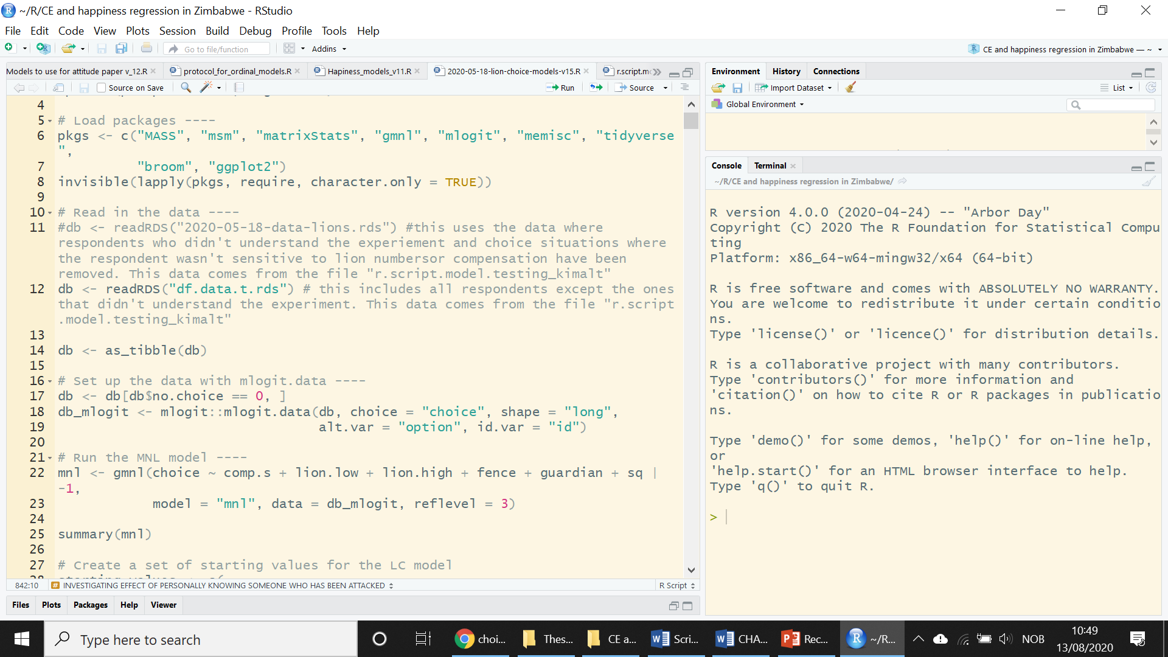
The software options
R
STATA
Python
Apollo
NLOGIT
And many more!
Don’t worry – collaborators can help!

Slide 15
Example: output from lion choice model
Attribute | Estimate | Standard error | Significance
Compensation | 0.016 | 0.05 | ***
Decrease in lion numbers | -0.01 | 0.01
Increase in lion numbers | -0.2 | 0.00 | ***
Mobile bomas | 0.72 | 0.03 | ***
Lion Guardians | 0.97 | 0.03 | ***

Slide 16
Lion = number of lions
Mobile bomas = protective fence
Lion guardians = keep lions away from villages
Monthly payment = monetary compensation payment

Slide 17
No price no value?
What is clean air worth?
Attribute | Option A | Option B | Status quo
Air pollution | Low | High | Medium
Increase in employment | 20 jobs | 25 jobs | 0 jobs
Tax | $40 | $35 | $0

Slide 18
Calculating economic value
$$\frac{Coefficient of the attribute to be valued}{Coefficient for the monetary term}$$
If we used compensation: we get willingness-to-accept (WTA)
If we used a payment: we get willingness-to-pay (WTP)

Slide 19
Example: output from lion choice model
Attribute | Estimate | Standard error | Significance
Compensation | 0.016 | 0.05 | ***
Decrease in lion numbers | -0.01 | 0.01
Increase in lion numbers | -0.2 | 0.00 | ***
Mobile bomas | 0.72 | 0.03 | ***
Community Guardians | 0.97 | 0.03 | ***

Slide 20
Calculating economic value
$$\frac{Coefficient of lion}{Coefficient of compensation payment}$$
If we used compensation: we get willingness-to-accept (WTA)
If we used a payment: we get willingness-to-pay (WTP)

Slide 21
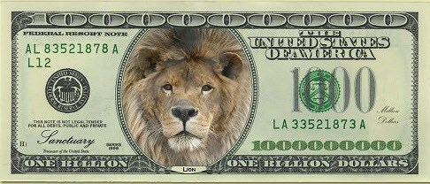
Calculating economic value
$\frac{Coefficient of lion}{Coefficient of compensation payment}$ = -$12.5 per month
If we used compensation: we get willingness-to-accept (WTA)
If we used a payment: we get willingness-to-pay (WTP)

Slide 22
Criticisms of the choice experiment method
Hypothetical bias
Utility mis-prediction
Anchoring
Insensitivity to scope

Slide 23
Examples from the literature
Willingness-to-pay (WTP) for cold water corals
WTP for small increase in protected area: $38
WTP for large increase in protected area: $47
If important fish habitat: WTP $99
Armstrong, C.W., Aanesen, M., van Rensburg, T.M. and Sandorf, E.D., 2019. Willingness to pay to protect cold water corals. Conservation Biology, 33(6), pp.1329-1337.

Slide 24
Willingness-to-pay for renewable energy investment in Korea
Willingness-to-pay for reduced air pollution: $0.10 (annually)
Willingness-to-pay for increased employment: $0.13 (annually)
Willingness-to-pay for improvement for wildlife: $0.084 (annually)
Ku, S.J. and Yoo, S.H., 2010. Willingness to pay for renewable energy investment in Korea: A choice experiment study. Renewable and Sustainable Energy Reviews, 14(8), pp.2196-2201.

Slide 25
The use of economic valuation in environmental policy
Cost-benefit analysis
Pricing/ resource management
Taxation
Legal procedures and damage litigation
Green national accounting
Market creation
Source: Susana Mourato, Non-Market Valuation I: Stated Preference Methods, London School of Economics

Slide 26
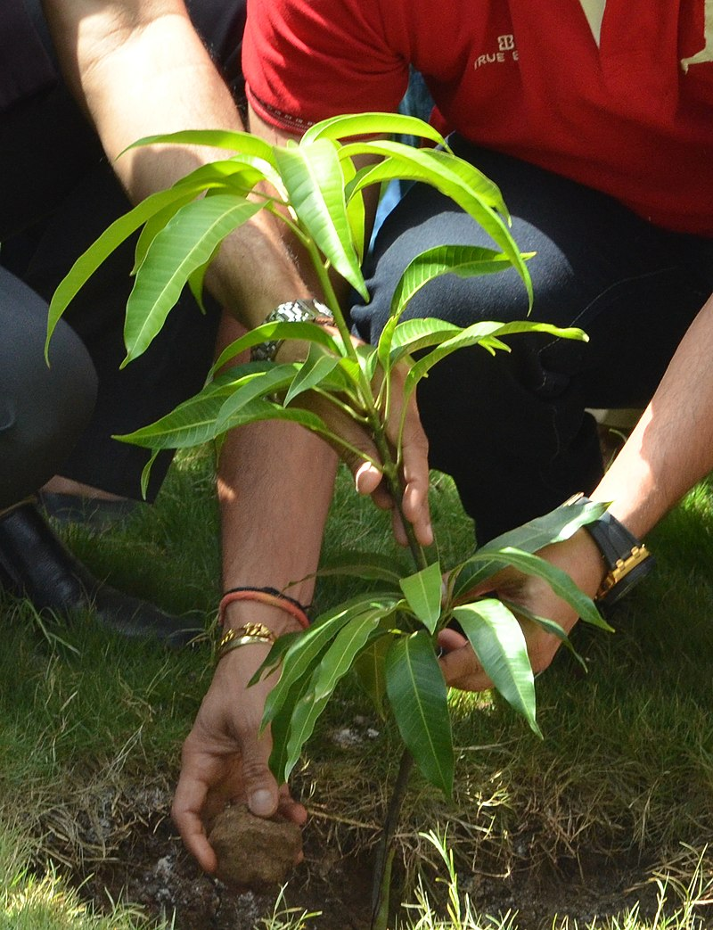
The use of economic valuation in environmental policy
Cost-benefit analysis
Pricing/ resource management
Taxation
Legal procedures and damage litigation
Green national accounting
Market creation
Source: Susana Mourato, Non-Market Valuation I: Stated Preference Methods, London School of Economics

Slide 27
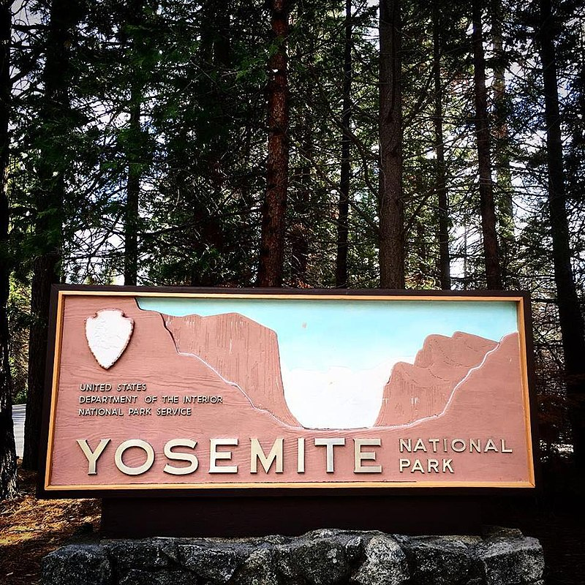
The use of economic valuation in environmental policy
Cost-benefit analysis
Pricing/ resource management
Taxation
Legal procedures and damage litigation
Green national accounting
Market creation
Source: Susana Mourato, Non-Market Valuation I: Stated Preference Methods, London School of Economics

Slide 28
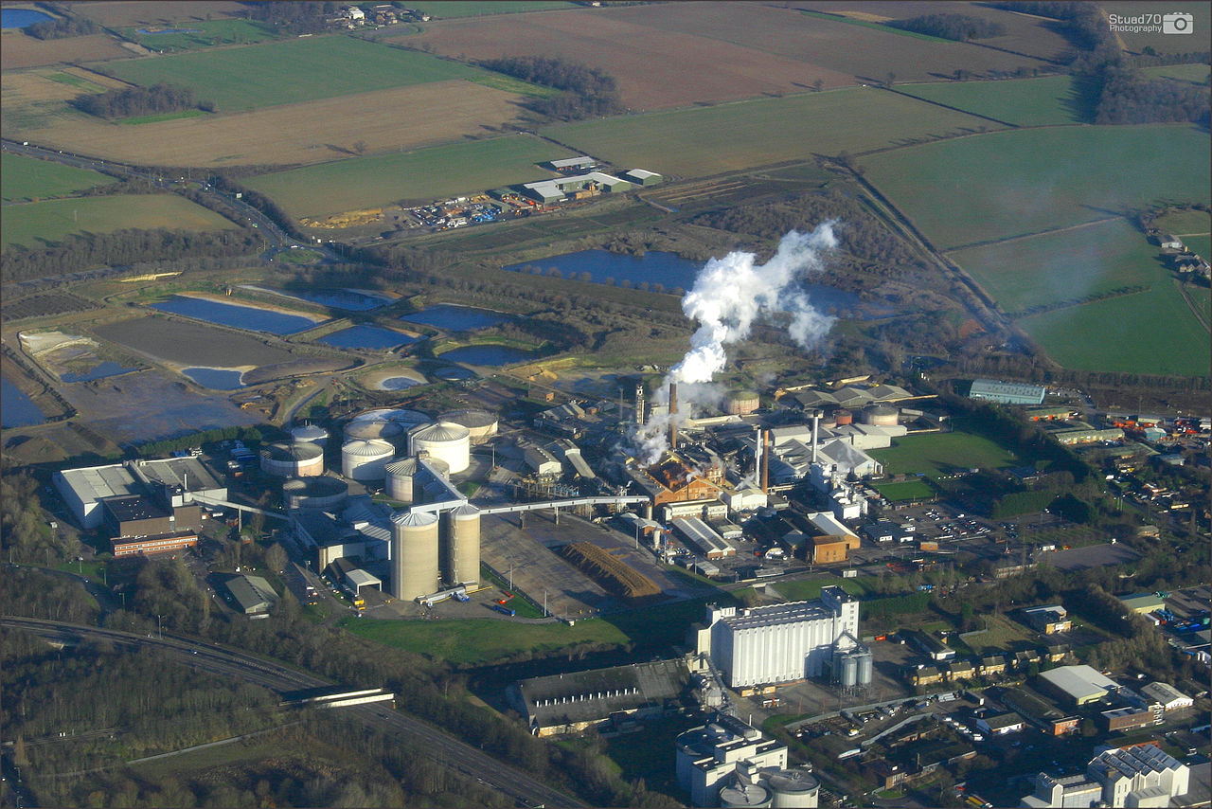
The use of economic valuation in environmental policy
Cost-benefit analysis
Pricing/ resource management
Taxation
Legal procedures and damage litigation
Green national accounting
Market creation
Source: Susana Mourato, Non-Market Valuation I: Stated Preference Methods, London School of Economics

Slide 29
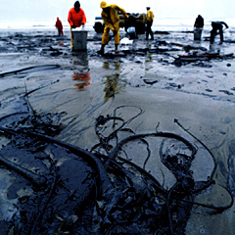
The use of economic valuation in environmental policy
Cost-benefit analysis
Pricing/ resource management
Taxation
Legal procedures and damage litigation
Green national accounting
Market creation
Source: Susana Mourato, Non-Market Valuation I: Stated Preference Methods, London School of Economics

Slide 30
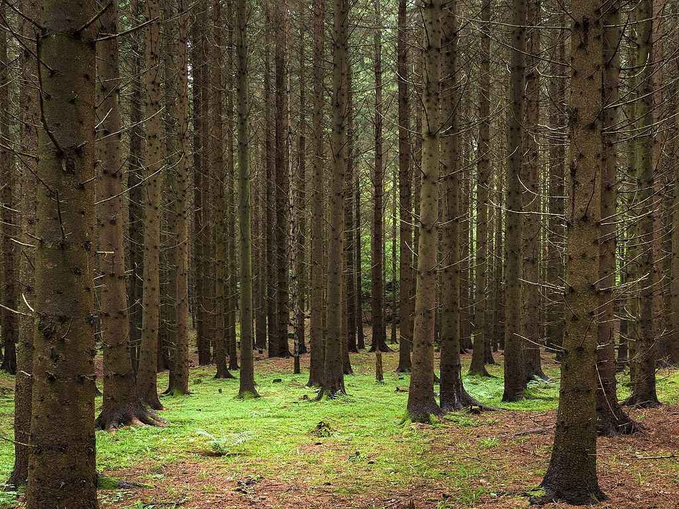
The use of economic valuation in environmental policy
Cost-benefit analysis
Pricing/ resource management
Taxation
Legal procedures and damage litigation
Green national accounting
Market creation
Source: Susana Mourato, Non-Market Valuation I: Stated Preference Methods, London School of Economics

Slide 31
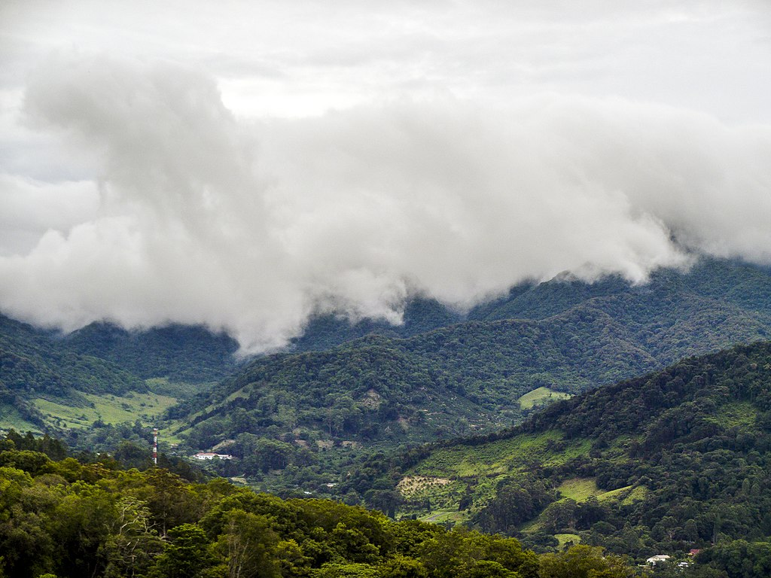
The use of economic valuation in environmental policy
Cost-benefit analysis
Pricing/ resource management
Taxation
Legal procedures and damage litigation
Green national accounting
Market creation
Source: Susana Mourato, Non-Market Valuation I: Stated Preference Methods, London School of Economics

Slide 32
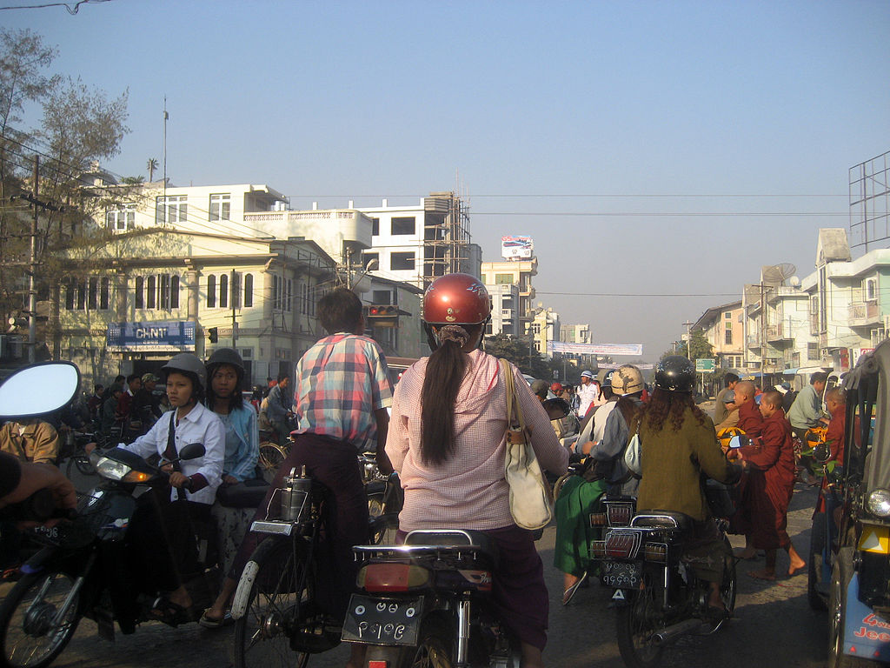
Willingness-to-pay for mortality risk reduction for traffic accidents in Myanmar
Value of avoiding one death: MMK 118.062 million
The total cost of death was estimated to range from MMK 594.681 billion (US$ 495.567 million) to MMK 820.296 billion (US$ 683.580 million) in 2015
WTP was associated with age, family status,
education, occupation, individual income,
household income, the vehicle used, exposure
to traffic, drunk driving, personal experiences,
and the perceived risk of traffic accidents.
Mon, E.E., Jomnonkwao, S., Khampirat, B., Satiennam, W. and Ratanavaraha, V., 2018. Willingness to pay for mortality risk reduction for traffic accidents in Myanmar. Accident Analysis & Prevention, 118, pp.18-28.

Slide 33
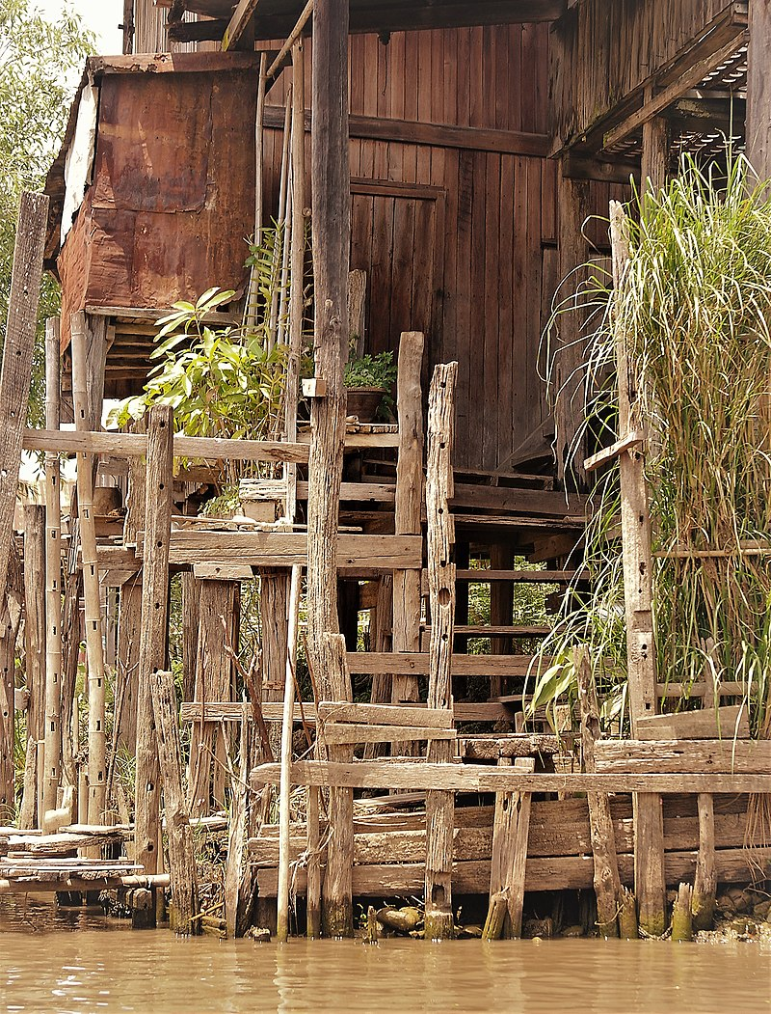
Water Quality Improvement and the Floating Settlements on Inlay Lake, Myanmar
The average gain from the lake water quality improvement is 5.9% of the average annual per capita income of those on the lake.
Hninn, S.T., Kaneko, S., Kawata, K. and Yoshida, Y., 2017. A nonparametric welfare analysis via a randomized conjoint field experiment: an application to water quality improvement and the floating settlements on Inlay Lake, Myanmar. IDEC DP2 Series, 7(3), pp.1-33.

Slide 34
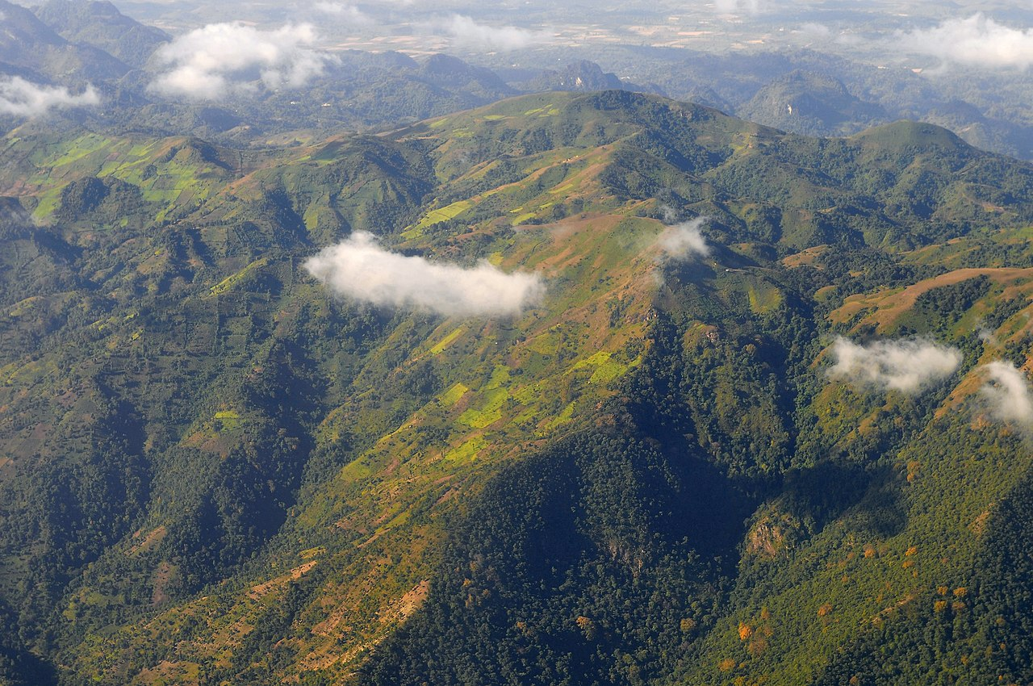
Conclusion
Choice experiments allow the study of preferences and trade-offs
Can be used for economic valuation of non-market goods
There are biases and weaknesses (such as the hypothetical bias)
Nonetheless, very useful for policy-making
Avoids inadvertent reductions of welfare
My contact details:
Email: kimsjacobsen@gmail.com
Twitter: kimsjacobsen
LinkedIn: Kim Solve Jacobsen

