Slide 1
LECTURE 2 SDGS AND ENERGY ACCESS
OnSSET/Global Electrification Platform
Version 1.0

Slide 2
Learning Outcomes
By the end of the lecture, you will be able to:
ILO1: Describe the status of energy access in the world.
ILO2: List technology options for electrification.
ILO3: Describe the historical context of mini-grids.
ILO4: Extract results from the Global Electrification Platform
Course Name
Notes:
This lecture has four Intended Learning Outcomes. After this lecture you will be able to:
Describe the status of energy access in the world.
List technology options for electrification.
Describe the historical context of mini-grids.
Extract results from the Global Electrification Platform
These learning outcomes will be important for the basic understanding of geospatial modelling.

Slide 3
2.1 Energy access and OnSSET
SDG7
SDG7: ‘Ensure access to affordable, reliable, sustainable and modern energy for all by 2030…’.
Picture source: UN, image
UN, 2021
Notes:
In 2015, the United Nations General Assembly launched the Agenda 2030 for Sustainable Development that includes 17 Sustainable Development Goals for people, planet, and prosperity. Throughout this course, we will be focusing on SDG7: ‘Ensure access to affordable, reliable, sustainable and modern energy for all by 2030’.
We will be using the Open Source Spatial Electrification Tool (OnSSET), which focuses specifically on access to electricity. As we previously have and will discuss continuously in this course, SDG7 and electricity are important both in themselves and as enablers for other goals and developments, for example improved health facilities, improved education, and economic development..

Slide 4
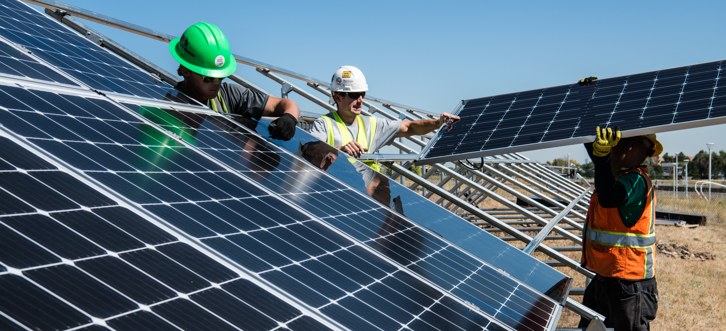
2.1 Energy access and OnSSET
Energy access important in many sectors
Fuso Nerini, 2018; UN, 2016
Notes:
But why is SDG7 so important? As we already covered in Lecture 1, SDG7 is important for several of the SDGs.
The energy system supports all sectors, from businesses, medicine, and education to agriculture, infrastructure, communications, and high technology. Access to electricity in poorer countries has begun to increase and energy efficiency continues to improve. At the same time, renewable energy is increasing in its share of produced electricity. For many decades, fossil fuels such as coal, oil, or gas have been major sources of electricity production, but burning carbon fuels produces large amounts of greenhouse gases, which cause climate change and have harmful impacts on people’s well-being and the environment. This affects everyone, not just a few populations. In addition global electricity use is rising rapidly. Without a stable electricity supply, countries will not be able to power their economies.

Slide 5
2.1 Energy access and OnSSET
Energy access and SDG7
In 2021, 789 million people did not have access to electricity services.
If we follow the current policies and trends 530 million people in sub-Saharan Africa would still be without access to electricity by 2030
Source: Adapted from Mentis et al. 2021
Picture source: OurWorldInData.org, image, licensed under CC-BY 4.0
IEA, 2019; IEA, 2020
Notes:
In 2010, around 1.2 billion people in the world did not have access to electricity. In the last decade, there has been a lot of progress, especially in Asia. According to the latest numbers, people without access have decreased to about 789 million people that do not have access to electricity services.
As you can see in the slide, sub-Saharan Africa is now the region where most people lack access to electricity in their homes. The International Energy Agency (I.E.A) projected in the 2019 World Energy Outlook (WEO) that if we follow the current policies and trends 530 million people in sub-Saharan Africa would still be without access to electricity by 2030. This would mean that we would fall short of the SDG7 target. In a more ambitious scenario, the IEA show that off-grid technologies would be the least-cost technology option for two-thirds of all new connections to achieve SDG7 and reach universal access by 2030. The national grid would supply the remaining third of new connections. This split between on- and off-grid technologies is what we will study throughout this course. What is the best option varies between countries depending on the demand targets and technology costs, to mention some parameters.

Slide 6
2.1 Energy access and OnSSET
Power system transformation
Achieving SDG7 by 2030 requires a fundamental transformation of the power sector in currently unserved areas
Modern electrification planning should consider:
1) System cost minimization
2) Technological innovation (new technologies and system configurations)
3) Environmental integrity
4) Private and/or public initiatives
5) Geopolitical concerns (energy security and reliability of supply)
Source: Mentis et al. 2021
Notes:
Achieving SDG7 by 2030 requires a fundamental transformation of the power sector in currently unserved areas. Modern electrification planning should consider a range of different factors in order to be successful.
First of all, the cost of the system needs to be considered, and it should be minimized to ensure that the funds that are needed can be raised by the governments, international organizations, and companies and also by the potential consumers.
A second factor to consider is that the planning process and models need to take into account technological innovation. The power system in countries where electricity access is low today does not necessarily need to copy the systems in countries which do have universal access to electricity. For example, as solar photovoltaic (PV) costs have decreased and solar home systems have become available, such solutions could be used to provide electricity access. Either, instead of or before the grid can be extended to that location. Therefore, the energy models for electricity access need to be able to include such systems in a good way.
A third factor is the environmental considerations, which also should be taken into account. Many times, the people lacking access to electricity are the same people that suffer the largest risks due to climate change. The power source used to generate electricity can affect the cost of electricity as well as its environmental impacts.
The fourth factor is who will pay for the investment? Are private companies allowed to invest in grid connected power generation, transmission, and distribution or only in the end-use sector? Similarly, is the government investing only in grid power or are they also operating mini-grids and solar home system schemes?
Finally, geopolitical concerns can also be a factor. This means considering if the energy is locally sourced, such as solar or wind, or if it is dependent on other countries which is often the case for fossil fuels if they need to be imported. Similarly, hydropower can also be geopolitical, if it depends on cross border rivers.

Slide 7
2.1 Energy access and OnSSET
Key messages
Access to sustainable energy (electricity) is key to achieving many Sustainable Development Goals (e.g., improved health facilities, improved education, economic development).
Power system planning should take into account many factors such as cost minimization, environmental aspects, and geo-politics.
Source: Mentis et al. 2021
Notes:
The key messages of this mini-lecture are, first, that access to sustainable energy is important not only as its own goal, but also because it can help improve many different areas such as health, education, and economic development.
Secondly, there are several different issues that should be considered in power system planning to increase access to electricity, from economic aspects to environmental considerations and geopolitical concerns.

Slide 8
Lecture 2.1 References
Fuso Nerini, F., Tomei, J., To, L.S., Bisaga, I., Parikh, P., Black, M., Borrion, A., Spataru, C., Castán Broto, V., Anandarajah, G., Milligan, B., Mulugetta, Y., 2018. Mapping synergies and trade-offs between energy and the Sustainable Development Goals. Nature Energy 3, 10–15. https://doi.org/10.1038/s41560-017-0036-5
International Energy Agency; International Renewable Energy Agency; United Nations Statistics Division; World Bank; World Health Organization. 2020. Tracking SDG 7 : The Energy Progress Report 2020. World Bank, Washington, DC. © World Bank. https://openknowledge.worldbank.org/handle/10986/33822 License: CC BY-NC 3.0 IGO
Mentis, D., Korkovelos, A., Sahlberg, A., Khavari, B., n.d. Lecture 1: Introduction to geospatial electrification modelling [WWW Document]. OnSSET Teaching Kit. URL https://onsset.github.io/teaching_kit/courses/module_1/Lecture_1/ (accessed 2.18.21).
2019. WORLD ENERGY OUTLOOK 2019. OECD Publishing 810. https://doi.org/10.1787/caf32f3b-en
UN, 2016. AFFORDABLE AND CLEAN ENERGY: 2016. https://www.un.org/sustainabledevelopment/wp-content/uploads/2016/08/7_Why-It-Matters-2020.pdf
Course Name
Mini Lecture Learning Objective

Slide 9
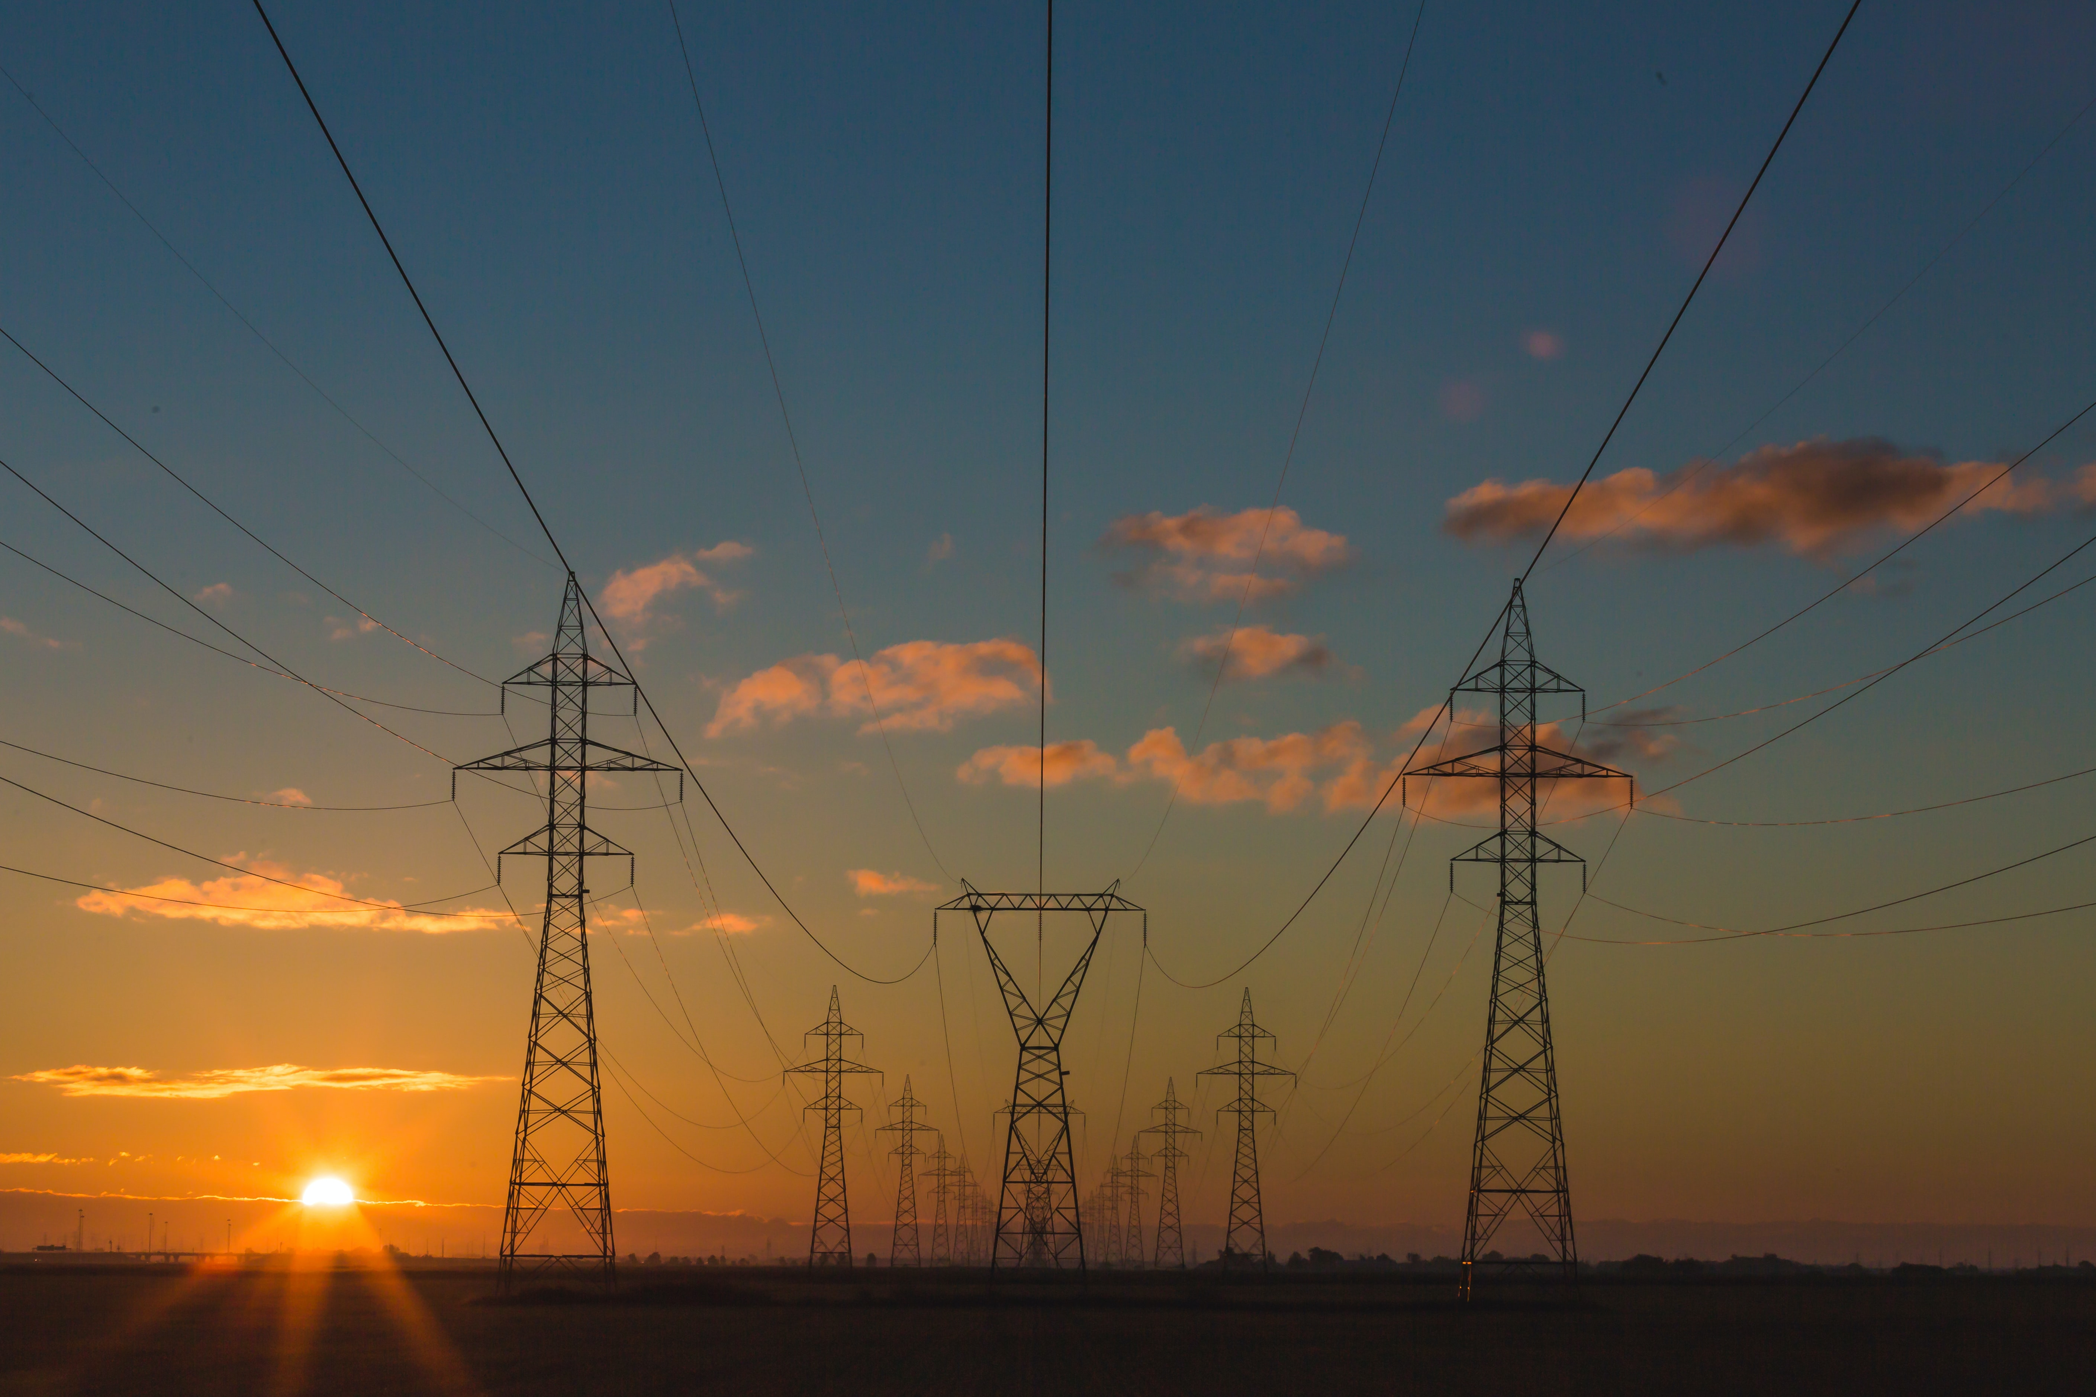
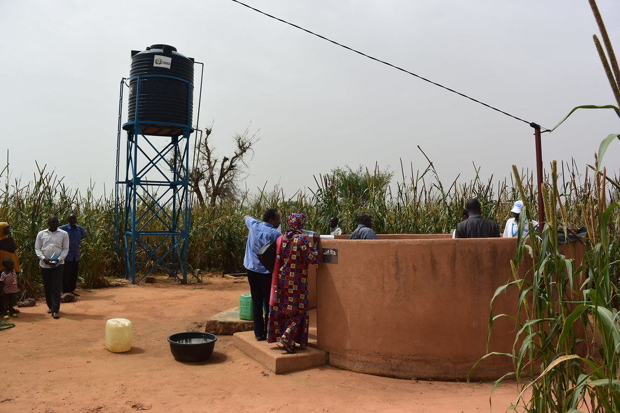
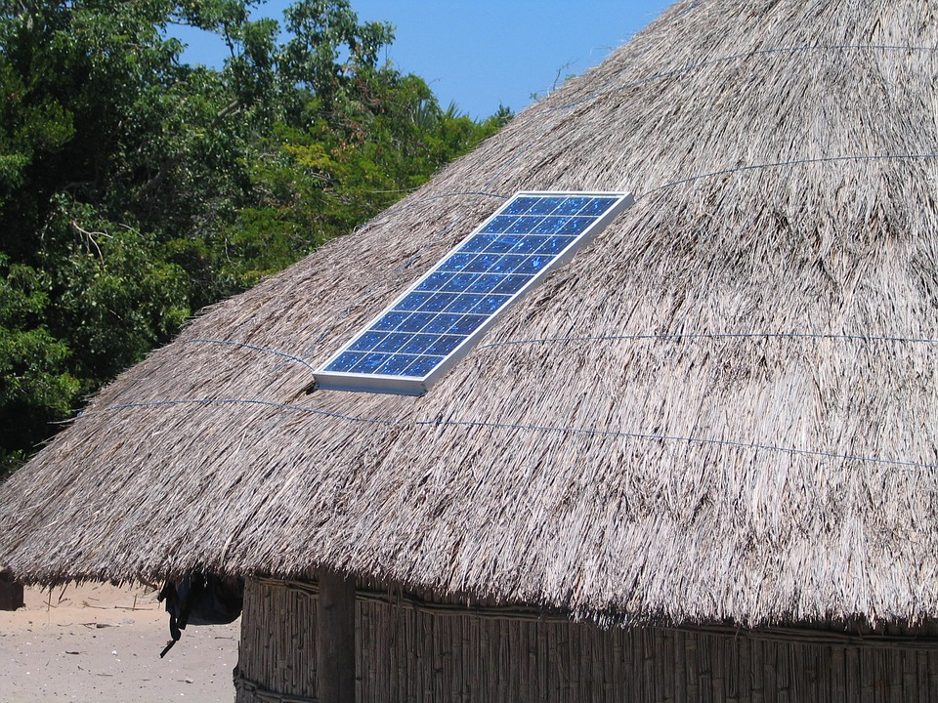
2.2 Electrification options
Electrification options
How can electricity access be achieved at the lowest cost?
GRID
MINI-GRIDS
STAND-ALONE SYSTEMS
Picture Source: International Renewable Energy Agency (IRENA) licensed under CC BY-NC-ND 2.0
Source: Adapted from Mentis et al. 2021
Notes:
In this section, we will go through the basic concepts of geospatial electrification modelling and the Open Source Spatial Electrification Tool (OnSSET). Many studies have shown that universal access to electricity can be achieved at the lowest cost through a combination of three categories of technologies. The first is often referred to as national or centralized grid, or simply grid. The second is mini-grid and the third stand-alone technologies. These technologies and categories will be briefly explained in the next section.

Slide 10
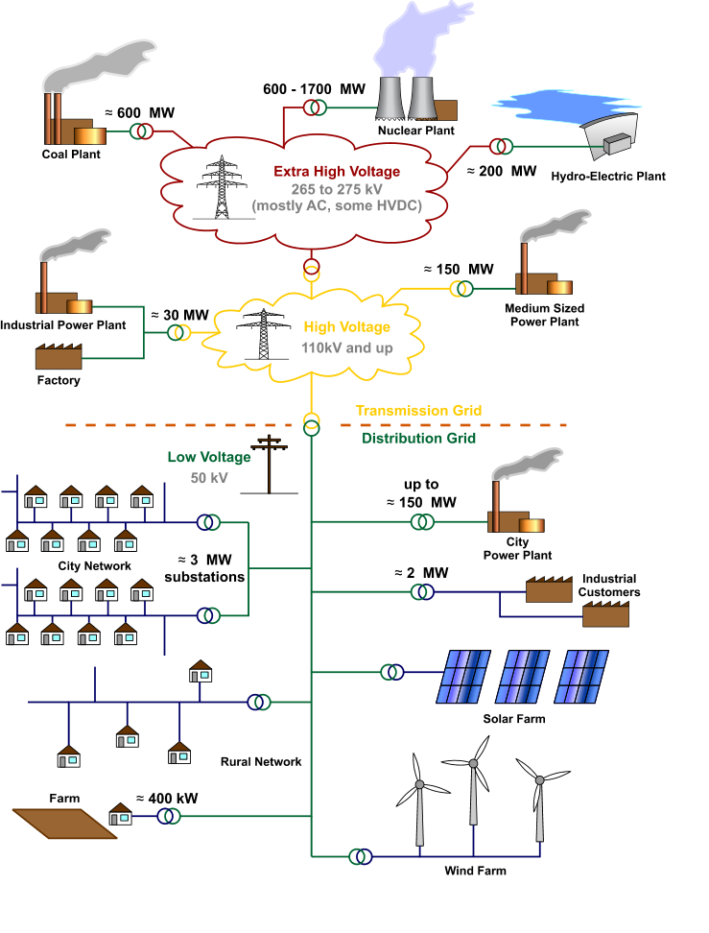
2.2 Electrification options
Electrification option: National/Regional Grid extension
Benefits and drawback of national grid
- Centralized electricity generation (mix of energy sources and power plants)
- Can better leverage economies of scale, which can lead to lower unit cost of electricity.
- Requires extension of Transmission & Distribution lines to the area of interest (HV-MV-LV + substations, transformers)
- Capital intensive & usually a lengthy process (in terms of planning, construction, and Operation & Maintenance)
- Does not depend on locally available resources (at the community level)
Picture Source: https://upload.wikimedia.org/wikipedia/commons/9/90/Electricity_Grid_Schematic_English.svg licensed under CC-BY 3.0
Source: Mentis et al. 2021
Notes:
First of all, the national grid can be divided into three general parts: centralized electricity generation, transmission, and distribution. Traditionally, the national grid has generated power through large power plants based on, for example, fossil fuels and hydropower which are connected to the transmission network. However, smaller power plants such as wind parks and PV panels can also be connected directly to the distribution network. The national grid utilizes economies of scale to reduce generation costs, but requires extensive networks to transmit and distribute electricity to the customers.
Looking at the flow chart we can see that the national grid has a specific energy flow:
Centralized electricity generation
The first part are the power plants, which you see at the top in the picture, which generate electricity.
Transmission of electricity with High Voltage (HV) – Medium Voltage (MV) lines
The electricity is then sent to the cities and settlements though the transmission network, which you see in yellow in the middle of the picture, which consists of high voltage and medium voltage lines.
Distribution of electricity with Medium Voltage – Low Voltage (LV) lines
Finally, the distribution networks, which you see in the bottom of the picture, receive the electricity from the transmission network and distributes it to the customer through medium voltage and low voltage lines.

Slide 11
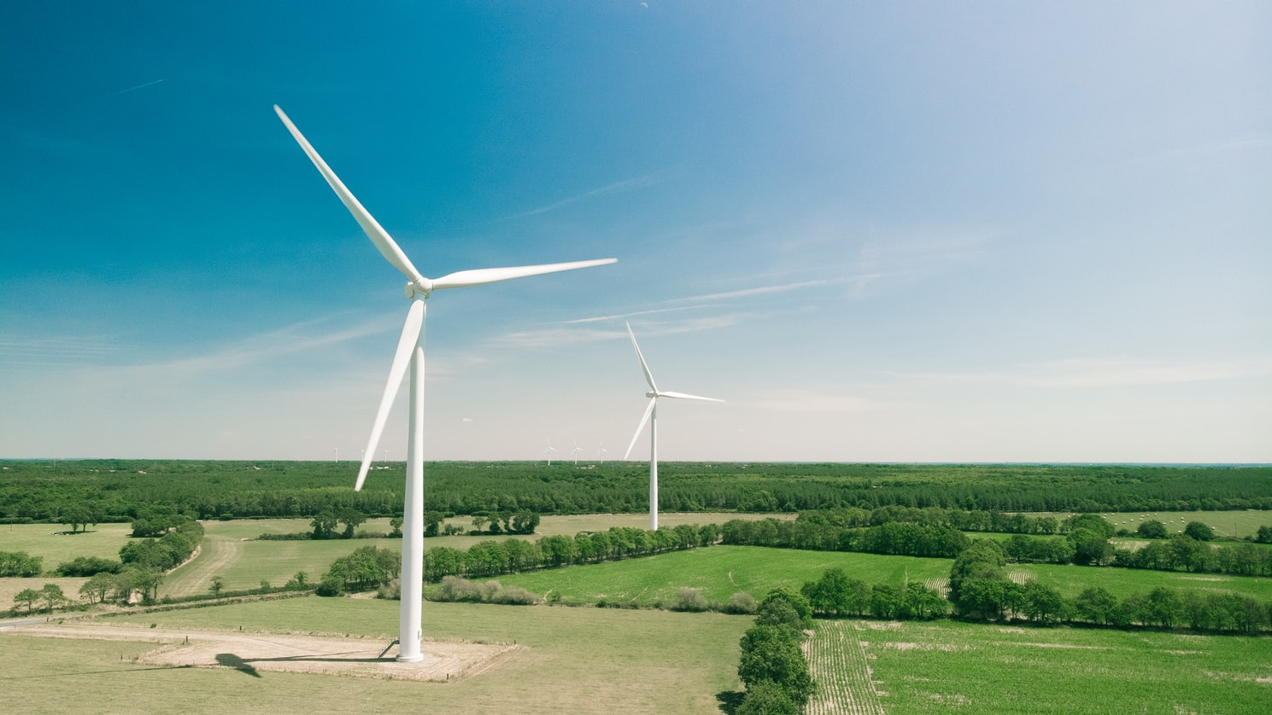
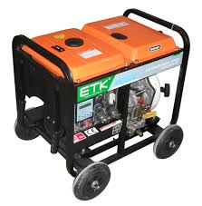
2.2 Electrification options
Mini-grid systems (PV, hydro, wind, diesel, or hybrids)
Benefits and drawback of mini-grids
Can supply medium/high demand levels, usually for a cluster of households and/or productive loads
No transmission costs but modest distribution costs (MV or LV)
Depend on locally available energy resources & involves battery storage & high upfront capital (if based on renewable sources)
Depend on fuel availability/cost (if diesel is included)
(Energypedia, 2021)
or
or
or
Photovoltaic (PV)
Small/Mini Hydro
Wind turbine
Diesel Generator
Source: Adapted from Mentis et al. 2021
Picture Source: image
Notes:
Mini-grids are a smaller version of the grid, supplying a single city or village based on local generation sources which connect to the distribution network that, in turn, connects each customer. The generation source can be, for example, solar panels, wind turbines, a diesel generator, or hydropower. These can be combined with batteries or a combination of the technologies with different generation sources (called hybrid).
The choice of a generation type in this case depends on what resource is available locally at the settlement where the mini-grid is situated. For example, if it is close to a river which would allow for hydropower to be used, or what is the solar or wind potential? Also what would be the cost of diesel if we need to buy it and also transport it to the settlement. With electricity generation directly at the settlement, there is no need for a transmission network. However, a smaller generation capacity means that the generation cannot benefit as much from economies of scale as one would in a national grid.
The benefits of mini-grid are as follows:
They can supply medium/high demand levels, usually for a cluster of households and/or productive loads. (This refers to isolated (off-grid) mini-grids, that are not interconnected to any regional or national grid system).
They have no transmission costs but modest distribution costs (MV or LV).
They depend on locally available energy resources and involve battery storage and high upfront capital (if based on renewable sources).
If diesel, they depend on fuel availability and/or cost.

Slide 12
2.2 Electrification options
Stand-alone systems (solar lanterns, SHS, diesel gensets)
Benefits and drawbacks of stand-alone system
Can best supply low demand levels, usually single households and a few customers
No transmission & distribution network is required
Deployed relatively easily/quickly
Depend on locally available resources, may involve battery storage, and have a relatively high upfront capital cost (for PV only)
Have lower upfront capital cost but depend on fuel availability/cost (if diesel-based)
or
Photovoltaic (PV)
Diesel Generator
Picture Source: https://pic.made-in-china.com/4f0j00jChQiVbmllpJ/Small-Diesel-Generator-Set-Generator.jpg
Source: Adapted from Mentis et al. 2021
Notes:
Finally, we have stand-alone technologies where the customer will have their own generation unit. This could be a small diesel generator or, as is more common today, their own solar home system (or SHS). These units are small and have a higher cost per kilowatt installed capacity, but they do not need any transmission and distribution network as the customer generates electricity directly where they need it. Similar to mini grid, stand-alone systems need to utilize the locally available resources. This means taking into account what the solar potential is and what would be the local cost of diesel, including transportation costs.
The benefits of stand-alone systems are as follows:
They can best supply low demand levels, usually single households and a few customers.
No transmission and distribution network is required.
They are Deployed relatively easily.
They depend on locally available resources, may involve battery storage, and have relatively high upfront capital cost (for PV only).
They have a lower upfront capital cost but depend on fuel availability/cost (for diesel only).

Slide 13
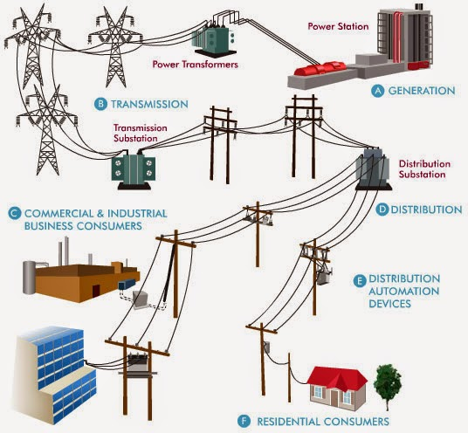
2.2 Electrification options
What are the options for electrification?
On Grid
Mini-Grid
Stand-alone
Typical medium–long term Energy System Models
Picture source: Huang et al. 2020, Image , licensed under CC-BY 3.0
Source: Adapted from Mentis et al. 2021
Mentis et al., 2016; Dalla Longa et al., 2018
Notes:
Historically national energy system models have focused on optimizing grid power generation. This means looking at a combination of power plants that can supply reliable electricity at a low cost. These take into account different constraints such as resource availability and greenhouse gas emissions. However, these models are not optimal for modelling off-grid technologies (where we include mini-grid and stand-alone technologies). Increasing access to electricity and currently unserved areas at a least cost option must consider also off-grid technologies. This is the reason there has been a development of geospatial electrification models, as we cover in more detail in the following sections.

Slide 14
Lecture 2.2 References
Dalla Longa, F., Strikkers, T., Kober, T., van der Zwaan, B., 2018. Advancing Energy Access Modelling with Geographic Information System Data. Environ Model Assess 23, 627–637. https://doi.org/10.1007/s10666-018-9627-1
Energypedia, 2021. Mini Grids [WWW Document]. URL https://energypedia.info/wiki/Mini_Grids#Definition_and_Overview (accessed 2.13.21).
Mentis, D., Howells, M., Rogner, H., Korkovelos, A., Arderne, C., Zepeda, E., Siyal, S., Taliotis, C., Bazilian, M., de Roo, A., Tanvez, Y., Oudalov, A., Scholtz, E., 2017. Lighting the World: the first application of an open source, spatial electrification tool (OnSSET) on Sub-Saharan Africa. Environmental Research Letters 12, 085003. https://doi.org/10.1088/1748-9326/aa7b29
Mentis, D., Korkovelos, A., Sahlberg, A., Khavari, B., n.d. Lecture 1: Introduction to geospatial electrification modelling [WWW Document]. OnSSET Teaching Kit. URL https://onsset.github.io/teaching_kit/courses/module_1/Lecture_1/ (accessed 2.18.21).
Mentis, D., Andersson, M., Howells, M., Rogner, H., Siyal, S., Broad, O., Korkovelos, A., Bazilian, M., 2016. The benefits of geospatial planning in energy access – A case study on Ethiopia. Applied Geography 72, 1–13. https://doi.org/10.1016/j.apgeog.2016.04.009
Course Name
Mini Lecture Learning Objective

Slide 15
2.3 Historical context of mini-grids
Can history shed some light on the roadmap to SDG7?
Picture Source: "Solar PV mini-grid powering a water pump for a rural village in Niger. Selected for funding in the fourth cycle." by International Renewable Energy Agency (IRENA) is licensed under CC BY-NC-ND 2.0
Korkovelos et al. 2020
Notes:
Access to modern energy, and electricity in particular, is an important ingredient of socio-economic progress and well-being. As previously covered in the lectures, many electrification efforts focus on the deployment of large centralized grid systems. In contrast to that, off-grid systems can provide electricity to a small share of the global population. However, with Agenda 2030 and achieving universal energy access for all, i.e., the Sustainable Development Goal 7, decentralized power solutions have the potential to play a key role for those parts of the population which still lack access to electricity. The International Energy Agency estimates that about 70% of rural households, could be electrified via off-grid technologies (both stand-alone and mini-grid) over the next decade. Although this transition is promising, it can also increase the complexity in the electrification planning process. This is because the off-grid technologies are different than the central grid and carry their own risks. As an example, a new and expensive technology, like small-scale renewables with storage, will be introduced in the rural areas of Sub-Saharan Africa where affordability might be a key factor. These small-scale renewable technologies also might be implemented by new actors which need to get involved and cooperate locally.

Slide 16
2.3 Historical context of mini-grids
Phases of electrification historically
Phase 1—Pilot Projects
Phase 2—Technological Roll out
Phase 3—Economic Expansion
Phase 4—Social Scale-up
Korkovelos et al., 2020
Notes:
The electrification process is, of course, case specific in terms of location, time, and resources available at each location. However, there seems to be common patterns between the historical development of electrification.
The first phase of development can be illustrated by small innovative pilot projects (of mini-grids) which take their support from a proposed business model and tests their initial feasibility.
The second phase is the roll-out phase where we find the customers who can afford to pay for the premium access to a certain electricity service (connecting to larger mini-grids). Here we also see the proof of the economic viability of the technology and the applications of it.
The third phase is the economic expansion of mini-grids towards bigger connected networks that then can benefit from the economy of scale. The potential economic opportunity that this presents also stimulates the area to further development.
The final fourth phase is the social scale-up whereby a public actor steps in and starts to regulate the market and also supplements the market. This helps settlements that are not as economically viable to nonetheless be connected. This is frequently referred to as electrifying the last mile.

Slide 17
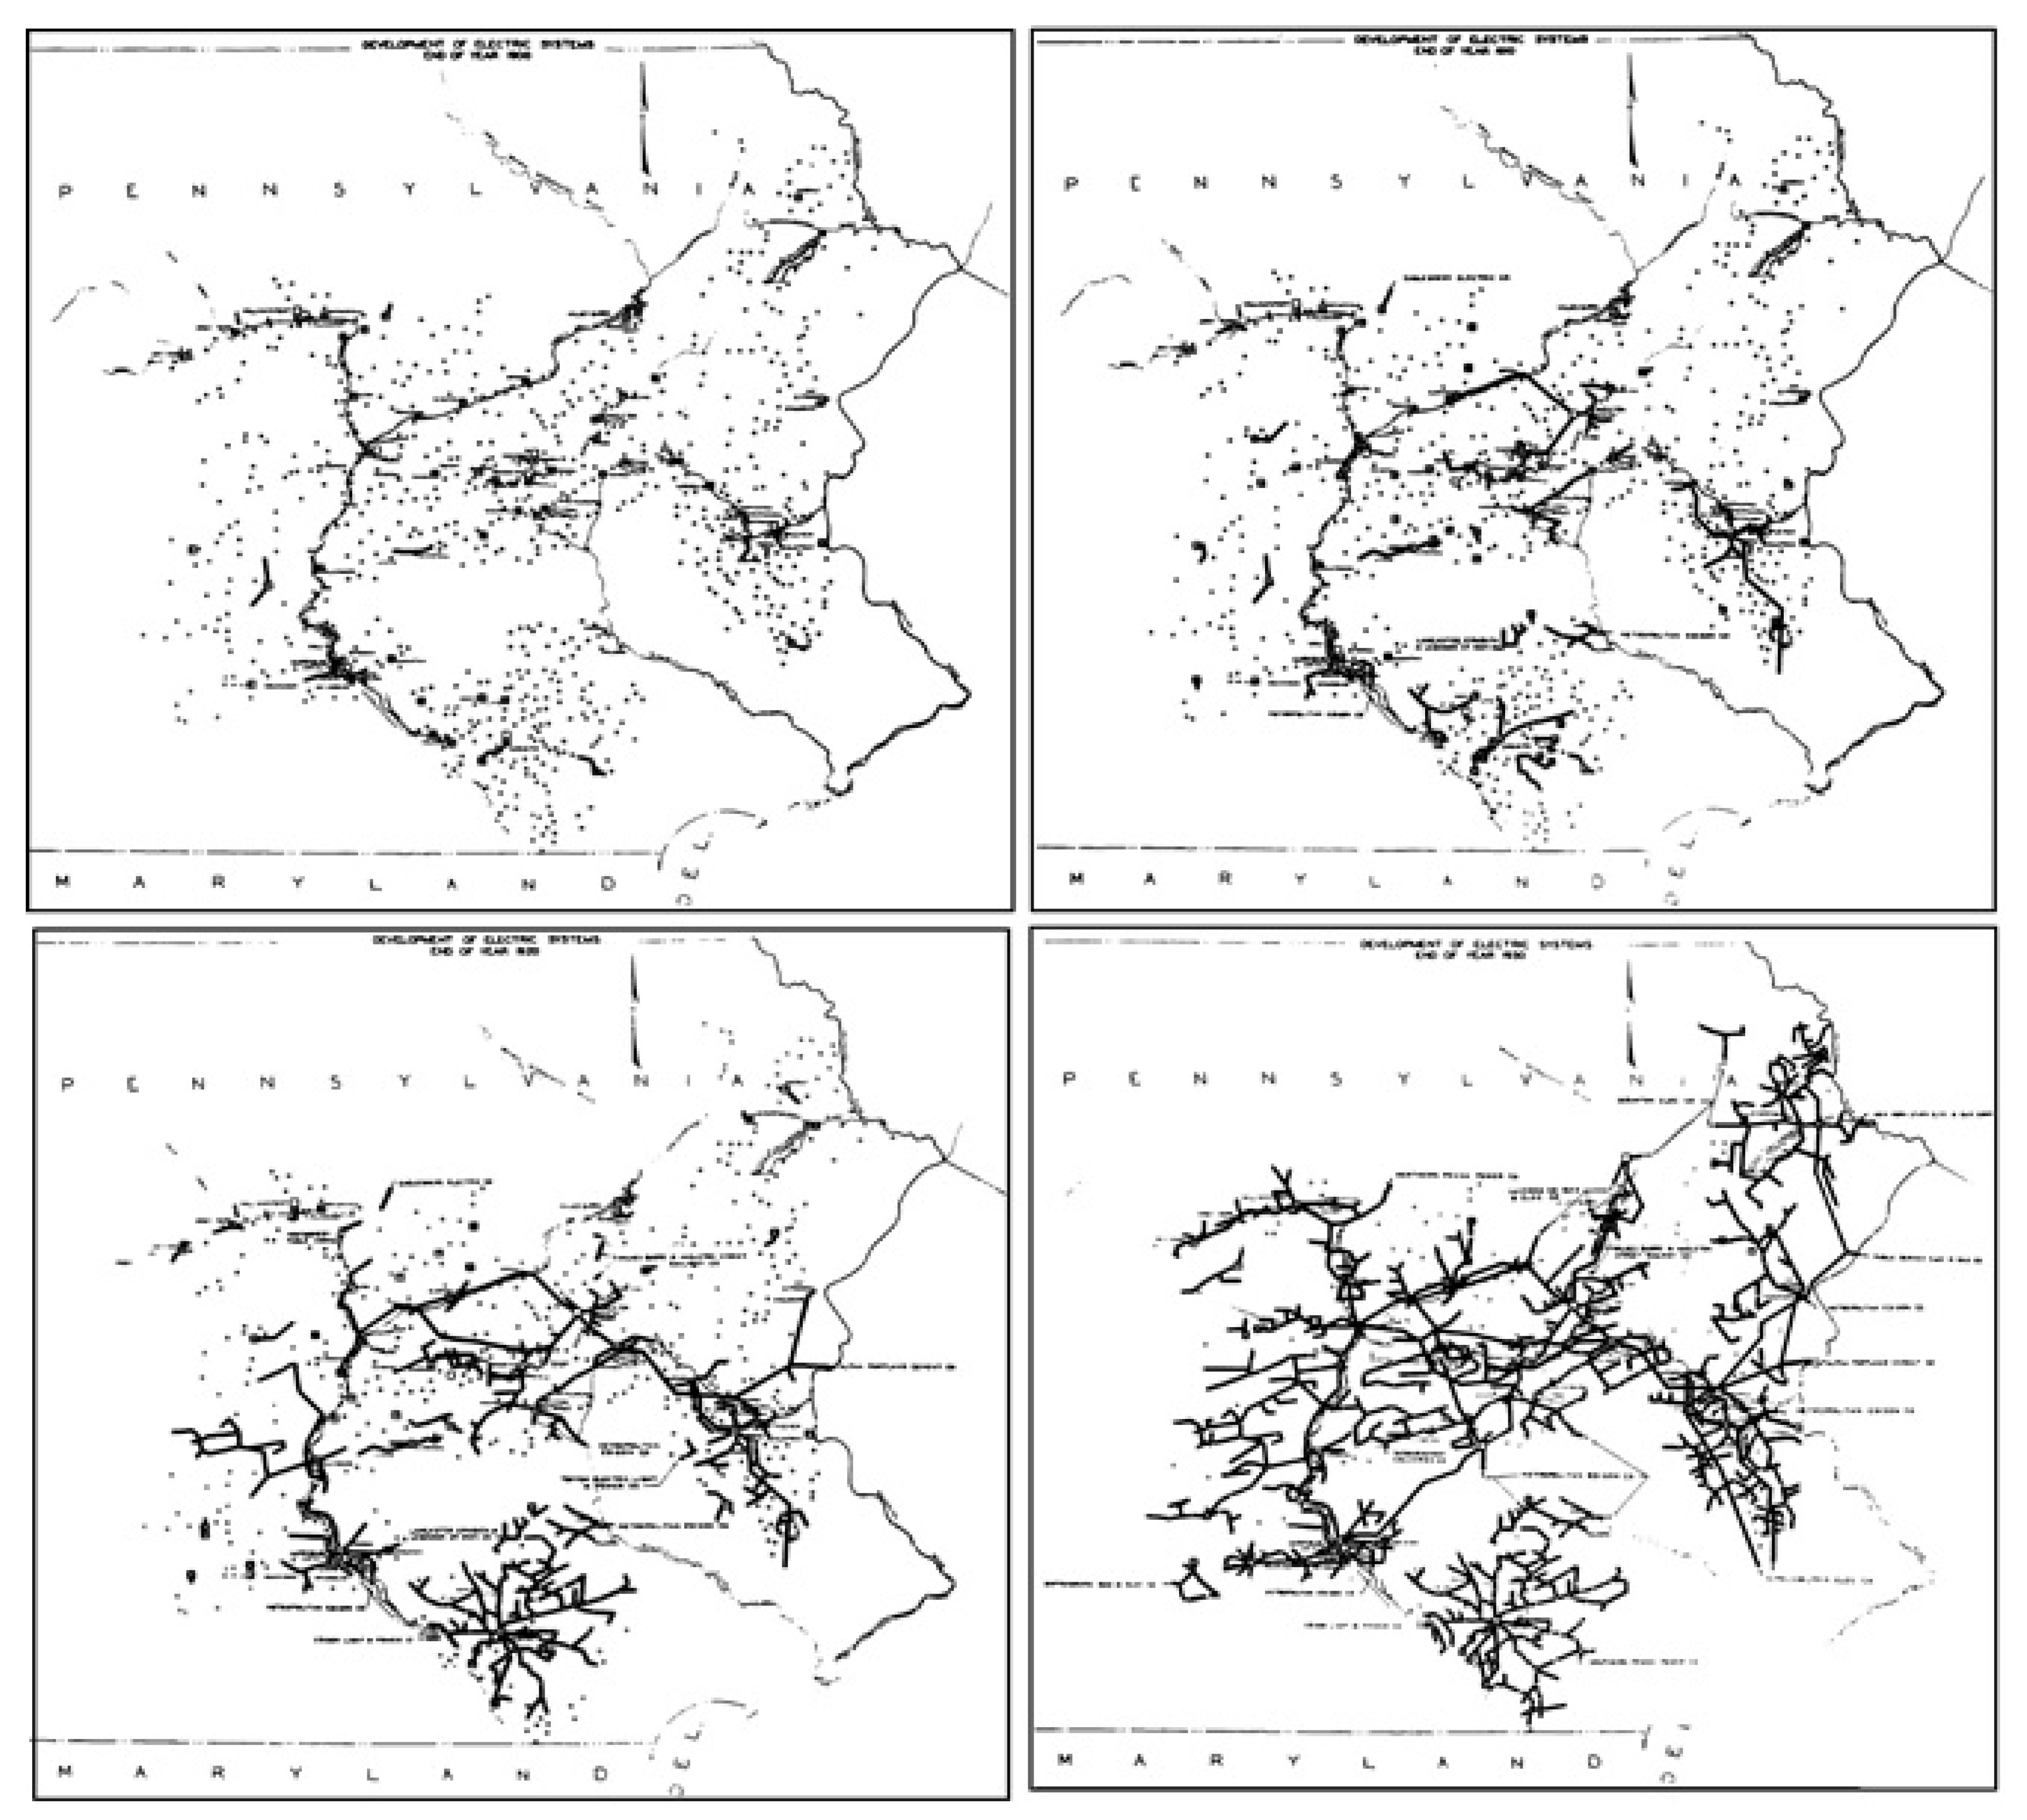
2.3 Historical context of mini-grids
The “last mile”
Development of electric power system in Pennsylvania between 1900 and 1930
Picture source: Korkovelos et al., 2020, Image, licensed under CC-BY 4.0
Korkovelos, 2020
Notes:
The last phase (social scale-up) occurs when both central grid and/or decentralized technologies are deployed, usually following a state electrification plan, and the population in the “last mile” receives energy access. Here we see common challenges which is related to Sustainable Development Goal 7. How to achieve universal electricity access – especially in regards to unserved remote, rural communities – and at what cost? In addition there are questions regarding how to ensure reliable and environmentally secure supply?
Historically these four phases generally occurred in sequence as seen in the picture, with bigger systems overtaking smaller ones as electrification progressed. This would eventually lead to the development of today's modern – and predominantly centralized – electricity networks in many countries. This is not the process today as centralized grid networks are available – at various levels of capacity and reliability – in most countries today. This means that today, un-electrified populations can bypass the need for small, pilot off-grid systems, and get directly connected to the central grid.

Slide 18
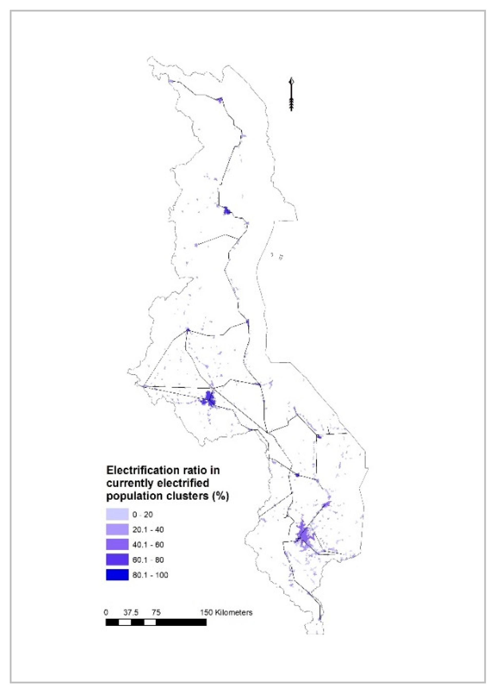
2.3 Historical context of mini-grids
Leapfrog to sustainable options?
Electrified population in Malawi 2018 at ~11%
Rural settlements are located far from the central grid.
Picture source: Korkovelos et al.,image 2019 licensed under CC-BY 4.0
Korkovelos, 2020, Korkovelos et al., 2019
Notes:
On the other hand, as history indicates, this leapfrog of connecting directly to the central grid is not an easy one, especially when it comes to more remote, poorer populations called the “last mile”. It highly depends on strong political determination backed with governmental funding. It is also time consuming in terms of planning and implementation. There are cases in which the cost of grid extension is so high that it is simply not a viable electrification option, even in countries that do have the financial, technological, and political resources to make this jump happen. Economically the cost was lower for distribution lines, and there was also a lower dependency on imported grid electricity. There was also a sense of ownership within the beneficiary community.
Today, both grid and off-grid technologies have matured from phase one to three and become both technically and financially more viable, which we will cover in later parts of the course. The possibility to connect multiple power plant technologies, have regional interconnections, and long distance transmission lines makes grid electricity flexible, reliable, and considerably cheap. On the other hand, mini-grids are available under various system configurations (AC or DC) and can be supplied by a variety of primary energy sources like oil, biomass, hydro, wind, solar, hydrogen, or hybrids. Also, Solar home systems and other mini, micro, or pico-generators can provide day-to-day electricity to households on demand. However, this range of technological options also increases the complexity in the electrification planning process. Questions like: Where, when, and at what costs might these technologies be deployed to address electricity access? Also who is going to pay and under what standards and/or conditions? How are these payments going to be made? These are questions commonly encountered by electrification planners today. With all this in mind, history can give us a few key lessons that might be useful for electrification policy today.

Slide 19
2.3 Historical context of mini-grids
What lessons can we learn from history?
Lesson 1 - Leverage available local resources
Lesson 2 - Economic profitability
Lesson 3 - Community involvement
Lesson 4 - Political determination and regulation
Korkovelos, 2020
Notes:
What lessons can we learn from history? First, early power systems were designed and built based on the local context including natural resources, available technologies, supply chains, and demand. That is, electrification technologies today should be designed around technologies that best tap into available local natural resources to ensure sustainable supply chains.
Second, the development of power systems was linked with profitability since the beginning. Whether publicly or privately owned, systems that were not economically sustainable eventually went out of operation. The initially small isolated systems were located in places with an evident and highly credible demand, for example industry, mines, or commercial stores. These could afford electricity services at a high price. Therefore, strong linkages between the provision of electricity and productivity are central in the development of sustainable electrification solutions.
Third, community involvement and creating a sense of ownership can improve power systems’ functionality in the long run; especially in rural settings. This is especially true for off-grid configurations which can require inclusive governance practices and/or an open dialogue regarding the design and operating parameters, such as construction, maintenance, expansion, and tariffs.
Finally, it is clear that, whatever the electrification approach is, the electricity access efforts seem to benefit when a strong, clear policy framework is set in place. This framework should be setting clear goals for electrification progress by creating a robust roadmap of electrification planning activities in the country/region. Roles in the electrification process should be clearly defined for the various stakeholders, such as planners, government, policy regulators, developers, investors, third party actors, e.g., NGOs, and the community.

Slide 20
Lecture 2.3 References
Korkovelos, A., 2020. Advancing the state of geospatial electrification modelling: New data, methods, applications, insight and electrification investment outlooks. http://kth.diva-portal.org/smash/get/diva2:1431484/FULLTEXT01.pdf
Korkovelos, A., Khavari, B., Sahlberg, A., Howells, M., Arderne, C., 2019. The Role of Open Access Data in Geospatial Electrification Planning and the Achievement of SDG7. An OnSSET-Based Case Study for Malawi. Energies 12, 1395. https://doi.org/10.3390/en12071395
Korkovelos, A., Zerriffi, H., Howells, M., Bazilian, M., Rogner, H.-H., Fuso Nerini, F., 2020. A Retrospective Analysis of Energy Access with a Focus on the Role of Mini-Grids. Sustainability 12, 1793. https://doi.org/10.3390/su12051793
Course Name

Slide 21
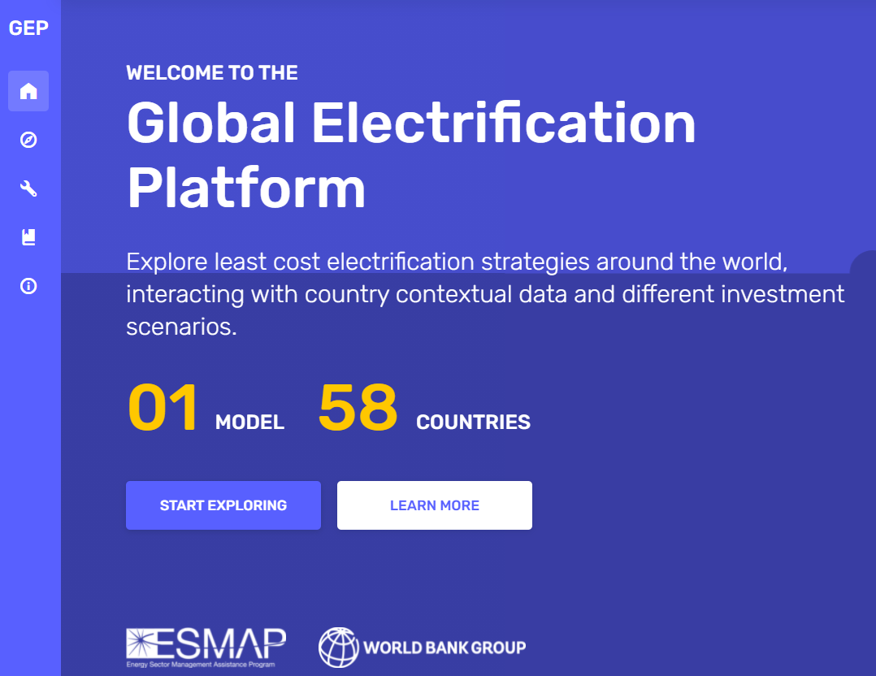
2.4 Global electrification platform (GEP)
Screenshot from: https://electrifynow.energydata.info
Notes:
In this mini-lecture we are going to look a little bit closer on the Global Electrification Platform (GEP) which was developed by the consortium of following institutions:
World Bank, ESMAP, KTH, Development Seed, World Resources Institute, ABB, GOOGLE, and the University of Cambridge.

Slide 22
2.4 Global electrification platform (GEP)
Levels and target audience
Level 1 - GEP Explorer: Up-to-date and openly accessible electrification investment outlooks
Level 2 - GEP Generator: Open-source UI for generating electrification outlooks on the fly
Level 3 - GEP Toolbox: Open access and fully-fledged documentation and training material
Notes:
The GEP platform was launched in 2019 and is an open portal for electrification investment data, analysis, and research. It is being designed upon the principles of openness and transparency and aspires to enable reusability, replicability, and reproducibility of embedded processes and data. Based on these principles, GEP output is available in three levels:
Level 1 - GEP Explorer: Up-to-date and openly accessible electrification investment outlooks
Level 2 - GEP Generator: Open source User Interface (UI) for generating electrification outlooks on the fly
Level 3 - GEP Toolbox: Open access documentation and training material
There are four main target audiences for the GEP:
High-level decision makers that will use output from the GEP Explorer that produces geo-infographic investment options for all target countries.
Policy and investment analysts that will use the GEP Scenario Generator to develop tailored scenarios to meet specific policy or investment goals.
Data producers and ICT developers that will use the GEP Toolbox and have a target into which additional information and methods can be utilized (with global impact).
Global development organizations that will have a platform for country outreach. The software provides a springboard for tailored analysis and engagement from academia to project developers.

Slide 23
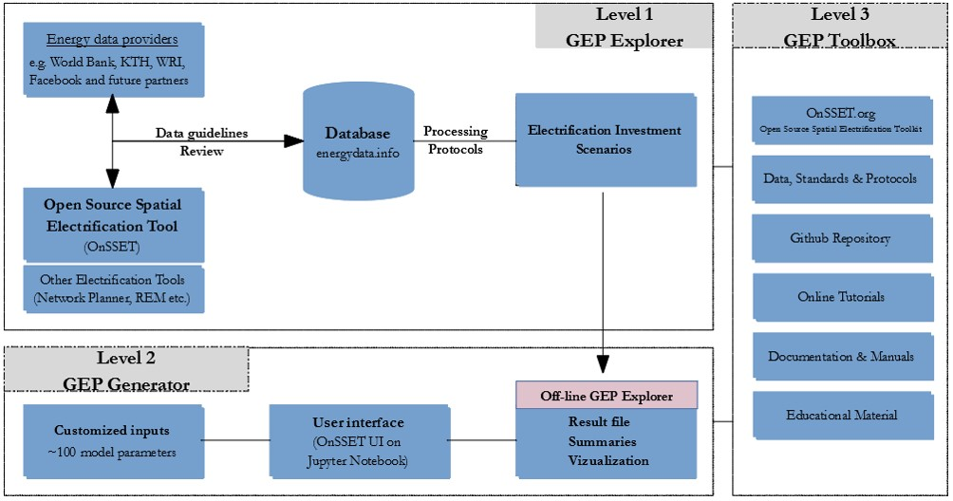
2.4 Global electrification platform (GEP)
The overall architecture of GEP
Picture Source: https://gep-user-guide.readthedocs.io/en/latest/Overview.html
Notes:
The architecture of the GEP is divided into the three levels previously described.
Level 1: Starts with the input of energy data providers such as World Bank, WRI, or KTH and is then combined into an energy model in OnSSET and run in several hundred scenarios. These are uploaded to a database and website where you can explore different investment scenarios in the GEP Explorer.
Level 2: is formulated for the analyst that wants to develop their own scenarios. The analyst collects the, approximately, 100 datasets needed to build the model. Then they run the model in the GEP Generator and explores the results on the local computer.
Level 3: is the GEP Toolbox where all teaching material, documentation, and source data are published.

Slide 24
2.4 Global electrification platform (GEP)
Global electrification platform - Explorer
GEP is an open access, interactive, online platform that allows for overview of electrification investment scenarios for 58 countries
The platform currently provides 96 electrification scenarios per country based on a version of the OnSSET model, exploring variations in population growth, demand level, technology costs, and other decision parameters.
The input data files, cost parameters, OnSSET model etc., is available for download for anyone to run their own, customized, scenarios.
The platform is available at https://electrifynow.energydata.info/
Screenshot from: https://electrifynow.energydata.info
Notes:
GEP Explorer is an open access website where you can browse through different electrification scenarios. On the website there are up to 96 scenarios, per country for 58 countries. The results on the platform have been generated using the OnSSET model. These scenarios explore the least-cost electrification options for different demand targets, technology costs, and other important aspects.
From GEP you can also download the input data that you have used and you can run your own model on your computer using the OnSSET code, which is available on GitHub.
For your first hands-on you will use the GEP Explorer to explore the results.

Slide 25
2.4 Global electrification platform (GEP)
Key messages
Open-source tool and datasets based on the principles of openness and transparency and aspires to enable reusability, replicability, and reproducibility
Platform is divided into three levels:
Level 1 - GEP Explorer
Level 2 - GEP Generator
Level 3 - GEP Toolbox
Four main target audience for the GEP:
High-level decision makers
Policy and investment analysts
Data producers and ICT developers
Global development organizations
Notes:
The key messages for the Global Electrification Platform that is an open source tool, with datasets based on the principles of openness and transparency. It aspires to enable reusability, replicability, and reproducibility
Secondly the platform is divided into three levels: GEP Explorer, GEP Generator, and GEP Toolbox.
Finally the target audience for the GEP is: High-level decision makers, policy and investment analysts, data producers and ICT developers, and global development organizations.

Slide 26
Lecture 2.4 References
Global Electrification Platform Explorer [WWW Document], n.d. . Global Electrification Platform Explorer. URL https://electrifynow.energydata.info (accessed 2.14.21).
Welcome to The GEP User’s Guide! — The GEP User Guide 09-06-2019 documentation [WWW Document], n.d. URL https://gep-user-guide.readthedocs.io/en/latest/ (accessed 2.14.21).

Slide 27
Thank you for your attention in this lecture!
22

Slide 28
Take Quiz
Moksnes N., Sahlberg A., Khavari B. 2021. Lecture 1: OnSSET/Global Electrification Platform. Release Version 1.0. [online presentation]. Climate Compatible Growth Programme, Energy Sector Management Assistance Program and World Bank Group
CCG courses (this will take you to the website link http://www.ClimateCompatibleGrowth.com/teachingmaterials)

