Slide 1
Assessment for distance learning (ADL) 2: Guidance and feedback
May 2019 Residential School
The Transformation by Innovation in Distance Education (TIDE) project is enhancing distance learning in Myanmar by building the capacity of Higher Education staff and students, enhancing programmes of study, and strengthening systems that support Higher Educational Institutions in Myanmar. TIDE is part of the UK-Aid-funded Strategic Partnerships for Higher Education Innovation and Reform (SPHEIR) programme(www.spheir.org.uk). SPHEIR is managed on behalf of FCDO by a consortium led by the British Council that includes PwC and Universities UK International. The TIDE project will close in May 2021.

Slide 2
Assessment for distance learning (ADL)
Session 2: Guidance and feedback
The Open University

Slide 3
Sessions 1 and 2
What is assessment, why it is important and how to evaluate an assessment✓
The role of guidance and feedback

Slide 4
Learning outcomes
After completing this session you should be able to:
Explain the role of feedback in assessment
Evaluate an assessment

Slide 5
Recap and reminder from yesterday Assessment
Why do we assess students? ✓
How do we assess students? ✓
What assessment will be the most effective? ...
Why do we give feedback?

Slide 6
The role of guidance
Guidance is information provided with the assessment to help and support the student to complete the assessment.
Types of guidance:
explanations
instructions
pointers to relevant teaching
word counts
number of marks

Slide 7
Activity: Review the question guidance
In pairs, look at the example guidance for the water report assessment question
Find one of each of the following types of guidance:
explanations
instructions
pointers to relevant teaching
word counts
number of marks
Share what you found in a discussion with the whole group

Slide 8
2. Why do we give feedback?
What is feedback? It is information students get about how they are doing in their efforts to learn. Feedback is critical in helping students learn and to monitor and think about their own learning
Feedback helps students learn by showing them:
what is well done
what is incorrect
how to improve
Feedback should encourage students to do better

Slide 9
Different types of feedback
Tutor marking and feedback
Other opportunities for feedback in distance learning
In-text questions and activities
Self assessment questions
Online questions, with responses and hints

Slide 10
The Open University assessment system
Students get feedback through Tutor Marked Assignments
Students submit assignments to a tutor.
Tutors write feedback on these assignments, give a mark (grade) and return to students.
Requires a postal or electronic submission system and tutors

Slide 11
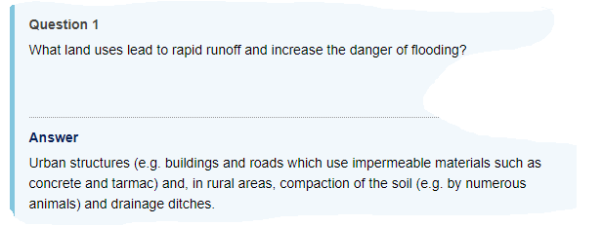
Feedback: Some Open University examples

Slide 12
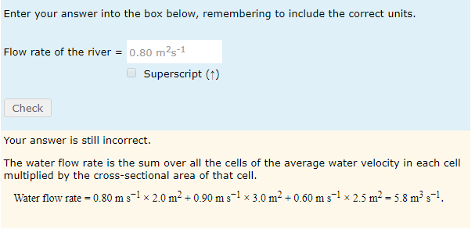
Feedback: Some Open University examples
Calculate the flow rate of the river using the data in the table

Slide 13
Activity: Evaluating tutor feedback
In pairs, evaluate the tutor feedback on the example answer using these prompts:
Does the tutor show what is well done?
Does the tutor show what is incorrect?
Is the student told how to improve?
Is the feedback encouraging to the student?
What is helpful and why?
What could be improved and how?
Share what you found in a discussion with the whole group

Slide 14
Summary
Guidance helps and supports the student to complete the assessment
Feedback is crucial for helping students learn, monitor and think about their own learning by showing
what is incorrect,
what is well done and
how to improve
Feedback can be
through marks and comments from a tutor on student work
through text-based answers in course materials
provided online

Slide 15
Questions? Thank you!

