Slide 1
Endangered species conservation
Nick Harvey
The Transformation by Innovation in Distance Education (TIDE) project is enhancing distance learning in Myanmar by building the capacity of Higher Education staff and students, enhancing programmes of study, and strengthening systems that support Higher Educational Institutions in Myanmar. TIDE is part of the UK-Aid-funded Strategic Partnerships for Higher Education Innovation and Reform (SPHEIR) programme(www.spheir.org.uk). SPHEIR is managed on behalf of FCDO by a consortium led by the British Council that includes PwC and Universities UK International. The TIDE project will close in May 2021.

Slide 2
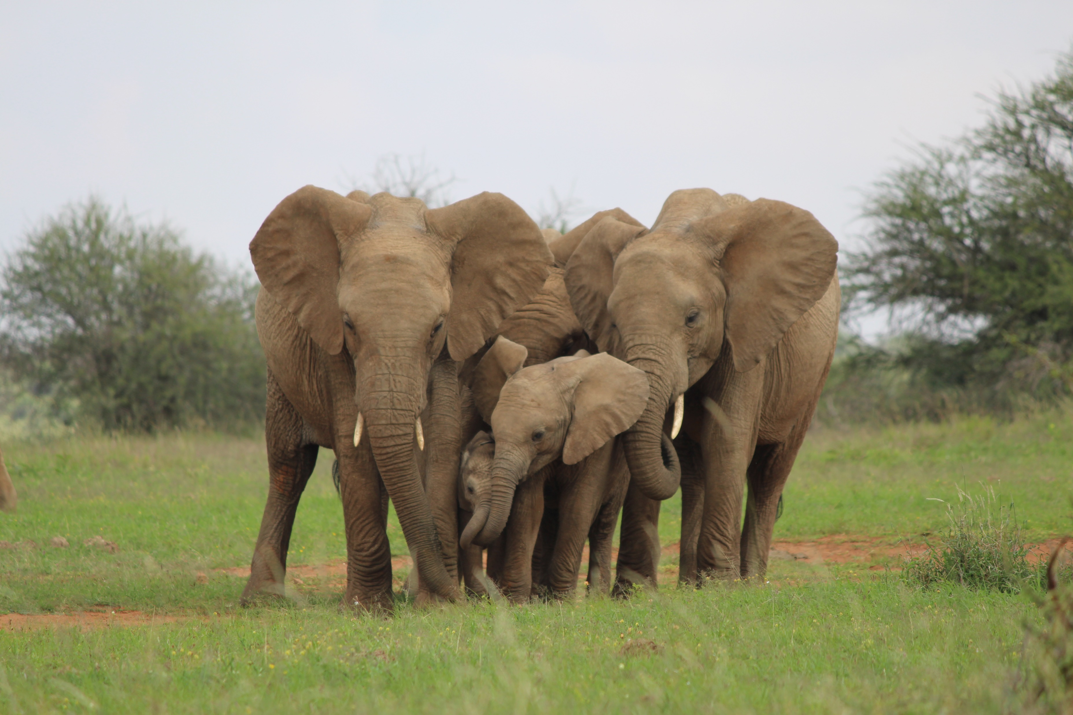
Endangered species conservation
Monitoring and studying endangered species
Notes:
Photo: author

Slide 3
What is species conservation?
Conservation that attempts to prevent the extinction of or increases the population size of a particular species
This is done all the time, usually for large charismatic species which are often birds and mammals:
Giant pandas - China
Elephants – Sub-Saharan Africa
Red kites - UK

Slide 4
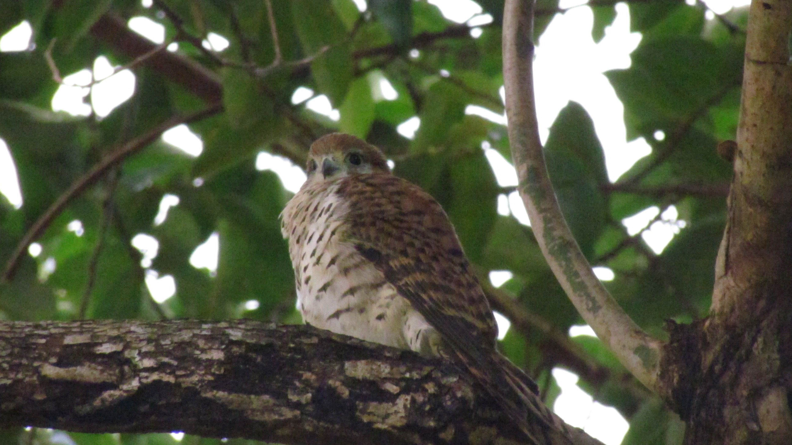
Mauritian birds
Species can be brought back from the brink of extinction
Mauritius Kestrel
4 birds in 1974
350-500 in 2013
Intensive interventions
Guarding nests from invasive predators
Removing eggs to induce double-clutching
Hatch eggs in captivity or give them to pairs with no eggs
Supplementary feeding
Notes:
Picture: Josh Noseworthy https://commons.wikimedia.org/wiki/File:Mauritius_Kestrel.jpg
Jones, C.G. and Merton, D.V., 2012. A tale of two islands: the rescue and recovery of endemic birds in New Zealand and Mauritius. Reintroduction biology: integrating science and management, 9.

Slide 5
Why do species conservation?
It has been decided a particular species is valuable - charisma
Flagship species
Umbrella species

Slide 6
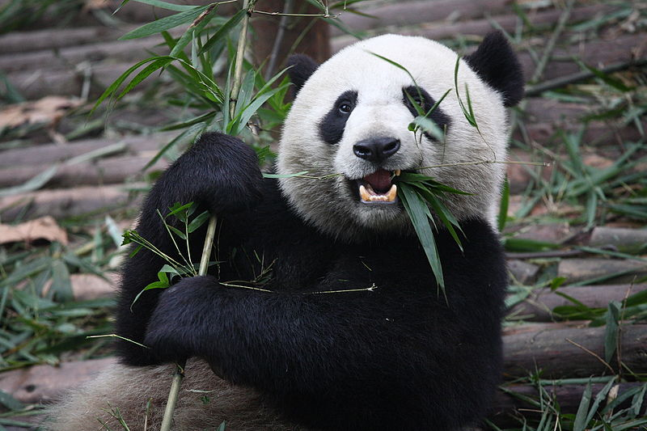
Flagship species
Generally a charismatic species that is used to raise money to protect other species
Notes:
Chen Wu from Shanghai, Chin https://commons.wikimedia.org/wiki/File:Giant_Panda_Eating.jpg

Slide 7
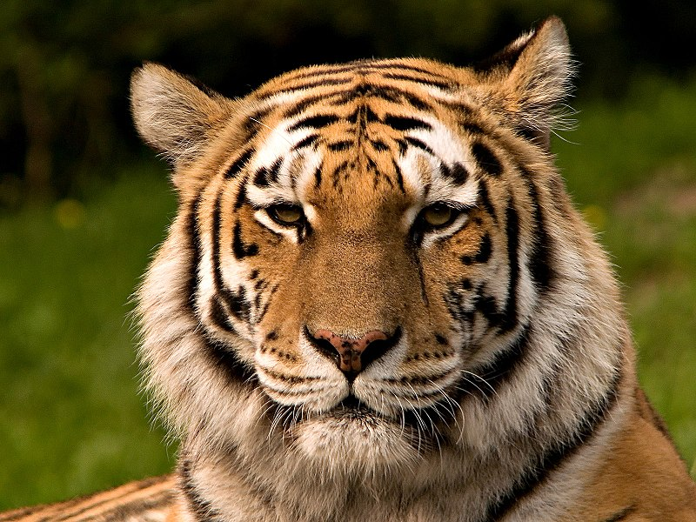
Umbrella species
Has a large range so when you protect that species’ habitat you protect a lot of other species at the same time
Notes:
Picture: S. Taheri, edited by Fir0002 https://commons.wikimedia.org/wiki/File:Siberischer_tiger_de_edit02.jpg

Slide 8
Small population paradigm

Slide 9
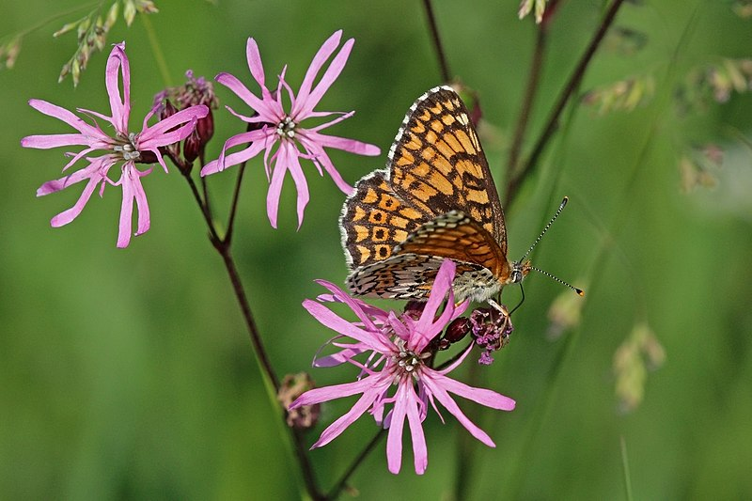
Problems of Small Populations
Genetic
Inbreeding
Loss of heterozygosity
Demographic
Stochasticity (randomness)
Sex ratio bias
Allee effects
Environmental
Fragmentation
Small range size
Sacherri et al 1998. Glanville fritillary
Notes:
Picture: Charles James Sharp https://commons.wikimedia.org/wiki/File:Glanville_fritillary_(Melitaea_cinxia).jpg
Saccheri, I., Kuussaari, M., Kankare, M., Vikman, P., Fortelius, W. and Hanski, I., 1998. Inbreeding and extinction in a butterfly metapopulation. Nature, 392(6675), pp.491-494.

Slide 10
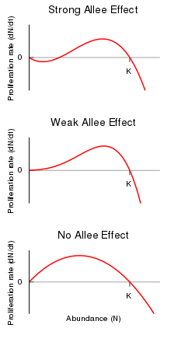
Populations can experience a greater threat of extinction just because they are small

Slide 11
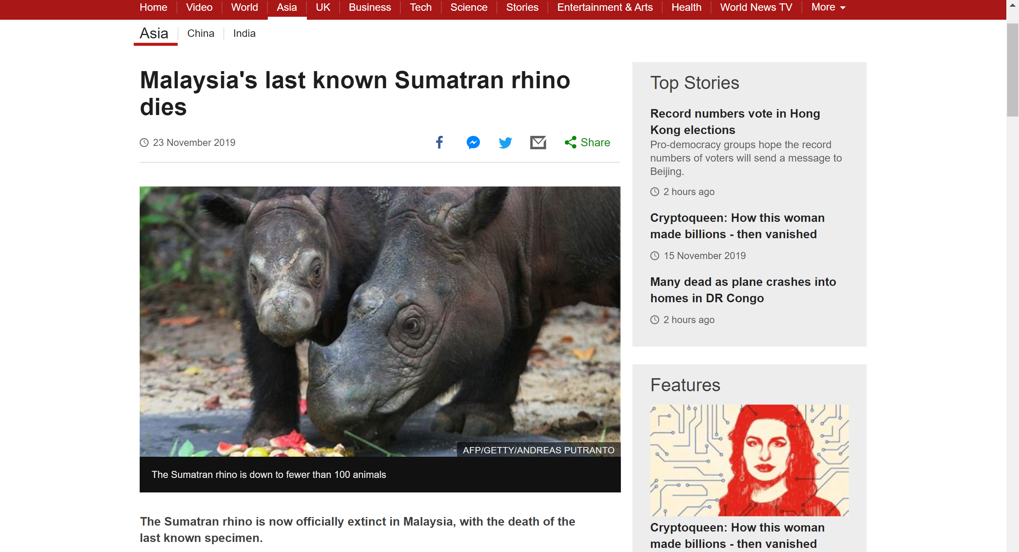

Slide 12
Sequence of events in protecting a species

Slide 13
Protecting a species
Estimate population size
Estimate extinction risk
Habitat requirements and range determinants
Conservation interventions
Notes:
http://www.greatgrevysrally.com/
Photo © Ami Vitale for The Nature Conservancy https://blog.nature.org/science/2015/11/30/good-news-elephants-community-reduce-poaching-35-percent/

Slide 14
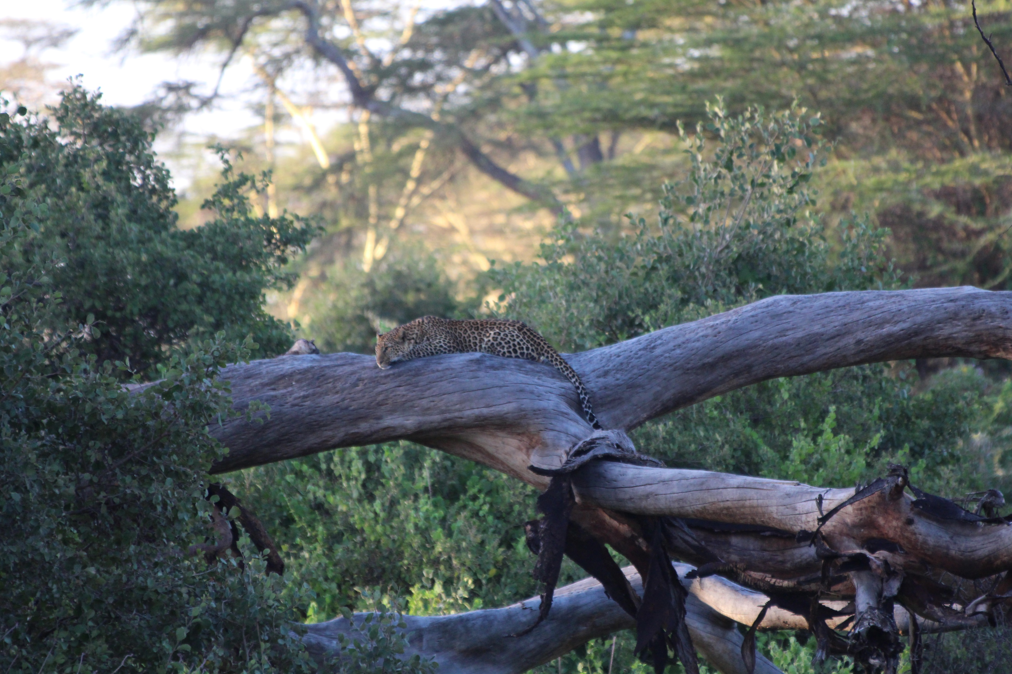
1. How to estimate population size of a shy species?
Almost always impossible to conduct a complete census of a population or a species
This is especially the case for species that are shy, camouflaged or otherwise hard to find

Slide 15
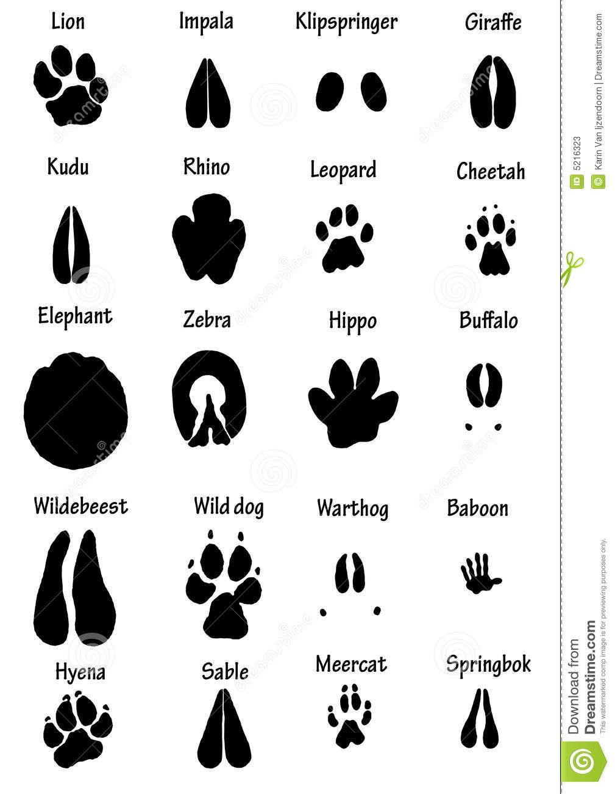
Tracking

Slide 16
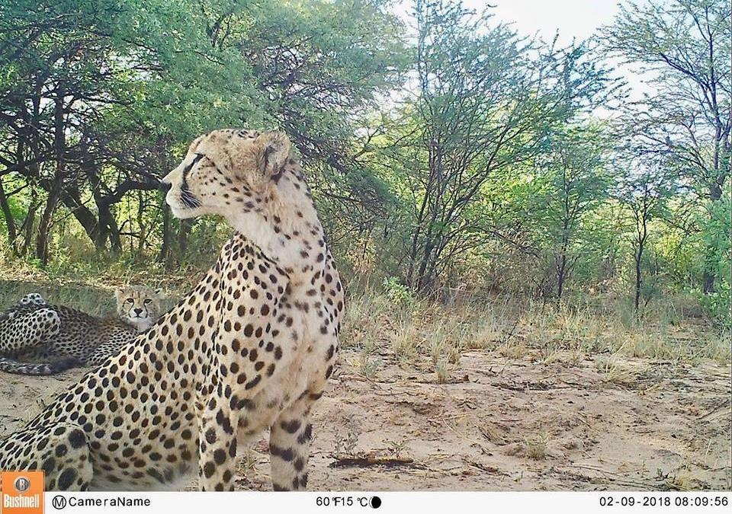
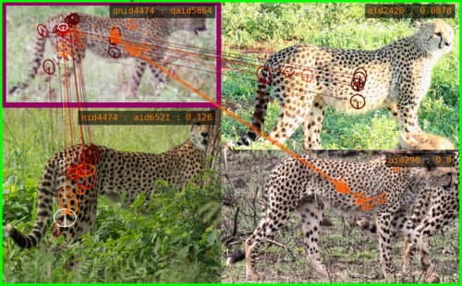
Camera traps and ID software

Slide 17
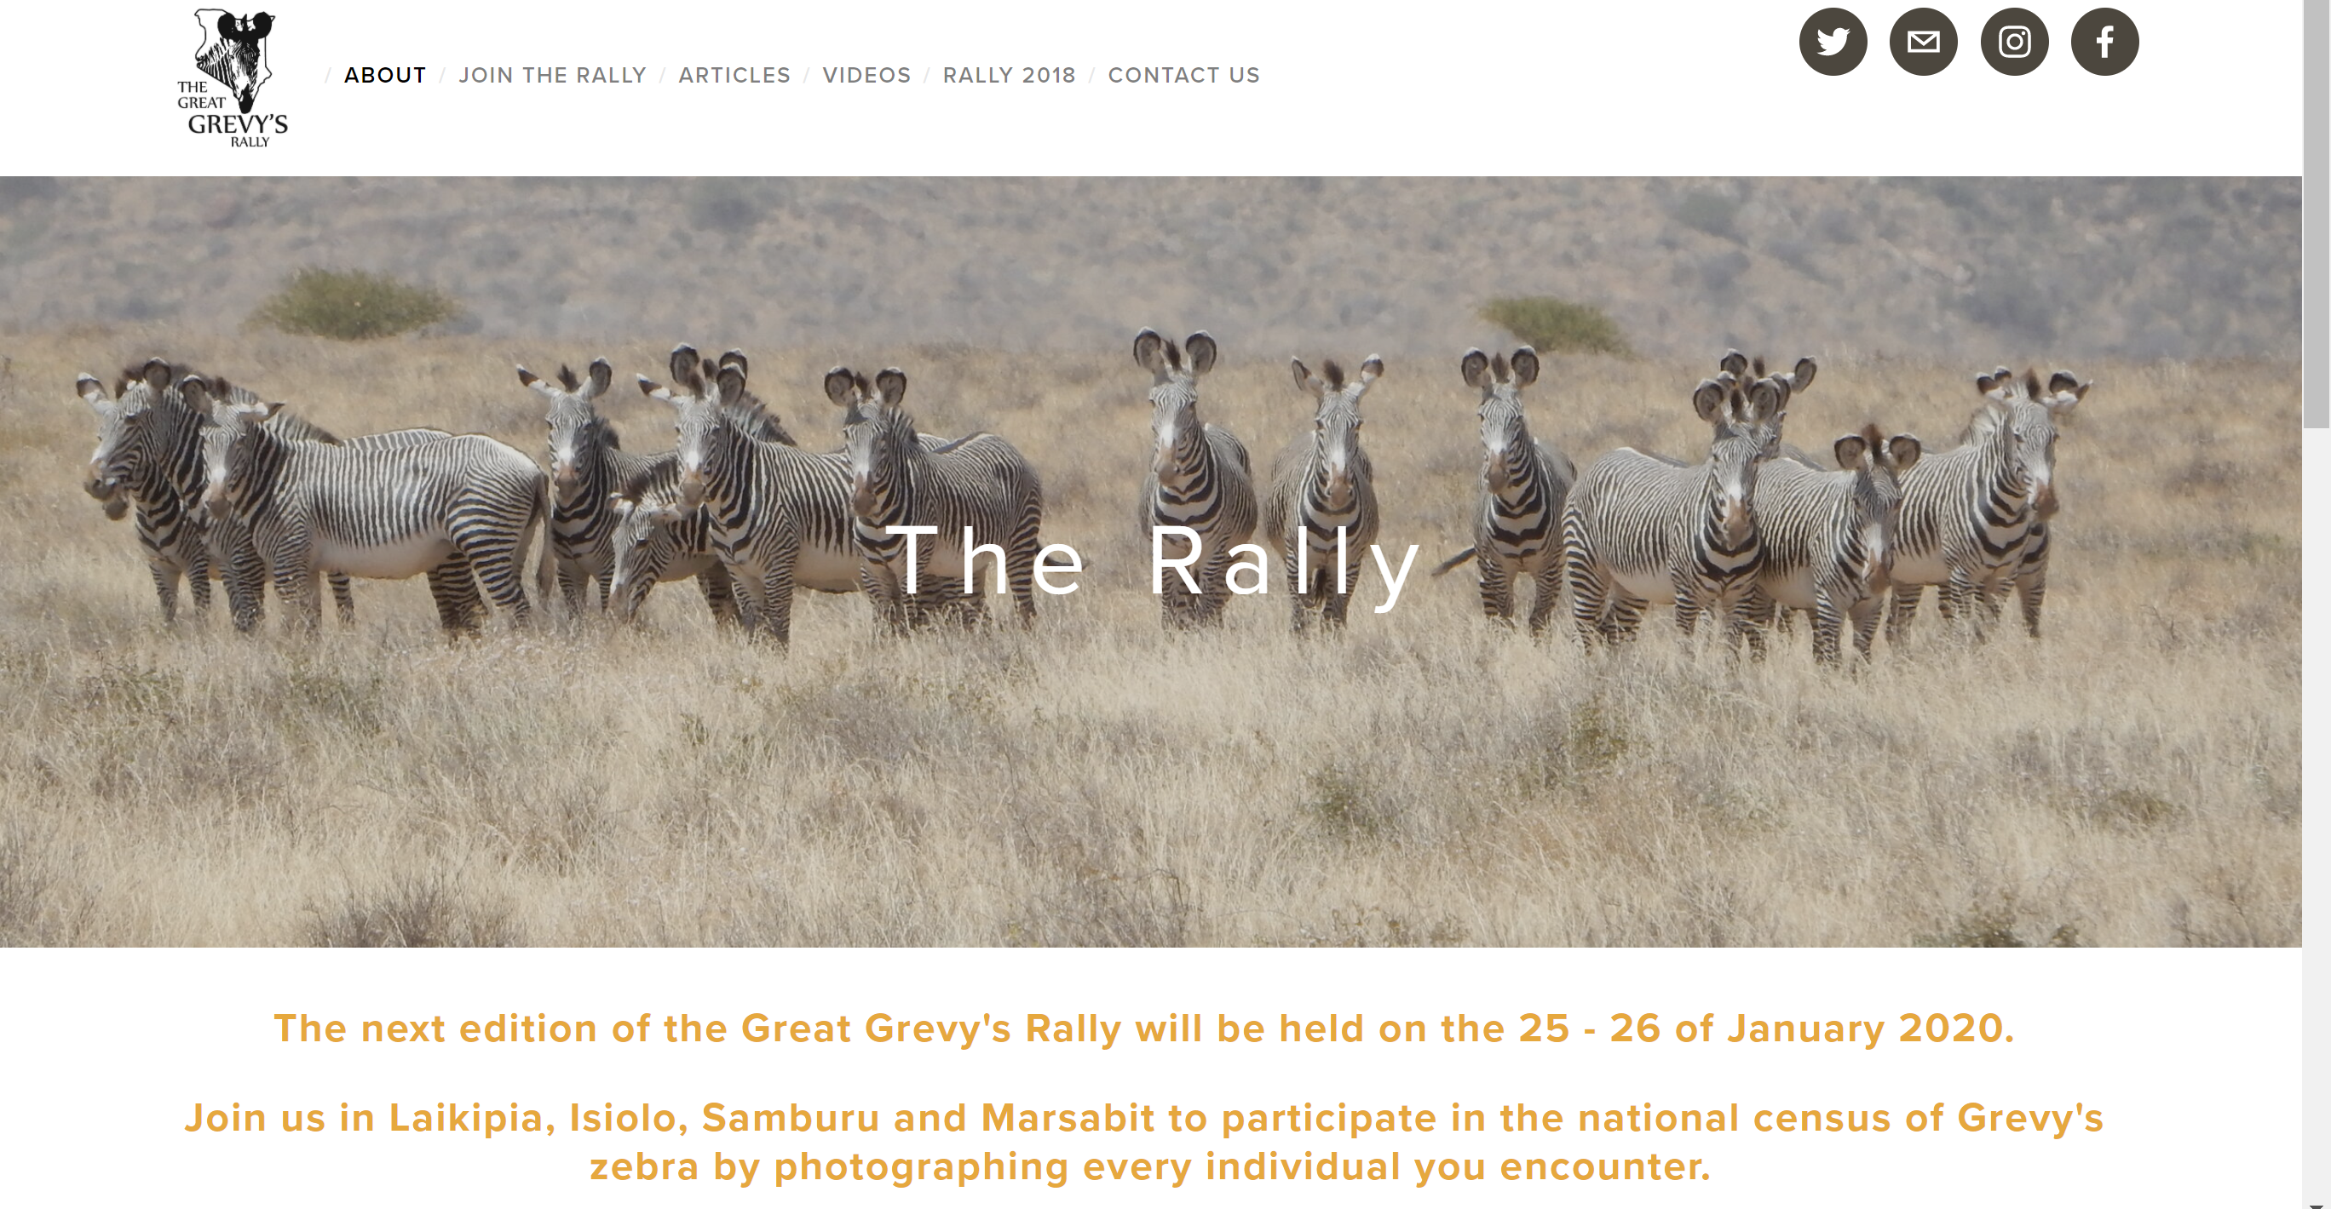
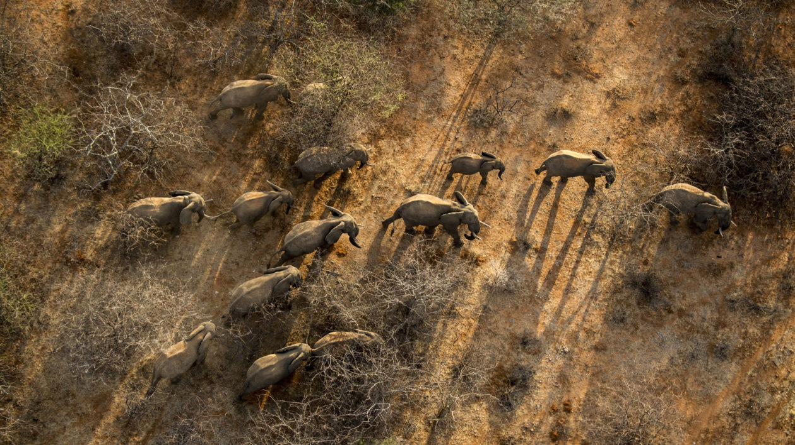
Sampling once or several times?
Single sample – count as many as you can
Observation bias- what proportion of population do you actually record?
Observations in disturbed habitats different from undisturbed
Notes:
http://www.greatgrevysrally.com/
Photo © Ami Vitale for The Nature Conservancy https://blog.nature.org/science/2015/11/30/good-news-elephants-community-reduce-poaching-35-percent/

Slide 18
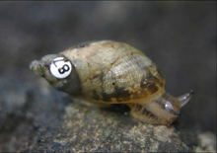
Capture – mark – recapture
Several sampling sessions
Record each time an individual is caught to determine proportion of new individuals at each time point

Slide 19
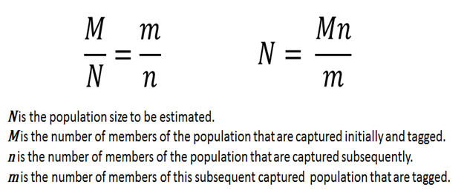

Slide 20
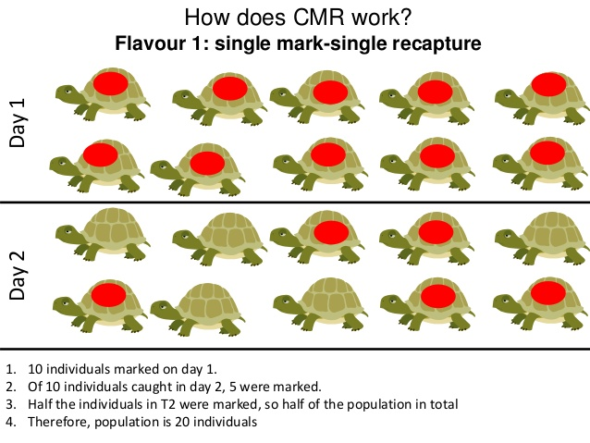

Slide 21
M = 10 (individuals caught on day 1)
n = 10 (individuals caught on day 2)
m = 5 (tagged individuals caught day 2)
N = (10 x 10) / 5
N = 20

Slide 22
2. Estimate extinction risk

Slide 23
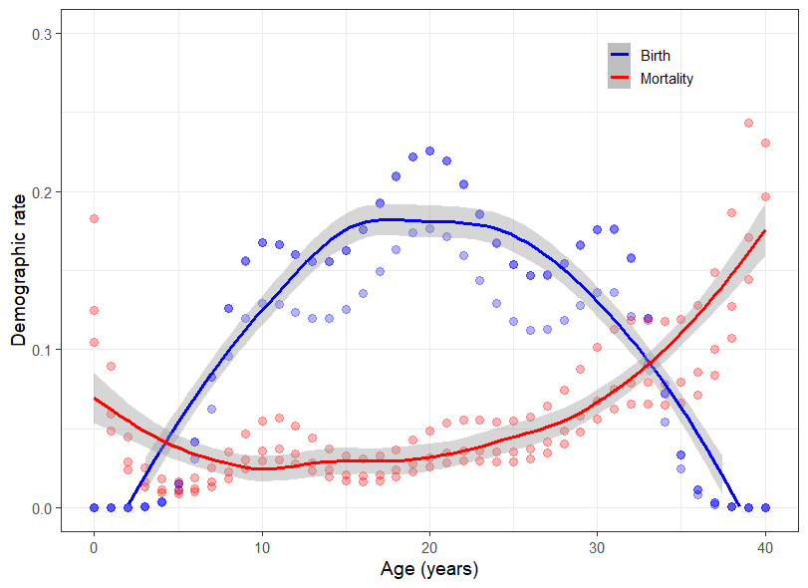
Vital rates

Slide 24
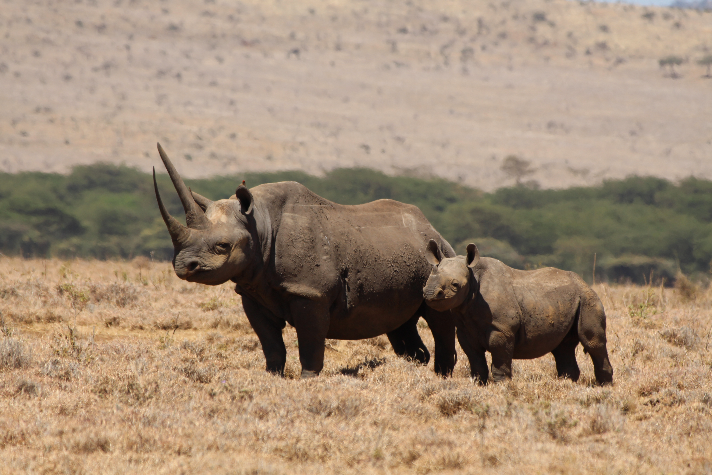
Population growth
r = (births + immigration) – (deaths + emigration)
Expressed as a %.
Population of 100
10 births and 5 deaths
r = 5
Change: 5/100 or 0.05 or 5% growth
Notes:
Photo: author

Slide 25
Population viability analysis
Models to evaluate risk or probability of extinction for a population
But provides evidence for management and surprisingly robust (Brook et al 2000)
Can be used to evaluate different management scenarios
Critiques
Data dependent- need numbers!
Overly Pessimistic – often predicts decline

Slide 26
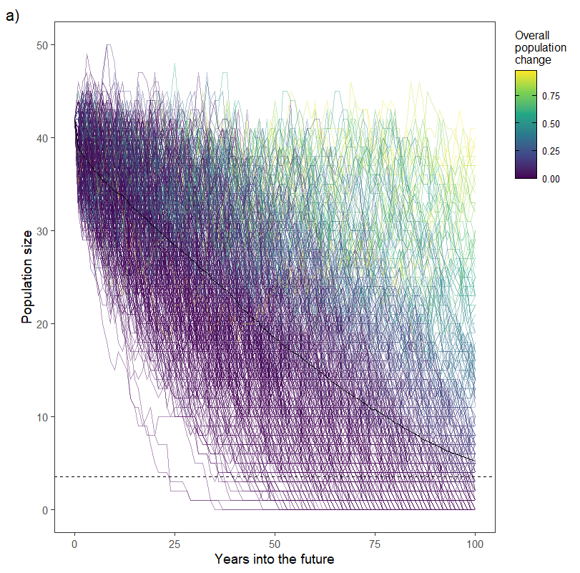
Population viability analysis

Slide 27
Uses
Predict the extinction risk of a particular population over a timeframe based on their vital rates and stochasticity
Model what changes in vital rates and management practices would have on the population and its chances of its extinction

Slide 28
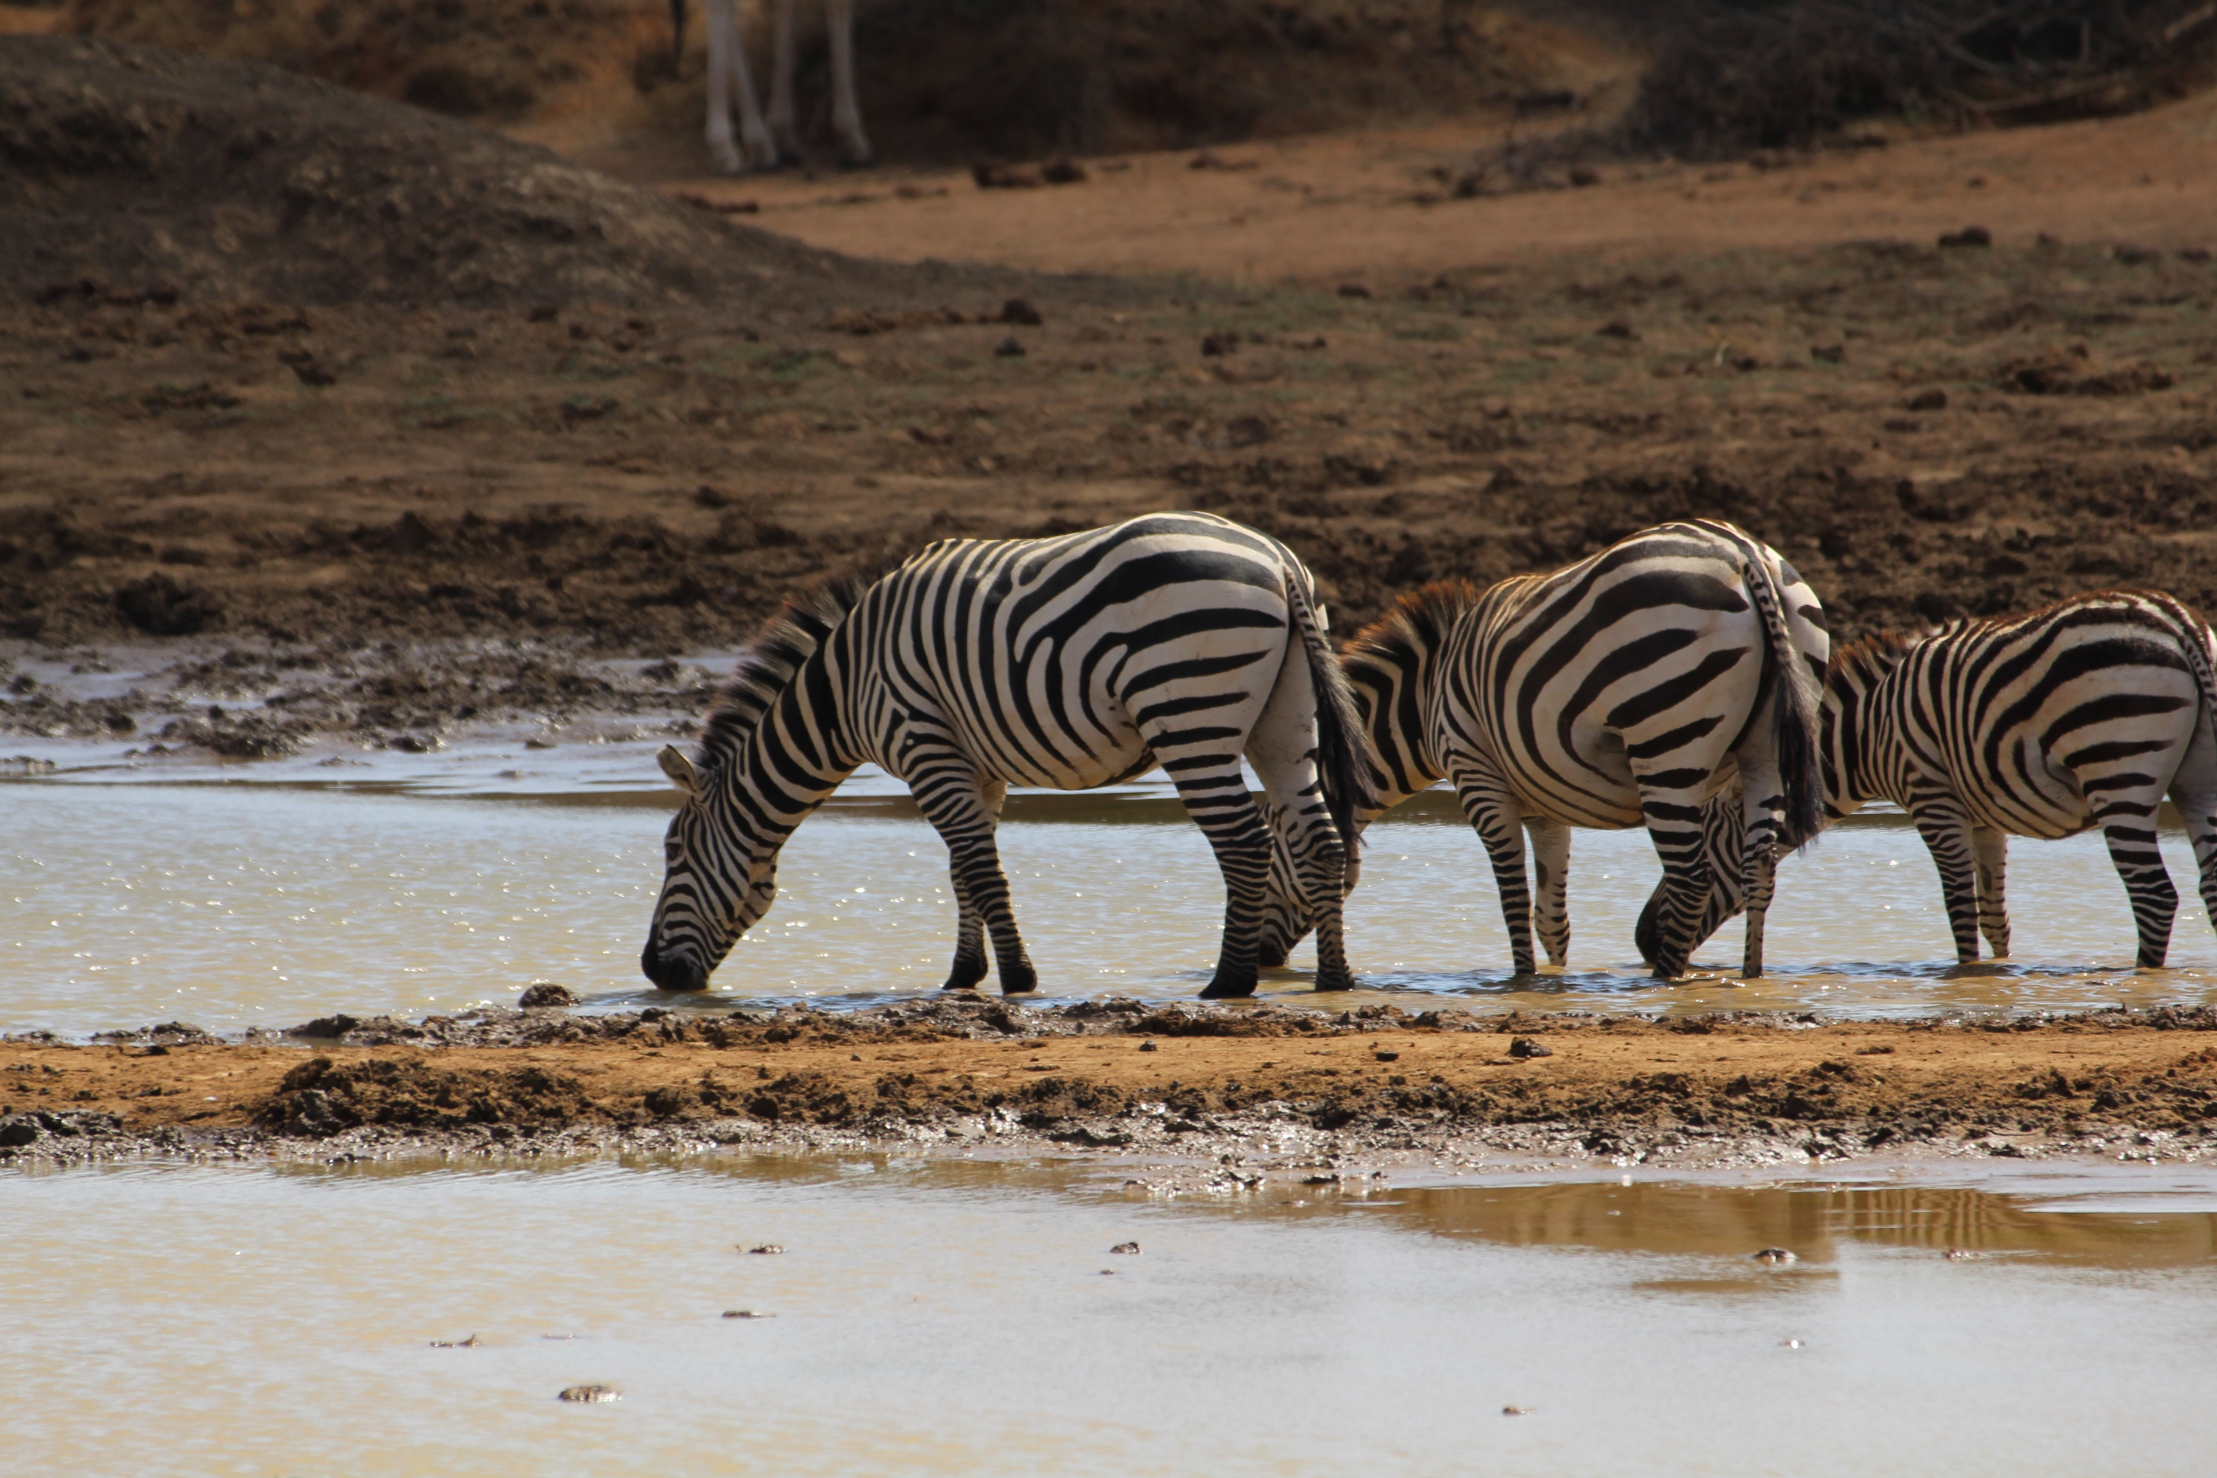
3 Habitat requirements and range determinants
Diet
Water
Climate
Other species
Notes:
Photo: author

Slide 29
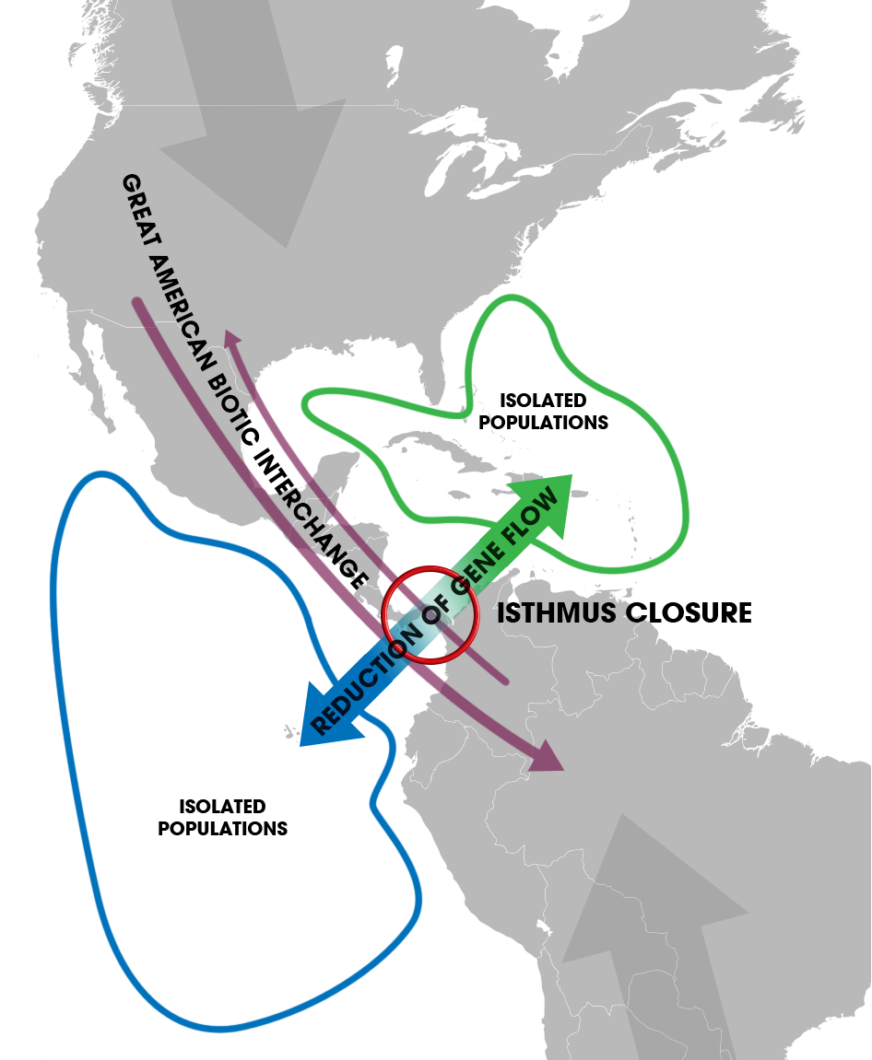
Abiotic barriers
Barriers to dispersal
Mountains, rivers, deserts, seas
Land for marine species

Slide 30
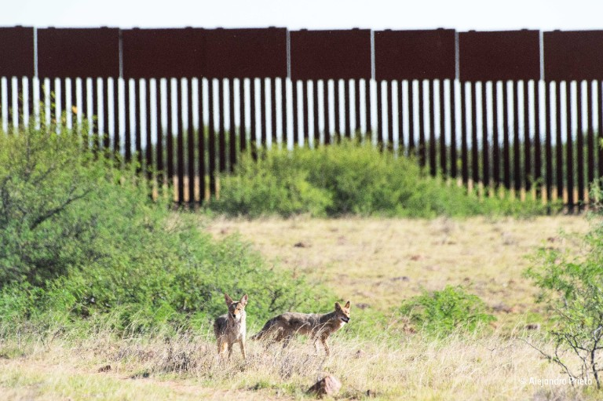
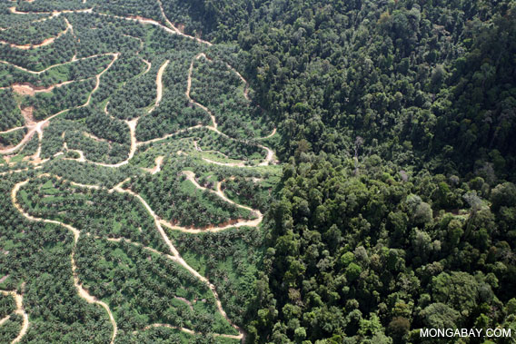
Human activity
Habitat destruction and fragmentation
Blocking of migration routes
Notes:
Image credit: Alejandro Prieto https://www.nhm.ac.uk/discover/wildlife-photographer-of-the-year-the-border-wall.html

Slide 31
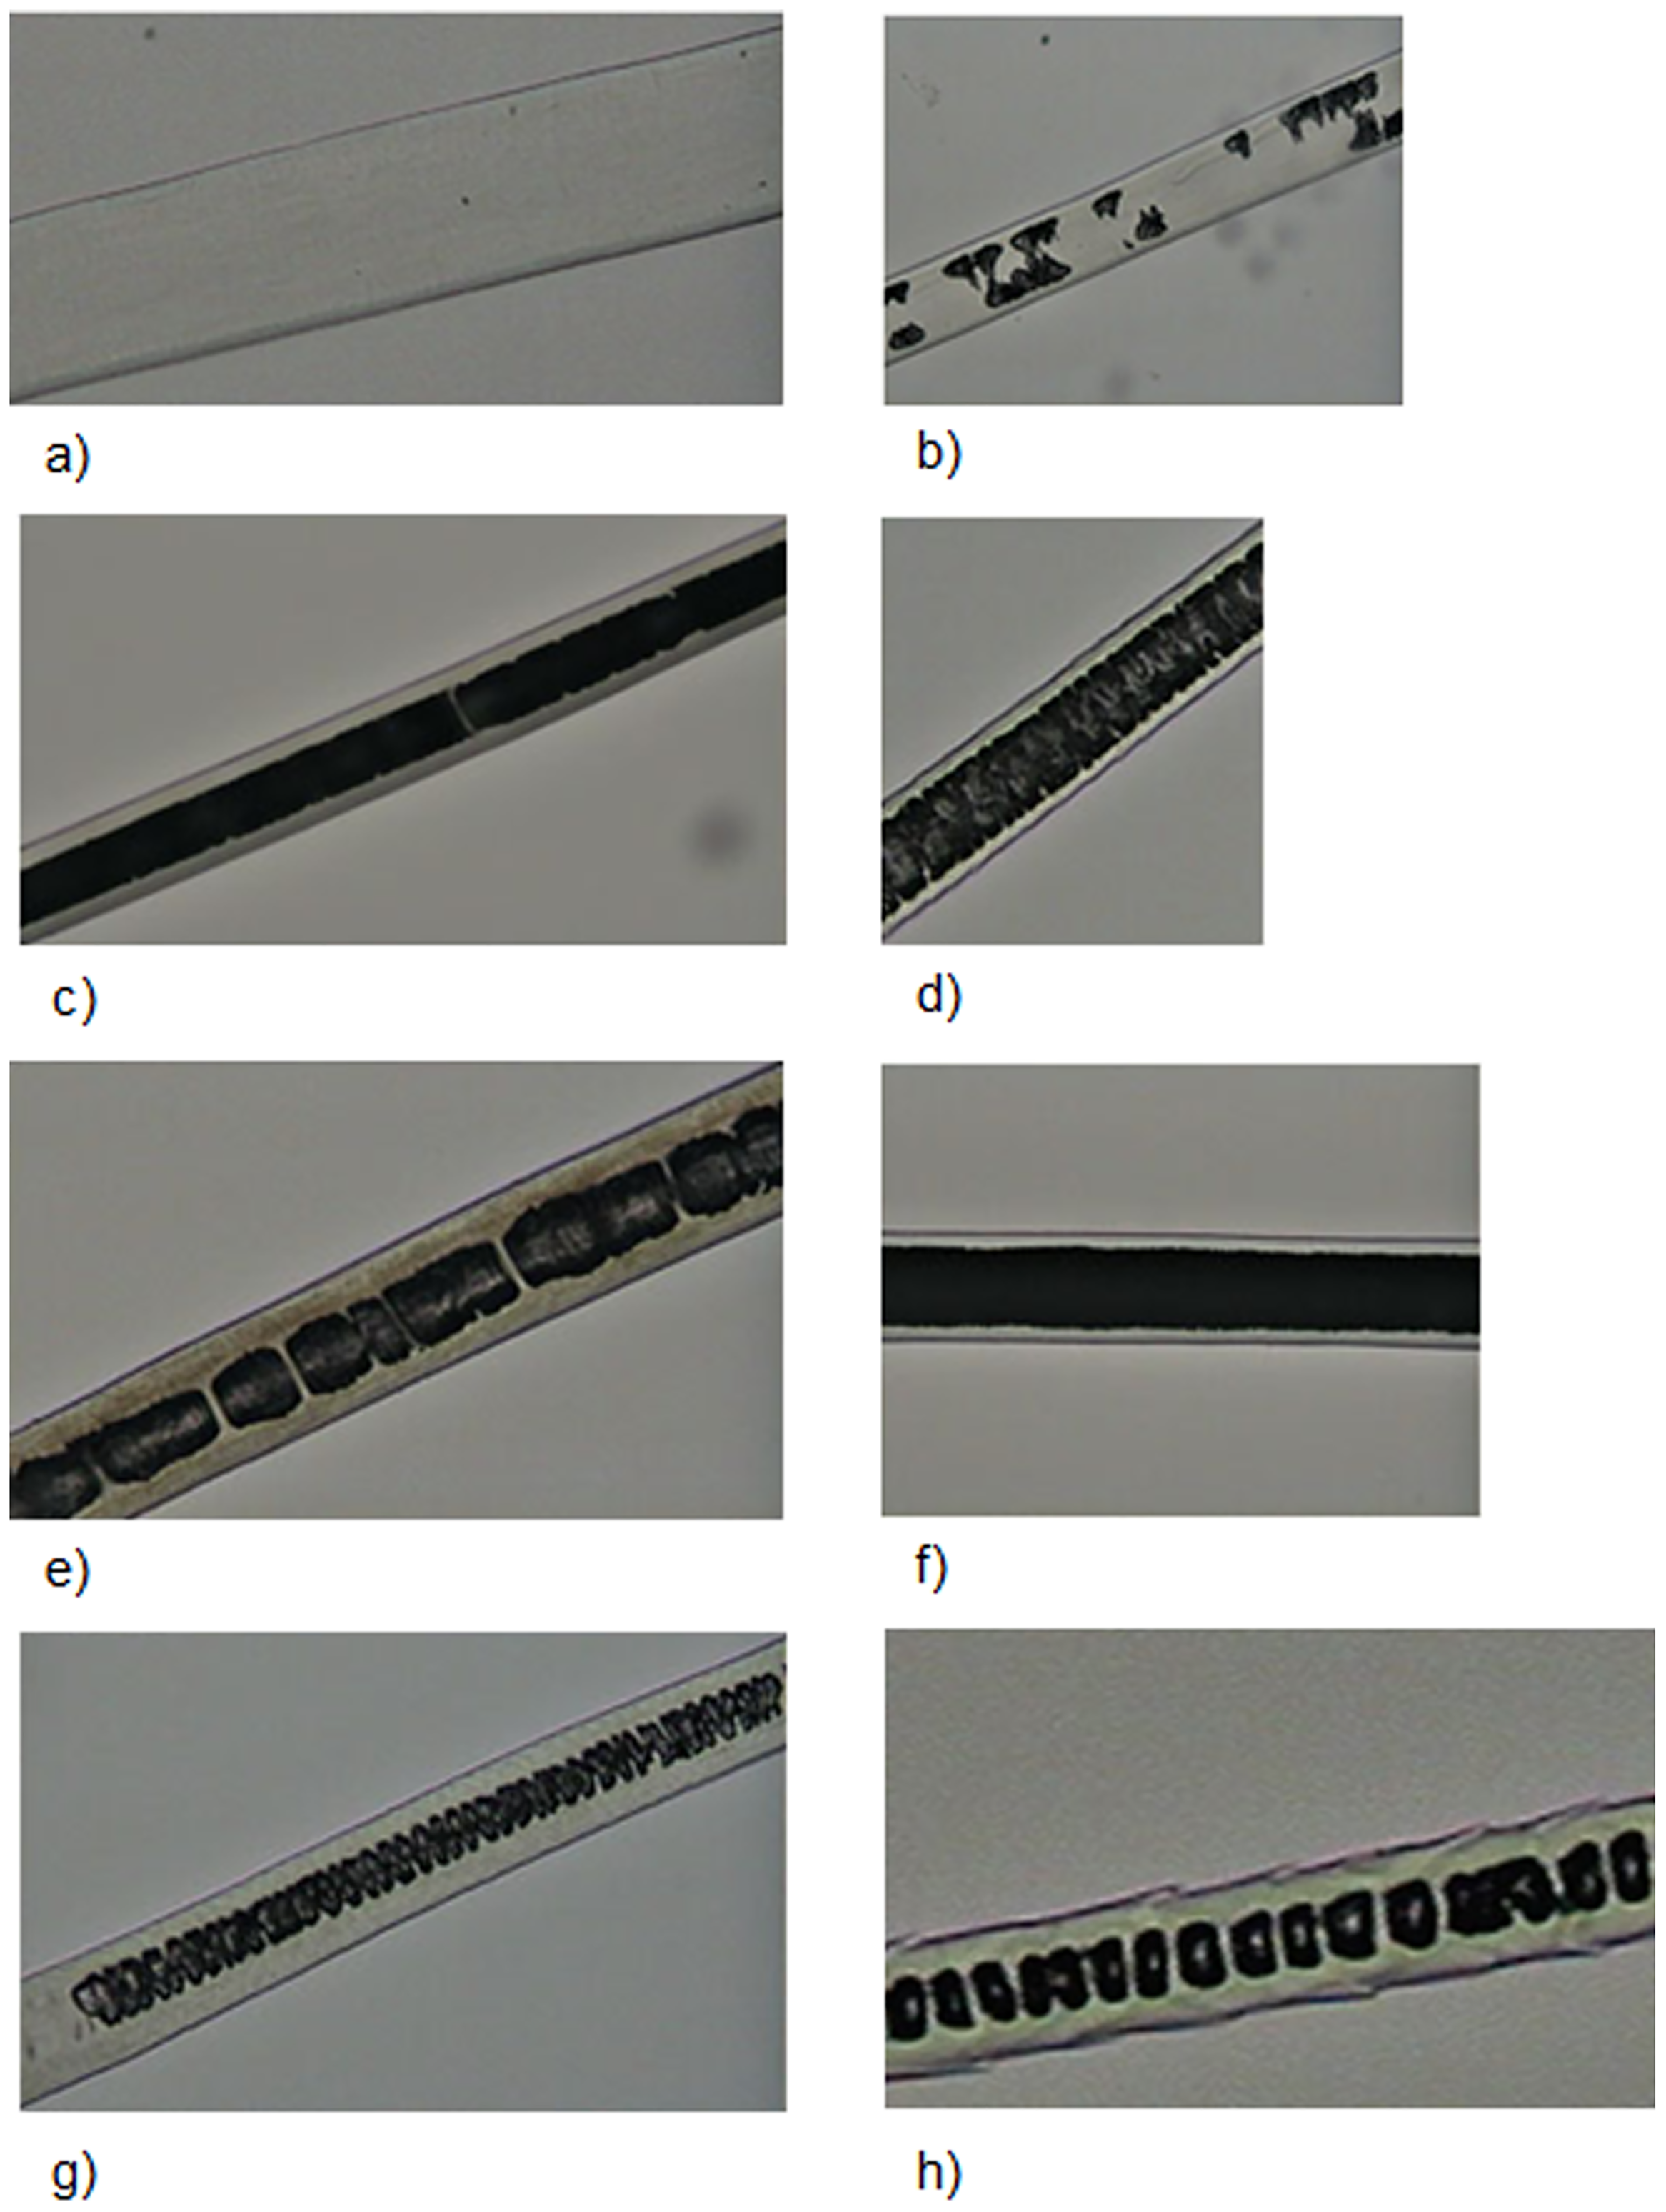
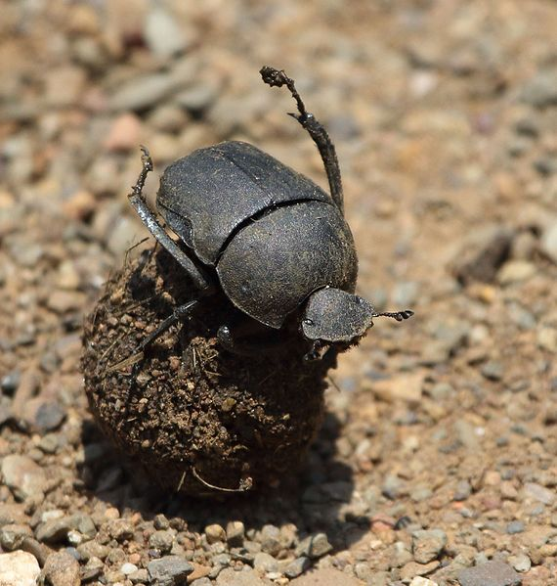
Methods of studying diet
Follow species and record what they eat
Dung analysis
Visually identify plant fragments or hairs
DNA metabarcoding
Notes:
Alberts CC, Saranholi BH, Frei F, Galetti PM Jr (2017) Comparing hair-morphology and molecular methods to identify fecal samples from Neotropical felids. PLoS ONE 12(9): e0184073. https://doi.org/10.1371/journal.pone.0184073
Photo: Alandmanson https://commons.wikimedia.org/wiki/File:Garreta_unicolor_2016_01_01_11_000244-1.jpg

Slide 32
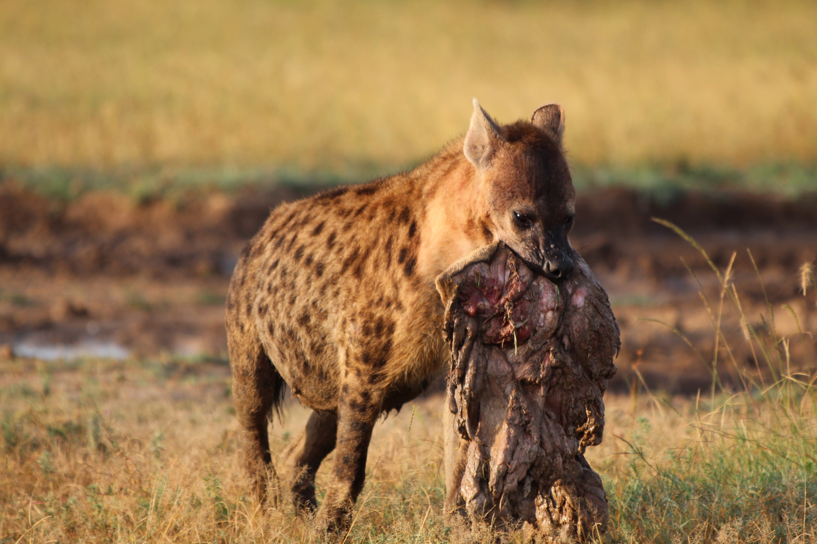
Habitat requirements and biology of target species
Space, diet, water
Other species – predators and competitors
Carrying capacity
Dispersal
Notes:
Photo: author

Slide 33
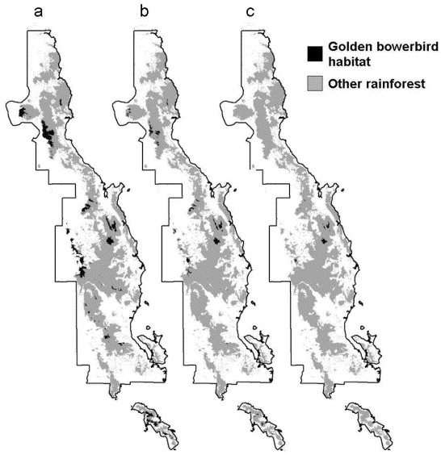
Predicting range changes
Hilbert et al. (2004), Biol Cons, 116(3)
Notes:
Hilbert, D.W., Bradford, M., Parker, T. and Westcott, D.A., 2004. Golden bowerbird (Prionodura newtonia) habitat in past, present and future climates: predicted extinction of a vertebrate in tropical highlands due to global warming. Biological Conservation, 116(3), pp.367-377.

Slide 34
Bioclimate envelopes
Use the current range of a species to decide what environmental variables determines this range.
Gives you an estimate of the fundamental niche of the species
Apply a climate change model to predict where these conditions will exist in the future
Limitations – Purely correlative, there is no mechanism attributed to why the species is limited by these environmental conditions
The niche reflected by this model may be determined by other factors such as biotic interactions and physical barriers to dispersal

Slide 35
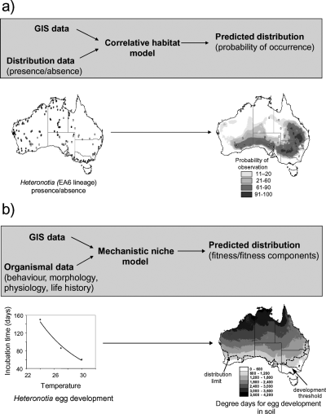
Putting biological and physiological traits into the model
In a mechanistic approach the interaction between the properties of the organism and the environmental conditions surrounding it are mechanistically modelled to determine the fitness consequences, which are then mapped onto the landscape.
Here, physiological data on rates of egg development at different temperatures.
Kearney, M., 2006.. Oikos, 115(1)
Notes:
Kearney, M., 2006. Habitat, environment and niche: what are we modelling?. Oikos, 115(1), pp.186-191.

Slide 36
4 – Conservation interventions
There are two main things that conservation interventions can do when it comes to reducing risk of extinction:
Decrease mortality
Increase breeding
Source-sink dynamics
Do we just need to protect habitat and prevent animals or do we need to intervene more closely and more intensively?

Slide 37
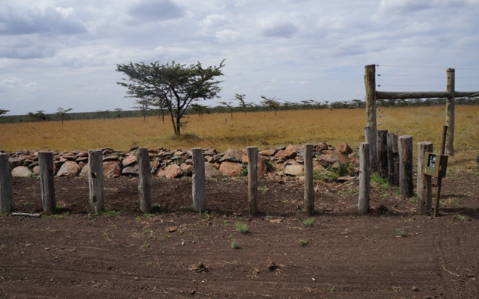
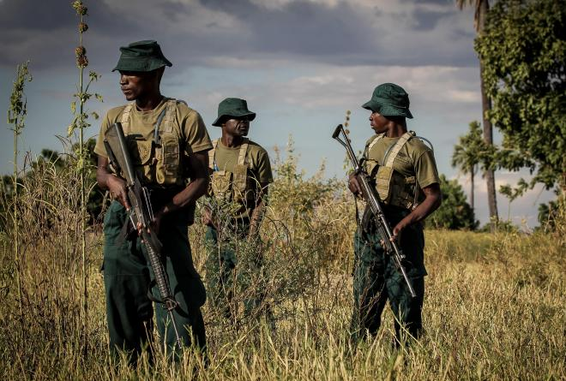
Preventing intentional killing and conflict Security
Notes:
Photos: Ol Pejeta https://www.olpejetaconservancy.org/conservation/wildlife-protection/understanding-fencing/
© Annegré Bosman Ι Pluk Media https://www.africanparks.org/newsroom/press-release/rhino-poaching-sentence

Slide 38
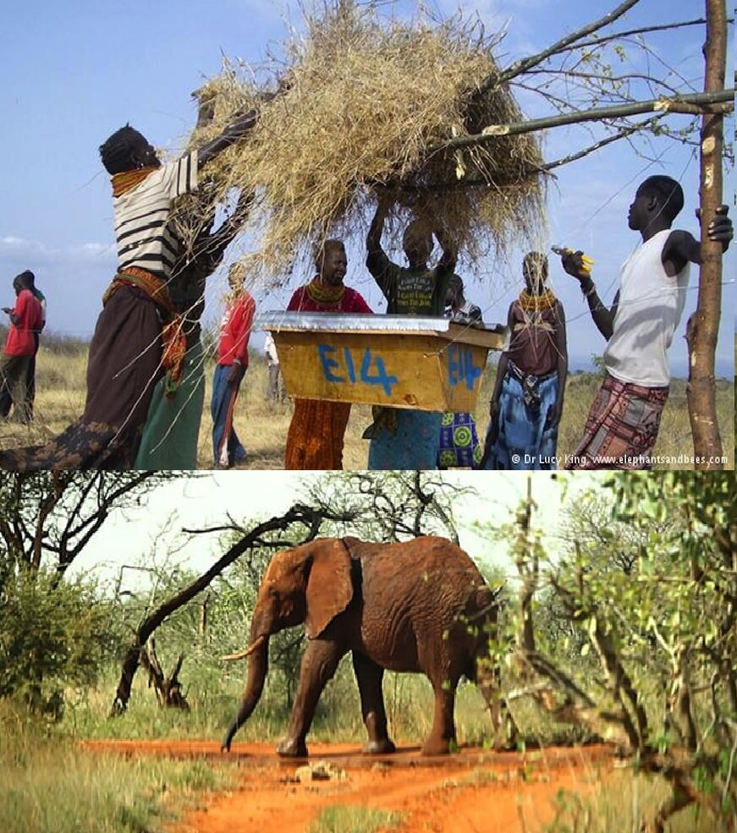
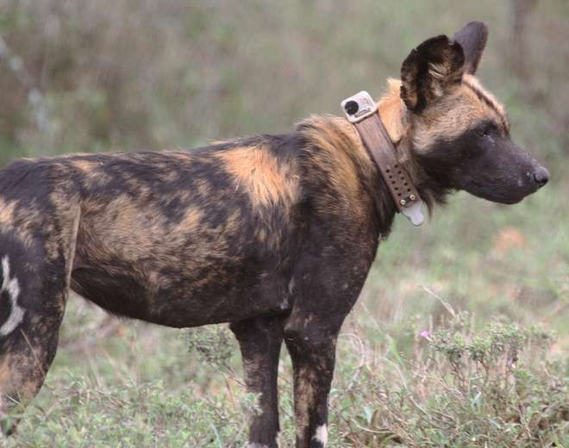
Preventing intentional killing and conflict Finding ways to co-exist
Notes:
Photos: https://anneofcarversville.com/glamtribal/2019/10/22/tdkp4gc2jnaol7w37ux6rpy9xunflx
https://www.zsl.org/blogs/wild-science/a-dog%E2%80%99s-life-using-conservation-technology-to-monitor-african-wild-dogs

Slide 39
Preventing intentional killing and conflict Providing economic alternatives
Can be more effective that just enforcement
Found to be the case in Bangladesh - nursery raising, fisheries, and livestock and poultry rearing, and involving local people in forest patrolling and as eco-tour guides, etc.
Mukul, S.A., Herbohn, J., Rashid, A.Z.M.M. and Uddin, M.B., 2014. Comparing the effectiveness of forest law enforcement and economic incentives to prevent illegal logging in Bangladesh. International Forestry Review, 16(3), pp.363-375.

Slide 40
Control invasive species
Usually a problem on oceanic islands
Is eradication possible? Depends on the size of the island and the species
If not, control numbers, protect nests and set up exclosures
Towns, D.R. and Broome, K.G., 2003. From small Maria to massive Campbell: forty years of rat eradications from New Zealand islands. New Zealand journal of zoology, 30(4), pp.377-398.
Gurevitch, J. and Padilla, D.K., 2004. Are invasive species a major cause of extinctions?. Trends in ecology & evolution, 19(9), pp.470-474.

Slide 41
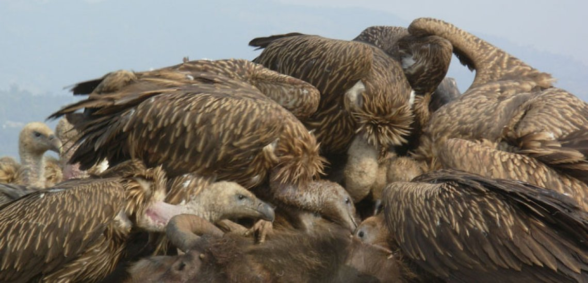
Other interventions
Provision of nest sites
Supplementary feeding
Provision of water
Translocations
Veterinary care
Vulture restaurant
Notes:
https://www.birdlife.org/asia/news/vulture-restaurants-hit-cambodia

Slide 42
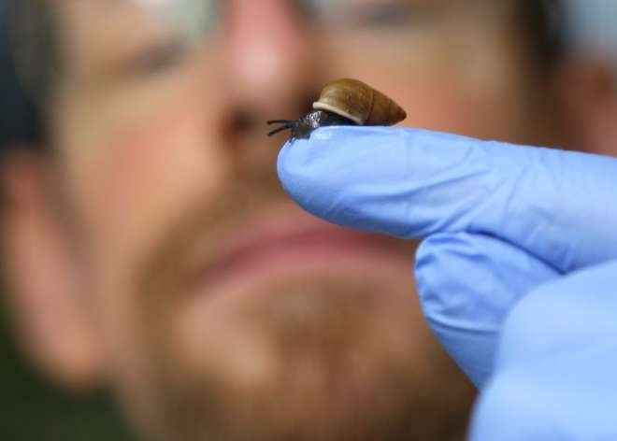
Captive breeding
Often seen as a last resort but can be effective
Generally more cost effective with smaller species Partula snails at ZSL
One Plan Approach
Notes:
McGowan, P.J., Traylor‐Holzer, K. and Leus, K., 2017. IUCN guidelines for determining when and how ex situ management should be used in species conservation. Conservation Letters, 10(3), pp.361-366.
Towns, D.R. and Broome, K.G., 2003. From small Maria to massive Campbell: forty years of rat eradications from New Zealand islands. New Zealand journal of zoology, 30(4), pp.377-398.
https://www.zsl.org/conservation/regions/oceania/partula-snail-conservation-programme

