Slide 1
Academic Professional Practice: Reflecting on our teaching
Jane Roberts
The Open University
The Transformation by Innovation in Distance Education (TIDE) project is enhancing distance learning in Myanmar by building the capacity of Higher Education staff and students, enhancing programmes of study, and strengthening systems that support Higher Educational Institutions in Myanmar. TIDE is part of the UK-Aid-funded Strategic Partnerships for Higher Education Innovation and Reform (SPHEIR) programme(www.spheir.org.uk). SPHEIR is managed on behalf of FCDO by a consortium led by the British Council that includes PwC and Universities UK International. The TIDE project will close in May 2021.

Slide 2
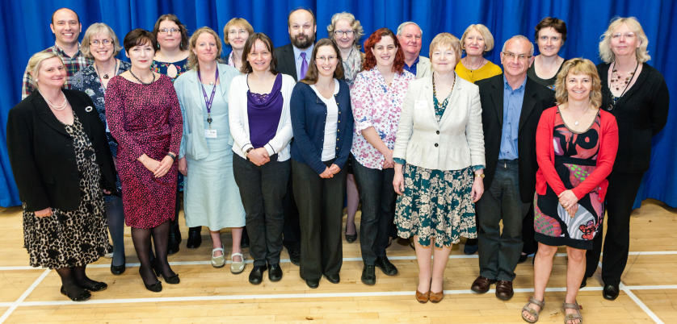
Tutor introduction
Dr Jane Roberts
BSc Biochemistry and PhD Energy Technology Policy (nuclear power)
Former Academic Lead, Applaud (OU HEA Fellowship scheme)
Associate Assessor and Consultant, Higher Education Academy
Past Vice-Chair, Friends of the Earth, England & Wales
Principal Fellow of the Higher Education Academy (PFHEA)
More details at https://iet.open.ac.uk/people/jane.roberts

Slide 3
The aims of today’s program
By the end of the session you should be able to:
Understand the Professional Standards Framework and how it applies to your teaching
Use a teaching diary to reflect on your teaching practices and identify areas for improvement
Develop an Action Plan to become an even better teacher

Slide 4
Today’s programme
Session 1
Introductions
Your teaching activities
The Professional Standards Framework (PSF)
Session 2
Teaching diaries
Case studies
Session 3
Academic Professional Practice action planning
Follow up between now and November
Notes:
Throughout the day you will be taking part in activities and discussions about your water and pollution teaching. By the end of the day you will have developed an Academic Professional Practice Action Plan.

Slide 5
Session 1
The Professional Standards Framework (PSF)

Slide 6
Why Academic Professional Practice?
As university teachers we need to:
Be expert in our subject
Be effective teachers of that subject
Understand how we can continually get even better at what we do
Notes:
Academic Professional Practice supports the other strands of TIDE, both subject knowledge and teaching.
These are 3 important elements of our academic practice, but today we will focus particularly on number 2 and 3.

Slide 7
Introductions
Name?
Your university?
One activity you enjoy the most in your teaching? And Why?
Notes:
We start by finding out about one or more teaching activities that each member of the group particularly enjoys. This will give us some examples of teaching that are used in Myanmar.

Slide 8
Professional Standards Framework:
Dimensions of practice
Areas of Activity
A1 Planning teaching
A2 Teaching and supporting learning
A3 Assessment and feedback
A4 Developing learning environments
A5 Professional development for teaching
Core knowledge
K1 Subject knowledge
K2 How to teach my subject
K3 How students learn
K4 Learning technologies
K5 How to evaluate teaching
K6 Quality assurance and enhancement
Professional values
V1 Valuing individual learners
V2 Valuing diversity and widening participation
V3 Evidence-based practice
V4 The wider context in our teaching
Copyright: Higher Education Academy/Advance-HE
Notes:
During Session 2 you will be introduced to the Professional Standards Framework, which is widely used in the and also internationally to support the professional development of university teachers.
The PSF has defined the scope of teaching into three dimensions.
AREAS OF ACTIVITY: these are the things that we do when we teach and support university students
CORE KNOWLEDGE: These are the different types of knowledge we need to teach effectively
PROFESSIONAL VALUES: These are the values that support effective teaching.

Slide 9
Areas of Activity
A1 Design and plan learning activities and/or programmes of study
A2 Teach and/or support learning
A3 Assess and give feedback to learners
A4 Develop effective learning environments and approaches to student support and guidance
A5 Engage in continuing professional development in subjects/disciplines and their pedagogy, incorporating research, scholarship and the evaluation of professional practices
Notes:
We will use our list of examples of teaching activities created in the beginning of the day and classify them based on the PSF Areas of Activity.
We will also discuss what else can be classified under each Area of Activity.
This new list of teaching activities will then be used to inform their Action Plans.

Slide 10
Core Knowledge
K1 The subject material
K2 Appropriate methods for teaching, learning and assessing in the subject area and at the level of the academic programme
K3 How students learn, both generally and within their subject/disciplinary area(s)
K4 The use and value of appropriate learning technologies
K5 Methods for evaluating the effectiveness of teaching
K6 The implications of quality assurance and quality enhancement for academic and professional practice with a particular focus on teaching
Notes:
Next, you will consider the types of knowledge used in your teaching. Can these be classified using K1- K6?

Slide 11
Professional Values
V1 Respect individual learners and diverse learning communities
V2 Promote participation in higher education and equality of opportunity for learners
V3 Use evidence-informed approaches and the outcomes from research, scholarship and continuing professional development
V4 Acknowledge the wider context in which higher education operates recognising the implications for professional practice
Notes:
Next, you will think about Professional Values, and how these support teaching. How are these Values demonstrated in the examples of your teaching?

Slide 12
Session 2
The use of teaching diaries to improve our practice

Slide 13
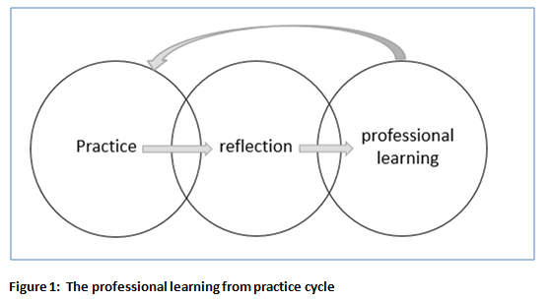
Using a teaching diary to reflect on practice
By writing we:
Think hard
Make links between different teaching activities
Create a record for future reflections
Notes:
Teaching is a practical skill. We get better by practicing, thinking hard (reflecting) about what went well and what did not, learning what we can do better next time, and having another go.
A teaching diary helps the reflection process. By writing about our teaching we have to think systematically and clearly. Within the teaching diary we record many different teaching experiences, and can make links between them. We also have a permanent record of our teaching and our reflections, which allows us to return and reflect again and again in the light of future experience.

Slide 14
Writing a teaching diary
What have I done?
How have I done it?
Why did I do it that way?
How successful was it?
How will I do it in the future?
WHAT? HOW? WHY? SO WHAT? NOW WHAT?
Notes:
Tell a story to yourself ……

Slide 15
Getting started with the teaching diary
Activity:
Write about a change you have made to your teaching
Use the following prompts:
What changes did I make?
Why did I make these changes?
How did students respond?
How successful was the change?
Will I make other changes in the future?
Make a short presentation to the class about your example
Notes:
Before we start, we would like that discussions that occur here are kept confidential. We would like this to be a safe and supportive environment for us all to share our most personal and critical reflections of learning and teaching without judgment.

Slide 16
Writing a case study
Title
Context
Activity aims
Why you developed the activity (TIDE??)
What does the teacher need to do?
Feedback on the activity from students and others
Strengths and weaknesses of the activity
Key words
References
Notes:
Title:
Context:
It will be helpful to set the context for the activity by explaining the course, level, qualification and numbers of students. Lab, classroom or field based?
Activity aims:
Set out the aims or learning outcomes for the activity. Try to use active and student centred language.
E.g. “For students to develop an appreciation of ……….” good
“To teach about x, y, z” not so good.
Why you developed the activity:
Why was the activity developed? If this activity was developed in response to a problem or issue, say so. Sustainable development, active learning, student feedback, comments from externals and peers, your own reflection - all are relevant.
What does the teacher need to do?
Explain in enough detail to allow others to try this. Be clear about staff input, preparatory activities, resources required, timings.
Feedback on the activity from students and others
Initial feedback from students, module evaluations, externals’ or colleagues’ commentary, etc. If working with outside organisations, their feedback is particularly valuable.
Strengths and weaknesses of the activity
Think hard about what went well and what could be made even better.
Key words:
References (if appropriate):
These should be in Harvard format.
Contact: Name, University, email.

Slide 17
Session 3
Action planning to become even better teachers

Slide 18
APP Action Planning
Identify three activities within your teaching (A1-A5) that you would like to get even better at.
For each of these activities use the table provided to:
Explain what you want to learn. Use the tags A1-V4 to relate this to the PSF.
Suggest what you need to do to learn this.
Suggest what resources or support you will need. This could be from TIDE, from your own university, from colleagues or other sources, such as the internet.
Suggest how you expect your teaching will change as a result of this learning.
Suggest some target dates for achieving this learning.

Slide 19
Between now and the November Residential
You will be asked to:
Use your teaching diary to reflect on your learning and teaching practices
Use your action plan to develop your teaching
Use the action planning method to identify how to develop other aspects of your teaching
Use the PSF Dimensions of Practice to identify your strengths as a teacher and also areas where you would like to develop
Try to wrote a case study about a change you have made to your teaching
In November you will be asked to report back on your progress

Slide 20
THANK YOU

