Slide 1
Energy and Flexibility Modelling
LECTURE 3: NAMING CONVENTION & TIME REPRESENTATION
Version 1.0

Slide 2
Learning Outcomes
ILO 1: Learn how to use the generic model naming convention
ILO 2: Understand the variability of energy demand
ILO 3: Understand the variability of renewable energy resources and energy prices
ILO 4: Learn how to represent time in an energy system model using SAND and OSeMOSYS
Course Name
MINI LECTURE NUMBER & NAME
Mini Lecture Learning Objective
2
Notes:
Welcome to Lecture 3 of this course. This lecture focuses on several important concepts including:
Generic model naming convention
Variability of energy demand
Variability of renewable energy resources and energy prices
Time representation

Slide 3
3.1 Naming Convention
3.1.1 Importance of Generic Naming
3
Notes:
This diagram shows an example Reference Energy System constructed for Nigeria. Here we can see total electricity demand divided into the residential, commercial, and industrial sectors, as well as all the technologies that could meet those demands. Since we want to consider all technologies that may become available in the future, the diagram includes power plant types that are not currently active in Nigeria, such as biomass power plants.
In this Reference Energy System, technologies have been given specific names that are relevant to Nigeria, for example Katsina Wind Power Plant is named, rather than using a generic term for all wind power plants. While this may make sense to somebody with knowledge of the Nigerian power system, using specific names can make it harder for other people to identify technologies and understand all of the components in a Reference Energy System. For this reason, we will use a generic naming convention when creating our Reference Energy Systems. This has other benefits, which are explained later.

Slide 4
3.1 Naming Convention
3.1.2 Importance of Code Names
4
Notes:
We can now see that all of the specific names in the Reference Energy System diagram have been replaced with generic names. This means that the diagram can now be easily understood by all users, with no confusion over specific power plant names. The use of generic naming also means that technologies can be identified quickly and easily. However, these names are too long to be used in our modelling system, and so short standard codes are used, as explained next.

Slide 5
3.1 Naming Convention
3.1.3 Why a naming convention?
5
Notes:
In this version of the Reference Energy System, technologies and commodities are names using short standard codes. These codes are generated using a standard naming convention, the structure of which is explained in the remaining part of this mini-lecture. The use of a standard naming convention like this is advantageous because it:
Allows quick and easy technology identification
Is easily replicable
Facilitates comprehension of model components and structure
Allows for structuring data in the model and results during post-processing

Slide 6
3.1 Naming Convention
3.1.4 OSeMOSYS Naming Convention Part 1
6
Notes:
This convention is applied to both technologies and commodities. The structure of the generic convention for naming technologies is shown in this figure with some examples. The technology name is composed of three segments: the first identifies the category of the technology, the second identifies the sector, then the third identifies the fuel or commodity it uses. Each segment is made up of 3 letters which identify the term. The technology name therefore has 6 or 9 letters in total, depending on whether it is assigned a category. For example a coal power plant can be named P.W.R.C.O.A: P.W.R identifies the sector as the power sector, and C.O.A identifies that the commodity used by this technology is Coal. If there is more than one type of a technology, a 3-digit number at the end is used to distinguish between types e.g. P.W.R.C.O.A.0.0.1 would be Coal Power Plant type 1 and P.W.R.C.O.A.0.0.2 would be Coal Power Plant type 2. Fuel import technologies are given the first 3 letters I.M.P, while fuel production technologies are given the first 3 letters M.I.N. Electricity transmission is given the name P.W.R.T.R.N, since it is in the Power sector and T.R.N is used to abbreviate the term transmission. The 3- or 6-letter abbreviations used for different commodities are shown in the next section.

Slide 7
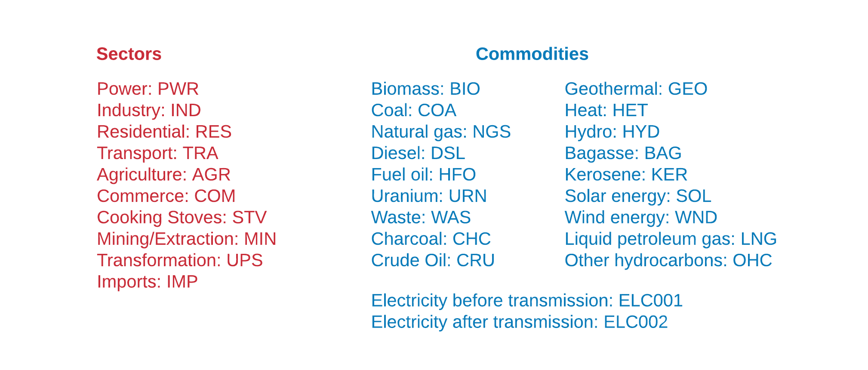
3.1 Naming Convention
3.1.5 OSeMOSYS Naming Convention Part 2
7
Notes:
Commodities are given 3- or 6-letter names which are shown in this slide. If a commodity is sector-specific, the first 3 letter segment of the name identifies the sector, while the second 3 letter segment identifies the commodity, for example diesel used in the transport sector would be named T.R.A.D.S.L.
Demands are typically given 9 letter names, structured in the same way as for technologies, with the first segment identifying the category, the second identifying the sector and the last identifying the fuel. For example, the residential demand for electricity is named D.E.M.R.E.S.E.L.C - D.E.M identifies this as a Demand, R.E.S as in the Residential Sector, and E.L.C as being Electricity.

Slide 8
Lecture 3.1 References
Taliotis, Constantinos, Gardumi, Francesco, Shivakumar, Abhishek, Sridharan, Vignesh, Ramos, Eunice, Beltramo, Agnese, … Howells, Mark. (2018, November). Time representation in OSeMOSYS. Zenodo. http://doi.org/10.5281/zenodo.4585695
Course Name
MINI LECTURE NUMBER & NAME
Mini Lecture Learning Objective
8

Slide 9
3.2 Importance of Time Representation
3.2.1 Time Variability in Energy Systems
Sources of Time Variability:
9
Notes:
All characteristics of the energy system vary over different time scales (days, weeks, seasons), both on the demand and the supply side.
These include:
Energy demand;
Availability of energy supply technologies;
Availability of renewable energy sources (such as water or solar irradiation) and storage;
Energy prices.
We therefore need to ensure there is enough capacity to meet the demand at all times. This means ensuring that everyone has access to energy when they need it.

Slide 10
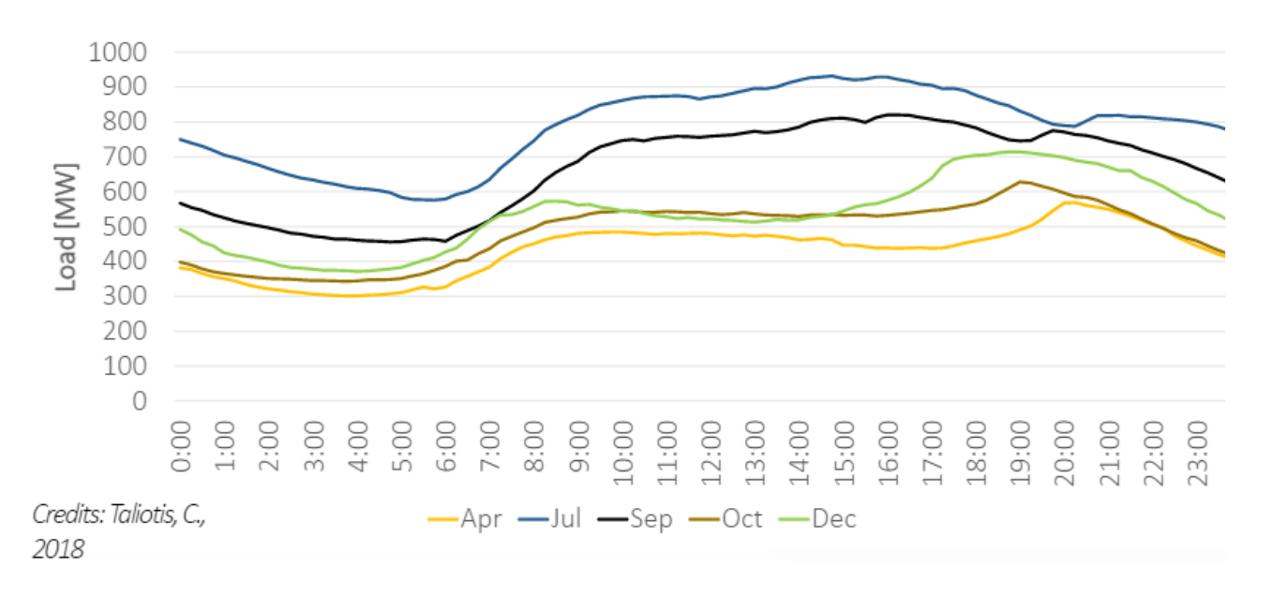
3.2 Importance of Time Representation
3.2.2 Variability of Energy Demand
(Taliotis et al. (2018), image, licensed under CC BY 4.0)
10
Notes:
In most cases, energy demand varies over time. This occurs on several scales. Firstly, energy demand is rarely constant throughout the day. Demand varies as consumers’ activities occur at different times of the day. For example, in many countries, we see the highest electricity demand in the late afternoon and early evening. This can be when consumers use most power, for example to cook a meal or turn lamps on as it gets dark. Secondly, energy demand is rarely constant throughout the year. Demand changes as the seasons change. For example, in cold countries, residential electricity demand may be higher in the winter than in the summer as consumers use more power for heating and lighting. This diagram shows an example of how electricity demand may vary on both daily and monthly timescales within a country.
It is often important to model these variations in demand over time in order to ensure sufficient energy can be supplied at all times.

Slide 11
3.2 Importance of Time Representation
3.2.3 Balancing the Electricity System
10
Notes:
At all times the electricity system has to be balanced. This means that generation has to equal consumption plus losses. Losses occur in energy systems for several reasons, for example power transmission technologies are not 100% efficient. This means that some energy is lost at several stages of the chain from electricity generation by power plants to electricity consumption by consumers. To ensure there is sufficient energy available, these losses must be considered in the balance of the system, meaning generation must equal the sum of consumption plus losses.
Because there is often no economically viable way to store very large quantities of electricity, it is important that this balance is maintained at all times, so in any one instance the total electricity generated should equal the sum of consumption plus losses. This has implications for the planning of energy supply, because some electricity generation technologies have limited flexibility, meaning they cannot be relied upon to produce electricity at all times. It is important that we model time variability so we can ensure that the system is balanced at all times.

Slide 12
3.2 Importance of Time Representation
3.2.4 System Losses & Reliability
11
Notes:
So, electricity systems are not completely efficient and contain several losses. This means that not all of the primary energy entering an electricity system is used by consumers. It is important to understand where these losses come from and consider them when modelling energy systems. The first source of losses is thermal energy losses in the generation of electricity; thermal electricity generation by power plants is not 100% efficient and some of the primary energy put in is lost as heat. These are usually the largest losses in the system. For example, not all of the energy in the coal burned at a coal power station is converted to electricity as a proportion of it is lost as heat. The concept of power plant efficiency is explored further in Lecture 4. A further source of energy losses is in the transmission and distribution of electricity, which again is not a 100% efficient process.
Because of these system losses, electricity systems must always generate more electricity than is actually consumed to ensure demand is met. In some cases, electricity systems can fail to meet demand, for example because there is insufficient generation capacity. This has significant impacts on society.

Slide 13
3.2 Importance of Time Representation
3.2.5 Unreliable Electricity Supply
Reduced quality of life
Limited healthcare provision
Problems associated with unreliable electricity supply
Loss of industrial productivity
Reduced access to education
13
Notes:
Unreliable electricity supply is a critical problem that has several serious societal impacts. Firstly, an unreliable electricity supply limits citizens’ quality of life and inhibits progress towards the Sustainable Development Goals. Without reliable supply, opportunities for education and business are limited, and provision of healthcare is challenging. Reliable electricity supply is also critical for industry and businesses to function and grow. If supply is unreliable, industrial production will be disrupted by blackouts and businesses may have to spend large amounts of money on back-up generators, which are also highly polluting. Unreliable electricity supply therefore forms a critical barrier to economic growth.
For these reasons, it is important that energy systems are planned in a way that ensures reliability. A critical element of this is considering the time variability of demand as well as system losses in energy modelling.

Slide 14
Lecture 3.2 References
Taliotis, Constantinos, Gardumi, Francesco, Shivakumar, Abhishek, Sridharan, Vignesh, Ramos, Eunice, Beltramo, Agnese, … Howells, Mark. (2018, November). Time representation in OSeMOSYS. Zenodo. http://doi.org/10.5281/zenodo.4558793
Course Name
MINI LECTURE NUMBER & NAME
Mini Lecture Learning Objective
14

Slide 15
3.3 Additional System Variability
3.3.1 Variability of Renewable Energy Part 1
15
Notes:
So, we have learnt that energy demand varies with time and that this must be considered in energy modelling. Another important consideration is that the availability of renewable energy resources also varies with time. This refers to the fact that the amount of energy available from solar, wind, and hydropower resources is not constant. For example, the amount of solar energy that can be converted to electricity by a solar PV panel is dependent on the strength of the sunlight (otherwise known as solar irradiance). Since it is often sunniest in the middle of the day and dark at night, a solar PV panel can therefore produce most electricity in the middle of the day and no electricity at night. Renewable energy availability will also vary by season, as the strength of the sunlight, wind conditions, and water flow all vary throughout the year. To ensure electricity systems are reliable and capable of meeting demand, it is important to model this variability.

Slide 16
3.3 Additional System Variability
3.3.2 Variability of Renewable Energy Part 2
(Taliotis et al. (2018), image, licensed under CC BY 4.0)
16
Notes:
This diagram exemplifies the variability of renewable energy generation. The Y axis is the solar PV capacity factor, which is essentially a measure of the availability of the PV power plant to generate electricity. Capacity factors are covered in more detail in later lectures. When the capacity factor is 0, this means the PV plant cannot generate any electricity, so this diagram shows that no electricity can be generated from approximately 7:00pm in the evening to 5:00am in the morning. The diagram then shows that the PV capacity factor rises throughout the day and peaks at midday before falling back down to 0 in the evening, tracking the strength of the sunlight. A key message from this diagram is that this PV plant could not be relied upon to produce electricity from approximately 7:00pm to 5:00am, whilst it would be a useful source of generation during the day. We must therefore consider this in energy system modelling, and this is another key reason why we model time variability in OSeMOSYS.

Slide 17
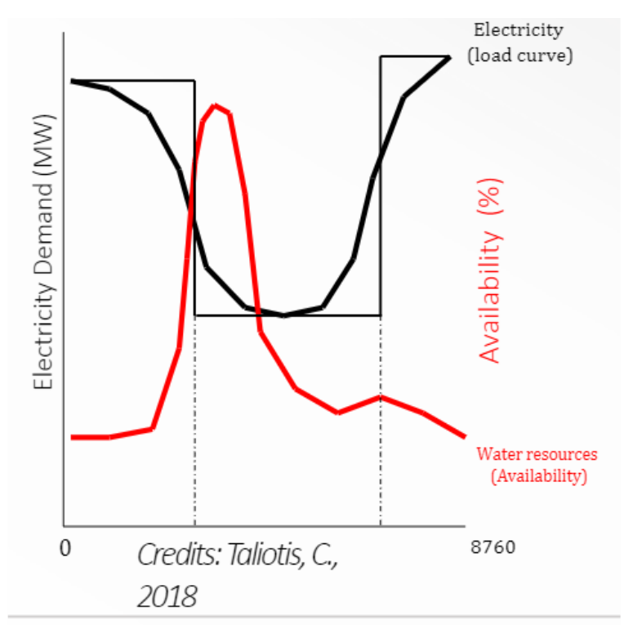
3.3 Additional System Variability
3.3.3 Introduction to the Importance of Flexibility
(Taliotis et al. (2018), image, licensed under CC BY 4.0)
17
Notes:
This graph shows example data on the availability of water resources for producing electricity at hydropower plants and the electricity demand profile. We can see that the peak water availability does not match the peak demand, so demand could not be met using hydropower alone. To ensure demand can always be met, even when there is variability in resource availability as shown on this figure, it is important that the system has sources of flexibility. Flexibility can come from several sources, such as energy storage. Energy storage refers to the idea of storing energy for use at a later time. In electricity systems, it is often helpful to store electricity produced when demand is low, so that the stored electricity can be used when demand is higher and/or less supply is available.
There are several types of energy storage. A common option is pumped storage hydropower, where water is pumped from a lower reservoir to a higher reservoir in order to store power, which is then released when the water is discharged back to the lower reservoir. Electricity systems may also contain standalone batteries, which store electricity from the transmission grid at times of low demand for release when demand is higher, or batteries are commonly combined with renewable energy generation technologies. For example, it is common to have battery storage at solar farms as this allows excess electricity generated during sunny periods to be stored and released when the solar intensity may be lower. Storage and flexibility are covered in more detail in later lectures.

Slide 18
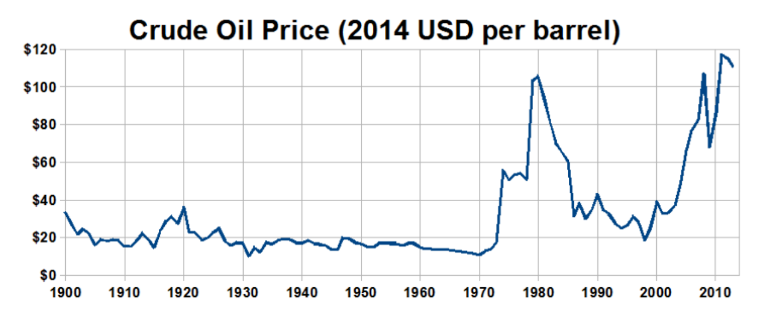
3.3 Additional System Variability
3.3.4 Price Variability
(Travelplanner, image, licensed under CC BY-SA 3.0)
18
Notes:
Another source of temporal variability in energy systems comes from the costs of commodities. Commodity prices can vary strongly over time due to changes in supply and demand. As a general rule, when the supply of a commodity exceeds the demand, prices fall, and when demand exceeds supply, prices rise. Supply and demand can be influenced by several external factors, such as economic downturns, which reduce demand, or natural disasters, which can temporarily slow production. We can see the volatility of commodity prices in the figure above. It is important that we consider this variation in commodity prices in energy system models in order to make our models more aligned with reality. In OSeMOSYS, this is done by specifying commodity prices in each year of the modelling period based on price forecasts, as outlined in lecture 4.

Slide 19
3.3 Additional System Variability
3.3.5 Overall Importance of Modelling Time Variability
19
Notes:
To summarize this and the previous mini-lecture, we have firstly learnt that several elements of energy systems vary over time. These include demand, which varies as power-consuming activities occur at different times of the day and differently in each season, electricity generation, which can vary as renewable resource availability varies over time, and energy prices. We have also seen the importance of balancing electricity supply and demand and the critical impacts that unreliable supply can have. To help mitigate these impacts, we must consider time variability when planning energy systems. This is therefore modelled in OSeMOSYS. The method of modelling time variability in OSeMOSYS is covered in more detail in the next section.

Slide 20
Lecture 3.3 References
Taliotis, Constantinos, Gardumi, Francesco, Shivakumar, Abhishek, Sridharan, Vignesh, Ramos, Eunice, Beltramo, Agnese, … Howells, Mark. (2018, November). Time representation in OSeMOSYS. Zenodo. http://doi.org/10.5281/zenodo.4558793
Course Name
MINI LECTURE NUMBER & NAME
Mini Lecture Learning Objective
20

Slide 21
3.4 Time Representation in OSeMOSYS
3.4.1 Introduction to Representing Time
21
Notes:
In OSeMOSYS we represent time variability by dividing a year into ‘time slices’. Before we talk more about using time slices in OSeMOSYS, it is important to appreciate what we are trying to consider when we use this time slice approach. Time slices are intended to be fractions of the year with different characteristics, typically representing different seasons and different times of the day. For example one time slice could represent all the evenings in summer and another could represent all the evenings in winter. The ultimate aim of this approach is to capture the variability in demand and resource availability over time in the country we are modelling. This means that the most appropriate definition of time slices may vary by country. For example, some countries have 4 clearly defined seasons, each of which has different weather patterns. For a country like this, we would probably want to ensure each of these seasons was represented by a different time slice in OSeMOSYS, because demand and renewable resource availability will be different in each one. However, other countries only have two seasons which need to be represented, for example countries with only a wet and a dry season.

Slide 22
3.4 Time Representation in OSeMOSYS
3.4.2 Time Slices
Based on Taliotis et al. (2018),(licensed under CC BY 4.0)
19
Notes:
For each season, we typically want to have separate day and night periods, since demand and resource availability differ between day and night as we learnt earlier. As an example, if we were modelling a country with 4 seasons of Winter, Spring, Summer, and Autumn, we would separate the day and night in each of these seasons. This would give a total of 8 time slices: Winter Day, Winter Night, Spring Day, Spring Night, Summer Day, Summer Night, Autumn Day, and Autumn Night. Once we have defined these time slices, we need to work out the proportion of the year that they represent. In some cases, we may assume that each season is of equal length and so represents an equal portion of the year. However in other cases we may want to use data to calculate these proportions by season. For example, we may know that typically Summer lasts longer than Winter in our country, and so we would try to represent that in OSeMOSYS. The proportion of the year taken up by each time slice is specified in OSeMOSYS using the Year Split parameter, as explained later and in hands-on exercises.

Slide 23
3.4 Time Representation in OSeMOSYS
3.4.3 Time Slices in SAND
20
Notes:
The SAND interface is the accessible Excel-based interface for OSeMOSYS that we will use throughout this course. You will learn more about SAND in the hands-on exercises. We will now look at an example of using time slices in the SAND interface.
For our example, we will assume we want to model 4 seasons: Winter, Spring, Summer, and Autumn. And each of these will be split into day and night, giving 8 time slices: Winter Day, Winter Night, Spring Day, Spring Night, Summer Day, Summer Night, Autumn Day, and Autumn Night. We will also assume that these time slices are of equal length. This means that each of these time slices will represent ⅛ of the year.
However, when using OSeMOSYS with the SAND interface, there is a preset number of 96 time slices. These 96 time slices represent 1 year and, since we want to split our year into Winter, Spring, Summer, and Autumn Day and Night with equal proportions, we will divide these 96 time slices by 8. This means that each of our original 8 time slices covers 12 time slices in SAND.

Slide 24
3.4 Time Representation in OSeMOSYS
3.4.4 Year Split
21
Notes:
So, we have 96 time slices, with ⅛ of them for each of Winter Day, Winter Night, Spring Day, Spring Night, Summer Day, Summer Night, Autumn Day, and Autumn Night. The next thing we need to define in our model is the Year Split, which is the proportion of the year taken up by each time slice. In our case this is relatively simple, since we are assuming that all of our seasons and day and night periods are of equal length, we can simply divide our year into 96 equal portions. The Year Split for each of our 96 time slices is therefore 1/96th. An important check for Year Split values is that they should sum to 1. For example 1 over 96 * 96 = 1. These values are inserted into the SAND interface, which you can try doing yourself in Hands-On Exercise 2.

Slide 25
3.4 Time Representation in OSeMOSYS
3.4.5 Additional Parameters: Discount Rate and Depreciation Method
Discount rate: rate used to determine the present value of future investments and costs
Considered in OSeMOSYS using the DiscountRate parameter, expressed in decimals, e.g., 0.1 would represent a discount rate of 10%
Depreciation: allocation of the cost of an asset over its lifetime
Considered in OSeMOSYS using the DepreciationMethod parameter, with a value of 1 for sinking fund depreciation (default) and 2 for straight-line depreciation
22
Notes:
In the last slide of this lecture we will quickly introduce two parameters used when setting up a model in OSeMOSYS, which we will practise using in Hands-On Exercise 2. We do not need to study discounting in detail in this course; however, we will go through a quick explanation and learn how it is considered in OSeMOSYS. The aim of discounting is to consider the time-value of money, whereby it is more financially beneficial to have x amount of money now, rather than the same amount of money some time in the future. For example, if given the choice between receiving $100 now or in two years' time, it makes sense to choose to have the money now. This is because you could invest it and earn interest, taking the value to over $100 in two years' time. This idea is considered in accounting using the Discount Rate, which is used to determine the present value of future cash flows. In OSeMOSYS, this is considered using the Discount Rate parameter, which is expressed in decimals. A typical discount rate might be 10%, which we would represent in OSeMOSYS by assigning a value of 0.1 to the Discount Rate parameter.
Depreciation is also complex; however, for our purposes we can think of it as the allocation of the cost of an asset over its lifetime. For example, if a company bought a new machine for $5,000 with an expected lifetime of 5 years, the company might depreciate the asset to give an annual depreciation expense of $1,000 every year for 5 years. There are several different methods of depreciation. This course does not intend to look at these methods in detail; however, we will introduce the two depreciation methods used in OSeMOSYS: sinking fund and straight-line depreciation.
Straight-line depreciation is a simple method where the annual depreciation expense is calculated by subtracting the salvage value of an asset from its total cost, and then dividing the remaining cost by the asset's lifetime to give the annual depreciation expense. The sinking fund method is a more complicated method of calculating depreciation expenses which also considers the cost of replacing the asset. In OSeMOSYS, the Depreciation Method parameter is used to choose the Depreciation Method implemented, with a value of 1 for sinking fund depreciation, which is used by default, and a value of 2 for straight-line depreciation.
This concludes our lecture on time representation.

Slide 26
Lecture 3.4 References
Taliotis, Constantinos, Gardumi, Francesco, Shivakumar, Abhishek, Sridharan, Vignesh, Ramos, Eunice, Beltramo, Agnese, … Howells, Mark. (2018, November). Time representation in OSeMOSYS. Zenodo. http://doi.org/10.5281/zenodo.4558793
Course Name
MINI LECTURE NUMBER & NAME
Mini Lecture Learning Objective
26

Slide 27
Take Quiz
Please use the following citation: Allington L., Cannone C., Hoseinpoori P., Kell A., Taibi E., Fernandez C.
Hawkes A., Howells M., 2021. Lecture 3: Course Name. Release Version 1.0. [online presentation]. Climate Compatible Growth Programme and the International Renewable Energy Agency
CCG courses (this will take you to the website link http://www.ClimateCompatibleGrowth.com/teachingmaterials)

