Slide 1
Introduction to Reusing OER
TIDE Residential School
November 2019
The Transformation by Innovation in Distance Education (TIDE) project is enhancing distance learning in Myanmar by building the capacity of Higher Education staff and students, enhancing programmes of study, and strengthening systems that support Higher Educational Institutions in Myanmar. TIDE is part of the UK-Aid-funded Strategic Partnerships for Higher Education Innovation and Reform (SPHEIR) programme(www.spheir.org.uk). SPHEIR is managed on behalf of FCDO by a consortium led by the British Council that includes PwC and Universities UK International. The TIDE project will close in May 2021.

Slide 2
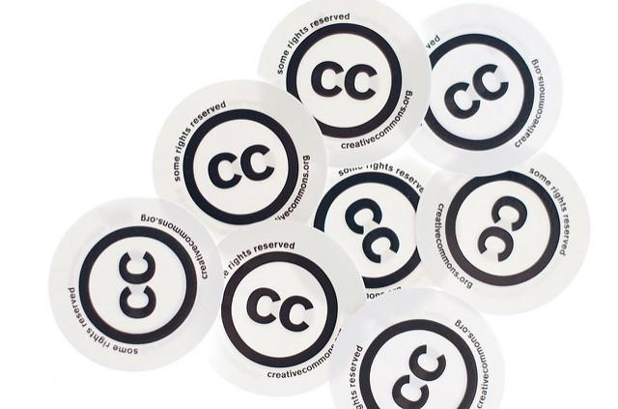
Introduction
to Reusing OER
Picture Credit: Creative Commons – cc stickers by Kristina Alexanderson is licensed CC BY 2.0
This work was created by Beck Pitt as part of the TIDE project and is licensed under the Creative Commons Attribution 4.0 International License unless otherwise stated. Minor amends were carried out to the slides in May 2021.

Slide 3
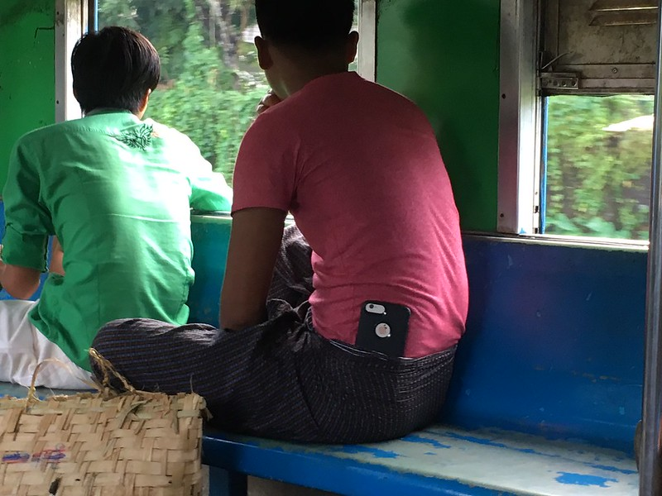
Learning Outcomes
By the end of this session you will be able to:
Use and reference OER and other resources appropriately.
Consolidate your knowledge of open license types and what they mean.
Photo credit: Mobile on the circular train, Yangon, Myanmar II by Beck Pitt is licensed CC BY 2.0

Slide 4
Activity 1: Open
License Refresher
Picture Credit: Creative Commons – cc stickers by Kristina Alexanderson is licensed CC BY 2.0
Notes:
What is each license type? What does it enable you to do?

Slide 11
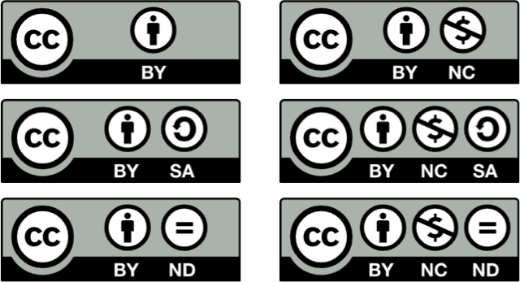

Slide 12
Open Educational Resources (OER)
“Open Educational Resources (OERs) are any type of educational materials that are in the public domain or introduced with an open license. The nature of these open materials means that anyone can legally and freely copy, use, adapt and re-share them. OERs range from textbooks to curricula, syllabi, lecture notes, assignments, tests, projects, audio, video and animation.”
(UNESCO, n.d. http://www.unesco.org/new/en/communication-and-information/access-to-knowledge/open-educational-resources/what-are-open-educational-resources-oers/) (my highlights in red)
Notes:
OER are a type of openly licensed resource.

Slide 13
Retain
Reuse
Revise
Remix
Redistribute
The 5 R’s
See: Defining the “Open” in Open Content and Open Educational Resources by David Wiley http://opencontent.org/definition/ and also The Access Compromise and the 5th R https://openedreader.org/chapter/the-access-compromise-and-the-5th-r/
Notes:
What is the ‘open’ of OER?
Originally 4 Rs but now 5 (addition of retain) by David Wiley,
The new ‘R’ (retain) enables people to keep a copy of a resource – important within the context of resources that are only available for a set period of time

Slide 14
Open Licenses and OER
Image credit: ‘Finding and using open educational resources (OER): implementing the Creative Commons CC BY license (slide 4)’ (Paul Stacey and Hal Plotkin, CC BY 4.0)
Notes:
We’ve seen this slide before – I want to emphasise the ‘open’ aspect here in recap. ND licensed resources would not be described as OER (refer back to 5Rs on previous slide – revise and remix)

Slide 15
What do we mean by adaptation?
Picture Credit: change by Trung Dũng Nguyễn is licensed CC BY-NC 2.0 https://www.flickr.com/photos/mrtrungdung/8880039737/in/
“something that is
changed or modified to suit new conditions or
needs”
Collins English Dictionary: British Dictionary definitions for adaptation (No 3): https://www.dictionary.com/browse/adaptation
Notes:
Can change some CC licensed materials – but not all of them
Change and modification can take two forms

Slide 16
Retain
Reuse
Revise
Remix
Redistribute
The 5 R’s
See: Defining the “Open” in Open Content and Open Educational Resources by David Wiley http://opencontent.org/definition/ and also The Access Compromise and the 5th R https://openedreader.org/chapter/the-access-compromise-and-the-5th-r/

Slide 17
Notes:
Which licenses enable adaptation? [note that there are animations on this slide!] These will indicate the licenses that do not enable remix or revision.

Slide 18
Activity 2: Reusing
OER
Picture Credit: Creative Commons – cc stickers by Kristina Alexanderson is licensed CC BY 2.0

Slide 19
Referencing Other Resources

Slide 20
Remember to reference any resources you incorporate into your own work, e.g. quote your source, paraphrase
You should not use resources without first seeking permission from the copyright owner (unless they are OER or Public Domain)
If there’s no licensing information on the resource do not assume that it is OK to use it!
You can provide a URL to a copyrighted resource in situ rather than embedding it in your work (e.g. video)
You could also look for an OER or Public Domain equivalent to use instead (and reference using TASL)
Notes:
Note that you do not have to attribute Public Domain resources. However, it’s good practice so that other people know where you found the original etc.

Slide 21
How to put a quote in an essay https://www.wikihow.com/Put-a-Quote-in-an-Essay
Referencing (Glasgow Caledonian Library, n.d.) https://www.gcu.ac.uk/library/subjecthelp/referencing/
Examples of Summary, Quotation and Paraphrase (Virginia Kearney, 2019, Owlcation) https://owlcation.com/academia/Examples-of-Summary-Quotation-and-Paraphrase
Direct Quotation, Paraphrasing and Referencing (Royal Literary Fund, 2019) https://www.rlf.org.uk/resources/direct-quotation-paraphrasing-referencing/
Citing References (The University of Reading, 2019) https://libguides.reading.ac.uk/citing-references/quotesandparaphrases
Chapter 5: Referencing (OpenLearn: Developing Good Academic Practice course, n.d.)
https://www.open.edu/openlearn/education/educational-technology-and-practice/educational-practice/developing-good-academic-practice/content-section-5
Notes:
Go to one of these websites and walk through an example
Different styles of referencing

Slide 22
Referencing Open Educational Resources (OER)
Picture Credit: Creative Commons – cc stickers by Kristina Alexanderson is licensed CC BY 2.0
Notes:
This applies to OER that you have not changed.

Slide 23
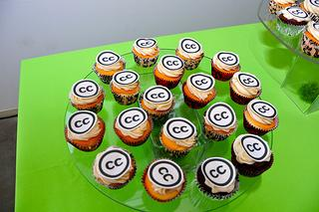
This screenshot and image is from Best Practices for Attribution by Creative Commons and is licensed CC BY 4.0
Notes:
Where we talked about correct attribution for the image.
See also: https://www.flickr.com/photos/sixteenmilesofstring/8256206923/

Slide 24
What about attributing OER created by others?
“Q: How do we incorporate other OER into our materials? How do we give credit?
A: Tweak CC BY license notice to read that there are exceptions.
Attribute authors of OER you are using according to CC best practices.”
Source: Presentation Adding the CC BY license to your materials (TAACCCT) by Jane Park is licensed CC BY 4.0
https://www.slideshare.net/janeatcc/taaccct-on-adding-the-cc-by-license-to-your-materials?qid=212813a1-8798-4d57-98da-f5792b147b2a&v=&b=&from_search=6 See slides 53-63

Slide 25
Screenshot source: Presentation Adding the CC BY license to your materials (TAACCCT) by Jane Park is licensed CC BY 4.0
https://www.slideshare.net/janeatcc/taaccct-on-adding-the-cc-by-license-to-your-materials?qid=212813a1-8798-4d57-98da-f5792b147b2a&v=&b=&from_search=6 See slides 53-63
Notes:
”Unless otherwise noted” makes it clear that there are other materials licensed differently in contained in the document.

Slide 26
Screenshot source: Presentation Adding the CC BY license to your materials (TAACCCT) by Jane Park is licensed CC BY 4.0
https://www.slideshare.net/janeatcc/taaccct-on-adding-the-cc-by-license-to-your-materials?qid=212813a1-8798-4d57-98da-f5792b147b2a&v=&b=&from_search=6 See slides 53-63

Slide 27
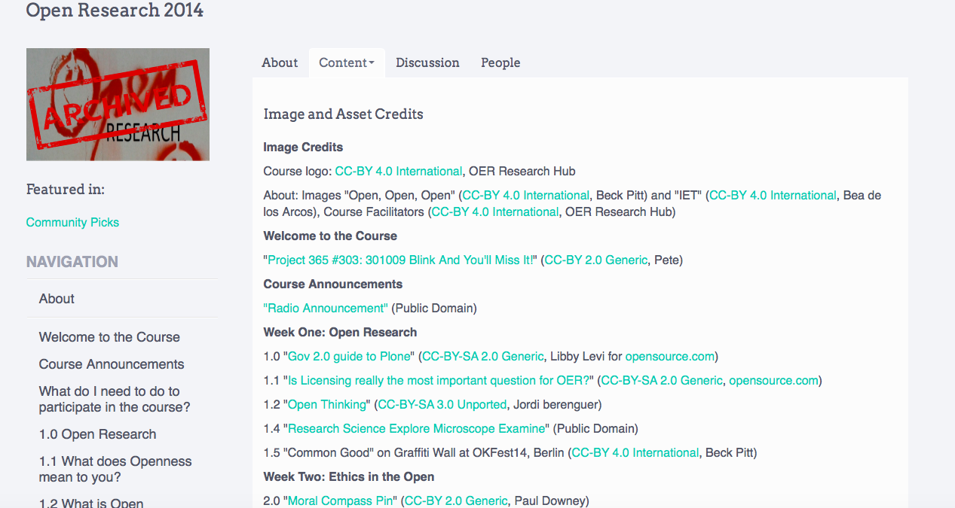
Screenshot source: Open Research 2014 “Image and Asset Credits” section by OER Hub is licensed CC BY-SA 4.0 https://courses.p2pu.org/en/courses/2377/content/4798/
Notes:
Course as a whole was licensed CC BY SA 4.0 (like all Peer 2 Peer University courses on the platform). However, we had an image and asset credits section in the course which provided detailed information on how the other assets we used were licensed.
Remember TASL – Title, Author, Source, License

Slide 28
Screenshot source: Open Research 2014 “About” section by OER Hub is licensed CC BY-SA 4.0 https://courses.p2pu.org/en/courses/2377/open-research-2014/
Notes:
Statement in course introduction… clearly shows the licensing (it was also on bottom of website) but explains that in the instance of this course other assets were used and they are ”governned by different licenses”

Slide 29
Screenshot source: Presentation Adding the CC BY license to your materials (TAACCCT) by Jane Park is licensed CC BY
https://www.slideshare.net/janeatcc/taaccct-on-adding-the-cc-by-license-to-your-materials?qid=212813a1-8798-4d57-98da-f5792b147b2a&v=&b=&from_search=6 See slides 53-63

Slide 30
Screenshot source: Becoming an Open Educator course section 2.2 is licensed CC BY 4.0 except where otherwise stated http://www.open.edu/openlearncreate/mod/oucontent/view.php?id=82522&section=2
Notes:
Or even as we’ve done in this presentation! [see any image that’s used…]
Remember TASL – Title, Author, Source, License

Slide 31
Licensing an Open Educational Resource (OER) which you have changed / revised
Picture Credit: Creative Commons – cc stickers by Kristina Alexanderson is licensed CC BY 2.0
Notes:
This applies to OER that you have changed

Slide 32
Notes:
Which licenses enable adaptation? [note that there are animations on this slide!] These will indicate the licenses that do not enable remix or revision.

Slide 33
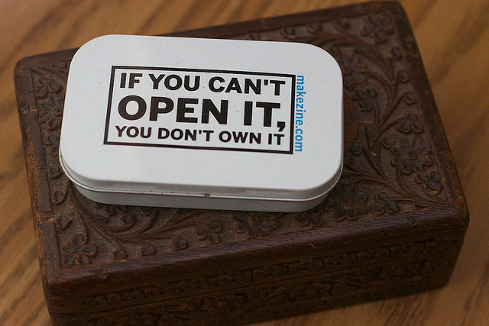
What do we mean
by revise?
Photo credit: Revised: If you Can’t Trademark it, You don’t own it by Alan Levine is licensed CC BY 2.0
https://www.flickr.com/photos/cogdog/18362774588/
“…to adapt, adjust, modify, or alter the content itself (e.g., translate the content into another language)”
David Wiley “Defining the “Open” in the Open Content and Open Educational Resources” http://opencontent.org/definition/ (my highlighted words)
Notes:
Two different references to adaptation in 5Rs – one revise the other remix
Emphasis here is on “the content itself”

Slide 34
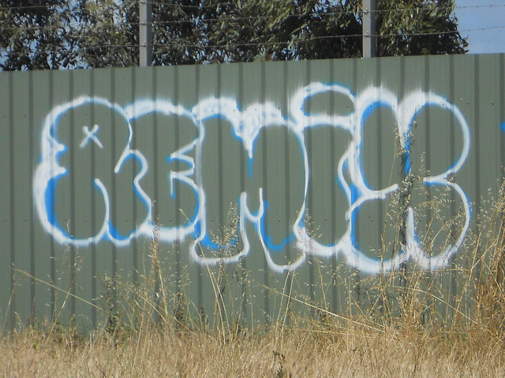
What do we mean
by remix?
Photo credit: Remix by Michael Coghlan is licensed CC BY-SA 2.0 https://www.flickr.com/photos/mikecogh/5135821856/in/faves-40959105@N00/
“…to combine the original or revised content with other material to create something new (e.g., incorporate the content into a mashup)”
David Wiley “Defining the “Open” in the Open Content and Open Educational Resources” http://opencontent.org/definition/ (my italics and highlighted words)

Slide 35
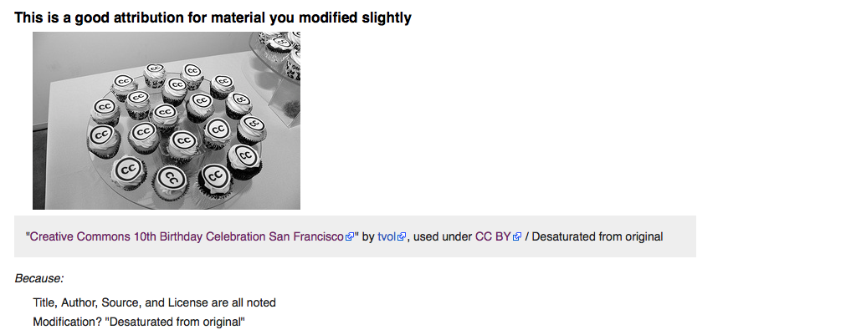
Revise: Modification
This screenshot is taken from the Creative Commons Wiki page on “Best Practices for Attribution” and is licensed CC BY https://wiki.creativecommons.org/wiki/Best_practices_for_attribution#This_is_a_good_attribution_for_material_you_modified_slightly
Notes:
Well here is that image when it’s been revised.
So in this instance the only change to the image has been that it is desaturated (original picture was in colour). This is a very minor change to the image.
Note TASL here and also the inclusion/acknowledgement of a change.

Slide 36
Screenshot source: https://wiki.creativecommons.org/wiki/Marking_your_work_with_a_CC_license Creative Commons Wiki

Slide 37
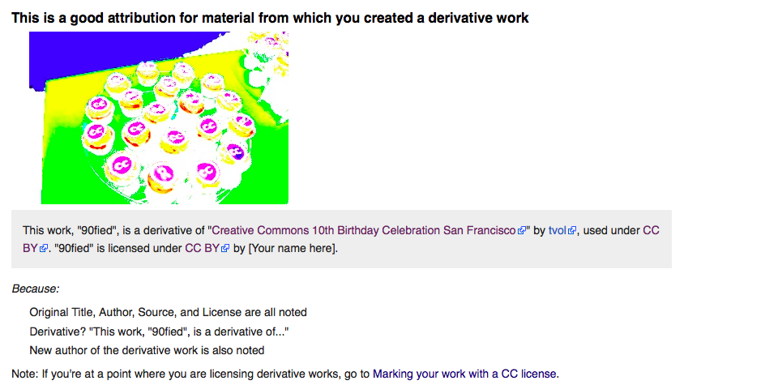
Revise: Derivatives
This screenshot is taken from the Creative Commons Wiki page on “Best Practices for Attribution” and is licensed CC BY https://wiki.creativecommons.org/wiki/Best_practices_for_attribution#This_is_a_good_attribution_for_material_you_modified_slightly
Notes:
“based on one or more existing works” Wikipedia
However in this instance the image has been modified substantially.
Need to reference original work and also license it in same spirit. Make it clear to users.
TASL: https://wiki.creativecommons.org/wiki/4.0/Treatment_of_adaptations#Draft_4

Slide 38
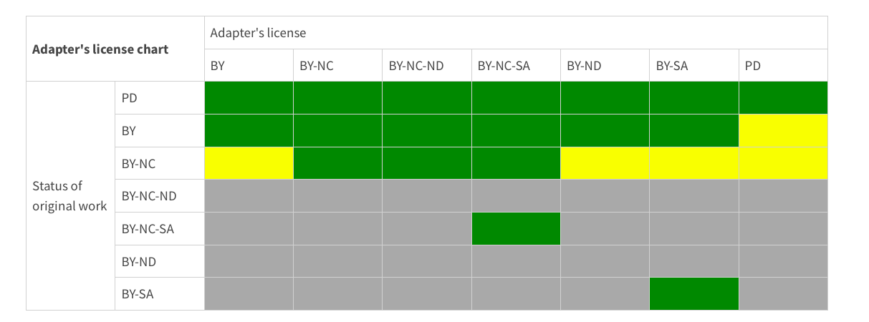
Adapter’s License Chart
Image Credit: Adaptors License Chart: https://creativecommons.org/faq/#what-is-creative-commons-and-what-do-you-do
Green: Yes
Grey: No
Yellow: Take care!
Notes:
And what about the license we can apply to the revised image? The original image is a CC BY image and you need to keep it in the spirit of the original license. Also good to indicate original source of image too.
https://creativecommons.org/faq/#what-is-creative-commons-and-what-do-you-do
This appeared in the Open License webinar so you might remember it from there.
Good practice. Yellow: Need to keep in the spirit of the original license. How will someone using your remix know?
Better instructions of colour coding in original resource (key by Beck so a bit basic!!)

Slide 39
“Can I combine material under different Creative Commons licenses in my work?
It depends. The first question to ask is whether doing so constitutes an adaptation. If the combination does not create an adaptation, then you may combine any CC-licensed content so long as you provide attribution and comply with the NonCommercial restriction if it applies.
If you want to combine material in a way that results in the creation of an adaptation (i.e. a “remix”), then you must pay attention to the particular license that applies to the content you want to combine.”
See: https://creativecommons.org/faq/#When_is_my_use_considered_an_adaptation
Notes:
So we saw earlier some of the different things that could constitute an adaptation (e.g. inserting references, translating something, correcting errors in a text – SEE SLIDE 14)

Slide 40
“What is an Adaptation?
The following are examples of adaptations as defined by the Share-Alike/No Derivatives license:
Modifying an image to create another image (for example, by cropping) is an adaptation;
Translating a short story from one language to another;
Photoshopping a picture to add to, or alter, its original elements;
Using a sample from one song to make a new song;
Adding a song as a soundtrack to a video.
The following uses are not adaptations:
Including a short story in a collection of short stories;
Using an unedited video in the background of a live concert;
Reproducing an unedited image on a website or in a document (such as Word or Powerpoint).”
(Source: p8, Finding and Remixing Openly Licensed Resources:
https://schools.leicester.gov.uk/media/2308/g3-finding-and-remixing-openly-licensed-resources-january-2015.pdf
Notes:
More on adaptation and derivatives…

Slide 41
Remix/Mash up examples
An OER Mashup: Astronomy Redesign: https://www.oercommons.org/authoring/3930-an-oer-mashup-astronomy-redesign/view
Examples of OER in Health Remixes from the African Health OER Network: https://www.oeconsortium.org/2013/10/examples-of-oer-in-health-remixes-from-the-african-health-oer-network/
The best OER Revise / Remix ever? https://opencontent.org/blog/archives/2629
Chapter 23: Valuing Open Textbooks: Derivatives, Adaptation and Remix by Anita Walz https://open.lib.umn.edu/affordablecontent/chapter/valuing-open-textbooks-derivatives-adaptation-and-remix/
Notes:
When showcasing these options, particularly in the instance where there are uses of multiple OER, go to the references/attribution section to show this or
https://openoregon.org/attribution-statements-for-remixed-oer-content/

Slide 42
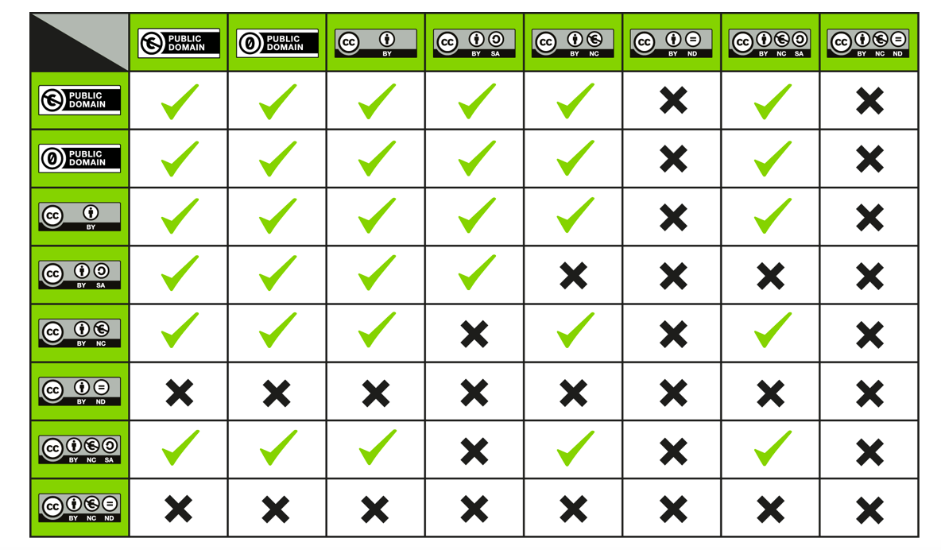
What can I remix?
Source: Can I combine material under different Creative Commons licenses in my work?
https://creativecommons.org/faq/#what-is-creative-commons-and-what-do-you-do
Notes:
https://creativecommons.org/faq/#what-is-creative-commons-and-what-do-you-do
You may remember that the following tables and tools were flagged up during the Open License webinar. This table shows you what different types of licensed resource you can remix.

Slide 43
“If you wish to use the work in a manner that is not permitted by the license, you should contact the rights holder (often the creator) to get permission first, or look for an alternative work that is licensed in a way that permits your anticipated use.”
(What should I think about before using material offered under a Creative Commons license? Creative Commons: https://creativecommons.org/faq/#what-is-creative-commons-and-what-do-you-do (my highlights in red)
What can I remix?
Notes:
Licenses that don’t work together? Best to look for alternatives

Slide 44
In today’s Finding OER session you found a range of resources on different environmental science themes. Working in your team on the resource you created:
How can you best acknowledge your sources?
How can you add in this information appropriately?
Notes:
25 minutes with 20 minutes group sharing afterwards.

Slide 45
Activity 3: Share
Experiences
Picture Credit: Creative Commons – cc stickers by Kristina Alexanderson is licensed CC BY 2.0

Slide 46
Working in your university group, reflect on your experiences of finding, evaluating and reusing OER:
What worked well?
What didn’t work well?
What could be improved?
Notes:
20 minutes with facilitator summary at the end.

Slide 47
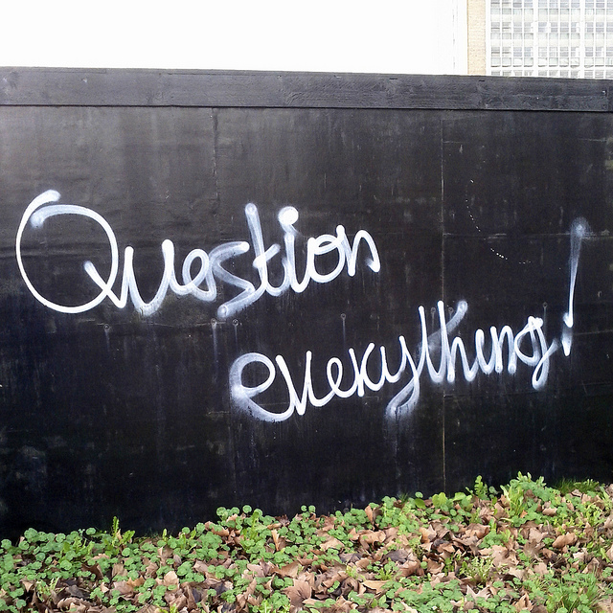
Any Questions?
Photo credit: Question everything! by Henry… is licensed CC BY-NC-ND https://www.flickr.com/photos/henrybloomfield/12680815144/

