Slide 1
Reading a Short Story Intermediate
Parson’s Pleasure by Roald Dahl
Part 3
English e-Reader https://english-e-reader.net/

Slide 3
Part 3: Before you read.
All of these words are in part 3 of the story. Do you know the meanings?
To gasp (v)
To stagger (v)
Fatuous (adj)
A layman (n)
Covetous (adj)
Chippendale (Proper n)
Guinea (n)
A stir (n)
Festoons (pl n)
Scrolls (pl n)

Slide 4
Try matching the definitions to the words
A chain of decorative flowers
A curved decorative cut in wood like a roll of paper
An old, British gold coin
To take a quick, deep breath because of surprise
To walk unsteadily as if about to fall
Stupid
A person without expert knowledge
Having a strong desire for something that others have
Excitement that is felt by a number of people
A famous 18th century English furniture maker
To gasp (v)
To stagger (v)
Fatuous (adj)
layman (n)
Covetous (adj)
Chippendale (Proper n)
Guinea (n)
A stir (n)
Festoon (n)
Scroll (n)

Slide 5
A chain of decorative flowers - Festoon
A curved decorative cut in wood like a roll of paper - Scroll
An old, British gold coin - Guinea
To take a quick, deep breath because of surprise - To gasp
To walk unsteadily as if about to fall - To stagger
Stupid - Fatuous
A person without expert knowledge - layman
Having a strong desire for something that others have - Covetous
Excitement that is felt by a number of people - A stir
A famous 18th century English furniture maker - Chippendale

Slide 6
Part 3: Before you read.
Can you guess what Mr. Boggis finds in Rummins’ farmhouse? Will he be able to buy it?
Read part 3 to find out?

Slide 7
Part 3: While you read.
Try to draw a sketch of the ‘commode’ using the descriptions of it in this part of the story.

Slide 8
Part 3: While you read.
It was a most impressive handsome affair, built in the French rococo style of Chippendale's Directoire period, a kind of large fat chest-of-drawers set upon four carved and fluted legs that raised it about a foot from the ground. There were six drawers in all, two long ones in the middle and two shorter ones on either side. The serpentine front was magnificently ornamented along the top and sides and bottom, and also vertically between each set of drawers, with intricate carvings of festoons and scrolls and clusters. The brass handles, although partly obscured by white paint, appeared to be superb. It was, of course, a rather 'heavy' piece, but the design had been executed with such elegance and grace that the heaviness was in no way offensive.

Slide 9
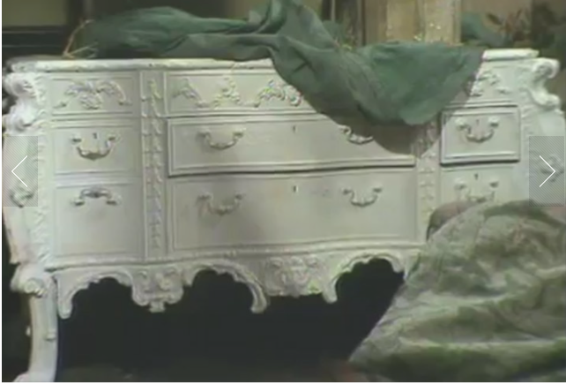
Part 3: While you read.
Does your drawing look a little like this?
Well done!

Slide 10
Part 3: After you read.
Put the ‘events’ in the order they happened in part 3 of the story.
Mr Boggis sees the commode for the first time.

Slide 11
Mr Boggis sees the commode for the first time.
Mr Boggis makes his final offer and Rummins accepts.
Mr Boggis scrapes some paint from the commode to show the others the ‘processed wood’.
Mr Boggis does his trick with the screws.
Mr Boggis offers 10 pounds for the commode.
Mr Boggis looks at and comments on some other furniture to distract from his reaction to the commode.
Mr Boggis pretends to be ill so that he can have some thinking time.
Mr Boggis says that the legs of the commode may be useful for another table that he owns.
Bert fetches the original receipt from a drawer.
Mr Boggis explains how they made the brass look old.
Mr Boggis offers 15 pounds for the commode.
Mr Boggis goes to get his car leaving the three men in the house.

Slide 12
1 - Mr Boggis sees the commode for the first time.
7 - Mr Boggis pretends to be ill so that he can have some thinking time.
6 - Mr Boggis looks at and comments on some other furniture to distract from his reaction to the commode.
8 - Mr Boggis says that the legs of the commode may be useful for another table that he owns.
9 - Bert fetches the original receipt from a drawer.
3 - Mr Boggis scrapes some paint from the commode to show the others the ‘processed wood’.
10 - Mr Boggis explains how they made the brass look old.
4 - Mr Boggis does his trick with the screws.
5 - Mr Boggis offers 10 pounds for the commode.
11 - Mr Boggis offers 15 pounds for the commode.
2 - Mr Boggis makes his final offer and Rummins accepts.
12 - Mr Boggis goes to get his car leaving the three men in the house.

