Slide 1
Supported by and in collaboration with
Politecnico di Milano
Off-Grid Systems Modelling with MicroGridsPy
LECTURE 4
Introduction to MicroGridsPy
Version 1.0

Slide 2
Learning Outcomes of the Lesson
Energy System Definition and Problem Formulation
Learners will understand how to define and configure MicroGridsPy energy systems, incorporating various energy sources and storage options, and learn to formulate optimization problems to determine the most efficient system configuration
Understanding MicroGridsPy Inputs
Comprehending the significance of input data, such as time series for load and renewable energy availability, and various techno-economic parameters, crucial for tailoring the simulation to specific scenarios
Mathematical Formulation in MicroGridsPy
Learners will grasp the mathematical foundations underlying MicroGridsPy, including the optimization algorithms and constraints used to determine the optimal design and operation of microgrids
Results in MicroGridsPy
Comprehensive introduction to the different set of results provided by MicroGridsPy
1

Slide 3
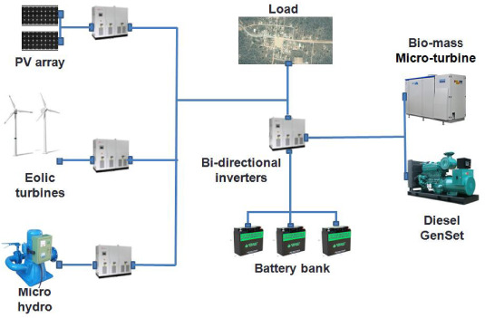
Energy System Definition
Energy System
The system combines a renewable generation technology (e.g. Solar PV, Wind turbine etc.), managed via bi-directional inverters and a storage system (e.g.: battery bank), and generators, diesel or biomass, ensure backup power. This configuration maintains a reliable electricity supply, balancing renewable energy with dependable backup.
MicroGridsPy energy system visualization
Load Demand
Biomass Micro-Turbine
PV modules
Renewable Generation Technologies
Backup systems
Bi-directional Inverters
Wind Turbines
Diesel Generator
Battery bank
Storage systems
2

Slide 4
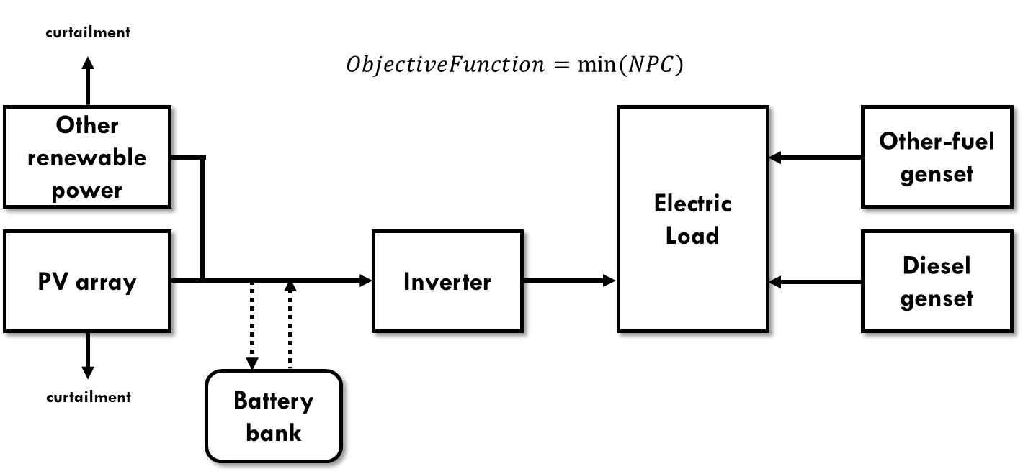
Problem Formulation
Problem
Determine the combination of installed capacities of RES, Batteries and Generators that makes the lowest Net Present Cost (NPC) for the lifetime of the project and accomplishes the constraints of the system.
1 - Define the inputs
Techno-economic parameters
Time series data
2 - Set constraints
Configuration settings
Optimization settings
Modelling equations
3 - Optimize the objective function
Net Present Cost (NPC)
Emissions
4 - Results
Sizing and dispatch
Costs
MicroGridsPy problem visualization and components interlinks
3

Slide 5
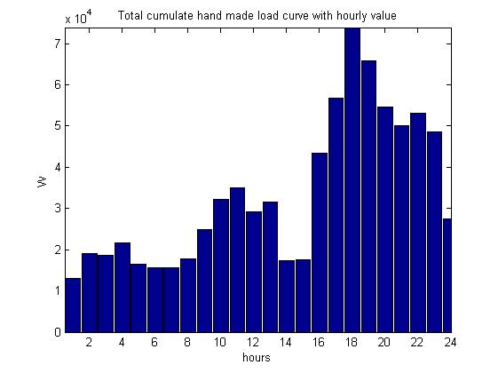
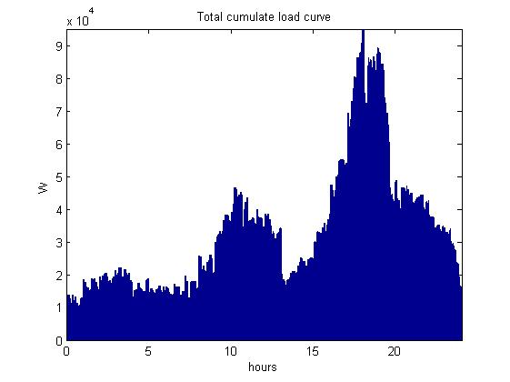
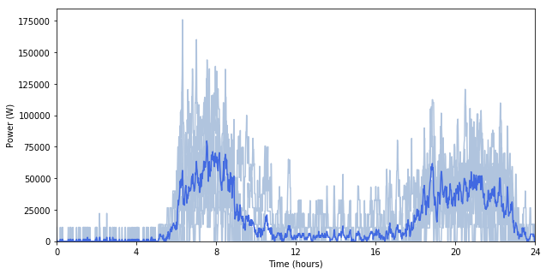
Input: load time series data
Time-dependent electricity estimated need of a given area or system. It is typically measured in Watts (or kilowatts, megawatts, etc.) and captures how electricity demand varies over different periods, usually in hourly or sub-hourly intervals.
Various examples of load curves
Load Curve
It underscores information such as peak demand, variability, baseload, and socioeconomic influences, essential for developing efficient, community-specific energy systems that provide reliable electricity.
Demand forecast
Demand forecasting is crucial for tailoring energy systems to rural communities' future needs. It ensures efficient, cost-effective system sizing, adapting to varying demand influenced by development and population changes.
$\sim$75% did not take into account an evolution of the load
$\sim 20\%$ arbitrary trends of demand evolution
(Sample of 85 studies [1])
Explored in Lecture 5...
4

Slide 6
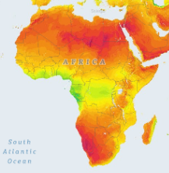
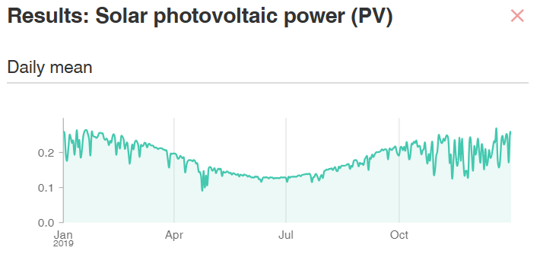
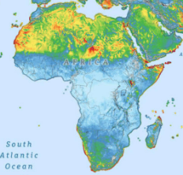
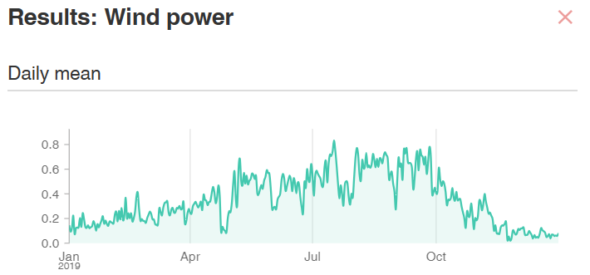
Input: renewables time series data
Estimated electricity production for each unitary generation technology at a specific time and location. It is typically measured in Watts (or kilowatts, megawatts, etc.) and illustrates how electricity production varies over time and by source, usually in hourly or sub-hourly intervals.
Solar Resource Availability
It reflects the amount of sunlight accessible at a specific location over time. This dataset is typically characterized by parameters like solar irradiance, panel efficiency, optimal panel tilt and orientation, local climate conditions, and system losses. These elements determine the potential energy output of solar panels.
Solar Atlas of Africa [2]
Wind Resource Availability
It tracks wind speed and direction at specific locations. Key factors for estimating wind turbine electricity production include wind speed, the turbine's power curve, cut-in and cut-out speeds, air density, and turbine height. These elements together determine the potential energy output of wind turbines.
Wind Atlas of Africa [3]
Examples of daily average load factor for solar and wind [4]
Explored in Lecture 6...
5

Slide 7
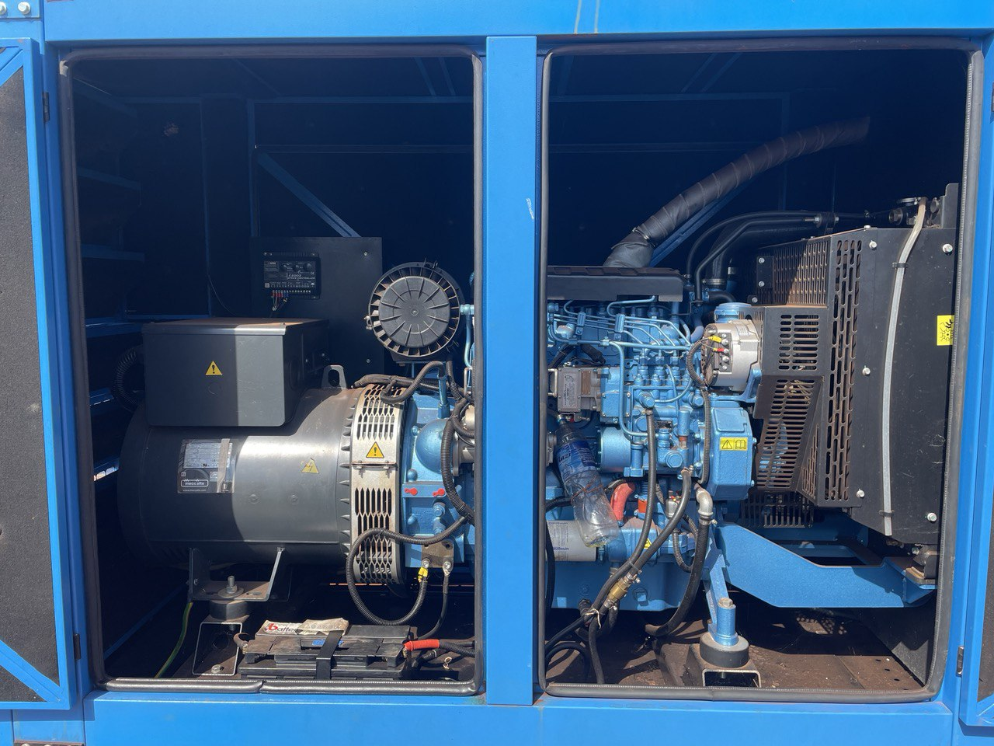
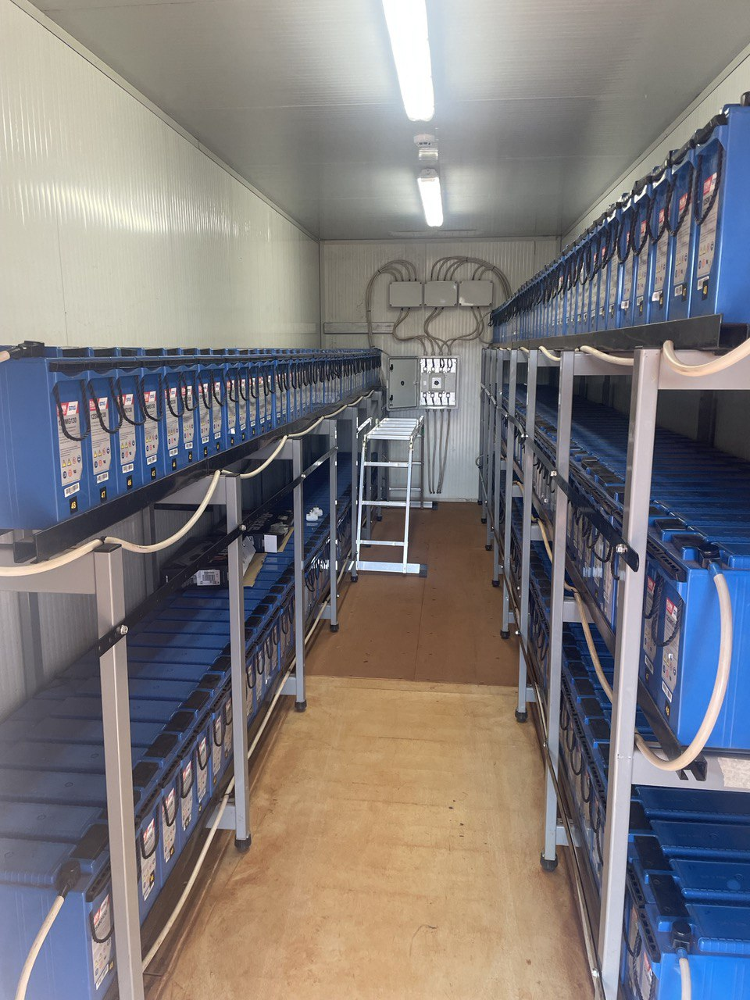
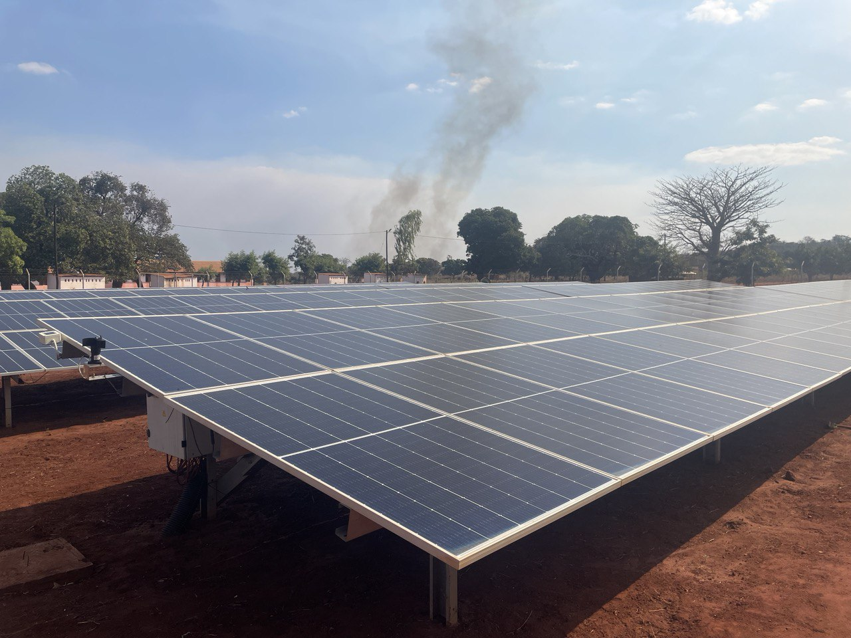
Input: Techno-economic parameters
Parameters definition requires detailed data to accurately reflect the system's economic, technical, and ecological dimensions, thereby ensuring a robust and comprehensive optimization model.
Specific Investment costs [e.g. $/W]
It encompasses all initial financial outlays required to acquire, install, and commission various components of the energy system.
Examples: CAPEX, PV installation, Wind turbine erection etc.
Specific Operation costs [e.g. $/Wh]
They cover the recurring expenses associated with the daily operation and maintenance of the energy system over its lifetime.
Examples: OPEX, maintenance costs etc.
Performance Metrics [e.g. %]
They represent the effectiveness with which each component converts energy from one form to another, maintains power quality, and ensures system durability and reliability.
Examples: lifetimes, efficiencies, depth of discharge etc.
Environmental factors [e.g. kgCO₂/kW]
They assess the environmental footprint of the energy system, considering the sustainability and ecological implications of its operation.
Examples: unit of indirect emissions, direct emissions etc.
On-field pictures of solar panels, battery bank and diesel generator
Explored in Lecture 7 and 8...
6

Slide 8
Mathematical Formulation
MicroGridsPy utilizes configuration and technology parameters as well as temporal data to optimize energy systems, balancing cost and efficiency while adhering to operational constraints.
Configuration Parameters
Time horizon
Renewable penetration
Battery independence
Lost load
Discount rate
Decision Variables
Objective Functions
Capacity of each technology Units of renewables capacity
Net present costs
Total operation costs
Technology Parameters
Specific technology costs
Specific emissions
Efficiencies
Lifetime
Secondary Variables
Constraints
Hourly energy produced
Fixed and variable costs
Total emissions
Optimization constraints
Renewables constraints
Technologies functioning equation
Time Series Data
Load Demand
Renewables electricity production
7

Slide 9
Mathematical Formulation
The model optimizes costs, ensuring energy production meets demand within defined constraints for system balance and efficiency.
Total Investment Cost
Yearly Operation Cost
Objective function:
$$NPC=Inv+\sum_{n=1}^{N}{\frac{YCC}{{\left(1+d\right)}^{n}}}$$
$$YCC=C_{O\&M}+C_{fuel}+C_{LostLoad}+C_{Batt.rep}$$
$C$: Variable cost
Total Actualized Operation Cost
$$E_{El,Demand}\left(t\right)=\sum_{r}{E_{{VRES}_{r}}\left(t\right)}+\sum_{g}{E_{{Gen}_{g}}\left(t\right)}−E_{bat,ch}\left(t\right)+E_{bat,dis}\left(t\right)−E_{Curt}\left(t\right)+E_{LostLoad}\left(t\right) [Wh]$$
Energy balance:
Optimization Constraints:
Renewable penetration, battery independence, lost load fraction equations etc.
Technology Constraints:
Renewables, batteries and generator functioning equations
8

Slide 10
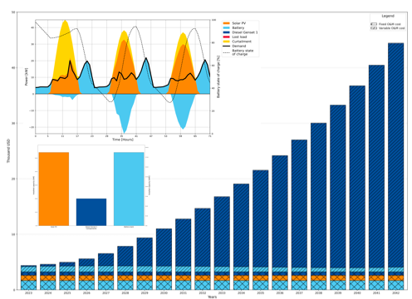
Results
MicroGridsPy offers a comprehensive array of results and plots, important for evaluating and optimizing mini-grid performance, including financial viability, operational efficiency, and energy reliability.
Sizing
Optimal installed capacity of each technology
Costs
Aggregated Investments costs
Aggregated Operation costs
Total cost metrics: NPC and LCOE
Yearly Energy and Cash flows
Yearly non-actualized costs for each technology
Yearly energy share for each technology
Energy time series data
Hourly data of the system’s energy balance, including technology energy production, battery energy flows, demand, lost load, and curtailment.
Examples MicroGridsPy results: dispatch, size and cash-flow plot
Explored in Lecture 9...
9

Slide 11
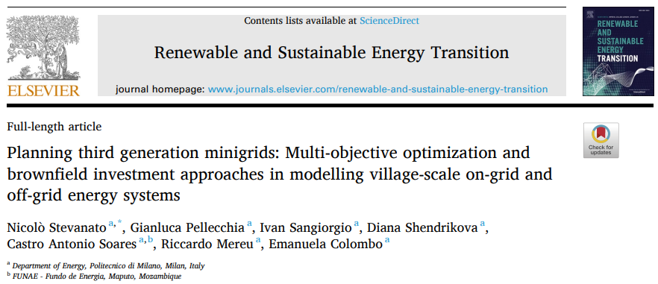
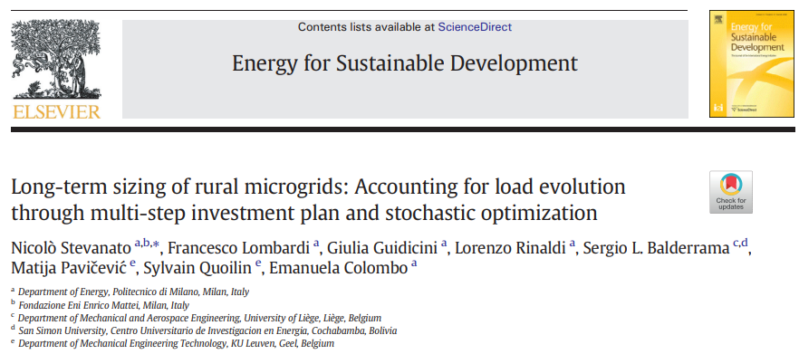
MicroGridsPy in Literature
MicroGridsPy has been referenced in various academic and industry literature, showcasing its relevance and application as a tool for optimizing and planning mini-grid systems.
Complete list of publications here: https://microgridspy-documentation.readthedocs.io/en/latest/index.html
10

Slide 12
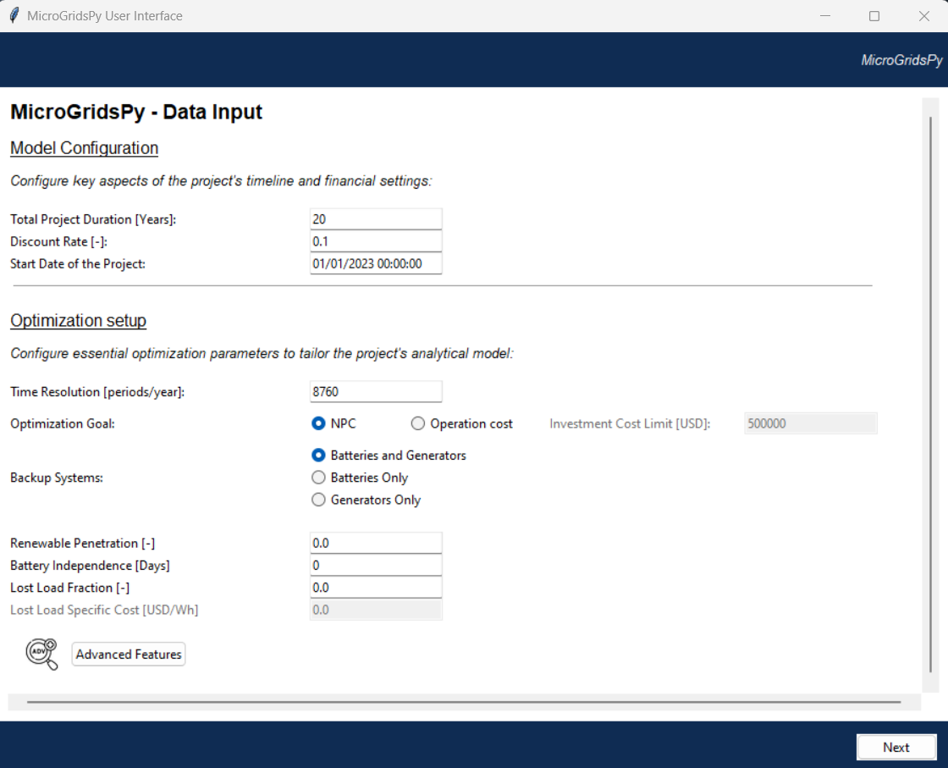
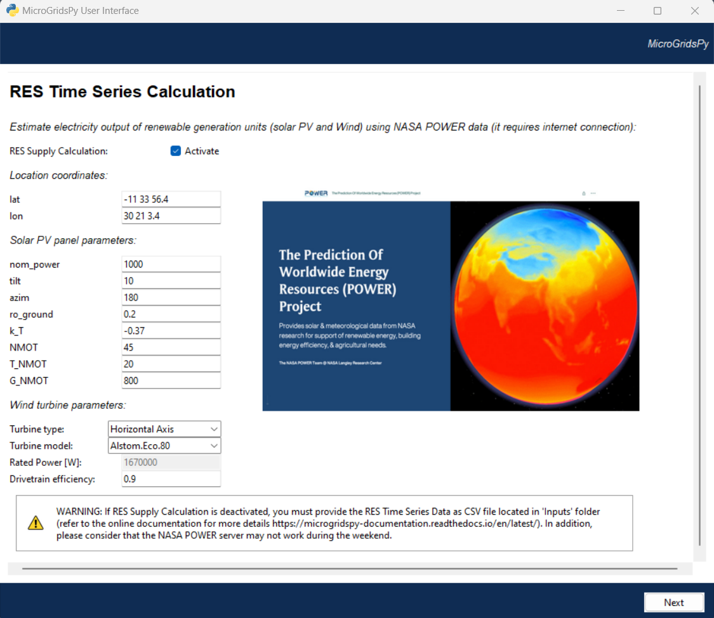
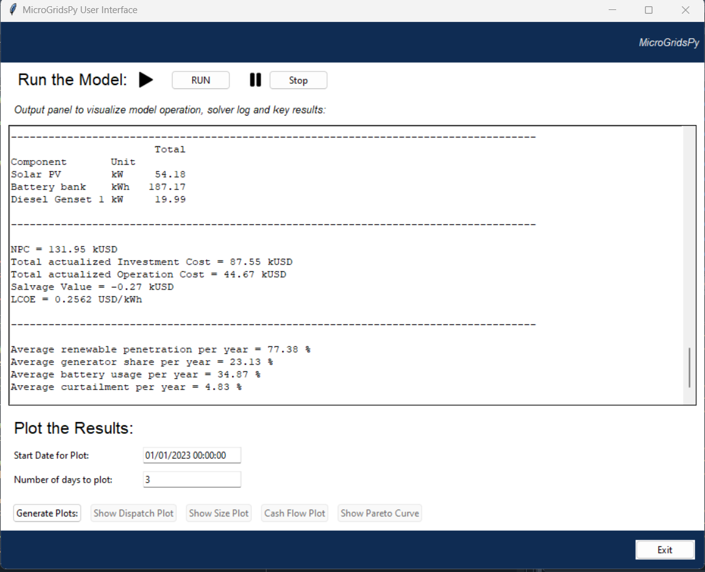
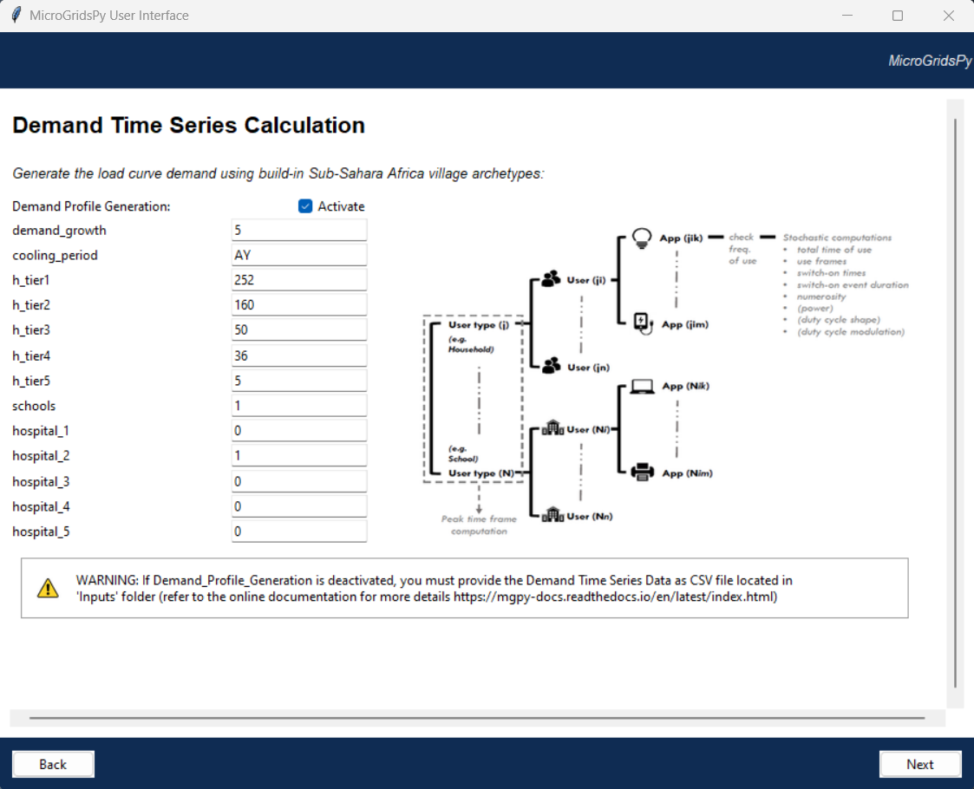
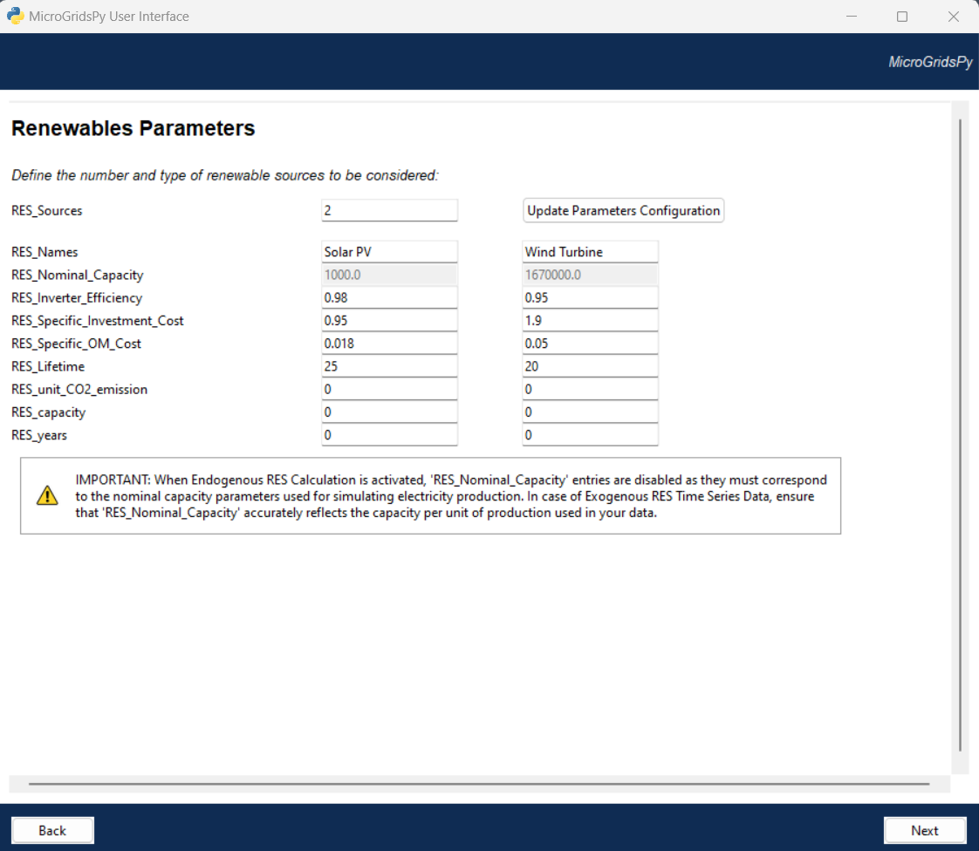
Graphical User Interface
The graphical user interface (GUI) application provides a user-friendly way to define and input data for MicroGridsPy. It is organized into different pages, each tailored to a specific aspect, with default configuration settings and parameters.
Comprehensive Data Input and Validation
Features robust data input for basic parameters, RES time series, and technology configurations, with input validation and tooltips on each page for accurate and clear data entry.
Dynamic Parameters Management and Visualization
The interface dynamically updates and manages parameter entries in response to user selections. This automatic enablement and disablement of options streamline the data input process, enhancing user interaction and decision-making through effective visualization.
Efficient Run Functionality and Results Visualization
It includes functionalities for progress tracking and visual display of results, making the modelling process seamless and efficient.
Run this python script within your working IDE to open the application
Code/User Interface/app_main.py
11

Slide 13
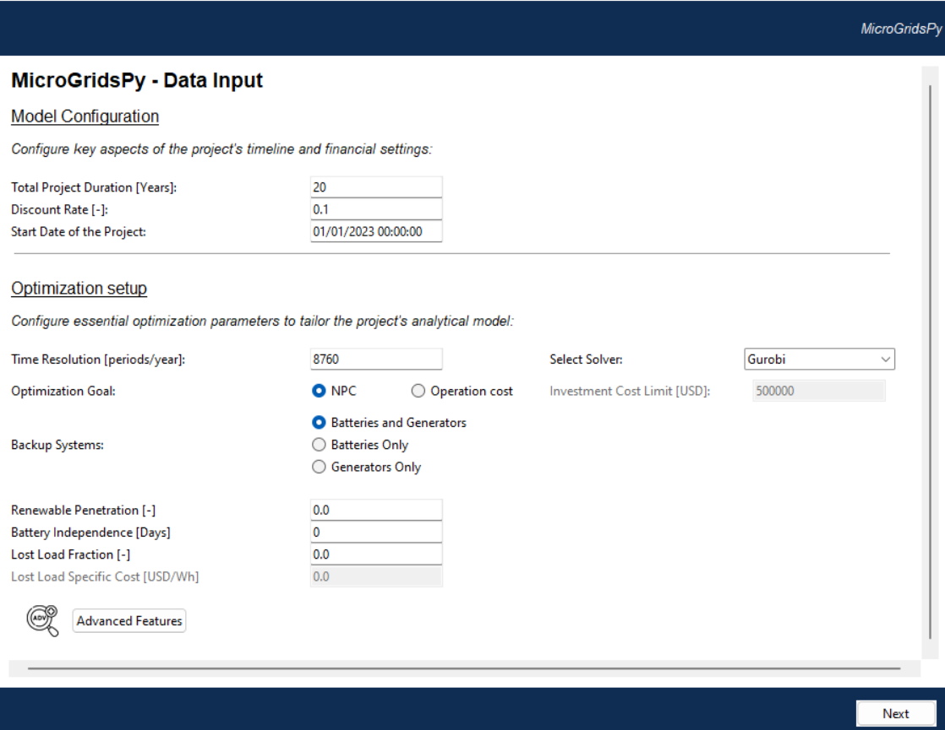
Model Configuration
Total Project Duration [years]
Discount Rate [%] (0-1)
They mainly affect the actualization of the costs and, therefore, the technology selection and sizing of the mini-grid.
Time Resolution
It affects result accuracy. Users can adjust it, but must ensure that any external time series data correspondingly match this resolution
Optimization Goal
Net Present Cost: focuses on optimizing both investment and operation costs
Operation Cost: targets minimizing only operational expenses with an option to limit capital expenditure
12

Slide 14
Model Configuration
Backup and Storage Systems
The user has the option to specify constraints on the types of technologies used for backup and storage within the model
Optimization constraints
Renewable Penetration: minimum percentage of total electricity from renewable sources
Battery Independence: number of days the battery can power the grid without external support
Lost Load Fraction and Cost: Threshold for unmet demand, with associated costs applicable only if there's a non-zero lost load
13

Slide 15
Model Configuration
vs
GLPK and Gurobi are currently compatible with MicroGridsPy and integrated options in the interface:
GLPK: An open-source, free-to-use option for small to medium optimization problems
Gurobi: A faster, commercial solver suitable for large problems. Free for academic use; installation recommended from Gurobi's website. Requires license activation.
GLPK is suitable for a range of optimization problems but operates slower than commercial solvers like Gurobi on large or complex issues. Performance can vary, with Gurobi often being significantly faster, which is crucial for large-scale or urgent tasks
14

Slide 16
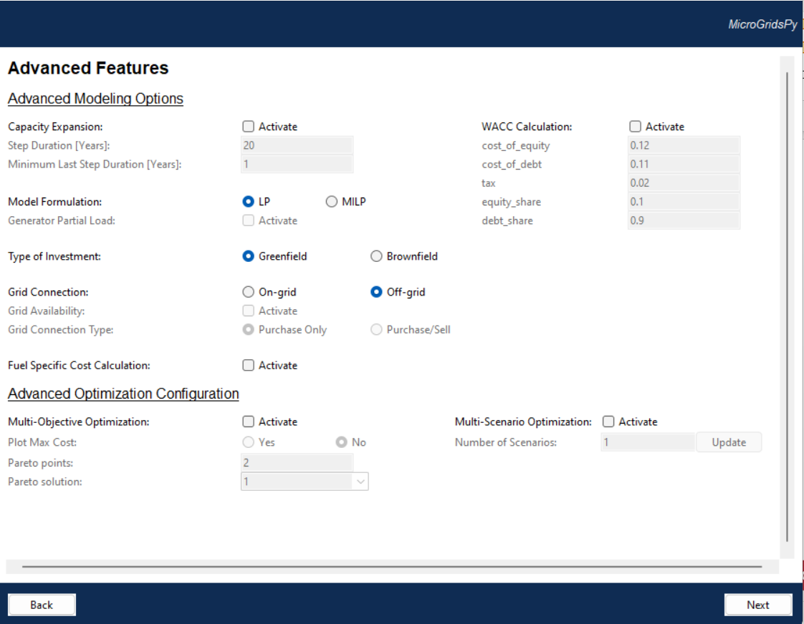
Advanced Features
It enables advanced features such as capacity expansion, special financials setup, grid connection options, and advanced linear or mixed-integer optimization. It also supports multi-objective and scenario-based optimization.
15

Slide 17
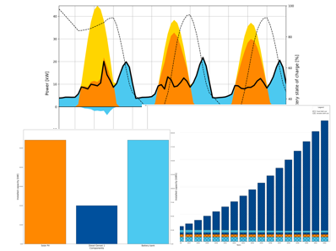
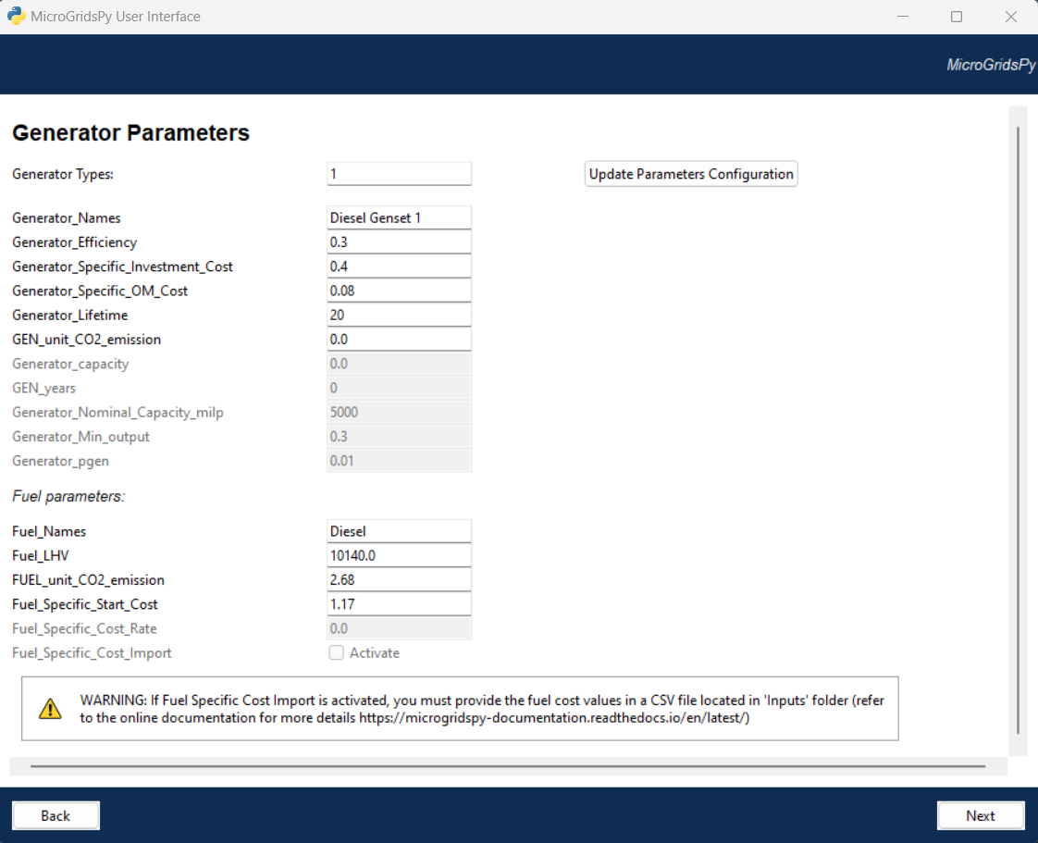
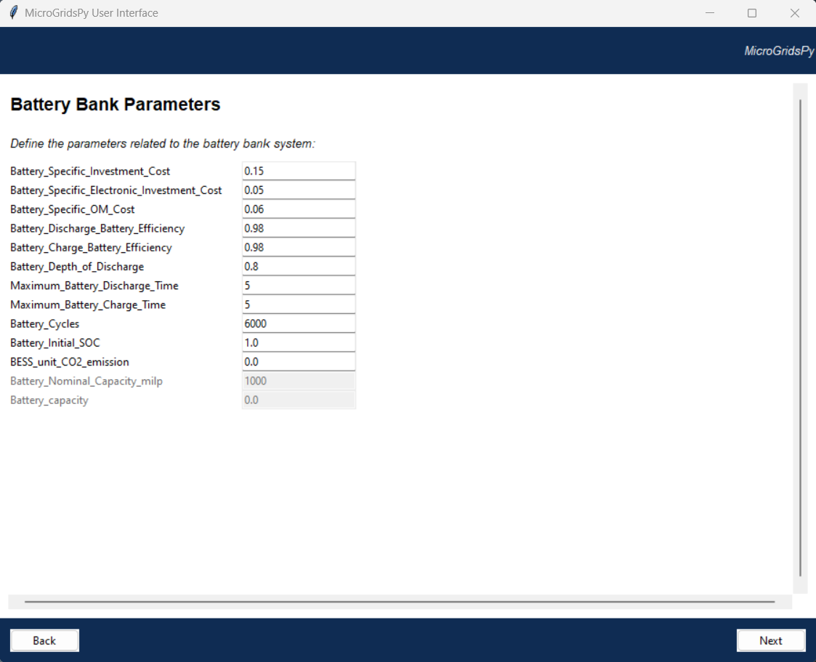
Default Configuration
The default settings and data implemented in the interface refer to an exemplative case study in Zambia's Bangweulu Wetlands. This basic scenario includes a 20-year time horizon, solar and wind renewable energy sources, linear programming optimization and backup systems comprising battery storage and diesel generators, without extra features or advanced models.
Please note that the default values provided in the MicroGridsPy interface are purely exemplative and may not strictly represent realistic values for actual implementations. It is essential to tailor these settings to specific project requirements and real-world conditions for accurate simulations and results.
16

Slide 18
References
[1] Riva et al., Long-term energy planning and demand forecast in remote areas of developing countries: Classification of case studies and insights from a modelling perspective, Energy Strategy Reviews 2018, http//doi.org/10.1016/j.esr.2018.02.006
[2] Global Solar Atlas, https://globalsolaratlas.info/map
[3] Global Wind Atlas, https://globalwindatlas.info/en
[4] Renewables Ninja, https://www.renewables.ninja/
17

Slide 19
Supported by and in collaboration with
Politecnico di Milano
Consolidated by Nicolò Stevanato, Alessandro Onori, Riccardo Mereu and Emanuela Colombo from Politecnico di Milano
Moksnes N., Sahlberg A., Khavari B. 2021. Lecture 1: OnSSET/Global Electrification Platform. Release Version 1.0. [online presentation]. Climate Compatible Growth Programme, Energy Sector Management Assistance Program and World Bank Group
Stevanato, N., Onori, A., Mereu, R., & Colombo, E., 2024. Lecture 1: Off-Grid Energy Systems Modelling with MicroGridsPy. Release Version 1.0 [online presentation]. Climate Compatible Growth Programme, Politecnico di Milano
CCG courses (this will take you to the website link http://www.ClimateCompatibleGrowth.com/teachingmaterials)

