Slide 1
Flood Management Institutions in Myanmar
Module 3 Lecture

Slide 2
Lecture 3: Understanding Flood Management Techniques in Myanmar
This lecture will cover the following topics:
Flood Management Policies and Institutions in Myanmar
Challenges & Recommendations for Flood Protection in Myanmar

Slide 3
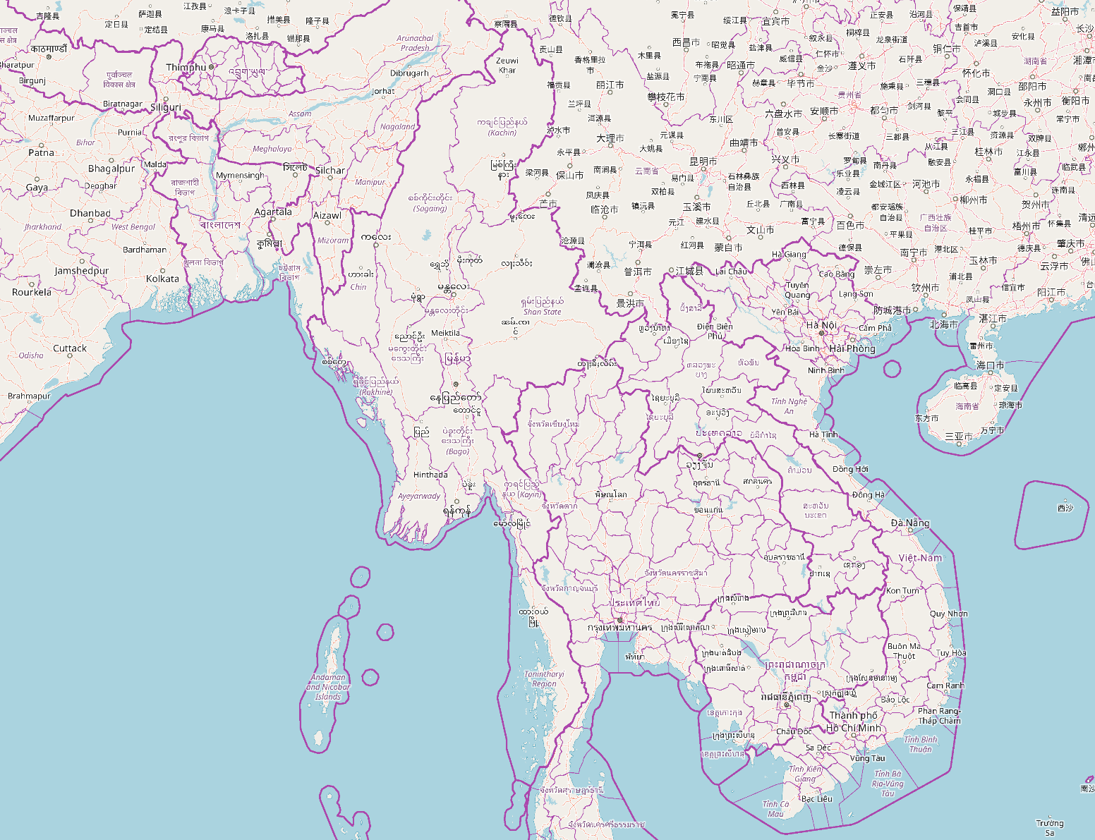
What are the major policies and institutions for flood management in Myanmar?

Slide 4
Flood Management Institutions in Myanmar
Notes:
Paper source: Shirai et al., (2018)) Data Communication for Efficient Water Resource Management Among Multiple Stakeholders – A Case Study in the Bago River Basin, Myanmar – Required reading 1 for Module 3.

Slide 5
Roles & Responsibilities of Institutions
Department of Hydropower Implementation (DHPI) (Required reading 1: Shirai et al., 2018)
Designs and constructs dams, procures necessary equipment for dam operations
In Bago River Basin – maintains Zaung Tu Dam – oversees operation – for generating electricity
Data communication among multiple stakeholders critical – to make decisions related to dam operation – dam has to discharge flood waters even when flood risk increased
Department of Hydrology and Meteorology (DMH)
DMH forecasts weather & water levels by analyzing metrological & hydrological data from observation stations in major rivers and cities
Has authority to issue flood forecasts and early warnings; also develops hazard maps of water-related disasters
31 meteorological observation stations nationwide, two of which are in the Bago region
For data communication with other stakeholders, the DMH sells some observed and processed data to others, such as the IWUMD and the Department of Hydropower Implementation (DHPI)

Slide 6
Roles & Responsibilities of Institutions
Irrigation, Water Utilization Management Department (IWUMD)
Role is to construct & operate river management facilities, such as embankments, sluice gates, and canals, and it dredges river beds to improve agricultural irrigation
IWUMD has data analysis function called the Irrigation Technology Centre (ITC) - role in application of science & technology for river infrastructure management
Collects data on the inflow and outflow of dams and weirs as well as water levels at those observation points
Lack of observation stations to cover entire areas of the Bago River Basin, especially in and around the city of Bago and downstream from it - is problem.
Necessary not only to increase the number of stations but also to automate data acquisition to obtain data quickly and frequently
General Administration Department (GAD) and Relief and Resettlement Department (RRD)
GAD manages administrative works normally – during emergencies - manages disaster information, including warnings
Warnings are issued from the DMH to the Ministry of Home Affairs and transferred to the local level, from districts to townships to villages.
District-level GAD office assesses damage and manages emergency responses by leading organizations, such as police stations, fire stations, and the local RRD
RRD manages & coordinates disaster relief activities, including the operation of evacuation shelters and the distribution of stored disaster emergency aid in close partnership with the GAD

Slide 7
Change in Institutional Framework for Disaster Management in Myanmar
The political system in Myanmar changed from a military regime to a democratic regime in 2011 (Source: Required reading 2 – Htein, Lim and Zaw (2018))
The new regime, the USDP government led by the first civilian President U Thein Sein, controlled a five-year cycle of state governance from 2011 to 2015
During the USDP government - National Disaster Management Law was enacted in 2013, and the National Natural Disaster Management Central Committee (NNDMC) was formed in 2015
Main purposes of the NNDMC - to prepare the disaster management plan systematically in a pre-disaster time and to provide effective disaster responses during disaster times
Main objective of the structural change in the NDMC was to promote quicker disaster response mechanisms for victims in disaster-affected areas.
Significant change included decentralization of authority to local governments to expedite prompt responses for rescues and humanitarian support
Notes:
Source: Htein, Lim, & Zaw. (2018). The evolution of collaborative networks towards more polycentric disaster responses between the 2015 and 2016 Myanmar floods. International Journal of Disaster Risk Reduction, 31, 964-982

Slide 8
Role of Military in Disaster Management in Myanmar
Myanmar has experienced severe disasters such as Cyclone Nargis in 2008 but 2015 floods represented the first experience of severe countrywide flooding (Source: Required reading 2 – Htein, Lim and Zaw (2018))
2016 flood response…harmony among the military, governments, and civil society organizations was much stronger and led to more collaboration in responses compared to 2015 floods
Military pivotal in 2015 flood response and continued to be one of critical participants in the 2016 flood response; that is, the overall interactive patterns of disaster management in Myanmar changed from a military-centred response in 2015 to a more collaborative-oriented and polycentric response in 2016.
During 2015 and 2016 floods, Myanmar military—the army, navy, and air force—still play a critical role in disaster management, especially in the activities of evacuation, search and rescue and humanitarian assistance
Notes:
Source: Htein, Lim, & Zaw. (2018). The evolution of collaborative networks towards more polycentric disaster responses between the 2015 and 2016 Myanmar floods. International Journal of Disaster Risk Reduction, 31, 964-982

Slide 9
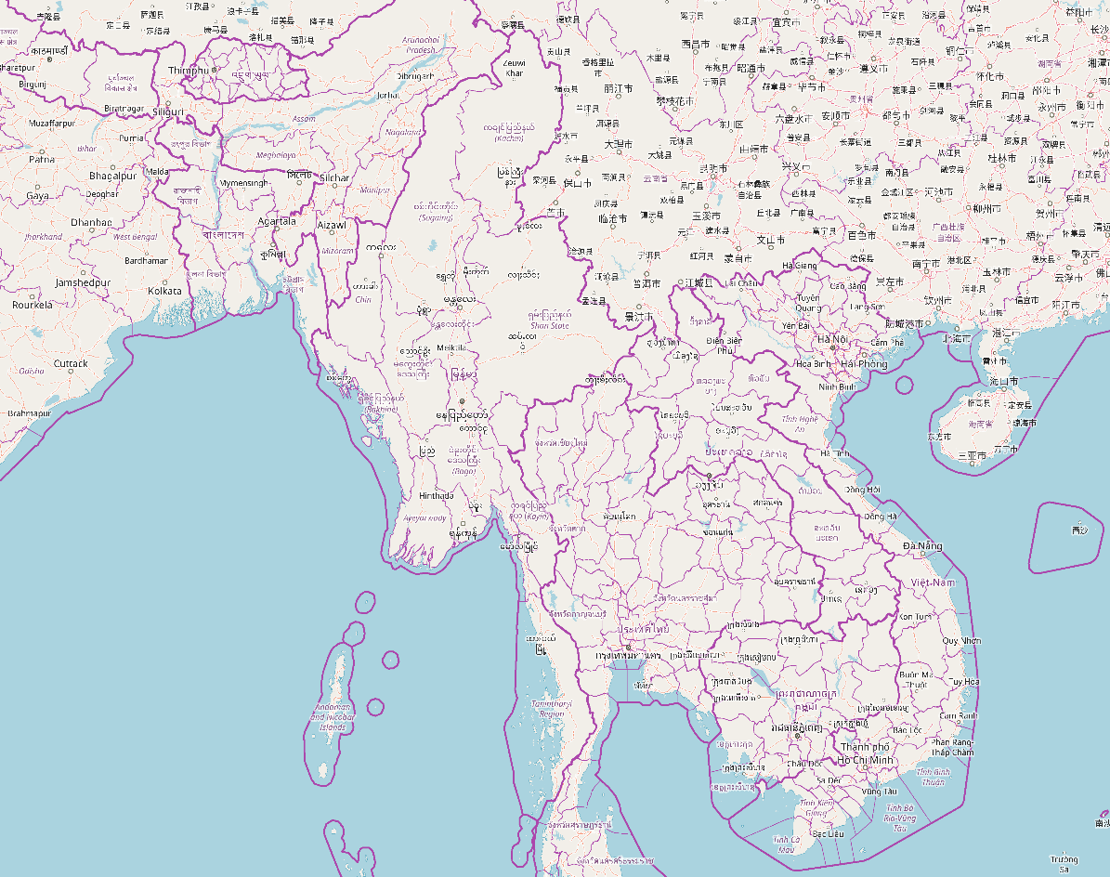
Challenges & Recommendations for Flood Management

Slide 10
Flood Management Challenges & Approaches
Challenges
Recommendations
Reducing flood hazard (example: Bago sub-basin)
Sedimentation
Deforestation – leading to erosion and sedimentation
Dredging and excavation work of natural drainages & creeks within river basin
Reconstruction & resection work for flood embankments
Excavation to attain sufficient water depth
Ban on logging
Notes:
(source: Nesheim et al., (2018) - required reading 3)

Slide 11
Guiding Principles of Environmental Conservation in Myanmar
Notes:
Source: Nesheim et al., (2018) – required reading #3

Slide 12
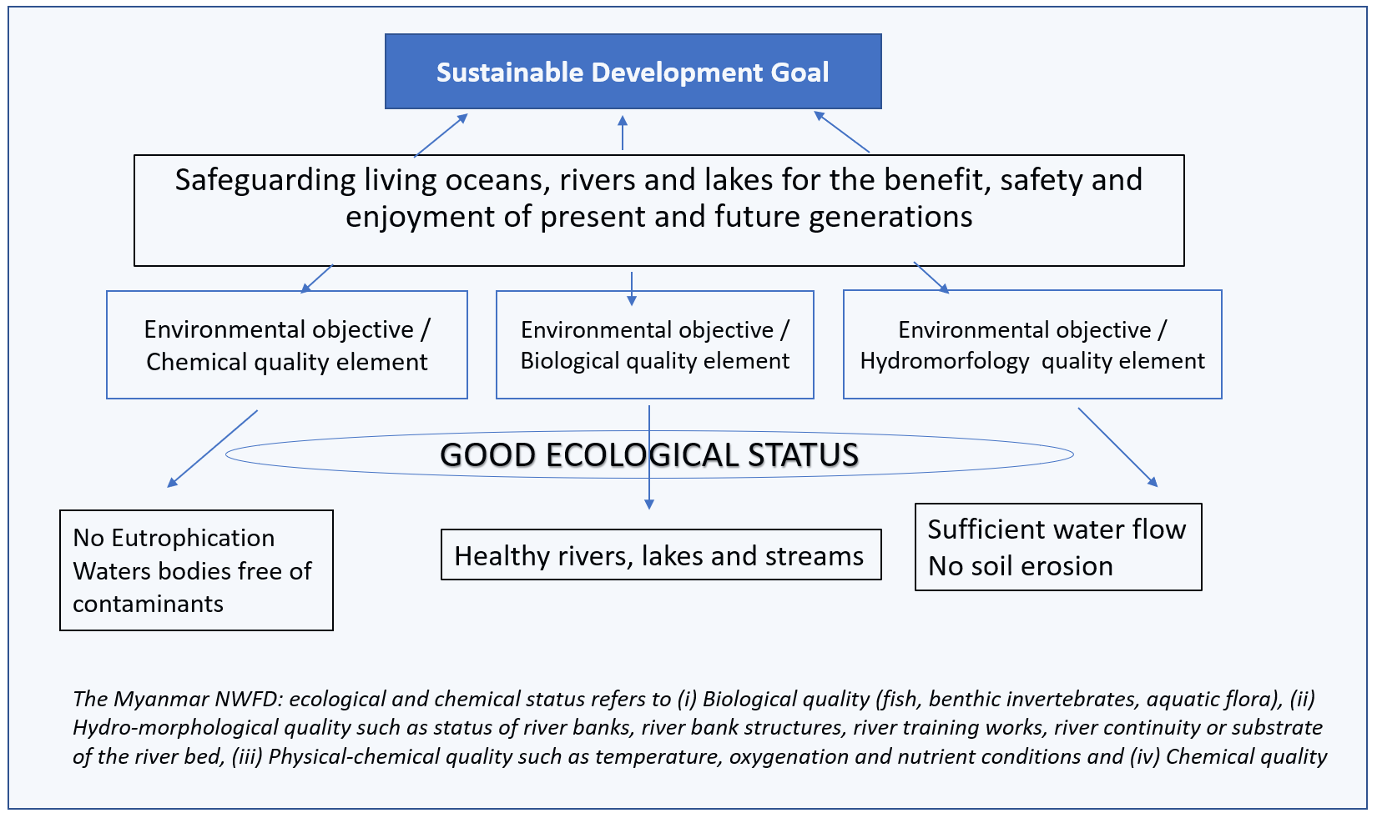
Myanmar New Water Framework Directive

Slide 13
Next Module: Early Warnings Systems and Hazard Maps – Tools for Detecting Floods

