Slide 1
Lecture 2 Law and Policy – Case Study
The Electricity Transition Playbook
Supported by and in collaboration with CCG and Green Grids Initiative
Version 1.0
Notes:
This second part of the law and policy lecture will focus on a specific case study. It is applying concepts from the lecture, in particular the idea of governance functions, in a specific context, in this case Mexico.

Slide 2
Case study overview
The case study is structured similar to the lecture and shows how the concepts from the lecture could be applied by:
Mapping the landscape of law and policy for electricity transitions
Understanding the circumstances under which law and policy came into place
Analysing law and policy with respect to core governance functions
Case study structure:
Introduction and context
2) Background on energy and governance in Mexico
3) Mapping law and policy in Mexico
4) Understanding the introduction of laws and policies
5) Analysing law and policy with respect to governance functions
6) Q&A
Notes:
The case study is structured similar to the lecture and shows how the concepts from the lecture could be applied by
Mapping the landscape of law and policy for electricity transitions,
Understanding the circumstances under which law and policy came into place, and
Analysing law and policy with respect to core governance functions.

Slide 3
Background and policy landscape
Electricity Transition Playbook: Law and Policy
Notes:
This first section is giving a very short background and is mapping a limited part of the relevant law and policy landscape in Mexico.

Slide 4
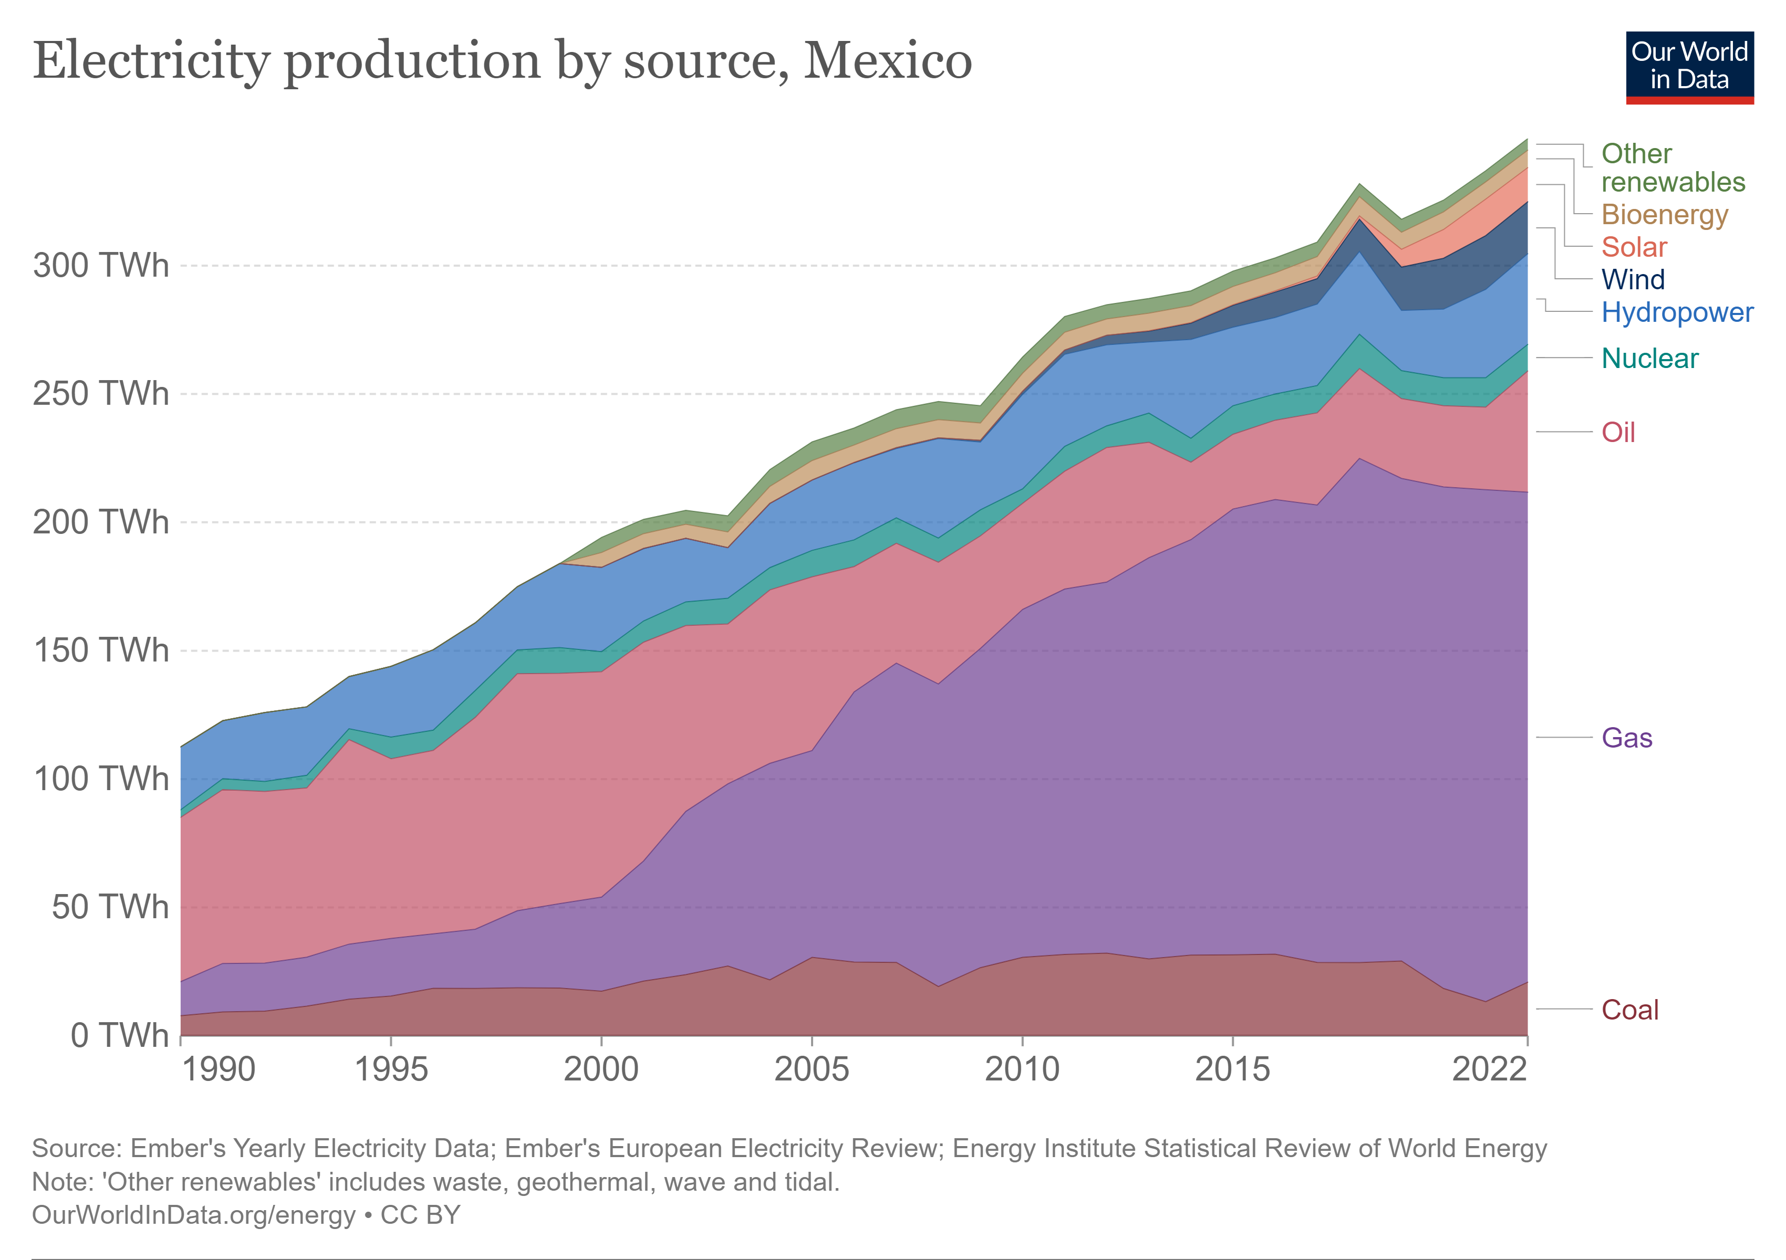
Background
Mexico is a country in North America with a population of around 130 million:
Mexico is a federal republic with a bicameral legislature and a president as head of state and government.
Electricity generation is largely fossil fuel based but wind and solar capacity tripled since 2015 and made up 12% of generation in 2021.
Mexico started a process of privatization of the electricity sector with the 1992 NAFTA trade agreement that culminated in a 2013 reform package. Since 2018, efforts towards renationalization have been pursued by the current administration.
Notes:
Mexico is a country in North America with a population of around 130 million.
It is a federal republic with a bicameral legislature and a president as head of state and government.
Mexico’s electricity generation is largely fossil fuel based but wind and solar capacity tripled since 2015 and made up 12% of generation in 2021.
Mexico started a process of privatization of the electricity sector with the 1992 North American Free Trade Agreement (NAFTA) that culminated in a 2013 reform package. Since 2018, efforts towards renationalization have been pursued by the current administration.

Slide 5
Electricity law and policy landscape
[T]he GLCC gives certainty and continuity to climate policy in Mexico and sets the country on a path to a low carbon economy. It establishes the basis for the creation of institutions, legal frameworks and financing to move towards a low carbon economy.
The Energy Transition Act's purpose is to promote sustainable and efficient use of energy, regulate the obligations of power companies related to the mandatory share of clean energies […] and push for the reduction of the polluting emissions of the electric power industry while ensuring competitiveness of the clean power sector within the new wholesale electricity market.
The Constitutional Reform on Energy (Energy Reform Decree and related 9 newly created laws and 12 modified laws) aims to modernise the energy system by introducing greater competitiveness and efficiency to the hydrocarbons sector, supporting shift towards low-carbon electricity generation and introducing the concept of sustainability' into the Constitution.
PRODESEN sets out the annual plan of the national electricity system for the next fifteen years. It also specifies the national energy policy in the context of electricity, and in accordance with the National Development Plan 2019-2024.
The National Electric System Development Plan 2022-2036 (PRODESEN) - 2022
Energy Transition Law - 2015
This document has medium and long-term planning components, 15 and 30 years, respectively, consistent with international best practices. Based on a series of studies and diagnostics mandated by the Energy and Transition Law, these planning components of the energy sector define clean energy goals and energy efficiency.
Transition Strategy to promote the use of cleaner technologies and fuels - 2016
General Law on Climate Change (GLCC) - 2012
Energy Reform Package - 2013
Information and text is adopted from the Climate Change Laws of the World database under a CC-BY-4.0 license.
Notes:
The first step of the analysis is about taking stock of existing law and policy relevant to the electricity transition in Mexico.
The slide highlights five important law and policy elements. There are many more that are not captured on the slide. Two of the laws are shortly explained.
First, the General Law on Climate Change was passed 2012. It provides an overarching legislative basis for climate action in Mexico, including some level of certainty and continuity in climate policy. It establishes basis for the creation of institutions, legal frameworks, processes and financing for the transition to a low carbon economy.
Second, the Energy Transition Law was passed in 2015. It intends to promote a sustainable and efficient energy system. The law sets out the basis for obligations of power companies to provide a mandatory share of clean energy and reduce pollution. It is attempting to ensure competitiveness through new wholesale electricity market.
This and the remaining laws and policies on the slide intend to give a rough overview over the law and policy landscape, aspects that are important to highlight:
This is far from a complete picture as there are many other policies and laws that intersect with the electricity transition.
Judging only from the introduction of climate laws, Mexico is relatively progressive with its climate change framework law one of the earliest ones globally.
There is complexity around the private/public character of the electricity sector, with current efforts at least partially trying to reverse earlier privatization through the Energy Reform Package 2013.

Slide 6
General Law on Climate Change
Electricity Transition Playbook: Law and Policy
Notes:
The rest of the case study focuses on the General Law on Climate Change as an example. First, it provides an overview over the process of policy development and adoption, and then goes through elements of the law from the perspective of governance functions.

Slide 7
Development process and adoption
During the Calderón Presidency (2006-2012) climate change became a priority for government. The National Development Plan 2007-2012 stressed the importance of considering climate change across all sectors and the government also published a Special Programme on Climate Change (PECC) in 2009.
To ensure further development of the climate agenda and resilience to short-term political considerations, efforts were started to enshrine climate action into law. This was initiated by the Mexican congress, in particular the senate, and started a long process for the government to develop a climate law.
Important elements playing a role in the process:
Consideration of international experience with climate laws, in particular direct engagement with the UK over the Climate Change Act, 2008 (UK)
Strengthening of the domestic climate agenda through international engagement, in particular Mexico's G20 Presidency and hosting of COP16
Political negotiations between parties and consolidation of different legislative efforts
Capacity and knowledge building for parliamentarians
Lobbying by the private sector and NGOs
The law was passed with a vast majority in the lower house and unanimously in the senate in 2012.
The analysis on this and the following slides is largely adapted from Averchenkova, A., & Guzman Luna, S. L. (2018). Mexico’s General Law on Climate Change: Key achievements and challenges ahead. Further resources are given on the final slide.
Notes:
Climate change became a priority for the Mexican government during the early years of the Presidency of Felipe Calderón (from 2006 to 2012)
For example, the National Development Plan 2007-2012 stressed the importance of considering climate change across all sectors and the government also published a Special Programme on Climate Change (PECC) in 2009. The PECC highlighted the long-term climate change agenda and medium-term mitigation and adaptation goals.
To ensure further development of this agenda and resilience to short-term political considerations, efforts were then started to enshrine climate action into law.
This was initiated by the Mexican congress, in particular the senate, and started a long process for the government to develop a climate law.
Important elements that played a role in the process are:
Consideration of international experience with climate laws, in particular direct engagement with the UK over the Climate Change Act, 2008 (UK)
Strengthening of the domestic climate agenda through international engagement, in particular Mexico's G20 Presidency and hosting of COP16
Political negotiations between parties and consolidation of different legislative efforts
Capacity and knowledge building for parliamentarians, in particular necessary due to Mexico's parliamentarians in the lower house being elected for only 3 years and without immediately re-election allowed
Lobbying by the private sector and NGOs
The law was passed with a vast majority in the lower house and unanimously in the senate in 2012.

Slide 8
Core elements: institutions
Governance functions
SINACC
CICC
INECC
C3
The law created the 'National System for Climate Change' (SINACC), a set of institutions that were created or were given a new mandate in the law, as well as associated processes for coordination and collaboration on climate change action. SINACC consists of:
Inter-Ministerial Commission on Climate Change (CICC): Permanent coordination mechanism between the federal ministries
National Institute of Ecology and Climate Change (INECC): Research institute coordinating and undertaking studies on climate change
Consultative Council on Climate Change (C3): Advisory body for the CICC comprising members of academia, social, and private sector
Federal Congress: The two chambers of congress and in particular two specific committees looking at climate change
State governments and municipal authorities: Part of SINACC and mandated to pursue mitigation and adaptation efforts
Coordination
Integration
Coordination
Integration
Knowledge
Knowledge
Engagement
Notes:
This second part is considering core elements of the law with respect to institutions, mechanisms, and targets from the perspective of governance functions. For this short overview, only institutions are considered.
The law created the 'National System for Climate Change' (SINACC), a set of institutions that were newly established or were given a new mandate in the law, as well as associated processes for coordination and collaboration across those institutions. The National System for Climate Change consists of:
Inter-Ministerial Commission on Climate Change (CICC). This is the permanent coordination mechanism between the federal ministries. It includes 14 ministries and operates 7 working groups, e.g., on adaptation or deforestation.
National Institute of Ecology and Climate Change (INECC). This research institute is coordinating and undertaking studies on climate change. The law expanded the scope of the institute to include work on climate change. The institute works with other research institutes, from academia, private sector, international partners.
Consultative Council on Climate Change (C3). This advisory body for the CICC comprising members of academia, social, and private sector. Its role is both to advise and to promote stakeholder engagement.
Federal Congress. Both chambers of congress and in particular two specific committees looking at climate change are part of SINACC.
State governments and municipal authorities. These are part of SINACC and are mandated to pursue mitigation and adaptation efforts.
Governance functions that could be attributed to different institutions are show on the right side of the slide. These could be allocated differently - this is just one way to map some of them on the institutions and system as a whole. There are more aspects of the law that might cover other governance functions.

Slide 9
Main achievements and challenges
Some of the positive outcomes of the law are that it is
providing a framework of institutions and processes for climate policy delivery,
setting long-term targets and enshrining continuity,
enhancing societal and political discourse on climate change, and
fostering the energy transition.
But the law is also facing a range of challenges in the implementation, partially due to its design but also other factors. Challenges include
unclear responsibilities and mandates,
difficulties in coordination,
weak mechanisms to ensure accountability,
insufficient financial means and mechanisms, and
reduced political commitment and leadership.
Notes:
Finally, it is important to highlight some of the main achievements and challenges of the law.
In general, while this is an interesting case study to learn, it is not necessarily a best practice example – there might not be any such example.
Some of the positive outcomes of the law are that it is
Providing a framework of institutions and processes for climate policy delivery,
Setting long-term targets and enshrining continuity,
Enhancing societal and political discourse on climate change, and
Fostering the energy transition.
But the law is also facing a range of challenges in the implementation, partially due to its design but also other factors. Challenges include
Unclear responsibilities and mandates. The law sets responsibilities but these are often not concrete enough and don't give a clear mandate. There is also a lack of financial means allocated, e.g., to local governments, to engage.
Difficulties in coordination. Institutions, like National System for Climate Change and processes established for coordination are partially to complex and do not achieve efficient coordination. The Inter-Ministerial Commission on Climate Change does not have a clearly defined role and mandate for potential coordination across the government
Weak mechanisms to ensure accountability. No institution is clearly tasked with monitoring implementation. It is unclear who is responsible for developing plans to meet targets/objectives set out in law.
Insufficient financial means and mechanisms. The Climate Change Fund received little federal funding and, thus, is playing no major role in climate policies. There is a lack of an effective finance strategy.
Reduced political commitment and leadership. Climate change became generally a lower priority on the political agenda in periods after the adoption of the law.
In summary, this case study aimed to provide an example of how concepts from the lecture, in particular governance functions, can be applied when considering law and policy for the electricity transitions. For this case study, this was necessarily done relatively simple, but the concept can also be applied when thinking more comprehensively about law and policy in different country's contexts.

Slide 10
Resources
Relevant resources include:
Mexico’s General Law on Climate Change: Key Achievements and Challenges Ahead, Averchenkova, Alina, and Sandra L Guzman Luna, 2018
Navigating Net-Zero: Global Lessons in Climate Law-Making, ClientEarth, 2021
Leader on Paper, Laggard in Practice: Policy Fragmentation and the Multi-Level Paralysis in Implementation of the Mexican Climate Act, Solorio, Israel, 2021
Climate Policy Integration: Taking Advantage of Policy Windows? An Analysis of the Energy and Environment Sectors in Mexico (1997–2018), Hernández, Alma Lucía García, and Simone Lucatello, 2022
Notes:
This slide provides references and further resources on the case study.

Slide 11
Supported by and in collaboration with CCG and Green Grids Initiative
Consolidated by Leonhard Hofbauer from CCG and Green Grids Initiative
Hofbauer, L., 2023, Lecture 2: Law and Policy – Case Study.
The Electricity Transition Playbook. Release Version 1.0 [online presentation]. Climate Compatible Growth Programme, Green Grids Initiative

