Slide 1
Causes of biodiversity loss
Nick Harvey
The Transformation by Innovation in Distance Education (TIDE) project is enhancing distance learning in Myanmar by building the capacity of Higher Education staff and students, enhancing programmes of study, and strengthening systems that support Higher Educational Institutions in Myanmar. TIDE is part of the UK-Aid-funded Strategic Partnerships for Higher Education Innovation and Reform (SPHEIR) programme(www.spheir.org.uk). SPHEIR is managed on behalf of FCDO by a consortium led by the British Council that includes PwC and Universities UK International. The TIDE project will close in May 2021.

Slide 2
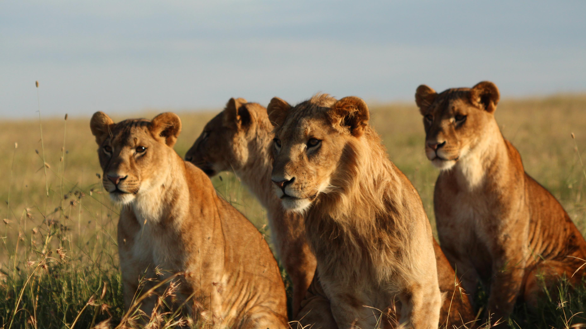
Causes of biodiversity loss
Notes:
Photo: author

Slide 3
Ultimate vs proximate causes
Notes:
Balmford, A., Carey, P., Kapos, V., Manica, A., Rodrigues, A.S., Scharlemann, J.P. and Green, R.E., 2009. Capturing the many dimensions of threat: comment on Salafsky et al. Conservation Biology, 23(2), pp.482-487.

Slide 4
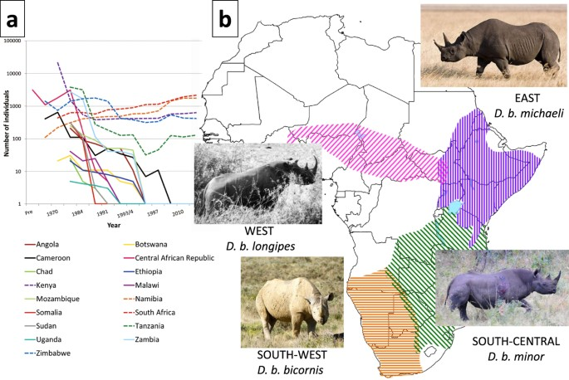
1. Unfavourable state of conservation target
Notes:
Moodley, Y., Russo, I.R.M., Dalton, D.L., Kotzé, A., Muya, S., Haubensak, P., Bálint, B., Munimanda, G.K., Deimel, C., Setzer, A. and Dicks, K., 2017. Extinctions, genetic erosion and conservation options for the black rhinoceros (Diceros bicornis). Scientific reports, 7, p.41417.

Slide 5
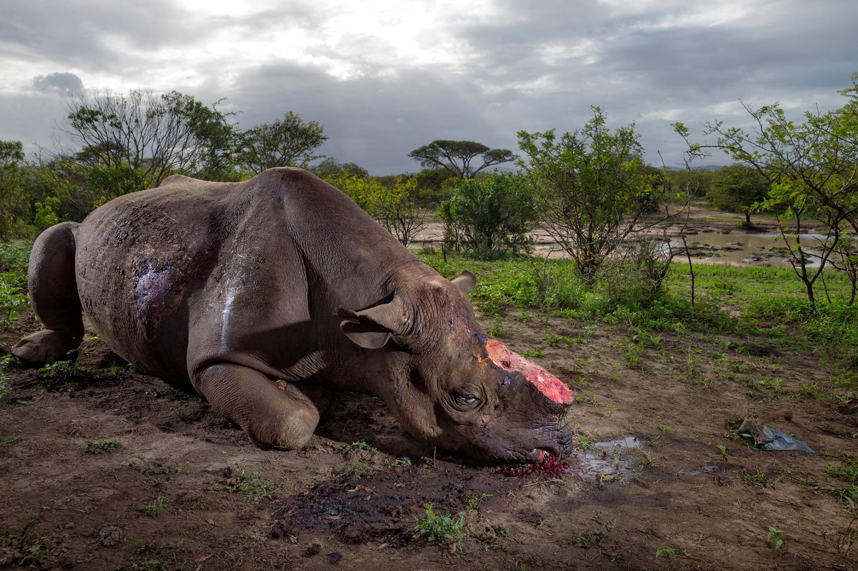
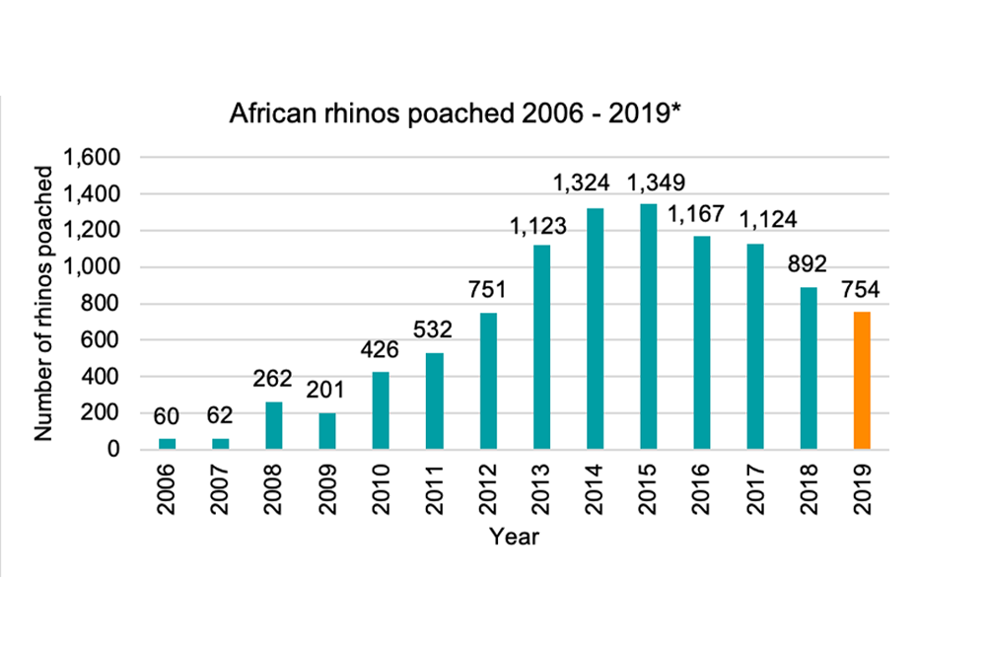
2. Threatening mechanism
Notes:
https://www.nationalgeographic.com/news/2018/01/wildlife-watch-rhino-poaching-crisis-continues-south-africa/
https://www.savetherhino.org/rhino-info/poaching-stats/

Slide 6
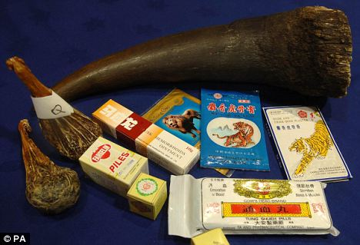
3. Source of threatening mechanism
Notes:
https://cleanmalaysia.com/2016/05/31/could-horn-farming-save-wild-rhinos/rhino-horn-medicine-1/

Slide 7
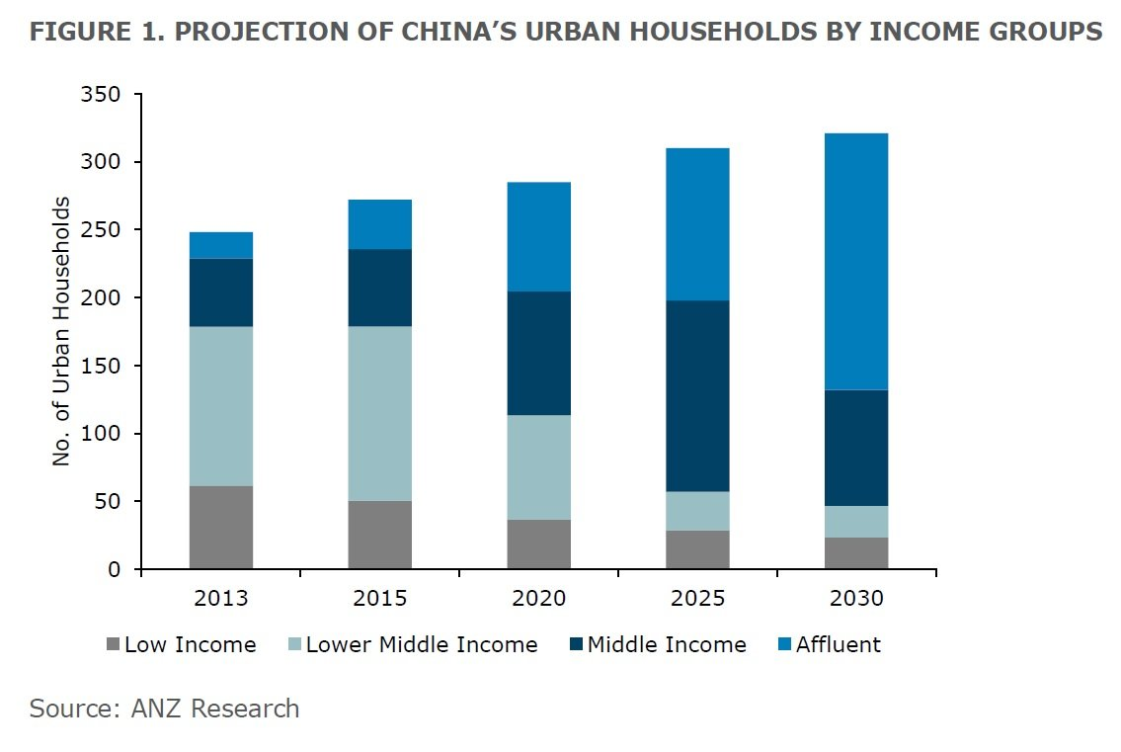
4. Underlying driver
Notes:
https://www.businessinsider.com/chinas-rising-middle-class-will-create-opportunities-the-world-has-never-seen-before-2015-5?r=US&IR=T

Slide 8
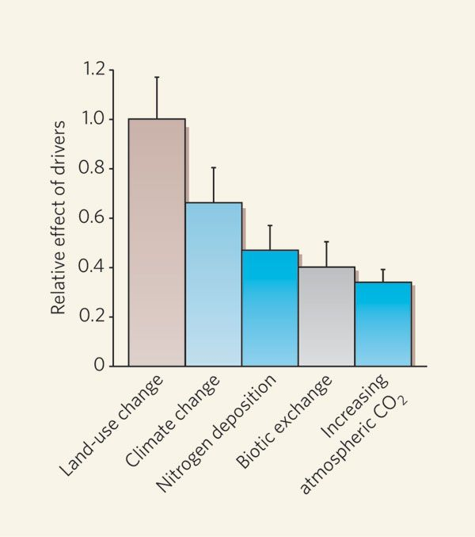
Primary threats
Thuiller, W. (2007) Biodiversity: climate change and the ecologist. Nature

Slide 9
Land-use change
Notes:
Foley, J.A., DeFries, R., Asner, G.P., Barford, C., Bonan, G., Carpenter, S.R., Chapin, F.S., Coe, M.T., Daily, G.C., Gibbs, H.K. and Helkowski, J.H., 2005. Global consequences of land use. science, 309(5734), pp.570-574.

Slide 10
Costs of conservation
5 types of cost
Acquisition
Management
Transaction
Damage
Opportunity
Conserving a particular area means that land cannot be used for other activities
Conservation does have economic benefits that are not often considered as well
Notes:
Naidoo, R., Balmford, A., Ferraro, P.J., Polasky, S., Ricketts, T.H. and Rouget, M., 2006. Integrating economic costs into conservation planning. Trends in ecology & evolution, 21(12), pp.681-687.

Slide 11
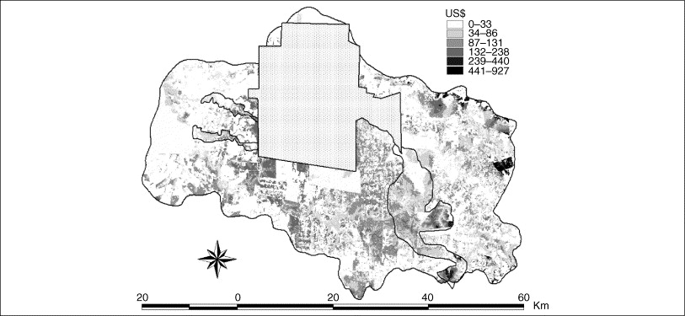
Notes:
Naidoo, R., Balmford, A., Ferraro, P.J., Polasky, S., Ricketts, T.H. and Rouget, M., 2006. Integrating economic costs into conservation planning. Trends in ecology & evolution, 21(12), pp.681-687.

Slide 12
Land-use change
Notes:
Foley, J.A., DeFries, R., Asner, G.P., Barford, C., Bonan, G., Carpenter, S.R., Chapin, F.S., Coe, M.T., Daily, G.C., Gibbs, H.K. and Helkowski, J.H., 2005. Global consequences of land use. science, 309(5734), pp.570-574.

Slide 13
Land-use change
Notes:
Foley, J.A., DeFries, R., Asner, G.P., Barford, C., Bonan, G., Carpenter, S.R., Chapin, F.S., Coe, M.T., Daily, G.C., Gibbs, H.K. and Helkowski, J.H., 2005. Global consequences of land use. science, 309(5734), pp.570-574.

Slide 14
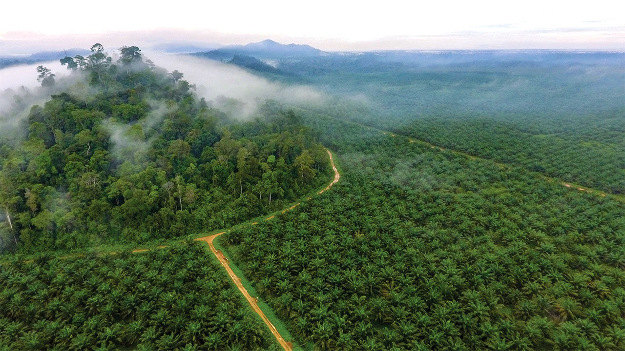
Notes:
https://www.sciencemag.org/news/2019/07/courting-controversy-scientists-team-industry-tackle-one-world-s-most-destructive-crops

Slide 15
Land Use Change
Ellis et al (2010) Anthropogenic transformation 1700-2000. Global Ecology and Biogeography

Slide 16
Most anthropogenic transformation in tropical and temperate deciduous forests and grasslands/shrublands
Why is this important?
Ellis et al (2010) Anthropogenic transformation 1700-2000. Global Ecology and Biogeography

Slide 17
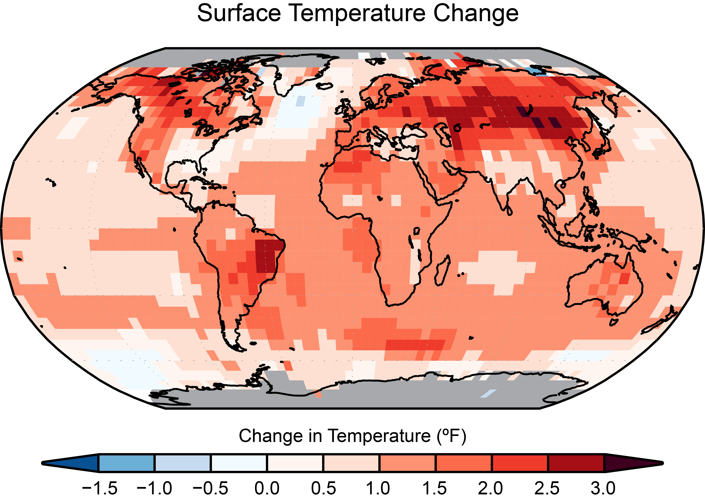
Notes:
https://science2017.globalchange.gov/chapter/1/
Vose, R. S., D. Arndt, V. F. Banzon, D. R. Easterling, B. Gleason, B. Huang, E. Kearns, J. H. Lawrimore, M. J. Menne, T. C. Peterson, R. W. Reynolds, T. M. Smith, C. N. Williams, and D. L. Wuertz, 2012: NOAA’s Merged Land-Ocean Surface Temperature Analysis. Bulletin of the American Meteorological Society, 93, 1677–1685, doi:10.1175/BAMS-D-11-00241.1.

Slide 18
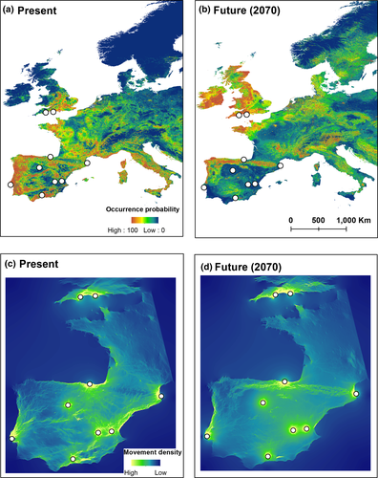
Climate change
Grey long‐eared bat, Plecotus austriacus
Generally, species will move towards the poles to higher altitudes
When modelling range shifts, also have to account for connectivity, habitat loss and other factors
Notes:
Razgour, O., Taggart, J.B., Manel, S., Juste, J., Ibanez, C., Rebelo, H., Alberdi, A., Jones, G. and Park, K., 2018. An integrated framework to identify wildlife populations under threat from climate change. Molecular ecology resources, 18(1), pp.18-31.

Slide 19
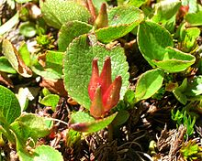
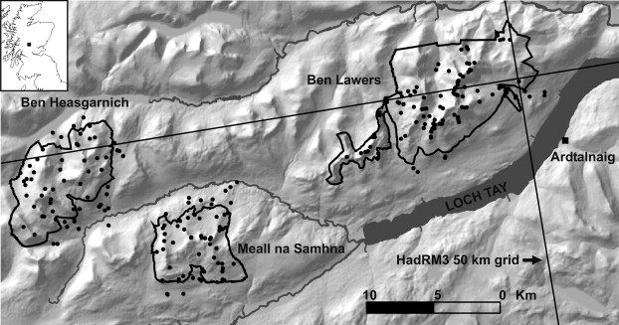
Climate change
What about polar and high altitude species?
They may have nowhere else to go
Alpine and polar plants in montane nature reserves, Scotland
Dwarf willow Salix herbacea
Notes:
Trivedi, M.R., Morecroft, M.D., Berry, P.M. and Dawson, T.P., 2008. Potential effects of climate change on plant communities in three montane nature reserves in Scotland, UK. Biological Conservation, 141(6), pp.1665-1675.

Slide 20
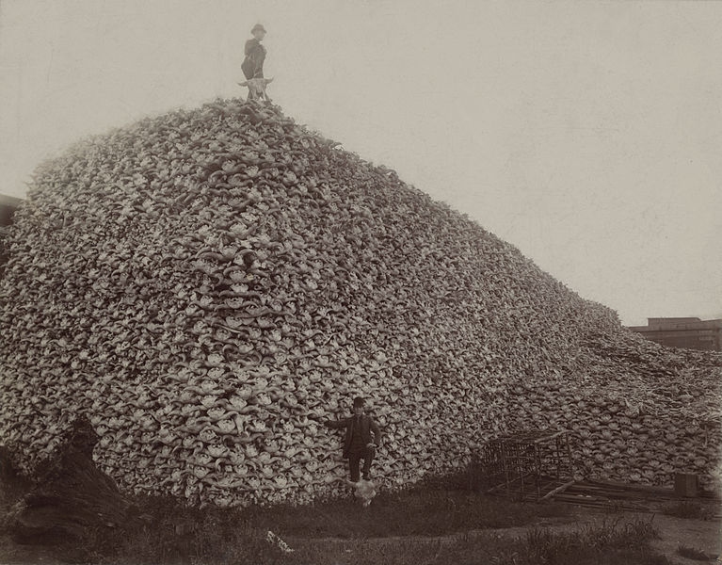
Hunting/harvesting
North American bison (Bison bison)
Mid-19th century, 30 million – 60 million
Transcontinental Railroad brought huge hunting parties, encouraged to kill the buffalo that Native Americans relied on
Often shot from the trains
By the end of 19th century, there were only 300 left
Notes:
https://www.smithsonianmag.com/history/where-the-buffalo-no-longer-roamed-3067904/

Slide 21
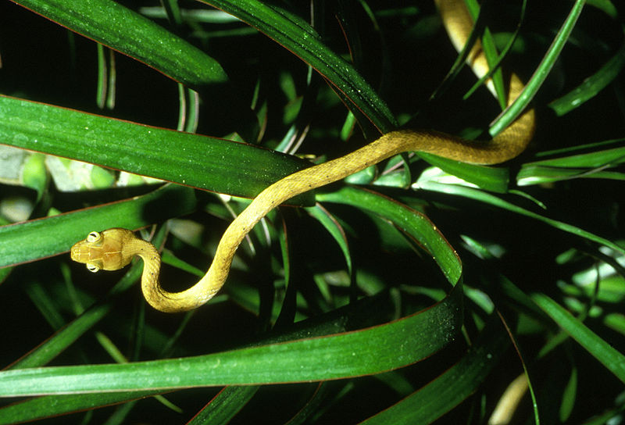
Biotic exchange and invasive species
Most often affects endemic island species, that have often been evolutionary isolated
Many islands have not had mammalian predators, so many species have no adaptations to predators
Brown tree snake introduced to Guam caused the extinction of 10 of the 12 native forest bird species
Notes:
https://theconversation.com/guams-forests-are-being-slowly-killed-off-by-a-snake-83224#:~:text=The%20brown%20tree%20snake%20was,Guam%20mysteriously%20began%20to%20decline.&text=Today%2C%2010%20of%20Guam's%2012,two%20are%20considered%20functionally%20extinct.

Slide 22
Pollution
Can affect any ecosystem, but freshwater ecosystems are particularly vulnerable, as they are ‘down-stream’ of terrestrial ecosystmes
They receive it from point-sources including mining, agriculture and industry
Amphibians also vulnerable due to permeable skins
Certain chemicals biomagnify through the food web - DDT

Slide 23
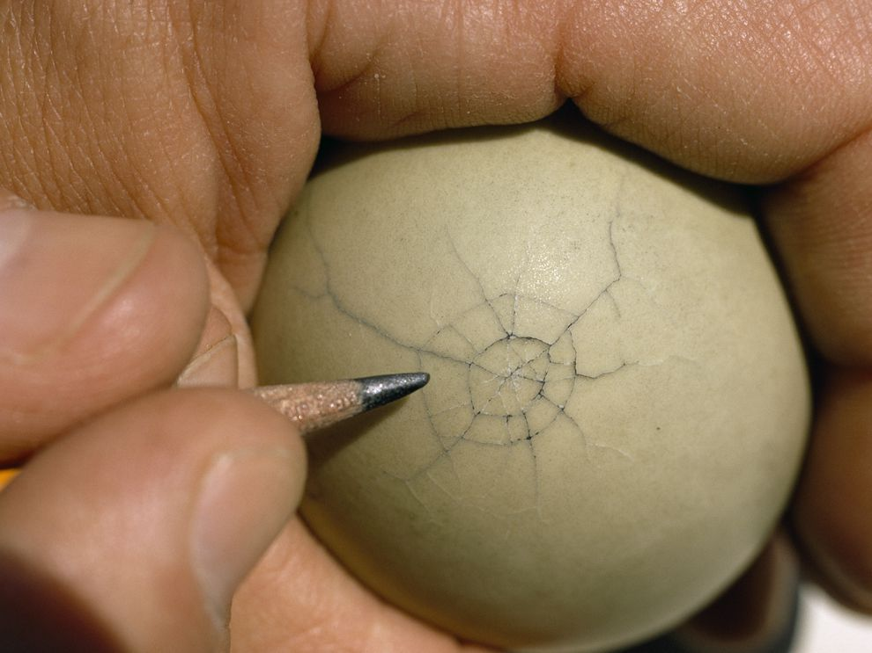
Notes:
Porter, R.D. and Wiemeyer, S.N., 1969. Dieldrin and DDT: effects on sparrow hawk eggshells and reproduction. Science, 165(3889), pp.199-200.
https://www.nationalgeographic.org/media/eggshell-cracks/

Slide 24
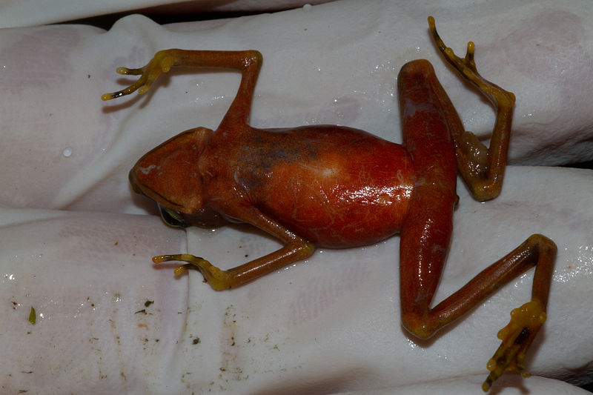
Disease
Disease can be a important driver of local biodiversity decline, and can interact with other causes
Diseases can also jump from wildlife to humans, zoonotic diseases are particularly important in light of the COVID-19 pandemic
Chytrid fungus has caused the decline of many amphibian species
Notes:
Smith, K.F., Acevedo‐Whitehouse, K. and Pedersen, A.B., 2009. The role of infectious diseases in biological conservation. Animal conservation, 12(1), pp.1-12.
Johnson, C.K., Hitchens, P.L., Pandit, P.S., Rushmore, J., Evans, T.S., Young, C.C. and Doyle, M.M., 2020. Global shifts in mammalian population trends reveal key predictors of virus spillover risk. Proceedings of the Royal Society B, 287(1924), p.20192736.
Carvalho, T., Becker, C.G. and Toledo, L.F., 2017. Historical amphibian declines and extinctions in Brazil linked to chytridiomycosis. Proceedings of the Royal Society B: Biological Sciences, 284(1848), p.20162254.
Picture: Brian Gratwicke from DC, USA https://commons.wikimedia.org/wiki/File:Chytrid-infected_female_Atelopus_limosus_(5421621532).jpg

Slide 25
Secondary problems

Slide 26
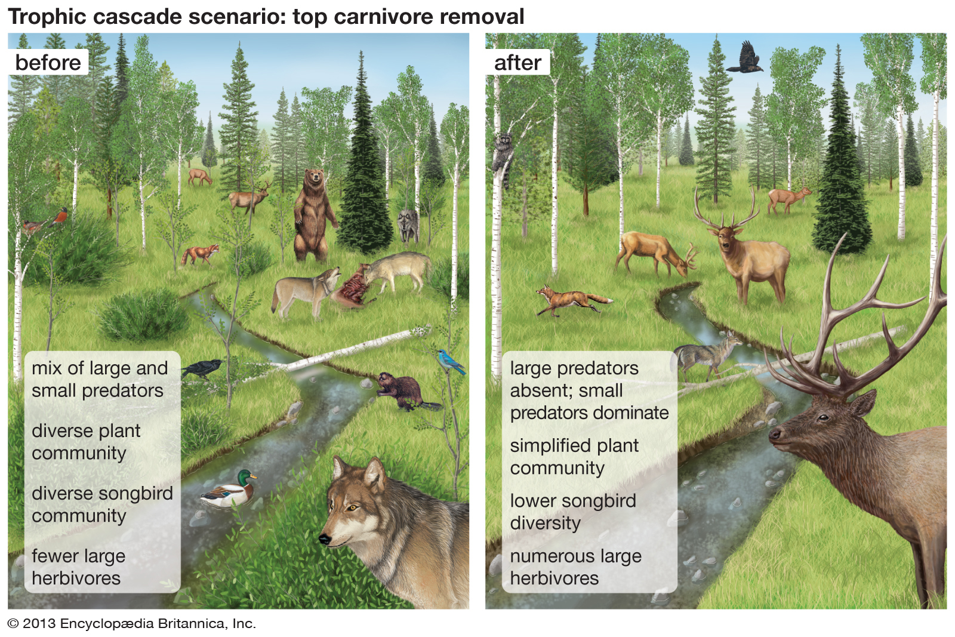
Trophic cascades
Threats can also have knock-on impacts on other species
Notes:
Ripple, W.J., Beschta, R.L., Fortin, J.K. and Robbins, C.T., 2014. Trophic cascades from wolves to grizzly bears in Y ellowstone. Journal of Animal Ecology, 83(1), pp.223-233.

Slide 27
Positive feedback cycles and tipping points
Notes:
Goosse, H., Kay, J.E., Armour, K.C., Bodas-Salcedo, A., Chepfer, H., Docquier, D., Jonko, A., Kushner, P.J., Lecomte, O., Massonnet, F. and Park, H.S., 2018. Quantifying climate feedbacks in polar regions. Nature communications, 9(1), pp.1-13.

