Slide 1
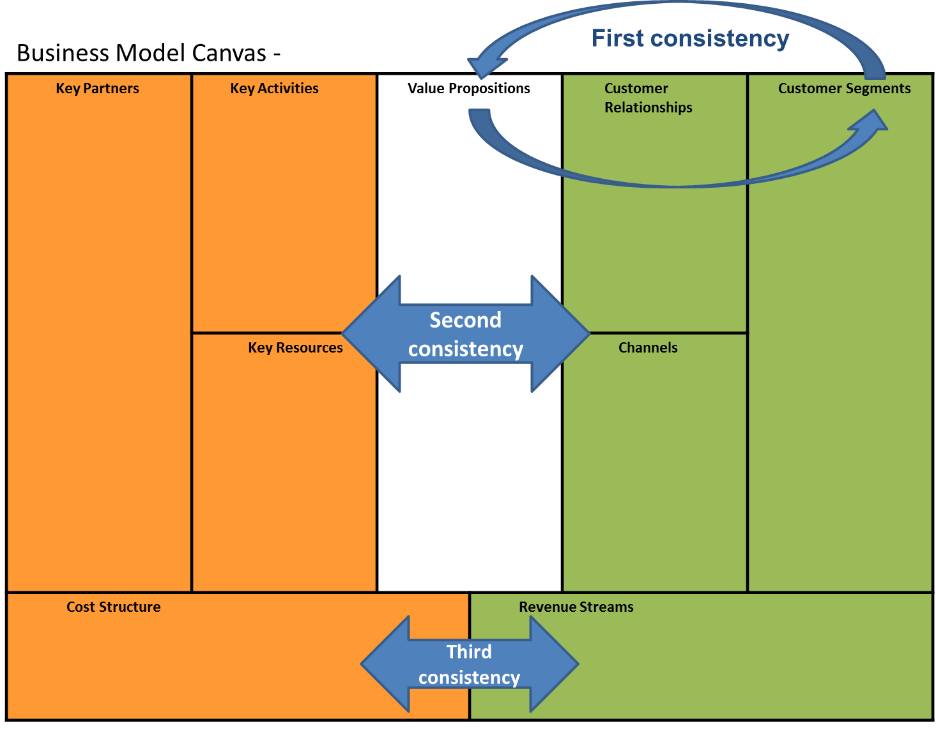
Business model canvas
Prepare a business model canvas of your business idea using the model in the next slide.
You can fill it using bullet points and short sentences to summarize what you will extensively present in the next part of the document.
You may want also to add small pictures and clip arts.
It is very important to focus on the coherence between the different parts of the canvas. You may want to spend some time reflecting and redrafting your canvas. In particular focus on the consistency between the customer segments you want to address and the value proposition as shown. There should be also a consistency between the left and right hand side of the canvas (orange and green shaded components). Finally, consider if the model is sustainable in terms of balance between costs and revenues.
You may find it useful to refer to the resources on business model canvases on the Strategyzer website:
https://strategyzer.com/

Slide 2






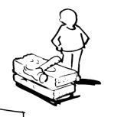



Business Model Canvas -
Key Partners | Key Activities | Value Propositions Write directly to the canvas… Or use the post-it™ note …or both |  | Customer Relationships | Customer Segments
 | Key Resources |  |  | Channels
Cost Structure |  |  | Revenue Streams
Double click on the post-it™ to edit. Recolour it using the picture format tools.

Slide 3
Executive summary
Write a summary of your project presenting the idea and how it intends to make money.
Give some details on the team and your motivation to pursue the project.

Slide 4
Executive summary
Max: 300 words

Slide 5
Customer segments (profile)
Clearly define the different groups of people or organizations to be served by describing:
(1) What they are trying to get, perform and complete (their needs)
(2) What difficulties they face in that,
and/or (3) which benefits they require, expect or desire.
You may find it useful to refer to the resources on business model canvases on the Strategyzer website:
https://strategyzer.com/

Slide 6
Customer segments (profile)
Max: 200 words

Slide 7
Value proposition
Prepare a value proposition which
(1) Describes the products and/or services you aim to propose
(2) Describes how you create values for customers,
and/or (3) how you alleviate a customer problem.
You may find it useful to refer to the resources on business model canvases on the Strategyzer website:
https://strategyzer.com/

Slide 8
Value proposition
Max: 200 words

Slide 9
Channels
Present the channels to reach the customer segments describing:
(1) The channel types you decide to use to convey your products/services to customers. There could be several options, such as:
1. Own channel
a. sale force
b. web sales
c. own stores
2. Partner channel
a. partner stores
b. wholesaler
c. no-profit channel
(2) How the channel phases are covered. You need to answer the following questions:
1. Awareness: how do you make customers aware of your company and of your products/services?
2. Evaluation: how do you help your customers understand what you offer them (value proposition)?
3. Purchase: how can your customers purchase your products?
4. Delivery: how do you bring value to customers?
5. After sales: how do you support customers in the after-sales?
(3) How channels are integrated and mixed: you can use many channels to get in touch with your customers. How do you plan to make them work together?

Slide 10
Channels
Max: 200 words

Slide 11
Customer relationships
Describe the types of relationships with each specific customer segment you identified before, explaining their motivation and type. They can range from automated online sales, and self-service to personal assistance and deep customizing. Explain your choice and the motivation behind.

Slide 12
Customer relationships
Max: 200 words

Slide 13
Key resources
Describe each physical, human, intellectual and financial resource you will involve in the business.
Dedicate particular attention to the presentation of the team members and their skills, explaining the management structure you will adopt.

Slide 14
Key resources
Max: 200 words

Slide 15
Key activities
What are the key activities required to be done by the value proposition? Or by the clients?
Clearly define what activities the company does to operate. They can include the production of goods, or the delivering of support services to clients, and so on. Also, you should reflect on the appropriateness of the channel selected to deliver each activity.

Slide 16
Key activities
Max: 200 words

Slide 17
Key partners
Identify the suppliers and the partners of your company, and the type of relationship you will have with them (e.g.: contract, simple market transaction, distribution agreements).
What is the rationale behind having each partner you identified? Do they provide some resource that is not economic to develop internally? Or do they provide some knowledge not available internally? Or, finally, can they reduce any risk or uncertainty by collaborating with you?

Slide 18
Key partners
Max: 200 words

Slide 19
Revenue streams
Identify how you plan to make money or be sustainable: explain how your product/service will be priced and which incomes you expect to have.
Your incomes can range from asset sales, usage or subscription fees, to licensing or renting. In this part, you need to clarify what, how and how much customers will pay.
For instance, if you provide an online counselling service, customers could pay a fee per hour, or a subscription to a certain number of hours. If you develop a smartphone app, possible revenues can come from advertising.
Focus on providing realistic figures on pricing and incomes for the next 5 years.

Slide 20
Revenue streams
Max: 200 words

Slide 21
Cost structure
Define the cost structure of your company considering the resources, activities and partnerships you have defined previously. Clearly identify the fixed and variable costs. Please indicate your projected net revenues for years 1 to 5.

Slide 22
Cost structure
Max: 200 words

