Slide 1
Executive summary
Write a summary of your project presenting:
• What is your idea?
• Why is it innovative?
• Who are the beneficiaries or users of the innovation?
• How can the innovation create value (financial, social, environmental…)?
• What are the next steps? What are you planning to do with this innovation?
Give us also some details on you and/or your team and your motivation to pursue the project.

Slide 2
Executive summary
Max: 500 words

Slide 3
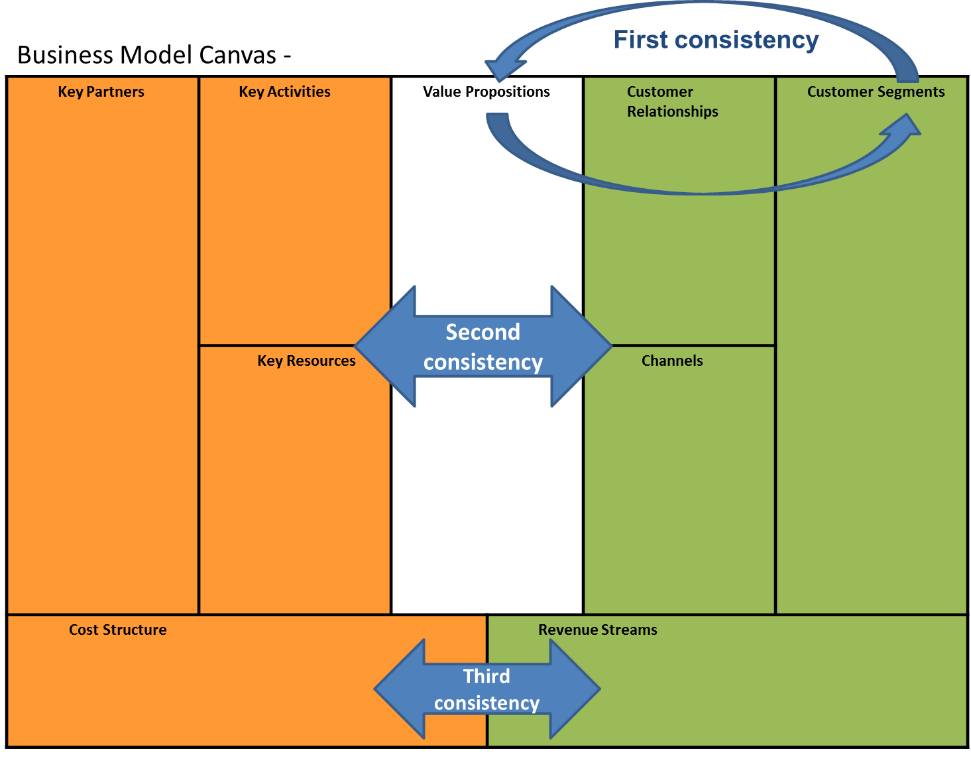
Business model canvas
Prepare a business model canvas of your business idea using the model in the next slide.
You can fill it using bullet points and short sentences to summarize what you will extensively present in the next part of the document.
You may want also to add small pictures and clip arts.
It is very important to focus on the coherence between the different parts of the canvas. You may want to spend some time reflecting and redrafting your canvas. In particular focus on the consistency between the customer segments you want to address and the value proposition as shown. There should be also a consistency between the left and right hand side of the canvas (orange and green shaded components). Finally, consider if the model is sustainable in terms of balance between costs and revenues.
You may find it useful to refer to the resources on business model canvases on the Strategyzer website:
https://strategyzer.com/

Slide 4










Business Model Canvas -
Key Partners | Key Activities | Value Propositions Write directly to the canvas… Or use the post-it™ note …or both |  | Customer Relationships | Customer Segments
 | Key Resources |  |  | Channels
Cost Structure |  |  | Revenue Streams
Double click on the post-it™ to edit. Recolour it using the picture format tools.

